Slide 1


Chapter 16
Section 1 Thermochemistry
Objectives
Define temperature and state the units in which it
is measured.
Define heat and state its units.
Perform specific-heat calculations.
Explain enthalpy change, enthalpy of reaction, enthalpy of formation, and enthalpy of combustion.
Solve problems involving enthalpies of reaction, enthalpies of formation, and enthalpies of combustion.

Slide 2
Chapter 16
Section 1 Thermochemistry
Thermochemistry
Virtually every chemical reaction is accompanied by a change in energy.
Chemical reactions usually either absorb or release energy as heat.
Thermochemistry is the study of the transfers of energy as heat that accompany chemical reactions and physical changes.

Slide 3
Chapter 16
Section 1 Thermochemistry
Heat and Temperature
The energy absorbed or released as heat in a chemical or physical change is measured in a calorimeter.
In one kind of calorimeter, known quantities of reactants are sealed in a reaction chamber that is immersed in a known quantity of water.
  Energy given off by the reaction is absorbed by the water, and the temperature change of the water is measured.
  From the temperature change of the water, it is possible to calculate the energy as heat given off by the reaction.

Slide 4
Chapter 16
Section 1 Thermochemistry
Heat and Temperature, continued
Temperature is a measure of the average kinetic energy of the particles in a sample of matter.
  The greater the kinetic energy of the particles in a sample, the hotter it feels.

Slide 5
Chapter 16
Section 1 Thermochemistry
Heat and Temperature, continued
The amount of energy transferred as heat is usually measured in joules.
A joule is the SI unit of heat as well as all other forms of energy.
Heat can be thought of as the energy transferred between samples of matter because of a difference in their temperatures.
Energy transferred as heat always moves spontaneously from matter at a higher temperature
to matter at a lower temperature.

Slide 6
Chapter 16
Section 1 Thermochemistry
Specific Heat
The specific heat of a substance is the amount of energy required to raise the temperature of one gram by one Celsius degree (1°C) or one kelvin (1 K).
  The temperature difference as measured in either
  Celsius degrees or kelvins is the same.

Slide 7
Chapter 16
Section 1 Thermochemistry
Specific Heat, continued
Values of specific heat are usually given in units of joules per gram per Celsius degree, J/(g•°C), or
joules per gram per kelvin, J/(g•K).

Slide 8

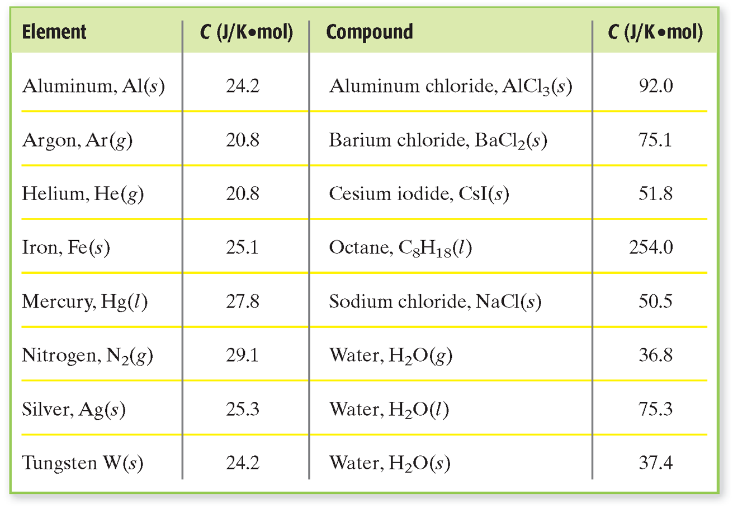
Molar Heat Capacities of Elements and Compounds
Chapter 16
Section 1 Thermochemistry

Slide 9
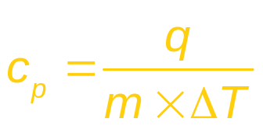
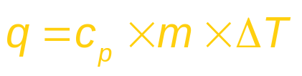
Chapter 16
Section 1 Thermochemistry
Specific Heat, continued
Specific heat is calculated according to the equation given below.
  c_{p} is the specific heat at a given pressure, q is the energy lost or gained, m is the mass of the sample, and ∆T is the difference between the initial and final temperatures.
The above equation can be rearranged to given an equation that can be used to find the quantity of energy gained or lost with a change of temperature.

Slide 10
Specific Heat, continued
Chapter 16
Section 1 Thermochemistry
Sample Problem A
A 4.0 g sample of glass was heated from 274 K to 314 K, a temperature increase of 40. K, and was found to have absorbed 32 J of energy as heat.
a. What is the specific heat of this type of glass?
b. How much energy will the same glass sample
gain when it is heated from 314 K to 344 K?

Slide 11
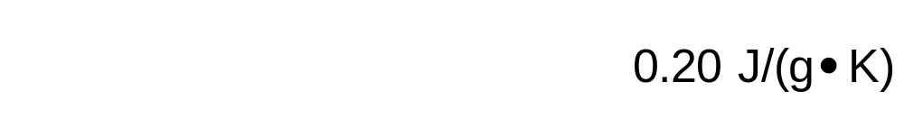
Chapter 16
Section 1 Thermochemistry
Specific Heat, continued
Sample Problem A Solution
Given: m = 4.0 g
∆T = 40. K
q = 32 J
Unknown: a. c_{p} in J/(g•K)
b. q for ∆T of 314 K → 344 K
Solution:
a.

Slide 12

Chapter 16
Section 1 Thermochemistry
Specific Heat, continued
Sample Problem A Solution, continued
Solution:
b.

Slide 13
For class today have out:
1) Homework/titration lab
2) Print out
Warm Up
1) How much energy is absorbed if 2.3 moles of iron is heated from 328K to 499K? The specific heat of iron is 0.449 J/(g x K).
2) Review: How much energy is required for 38g of ice at 0ºC to melt to water. (ΔH_{v} = 40.79kJ/mol ΔH_{f} = 6.009kJ/mol)

Slide 14
Chapter 16
Section 1 Thermochemistry
Enthalpy of Reaction
The energy absorbed as heat during a chemical reaction at constant pressure is represented by ∆H. H is the symbol for a quantity called enthalpy.
Only changes in enthalpy can be measured. ∆H is read as “change in enthalpy.”
An enthalpy change is the amount of energy absorbed or released by a system as heat during a process at constant pressure.

Slide 15
Chapter 16
Section 1 Thermochemistry
Enthalpy of Reaction, continued
Enthalpy change is always the difference between the enthalpies of products and reactants.
∆H = H_{products} – H_{reactants}
A chemical reaction that releases energy is exothermic.
  example:
2H₂(g) + O₂(g) → 2H₂O(g) + 483.6 kJ

Slide 16
Chapter 16
Section 1 Thermochemistry
Enthalpy of Reaction, continued
In an endothermic reaction, the products have a larger enthalpy than the reactants, and the reaction absorbs energy.
  example:
2H₂O(g) + 483.6 kJ → 2H₂(g) + O₂(g)

Slide 17
Chapter 16
Section 1 Thermochemistry
Enthalpy of Reaction, continued
Thermochemical equations are usually written by designating a ∆H value rather than writing the energy as a reactant or product.
2H₂(g) + O₂(g) → 2H₂O(g) ∆H = –483.6 kJ

Slide 18
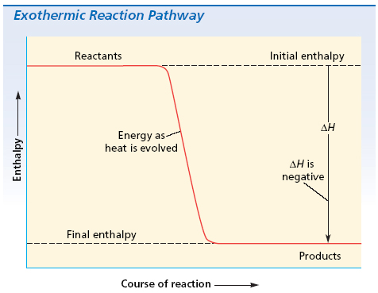
Chapter 16
Section 1 Thermochemistry
Enthalpy of Reaction, continued
In an exothermic reaction, energy is evolved, or given off, during the reaction; ∆H is negative.

Slide 19
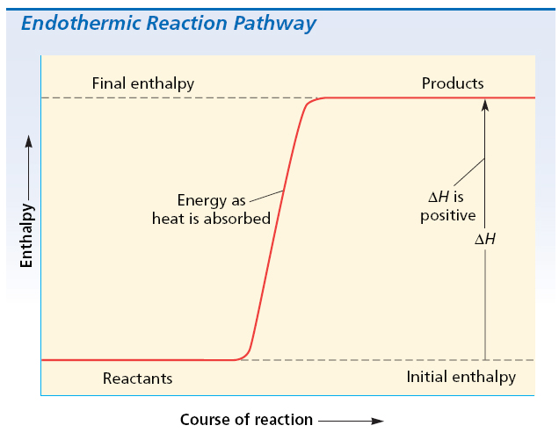
Chapter 16
Section 1 Thermochemistry
Enthalpy of Reaction, continued
In an endothermic reaction, energy is absorbed; in this case, ∆H is designated as positive.

Slide 20
Chapter 16
Section 1 Thermochemistry
Calculating Enthalpies of Reaction
The basis for calculating enthalpies of reaction is known as Hess’s law: the overall enthalpy change in a reaction is equal to the sum of enthalpy changes for the individual steps in the process.

Slide 21

Chapter 16
Section 1 Thermochemistry
Calculating Enthalpies of Reaction, continued
Look at an overall equation and break the equation into its individual pieces.
Each step has its own Enthalpy.
To demonstrate how to apply Hess’s law, we will work through the formation of methane gas, CH₄:
C(s) + 2H₂(g) → CH₄(g)

Slide 22
Chapter 16
Section 1 Thermochemistry
Calculating Enthalpies of Reaction, continued
The component reactions in this case are the combustion reactions of carbon, hydrogen, and methane:
C(s) + O₂(g) → CO₂(g)
H₂(g) + O₂(g) → H₂O(l)
CH₄(g) + 2O₂(g) → CO₂(g) + 2H₂O(l)

Slide 23
Chapter 16
Section 1 Thermochemistry
Calculating Enthalpies of Reaction, continued
The overall reaction involves the formation rather than the combustion of methane, so the combustion equation for methane is reversed, and its enthalpy changed from negative to positive:
CO₂(g) + 2H₂O(l) → CH₄(g) + 2O₂(g) ∆H⁰ = +890.8 kJ

Slide 24
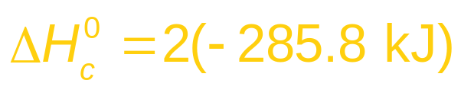
Chapter 16
Section 1 Thermochemistry
Calculating Enthalpies of Reaction, continued
Because 2 moles of water are used as a reactant in the above reaction, 2 moles of water will be needed as a product.
Therefore, the coefficients for the formation of water reaction, as well as its enthalpy, need to be multiplied by 2:
2H₂(g) + O₂(g) → 2H₂O(l)

Slide 25
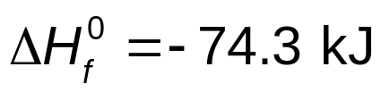
Chapter 16
Section 1 Thermochemistry
Calculating Enthalpies of Reaction, continued
We are now ready to add the three equations together using Hess’s law to give the enthalpy of formation for methane and the balanced equation.
C(s) + O₂(g) → CO₂(g)
2H₂(g) + O₂(g) → 2H₂O(l)
CO₂(g) + 2H₂O(l) → CH₄(g) + 2O₂(g)
C(s) + 2H₂(g) → CH₄(g)

Slide 26
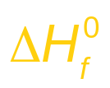
Chapter 16
Section 1 Thermochemistry
Calculating Enthalpies of Reaction, continued
Any enthalpy of reaction may be calculated using enthalpies of formation for all the substances in the reaction of interest, without knowing anything else about how the reaction occurs.
∆H⁰ = sum of [( of products) × (mol of products)]
– sum of [( of reactants) × (mol of reactants)]

Slide 27
Chapter 16
Section 1 Thermochemistry
Calculating Enthalpies of Reaction, continued
Sample Problem B
Calculate the enthalpy of reaction for the combustion of nitrogen monoxide gas, NO, to form nitrogen dioxide gas, NO₂, as given in the following equation.
2NO(g) + O₂(g) → 2NO₂(g)
B. How much energy is released when 4.3g of NO react with excess oxygen.

Slide 28
Chapter 16
Section 1 Thermochemistry
Calculating Enthalpies of Reaction, continued
Sample Problem B Solution
Given:
Unknown:
Solution:
Using Hess’s law, combine the given thermochemical equations in such a way as to obtain the unknown equation, and its ∆H⁰ value.

Slide 29
Chapter 16
Section 1 Thermochemistry
Calculating Enthalpies of Reaction, continued
Sample Problem B Solution, continued
The desired equation is:
Reversing the first given reaction and its sign yields the following thermochemical equation:
The other equation should have NO₂ as a product, so we can use the second given equation as is:

Slide 30
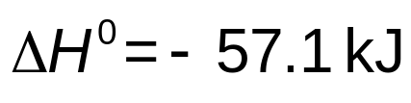
Chapter 16
Section 1 Thermochemistry
Calculating Enthalpies of Reaction, continued
Sample Problem B Solution, continued
We can now add the equations and their ∆H⁰ values to obtain the unknown ∆H⁰ value.

Slide 31
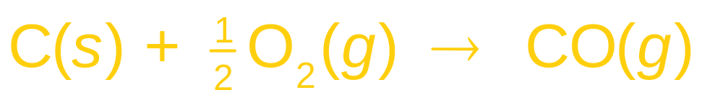
Chapter 16
Section 1 Thermochemistry
Determining Enthalpy of Formation
When carbon is burned in a limited supply of oxygen, carbon monoxide is produced:
The above overall reaction consists of two reactions:
  1) carbon is oxidized to carbon dioxide
  2) carbon dioxide is reduced to give carbon monoxide.

Slide 32
Chapter 16
Section 1 Thermochemistry
Determining Enthalpy of Formation, continued
Because these two reactions occur simultaneously, it is not possible to directly measure the enthalpy of formation of CO(g) from C(s) and O₂(g).
We do know the enthalpy of formation of carbon dioxide and the enthalpy of combustion of carbon monoxide:

Slide 33
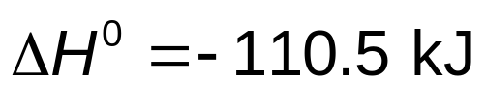
Chapter 16
Section 1 Thermochemistry
Determining Enthalpy of Formation, continued
We reverse the second equation because we need CO as a product. Adding gives the desired enthalpy of formation of carbon monoxide.

Slide 34
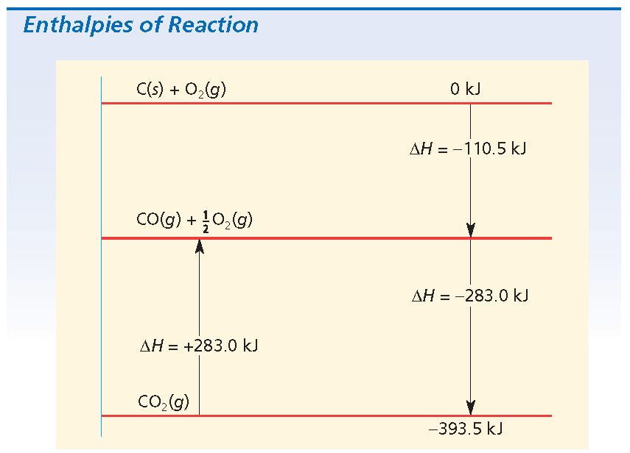
Chapter 16
Section 1 Thermochemistry
Determining Enthalpy of Formation, continued
The graph below models the process just described. It shows the enthalpies of reaction for CO₂ and CO.

Slide 35
Chapter 16
Section 1 Thermochemistry
Determining Enthalpy of Formation, continued
Sample Problem C
Calculate the enthalpy of formation of pentane, C₅H₁₂, using the information on enthalpies of formation and the information on enthalpies of combustion in the appendix. Solve by combining the known thermochemical equations.

Slide 36
Chapter 16
Section 1 Thermochemistry
Determining Enthalpy of Formation, continued
Sample Problem C Solution
Given: C(s) + O₂(g) → CO₂(g)
H₂(g) + O₂(g) → H₂O(l)
C₅H₁₂(g) + 8O₂(g) → 5CO₂(g) + 6H₂O(l)
Unknown:
Solution:
Combine the given equations according to Hess’s law.

Slide 37
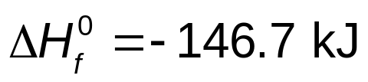
Chapter 16
Section 1 Thermochemistry
Determining Enthalpy of Formation, continued
Sample Problem C Solution, continued
5C(s) + 5O₂(g) → 5CO₂(g)
6H₂(g) + 3O₂(g) → 6H₂O(l)
5CO₂(g) + 6H₂O(l) → C₅H₁₂(g) + 8O₂(g)
5C(s) + 6H₂(g) → C₅H₁₂(g)

Slide 38
Section 2 Driving Force of Reactions
Chapter 16
Objectives
Explain the relationship between enthalpy change and the tendency of a reaction to occur.
Explain the relationship between entropy change and the tendency of a reaction to occur.
Discuss the concept of free energy, and explain how the value of this quantity is calculated and interpreted.
Describe the use of free energy change to determine the tendency of a reaction to occur.

Slide 39
Section 2 Driving Force of Reactions
Chapter 16
Enthalpy and Reaction Tendency
The great majority of chemical reactions in nature
are exothermic.
  The tendency throughout nature is for a reaction to proceed in a direction that leads to a lower energy state.
Some endothermic reactions do occur spontaneously.
Something other than enthalpy change can help determine whether a reaction will occur.

Slide 40
Section 2 Driving Force of Reactions
Chapter 16
Entropy and Reaction Tendency
Melting is one example of a naturally occurring endothermic process.
  An ice cube melts spontaneously at room temperature as energy is transferred from the warm air to the ice.
The well-ordered arrangement of water molecules in the ice crystal is lost, and the less-ordered liquid phase of higher energy content is formed.
A system that can go from one state to another without an enthalpy change does so with an increase in entropy.

Slide 41
Section 2 Driving Force of Reactions
Chapter 16
Entropy and Reaction Tendency, continued
The decomposition of ammonium nitrate:
2NH₄NO₃(s) 2N₂(g) + 4H₂O(l) + O₂(g)
On the left side are 2 mol of solid ammonium nitrate.
The right-hand side of the equation shows 3 mol of gaseous molecules plus 4 mol of a liquid.
The arrangement of particles on the right-hand side of the equation is more random than the arrangement on the left side and hence is less ordered.

Slide 42
Section 2 Driving Force of Reactions
Chapter 16
Entropy and Reaction Tendency, continued
There is a tendency in nature to proceed in a direction that increases the randomness of a system.
  A random system is one that lacks a regular arrangement of its parts.
This tendency toward randomness is called entropy.
Entropy, S, can be defined in a simple qualitative way as a measure of the degree of randomness of
the particles, such as molecules, in a system.

Slide 43
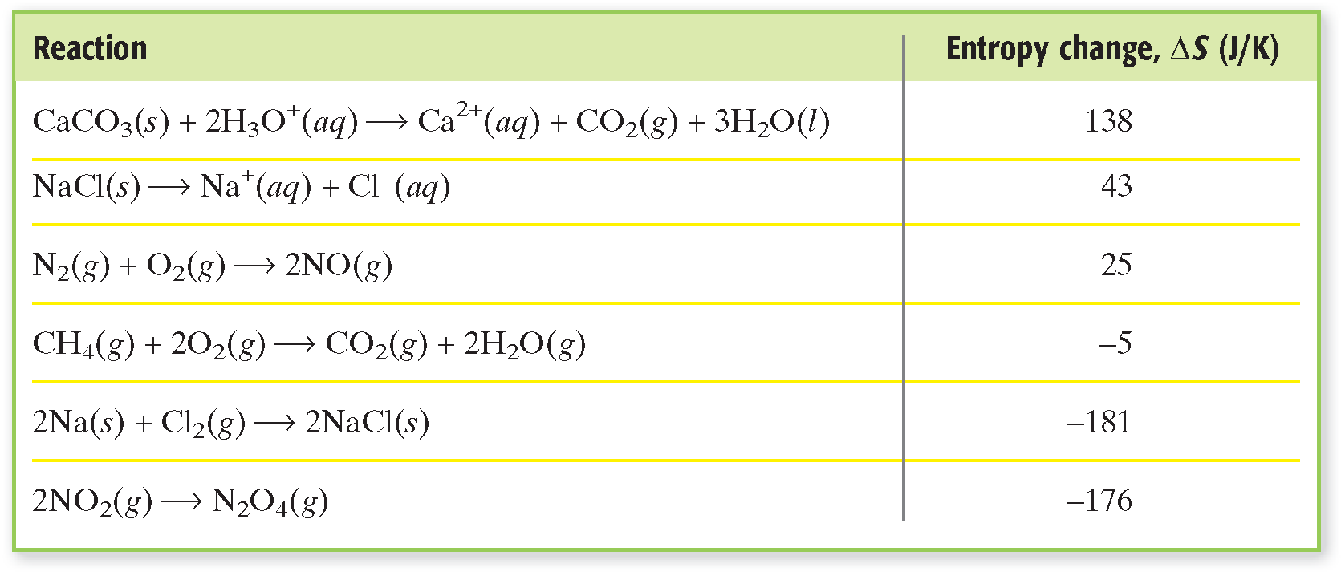
Standard Entropy Changes for Some Reactions
Section 2 Driving Force of Reactions
Chapter 16

Slide 44
Section 2 Driving Force of Reactions
Chapter 16
Entropy and Reaction Tendency, continued
To understand the concept of entropy, consider
the comparison between particles in solids, liquids, and gases.
  In a solid, the particles are in fixed positions, and we can easily determine the locations of the particles.
  In a liquid, the particles are very close together, but they can move around. Locating an individual particle is more difficult. The system is more random, and the entropy is higher.

Slide 45
Section 2 Driving Force of Reactions
Chapter 16
Entropy and Reaction Tendency, continued
  In a gas, the particles are moving rapidly and are far apart. Locating an individual particle is much more difficult, and the system is much more random. The entropy is even higher.

Slide 46

Entropy
Chapter 16
Visual Concepts
Click below to watch the Visual Concept.
Visual Concept

Slide 47
Section 2 Driving Force of Reactions
Chapter 16
Entropy and Reaction Tendency, continued
Absolute entropy, or standard molar entropy, of substances are recorded in tables and reported in units of kJ/(mol•K).
Entropy change, which can also be measured, is defined as the difference between the entropy of the products and the reactants.
An increase in entropy is represented by a positive value for ∆S, and a decrease in entropy is represented by a negative value for ∆S.

Slide 48
Section 2 Driving Force of Reactions
Chapter 16
Free Energy
Processes in nature are driven in two directions: toward least enthalpy and toward largest entropy.
As a way to predict which factor will dominate for a given system, a function has been defined to relate the enthalpy and entropy factors at a given temperature and pressure.
This combined enthalpy-entropy function is called
the free energy, G, of the system; it is also called Gibbs free energy.

Slide 49
Section 2 Driving Force of Reactions
Chapter 16
Free Energy, continued
Only the change in free energy can be measured. It can be defined in terms of enthalpy and entropy.
At a constant pressure and temperature, the free-energy change, ∆G, of a system is defined as the difference between the change in enthalpy, ∆H, and the product of the Kelvin temperature and the entropy change, which is defined as T∆S:
∆G⁰ = ∆H⁰ – T∆S⁰

Slide 50
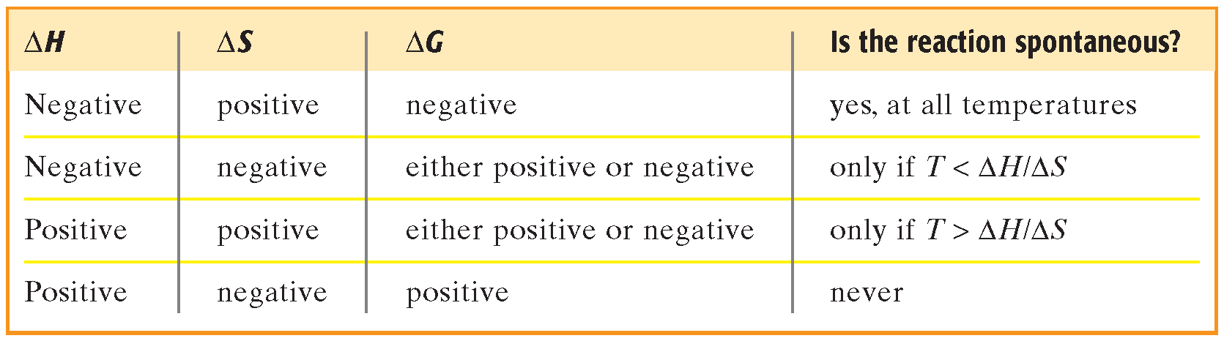
Relating Enthalpy and Entropy to Spontaneity
Section 2 Driving Force of Reactions
Chapter 16

Slide 51
Equation for Free-Energy Change
Chapter 16
Visual Concepts
Click below to watch the Visual Concept.
Visual Concept

Slide 52
Section 2 Driving Force of Reactions
Chapter 16
Free Energy, continued
∆G⁰ = ∆H⁰ – T∆S⁰
The expression for free energy change is for substances in their standard states.
The product T∆S and the quantities ∆G and ∆H have the same units, usually kJ/mol. If ∆G < 0, the reaction is spontaneous.
∆H and ∆G can have positive or negative values. This leads to four possible combinations of terms.

Slide 53
Relating Enthalpy, Entropy, and Free-Energy Changes
Chapter 16
Visual Concepts
Click below to watch the Visual Concept.
Visual Concept

Slide 54
Comparing Enthalpy and Entropy
Chapter 16
Visual Concepts
Click below to watch the Visual Concept.
Visual Concept

Slide 55
Section 2 Driving Force of Reactions
Chapter 16
Free Energy, continued
Sample Problem D
For the reaction NH₄Cl(s) → NH₃(g) + HCl(g),
at 298.15 K, ∆H⁰ = 176 kJ/mol and ∆S⁰ =
0.285 kJ/(mol•K). Calculate ∆G⁰, and tell whether this reaction is spontaneous in the forward direction at 298.15 K.

Slide 56
Section 2 Driving Force of Reactions
Chapter 16
Free Energy, continued
Sample Problem D Solution
Given: ∆H⁰ = 176 kJ/mol at 298.15 K
∆S⁰ = 0.285 kJ/(mol•K) at 298.15 K
Unknown: ∆G⁰ at 298.15 K
Solution: The value of ∆G⁰ can be calculated according to the following equation:
∆G⁰ = ∆H⁰ – T∆S⁰
∆G⁰ = 176 kJ/mol – 298 K [0.285 kJ/(mol•K)]
∆G⁰ = 176 kJ/mol – 84.9 kJ/mol
∆G⁰ = 91 kJ/mol

Slide 57

End of Chapter 16 Show

Slide 58
Multiple Choice
Chapter 16
Standardized Test Preparation
1. Which of the following two conditions will favor a spontaneous reaction?
A. an increase in entropy and a decrease in enthalpy
B. an increase in entropy and an increase in enthalpy
C. a decrease in entropy and a decrease in enthalpy
D. a decrease in entropy and an increase in enthalpy

Slide 59
Multiple Choice
Chapter 16
Standardized Test Preparation
1. Which of the following two conditions will favor a spontaneous reaction?
A. an increase in entropy and a decrease in enthalpy
B. an increase in entropy and an increase in enthalpy
C. a decrease in entropy and a decrease in enthalpy
D. a decrease in entropy and an increase in enthalpy

Slide 60
Multiple Choice
Chapter 16
Standardized Test Preparation
2. The gasification of coal is a method of producing methane by the following reaction.
C(s) + 2H₂(g) → CH₄(g) ∆H = ?
Find ∆H by using the enthalpy changes in the following
combustion reactions:
C(s) + O₂(g) → CO₂(g) ∆H = –394 kJ
H₂(g) + O₂(g) → H₂O(l) ∆H = –286 kJ
CH₄(g) + 2O₂(g) → CO₂(g) + 2H₂O(l) ∆H = –891 kJ
A. 75 kJ
B. –75 kJ
C. 1856 kJ
D. –1856 kJ

Slide 61
Multiple Choice
Chapter 16
Standardized Test Preparation
2. The gasification of coal is a method of producing methane by the following reaction.
C(s) + 2H₂(g) → CH₄(g) ∆H = ?
Find ∆H by using the enthalpy changes in the following
combustion reactions:
C(s) + O₂(g) → CO₂(g) ∆H = –394 kJ
H₂(g) + O₂(g) → H₂O(l) ∆H = –286 kJ
CH₄(g) + 2O₂(g) → CO₂(g) + 2H₂O(l) ∆H = –891 kJ
A. 75 kJ
B. –75 kJ
C. 1856 kJ
D. –1856 kJ

Slide 62
Multiple Choice
Chapter 16
Standardized Test Preparation
3. Two metals of equal mass but different specific heats absorb the same amount of heat. Which metal undergoes the smaller change in temperature?
A. The metal with the higher specific heat.
B. The metal with the lower specific heat.
C. Both undergo the same change in temperature.
D. Cannot determine from the information given.

Slide 63
Multiple Choice
Chapter 16
Standardized Test Preparation
3. Two metals of equal mass but different specific heats absorb the same amount of heat. Which metal undergoes the smaller change in temperature?
A. The metal with the higher specific heat.
B. The metal with the lower specific heat.
C. Both undergo the same change in temperature.
D. Cannot determine from the information given.

Slide 64
Multiple Choice
Chapter 16
Standardized Test Preparation
4. Which of the following processes has a negative ∆S?
A. evaporating 1 mol of a liquid
B. raising the temperature of 1 L of water from
295 K to 350 K
C. freezing of 1 mol of a liquid
D. None of the above.

Slide 65
Multiple Choice
Chapter 16
Standardized Test Preparation
4. Which of the following processes has a negative ∆S?
A. evaporating 1 mol of a liquid
B. raising the temperature of 1 L of water from
295 K to 350 K
C. freezing of 1 mol of a liquid
D. None of the above.

Slide 66
Multiple Choice
Chapter 16
Standardized Test Preparation
5. At a constant pressure, the following reaction is exothermic: 2NO₂(g) → N₂O₄(g). Which of the following statements is true about the reaction (as written)?
A. The reaction is always spontaneous.
B. The reaction is spontaneous at low temperatures, but not at high temperatures.
C. The reaction is spontaneous at high temperatures, but not at low temperatures.
D. The reaction is never spontaneous.

Slide 67
Multiple Choice
Chapter 16
Standardized Test Preparation
5. At a constant pressure, the following reaction is exothermic: 2NO₂(g) → N₂O₄(g). Which of the following statements is true about the reaction (as written)?
A. The reaction is always spontaneous.
B. The reaction is spontaneous at low temperatures, but not at high temperatures.
C. The reaction is spontaneous at high temperatures, but not at low temperatures.
D. The reaction is never spontaneous.

Slide 68
Short Answer
Chapter 16
Standardized Test Preparation
6. For a reaction in which a diatomic molecule dissociates into atoms, what are the signs of ∆S and ∆H? Explain your answer. You may use the reaction N₂(g) → 2N(g) as an example of such a reaction.

Slide 69
Short Answer
Chapter 16
Standardized Test Preparation
6. For a reaction in which a diatomic molecule dissociates into atoms, what are the signs of ∆S and ∆H? Explain your answer. You may use the reaction N₂(g) → 2N(g) as an example of such a reaction.
Answer: ∆S is positive, because the reaction is producing more moles of gas than were originally present. Therefore, there is more randomness in the sample. ∆H is positive, because bonds are being broken and it takes energy to break a bond.

Slide 70
Extended Response
Chapter 16
Standardized Test Preparation
7. For certain molecules, enthalpies of formation can be determined from combustion data. Using the diagram on the next slide, calculate the enthalpy of formation of methane gas, CH₄(g), and the enthalpies for two of the combustion reactions shown on that slide.

Slide 71
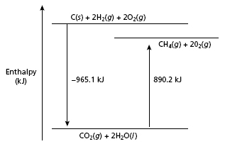
Extended Response
Chapter 16
Standardized Test Preparation
7. continued
C(s) + O₂(g) → CO₂(g) ∆H = –393.5 kJ
H₂(g) + O₂(g) → H₂O(l) ∆H = ?
CH₄(g) + 2O₂(g) → CO₂(g) + 2H₂O(l) ∆H = ?

Slide 72
Extended Response
Chapter 16
Standardized Test Preparation
7. For certain molecules, enthalpies of formation can be determined from combustion data. Using the diagram on the next slide, calculate the enthalpy of formation of methane gas, CH₄(g), and the enthalpies for two of the combustion reactions shown on that slide.
Answer: The formation reaction for CH₄(g) is C(s) + 2H₂(g) → CH₄(g). From the graph, ∆H for H₂(g) + O₂(g) → H₂O(l) is [−965.1 kJ − (−393.5 kJ)]/2 = −285.8 kJ.
The ∆H for CH₄(g) + 2O₂(g) → CO₂(g) + 2H₂O(l) can be read directly from the graph and is −890.2 kJ. The enthalpy of formation for CH₄(g) is −965.1 kJ + 890.2 kJ = −74.9 kJ.

