Slide 1
Warm Up
Complete the table below
Atom Name (hyphen notation) | Atomic Symbol | Atomic Number | # Protons | # electron | # Neutrons | Mass Number | Nuclear Symbol
 | Fe |  |  |  | 30
Silver -108
 |  |  |  |  |  |  | ⁴⁰K
 |  |  | 18 |  |  | 40
19

Slide 2
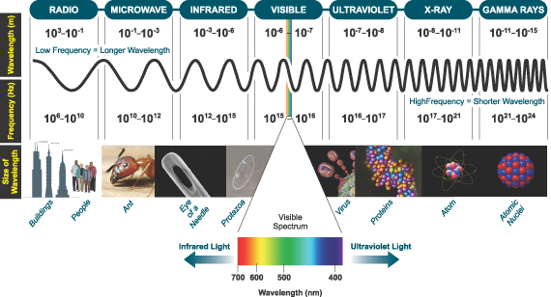

Electrons in Atoms
  First we need to understand a little bit about light behavior.
  The way electrons absorb or deflect light energy has to do with what we see.
  In your book we have the Electromagnetic Spectrum. The spectrum displays the wavelengths and frequency of different types of light (radiation).

Slide 3



Radiowaves
  Longer lower energy waves.
  We use these to tune our radios AM and FM.
  Our cell phones work on radio waves.
  And old TVs.
  These waves are very long…Up to a football field, but as small as a football.

Slide 4

Microwaves
  Next in length on the electromagnetic spectrum. Most people use these everyday with their microwaves. The waves interact specifically with molecules that have polar bonds.
  They excite things that are unbalanced in polar charges. Mainly water!

Slide 5
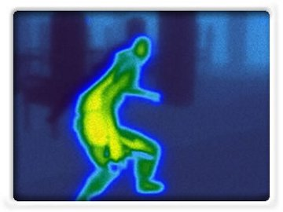

Infrared Light
  We have know there are other types of light, but our eyes do not see them.
  For example Infrared light. Infrared light is heat.
  Anything with heat exhibits infrared. We can not see these waves, but sensors can detect differences in energy and translate to pictures.

Slide 6
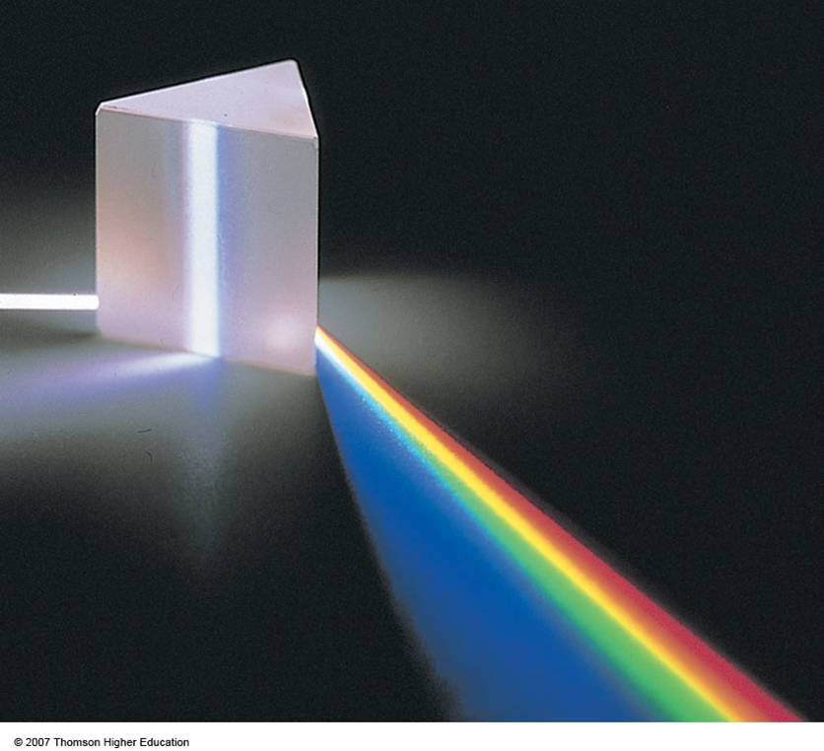
Visible Light
  We can see only a small piece of this large variety of light energy. The visible spectra is only 700-350nm in length. Our eyes can only register waves of this energy.
  The cones in our eyes pick up these light waves and process the intensity impulses to our brains.

Slide 7
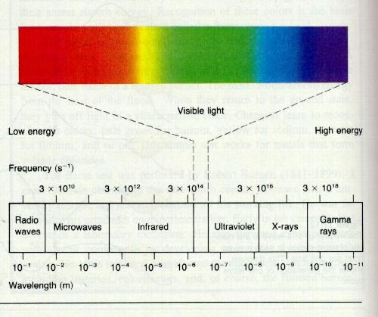
Visible Light
  Different colors have different energy. So our brain process different colors based on the intensity of light.

Slide 8



Electrons in Atoms
  We cannot see UV light but it does effect us. For example getting sunburned on a cloudy day. The UV light penetrates the clouds.
  There are organisms that can see UV light. Like bees.

Slide 9
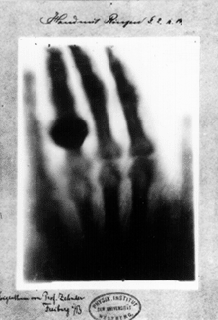


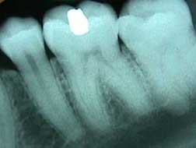

X-Rays
  After UV rays we have x-rays. X-rays are higher in energy and can penetrate our skin where teeth and metals absorb the X-rays.

Slide 10
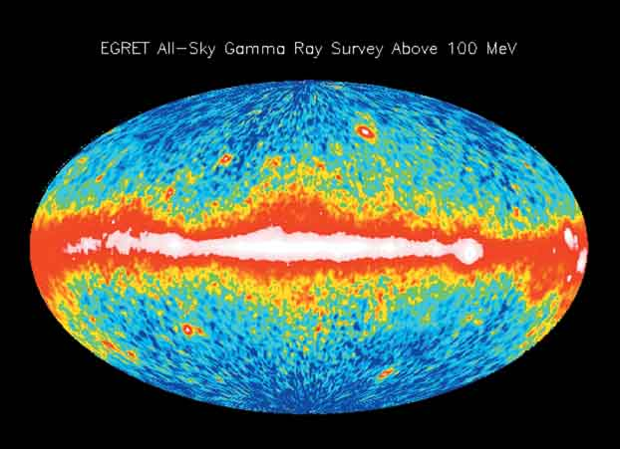
Gamma Rays
  Gamma Rays are products of Nuclear Radiation. When the nucleus decays or is destroyed we get gamma rays.
  Gamma rays are very dangerous and cause significant health problems. We have a large source of Gamma ray production in space where very violent reactions are occurring.

Slide 11
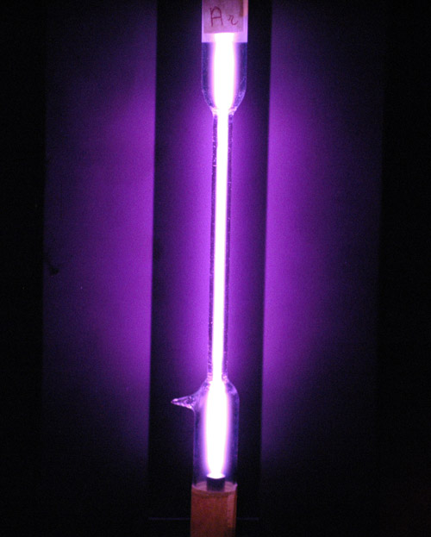
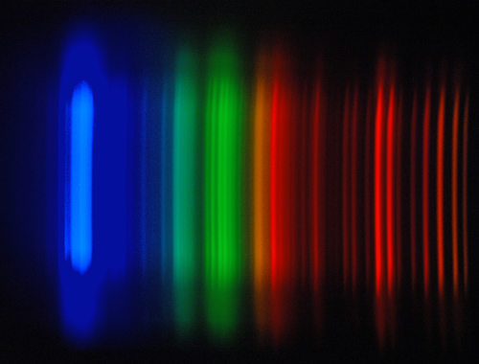
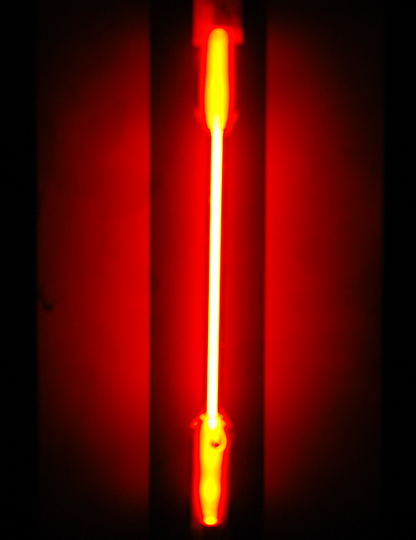
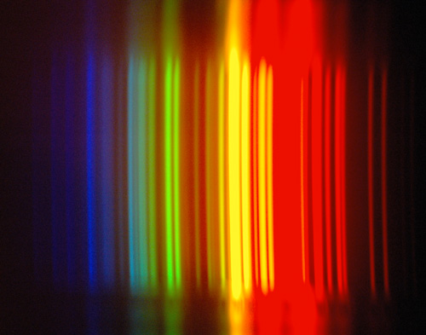
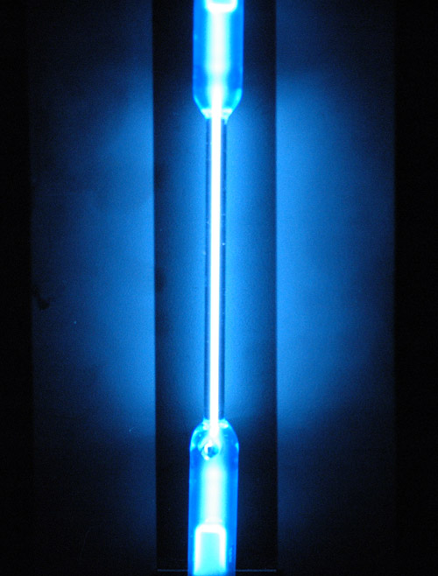
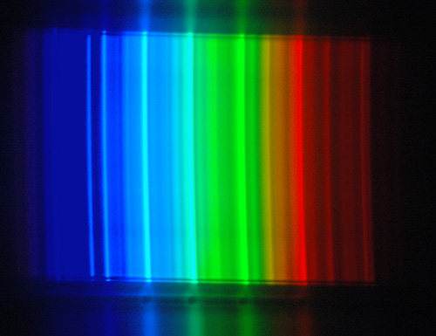
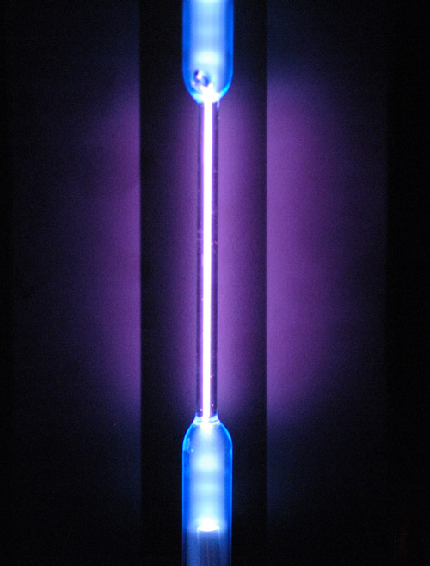
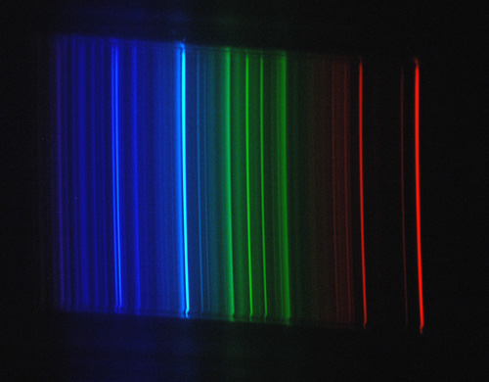
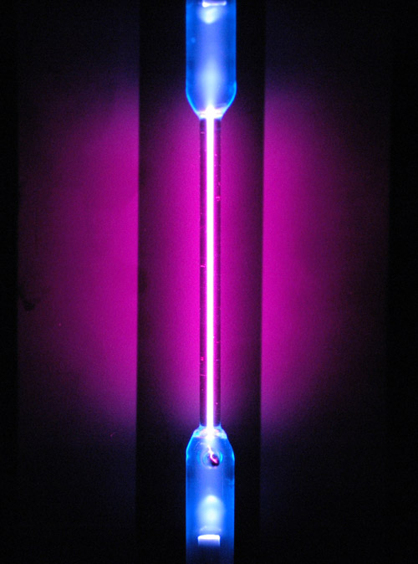
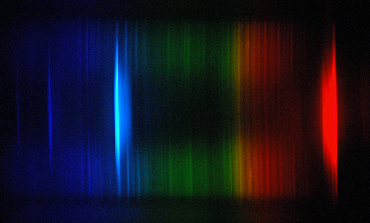
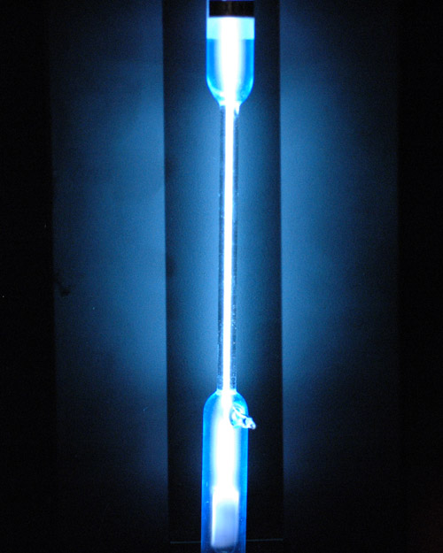
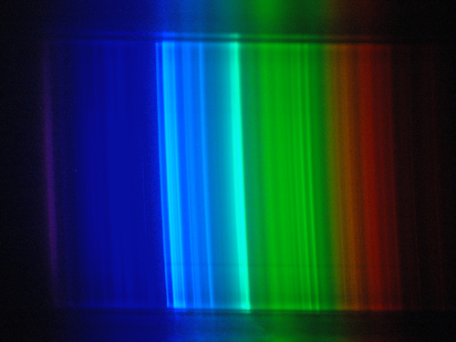
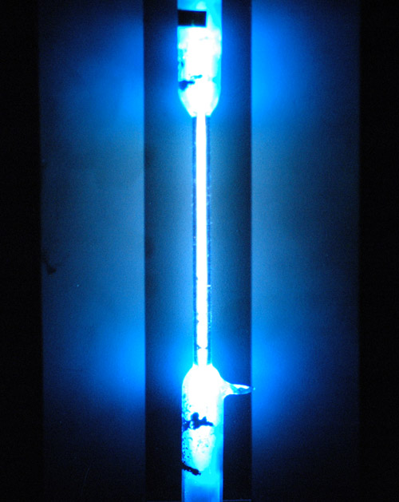
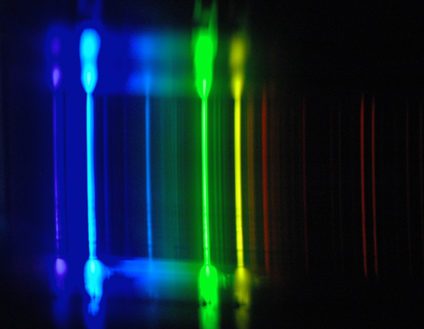
  Thus we have different light from different atoms
Argon
Neon
CO₂
Oxygen
Hydrogen
Xenon
Mercury

Slide 12
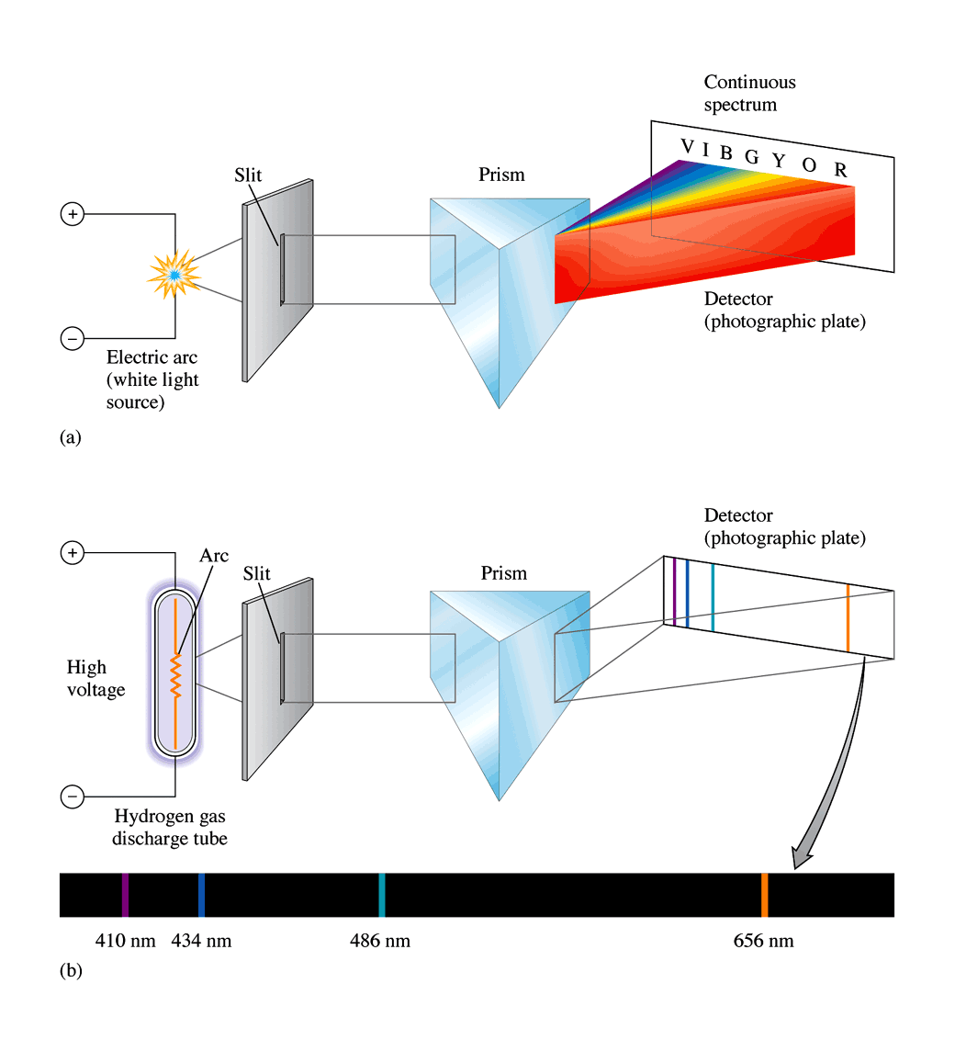
When white light is directed through a prism all of the various colors that make up white light, ROYGBIV are separated and create what we see as a rainbow.

Slide 13
Atomic Emission Spectra - a gaseous element is charged in a vacuum tube and the light created is passed through a prism.
Each element has its own emission spectra like a fingerprint of a human.

Slide 14
1.
n=3
Electrons absorb energy and become excited. They will jump from one energy level to the next.
This electron jumps from the n=1 energy level to the n=3 energy level.
n=2
n=1

Slide 15
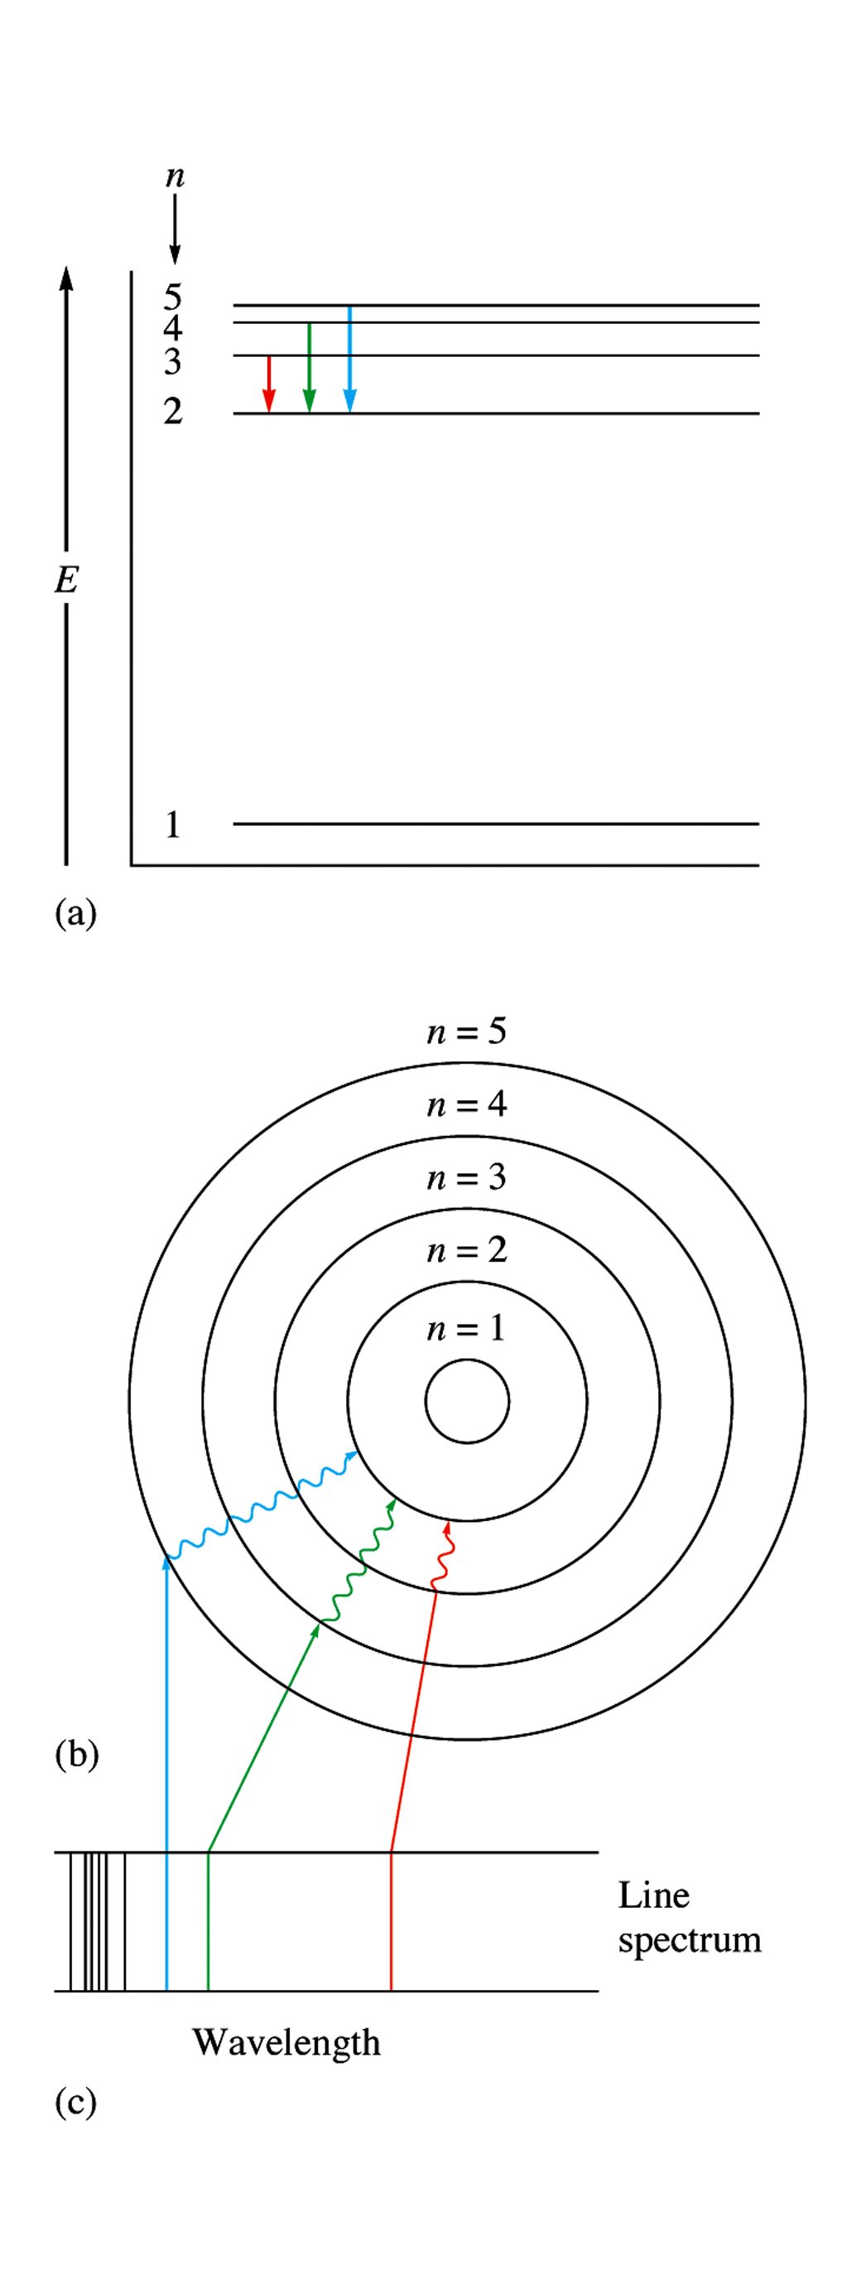
Energy escapes from the electron.
It returns to its original position and releases the energy it absorbed.
This energy sometimes falls within the electromagnetic spectrum in the visible region.

Slide 16
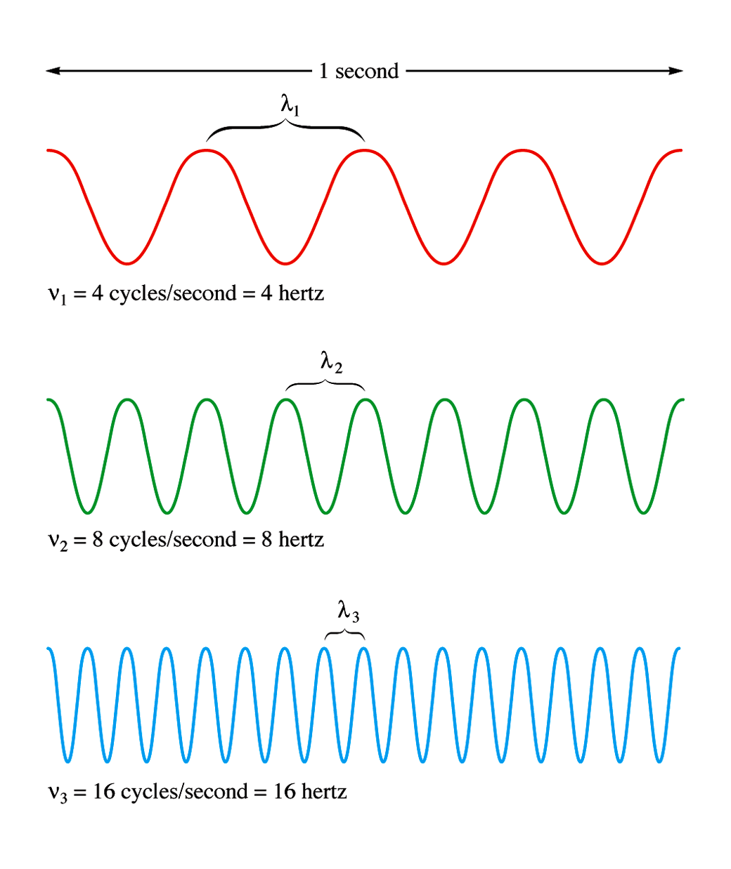

Waves and cycles

Slide 17
Equation Variables
Wavelength - λ (lambda) - The distance from crest to crest or trough to trough of a wave
Frequency - ν (nu) - The number of wavelengths that occur in a given period of time
Speed of light (or any EM radiation) - c - calculated out as a constant value of 3.00 x 10 ⁸ m/s

Slide 18
Wavelength and Frequency
Relationship of the three:
C = λν
λ = c/ν or ν = c/λ
Practice problem:
Calculate the frequency of the red light found in fireworks if that light has a wavelength of 560 nm

Slide 19
Energy and Waves
Energy is also associated with these values. If you know the frequency of the EMR, then you can calculate how much energy it has using:
E (energy) = hν 
h is a constant that is named after the person who calculated it. Planck’s Constant = 6.626 x 10 ⁻³⁴ J • s

Slide 20
Practice Problem:
Calculate the amount of energy that is emitted by a wavelength of light at 4.50 x 10 ² nm.

Slide 21
Excited Gas Lab
Question #1
Find the wavelength of the light shown for Hydrogen (3 colors). Look them up!
Show calculations for the frequency of each color.
Show calculations for the Energy of each color. s

Slide 22
Excited Gas Lab
Question #2
Why are you able to see the color bands observed? s

Slide 23
Lab Warm Up
A yellow light is emitted from the Atomic Emission Spectra from excited neon gas. Look up wavelength of yellow light in the text (p 98)
1) Calculate the frequency of this wavelength.
2) When do we see light from atoms?
  When the electrons are excited? (absorb energy)
  Or When they fall back to the ground state? (release energy

Slide 24
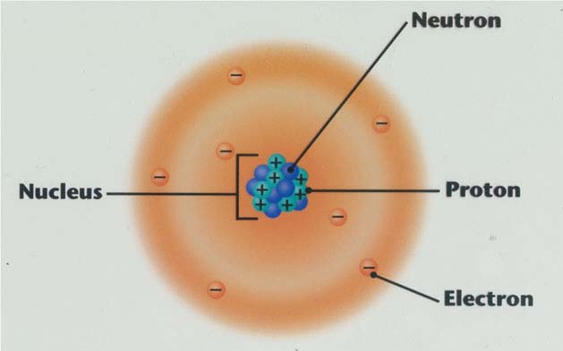

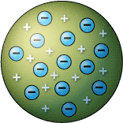
The Atom Model
We studied the atom model earlier.
1803 – Dalton says we can break down the atom into smaller pieces.
1897 – JJ Thompson discovered the electrons (cathode ray tube) and came up with the plum pudding model.
1911 – Rutherford showed that the atoms had a dense, positively charged nucleus and atoms were mostly empty space.

Slide 25
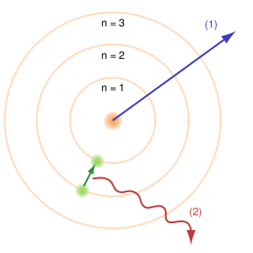
The Atom Model
1913 – Niels Bohr, young Danish physicist proposed electrons follow a circular path around the nucleus, much like the motion of planets

Slide 26
The Atom Model
1913 – Niels Bohr, young Danish physicist proposed electrons follow a circular path around the nucleus, much like the motion of planets
Notice the rings are numbered. These are called energy levels.

Slide 27
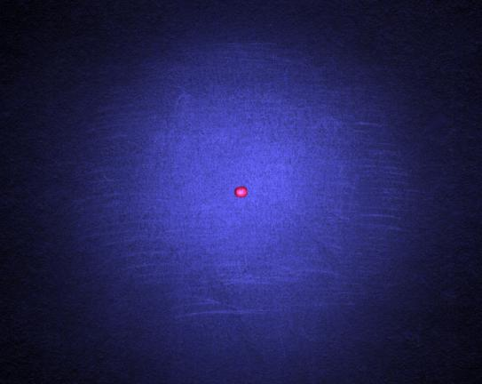
The Atom Model
1926 – Erwin Schrodinger developed the quantum mechanical model of the atom. Used mathematical equations to calculate the probability of electron locations.
It is impossible to know an electron’s exact location and direction at any time.

Slide 28
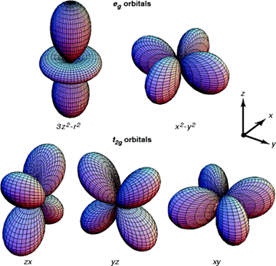
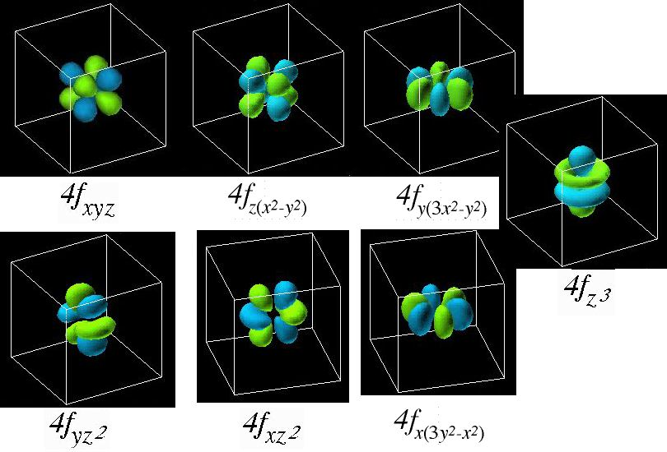

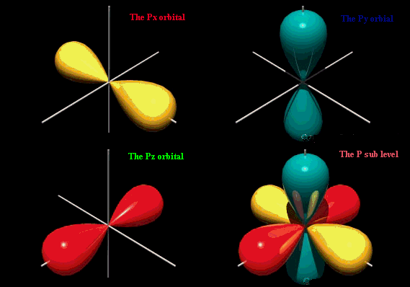
The Atom Model
Each orbital holds only 2 electrons.
Subshell # of orbitals # of electrons
s 1 (spherical) 2
p 3 (dumbell) 6
d 5 (4 clover shaped) 10
(1 dumbell w/lifesaver)
f 7 (complex) 14

Slide 29
The Atom Model
The atoms all have the same organization of energy levels, subshells and oribtals. Each orbital can only hold two electrons.
Energy Level Subshells # of electrons
1 1 (s) 2
2 2 (s, p) 8
3 3 (s, p, d) 18
4 4 (s, p, d, f) 32
5 5 (s, p, d, f, g) 50

Slide 30
4 Quantum Numbers
Principal quantum # (n) – indicates the main energy level occupied by the electron.
Angular Momentum Quantum # (l) – indicates the shape of the orbital.
Magnetic Quantum # (m) – indicates the orientation of an orbital around the nucleus.
Spin Quantum # - +1/2 or -1/2

Slide 31
The Atom Model
The electrons live in the oribitals. They have neighborhoods (energy levels), streets (orbital) and house number (electron number). Instead of writing the address we write the Electron Configuration.
For example Neon’s configuration: 1s² 2s² 2p⁶
Neon has 10 electrons, we fill up starting from the lowest shells to highest.
1s² 2s² 2p⁶ 3s² 3p⁶ 4s² 3d¹⁰ 4p⁶ 5s² 4d¹⁰ 5p⁶ 6s² 4f¹⁴ 5d¹⁰ 6p⁶ 7s² 5f¹⁴ 6d¹⁰
Energy -----------→------------------→---------------→------------------→-----------------→

Slide 32
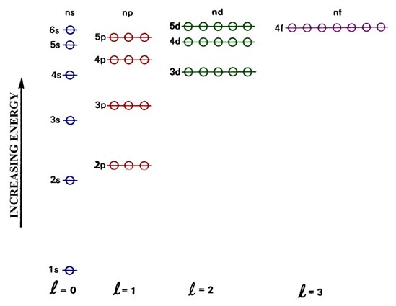
The Atom Model
There are rules for electron configuration.
1. Aufbau Principal – Electrons enter orbitals of the lowest energy first.
Be= 4e⁻

Slide 33
The Atom Model
There are rules for electron configuration.
2. Pauli exclusion principal – No more than two electrons can fit in any electron orbital.
Be= 4e⁻

Slide 34
The Atom Model
There are rules for electron configuration.
3. Hund’s Rule – Electrons will add to a subshell of equal energy one at a time before doubling up!
N= 7e⁻

Slide 35
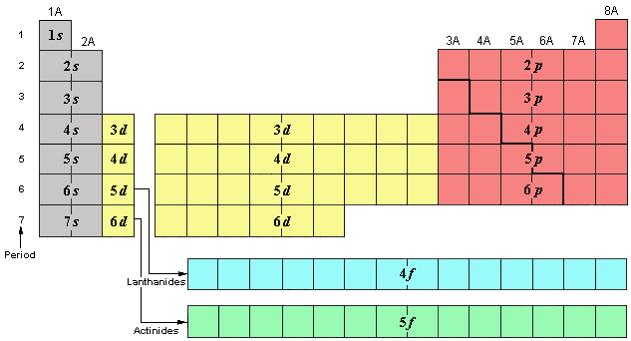
The Atom Model
Here is the trick. The periodic table is your Mapquest!
The atoms are all in order and you can follow by reading the map.

Slide 36
The Atom Model
What is the Electron Configuration for Beryllium (Be)?
1s²2s²

Slide 37
The Atom Model
What is the Electron Configuration for Sulfur?
1s²2s²2p⁶3s²3p⁴

Slide 38
The Atom Model
What is the Electron Configuration for Iron?
1s²2s²2p⁶3s²3p⁶4s²3d⁶

Slide 39
The Atom Model
What element’s electron configuration ends in 4p¹?
gallium

Slide 40
Noble Gas Configuration
Noble Gas configurations. Atoms wish to be the noble gases. We can use these as anchors for short hand notation. Look at noble gas closest (with out going over)
For Potassium (K) the configuration is 1s²2s²2p⁶3s²3p⁶4s¹
Shorthand, Noble Gas Config. [Ar]4s¹

Slide 41
HW # 7 Answers
18) a. 1; s b. 2; s and p c. 3 s, p and d
d. 4, s, p, d and f e. 7
24) 2s is higher than 1s 2s is further than 1s
29) The highest energy level filled in the configuration. Example 1s²2s²2p⁶3s² 3 is the highest level.
a. 1 b. 2 c. 3 d. 4 e. 5
a. P 1s – 2s – 2p -- -- -- 3s – 3p -- -- --
  b. B 1s – 2s – 2p -- -- --
  32) a. 1s²2s¹ b. 1s² 2s²2p⁴
  a. 8e⁻ b. 8
  A. Group 18, unreactive gaes. B. Substitute the noble gas into the electron configuration
  A. [Ne] 3s²³p⁵ B. [Ar] 4s²
  Ten electros from Ne plus 2 more. 12 e⁻ Magnesium
  A. Na 1s²2s²2p⁶3s¹ [Ne]3s¹ B. 1s²2s²2p⁶3s²3p⁶4s²3d¹⁰4p⁶5s² [Kr]5s²
  A. Boron B. Chlorine
39) 1s²2s²2p⁶3s²3p⁶4s²3d¹⁰4p⁶5s²4d¹⁰5p⁶6s²4f¹⁴5d¹⁰6p⁶7s²5f¹⁴6d¹⁰7p⁶
40) a. [Ar] 4s²3d¹⁰4p³ b. [Xe] 6s²4f¹⁴5d¹⁰6p²

