Slide 1
Warm Up
Balance the following and write the reaction types and names of the compounds:
H₃PO₃ → H₃PO₄ + PH₃
As₂S₃ + O₂ → As₂O₃ + SO₂

Slide 2
Warm Up Page 2
Solid ammonium carbonate, (NH₄)₂CO₃, is used as the active ingredient in “smelling salts”. When solid ammonium carbonate is heated, it decomposes into ammonia gas (NH₃), carbon dioxide gas, and water vapor.
Balance the reaction and identify the reaction type

Slide 3
Stoichiometry!
  Chapter 9
  Stoichiometry – the calculation of quantities in chemical reactions.
  Derived from the Greek language.
  Stoichio – meaning element
  Metry – meaning measure

Slide 4
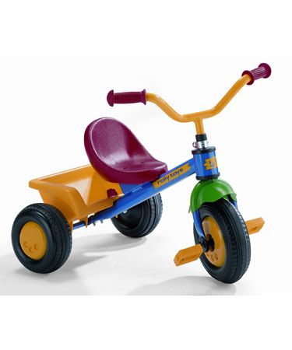
The bike factory
  Task at hand we are going to be in the bike building business.
  What do we need to build one toy tricycle?

Slide 5
The bike factory

Slide 6
The bike factory
  For the holiday season we just got our first order.
  The toy shop in town just ordered 50 bikes.
  What do you need to order?

Slide 7
Stoichiometry
  This is the basic concept of stoichiometry.
  Using an equation like a recipe to calculate amount of products and reactants.

Slide 8

Stoichiometry
  Let’s look at an example:
  The reaction of nitrogen gas and hydrogen gas to produce ammonia (NH₃).
  N₂ + H₂ → NH₃
  Are we balanced?

Slide 9
Stoichiometry
  Like our tricycle equation, the balanced equation is VERY IMPORTANT!
  It is our recipe
  The coefficients serves as mole ratios for the reaction.
  What are the possible mole ratios?

Slide 10
Stoichiometry
1 mole of N₂
+
3 moles of H₂
2 moles of NH₃
The coefficients give us mole ratios of the reaction.
How many moles of H₂ would we need to produce 20 moles of NH_{3?}

Slide 11
Stoichiometry
Balance the equation for the reaction of water decomposing into hydrogen gas and oxygen gas, also know as electrolysis.
2
H₂O → H₂ + O₂
2
Using stoichiometry find how many moles of H₂ and O₂ are created from 2 moles of H₂O.
2) How many moles of H₂O are needed to produce 12 moles of O₂ gas.

Slide 12
Stoichiometry
Moles to Grams!
2
H₂O → H₂ + O₂
2
Using stoichiometry find how many grams of O₂ are produced from 2 moles of H₂O.

Slide 13
Stoichiometry
Grams to Grams!
Sodium Hydroxide reacts with carbon dioxide to produce sodium carbonate and water.
NaOH + CO₂ → Na₂CO₃ + H₂O
How many grams of CO₂ are need to produce 25g of Sodium Carbonate?
How many grams of CO₂ will react with 210g of NaOH?

Slide 14
Stoichiometry
Practice, Practice, Practice……..On a separate sheet of paper.
Methanol CH₃OH is an important industrial compound that is produced from the following reaction: CO(g) + H₂(g) → CH₃OH(g). What is the mass of each reactant needed to produce 100.0 kg of methanol?

Slide 15
Stoichiometry
Practice, Practice, Practice……..
The density of acetic acid at 20 degrees Celsius is 1.05g/mL. How many grams of acetic acid are produced from 75g of Salicylic Acid (C₇H₆O₃).
C₇H₆O₃ + C₄H₆O₃ --> C₉H₈O₄ + H₂C₂H₃O₂

Slide 16
Warm Up
Solid tin metal reacts with hydrofluoric acid to produce Tin(II) Fluoride and Hydrogen Gas
Sn + HF → SnF₂ + H₂
How many moles of HF react with 1.44 moles of Sn?
How many grams of SnF₂ are produced?
How many molecules of H₂ gas are produced in the reaction above?
How Many atoms of H₂ are produced?

Slide 17
a. 5.0 mol H₂
b. 2.5 mol O₂
A.15.8 mol O₂
b. 9.00 mol CO₂, 13.5 mol H₂O
575g Na, 886g Cl₂
A. 75.1 mol CO
b. 50.1 mol Fe, 75.1 mol CO₂
87390g CO, 12610g H₂

Slide 18
42.04mol NaOH, 21.02 mols of each product
13. a. 3.058mol NaHCO₃
b. 3.058mol CO₂, 1.529mol Na₂SO₄, 3.058mol H₂O
a. 0.0104mol Cu(NO₃)₂
b. 0.0104mol Cu, 0.0209mol AgNO₃
a. HCl is limiting reactant
b. Zn is limiting
c. Fe(OH)₃ is limiting
a. 2.0mol NaCl, 2.0mol H₂O
b. 2.5mol ZnCl₂, 2.5mol H₂
c. 2.0mol Fe₂(SO₄)_{3,}, 12mol H₂O
a. H₂SO₄ is limiting
b. 9.05g excess Al(OH)₃
c. 34.9g Al₂(SO₄)₃, 11.0g H₂O

Slide 19
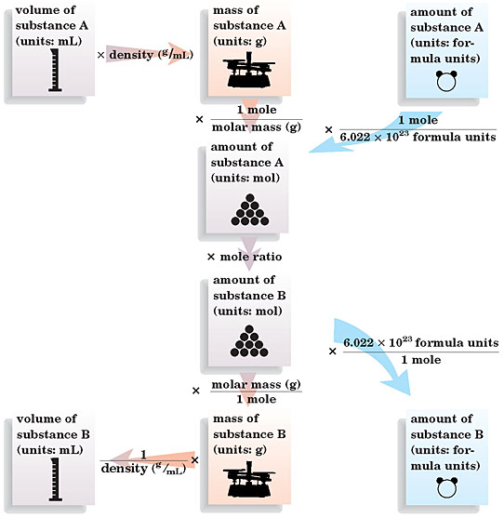

Slide 20
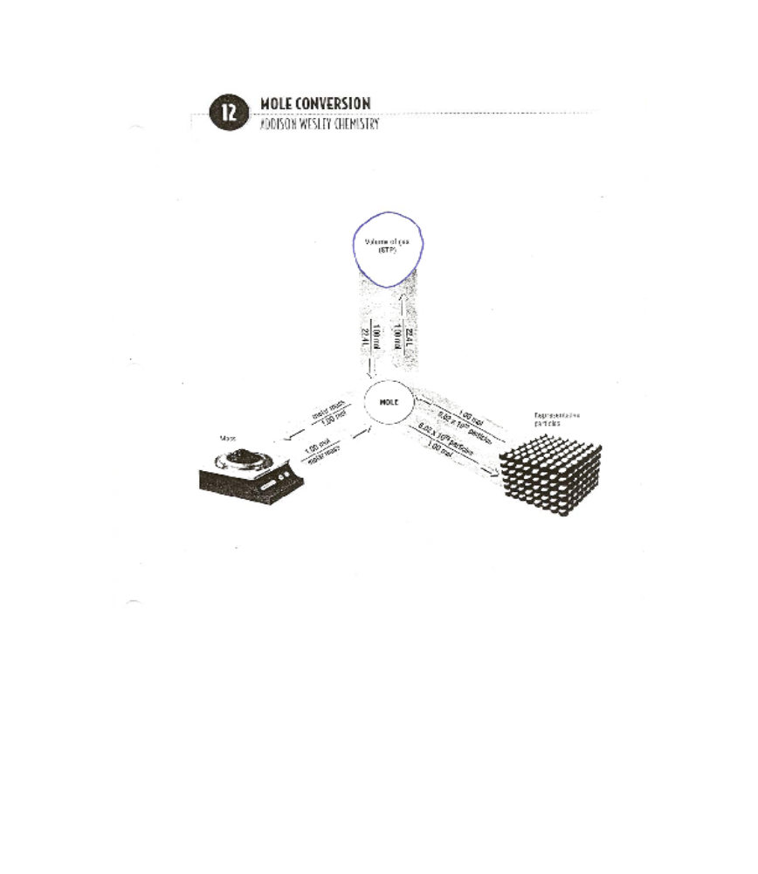
STOICH MAP
Moles Wanted
Moles Given
MOLE RATIO
Given
Wanted

Slide 21

Limiting Reactants
Section 3 Limiting Reactants and Percentage Yield
The limiting reactant is the reactant that limits the amount of the other reactant that can combine and the amount of product that can form in a chemical reaction.
The excess reactant is the substance that is not used up completely in a reaction.

Slide 22
Sample Problem
Silicon dioxide (quartz) is usually quite unreactive but
reacts readily with hydrogen fluoride according to the
following equation.
SiO₂(s) + HF(g) → SiF₄(g) + H₂O(l)
If 6.0 mol HF is added to 4.5 mol SiO₂, which is the
limiting reactant?

Slide 23
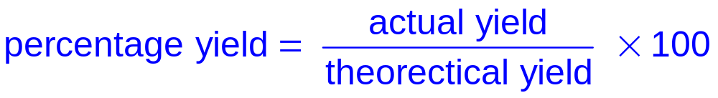
Percentage Yield
The theoretical yield is the maximum amount of product that can be produced from a given amount of reactant.
The actual yield of a product is the measured amount of that product obtained from a reaction.
The percentage yield is the ratio of the actual yield to the theoretical yield, multiplied by 100.

Slide 24
Sample Problem
Chlorobenzene, C₆H₅Cl, is used in the production of many important chemicals, such as aspirin, dyes, and disinfectants. One industrial method of preparing chlorobenzene is to react benzene, C₆H₆, with chlorine, as represented by the following equation.
C₆H₆ (l) + Cl₂(g) → C₆H₅Cl(l) + HCl(g)
When 36.8 g C₆H₆ react with an excess of Cl₂, the actual yield of C₆H₅Cl is 38.8 g.
What is the percentage yield of C₆H₅Cl?

Slide 25
Warm Up
CH₃OH(l) + CO(g) → HC₂H₃O₂
  In an experiment 15.0g of methanol (CH₃OH) and 10.0g of carbon monoxide are placed in a reaction vessel giving the reaction above.
  a) What is the theoretical yield of acetic acid?
  b) What is the percentage yield if the actual yield is only 19.1g?

Slide 26
Warm Up
Sodium bicarbonate reacts with acetic acid to produce carbon dioxide, water and sodium acetate. What mass of sodium bicarbonate is need to react with excess acetic acid (vinegar) to produce 34.4L of CO₂ at STP?

Slide 27
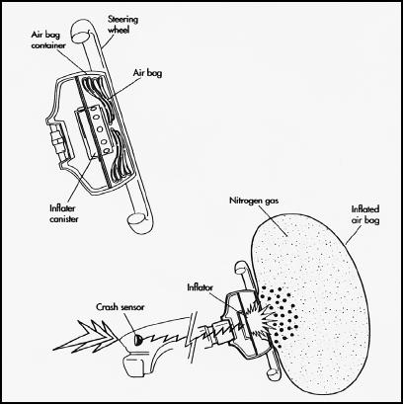
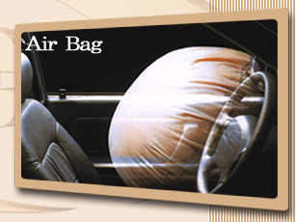
AIR BAGS!!!
2NaN_{3(s)} → 3N_{2(g)} + 2Na_{(s)}
Very exothermic!

Slide 28
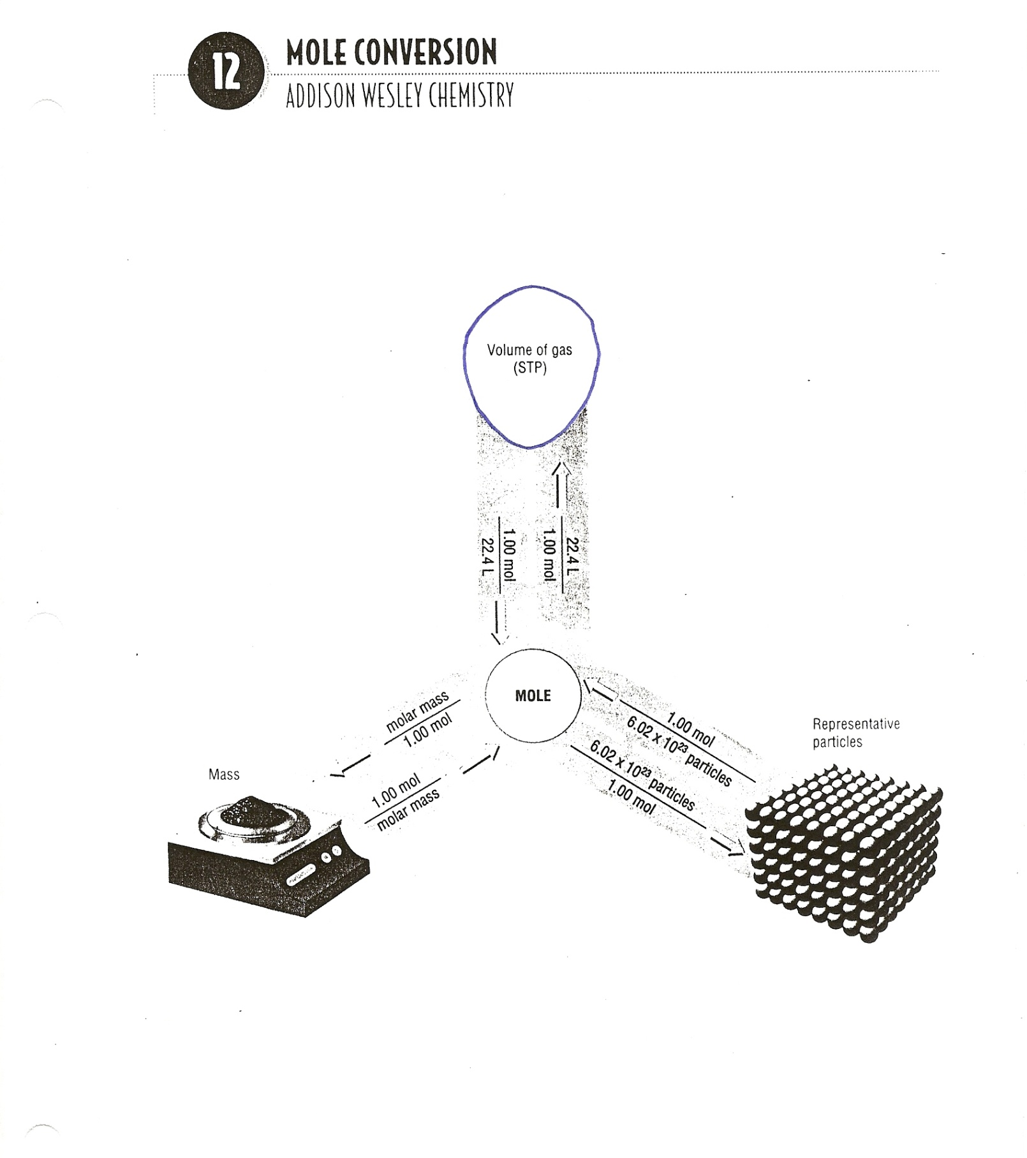

Slide 29
Volume of Gases
STP – Standard Temperature and Pressure. (STP) These conditions are 1atm and 0° Celsius.
At STP we know that 1 mole of any GAS will occupy 22.4 L.
        1 mole gas at STP = 22.4 L

Slide 30
Air Bag Lab
Purpose: Determine the amount of gas produced in a chemical reaction to inflate a plastic air bag.
Materials: Ziploc Bag, weigh boat, scale, 5% vinegar solution, sodium bicarbonate 1000mL beaker, 100mL graduated cylinder

Slide 31
Air Bag Lab
Procedure:
1) Determine the volume of the Ziploc bag by filling it to capacity with water and seal.
2) Then empty water into an empty 400mL beaker to determine the volume.
3) Use this volume and stoichiometry to calculate the mass of sodium bicarbonate needed to inflate the bag.

Slide 32
Air Bag Lab
Procedure:
4) Weigh out the mass calculated using a weigh boat. Set aside until later
5) Using 100mL graduated cylinder obtain 100mL of acetic acid.
6) Add acetic Acid to bag. Separate by twisting off in one corner.
7) Add NaHCO₃ to the bag and seal.
8) Untwist the bag and allow reaction to occur.

Slide 33
Air Bag Lab
Data:
Volume of Ziploc Bag:_______________
Mass of Sodium bicarbonate needed:__________
Sample Calculations:
NaHCO₃ + HCH₃COO → CO₂ +H₂O + NaCH₃COO

Slide 34
Grading
This lab will be worth Stamps
This lab will be worth up to 20 stamps.
For full credit. I will need to see lab write up, all work and calculations.
The big piece will be a properly inflated bag.
A flat bag will lose up to ten stamps. Even if work is shown. I want to see filled bags, people’s lives depend on this!

