Slide 1



Nuclear Chemistry
Chapter 21

Slide 2
Warm Up
Astatine – 210 goes through alpha decay, beta decay and alpha decay in that order to become stable. Write the reactions that represent this process.

Slide 3
Goals for Nuclear Chem
1) 11. Nuclear processes are those in which an atomic nucleus changes, including radioactive decay of naturally occurring and human-made isotopes,nuclear fission, and nuclear fusion. As a basis for understanding this concept:
a. Students know protons and neutrons in the nucleus are held together by nuclear forces that overcome the electromagnetic repulsion between the protons.
b. Students know the energy release per gram of material is much larger in nuclear fusion or fission reactions than in chemical reactions. The change in mass (calculated by E = mc²) is small but significant in nuclear reactions.
c. Students know some naturally occurring isotopes of elements are radioactive, as are isotopes formed in nuclear reactions.
d. Students know the three most common forms of radioactive decay (alpha, beta, and gamma) and know how the nucleus changes in each type of decay.
e. Students know alpha, beta, and gamma radiation produce different amounts and kinds of damage in matter and have different penetrations.

Slide 4
Nuclear Chemistry
Nuclear Chemistry Deals with the study of the nucleus.
This deals with atoms protons, neutrons and their existence.

Slide 5
Types of Radiation
Radiation
Alpha particles
Beta particles
Gamma particles
Radiation occurs when a nucleus is unstable and must alter is components to obtain stability.
When we are looking at any type of radiation or radioactive decay we must remember that matter is conserved!

Slide 6
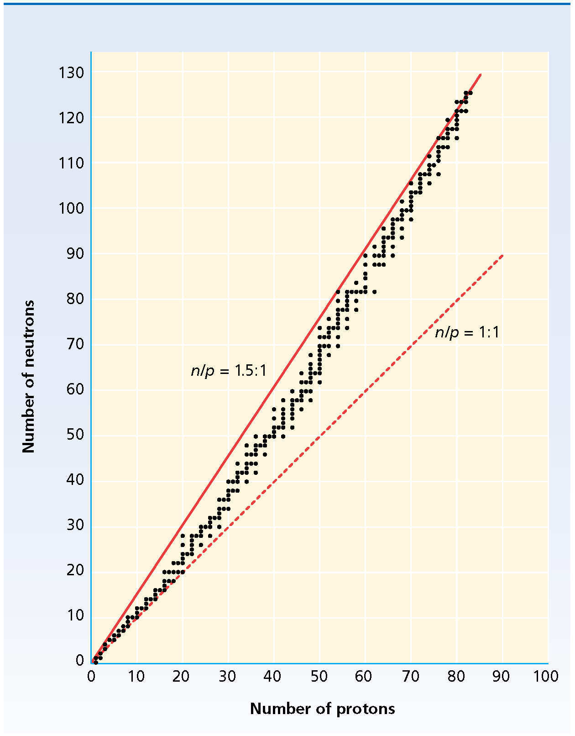
Nuclear Stability
Isotopes with low atomic numbers
  Stable ratio is 1 neutron to 1 proton
Isotopes with high atomic numbers
  Stable ratio is 1.5 neutrons to 1 proton
This creates the band of stability
fig 28.6

Slide 7
Nuclear Stability
Remember Nuclear Forces.
Protons have repulsive forces.
Close distance between protons and neutrons keep the nucleus together.
fig 28.6

Slide 8
Nuclear Stability and Decay
Unstable isotopes will undergo decay to achieve a more stable ratio of neutrons to protons
The type of decay depends on the ratio of neutrons to protons
  Too many neutrons. Turn neutrons to protons. (beta decay). Or the nucleus loses mass. (alpha decay)
  Too many protons, the atom captures electrons and turn protons to neutrons, this emits a positron

Slide 9
Alpha particles
Helium nuclei
  Contains 2 protons and 2 neutrons
  Net charge of +2
  Has a mass of 4 amu
    High mass limits penetrability
  Looks like: ⁴₂He or α

Slide 10
Alpha particles in a reaction
Alpha radiation is emitted from U-238
  ²³⁸₉₂U →²³⁴₉₀Th + ⁴₂He
  Is matter conserved?
  Yes!
Now you try!
Alpha radiation is emitted from Rn-222
²²²₈₆Rn →²¹⁸₈₄Po+ ⁴₂He
Is matter conserved?
Yes

Slide 11
Beta particles
Fast moving electrons
formed by the decomposition of a neutron in to a proton and the fast moving electron
They have a negligible mass
  Consequently they are more penetrating than alpha particles
They have a charge of -1

Slide 12
Beta particles in a reaction
The general reaction
¹₀n→¹₁H + ⁰₋₁e
What does that mean?
A neutron is converted into a proton
So, the mass number remains the same but the atomic number increases by one

Slide 13
Beta particles in a reaction
C-14 is a beta emitter, show the decay process
¹⁴₆C →¹⁴₇N + ⁰₋₁e
Is matter conserved?
Yes!
Now you try
⁴⁰₁₉K →
⁴⁰₁₉K → ⁴⁰₂₀Ca + ⁰₋₁e

Slide 14
Gamma Rays
High energy electromagnetic radiation given off by a radioisotope
Often emitted with alpha and beta particles
Gamma rays have no mass and no charge, so they do not alter the atomic number or the mass number
Gamma particles have the largest penetration ability

Slide 15
Gamma particles in a reaction
²³⁰₉₀Th→²²⁶₈₈Ra + ⁴₂He + γ
  When the alpha particle is released a huge amount of energy is also released (the gamma particle)!

Slide 16
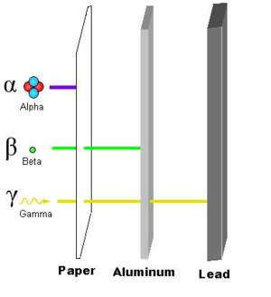

Slide 17
Is the following Alpha emission or beta emission?
²³⁴Th --→ ⁰B + ²³⁴Pa
²³⁸U --→ ⁴He + ²³⁴Th
90
-1
91
92
2
90

Slide 18
Radioactive
All nuclei with atomic numbers greater than 83 are radioactive
These nuclei have both too many neutrons and too many protons to be stable
  So most undergo decay
Most emit alpha particles,

Slide 19
Transmutation
The conversion of an atom of one element into an atom of another element
This occurs in radioactive decay
This can also occur when a high energy particle bombards the nucleus of an atom
Notes:
Particles

Slide 20
Fission
When some radioactive nuclei are bombarded with neutrons they undergo splitting of a nucleus into smaller fragments called fission
Neutrons are released from fission reaction, creating a chain reaction

Slide 21
Nuclear Fission & Energy
Nuclear fission can release an enormous amount of energy
  Ex. 1kg of U-235 release the same amount of energy as 20,000 tons of dynamite
  Energy is calculated by E=mc²
  E = Energy
  m = difference of mass
  c = speed of light
  In fusion and fission a very small amount of mass of is converted to energy and visa versa.

Slide 22
How can we use fission energy?
We need to control the energy released
  By releasing energy slower
    Neutron Moderation: slows the neutrons down
    Neutron Absorption: decrease neutrons that react
  By converting energy to heat
    Coolant removes heat from reactor core
This creates a manageable amount of useable power

Slide 23

Nuclear Fusion
Fusion occurs when nuclei combine to produce a nucleus of greater mass
Usually release more energy than fission
Only take place at temps greater than 40,000,000˚C
Ex. 4¹₁H + 2⁰₋₁e → ⁴₂He + energy

Slide 24
Nuclear Fusion as an energy source
JET (Joint European Torus) have achieved the
  Temperatures
  Densities
  Degrees of containment
  Required to produce fusion power

Slide 25
Radiation in your life!
Where do we use radiation?
  Energy Sources
  Disease Diagnosis
  Disease Treatment
  Biotech Tracers & Research
  Criminal Investigations
  Anthropological Dating

Slide 26
Radiation in your life!
How do we measure your exposure level?
  Geiger counter
  Film badges

