Slide 1
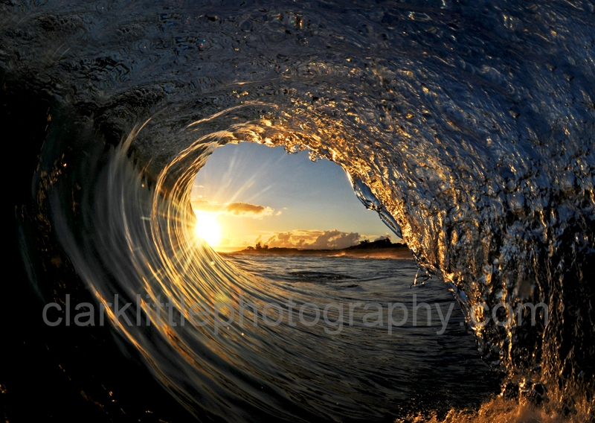
Ocean Energy
Jared Weinstein, Aran Merati, Allison Steitz

Slide 2

1. Scientific Development
Scientists are utilizing the massive energy in the ocean
They are using various sources
  Waves’ energy
  Currents’ energy
  Tides’ energy

Slide 3

2. Benefit to Society
Alternate source of energy
“Green”
Renewable resource
Clean

Slide 4
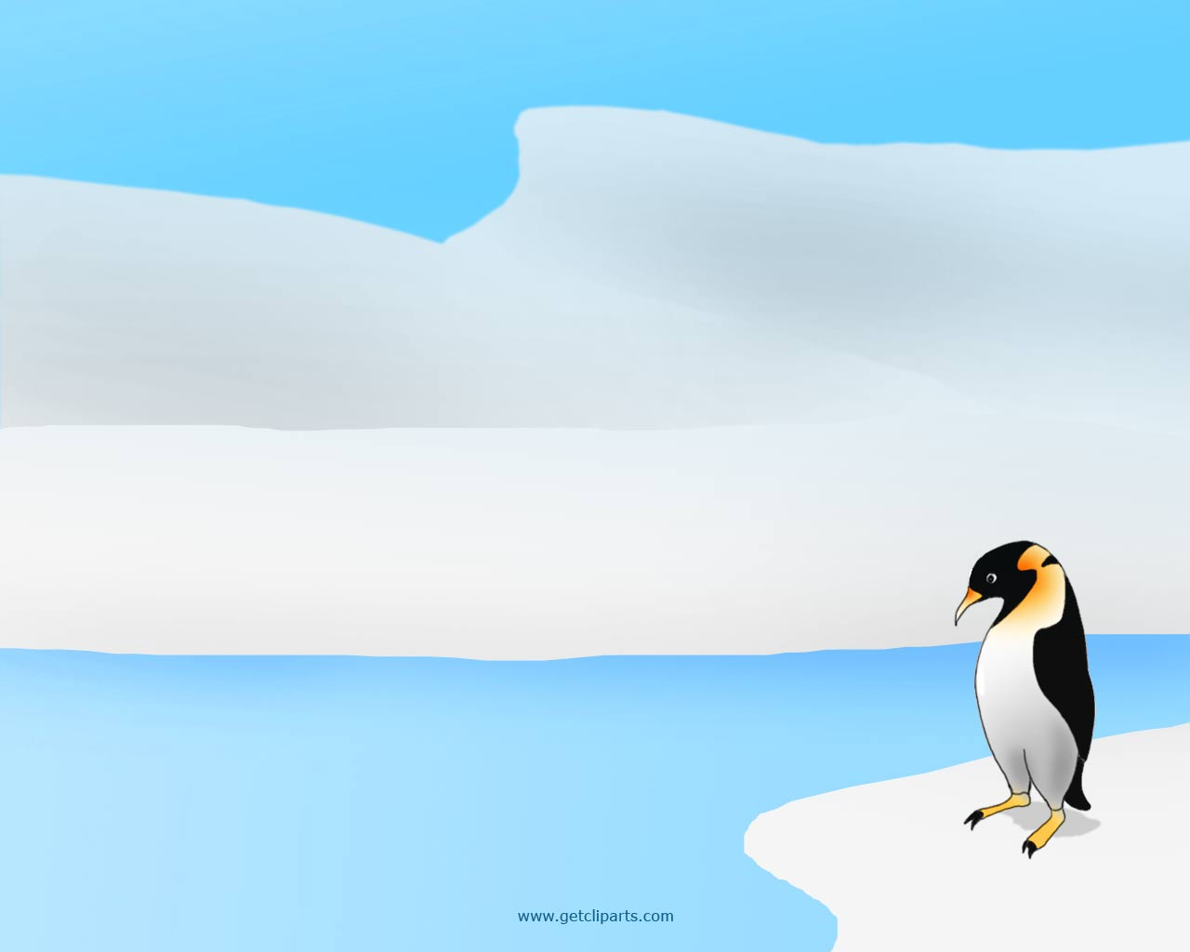
Advantages to Ocean Energy
More predictable than wind or sunlight
  Enable a more straightforward and reliable integration into the electric utility grid.
Wave energy also offers much higher energy densities
  Enabling devices to extract more power from a smaller volume at consequent lower costs

Slide 5
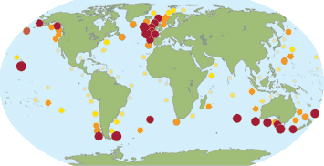
Wave-rich places
The dark red circles on the map above show areas of the world's oceans with the greatest wave power.
Not by coincidence, wave-rich locations are funding research for wave energy technology.

Slide 6
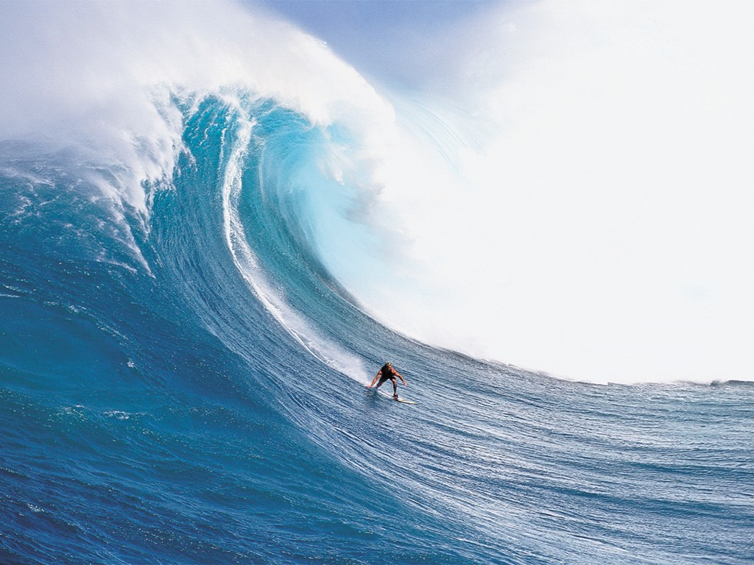
WAVE ENERGY

Slide 7

How are waves caused?
Waves are caused by the wind blowing over the surface of the ocean, and complex groundswell patterns.
  In many areas of the world, the wind blows with enough consistency and force to provide continuous waves.
Waves contain a massive amount of energy
  Wave power devices extract energy directly from the surface motion of ocean waves or from pressure fluctuations below the surface

Slide 8

Waves = Energy
Waves are actually energy.
Energy, not water, moves across the ocean's surface.
Water particiles only travel in a small circle as a wave passes
1/500 of the oceans’ untapped energy would provide enough energy to power the world
Notes:
The best way to understand waves as energy is to think of a long rope laid on the ground. If you pick up one end and give it a good snap --there's a ripple effect all the way to the other end -- just like the waves on the ocean! That means that energy is applied at one end and it moves to the other end. The energy is released at the other end of the rope, just as the energy of waves is releases on shores.

Slide 9
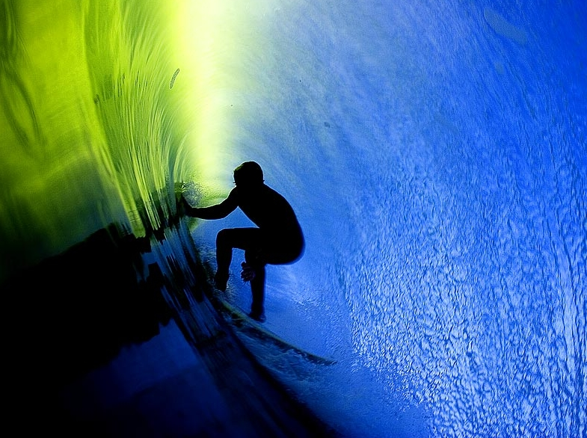
Wave Power
Wave power varies considerably
  Not everywhere can wave power be harnessed effectively
Wave-power rich areas of the world
  The western coasts of Scotland, northern Canada, southern Africa, Australia, and the northwestern coasts of the United States

Slide 10
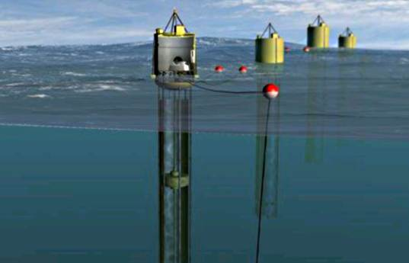
Ocean Wave Energy Technologies
A combination of prototypes are currently being tested
Area to be installed
  Nearshore
  Offshore (40 m)
  Far offshore
Notes:
A variety of technologies have been proposed to capture the energy from waves. Some of the more promising designs are undergoing demonstration testing at commercial scales.
Wave technologies have been designed to be installed in locations. The OCS Alternative Energy Programmatic EIS is concerned primarily with offshore and far offshore wave technologies. Offshore systems are situated in deep water, typically of more than 40 meters (131 feet).

Slide 11
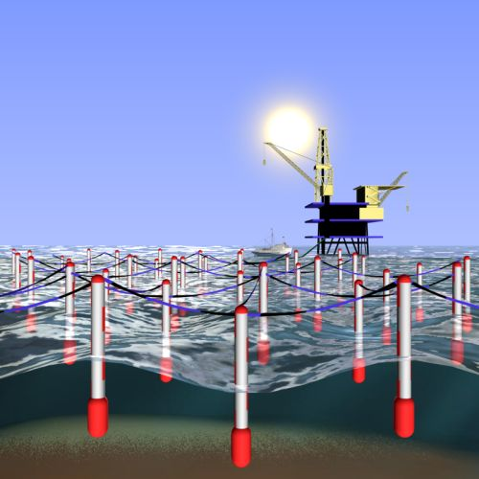
Ocean Wave Energy Technologies
Installation
  All wave energy technologies are intended to be installed at or near the water's surface
  Differ in their orientation to the waves with which they are interacting
  They convert the energy of the waves into other energy forms, usually electricity.

Slide 12

DEVICES

Slide 13

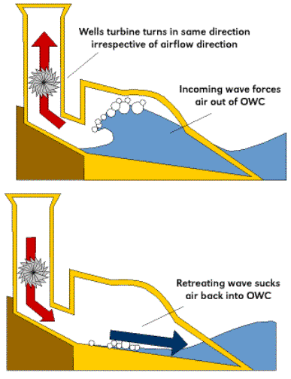
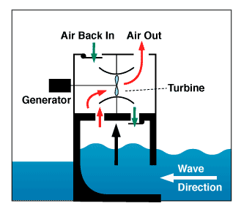
Devices
Terminator devices
  Limited by Betz effect
    59.3% kinetic energy conversion limit
  Most common is the oscillating water column →
    Captures or reflects the power of the wave to spin a turbine
    Typically onshore or nearshore
  Offshore turbine →
Notes:
extend perpendicular to the direction of wave travel and capture or reflect the power of the wave
The following wave technologies have been the target of recent development.
The following wave technologies have been the target of recent development.
The following wave technologies have been the target of recent development.

Slide 14
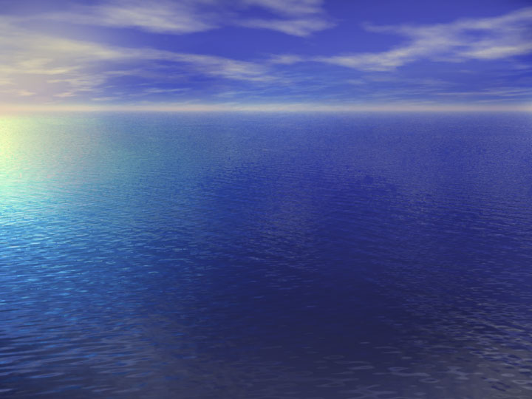
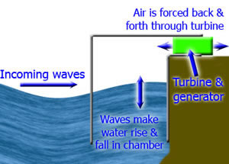
How it works
Waves arrive at power station
Waves cause water to rise and fall in chamber
Air is forced in and out of the hole at the top of the chamber
Air turns turbine, which powers generator
Con: Possibly very noisy without a silencer
  Noise of device usually drowned out by waves

Slide 15

A clean energy technology company
Commercializing a vertical axis hydro turbine
  capable of converting tidal currents into firm, renewable electricity
Devices they use:
  Underwater windmills
  Ducted fan
  Tidal bridge

Slide 16
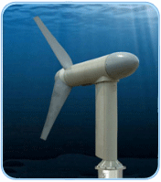
Underwater Windmills
  Propellers mounted on a fixed piling
  Tethered by anchoring systems or held in place on the seabed by heavy gravity mount bases.
  Employs principles of lift
  Since water is so much denser than air, underwater windmills necessarily have short, low aspect foil sections and are limited in span by structural requirements and water depth.
  Laws of physics handicap the bottom mounted underwater windmill.

Slide 17
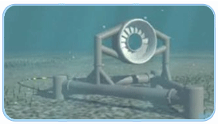
Ducted fan
  giant versions of common air conditioning and heating fans
  venturi-shaped duct to increase the velocity of the water flow over blades attached to an outer housing
  Difficult to maintain
    Hard to service
    Affected by marine life

Slide 18
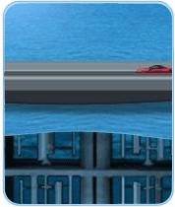
Tidal Bridge
  Fluids tend to flow around rather than through energy capture devices.
  Modular turbine units that are stacked to extend from the ocean floor to the water surface
  Generators and machinery housed in accessible climate-controlled above-water rooms for cost effective maintenance and reduced environmental aging for equipment.
  Produces power on both incoming and outgoing tides.
  Transportation Bridge provides the Blue Energy technology with a supplemental billion dollar market driver.
  Limited impact on marine life
  No Co2, mercury, or sulfur dioxide emissions.
  No fuel cost-----ever!

Slide 19

PROS
The energy is free – no fuel is needed and no waste is produced
Inexpensive to operate and maintain
Can produce a significant amount of energy.
Green

Slide 20

CONS
• Depends on the waves – variable energy supply
• Some designs generate noise
• Must be able to withstand very rough weather
• Costly to develop
• Threat to navigation
• May obstruct mooring and fishing
• May degrade scenic ocean front views
Can disturb or disrupt marine life (toxic spills)

Slide 21
Personal Opinions
Good idea, but not yet developed enough
Will be a major player in the natural energy supply in the future
At the moment, too many cons
Light at the end of the tunnel- Aran’s uncle

Slide 22
Works Cited
OCS Alternative Energy Program Use Programmatic EIS. N.p., n.d. Web. 26 May 2010. <http://ocsenergy.anl.gov/guide/wave/index.cfm>.
AE Wave Power. N.p., n.d. Web. 26 May 2010. <http://www.alternative-energy-news.info/technology/hydro/wave-power/>.
Energy Resources: Wave Power. N.p., 29 Jan. 2010. Web. 27 May 2010. <http://home.clara.net/darvill/altenerg/wave.htm>.
U.S. Department of Energy. N.p., 30 Dec. 2008. Web. 26 May 2010. <http://www.energysavers.gov/renewable_energy/ocean/index.cfm/mytopic=50009>.
Hernandez, Christina. "How it Works: Wave Power." Smart Planet. N.p., 27 May 2010. Web. 27 May 2010. <http://www.smartplanet.com/people/blog/pure-genius/how-it-works-wave-power/3769/>.

