Slide 1

Molecular Geometry and Chemical Bonding Theory

Slide 2

Bond Theory
In this chapter we will discuss the geometries of molecules in terms of their electronic structure.
  We will also explore two theories of chemical bonding: valence bond theory and molecular orbital theory.
  Molecular geometry is the general shape of a molecule, as determined by the relative positions of the atomic nuclei.
Notes:
2

Slide 3
The Valence-Shell Electron Pair Repulsion Model
The valence-shell electron pair repulsion (VSEPR) model predicts the shapes of molecules and ions by assuming that the valence shell electron pairs are arranged as far from one another as possible.
  To predict the relative positions of atoms around a given atom using the VSEPR model, you first note the arrangement of the electron pairs around that central atom.
Notes:
2

Slide 4
Predicting Molecular Geometry
The following rules and figures will help discern electron pair arrangements.
    Draw the Lewis structure
    Determine how many electrons pairs are around the central atom. Count a multiple bond as one pair.
    Arrange the electrons pairs are shown in Figure 10.3.
Notes:
2

Slide 5
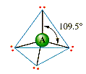


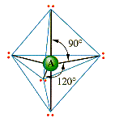
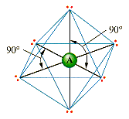
Arrangement of Electron Pairs About an Atom
2 pairs
Linear
3 pairs
Trigonal planar
4 pairs
Tetrahedral
5 pairs
Trigonal bipyramidal
6 pairs
Octahedral

Slide 6
Predicting Molecular Geometry
The following rules and figures will help discern electron pair arrangements.
    Obtain the molecular geometry from the directions of bonding pairs, as shown in Figures 10.4 and 10.8.
      (See Animations: Electron Pair Repulsion, 2 Pairs; Electron Pair Repulsion, 3 Pairs; and Electron Pair Repulsion, 4 Pairs)
Notes:
2

Slide 7

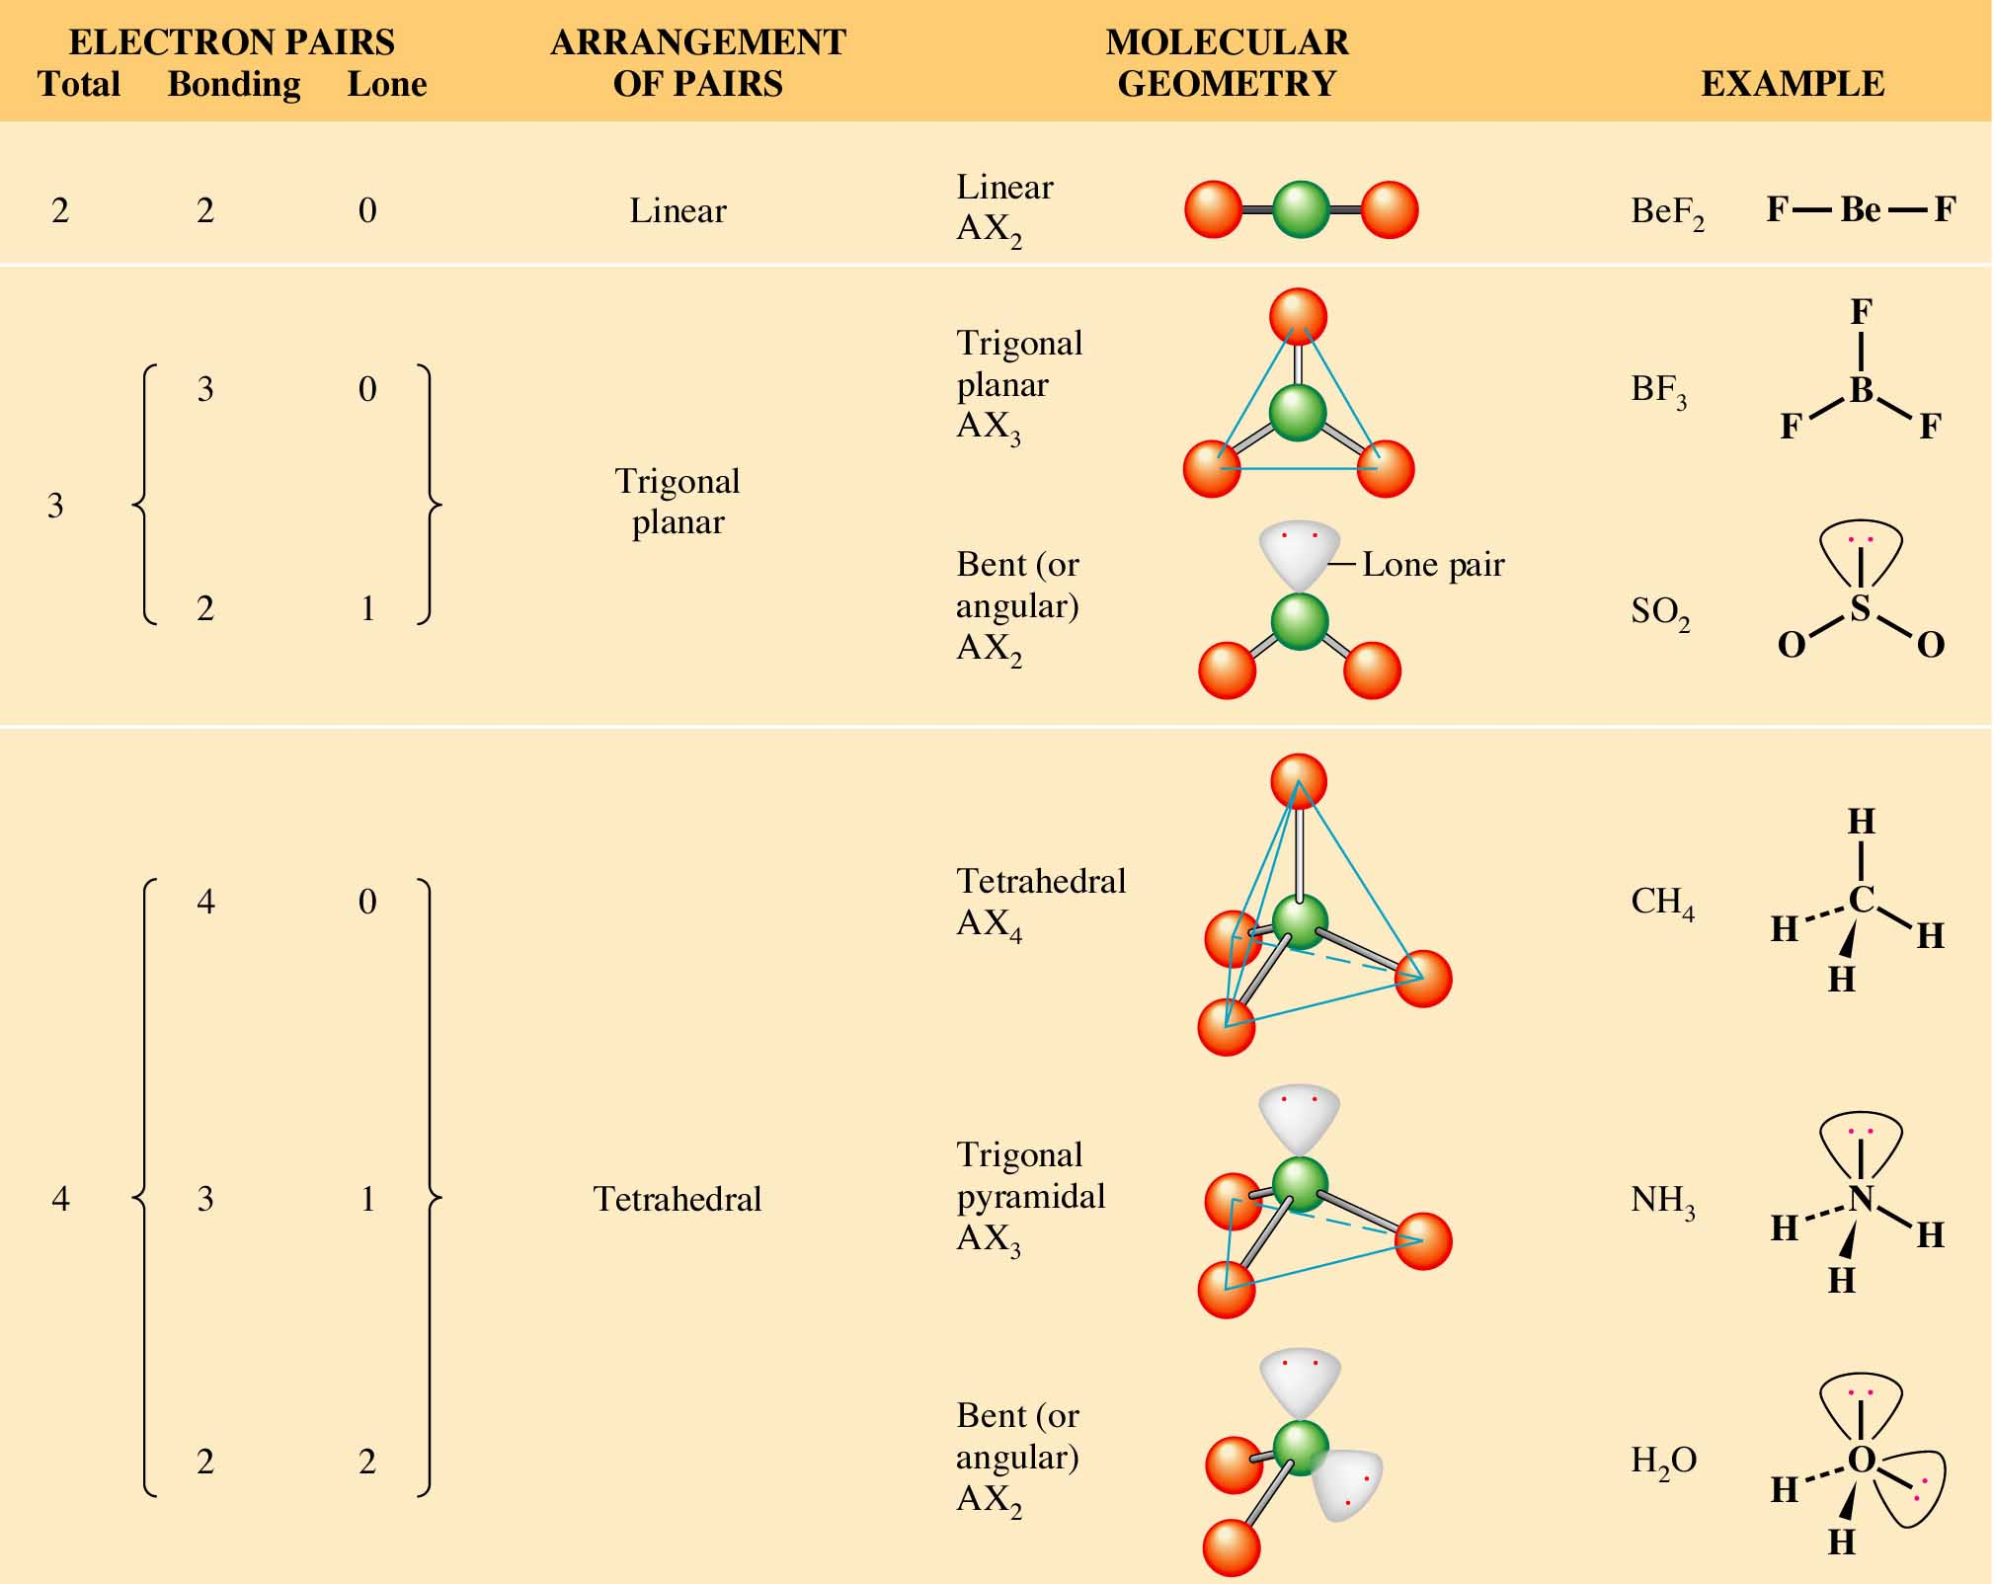

Slide 8
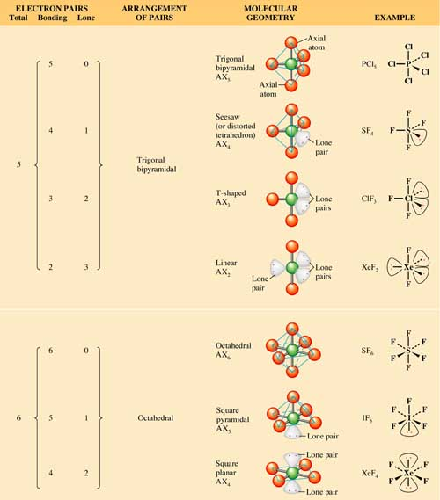

Slide 9
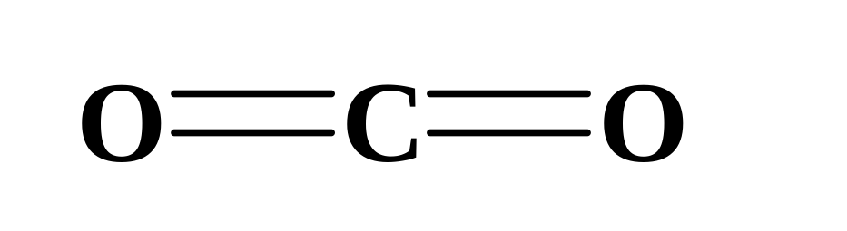
Predicting Molecular Geometry
Two electron pairs (linear arrangement).
:
:
:
:
  You have two double bonds, or two electron groups about the carbon atom.
  Thus, according to the VSEPR model, the bonds are arranged linearly, and the molecular shape of carbon dioxide is linear. Bond angle is 180º.
Notes:
2

Slide 10
Predicting Molecular Geometry
Three electron pairs (trigonal planar arrangement).
:
:
O
C
:
:
:
Cl
Cl
:
:
:
  The three groups of electron pairs are arranged in a trigonal plane. Thus, the molecular shape of COCl₂ is trigonal planar. Bond angle is 120º.
Notes:
2

Slide 11
Predicting Molecular Geometry
Three electron pairs (trigonal planar arrangement).
:
O
:
:
O
O
:
:
:
  Ozone has three electron groups about the central oxygen. One group is a lone pair.
  These groups have a trigonal planar arrangement.
Notes:
2

Slide 12
Predicting Molecular Geometry
Three electron pairs (trigonal planar arrangement).
:
O
:
:
O
O
:
:
:
  Since one of the groups is a lone pair, the molecular geometry is described as bent or angular.
Notes:
2

Slide 13
Predicting Molecular Geometry
Three electron pairs (trigonal planar arrangement).
:
O
:
:
O
O
:
:
:
  Note that the electron pair arrangement includes the lone pairs, but the molecular geometry refers to the spatial arrangement of just the atoms.
Notes:
2

Slide 14
Predicting Molecular Geometry
Four electron pairs (tetrahedral arrangement).
:
:Cl:
H
H
:
:
:Cl
C
Cl:
:
N
H
:
:
:
O
H
:Cl:
:
:
H
  Four electron pairs about the central atom lead to three different molecular geometries.
Notes:
2

Slide 15
Predicting Molecular Geometry
Four electron pairs (tetrahedral arrangement).
:
:Cl:
H
H
C
:
N
H
:
:
:
:Cl
Cl:
O
H
:
:
:
:Cl:
H
:
tetrahedral
Notes:
2

Slide 16
Predicting Molecular Geometry
Four electron pairs (tetrahedral arrangement).
:
:Cl:
:
H
C
N
:
:
:
:Cl
Cl:
H
H
O
H
:
:
:
:Cl:
H
:
tetrahedral
trigonal pyramid
Notes:
2

Slide 17
Predicting Molecular Geometry
Four electron pairs (tetrahedral arrangement).
:
:Cl:
:
:
C
N
O
:
:
:
:Cl
Cl:
H
H
H
:
:
:Cl:
H
H
:
tetrahedral
trigonal pyramid
bent
Notes:
2

Slide 18
Predicting Molecular Geometry
Five electron pairs (trigonal bipyramidal arrangement).
:
: F :
:
F :
:
:
: F
P
:
:
F :
:
: F :
:
  This structure results in both 90º and 120º bond angles.
Notes:
2

Slide 19
Predicting Molecular Geometry
Other molecular geometries are possible when one or more of the electron pairs is a lone pair.
SF₄
ClF₃
XeF₂
  Let’s try their Lewis structures.
Notes:
2

Slide 20
Predicting Molecular Geometry
Other molecular geometries are possible when one or more of the electron pairs is a lone pair.
F
F
ClF₃
XeF₂
S
:
F
F
see-saw
Notes:
2

Slide 21
Predicting Molecular Geometry
Other molecular geometries are possible when one or more of the electron pairs is a lone pair.
F
F
F
:
XeF₂
S
:
Cl
F
F
:
F
F
see-saw
T-shape
Notes:
2

Slide 22
Predicting Molecular Geometry
Other molecular geometries are possible when one or more of the electron pairs is a lone pair.
F
F
F
F
:
:
S
:
Cl
F
Xe
:
F
:
:
F
F
F
see-saw
T-shape
linear
Notes:
2

Slide 23
Predicting Molecular Geometry
Six electron pairs (octahedral arrangement).
:
:
:F:
:
:F
F:
:
:
S
:
:
:F
F:
:
:
:F:
:
  This octahedral arrangement results in 90º bond angles.
Notes:
2

Slide 24
Predicting Molecular Geometry
Six electron pairs (octahedral arrangement).
IF₅
XeF₄
  Six electron pairs also lead to other molecular geometries.
Notes:
2

Slide 25
Predicting Molecular Geometry
Six electron pairs (octahedral arrangement).
F
F
F
I
XeF₄
F
F
:
square pyramid
(See Animation: Iodine Peutafluoride Structure)
Notes:
2

Slide 26
Predicting Molecular Geometry
Six electron pairs (octahedral arrangement).
F
:
F
F
F
F
I
Xe
F
F
F
F
:
:
square pyramid
square planar
  Figures 10.2, 10.4, and 10.8 summarize all the possible molecular geometries.
Notes:
2

Slide 27
Warm Up
Determine the geometry and polarity of the following
SO₃⁻²
SF₄
Explain why in the bond angles in the tetrahedral geometries the bond angle decreases with increased non bonding pairs.

Slide 28
Dipole Moment and Molecular Geometry
The dipole moment is a measure of the degree of charge separation in a molecule.
  We can view the polarity of individual bonds within a molecule as vector quantities.
  Thus, molecules that are perfectly symmetric have a zero dipole moment. These molecules are considered nonpolar. (see Table 10.1)
δ⁺
δ⁻
δ⁻
Notes:
2

Slide 29
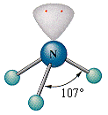
Dipole Moment and Molecular Geometry
However, molecules that exhibit any asymmetry in the arrangement of electron pairs would have a nonzero dipole moment. These molecules are considered polar.
δ⁻
δ⁻
:
N
H
H
H
δ⁺
δ⁺
Notes:
2

Slide 30
Valence Bond Theory
Valence bond theory is an approximate theory to explain the covalent bond from a quantum mechanical view.
  According to this theory, a bond forms between two atoms when the following conditions are met. (See Figures 10.21 and 10.22)
    Two atomic orbitals “overlap”
    The total number of electrons in both orbitals is no more than two.
Notes:
2

Slide 31
Hybrid Orbitals
The bonding in carbon might be explained as follows:
  Four unpaired electrons are formed as an electron from the 2s orbital is promoted (excited) to the vacant 2p orbital.
  More than enough energy is supplied for this promotion from the formation of two additional covalent bonds.
Notes:
2

Slide 32

2p
2p
2s
2s
Energy
1s
1s
C atom (ground state)
C atom (promoted)
Notes:
2

Slide 33
Hybrid Orbitals
One bond on carbon would form using the 2s orbital while the other three bonds would use the 2p orbitals.
  This does not explain the fact that the four bonds in CH₄ appear to be identical.
  Valence bond theory assumes that the four available atomic orbitals in carbon combine to make four equivalent “hybrid” orbitals.
Notes:
2

Slide 34
Hybrid Orbitals
Hybrid orbitals are orbitals used to describe bonding that are obtained by taking combinations of atomic orbitals of an isolated atom.
  In this case, a set of hybrids are constructed from one “s” orbital and three “p” orbitals, so they are called sp³ hybrid orbitals.
  The four sp³ hybrid orbitals take the shape of a tetrahedron (See Figure 10.23).
Notes:
2

Slide 35
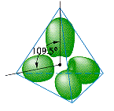
You can represent the hybridization of carbon in CH₄ as follows.
2p
sp³
sp³
C-H bonds
2s
Energy
1s
1s
1s
C atom
(ground state)
C atom
(hybridized state)
C atom
(in CH₄)
Notes:
2

Slide 36
Hybrid Orbitals
Note that there is a relationship between the type of hybrid orbitals and the geometric arrangement of those orbitals.
  Thus, if you know the geometric arrangement, you know what hybrid orbitals to use in the bonding description.
  Figure 10.24 summarizes the types of hybridization and their spatial arrangements.
Notes:
2

Slide 37
Hybrid Orbitals
Hybrid Orbitals | Geometric Arrangements | Number of Orbitals | Example
sp | Linear (See Animation: sp Hydridization) | 2 | Be in BeF₂
sp² | Trigonal planar (See Animation: sp^{2 Hydridization)} | 3 | B in BF₃
sp³ | Tetrahedral (See Animation: sp^{3 Hydridization)} | 4 | C in CH₄
sp³d | Trigonal bipyramidal | 5 | P in PCl₅
sp³d² | Octahedral | 6 | S in SF₆
Notes:
2

Slide 38
Hybrid Orbitals
To obtain the bonding description of any atom in a molecule, you proceed as follows:
  Write the Lewis electron-dot formula for the molecule.
  From the Lewis formula, use the VSEPR theory to determine the arrangement of electron pairs around the atom.
Notes:
2

Slide 39
Hybrid Orbitals
To obtain the bonding description of any atom in a molecule, you proceed as follows:
  From the geometric arrangement of the electron pairs, obtain the hybridization type (see Table 10.2).
  Assign valence electrons to the hybrid orbitals of this atom one at a time, pairing only when necessary.
Notes:
2

Slide 40
Hybrid Orbitals
To obtain the bonding description of any atom in a molecule, you proceed as follows:
  Form bonds to this atom by overlapping singly occupied orbitals of other atoms with the singly occupied hybrid orbitals of this atom.
Notes:
2

Slide 41
A Problem to Consider
Describe the bonding in H₂O according to valence bond theory. Assume that the molecular geometry is the same as given by the VSEPR model.
  From the Lewis formula for a molecule, determine its geometry about the central atom using the VSEPR model.
Notes:
2

Slide 42
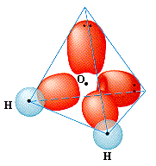

A Problem to Consider
Describe the bonding in H₂O according to valence bond theory. Assume that the molecular geometry is the same as given by the VSEPR model.
  The Lewis formula for H₂O is
Notes:
2

Slide 43
A Problem to Consider
Describe the bonding in H₂O according to valence bond theory. Assume that the molecular geometry is the same as given by the VSEPR model.
  From this geometry, determine the hybrid orbitals on this atom, assigning its valence electrons to these orbitals one at a time.
Notes:
2

Slide 44
A Problem to Consider
Describe the bonding in H₂O according to valence bond theory. Assume that the molecular geometry is the same as given by the VSEPR model.
  Note that there are four pairs of electrons about the oxygen atom.
  According to the VSEPR model, these are directed tetrahedrally, and from the previous table you see that you should use sp³ hybrid orbitals.
Notes:
2

Slide 45
A Problem to Consider
Describe the bonding in H₂O according to valence bond theory. Assume that the molecular geometry is the same as given by the VSEPR model.
  Each O-H bond is formed by the overlap of a 1s orbital of a hydrogen atom with one of the singly occupied sp³ hybrid orbitals of the oxygen atom.
Notes:
2

Slide 46
You can represent the bonding to the oxygen atom in H₂O as follows:
2p
sp³
sp³
lone
pairs
O-H
bonds
2s
Energy
1s
1s
1s
O atom
(ground state)
O atom
(hybridized state)
O atom
(in H₂O)
Notes:
2

Slide 47
A Problem to Consider
Describe the bonding in XeF₄ using hybrid orbitals.
  From the Lewis formula for a molecule, determine its geometry about the central atom using the VSEPR model.
Notes:
2

Slide 48
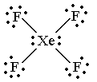
A Problem to Consider
Describe the bonding in XeF₄ using hybrid orbitals.
  The Lewis formula of XeF₄ is
Notes:
2

Slide 49
A Problem to Consider
Describe the bonding in XeF₄ using hybrid orbitals.
  From this geometry, determine the hybrid orbitals on this atom, assigning its valence electrons to these orbitals one at a time.
Notes:
2

Slide 50
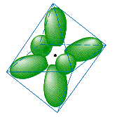
A Problem to Consider
Describe the bonding in XeF₄ using hybrid orbitals.
  The xenon atom has four single bonds and two lone pairs. It will require six orbitals to describe the bonding.
  This suggests that you use sp³d² hybrid orbitals on xenon.
Notes:
2

Slide 51
A Problem to Consider
Describe the bonding in XeF₄ using hybrid orbitals.
  Each Xe-F bond is formed by the overlap of a xenon sp³d² hybrid orbital with a singly occupied fluorine 2p orbital.
  You can summarize this as follows:
Notes:
2

Slide 52
5d
5p
5s
Xe atom (ground state)
Notes:
2

Slide 53
5d
sp³d²
Xe atom (hybridized state)
Notes:
2

Slide 54
5d
sp³d²
lone pairs
Xe-F bonds
Xe atom (in XeF₄)
Notes:
2

Slide 55

Multiple Bonding
According to valence bond theory, one hybrid orbital is needed for each bond (whether a single or multiple) and for each lone pair.
  For example, consider the molecule ethene.
Notes:
2

Slide 56
Multiple Bonding
Each carbon atom is bonded to three other atoms and no lone pairs, which indicates the need for three hybrid orbitals.
  This implies sp² hybridization.
  The third 2p orbital is left unhybridized and lies perpendicular to the plane of the trigonal sp² hybrids.
  The following slide represents the sp² hybridization of the carbon atoms.
Notes:
2

Slide 57
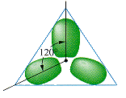
(unhybridized)
2p
2p
sp²
2s
Energy
1s
1s
C atom (ground state)
C atom (hybridized)
Notes:
2

Slide 58
Multiple Bonding
To describe the multiple bonding in ethene, we must first distinguish between two kinds of bonds.
  A σ (sigma) bond is a “head-to-head” overlap of orbitals with a cylindrical shape about the bond axis. This occurs when two “s” orbitals overlap or “p” orbitals overlap along their axis.
  A π (pi) bond is a “side-to-side” overlap of parallel “p” orbitals, creating an electron distribution above and below the bond axis.
Notes:
2

Slide 59
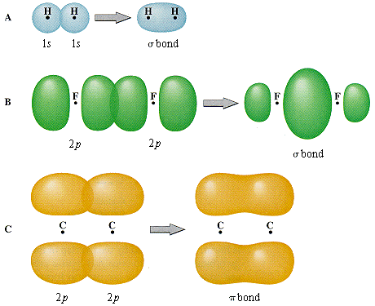
Figure 10.25
(See Animation: Pi-Bond)
Notes:
2

Slide 60
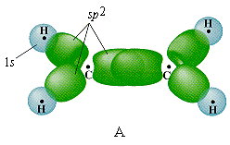
Multiple Bonding
Now imagine that the atoms of ethene move into position.
  Two of the sp² hybrid orbitals of each carbon overlap with the 1s orbitals of the hydrogens.
  The remaining sp² hybrid orbital on each carbon overlap to form a σ bond.
Notes:
2

Slide 61
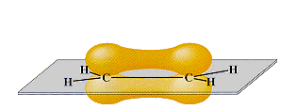
Multiple Bonding
The remaining “unhybridized” 2p orbitals on each of the carbon atoms overlap side-to-side forming a π bond.
  You therefore describe the carbon-carbon double bond as one σ bond and one π bond.
Notes:
2

Slide 62
Molecular Orbital Theory
Molecular orbital theory is a theory of the electronic structure of molecules in terms of molecular orbitals, which may spread over several atoms or the entire molecule.
  As atoms approach each other and their atomic orbitals overlap, molecular orbitals are formed.
  In the quantum mechanical view, both a bonding and an antibonding molecular orbital are formed.
Notes:
2

Slide 63
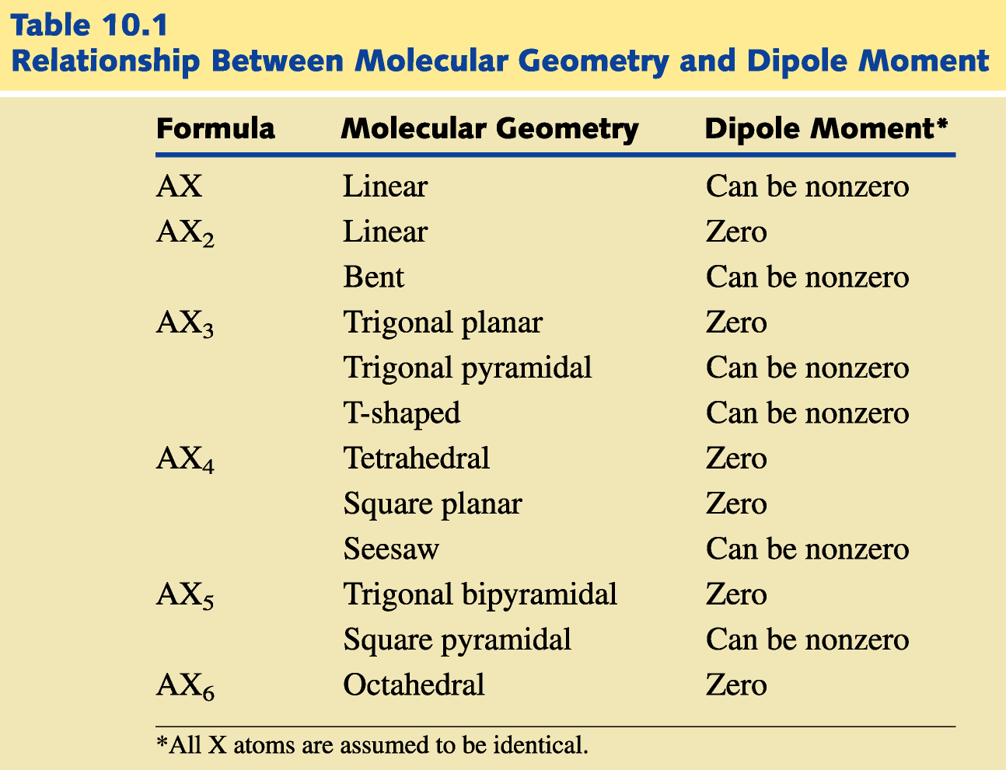
Return to Slide 27

Slide 64
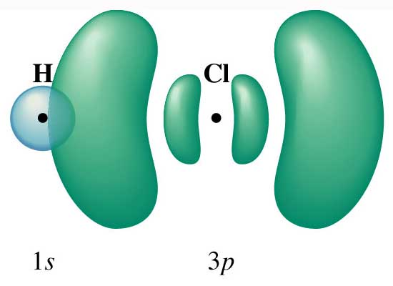
Figure 10.21: Bonding in HCl.
Return to Slide 29

Slide 65
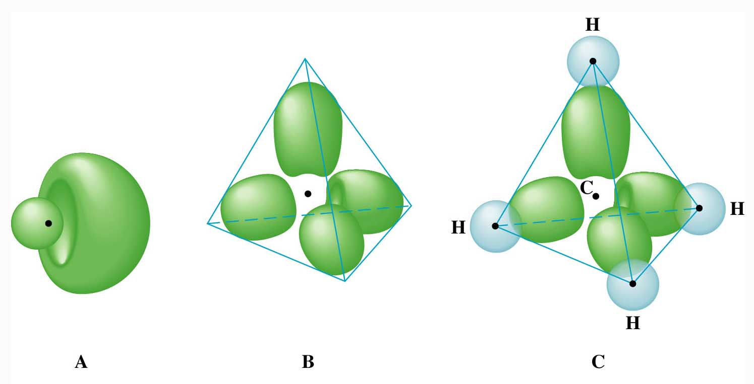
Figure 10.22: Spatial arrangement of sp³ hybrid orbitals.
Return to Slide 29

Slide 66
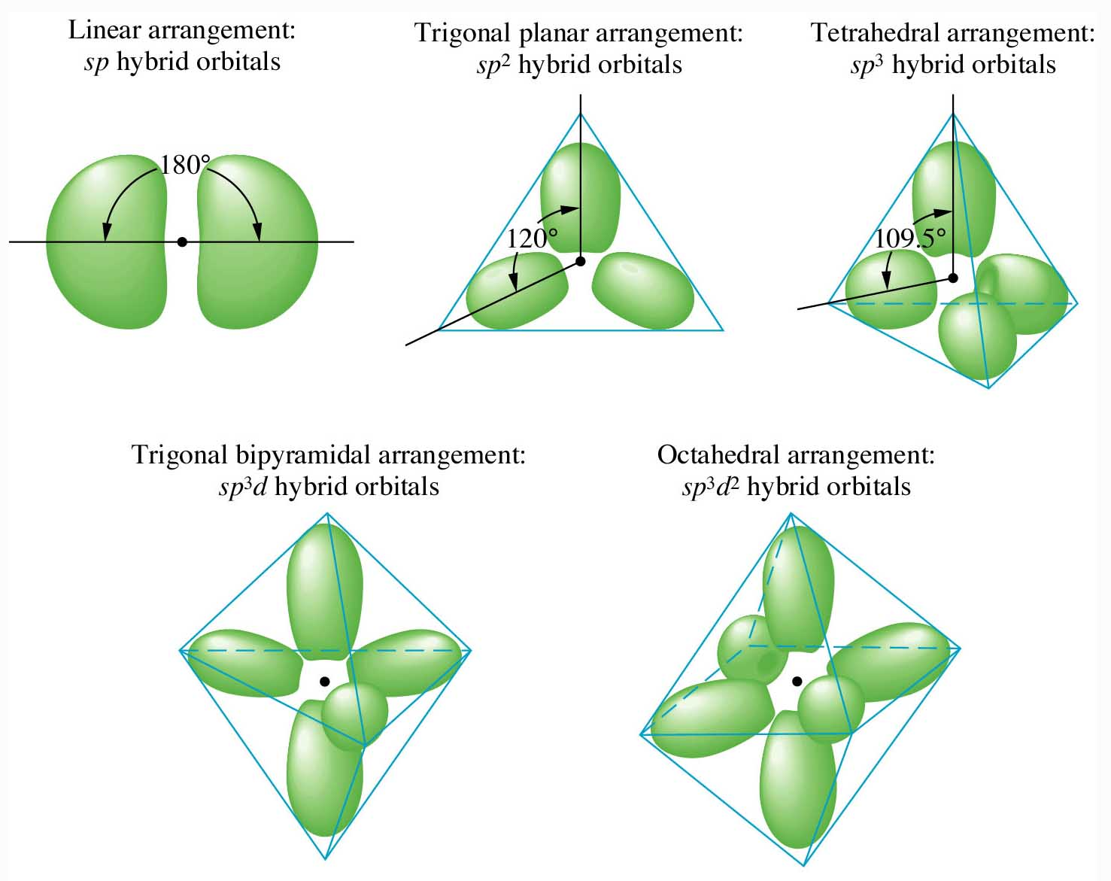
Figure 10.23: Diagrams of hybrid orbitals showing their spatial arrangements.
Return to Slide 34

