Slide 1
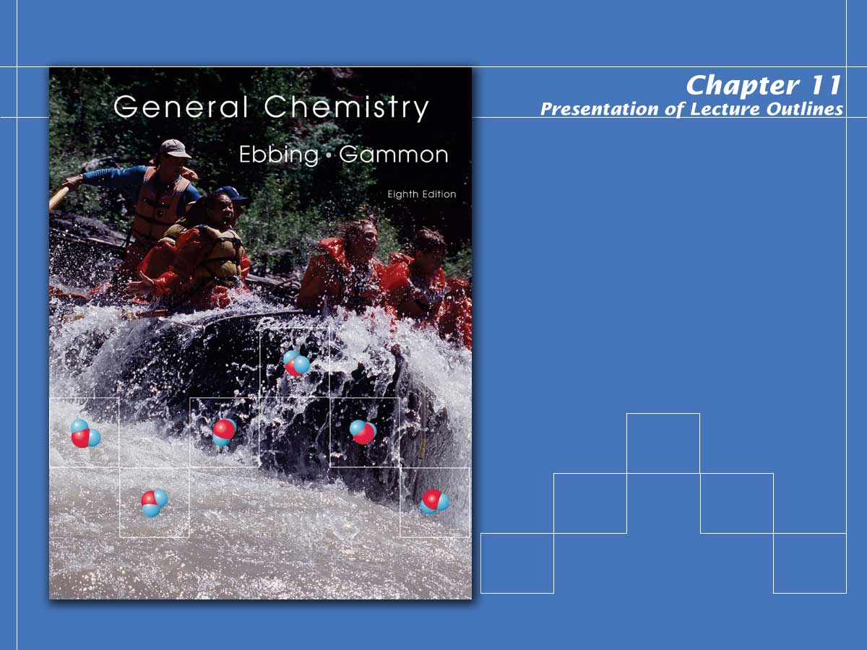
States of Matter: Liquids and Solids

Slide 2

States of Matter
Comparison of gases, liquids, and solids. (See Figure 11.2)
  Gases are compressible fluids. Their molecules are widely separated.
  Liquids are relatively incompressible fluids. Their molecules are more tightly packed.
  Solids are nearly incompressible and rigid. Their molecules or ions are in close contact and do not move.
Notes:
2

Slide 3
Changes of State
A change of state or phase transition is a change of a substance from one state to another.
gas
boiling
condensation
sublimation
(see Figure 11.3)
liquid
condensation or
deposition
melting
freezing
solid
Notes:
2

Slide 4
Vapor Pressure
Liquids are continuously vaporizing.
  If a liquid is in a closed vessel with space above it, a partial pressure of the vapor state builds up in this space.
  The vapor pressure of a liquid is the partial pressure of the vapor over the liquid, measured at equilibrium at a given temperature. (See Figure 11.4)
Notes:
2

Slide 5
Vapor Pressure
The vapor pressure of a liquid depends on its temperature. (See Figure 11.7)
  As the temperature increases, the kinetic energy of the molecular motion becomes greater, and vapor pressure increases.
  Liquids and solids with relatively high vapor pressures at normal temperatures are said to be volatile.
Notes:
2

Slide 6
Boiling Point
The temperature at which the vapor pressure of a liquid equals the pressure exerted on the liquid is called the boiling point.
  As the temperature of a liquid increases, the vapor pressure increases until it reaches atmospheric pressure.
  At this point, stable bubbles of vapor form within the liquid. This is called boiling.
  The normal boiling point is the boiling point at 1 atm.
Notes:
2

Slide 7
Freezing Point
The temperature at which a pure liquid changes to a crystalline solid, or freezes, is called the freezing point.
  The melting point is identical to the freezing point and is defined as the temperature at which a solid becomes a liquid.
  Unlike boiling points, melting points are affected significantly by only large pressure changes.
Notes:
2

Slide 8
Heat of Phase Transition
To melt a pure substance at its melting point requires an extra boost of energy to overcome lattice energies.
  The heat needed to melt 1 mol of a pure substance is called the heat of fusion and denoted ΔH_{fus}.
  For ice, the heat of fusion is 6.01 kJ/mol.
Notes:
2

Slide 9
Heat of Phase Transition
To boil a pure substance at its boiling point requires an extra boost of energy to overcome intermolecular forces.
  The heat needed to boil 1 mol of a pure substance is called the heat of vaporization and denoted ΔH_{vap}. (see Figure 11.9)
  For ice, the heat of vaporization is 40.66 kJ/mol.
Notes:
2

Slide 10
A Problem to Consider
Calculate the energy to heat 33.4 g of ice from -5⁰C to 110⁰C?
Notes:
2

Slide 11
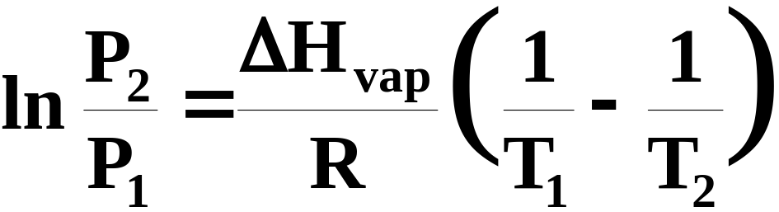
Clausius-Clapeyron Equation
We noted earlier that vapor pressure was a function of temperature.
  It has been demonstrated that the logarithm of the vapor pressure of a liquid varies linearly with absolute temperature.
  Consequently, the vapor pressure of a liquid at two different temperatures is described by:
Notes:
2

Slide 12
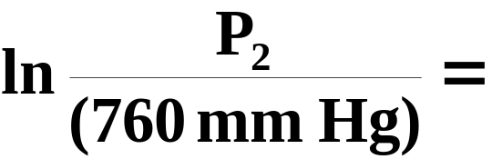
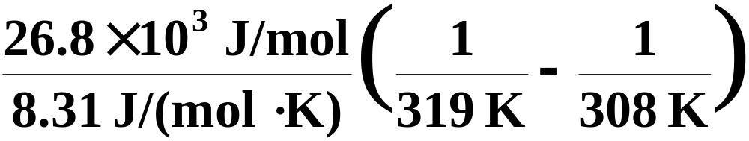
A Problem to Consider
Carbon disulfide, CS₂, has a normal boiling point of 46°C (vapor pressure = 760 mmHg) and a heat of vaporization of 26.8 kJ/mol. What is the vapor pressure of carbon disulfide at 35°C?
  Substituting into the Clausius-Clapeyron equation, we obtain:
Notes:
2

Slide 13
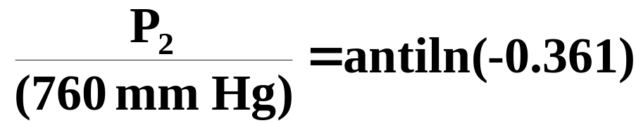

A Problem to Consider
Carbon disulfide, CS₂, has a normal boiling point of 46°C (vapor pressure = 760 mmHg) and a heat of vaporization of 26.8 kJ/mol. What is the vapor pressure of carbon disulfide at 35°C?
  Taking the antiln we obtain:
Notes:
2

Slide 14
Phase Diagrams
A phase diagram is a graphical way to summarize the conditions under which the different states of a substance are stable.
  The diagram is divided into three areas representing each state of the substance.
  The curves separating each area represent the boundaries of phase changes.
Notes:
2

Slide 15
Phase Diagrams
Below is a typical phase diagram. It consists of three curves that divide the diagram into regions labeled “solid, liquid, and gas”.
.
B
C
solid
liquid
pressure
.
gas
D
A
temperature
Notes:
2

Slide 16
Phase Diagrams
Curve AB, dividing the solid region from the liquid region, represents the conditions under which the solid and liquid are in equilibrium.
.
B
C
solid
liquid
pressure
.
gas
A
D
temperature
Notes:
2

Slide 17
Phase Diagrams
Usually, the melting point is only slightly affected by pressure. For this reason, the melting point curve, AB, is nearly vertical.
.
B
C
solid
liquid
pressure
.
gas
A
D
temperature
Notes:
2

Slide 18
Phase Diagrams
Curve AC, which divides the liquid region from the gaseous region, represents the boiling points of the liquid for various pressures.
.
B
C
solid
liquid
pressure
.
gas
A
D
temperature
Notes:
2

Slide 19
Phase Diagrams
Curve AD, which divides the solid region from the gaseous region, represents the vapor pressures of the solid at various temperatures.
.
B
C
solid
liquid
pressure
.
gas
A
D
temperature
Notes:
2

Slide 20
Phase Diagrams
The curves intersect at A, the triple point, which is the temperature and pressure where three phases of a substance exist in equilibrium.
.
B
C
solid
liquid
pressure
.
gas
A
D
temperature
Notes:
2

Slide 21
Phase Diagrams
The curves intersect at A, the triple point, which is the temperature and pressure where three phases of a substance exist in equilibrium.
.
B
C
solid
liquid
(see Figures
11.11 and 11.12)
pressure
.
gas
A
D
temperature
Notes:
2

Slide 22
Phase Diagrams
The temperature above which the liquid state of a substance no longer exists regardless of pressure is called the critical temperature.
.
B
C
solid
liquid
pressure
.
gas
A
D
T_{crit}
temperature
Notes:
2

Slide 23
Phase Diagrams
The vapor pressure at the critical temperature is called the critical pressure. Note that curve AC ends at the critical point, C.
.
P_{crit}
B
C
solid
liquid
pressure
(see Figure 11.13)
.
gas
A
D
T_{crit}
temperature
Notes:
2

Slide 24
Properties of Liquids; Surface Tension and Viscosity
The molecular structure of a substance defines the intermolecular forces holding it together.
  Many physical properties of substances are attributed to their intermolecular forces.
  These properties include vapor pressure and boiling point.
  Two additional properties shown in Table 11.2 are surface tension and viscosity.
Notes:
2

Slide 25
Properties of Liquids; Surface Tension and Viscosity
Surface tension is the energy required to increase the surface area of a liquid by a unit amount.
  A molecule within a liquid is pulled in all directions, whereas a molecule on the surface is only pulled to the interior. (See Figure 11.16).
  As a result, there is a tendency for the surface area of the liquid to be minimized (See Figure 11.18 ).
Notes:
2

Slide 26
Properties of Liquids; Surface Tension and Viscosity
Surface tension is the energy required to increase the surface area of a liquid by a unit amount.
  This explains why falling raindrops are nearly spherical, minimizing surface area.
  In comparisons of substances, as intermolecular forces between molecules increase, the apparent surface tension also increases.
Notes:
2

Slide 27
Intermolecular Forces; Explaining Liquid Properties
Viscosity is the resistance to flow exhibited by all liquids and gases.
  Viscosity can be illustrated by measuring the time required for a steel ball to fall through a column of the liquid. (see Figure 11.20)
  Even without such measurements, you know that syrup has a greater viscosity than water.
  In comparisons of substances, as intermolecular forces increase, viscosity usually increases.
Notes:
2

Slide 28
Intermolecular Forces; Explaining Liquid Properties
Many of the physical properties of liquids (and certain solids) can be explained in terms of intermolecular forces, the forces of attraction between molecules.
  Three types of forces are known to exist between neutral molecules.
    Dipole-dipole forces
    London (or dispersion) forces
    Hydrogen bonding
Notes:
2

Slide 29
Intermolecular Forces; Explaining Liquid Properties
The term van der Waals forces is a general term including dipole-dipole and London forces.
  Van der Waals forces are the weak attractive forces in a large number of substances.
  Hydrogen bonding occurs in substances containing hydrogen atoms bonded to certain very electronegative atoms.
  Approximate energies of intermolecular attractions are listed in Table 11.4.
Notes:
2

Slide 30
Dipole-Dipole Forces
Polar molecules can attract one another through dipole-dipole forces.
  The dipole-dipole force is an attractive intermolecular force resulting from the tendency of polar molecules to align themselves positive end to negative end.
δ⁺
H
Cl
δ⁻
δ⁺
H
Cl
δ⁻
  Figure 11.21 shows the alignment of polar molecules.
Notes:
2

Slide 31
London Forces
London forces are the weak attractive forces resulting from instantaneous dipoles that occur due to the distortion of the electron cloud surrounding a molecule.
    London forces increase with molecular weight. The larger a molecule, the more easily it can be distorted to give an instantaneous dipole.
    All covalent molecules exhibit some London force.
    Figure 11.22 illustrates the effect of London forces.
Notes:
2

Slide 32
Van der Waals Forces and the Properties of Liquids
In summary, intermolecular forces play a large role in many of the physical properties of liquids and gases. These include:
  vapor pressure
  boiling point
  surface tension
  viscosity
Notes:
2

Slide 33
Van der Waals Forces and the Properties of Liquids
The vapor pressure of a liquid depends on intermolecular forces. When the intermolecular forces in a liquid are strong, you expect the vapor pressure to be low.
  Table 11.2 illustrates this concept. As intermolecular forces increase, vapor pressures decrease.
Notes:
2

Slide 34
Van der Waals Forces and the Properties of Liquids
The normal boiling point is related to vapor pressure and is lowest for liquids with the weakest intermolecular forces.
  When intermolecular forces are weak, little energy is required to overcome them. Consequently, boiling points are low for such compounds.
Notes:
2

Slide 35
Van der Waals Forces and the Properties of Liquids
Surface tension increases with increasing intermolecular forces.
  Surface tension is the energy needed to reduce the surface area of a liquid.
  To increase surface area, it is necessary to pull molecules apart against the intermolecular forces of attraction.
Notes:
2

Slide 36
Van der Waals Forces and the Properties of Liquids
Viscosity increases with increasing intermolecular forces because increasing these forces increases the resistance to flow.
  Other factors, such as the possibility of molecules tangling together, affect viscosity.
  Liquids with long molecules that tangle together are expected to have high viscosities.
Notes:
2

Slide 37
Hydrogen Bonding
Hydrogen bonding is a force that exists between a hydrogen atom covalently bonded to a very electronegative atom, X, and a lone pair of electrons on a very electronegative atom, Y.
  To exhibit hydrogen bonding, one of the following three structures must be present.
:
:
:
H
N
H
O
H
F
  Only N, O, and F are electronegative enough to leave the hydrogen nucleus exposed.
Notes:
2

Slide 38
Hydrogen Bonding
Molecules exhibiting hydrogen bonding have abnormally high boiling points compared to molecules with similar van der Waals forces.
  For example, water has the highest boiling point of the Group VI hydrides. (see Figure 11.24A)
  Similar trends are seen in the Group V and VII hydrides. (see Figure 11.24B)
Notes:
2

Slide 39
Hydrogen Bonding
A hydrogen atom bonded to an electronegative atom appears to be special.
  The electrons in the O-H bond are drawn to the O atom, leaving the dense positive charge of the hydrogen nucleus exposed.
  It’s the strong attraction of this exposed nucleus for the lone pair on an adjacent molecule that accounts for the strong attraction.
  A similar mechanism explains the attractions in HF and NH₃.
Notes:
2

Slide 40
Hydrogen Bonding
:
:
:
:
O
O
H
H
H
H
:
:
:
:
O
O
H
H
H
H
Notes:
2

Slide 41
Solid State
A solid is a nearly incompressible state of matter with a well-defined shape. The units making up the solid are in close contact and in fixed positions.
  Solids are characterized by the type of force holding the structural units together.
  In some cases, these forces are intermolecular, but in others they are chemical bonds (metallic, ionic, or covalent).
Notes:
2

Slide 42
Solid State
From this point of view, there are four types of solids.
  Molecular (Van der Waals forces)
  Metallic (Metallic bond)
  Ionic (Ionic bond)
  Covalent (Covalent bond)
Notes:
2

Slide 43
Types of Solids
A molecular solid is a solid that consists of atoms or molecules held together by intermolecular forces.
  Many solids are of this type.
  Examples include solid neon, solid water (ice), and solid carbon dioxide (dry ice).
Notes:
2

Slide 44
Types of Solids
A metallic solid is a solid that consists of positive cores of atoms held together by a surrounding “sea” of electrons (metallic bonding).
  In this kind of bonding, positively charged atomic cores are surrounded by delocalized electrons.
  Examples include iron, copper, and silver.
Notes:
2

Slide 45
Types of Solids
An ionic solid is a solid that consists of cations and anions held together by electrical attraction of opposite charges (ionic bond).
  Examples include cesium chloride, sodium chloride, and zinc sulfide (but ZnS has considerable covalent character).
Notes:
2

Slide 46
Types of Solids
A covalent network solid is a solid that consists of atoms held together in large networks or chains by covalent bonds.
  Examples include carbon, in its forms as diamond or graphite (see Figure 11.27), asbestos, and silicon carbide.
  Table 11.5 summarizes these four types of solids.
Notes:
2

Slide 47
Physical Properties
Many physical properties of a solid can be attributed to its structure.
Melting Point and Structure
  For a solid to melt, the forces holding the structural units together must be overcome.
  For a molecular solid, these are weak intermolecular attractions.
  Thus, molecular solids tend to have low melting points (below 300ºC).
Notes:
2

Slide 48
Physical Properties
Many physical properties of a solid can be attributed to its structure.
Melting Point and Structure
  For ionic solids and covalent network solids to melt, chemical bonds must be broken.
  For that reason, their melting points are relatively high.
  See Table 11.1.
Notes:
2

Slide 49
Physical Properties
Many physical properties of a solid can be attributed to its structure.
Melting Point and Structure
  Note that for ionic solids, melting points increase with the strength of the ionic bond.
  Ionic bonds are stronger when:
    The magnitude of charge is high.
    The ions are small (higher charge density).
Notes:
2

Slide 50
Physical Properties
Many physical properties of a solid can be attributed to its structure.
Hardness and Structure
  Covalent network solids are quite hard because of the rigidity of the covalent network structure.
  Diamond and silicon carbide (SiC), three-dimensional covalent network solids, are among the hardest substances known.
Notes:
2

Slide 51
Crystalline Solids; Crystal Lattices and Unit Cells
Solids can be crystalline or amorphous.
  A crystalline solid is composed of one or more crystals; each crystal has a well-defined, ordered structure in three dimensions.
    Examples include sodium chloride and sucrose.
  An amorphous solid has a disordered structure. It lacks the well-defined arrangement of basic units found in a crystal.
    Glass is an amorphous solid.
Notes:
2

Slide 52
Crystal Lattices
A crystal lattice is the geometric arrangement of lattice points in a crystal.
  A unit cell is the smallest boxlike unit from which you can construct a crystal by stacking the units in three dimensions (see Figure 11.29).
  There are seven basic shapes possible for unit cells, which give rise to seven crystal systems used to classify crystals (see Figure 11.31 and Table 11.6).
Notes:
2

Slide 53
Operational Skills
Calculating the heat required for a phase change of a given mass of substance.
Calculating vapor pressures and heats of vaporization.
Relating the conditions for the liquification of a gas to the critical temperature.
Identifying intermolecular forces.
Determining relative vapor pressure on the basis of intermolecular attraction.
Identifying types of solids.
Notes:
2

Slide 54
Operational Skills
Determining the relative melting points based on types of solids.
Determining the relative melting points based on types of solids.
Notes:
2

Slide 55
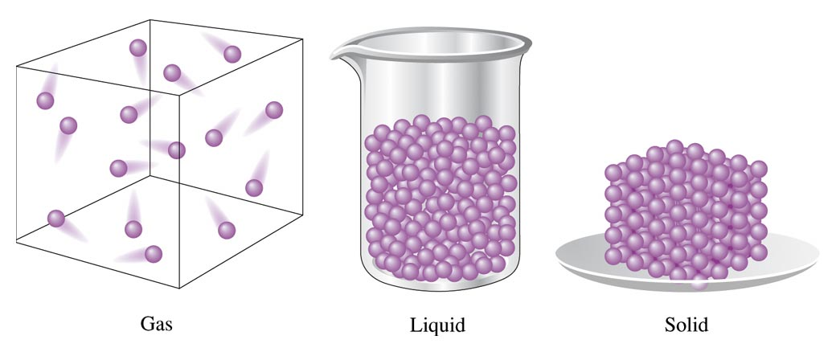
Figure 11.2: Representation of the States of Matter
Return to Slide 2

Slide 56

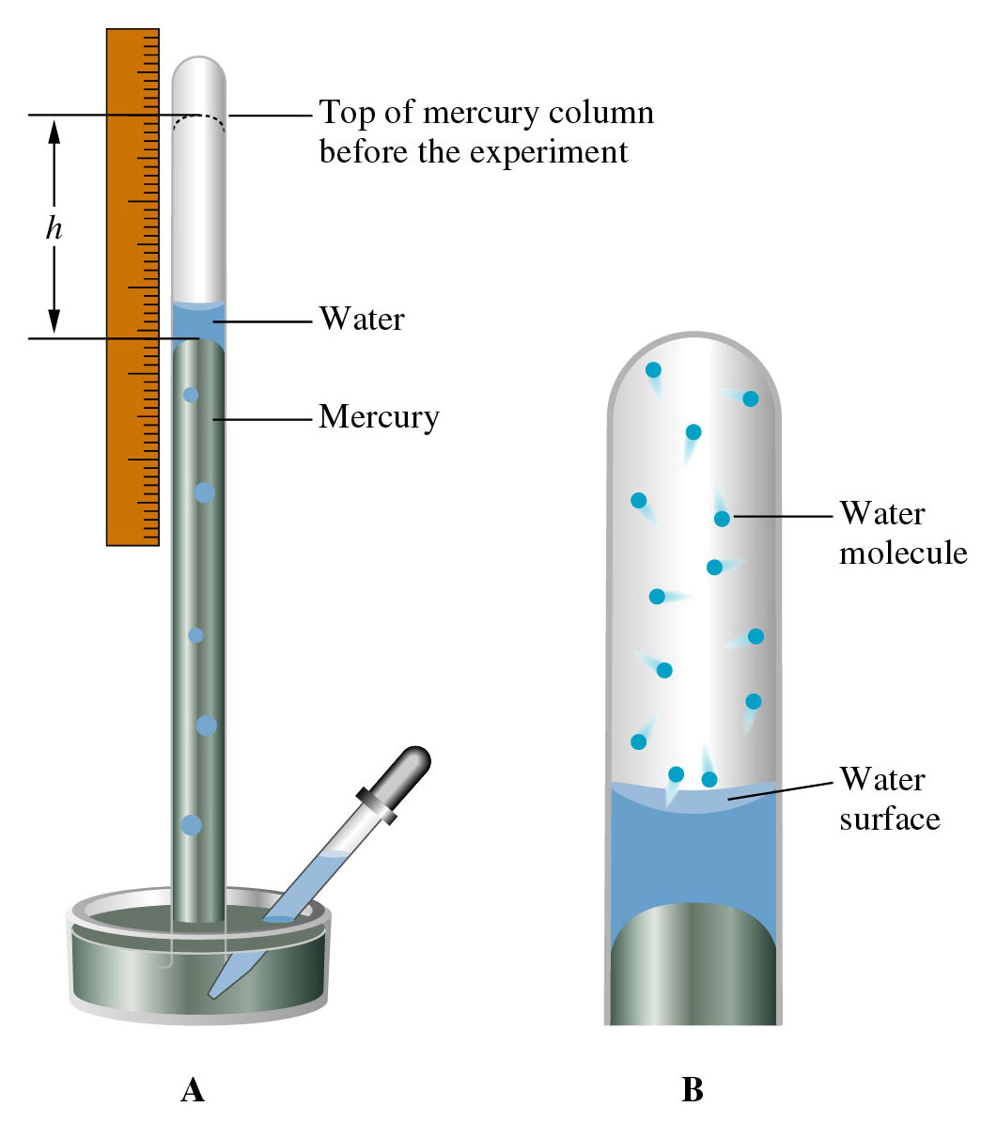
Figure 11.4:
Measurement of the vapor pressure of water.
Return to Slide 4

Slide 57
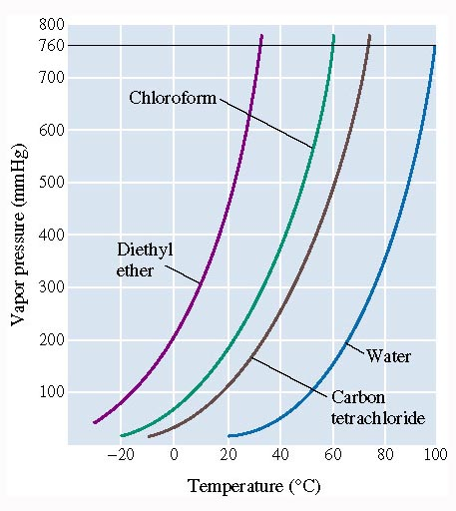
Figure 11.7: Variation of vapor pressure with temperature.
Return to Slide 5

Slide 58
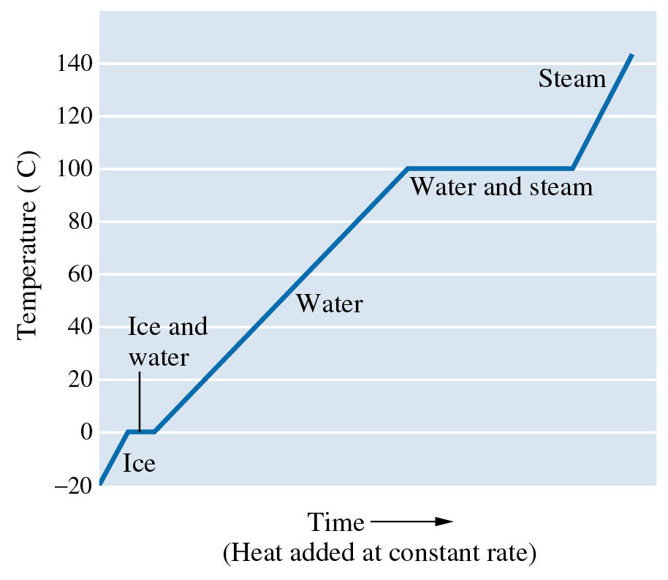
Figure 11.9: Heating curve for water.
Return to Slide 9

Slide 59
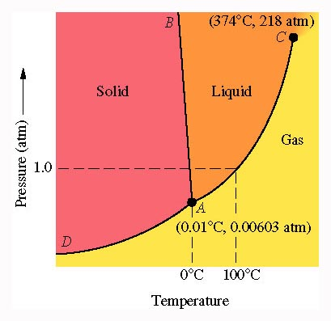
Figure 11.11: Phase diagram for water (not to scale).
Return to Slide 24

Slide 60
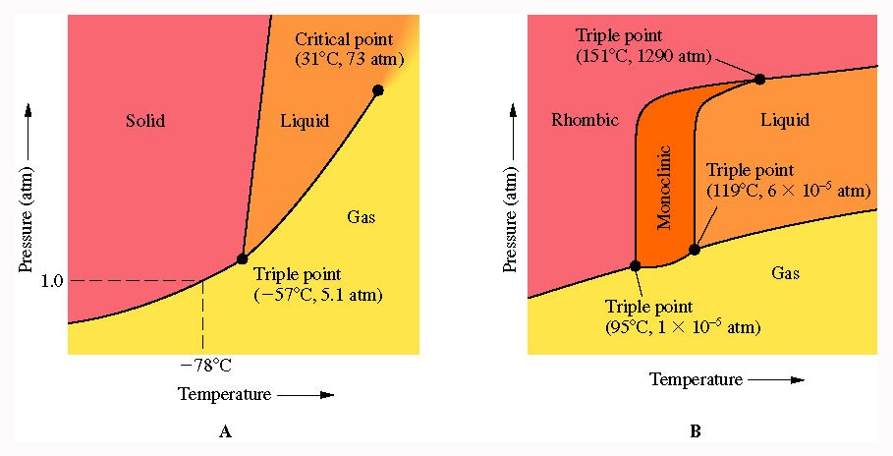
Figure 11.12: Phase diagrams for carbon dioxide and sulfur (not to scale).
Return to Slide 24

Slide 61
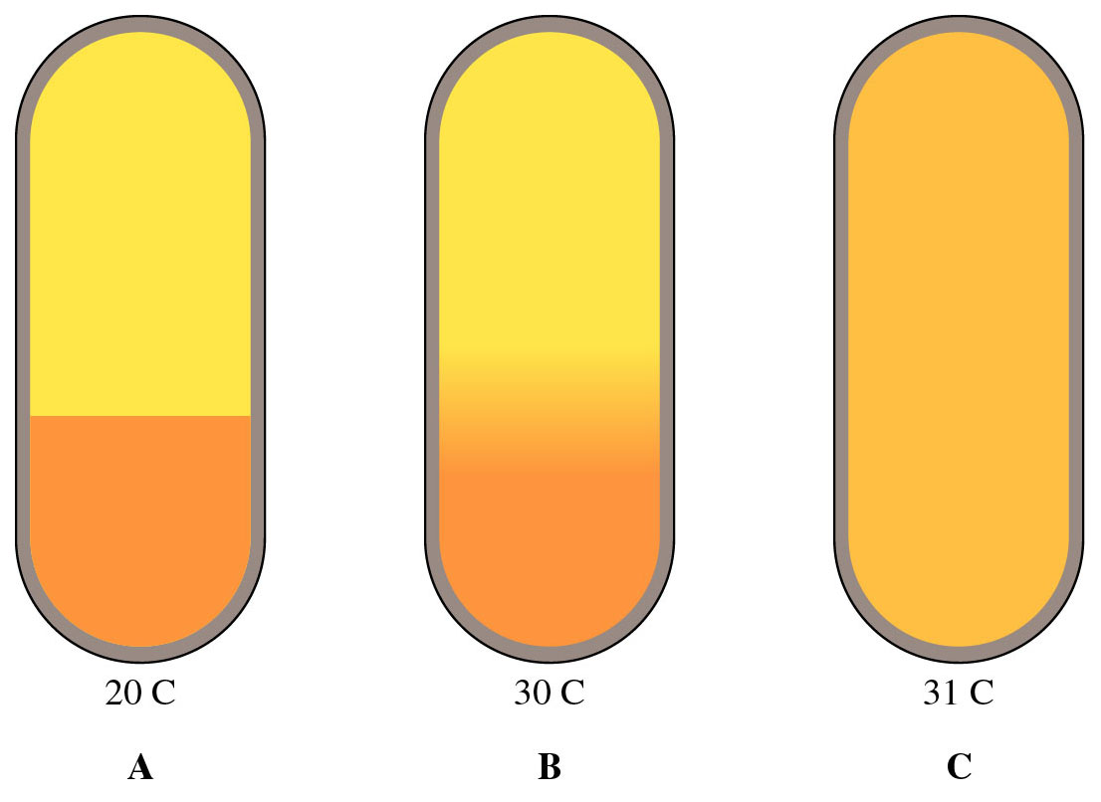
Figure 11.13: Observing the critical phenomenon.
Return to Slide 26

Slide 62
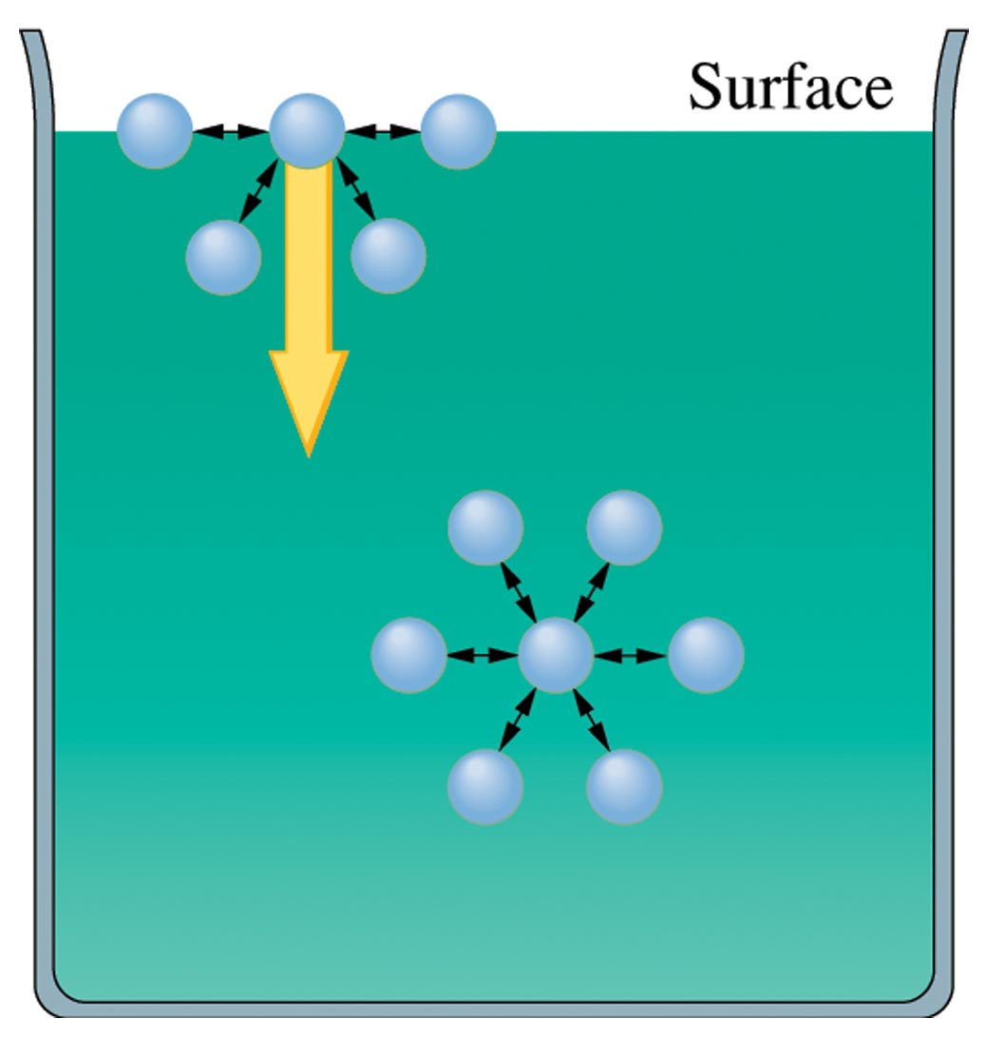
Figure 11.16: Explaining Surface Tension
Return to Slide 28

Slide 63
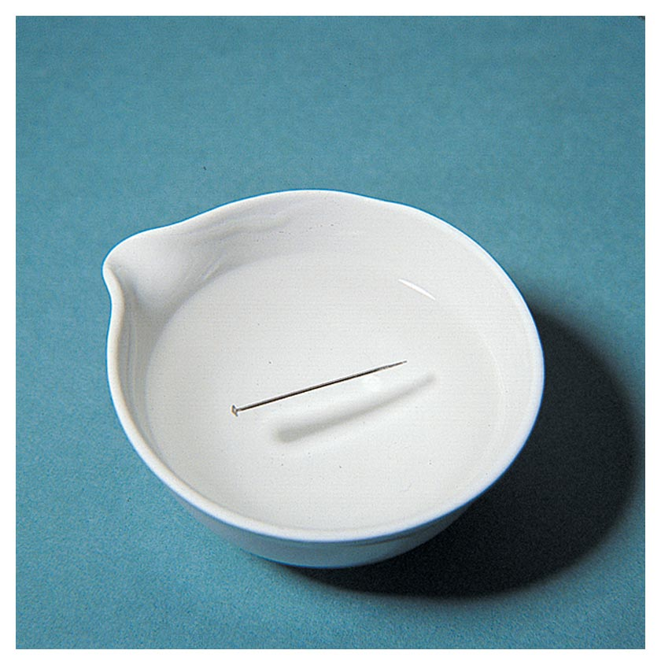

Figure 11.18: Demonstration of Surface Tension of Water
Return to Slide 28

Slide 64
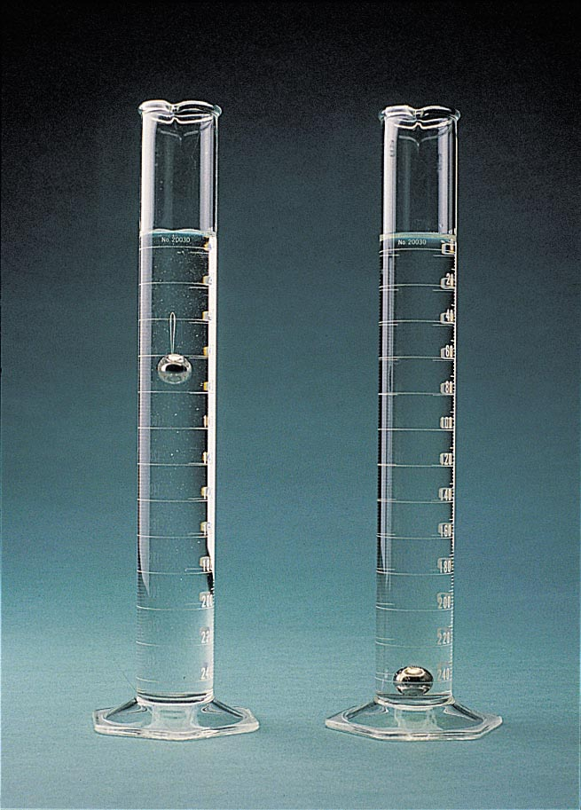
Figure 11.20:
Comparison of the viscosities of two liquids. Photo courtesy of James Scherer.
Return to Slide 30

Slide 65
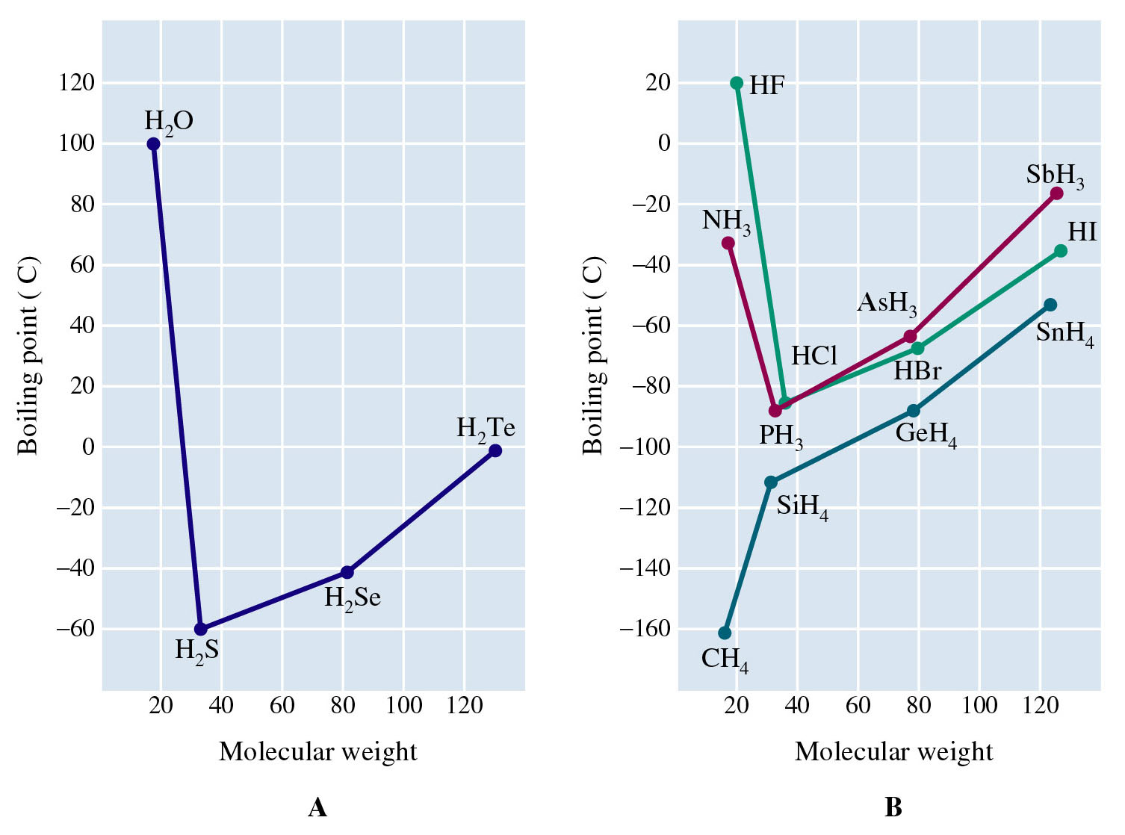
Figure 11.24: Boiling point versus molecular weight for hydrides.
Return to Slide 41

Slide 66
Figure 11.24: Boiling point versus molecular weight for hydrides.
Return to Slide 41

Slide 67
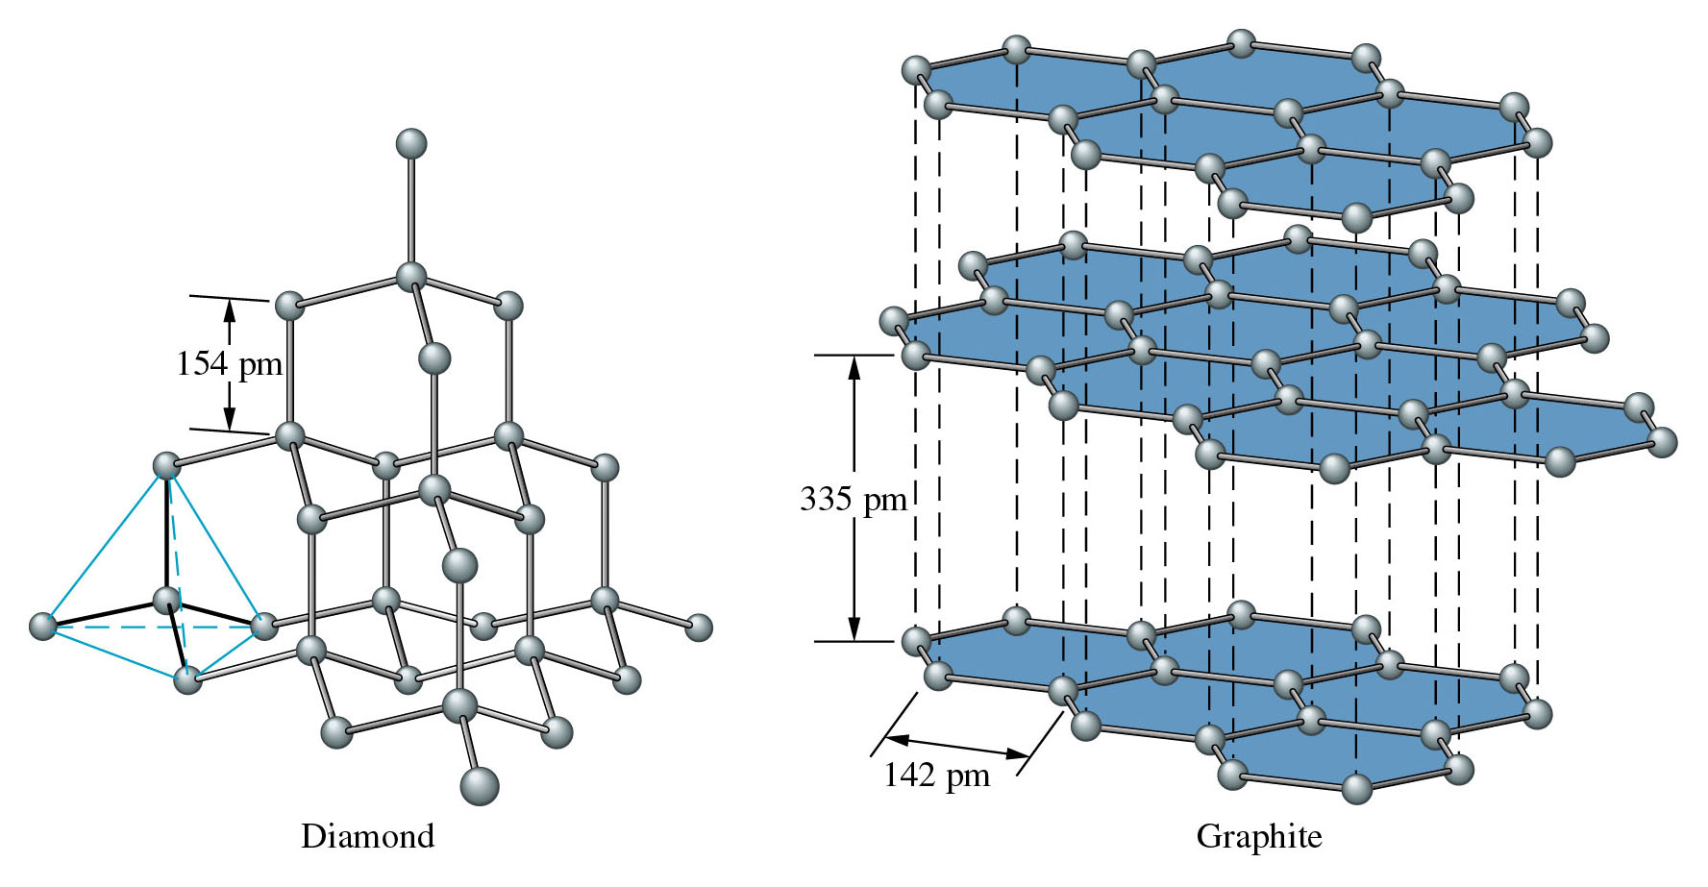
Figure 11.27: Structures of diamond and graphite.
Return to Slide 49

Slide 68
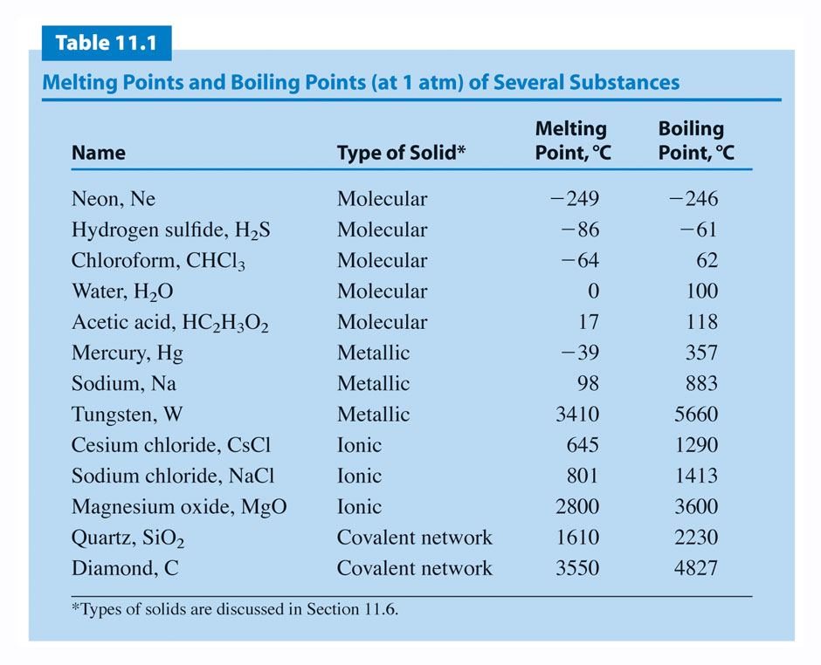
Return to Slide 51

Slide 69
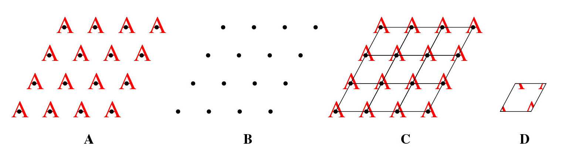
Figure 11.29: A two-dimensional pattern.
Return to Slide 60

Slide 70
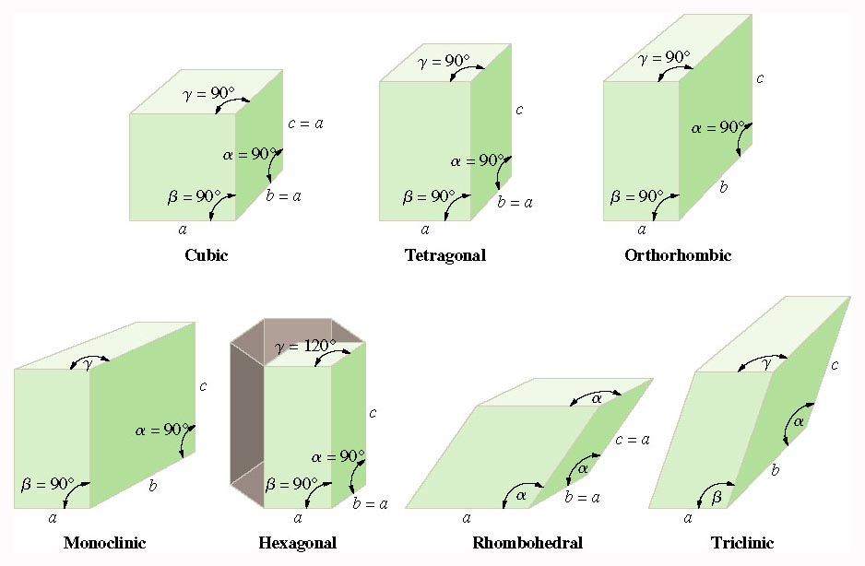
Figure 11.31: Unit-cell shapes of the different crystal systems.
Return to Slide 60

Slide 71
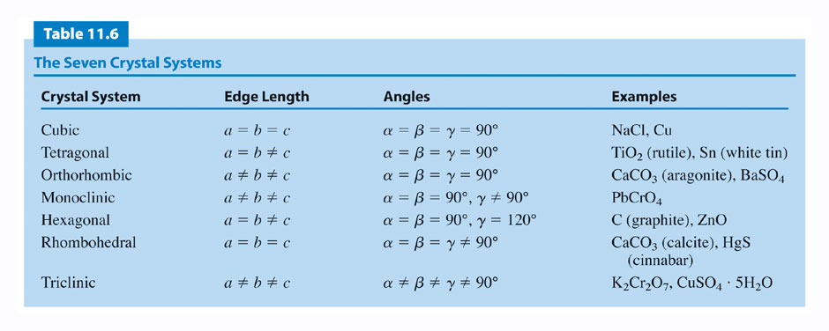
Return to Slide 60

Slide 72
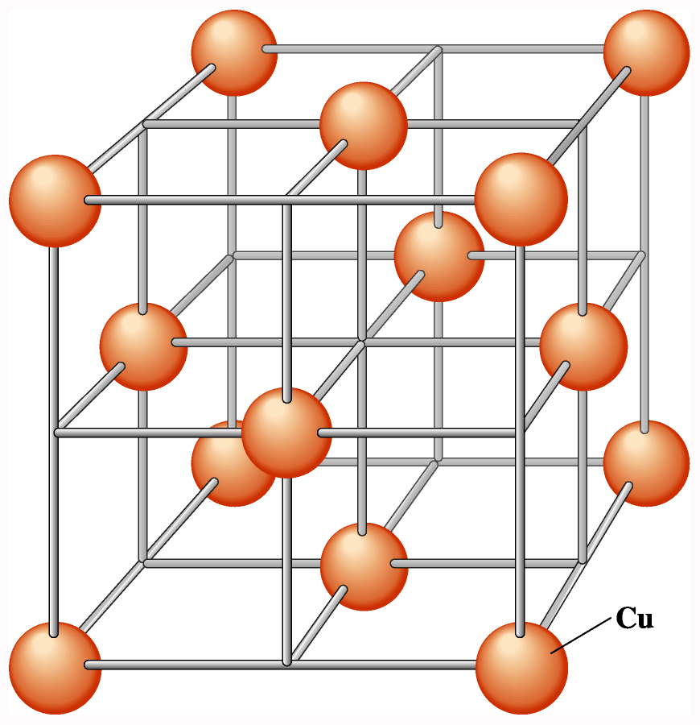
Figure 11.30: Crystal structure and crystal lattice of copper.
Return to Slide 63

Slide 73
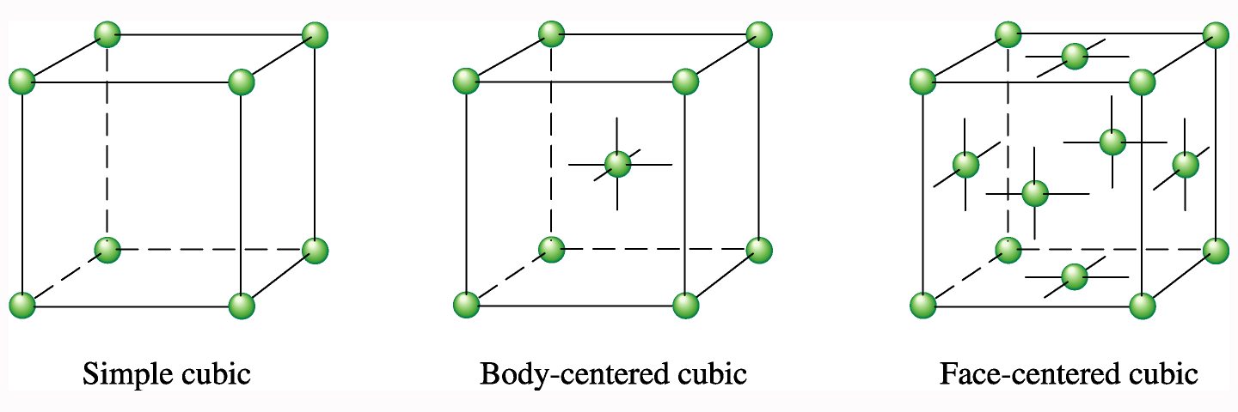
Figure 11.32: Cubic unit cells.
Return to Slide 63

Slide 74
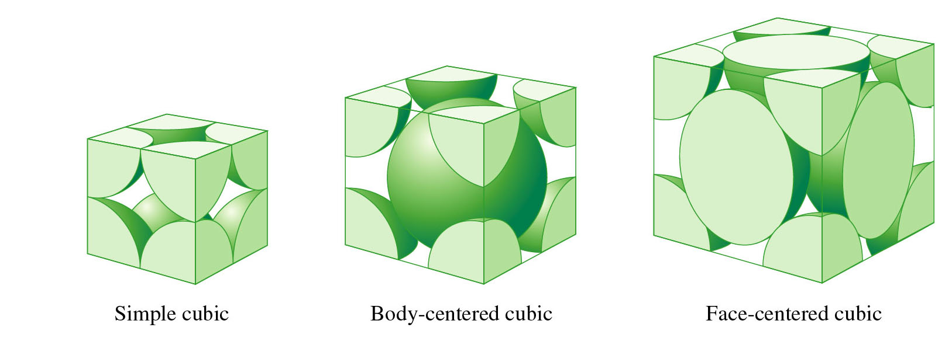
Figure 11.33: Space-filling representation of cubic unit cells.
Return to Slide 63

Slide 75
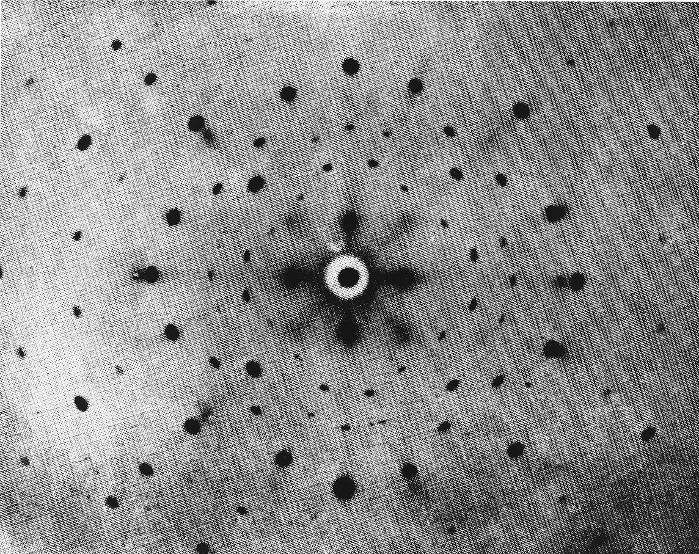
Figure 11.47: A crystal diffraction pattern.
From Preston, Proceedings of the Royal Society, A, Volume 172, plate 4, figure 5A
Return to Slide 66

