Slide 1
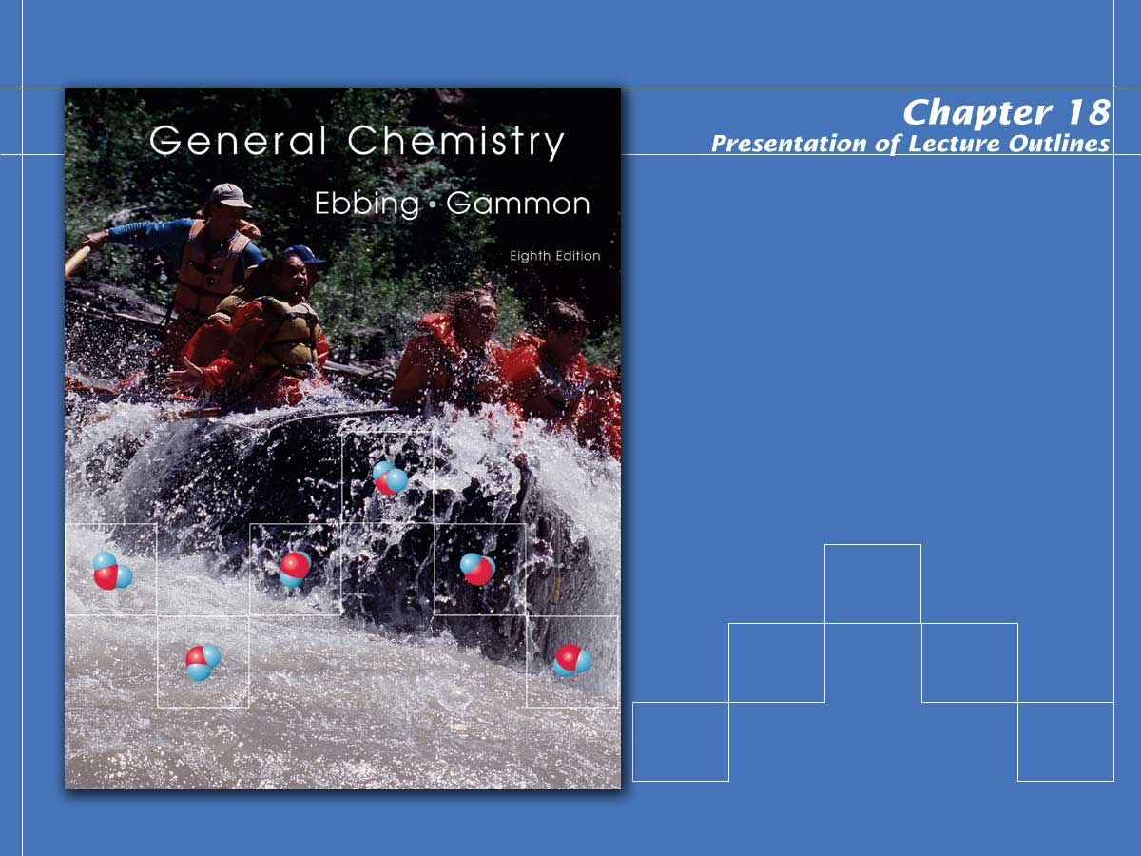
Solubility and Complex-ion Equilibria

Slide 2
Solubility Equilibria
Many natural processes depend on the precipitation or dissolving of a slightly soluble salt.
  In the next section, we look at the equilibria of slightly soluble, or nearly insoluble, ionic compounds.
  Their equilibrium constants can be used to answer questions regarding solubility and precipitation.
Copyright © Houghton Mifflin Company.All rights reserved.
Presentation of Lecture Outlines, 18–<number>
Notes:
2

Slide 3
The Solubility Product Constant
When an excess of a slightly soluble ionic compound is mixed with water, an equilibrium is established between the solid and the ions in the saturated solution.
  For the salt calcium oxalate, CaC₂O₄, you have the following equilibrium.
H₂O
Copyright © Houghton Mifflin Company.All rights reserved.
Presentation of Lecture Outlines, 18–<number>
Notes:
2

Slide 4
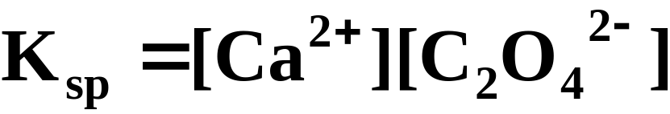
The Solubility Product Constant
When an excess of a slightly soluble ionic compound is mixed with water, an equilibrium is established between the solid and the ions in the saturated solution.
  The equilibrium constant for this process is called the solubility product constant.
Copyright © Houghton Mifflin Company.All rights reserved.
Presentation of Lecture Outlines, 18–<number>
Notes:
2

Slide 5
The Solubility Product Constant
In general, the solubility product constant is the equilibrium constant for the solubility equilibrium of a slightly soluble (or nearly insoluble) ionic compound.
  It equals the product of the equilibrium concentrations of the ions in the compound.
  Each concentration is raised to a power equal to the number of such ions in the formula of the compound.
Copyright © Houghton Mifflin Company.All rights reserved.
Presentation of Lecture Outlines, 18–<number>
Notes:
2

Slide 6
The Solubility Product Constant
In general, the solubility product constant is the equilibrium constant for the solubility equilibrium of a slightly soluble (or nearly insoluble) ionic compound.
  For example, lead iodide, PbI₂, is another slightly soluble salt. Its equilibrium is:
H₂O
Copyright © Houghton Mifflin Company.All rights reserved.
Presentation of Lecture Outlines, 18–<number>
Notes:
2

Slide 7
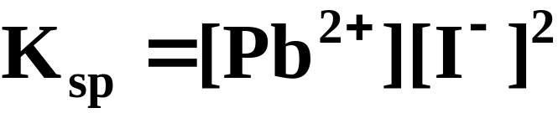
The Solubility Product Constant
In general, the solubility product constant is the equilibrium constant for the solubility equilibrium of a slightly soluble (or nearly insoluble) ionic compound.
  The expression for the solubility product constant is:
Copyright © Houghton Mifflin Company.All rights reserved.
Presentation of Lecture Outlines, 18–<number>
Notes:
2

Slide 8
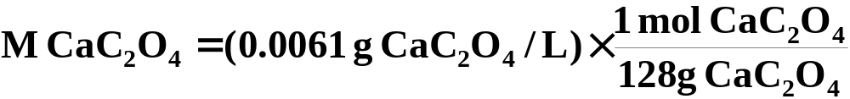

Calculating K_{sp} from the Solubility
A 1.0-L sample of a saturated calcium oxalate solution, CaC₂O₄, contains 0.0061-g of the salt at 25°C. Calculate the K_{sp} for this salt at 25°C.
  We must first convert the solubility of calcium oxalate from 0.0061 g/liter to moles per liter.
Copyright © Houghton Mifflin Company.All rights reserved.
Presentation of Lecture Outlines, 18–<number>
Notes:
2

Slide 9
Calculating K_{sp} from the Solubility
A 1.0-L sample of a saturated calcium oxalate solution, CaC₂O₄, contains 0.0061-g of the salt at 25°C. Calculate the K_{sp} for this salt at 25°C.
  When 4.8 x 10⁻⁵ mol of solid dissolve it forms 4.8 x 10⁻⁵ mol of each ion.
H₂O
Starting
0
0
Change
+4.8 x 10⁻⁵
+4.8 x 10⁻⁵
Equilibrium
4.8 x 10⁻⁵
4.8 x 10⁻⁵
Copyright © Houghton Mifflin Company.All rights reserved.
Presentation of Lecture Outlines, 18–<number>
Notes:
2

Slide 10
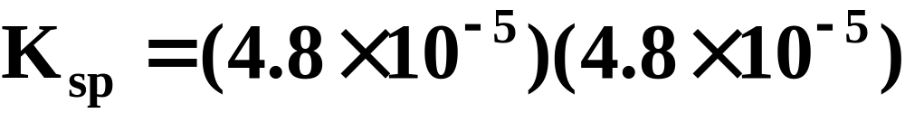
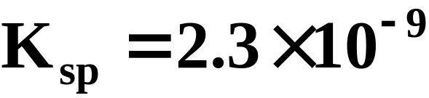
Calculating K_{sp} from the Solubility
A 1.0-L sample of a saturated calcium oxalate solution, CaC₂O₄, contains 0.0061-g of the salt at 25°C. Calculate the K_{sp} for this salt at 25°C.
  You can now substitute into the equilibrium-constant expression.
Copyright © Houghton Mifflin Company.All rights reserved.
Presentation of Lecture Outlines, 18–<number>
Notes:
2

Slide 11
Calculating K_{sp} from the Solubility
By experiment, it is found that 1.2 x 10⁻³ mol of lead(II) iodide, PbI₂, dissolves in 1.0 L of water at 25°C. What is the K_{sp} at this temperature?
  Note that in this example, you find that 1.2 x 10⁻³ mol of the solid dissolves to give 1.2 x 10⁻³ mol Pb²⁺ and 2 x (1.2 x 10⁻³) mol of I⁻.
Copyright © Houghton Mifflin Company.All rights reserved.
Presentation of Lecture Outlines, 18–<number>
Notes:
2

Slide 12
Calculating K_{sp} from the Solubility
By experiment, it is found that 1.2 x 10⁻³ mol of lead(II) iodide, PbI₂, dissolves in 1.0 L of water at 25°C. What is the K_{sp} at this temperature?
  The following table summarizes.
H₂O
Starting |  |  | 0 | 0
Change |  |  | +1.2 x 10⁻³ | +2 x (1.2 x 10⁻³⁾
Equilibrium |  |  | 1.2 x 10⁻³ | 2 x (1.2 x 10⁻³⁾
Copyright © Houghton Mifflin Company.All rights reserved.
Presentation of Lecture Outlines, 18–<number>
Notes:
2

Slide 13
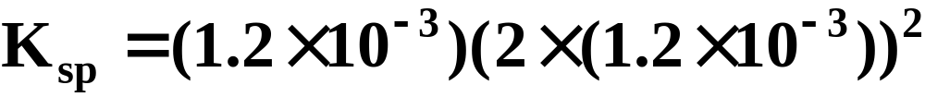
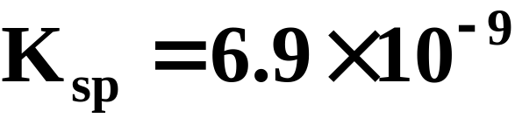
Calculating K_{sp} from the Solubility
By experiment, it is found that 1.2 x 10⁻³ mol of lead(II) iodide, PbI₂, dissolves in 1.0 L of water at 25°C. What is the K_{sp} at this temperature?
  Substituting into the equilibrium-constant expression:
Copyright © Houghton Mifflin Company.All rights reserved.
Presentation of Lecture Outlines, 18–<number>
Notes:
2

Slide 14
Calculating K_{sp} from the Solubility
By experiment, it is found that 1.2 x 10⁻³ mol of lead(II) iodide, PbI₂, dissolves in 1.0 L of water at 25°C. What is the K_{sp} at this temperature?
  Table 18.1 lists the solubility product constants for various ionic compounds.
  If the solubility product constant is known, the solubility of the compound can be calculated.
Copyright © Houghton Mifflin Company.All rights reserved.
Presentation of Lecture Outlines, 18–<number>
Notes:
2

Slide 15
Calculating the Solubility from K_{sp}
The mineral fluorite is calcium fluoride, CaF₂. Calculate the solubility (in grams per liter) of calcium fluoride in water from the K_{sp} (3.4 x 10⁻¹¹)
  Let x be the molar solubility of CaF₂.
H₂O
Starting
0
0
Change
+x
+2x
Equilibrium
x
2x
Copyright © Houghton Mifflin Company.All rights reserved.
Presentation of Lecture Outlines, 18–<number>
Notes:
2

Slide 16
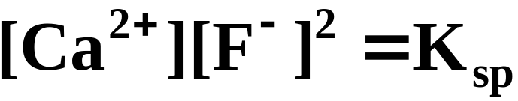
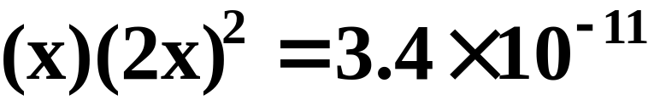

Calculating the Solubility from K_{sp}
The mineral fluorite is calcium fluoride, CaF₂. Calculate the solubility (in grams per liter) of calcium fluoride in water from the K_{sp} (3.4 x 10⁻¹¹)
  You substitute into the equilibrium-constant equation
Copyright © Houghton Mifflin Company.All rights reserved.
Presentation of Lecture Outlines, 18–<number>
Notes:
2

Slide 17
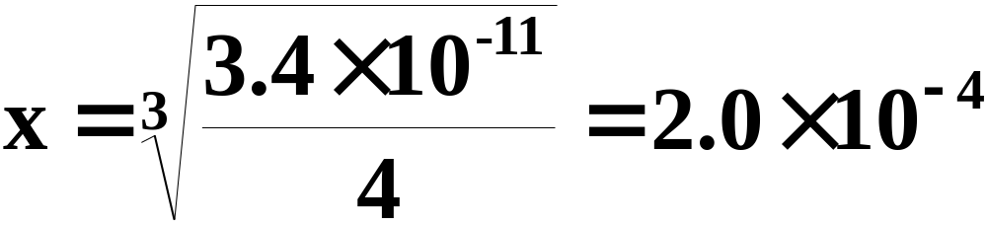
Calculating the Solubility from K_{sp}
The mineral fluorite is calcium fluoride, CaF₂. Calculate the solubility (in grams per liter) of calcium fluoride in water from the K_{sp} (3.4 x 10⁻¹¹)
  You now solve for x.
Copyright © Houghton Mifflin Company.All rights reserved.
Presentation of Lecture Outlines, 18–<number>
Notes:
2

Slide 18
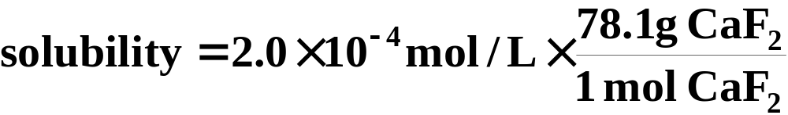
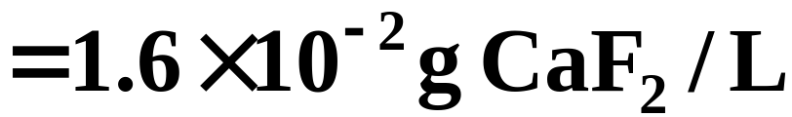
Calculating the Solubility from K_{sp}
The mineral fluorite is calcium fluoride, CaF₂. Calculate the solubility (in grams per liter) of calcium fluoride in water from the K_{sp} (3.4 x 10⁻¹¹)
  Convert to g/L (CaF₂ 78.1 g/mol).
Copyright © Houghton Mifflin Company.All rights reserved.
Presentation of Lecture Outlines, 18–<number>
Notes:
2

Slide 19
Solubility and the Common-Ion Effect
In this section we will look at calculating solubilities in the presence of other ions.
  The importance of the K_{sp} becomes apparent when you consider the solubility of one salt in the solution of another having the same cation.
Copyright © Houghton Mifflin Company.All rights reserved.
Presentation of Lecture Outlines, 18–<number>
Notes:
2

Slide 20
Solubility and the Common-Ion Effect
In this section we will look at calculating solubilities in the presence of other ions.
  For example, suppose you wish to know the solubility of calcium oxalate in a solution of calcium chloride.
  Each salt contributes the same cation (Ca²⁺)
  The effect is to make calcium oxalate less soluble than it would be in pure water.
Copyright © Houghton Mifflin Company.All rights reserved.
Presentation of Lecture Outlines, 18–<number>
Notes:
2

Slide 21
A Problem To Consider
What is the molar solubility of calcium oxalate in 0.15 M calcium chloride? The K_{sp} for calcium oxalate is 2.3 x 10⁻⁹.
  Note that before the calcium oxalate dissolves, there is already 0.15 M Ca²⁺ in the solution.
H₂O
Starting
0.15
0
Change
+x
+x
Equilibrium
0.15+x
x
Copyright © Houghton Mifflin Company.All rights reserved.
Presentation of Lecture Outlines, 18–<number>
Notes:
2

Slide 22
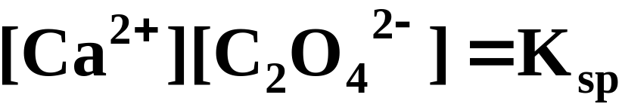
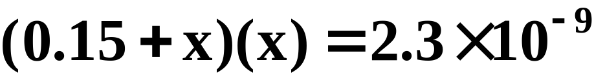
A Problem To Consider
What is the molar solubility of calcium oxalate in 0.15 M calcium chloride? The K_{sp} for calcium oxalate is 2.3 x 10⁻⁹.
  You substitute into the equilibrium-constant equation
Copyright © Houghton Mifflin Company.All rights reserved.
Presentation of Lecture Outlines, 18–<number>
Notes:
2

Slide 23
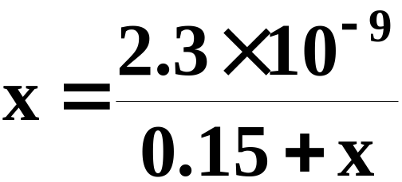
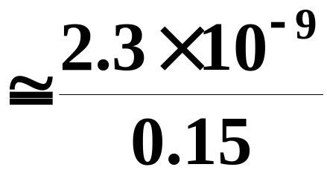
A Problem To Consider
What is the molar solubility of calcium oxalate in 0.15 M calcium chloride? The K_{sp} for calcium oxalate is 2.3 x 10⁻⁹.
  Now rearrange this equation to give
  We expect x to be negligible compared to 0.15.
Copyright © Houghton Mifflin Company.All rights reserved.
Presentation of Lecture Outlines, 18–<number>
Notes:
2

Slide 24
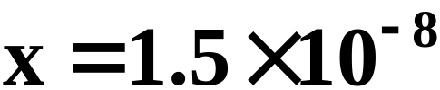
A Problem To Consider
What is the molar solubility of calcium oxalate in 0.15 M calcium chloride? The K_{sp} for calcium oxalate is 2.3 x 10⁻⁹.
  Now rearrange this equation to give
Copyright © Houghton Mifflin Company.All rights reserved.
Presentation of Lecture Outlines, 18–<number>
Notes:
2

Slide 25
A Problem To Consider
What is the molar solubility of calcium oxalate in 0.15 M calcium chloride? The K_{sp} for calcium oxalate is 2.3 x 10⁻⁹.
  Therefore, the molar solubility of calcium oxalate in 0.15 M CaCl₂ is 1.5 x 10⁻⁸ M.
  In pure water, the molarity was 4.8 x 10⁻⁵ M, which is over 3000 times greater.
Copyright © Houghton Mifflin Company.All rights reserved.
Presentation of Lecture Outlines, 18–<number>
Notes:
2

Slide 26
Precipitation Calculations
Precipitation is merely another way of looking at solubility equilibrium.
  Rather than considering how much of a substance will dissolve, we ask: Will precipitation occur for a given starting ion concentration?
Copyright © Houghton Mifflin Company.All rights reserved.
Presentation of Lecture Outlines, 18–<number>
Notes:
2

Slide 27
Criteria for Precipitation
To determine whether an equilibrium system will go in the forward or reverse direction requires that we evaluate the reaction quotient, Q_{c}.
  To predict the direction of reaction, you compare Q_{c} with K_{c} (Chapter 14).
  The reaction quotient has the same form as the K_{sp} expression, but the concentrations of products are starting values.
Copyright © Houghton Mifflin Company.All rights reserved.
Presentation of Lecture Outlines, 18–<number>
Notes:
2

Slide 28
Criteria for Precipitation
To determine whether an equilibrium system will go in the forward or reverse direction requires that we evaluate the reaction quotient, Q_{c}.
  Consider the following equilibrium.
H₂O
Copyright © Houghton Mifflin Company.All rights reserved.
Presentation of Lecture Outlines, 18–<number>
Notes:
2

Slide 29
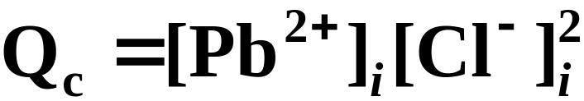
Criteria for Precipitation
To determine whether an equilibrium system will go in the forward or reverse direction requires that we evaluate the reaction quotient, Q_{c}.
  The Q_{c} expression is
  where initial concentration is denoted by i.
Copyright © Houghton Mifflin Company.All rights reserved.
Presentation of Lecture Outlines, 18–<number>
Notes:
2

Slide 30
Criteria for Precipitation
To determine whether an equilibrium system will go in the forward or reverse direction requires that we evaluate the reaction quotient, Q_{c}.
  If Q_{c} exceeds the K_{sp}, precipitation occurs.
  If Q_{c} is less than K_{sp}, more solute can dissolve.
  If Q_{c} equals the K_{sp}, the solution is saturated.
Copyright © Houghton Mifflin Company.All rights reserved.
Presentation of Lecture Outlines, 18–<number>
Notes:
2

Slide 31
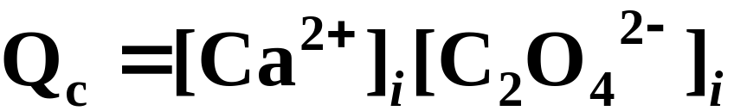
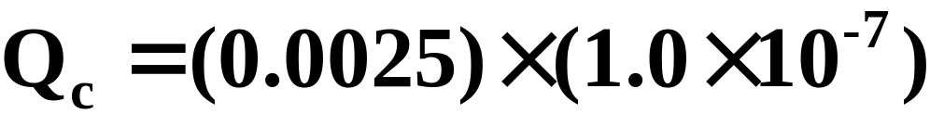
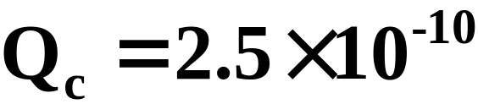
Predicting Whether Precipitation Will Occur
The concentration of calcium ion in blood plasma is 0.0025 M. If the concentration of oxalate ion is 1.0 x 10⁻⁷ M, do you expect calcium oxalate to precipitate? K_{sp} for calcium oxalate is 2.3 x 10⁻⁹.
  The ion product quotient, Q_{c}, is:
Copyright © Houghton Mifflin Company.All rights reserved.
Presentation of Lecture Outlines, 18–<number>
Notes:
2

Slide 32
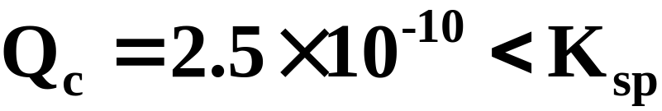
Predicting Whether Precipitation Will Occur
The concentration of calcium ion in blood plasma is 0.0025 M. If the concentration of oxalate ion is 1.0 x 10⁻⁷ M, do you expect calcium oxalate to precipitate? K_{sp} for calcium oxalate is 2.3 x 10⁻⁹.
  This value is smaller than the K_{sp}, so you do not expect precipitation to occur.
Copyright © Houghton Mifflin Company.All rights reserved.
Presentation of Lecture Outlines, 18–<number>
Notes:
2

Slide 33
Fractional Precipitation
Fractional precipitation is the technique of separating two or more ions from a solution by adding a reactant that precipitates first one ion, then another, and so forth.
  For example, when you slowly add potassium chromate, K₂CrO₄, to a solution containing Ba²⁺ and Sr²⁺, barium chromate precipitates first.
Copyright © Houghton Mifflin Company.All rights reserved.
Presentation of Lecture Outlines, 18–<number>
Notes:
2

Slide 34
Fractional Precipitation
Fractional precipitation is the technique of separating two or more ions from a solution by adding a reactant that precipitates first one ion, then another, and so forth.
  After most of the Ba²⁺ ion has precipitated, strontium chromate begins to precipitate.
  It is therefore possible to separate Ba²⁺ from Sr²⁺ by fractional precipitation using K₂CrO₄.
  BaCrO₄ Ksp = 1.2 x 10⁻¹⁰; SrCrO₄ Ksp = 3.5 x 10⁻²
Copyright © Houghton Mifflin Company.All rights reserved.
Presentation of Lecture Outlines, 18–<number>
Notes:
2

Slide 35
Effect of pH on Solubility
Sometimes it is necessary to account for other reactions aqueous ions might undergo.
  For example, if the anion is the conjugate base of a weak acid, it will react with H₃O⁺.
  You should expect the solubility to be affected by pH.
Copyright © Houghton Mifflin Company.All rights reserved.
Presentation of Lecture Outlines, 18–<number>
Notes:
2

Slide 36
Effect of pH on Solubility
Sometimes it is necessary to account for other reactions aqueous ions might undergo.
  Consider the following equilibrium.
H₂O
  Because the oxalate ion is conjugate to a weak acid (HC₂O₄⁻), it will react with H₃O⁺.
H₂O
Copyright © Houghton Mifflin Company.All rights reserved.
Presentation of Lecture Outlines, 18–<number>
Notes:
2

Slide 37
Effect of pH on Solubility
Sometimes it is necessary to account for other reactions aqueous ions might undergo.
  According to Le Chatelier’s principle, as C₂O₄²⁻ ion is removed by the reaction with H₃O⁺, more calcium oxalate dissolves.
  Therefore, you expect calcium oxalate to be more soluble in acidic solution (low pH) than in pure water.
Copyright © Houghton Mifflin Company.All rights reserved.
Presentation of Lecture Outlines, 18–<number>
Notes:
2

Slide 38
Complex-Ion Equilibria
Many metal ions, especially transition metals, form coordinate covalent bonds with molecules or anions having a lone pair of electrons.
  This type of bond formation is essentially a Lewis acid-base reaction (Chapter 16).
Copyright © Houghton Mifflin Company.All rights reserved.
Presentation of Lecture Outlines, 18–<number>
Notes:
2

Slide 39
Complex-Ion Equilibria
Many metal ions, especially transition metals, form coordinate covalent bonds with molecules or anions having a lone pair of electrons.
  For example, the silver ion, Ag+, can react with ammonia to form the Ag(NH₃)₂⁺ ion.
See Figure 18.6.
Copyright © Houghton Mifflin Company.All rights reserved.
Presentation of Lecture Outlines, 18–<number>
Notes:
2

Slide 40
Complex-Ion Equilibria
A complex ion is an ion formed from a metal ion with a Lewis base attached to it by a coordinate covalent bond.
  A complex is defined as a compound containing complex ions.
  A ligand is a Lewis base (an electron pair donor) that bonds to a metal ion to form a complex ion.
Copyright © Houghton Mifflin Company.All rights reserved.
Presentation of Lecture Outlines, 18–<number>
Notes:
2

Slide 41
Complex-Ion Formation
The aqueous silver ion forms a complex ion with ammonia in steps.
When you add these equations, you get the overall equation for the formation of Ag(NH₃)₂⁺.
Copyright © Houghton Mifflin Company.All rights reserved.
Presentation of Lecture Outlines, 18–<number>
Notes:
2

Slide 42
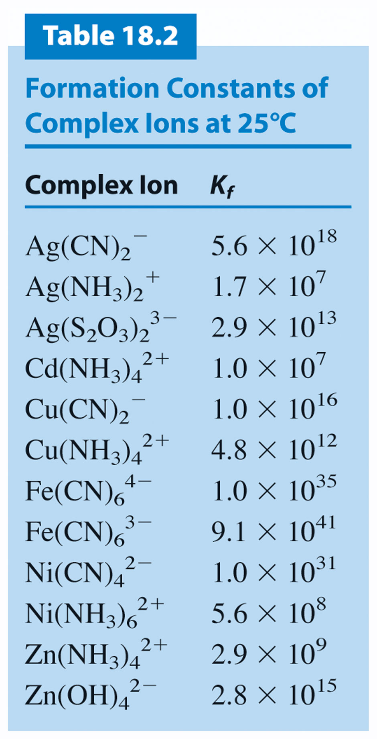
Copyright © Houghton Mifflin Company.All rights reserved.
Presentation of Lecture Outlines, 18–<number>

Slide 43
Amphoteric Hydroxides
An amphoteric hydroxide is a metal hydroxide that reacts with both acids and bases.
  For example, zinc hydroxide, Zn(OH)₂, reacts with a strong acid and the metal hydroxide dissolves.
Copyright © Houghton Mifflin Company.All rights reserved.
Presentation of Lecture Outlines, 18–<number>
Notes:
2

Slide 44
Amphoteric Hydroxides
An amphoteric hydroxide is a metal hydroxide that reacts with both acids and bases.
  With a base however, Zn(OH)₂ reacts to form the complex ion Zn(OH)₄²⁻.
Copyright © Houghton Mifflin Company.All rights reserved.
Presentation of Lecture Outlines, 18–<number>
Notes:
2

Slide 45
Amphoteric Hydroxides
An amphoteric hydroxide is a metal hydroxide that reacts with both acids and bases.
  When a strong base is slowly added to a solution of ZnCl₂, a white precipitate of Zn(OH)₂ first forms.
Copyright © Houghton Mifflin Company.All rights reserved.
Presentation of Lecture Outlines, 18–<number>
Notes:
2

Slide 46
Amphoteric Hydroxides
An amphoteric hydroxide is a metal hydroxide that reacts with both acids and bases.
  But as more base is added, the white preciptate dissolves, forming the complex ion Zn(OH)₄²⁻. (see Figure 18.7)
  Other common amphoteric hydroxides are those of aluminum, chromium(III), lead(II), tin(II), and tin(IV).
Copyright © Houghton Mifflin Company.All rights reserved.
Presentation of Lecture Outlines, 18–<number>
Notes:
2

Slide 47
Qualitative Analysis
Qualitative analysis involves the determination of the identity of substances present in a mixture.
  In the qualitative analysis scheme for metal ions, a cation is usually detected by the presence of a characteristic precipitate.
  Figure 18.8 summarizes how metal ions in an aqueous solution are separated into five analytical groups.
Copyright © Houghton Mifflin Company.All rights reserved.
Presentation of Lecture Outlines, 18–<number>
Notes:
2

Slide 48

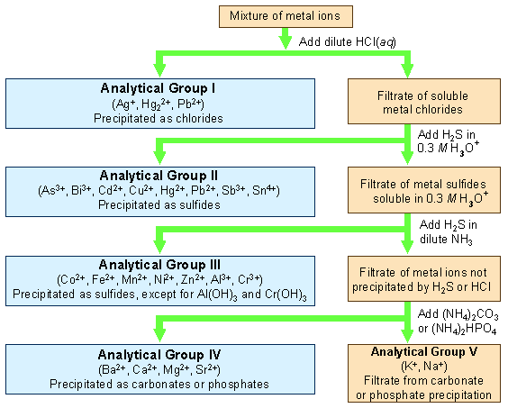
Figure 18.8
Notes:
2

Slide 49
Operational Skills
Writing solubility product expressions
Calculating K_{sp} from the solubility, or vice versa.
Calculating the solubility of a slightly soluble salt in a solution of a common ion.
Predicting whether precipitation will occur
Determining the qualitative effect of pH on solubility
Calculating the concentration of a metal ion in equilibrium with a complex ion
Predicting whether a precipitate will form in the presence of the complex ion
Calculating the solubility of a slightly soluble ionic compound in a solution of the complex ion
Copyright © Houghton Mifflin Company.All rights reserved.
Presentation of Lecture Outlines, 18–<number>
Notes:
2

Slide 50

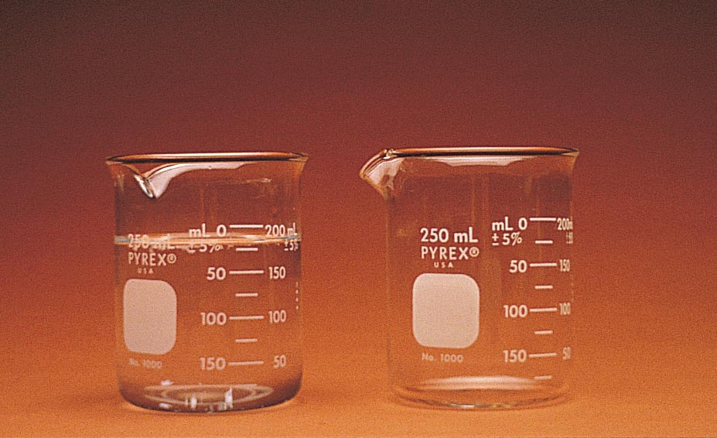
Figure 18.7: After more NaOH is added, the precipitate dissolves by forming the hydroxo complex Zn(OH)₄²⁻
Photo courtesy of James Scherer.
Return to slide 55
Copyright © Houghton Mifflin Company.All rights reserved.
Presentation of Lecture Outlines, 18–<number>

