Slide 1
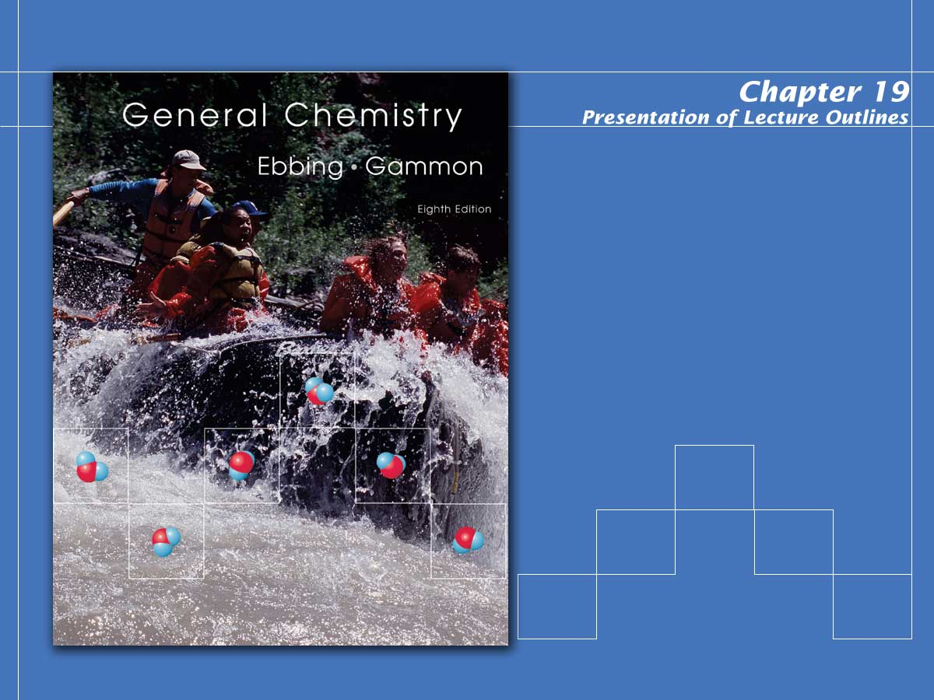
Thermodynamics and Equilibrium

Slide 2
Thermodynamics
Thermodynamics is the study of the relationship between heat and other forms of energy in a chemical or physical process.
  We introduced the thermodynamic property of enthalpy, H, in Chapter 6.
  We noted that the change in enthalpy equals the heat of reaction at constant pressure.
  In this chapter we will define enthalpy more precisely, in terms of the energy of the system.
Copyright © Houghton Mifflin Company.All rights reserved.
Presentation of Lecture Outlines, 19–<number>
Notes:
2

Slide 3
First Law of Thermodynamics
To state the laws of thermodynamics, we must first understand the internal energy of a system and how you can change it.
  Heat is energy that moves into or out of a system because of a temperature difference between system and surroundings.
  Work, on the other hand, is the energy exchange that results when a force F moves an object through a distance d; work (w) = F×d
Copyright © Houghton Mifflin Company.All rights reserved.
Presentation of Lecture Outlines, 19–<number>
Notes:
2

Slide 4
First Law of Thermodynamics
To state the laws of thermodynamics, we must first understand the internal energy of a system and how you can change it.
  Remembering our sign convention.
    Work done by the system is negative.
    Work done on the system is positive.
    Heat evolved by the system is negative.
    Heat absorbed by the system is positive.
Copyright © Houghton Mifflin Company.All rights reserved.
Presentation of Lecture Outlines, 19–<number>
Notes:
2

Slide 5

First Law of Thermodynamics
To state the laws of thermodynamics, we must first understand the internal energy of a system and how you can change it.
  In general, the first law of thermodynamics states that the change in internal energy, ΔU, equals heat plus work.
Copyright © Houghton Mifflin Company.All rights reserved.
Presentation of Lecture Outlines, 19–<number>
Notes:
2

Slide 6

Heat of Reaction and Internal Energy
When a reaction is run in an open vessel (at constant P), any gases produced represent a potential source of “expansion” work.
  It follows therefore, that
  You can calculate the work done by a chemical reaction simply by multiplying the atmospheric pressure by the change in volume, ΔV.
Copyright © Houghton Mifflin Company.All rights reserved.
Presentation of Lecture Outlines, 19–<number>
Notes:
2

Slide 7
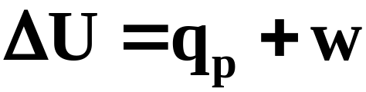

Heat of Reaction and Internal Energy
When a reaction is run in an open vessel (at constant P), any gases produced represent a potential source of “expansion” work.
  Relating the change in internal energy to the heat of reaction, you have
Copyright © Houghton Mifflin Company.All rights reserved.
Presentation of Lecture Outlines, 19–<number>
Notes:
2

Slide 8
Enthalpy and Enthalpy Change
In Chapter 6, we tentatively defined enthalpy in terms of the relationship of ΔH to the heat at constant pressure.
  We now define enthalpy, H , precisely as the quantity U + PV.
  Because U, P, and V are state functions, H is also a state function.
Copyright © Houghton Mifflin Company.All rights reserved.
Presentation of Lecture Outlines, 19–<number>
Notes:
2

Slide 9
Spontaneous Processes and Entropy
A spontaneous process is a physical or chemical change that occurs by itself.
  Examples include:
    A rock at the top of a hill rolls down.
    Heat flows from a hot object to a cold one.
    An iron object rusts in moist air.
  These processes occur without requiring an outside force and continue until equilibrium is reached.
Copyright © Houghton Mifflin Company.All rights reserved.
Presentation of Lecture Outlines, 19–<number>
Notes:
2

Slide 10
Entropy and the Second Law of Thermodynamics
The second law of thermodynamics addresses questions about spontaneity in terms of a quantity called entropy.
  Entropy, S , is a thermodynamic quantity that is a measure of the randomness or disorder of a system.
  The SI unit of entropy is joules per Kelvin (J/K) and, like enthalpy, is a state function.
Copyright © Houghton Mifflin Company.All rights reserved.
Presentation of Lecture Outlines, 19–<number>
Notes:
2

Slide 11
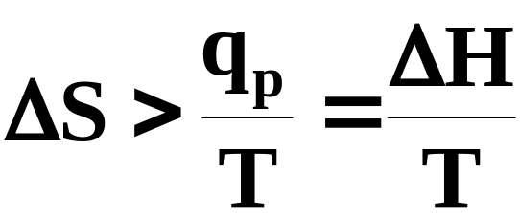
Entropy, Enthalpy, and Spontaneity
Now you can see how thermodynamics is applied to the question of reaction spontaneity.
  Recall that the heat at constant pressure, q_{p} , equals the enthalpy change, ΔH.
  The second law for a spontaneous reaction at constant temperature and pressure becomes
(Spontaneous reaction, constant T and P)
Copyright © Houghton Mifflin Company.All rights reserved.
Presentation of Lecture Outlines, 19–<number>
Notes:
2

Slide 12

Entropy, Enthalpy, and Spontaneity
Now you can see how thermodynamics is applied to the question of reaction spontaneity.
  Rearranging this equation, we find
(Spontaneous reaction, constant T and P)
  This inequality implies that for a reaction to be spontaneous, ΔH-TΔS must be negative.
  If ΔH-TΔS is positive, the reverse reaction is spontaneous. If ΔH-TΔS=0, the reaction is at equilibrium
Copyright © Houghton Mifflin Company.All rights reserved.
Presentation of Lecture Outlines, 19–<number>
Notes:
2

Slide 13
Standard Entropies and the Third Law of Thermodynamics
The third law of thermodynamics states that a substance that is perfectly crystalline at 0 K has an entropy of zero.
  When temperature is raised, however, the substance becomes more disordered as it absorbs heat.
  The entropy of a substance is determined by measuring how much heat is required to change its temperature per Kelvin degree.
Copyright © Houghton Mifflin Company.All rights reserved.
Presentation of Lecture Outlines, 19–<number>
Notes:
2

Slide 14
Standard Entropies and the Third Law of Thermodynamics
The standard entropy of a substance or ion (Table 19.1), also called its absolute entropy, Sº, is the entropy value for the standard state of the species.
  Standard state implies 25 ºC, 1 atm pressure, and 1 M for dissolved substances.
Copyright © Houghton Mifflin Company.All rights reserved.
Presentation of Lecture Outlines, 19–<number>
Notes:
2

Slide 15
Standard Entropies and the Third Law of Thermodynamics
The standard entropy of a substance or ion (Table 19.1), also called its absolute entropy, Sº, is the entropy value for the standard state of the species.
  Note that the elements have nonzero values, unlike standard enthalpies of formation, ΔH_{f}º , which by convention, are zero.
Copyright © Houghton Mifflin Company.All rights reserved.
Presentation of Lecture Outlines, 19–<number>
Notes:
2

Slide 16
Standard Entropies and the Third Law of Thermodynamics
The standard entropy of a substance or ion (Table 19.1), also called its absolute entropy, Sº, is the entropy value for the standard state of the species.
  The symbol Sº, rather than ΔSº, is used for standard entropies to emphasize that they originate from the third law.
Copyright © Houghton Mifflin Company.All rights reserved.
Presentation of Lecture Outlines, 19–<number>
Notes:
2

Slide 17
Entropy Change for a Reaction
You can calculate the entropy change for a reaction using a summation law, similar to the way you obtained ΔSº.
  Even without knowing the values for the entropies of substances, you can sometimes predict the sign of ΔSº for a reaction.
Copyright © Houghton Mifflin Company.All rights reserved.
Presentation of Lecture Outlines, 19–<number>
Notes:
2

Slide 18
Entropy Change for a Reaction
You can calculate the entropy change for a reaction using a summation law, similar to the way you obtained ΔSº.
  The entropy usually increases in the following situations:
    A reaction in which a molecule is broken into two or more smaller molecules.
Copyright © Houghton Mifflin Company.All rights reserved.
Presentation of Lecture Outlines, 19–<number>
Notes:
2

Slide 19
Entropy Change for a Reaction
You can calculate the entropy change for a reaction using a summation law, similar to the way you obtained ΔSº.
  The entropy usually increases in the following situations:
    A reaction in which there is an increase in the moles of gases.
Copyright © Houghton Mifflin Company.All rights reserved.
Presentation of Lecture Outlines, 19–<number>
Notes:
2

Slide 20
Entropy Change for a Reaction
You can calculate the entropy change for a reaction using a summation law, similar to the way you obtained ΔSº.
  The entropy usually increases in the following situations:
    A process in which a solid changes to liquid or gas or a liquid changes to gas.
Copyright © Houghton Mifflin Company.All rights reserved.
Presentation of Lecture Outlines, 19–<number>
Notes:
2

Slide 21
A Problem To Consider
Calculate the change in entropy, ΔSº, at 25ºC for the reaction in which urea is formed from NH₃ and CO₂. The standard entropy of NH₂CONH₂ is 174 J/(mol.K). See Table 19.1 for other values.
  The calculation is similar to that used to obtain ΔHº from standard enthalpies of formation.
Copyright © Houghton Mifflin Company.All rights reserved.
Presentation of Lecture Outlines, 19–<number>
Notes:
2

Slide 22
A Problem To Consider
Calculate the change in entropy, ΔSº, at 25ºC for the reaction in which urea is formed from NH₃ and CO₂. The standard entropy of NH₂CONH₂ is 174 J/(mol.K). See Table 19.1 for other values.
Sº:
2 x 193
214
174
70
  It is convenient to put the standard entropies (multiplied by their stoichiometric coefficients) below the formulas.
Copyright © Houghton Mifflin Company.All rights reserved.
Presentation of Lecture Outlines, 19–<number>
Notes:
2

Slide 23
A Problem To Consider
Calculate the change in entropy, ΔSº, at 25ºC for the reaction in which urea is formed from NH₃ and CO₂. The standard entropy of NH₂CONH₂ is 174 J/(mol.K). See Table 19.1 for other values.
  We can now use the summation law to calculate the entropy change.
Copyright © Houghton Mifflin Company.All rights reserved.
Presentation of Lecture Outlines, 19–<number>
Notes:
2

Slide 24
A Problem To Consider
Calculate the change in entropy, ΔSº, at 25ºC for the reaction in which urea is formed from NH₃ and CO₂. The standard entropy of NH₂CONH₂ is 174 J/(mol.K). See Table 19.1 for other values.
  We can now use the summation law to calculate the entropy change.
Copyright © Houghton Mifflin Company.All rights reserved.
Presentation of Lecture Outlines, 19–<number>
Notes:
2

Slide 25
Free Energy Concept
The American physicist J. Willard Gibbs introduced the concept of free energy (sometimes called the Gibbs free energy), G, which is a thermodynamic quantity defined by the equation G=H-TS.
  This quantity gives a direct criterion for spontaneity of reaction.
Copyright © Houghton Mifflin Company.All rights reserved.
Presentation of Lecture Outlines, 19–<number>
Notes:
2

Slide 26

Free Energy and Spontaneity
Changes in H an S during a reaction result in a change in free energy, ΔG , given by the equation
  Thus, if you can show that ΔG is negative at a given temperature and pressure, you can predict that the reaction will be spontaneous.
Copyright © Houghton Mifflin Company.All rights reserved.
Presentation of Lecture Outlines, 19–<number>
Notes:
2

Slide 27
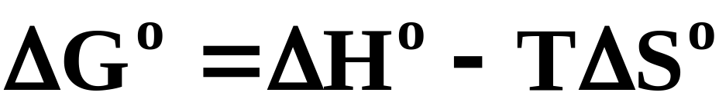
Standard Free-Energy Change
The standard free energy change, ΔGº, is the free energy change that occurs when reactants and products are in their standard states.
  The next example illustrates the calculation of the standard free energy change, ΔGº, from ΔHº and ΔSº.
Copyright © Houghton Mifflin Company.All rights reserved.
Presentation of Lecture Outlines, 19–<number>
Notes:
2

Slide 28
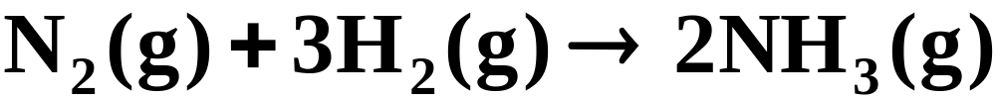
A Problem To Consider
What is the standard free energy change, ΔGº, for the following reaction at 25ºC? Use values of ΔH_{f}º and Sº, from Tables 6.2 and 19.1.
ΔH_{f}º:
0
0
2 x (-45.9) kJ
Sº:
191.5
3 x 130.6
2 x 193 J/K
  Place below each formula the values of ΔH_{f}º and Sº multiplied by stoichiometric coefficients.
Copyright © Houghton Mifflin Company.All rights reserved.
Presentation of Lecture Outlines, 19–<number>
Notes:
2

Slide 29
A Problem To Consider
What is the standard free energy change, ΔGº, for the following reaction at 25ºC? Use values of ΔH_{f}º and Sº, from Tables 6.2 and 19.1.
  You can calculate ΔHº and ΔSº using their respective summation laws.
Copyright © Houghton Mifflin Company.All rights reserved.
Presentation of Lecture Outlines, 19–<number>
Notes:
2

Slide 30
A Problem To Consider
What is the standard free energy change, ΔGº, for the following reaction at 25ºC? Use values of ΔH_{f}º and Sº, from Tables 6.2 and 19.1.
  You can calculate ΔHº and ΔSº using their respective summation laws.
Copyright © Houghton Mifflin Company.All rights reserved.
Presentation of Lecture Outlines, 19–<number>
Notes:
2

Slide 31

A Problem To Consider
What is the standard free energy change, ΔGº, for the following reaction at 25ºC? Use values of ΔH_{f}º and Sº, from Tables 6.2 and 19.1.
  Now substitute into our equation for ΔGº. Note that ΔSº is converted to kJ/K.
Copyright © Houghton Mifflin Company.All rights reserved.
Presentation of Lecture Outlines, 19–<number>
Notes:
2

Slide 32
Standard Free Energies of Formation
The standard free energy of formation, ΔG_{f}º, of a substance is the free energy change that occurs when 1 mol of a substance is formed from its elements in their stablest states at 1 atm pressure and 25ºC.
  By tabulating ΔG_{f}º for substances, as in Table 19.2, you can calculate the ΔGº for a reaction by using a summation law.
Copyright © Houghton Mifflin Company.All rights reserved.
Presentation of Lecture Outlines, 19–<number>
Notes:
2

Slide 33
A Problem To Consider
Calculate ΔGº for the combustion of 1 mol of ethanol, C₂H₅OH, at 25ºC. Use the standard free energies of formation given in Table 19.2.
ΔG_{f}º:
-174.8
0
2(-394.4)
3(-228.6)kJ
  Place below each formula the values of ΔG_{f}º multiplied by stoichiometric coefficients.
Copyright © Houghton Mifflin Company.All rights reserved.
Presentation of Lecture Outlines, 19–<number>
Notes:
2

Slide 34
A Problem To Consider
Calculate ΔGº for the combustion of 1 mol of ethanol, C₂H₅OH, at 25ºC. Use the standard free energies of formation given in Table 19.2.
ΔG_{f}º:
-174.8
0
2(-394.4)
3(-228.6)kJ
  You can calculate ΔGº using the summation law.
Copyright © Houghton Mifflin Company.All rights reserved.
Presentation of Lecture Outlines, 19–<number>
Notes:
2

Slide 35

A Problem To Consider
Calculate ΔGº for the combustion of 1 mol of ethanol, C₂H₅OH, at 25ºC. Use the standard free energies of formation given in Table 19.2.
ΔG_{f}º:
ΔG_{f}º:
-174.8
-174.8
0
0
2(-394.4)
2(-394.4)
3(-228.6)kJ
3(-228.6)kJ
  You can calculate ΔGº using the summation law.
Copyright © Houghton Mifflin Company.All rights reserved.
Presentation of Lecture Outlines, 19–<number>
Notes:
2

Slide 36
ΔGº as a Criteria for Spontaneity
The following rules are useful in judging the spontaneity of a reaction.
  When ΔGº is a large negative number (more negative than about –10 kJ), the reaction is spontaneous as written, and the reactants transform almost entirely to products when equilibrium is reached.
Copyright © Houghton Mifflin Company.All rights reserved.
Presentation of Lecture Outlines, 19–<number>
Notes:
2

Slide 37
ΔGº as a Criteria for Spontaneity
The following rules are useful in judging the spontaneity of a reaction.
  When ΔGº is a large positive number (more positive than about +10 kJ), the reaction is nonspontaneous as written, and reactants do not give significant amounts of product at equilibrium.
Copyright © Houghton Mifflin Company.All rights reserved.
Presentation of Lecture Outlines, 19–<number>
Notes:
2

Slide 38
ΔGº as a Criteria for Spontaneity
The following rules are useful in judging the spontaneity of a reaction.
  When ΔGº is a small negative or positive value (less than about 10 kJ), the reaction gives an equilibrium mixture with significant amounts of both reactants and products.
Copyright © Houghton Mifflin Company.All rights reserved.
Presentation of Lecture Outlines, 19–<number>
Notes:
2

Slide 39
Free Energy Change During Reaction
As a system approaches equilibrium, the instantaneous change in free energy approaches zero.
  Figure 19.9 illustrates the change in free energy during a spontaneous reaction.
  As the reaction proceeds, the free energy eventually reaches its minimum value.
  At that point, ΔG = 0, and the net reaction stops; it comes to equilibrium.
Copyright © Houghton Mifflin Company.All rights reserved.
Presentation of Lecture Outlines, 19–<number>
Notes:
2

Slide 40

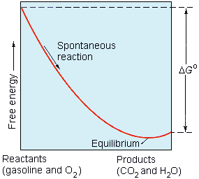
Figure 19.9 Free-energy change during a spontaneous reaction.
Notes:
2

Slide 41
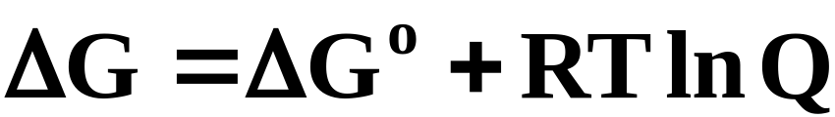
Relating ΔGº to the Equilibrium Constant
The free energy change when reactants are in non-standard states (other than 1 atm pressure or 1 M) is related to the standard free energy change, ΔGº, by the following equation.
  Here Q is the thermodynamic form of the reaction quotient.
Copyright © Houghton Mifflin Company.All rights reserved.
Presentation of Lecture Outlines, 19–<number>
Notes:
2

Slide 42
Relating ΔGº to the Equilibrium Constant
The free energy change when reactants are in non-standard states (other than 1 atm pressure or 1 M) is related to the standard free energy change, ΔGº, by the following equation.
  ΔG represents an instantaneous change in free energy at some point in the reaction approaching equilibrium.
Copyright © Houghton Mifflin Company.All rights reserved.
Presentation of Lecture Outlines, 19–<number>
Notes:
2

Slide 43
Relating ΔGº to the Equilibrium Constant
The free energy change when reactants are in non-standard states (other than 1 atm pressure or 1 M) is related to the standard free energy change, ΔGº, by the following equation.
  At equilibrium, ΔG=0 and the reaction quotient Q becomes the equilibrium constant K.
Copyright © Houghton Mifflin Company.All rights reserved.
Presentation of Lecture Outlines, 19–<number>
Notes:
2

Slide 44
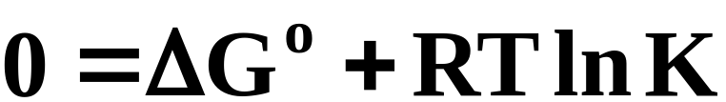
Relating ΔGº to the Equilibrium Constant
The free energy change when reactants are in non-standard states (other than 1 atm pressure or 1 M) is related to the standard free energy change, ΔGº, by the following equation.
  At equilibrium, ΔG=0 and the reaction quotient Q becomes the equilibrium constant K.
Copyright © Houghton Mifflin Company.All rights reserved.
Presentation of Lecture Outlines, 19–<number>
Notes:
2

Slide 45
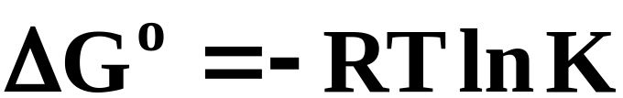
Relating ΔGº to the Equilibrium Constant
This result easily rearranges to give the basic equation relating the standard free-energy change to the equilibrium constant.
  When K > 1 , the ln K is positive and ΔGº is negative.
  When K < 1 , the ln K is negative and ΔGº is positive.
Copyright © Houghton Mifflin Company.All rights reserved.
Presentation of Lecture Outlines, 19–<number>
Notes:
2

Slide 46
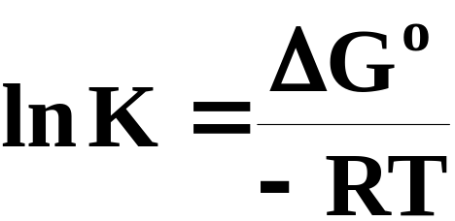
A Problem To Consider
Find the value for the equilibrium constant, K, at 25ºC (298 K) for the following reaction. The standard free-energy change, ΔGº, at 25ºC equals –13.6 kJ.
  Rearrange the equation ΔGº=-RTlnK to give
Copyright © Houghton Mifflin Company.All rights reserved.
Presentation of Lecture Outlines, 19–<number>
Notes:
2

Slide 47
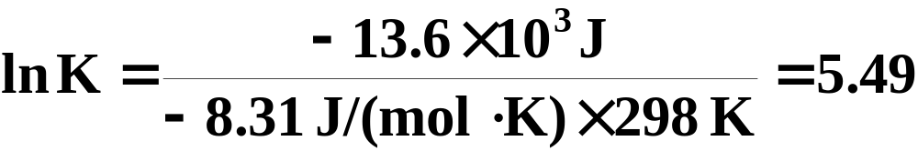
A Problem To Consider
Find the value for the equilibrium constant, K, at 25ºC (298 K) for the following reaction. The standard free-energy change, ΔGº, at 25ºC equals –13.6 kJ.
  Substituting numerical values into the equation,
Copyright © Houghton Mifflin Company.All rights reserved.
Presentation of Lecture Outlines, 19–<number>
Notes:
2

Slide 48
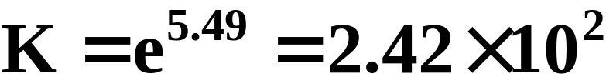
A Problem To Consider
Find the value for the equilibrium constant, K, at 25ºC (298 K) for the following reaction. The standard free-energy change, ΔGº, at 25ºC equals –13.6 kJ.
  Hence,
Copyright © Houghton Mifflin Company.All rights reserved.
Presentation of Lecture Outlines, 19–<number>
Notes:
2

Slide 49
Spontaneity and Temperature Change
All of the four possible choices of signs for ΔHº and ΔSº give different temperature behaviors for ΔGº.
ΔHº | ΔSº | ΔGº | Description
– | + | – | Spontaneous at all T
+ | – | + | Nonspontaneous at all T
– | – | + or – | Spontaneous at low T; Nonspontaneous at high T
+ | + | + or – | Nonspontaneous at low T; Spontaneous at high T
Copyright © Houghton Mifflin Company.All rights reserved.
Presentation of Lecture Outlines, 19–<number>
Notes:
2

Slide 50
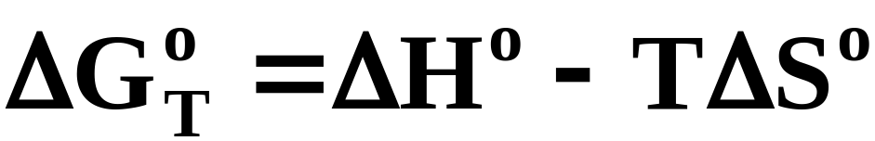
Calculation of ΔGº at Various Temperatures
In this method you assume that ΔHº and ΔSº are essentially constant with respect to temperature.
  You get the value of ΔG_{T}º at any temperature T by substituting values of ΔHº and ΔSº at 25 ºC into the following equation.
Copyright © Houghton Mifflin Company.All rights reserved.
Presentation of Lecture Outlines, 19–<number>
Notes:
2

Slide 51
A Problem To Consider
Find the ΔGº for the following reaction at 25ºC and 1000ºC. Relate this to reaction spontaneity.
ΔH_{f}º:
-1206.9
-635.1
-393.5 kJ
Sº:
92.9
38.2
213.7 J/K
  Place below each formula the values of ΔH_{f}º and Sº multiplied by stoichiometric coefficients.
Copyright © Houghton Mifflin Company.All rights reserved.
Presentation of Lecture Outlines, 19–<number>
Notes:
2

Slide 52
A Problem To Consider
Find the ΔGº for the following reaction at 25ºC and 1000ºC. Relate this to reaction spontaneity.
ΔH_{f}º:
-1206.9
-635.1
-393.5 kJ
Sº:
92.9
38.2
213.7 J/K
  You can calculate ΔHº and ΔSº using their respective summation laws.
Copyright © Houghton Mifflin Company.All rights reserved.
Presentation of Lecture Outlines, 19–<number>
Notes:
2

Slide 53
A Problem To Consider
Find the ΔGº for the following reaction at 25ºC and 1000ºC. Relate this to reaction spontaneity.
ΔH_{f}º:
-1206.9
-635.1
-393.5 kJ
Sº:
92.9
38.2
213.7 J/K
Copyright © Houghton Mifflin Company.All rights reserved.
Presentation of Lecture Outlines, 19–<number>
Notes:
2

Slide 54
A Problem To Consider
Find the ΔGº for the following reaction at 25ºC and 1000ºC. Relate this to reaction spontaneity.
ΔH_{f}º:
-1206.9
-635.1
-393.5 kJ
Sº:
92.9
38.2
213.7 J/K
Copyright © Houghton Mifflin Company.All rights reserved.
Presentation of Lecture Outlines, 19–<number>
Notes:
2

Slide 55
A Problem To Consider
Find the ΔGº for the following reaction at 25ºC and 1000ºC. Relate this to reaction spontaneity.
ΔH_{f}º:
-1206.9
-635.1
-393.5 kJ
Sº:
92.9
38.2
213.7 J/K
  Now you substitute ΔHº, ΔSº (=0.1590 kJ/K), and T (=298K) into the equation for ΔG_{f}º.
Copyright © Houghton Mifflin Company.All rights reserved.
Presentation of Lecture Outlines, 19–<number>
Notes:
2

Slide 56
A Problem To Consider
Find the ΔGº for the following reaction at 25ºC and 1000ºC. Relate this to reaction spontaneity.
ΔH_{f}º:
-1206.9
-635.1
-393.5 kJ
Sº:
92.9
38.2
213.7 J/K
  Now you substitute ΔHº, ΔSº (=0.1590 kJ/K), and T (=298K) into the equation for ΔG_{f}º.
Copyright © Houghton Mifflin Company.All rights reserved.
Presentation of Lecture Outlines, 19–<number>
Notes:
2

Slide 57
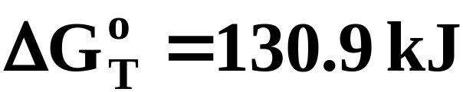
A Problem To Consider
Find the ΔGº for the following reaction at 25ºC and 1000ºC. Relate this to reaction spontaneity.
ΔH_{f}º:
-1206.9
-635.1
-393.5 kJ
Sº:
92.9
38.2
213.7 J/K
  Now you substitute ΔHº, ΔSº (=0.1590 kJ/K), and T (=298K) into the equation for ΔG_{f}º.
So the reaction is nonspontaneous at 25ºC.
Copyright © Houghton Mifflin Company.All rights reserved.
Presentation of Lecture Outlines, 19–<number>
Notes:
2

Slide 58
A Problem To Consider
Find the ΔGº for the following reaction at 25ºC and 1000ºC. Relate this to reaction spontaneity.
ΔH_{f}º:
-1206.9
-635.1
-393.5 kJ
Sº:
92.9
38.2
213.7 J/K
  Now we’ll use 1000ºC (1273 K) along with our previous values for ΔHº and ΔSº.
Copyright © Houghton Mifflin Company.All rights reserved.
Presentation of Lecture Outlines, 19–<number>
Notes:
2

Slide 59
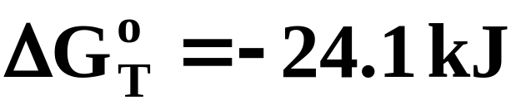
A Problem To Consider
Find the ΔGº for the following reaction at 25ºC and 1000ºC. Relate this to reaction spontaneity.
ΔH_{f}º:
-1206.9
-635.1
-393.5 kJ
Sº:
92.9
38.2
213.7 J/K
  Now we’ll use 1000ºC (1273 K) along with our previous values for ΔHº and ΔSº.
So the reaction is spontaneous at 1000ºC.
Copyright © Houghton Mifflin Company.All rights reserved.
Presentation of Lecture Outlines, 19–<number>
Notes:
2

Slide 60
Operational Skills
Calculating the entropy change for a phase transition
Predicting the sign of the entropy change of a reaction
Calculating ΔSº for a reaction
Calculating ΔGº from ΔHº and ΔSº
Calculating ΔGº from standard free energies of formation
Interpreting the sign of ΔGº
Writing the expression for a thermodynamic equilibrium constant
Calculating K from the standard free energy change
Calculating ΔGº and K at various temperatures
Copyright © Houghton Mifflin Company.All rights reserved.
Presentation of Lecture Outlines, 19–<number>
Notes:
2

