Slide 1
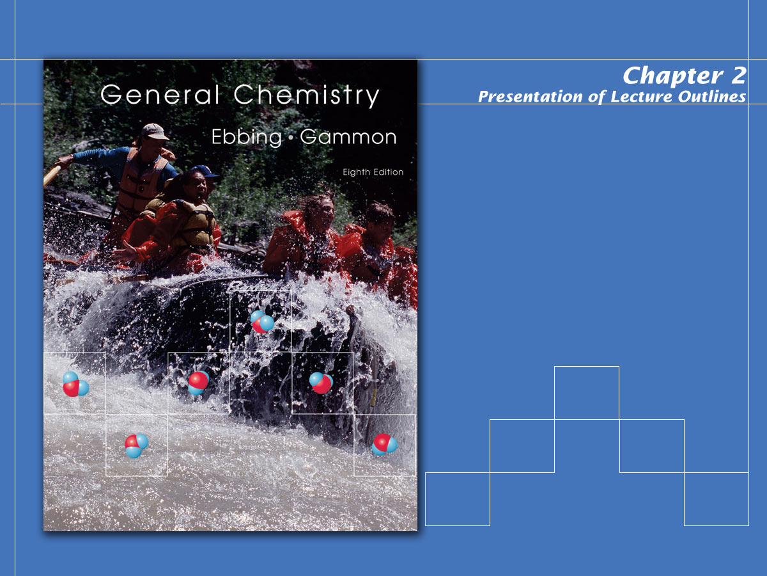
Atoms, Molecules, and Ions

Slide 2

Atomic Theory of Matter
Postulates of Dalton’s Atomic Theory
  All matter is composed of indivisible atoms. An atom is an extremely small particle of matter that retains its identity during chemical reactions. (See Figure 2.2)
  An element is a type of matter composed of only one kind of atom, each atom of a given element having the same properties. Mass is one such property. Thus the atoms of a given element have a characteristic mass.
Notes:
2

Slide 3
Atomic Theory of Matter
  A compound is a type of matter composed of atoms of two or more elements chemically combined in fixed proportions.
Postulates of Dalton’s Atomic Theory
  The relative numbers of any two kinds of atoms in a compound occur in simple ratios.
  Water, for example, consists of hydrogen and oxygen in a 2 to 1 ratio.
Notes:
2

Slide 4
Atomic Theory of Matter
Postulates of Dalton’s Atomic Theory
  A chemical reaction consists of the rearrangements of the atoms present in the reacting substances to give new chemical combinations present in the substances formed by the reaction.
  Atoms are not created, destroyed, or broken into smaller particles by any chemical reaction.
Notes:
2

Slide 5
Atomic Theory of Matter
The Structure of the Atom
  Although Dalton postulated that atoms were indivisible, experiments at the beginning of the present century showed that atoms themselves consist of particles.
  Experiments by Ernest Rutherford in 1910 showed that the atom was mostly “empty space.”
Notes:
2

Slide 6
Atomic Theory of Matter
The structure of the atom
  These experiments showed that the atom consists of two kinds of particles: a nucleus, the atom’s central core, which is positively charged and contains most of the atom’s mass, and one or more electrons.
  Electrons are very light, negatively charged particles that exist in the region around the atom’s positively charged nucleus.
Notes:
2

Slide 7
Atomic Theory of Matter
The structure of the atom
  In 1897, the British physicist J. J. Thompson (See Figure 2.4 and conducted a series of experiments that showed that atoms were not indivisible particles.
  From his experiments, Thompson calculated the ratio of the electron’s mass, m_{e}, to its electric charge, e.
Notes:
2

Slide 8
Atomic Theory of Matter
The structure of the atom
  In 1909, U.S. physicist, Robert Millikan had obtained the charge on the electron. (See Figure 2.6)
  These two discoveries combined provided us with the electron’s mass of 9.109 x 10⁻³¹ kg, which is more than 1800 times smaller than the mass of the lightest atom (hydrogen).
  These experiments showed that the electron was indeed a subatomic particle.
Notes:
2

Slide 9
Atomic Theory of Matter
The nuclear model of the atom.
  Ernest Rutherford, a British physicist, put forth the idea of the nuclear model of the atom in 1911, based on experiments done in his laboratory by Hans Geiger and Ernest Morrison. (See Figure 2.7)
  Rutherford’s famous gold leaf experiment gave credibility to the theory that the majority of the mass of the atom was concentrated in a very small nucleus.
Notes:
2

Slide 10
Atomic Theory of Matter
Nuclear structure; Isotopes
  The nucleus of an atom is composed of two different kinds of particles: protons and neutrons.
  An important property of the nucleus is its positive electric charge.
Notes:
2

Slide 11
Atomic Theory of Matter
Nuclear structure; Isotopes
  A proton is the nuclear particle having a positive charge equal to that of the electron’s (a “unit” charge) and a mass more than 1800 times that of the electron’s. (See Figure 2.9)
  The number of protons in the nucleus of an atom is referred to as its atomic number (Z).
Notes:
2

Slide 12
Atomic Theory of Matter
Nuclear structure; Isotopes
  An element is a substance whose atoms all have the same atomic number.
  The neutron is a nuclear particle having a mass almost identical to that of a proton, but no electric charge.
Notes:
2

Slide 13
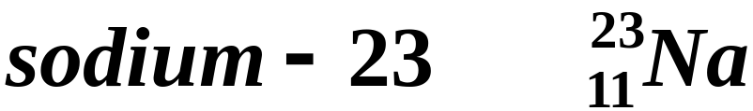
Atomic Theory of Matter
Nuclear structure; Isotopes
  The mass number is the total number of protons and neutrons in a nucleus.
  A nuclide is an atom characterized by a definite atomic number and mass number.
  The shorthand notation for a nuclide consists of its symbol with the atomic number as a subscript on the left and its mass number as a superscript on the left.
Notes:
2

Slide 14
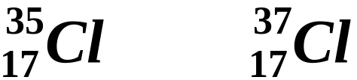
Atomic Theory of Matter
Nuclear structure; Isotopes
  Isotopes are atoms whose nuclei have the same atomic number but different mass numbers; that is, the nuclei have the same number of protons but different numbers of neutrons.
  Chlorine, for example, exists as two isotopes: chlorine-35 and chlorine-37.
  The fractional abundance is the fraction of a sample of atoms that is composed of a particular isotope. (See Figure 2.13)
Notes:
2

Slide 15
Atomic Weights
Calculate the atomic weight of boron, B, from the following data:
ISOTOPE ISOTOPIC MASS (amu) FRACTIONAL ABUNDANCE
B-10 10.013 0.1978
B-11 11.009 0.8022

Slide 16
Atomic Weights
Calculate the atomic weight of boron, B, from the following data:
ISOTOPE ISOTOPIC MASS (amu) FRACTIONAL ABUNDANCE
B-10 10.013 0.1978
B-11 11.009 0.8022
B-10: 10.013 x 0.1978 = 1.9805
B-11: 11.009 x 0.8022 = 8.8314
10.8119 = 10.812 amu
( = atomic wt.)

Slide 17
Atomic Weights
Dalton’s Relative Atomic Masses
  Since Dalton could not weigh individual atoms, he devised experiments to measure their masses relative to the hydrogen atom.
  Hydrogen was chosen as it was believed to be the lightest element. Daltons assigned hydrogen a mass of 1.
  For example, he found that carbon weighed 12 times more than hydrogen. He therefore assigned carbon a mass of 12.
Notes:
2

Slide 18
Atomic Weights
Dalton’s Relative Atomic Masses
  Dalton’s atomic weight scale was eventually replaced in 1961, by the present carbon–12 mass scale.
  One atomic mass unit (amu) is, therefore, a mass unit equal to exactly 1/12 the mass of a carbon–12 atom.
  On this modern scale, the atomic weight of an element is the average atomic mass for the naturally occurring element, expressed in atomic mass units.
Notes:
2

Slide 19
The Periodic Table
In 1869, Dmitri Mendeleev discovered that if the known elements were arranged in order of atomic number, they could be placed in horizontal rows such that the elements in the vertical columns had similar properties.
  A tabular arrangement of elements in rows and columns, highlighting the regular repetition of properties of the elements, is called a periodic table. (See Figure 2.15)
Notes:
2

Slide 20
The Periodic Table
Periods and Groups
  A period consists of the elements in one horizontal role of the periodic table.
  A group consists of the elements in any one column of the periodic table.
  The groups are usually numbered.
  The eight “A” groups are called main group (or representative) elements. (See Figure 2.15)
Notes:
2

Slide 21
The Periodic Table
Periods and Groups
  The “B” groups are called transition elements.
  The two rows of elements at the bottom of the table are called inner transition elements.
  Elements in any one group have similar properties.
Notes:
2

Slide 22
The Periodic Table
Periods and Groups
  The elements in group IA, often known as the alkali metals, are soft metals that react easily with water.
  The group VIIA elements, known as the halogens, are also reactive elements.
Notes:
2

Slide 23
The Periodic Table
Metals, Nonmetals, and Metalloids
  A metal is a substance or mixture that has a characteristic luster and is generally a good conductor of heat and electricity.
  A nonmetal is an element that does not exhibit the characteristics of the metal.
  A metalloid, or semi-metal, is an element having both metallic and nonmetallic properties.
Notes:
2

Slide 24
Chemical Formulas; Molecular and Ionic Substances
The chemical formula of a substance is a notation using atomic symbols with subscripts to convey the relative proportions of atoms of the different elements in a substance.
  Consider the formula of aluminum oxide, Al₂O₃. This formula implies that the compound is composed of aluminum atoms and oxygen atoms in the ratio 2:3.
Notes:
2

Slide 25
Chemical Formulas; Molecular and Ionic Substances
Molecular substances (See Figure 2.18)
  A molecule is a definite group of atoms that are chemically bonded together – that is, tightly connected by attractive forces.
  A molecular substance is a substance that is composed of molecules, all of which are alike.
  A molecular formula gives the exact number of atoms of elements in a molecule.
  Structural formulas show how the atoms are bonded to one another in a molecule.
Notes:
2

Slide 26
Chemical Formulas; Molecular and Ionic Substances
Ionic substances
  Although many substances are molecular, others are composed of ions.
  An ion is an electrically charged particle obtained from an atom or chemically bonded group of atoms by adding or removing electrons.
  Sodium chloride is a substance made up of ions. (See Figure 2.21)
Notes:
2

Slide 27
Chemical Formulas; Molecular and Ionic Substances
Ionic substances
  When an atom picks up extra electrons, it becomes a negatively charged ion, called an anion.
  An atom that loses electrons becomes a positively charged ion, called a cation.
  An ionic compound is a compound composed of cations and anions.
Notes:
2

Slide 28
Chemical Formulas; Molecular and Ionic Substances
Ionic substances
  The formula of an ionic compound is written by giving the smallest possible whole-number ratio of different ions in the substance.
  The formula unit of the substance is the group of atoms or ions explicitly symbolized by its formula.
Notes:
2

Slide 29
Chemical Substances; Formulas and Names
Naming simple compounds
  Chemical compounds are classified as organic or inorganic.
  Organic compounds are compounds that contain carbon combined with other elements, such as hydrogen, oxygen, and nitrogen.
  Inorganic compounds are compounds composed of elements other than carbon.
Notes:
2

Slide 30
Chemical Formulas; Molecular and Ionic Substances
Organic compounds
  An important class of molecular substances that contain carbon is the organic compounds.
  Organic compounds make up the majority of all known compounds.
  The simplest organic compounds are hydrocarbons, or compounds containing only hydrogen and carbon.
  Common examples include methane, CH₄, ethane, C₂H₆, and propane, C₃H₈.
Notes:
2

Slide 31
Chemical Substances; Formulas and Names
Rules for naming monatomic ions
  Monatomic cations are named after the element. For example, Al³⁺ is called the aluminum ion.
  If there is more than one cation of an element, a Roman numeral in parentheses denoting the charge on the ion is used. This often occurs with transition elements.
  The names of the monatomic anions use the stem name of the element followed by the suffix – ide. For example, Br⁻ is called the bromide ion.
Notes:
2

Slide 32
Naming Binary Compounds
NaF -
LiCl -
MgO -

Slide 33
Naming Binary Compounds
NaF - Sodium Fluoride
LiCl - Lithium Chloride
MgO - Magnesium Oxide

Slide 34
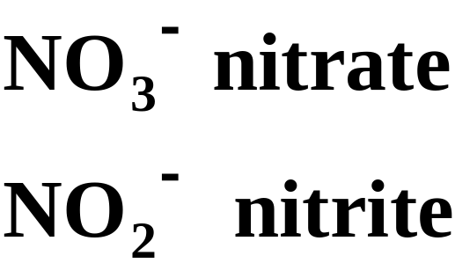
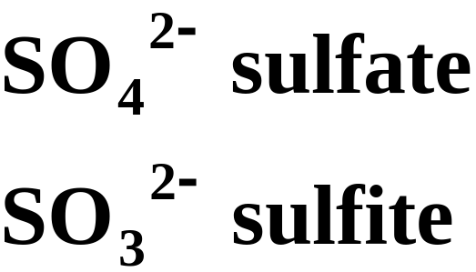
Chemical Substances; Formulas and Names
Polyatomic ions
  A polyatomic ion is an ion consisting of two or more atoms chemically bonded together and carrying a net electric charge.
  Table 2.6 lists some common polyatomic ions. Here a few examples.
Notes:
2

Slide 35
Ions You Should Know
NH₄⁺ - Ammonium
OH⁻ - Hydroxide
CN⁻ - Cyanide
SO₄²⁻ - Sulfate
ClO₄⁻ - Perchlorate
O₂²⁻ - Peroxide
PO₄³⁻ - Phosphate
CO₃²⁻ - Carbonate
HCO₃⁻ - Bicarbonate or Hydrogen Carbonate

Slide 36
More Practice
Na2SO4 Na2SO3
Sodium Sulfate Sodium Sulfite
AgCN Cd(OH)2
Silver Cyanide Cadmium Hydroxide
Ca(OCl)2 KClO4
Calcium Hypochlorite Potassium Perchlorate

Slide 37
Chemical Substances; Formulas and Names
Binary molecular compounds
  A binary compound is a compound composed of only two elements.
  Binary compounds composed of a metal and a non-metal are usually ionic and are named as ionic compounds.
  Binary compounds composed of two nonmetals are usually molecular and are named using a prefix system.
Notes:
2

Slide 38
Chemical Substances; Formulas and Names
Binary molecular compounds
  The name of the compound has the elements in the order given in the formula.
  You name the first element using the exact element name.
  Name the second element by writing the stem name of the element with the suffix “–ide.”
  If there is more than one atom of any given element, you add a prefix. Table 2.7 lists the Greek prefixes used.
Notes:
2

Slide 39
Chemical Substances; Formulas and Names
Binary molecular compounds
  Here are some examples of prefix names for binary molecular compounds.
  SF₄ sulfur tetrafluoride
  ClO₂ chlorine dioxide
  SF₆ sulfur hexafluoride
  Cl₂O₇ dichlorine heptoxide
Notes:
2

Slide 40
Chemical Substances; Formulas and Names
Acids
  Acids are traditionally defined as compounds with a potential H⁺ as the cation.
  Binary acids consist of a hydrogen ion and any single anion. For example, HCl is hydrochloric acid.
  An oxoacid is an acid containing hydrogen, oxygen, and another element. An example is HNO₃, nitric acid. (See Figure 2.26)
  Table 2.8 lists some oxoanions and their oxoacids.
Notes:
2

Slide 41
Chemical Substances; Formulas and Names
Hydrates
  A hydrate is a compound that contains water molecules weakly bound in its crystals.
  Hydrates are named from the anhydrous (dry) compound, followed by the word “hydrate” with a prefix to indicate the number of water molecules per formula unit of the compound.
  For example, CuSO₄. 5H₂O is known as copper(II)sulfate pentahydrate. (See Figure 2.27)
Notes:
2

Slide 42
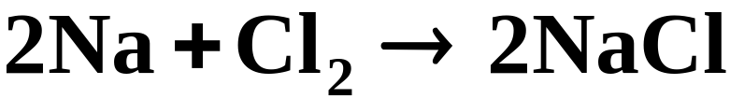
Chemical Reactions: Equations
Writing chemical equations
  A chemical equation is the symbolic representation of a chemical reaction in terms of chemical formulas.
  For example, the burning of sodium and chlorine to produce sodium chloride is written
  The reactants are starting substances in a chemical reaction. The arrow means “yields.” The formulas on the right side of the arrow represent the products.
Notes:
2

Slide 43
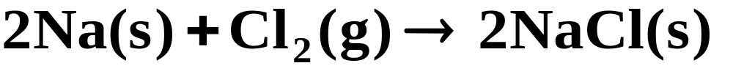
Chemical Reactions: Equations
Writing chemical equations
  In many cases, it is useful to indicate the states of the substances in the equation.
  When you use these labels, the previous equation becomes
Notes:
2

Slide 44
Chemical Reactions: Equations
Writing chemical equations
  The law of conservation of mass dictates that the total number of atoms of each element on both sides of a chemical equation must match. The equation is then said to be balanced.
  Consider the combustion of methane to produce carbon dioxide and water.
Notes:
2

Slide 45
Chemical Reactions: Equations
  For this equation to balance, two molecules of oxygen must be consumed for each molecule of methane, producing one molecule of CO₂ and two molecules of water.
Writing chemical equations
2
2
  Now the equation is “balanced.”
Notes:
2

Slide 46
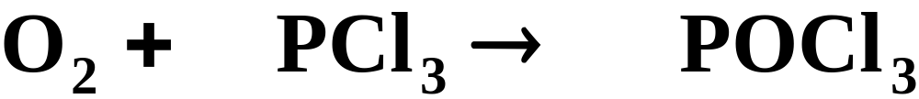
Chemical Reactions: Equations
Balance the following equations.
2
2
6
6
2
9
2
6
4
3
Notes:
2

Slide 47
Operational Skills
Writing nuclide symbols.
Determining atomic weight from isotopic masses and fractional abundances.
Writing an ionic formula, given the ions.
Writing the name of a compound from its formula, or vice versa.
Writing the name and formula of an anion from an acid.
Balancing simple equations.
Notes:
2

Slide 48
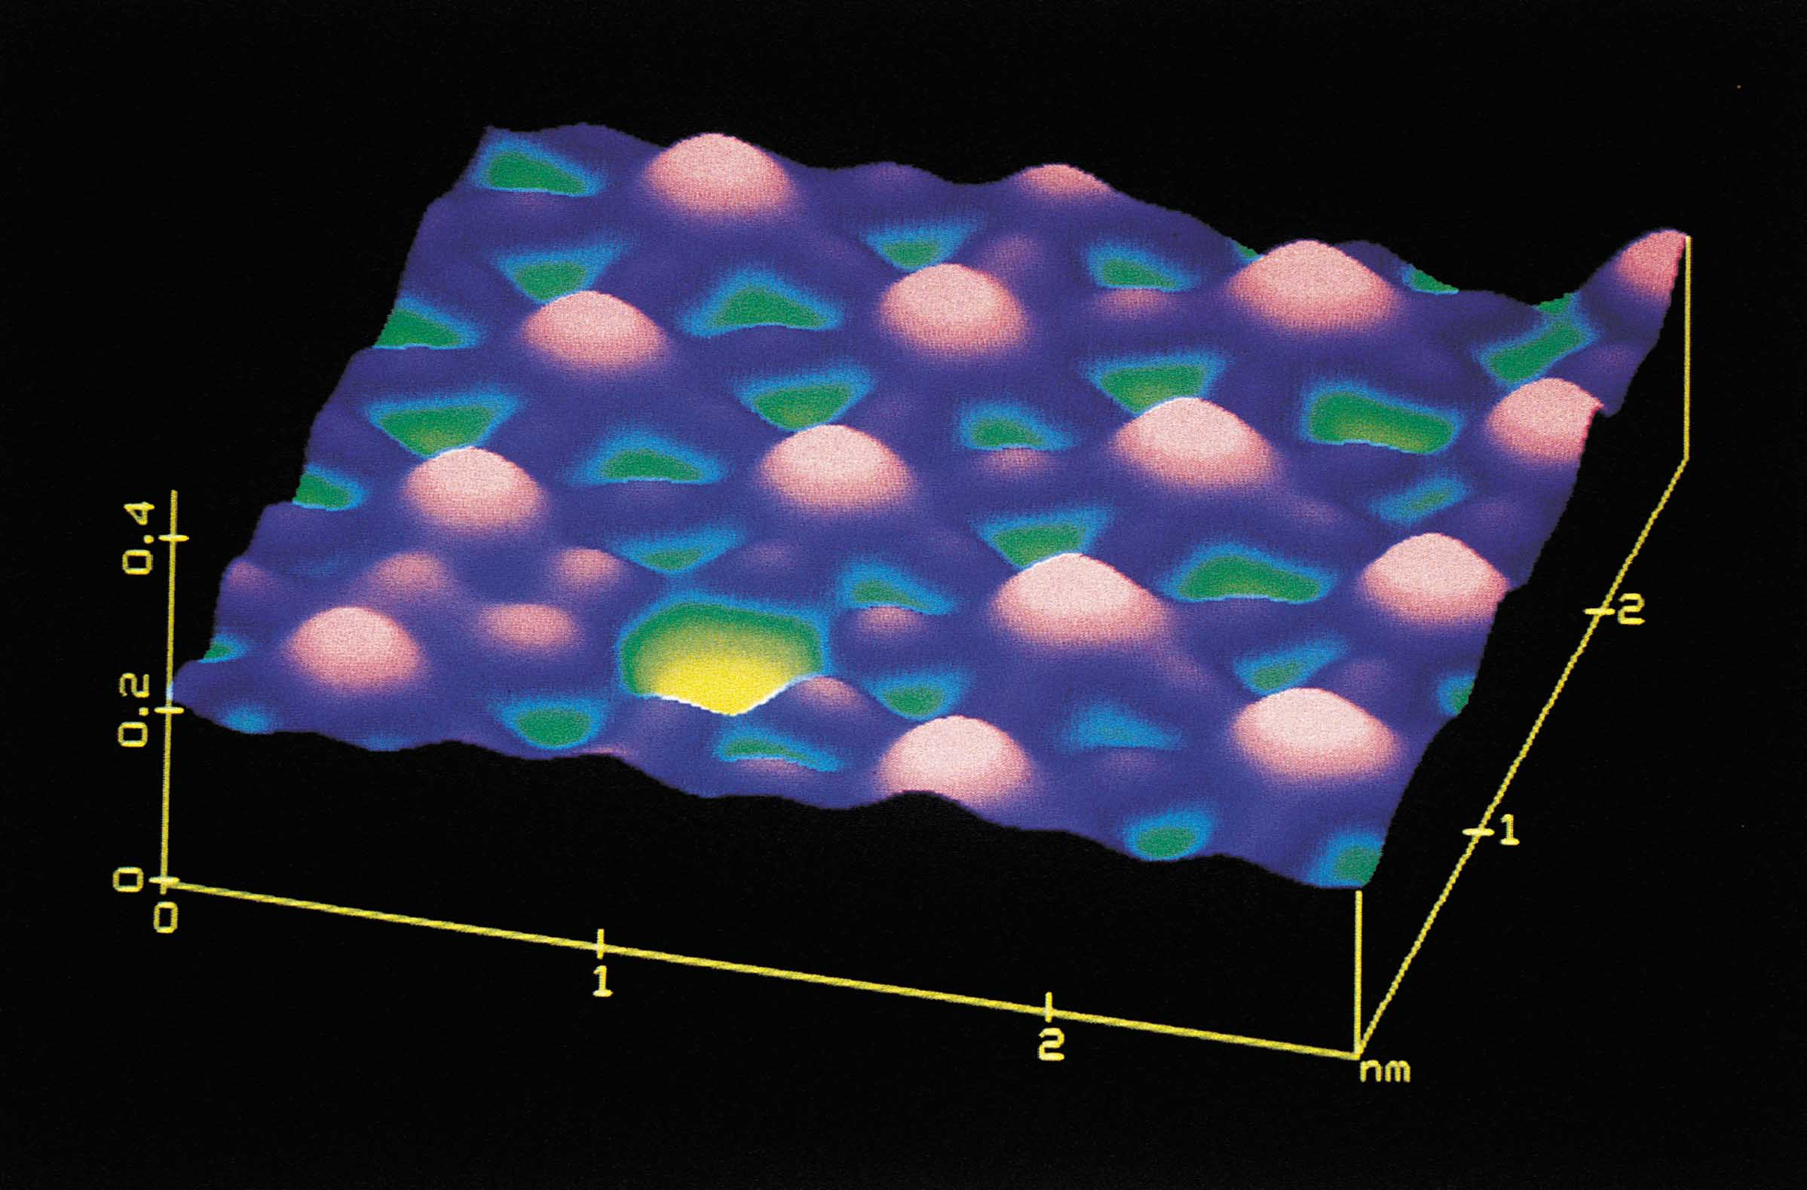
Figure 2.2: Iodine atoms on a metal surface. Courtesy of Digital Instruments.
Return to Slide 2

Slide 49
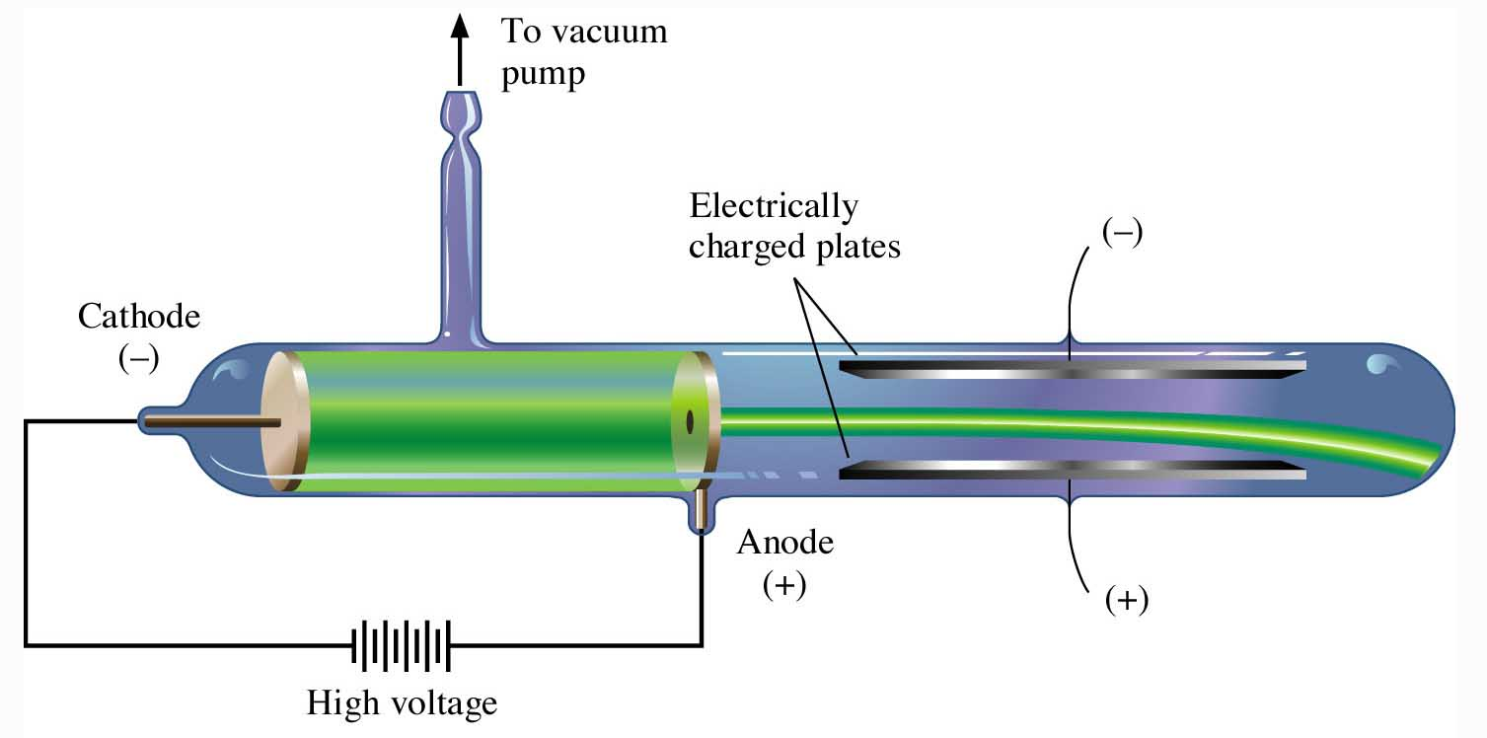
Figure 2.4: Formation of cathode rays.
Return to Slide 8

Slide 50
Video: Cathode Ray Tube
(Click here to open QuickTime video)
Return to Slide 8

Slide 51
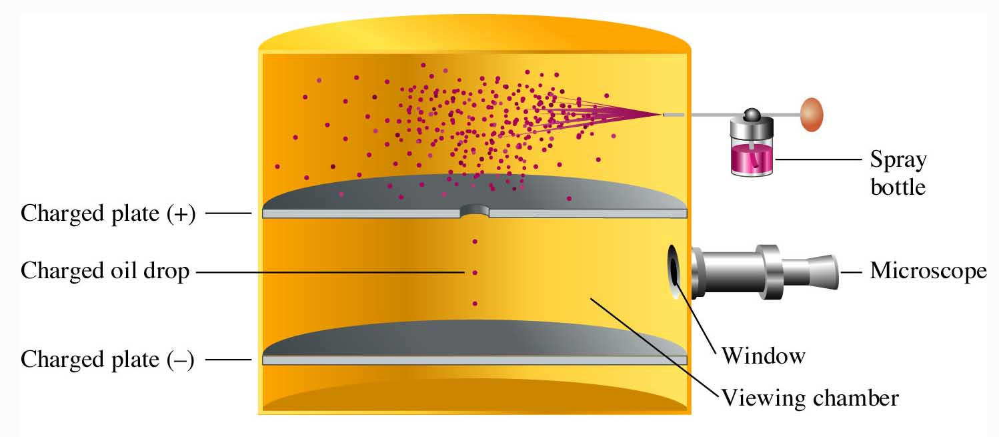
Figure 2.6: Millikan’s oil drop experiment.
Return to Slide 9

Slide 52
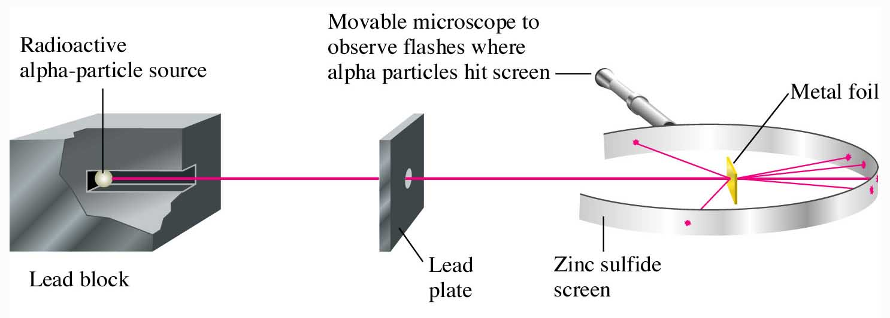
Figure 2.7: Alpha-particle scattering from metal foils.
Return to Slide 10

Slide 53
Animation: Scattering of Particles by Gold Foil
(Click here to open QuickTime animation)
Return to Slide 10

Slide 54

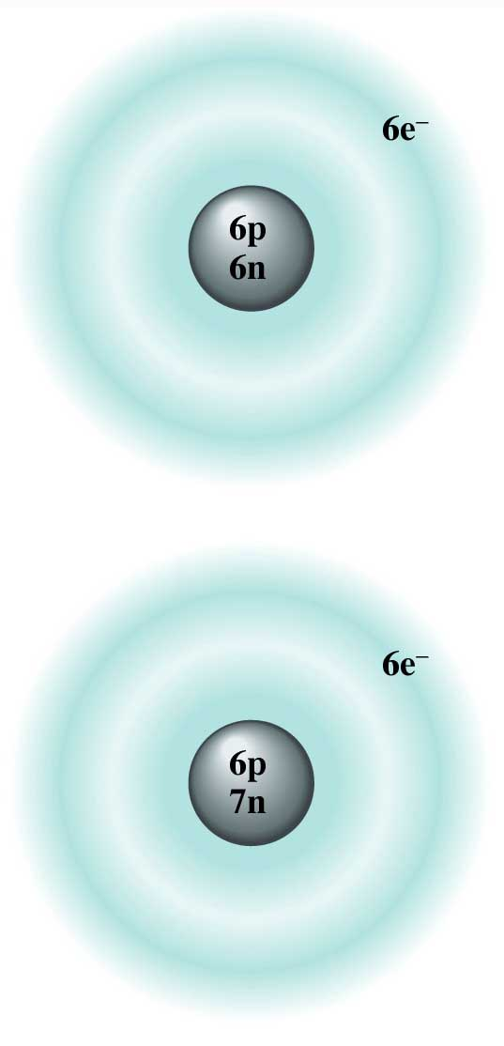
Figure 2.9:
A representation of two isotopes of carbon.
Return to Slide 12

Slide 55
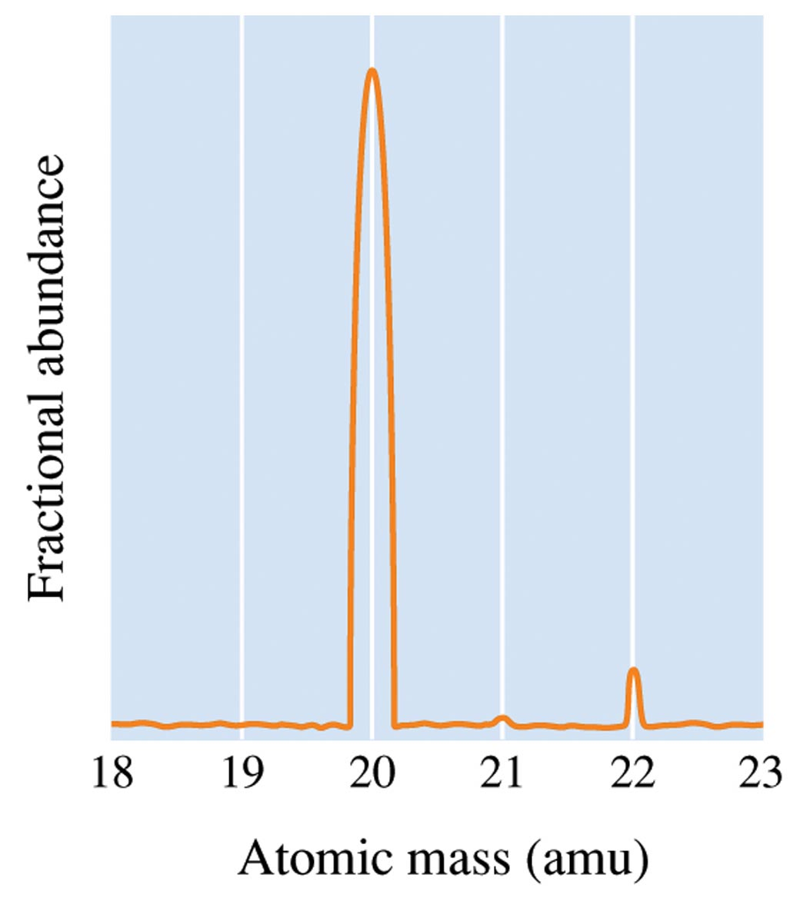
Figure 2.13: The Mass Spectrum of Neon
Return to Slide 15

Slide 56
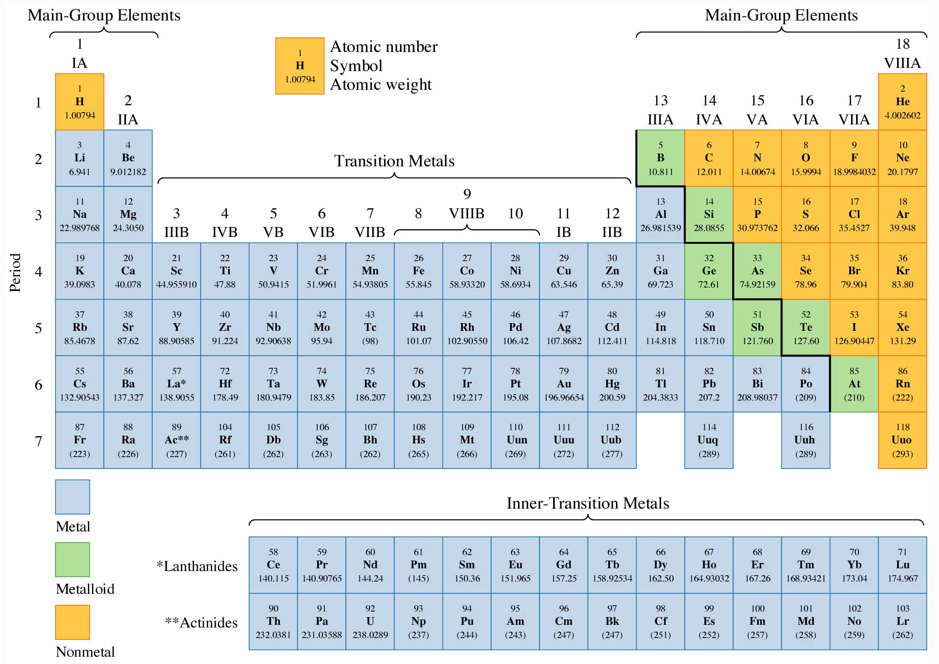
Figure 2.15: A modern form of the periodic table.
Return to Slide 20

Slide 57
Figure 2.15: A modern form of the periodic table.
Return to Slide 21

Slide 58
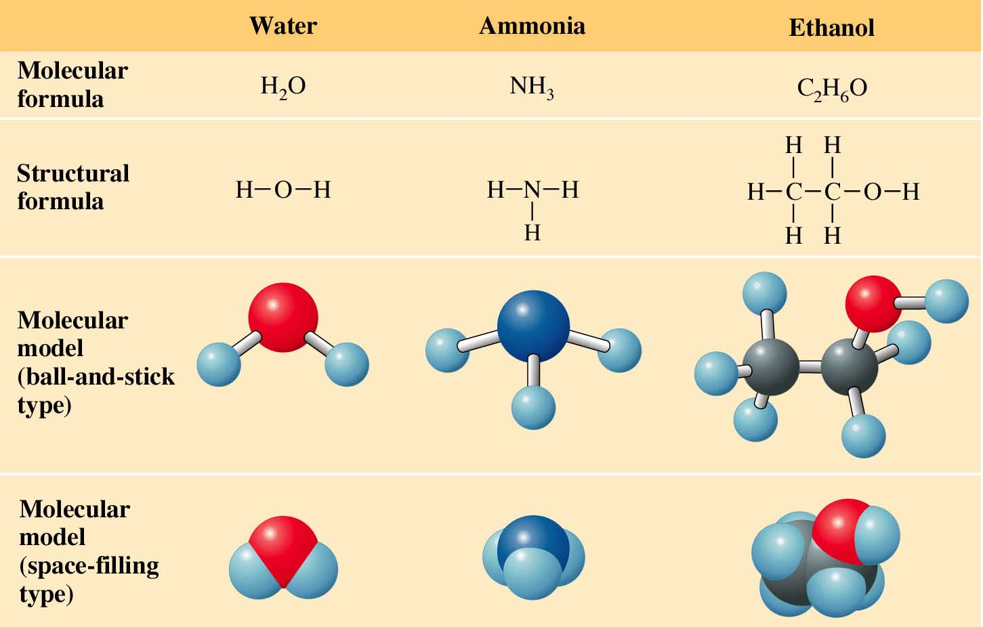
Figure 2.18: Molecular and structural formulas and molecular models.
Return to Slide 26

Slide 59
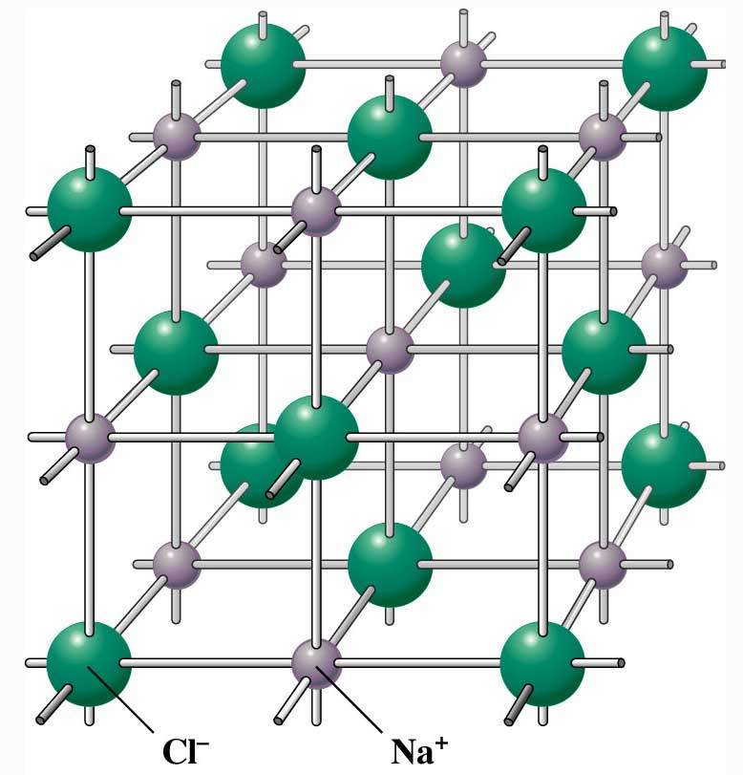
Figure 2.21: A model of a portion of crystal.
Return to Slide 27

Slide 60
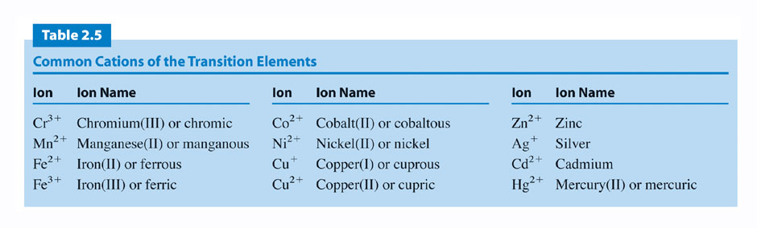
Return to Slide 33

Slide 61
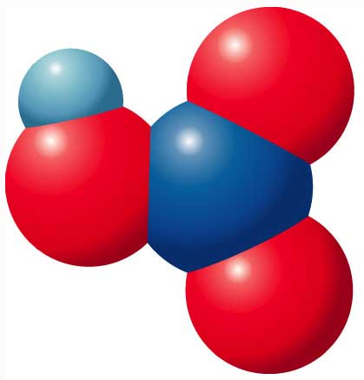
Figure 2.26: Molecular model of nitric acid.
Return to Slide 43

Slide 62
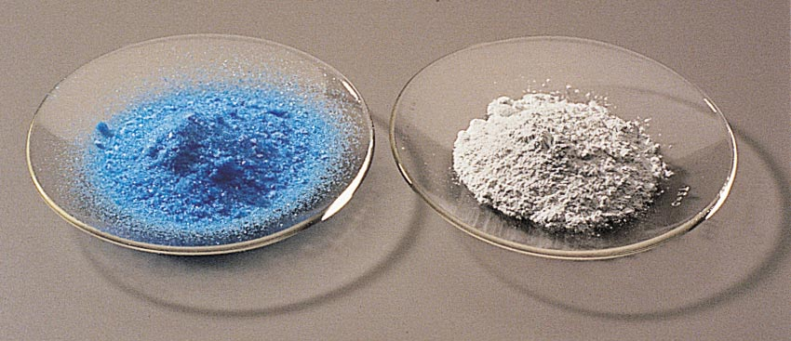
Figure 2.27: Copper (II) sulfate.
Photo courtesy of James Scherer.
Return to Slide 44

