Slide 1
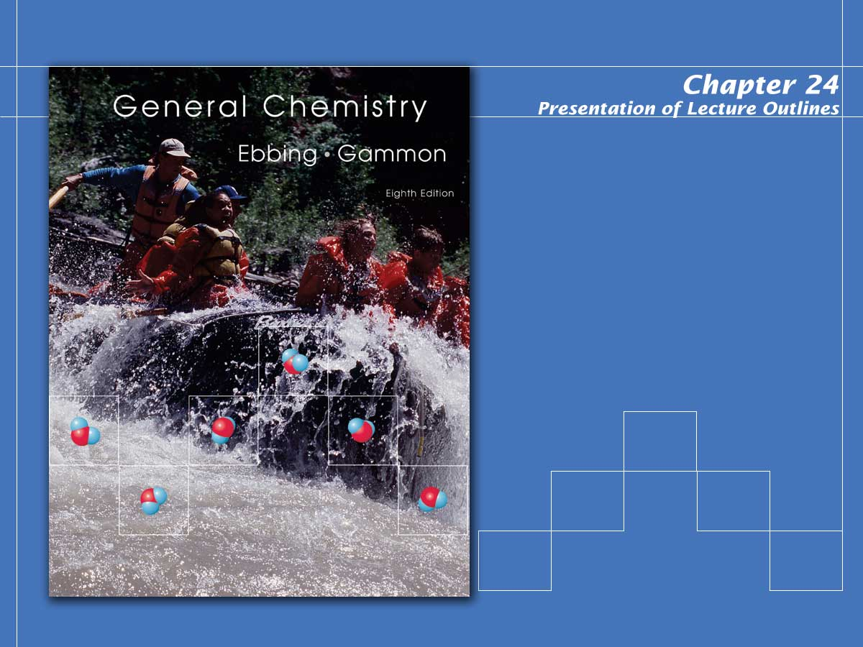
Organic Chemistry

Slide 2

Organic Chemistry
Organic chemistry is the chemistry of compounds containing carbon.
  In this chapter we will discuss the structural features of organic molecules, nomenclature, and a few important chemical reactions.
Notes:
2

Slide 3

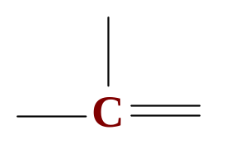


The Bonding of Carbon
Because carbon has four valence electrons, it can form four covalent bonds.
  Carbon forms single, double, and triple bonds to achieve a filled octet.
  A unique feature of carbon is its ability to bond with other carbons to form long chains or rings of various length. (see Figure 24.1)
Notes:
2

Slide 4
Hydrocarbons
The simplest organic compounds are hydrocarbons, compounds containing only carbon and hydrogen. (see Figure 24.2)
  The three main groups of hydrocarbons are:
    saturated hydrocarbons, hydrocarbons with only single bonds between the carbon atoms.
    unsaturated hydrocarbons, hydrocarbons that contain double or triple bonds between carbon atoms.
Notes:
2

Slide 5
Hydrocarbons
The simplest organic compounds are hydrocarbons, compounds containing only carbon and hydrogen. (see Figure 24.2)
  The three main groups of hydrocarbons are:
    aromatic hydrocarbons, hydrocarbons that contain a benzene ring (a six-membered ring of carbon atoms with alternating single and double carbon-carbon bonds described by resonance formulas).
Notes:
2

Slide 6
Hydrocarbons
The simplest organic compounds are hydrocarbons, compounds containing only carbon and hydrogen. (see Figure 24.2)
  The saturated and unsaturated hydrocarbons are often referred to as the aliphatic hydrocarbons.
Notes:
2

Slide 7
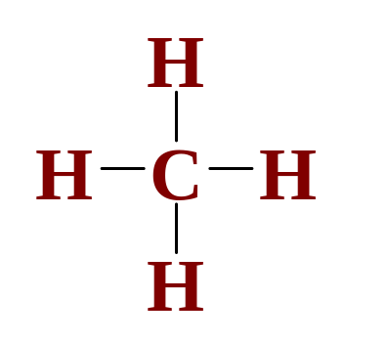
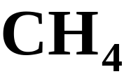
Alkanes
The alkanes are acyclic, saturated hydrocarbons that form a homologous series of compounds, with the general formula C_{n}H_{2n+2}.
  The simplest hydrocarbon is methane, CH₄. (see Figure 24.3)
molecular formula
structural formula
Notes:
2

Slide 8
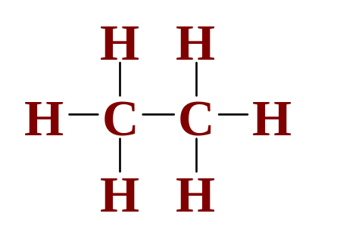
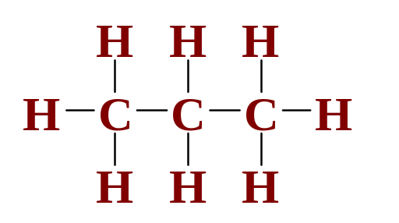
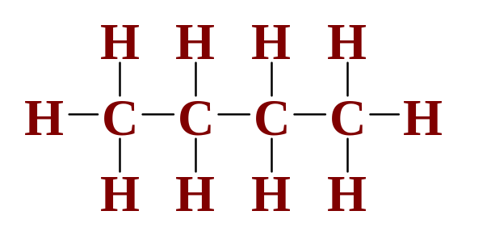
Alkanes
The structural formulas for the first four straight-chain (or normal) alkanes are shown below.
methane
ethane
propane
butane
Notes:
2

Slide 9




Alkanes
Chemists often use condensed structural formulas, where the bonds around each carbon atom are not explicitly written.
methane
ethane
propane
butane
Notes:
2

Slide 10
Alkanes
The alkanes constitute a homologous series of compounds in which one compound differs from a preceding one by a fixed group of atoms, in this case, a –CH2– group.
  Members of a homologous series have similar chemical properties, and their physical properties change throughout the series in a regular way.
Notes:
2

Slide 11
Alkanes
The alkanes constitute a homologous series of compounds in which one compound differs from a preceding one by a fixed group of atoms, in this case, a –CH₂– group.
  Table 24.1 lists the melting points and boiling points of the first ten alkanes.
  Note that the melting and boiling points increase with an increase in the number of carbon atoms.
Notes:
2

Slide 12
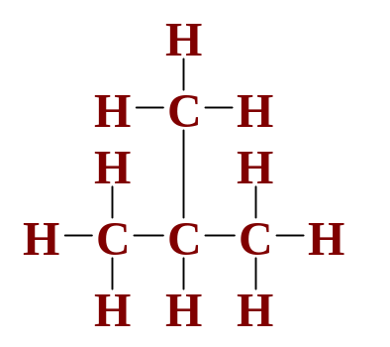
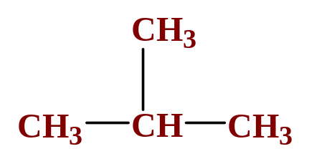
Constitutional Isomerism and Branched-Chain Alkanes
In addition to straight-chain alkanes, branched-chain alkanes are possible.
  For example, isobutane (or 2-methylpropane) has the structure
or
Notes:
2

Slide 13
Constitutional Isomerism and Branched-Chain Alkanes
In addition to straight-chain alkanes, branched-chain alkanes are possible.
  Note that isobutane, C₄H₁₀, has the same molecular formula as normal butane.
  Butane and isobutane are constitutional (or structural) isomers, compounds with the same molecular formula but different structural formulas. (see Figure 24.4)
Notes:
2

Slide 14
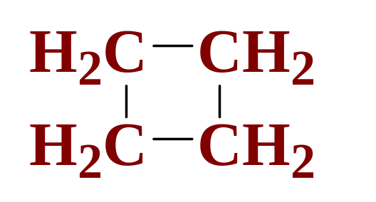
Cycloalkanes
The cycloalkanes are cyclic, saturated hydrocarbons that form another homologous series with the general formula C_{n}H_{2n} in which the carbon atoms are joined in a ring.
  Below is the structure for cyclobutane.
Notes:
2

Slide 15
Cycloalkanes
The cycloalkanes are cyclic, saturated hydrocarbons that form another homologous series with the general formula C_{n}H_{2n} in which the carbon atoms are joined in a ring.
  Figure 24.6 gives the names and structural formulas for the first four cycloalkanes.
Notes:
2

Slide 16
Sources and Uses of Alkanes and Cycloalkanes
Fossil fuels are the principal source of all types of organic compounds.
  Crude oil is a mixture of alkanes, cycloalkanes, and aromatic hydrocarbons. (see Table 24.2)
  Because fossil fuels are mixtures of hydrocarbons, it is usually necessary to separate these mixtures by distillation. (see Table 24.4)
  The alkanes serve as the starting point for most plastics and pharmaceuticals. (see Figure 24.7)
Notes:
2

Slide 17
Reactions of Alkanes With Oxygen
All hydrocarbons burn in an excess of O2 to produce carbon dioxide, water, and heat.
  For example, a propane gas grill uses the reaction
Notes:
2

Slide 18
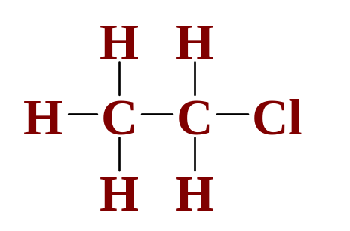
Substitution Reactions of Alkanes
A substitution reaction is a reaction in which a part of the reacting molecule is substituted for an H atom on a hydrocarbon.
  For example, the reaction of ethane with Cl₂.
+
Cl-Cl
+
H-Cl
Notes:
2

Slide 19
Alkenes and Alkynes
The alkenes and alkynes are unsaturated hydrocarbons (cyclic or acyclic) that contain carbon-carbon double or triple bonds.
  Under proper conditions, molecular hydrogen can be added to an alkene or an alkyne to produce a saturated compound in a process called catalytic hydrogenation.
Notes:
2

Slide 20
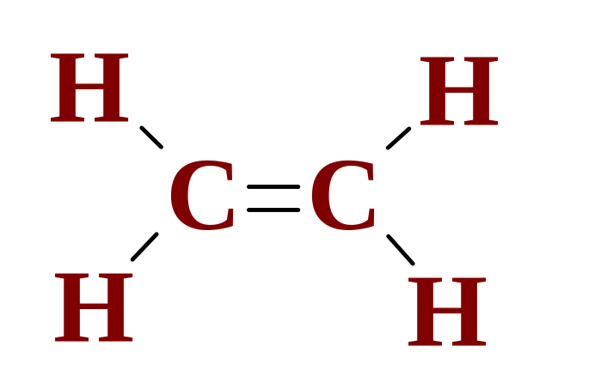
Alkenes and Geometric Isomers
Alkenes are hydrocarbons with the general formula C_{n}H_{2n} and contain a carbon-carbon double bond. (also called olefins)
  The simplest alkene is ethylene.
Notes:
2

Slide 21
Alkenes and Geometric Isomers
Alkenes are hydrocarbons with the general formula C_{n}H_{2n} and contain a carbon-carbon double bond. (also called olefins) (See Animation: Carbon-Carbon Double Bond)
  Geometric isomers are isomers in which some atoms occupy different relative positions in space.
Notes:
2

Slide 22
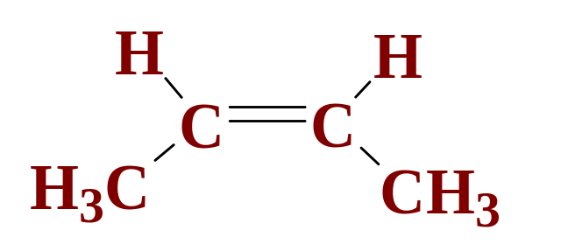
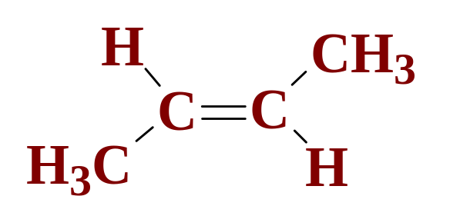
Alkenes and Geometric Isomers
Alkenes are hydrocarbons with the general formula C_{n}H_{2n} and contain a carbon-carbon double bond. (also called olefins)
  For example, 2-butene has two geometric isomers, called cis-2-butene and trans-2-butene.
cis-2-butene
trans-2-butene
Notes:
2

Slide 23
Oxidation Reactions of Alkenes
Because alkenes are hydrocarbons, they undergo complete combustion reactions with oxygen.
  Unsaturated hydrocarbons can also be partially oxidized under relatively mild conditions.
  For example, when aqueous potassium permanganate is added to an alkene (or alkyne), the purple color of KMnO₄ fades as a brown precipitate of MnO₂ forms. (see Figure 24.9)
Notes:
2

Slide 24
Addition Reactions of Alkenes
Alkenes are more reactive than alkanes because many reactants add to the double bond.
  An addition reaction is a reaction in which parts of a reactant are added to each carbon atom of a carbon-carbon double bond which converts to a carbon-carbon single bond.
Notes:
2

Slide 25
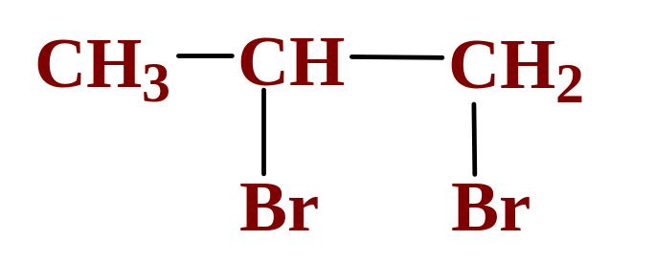
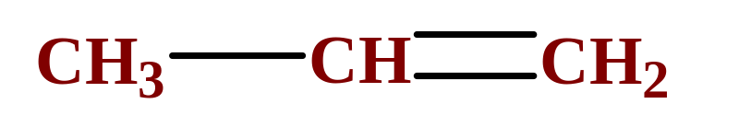
Addition Reactions of Alkenes
Alkenes are more reactive than alkanes because many reactants add to the double bond.
  A simple example is the addition of a halogen, such as Br₂, to propene.
+ Br₂
Notes:
2

Slide 26

Alkynes
Alkynes are unsaturated hydrocarbons containing a carbon-carbon triple bond.
  The general formula is C_{n}H_{2n-2}.
  The simplest alkyne is acetylene (ethyne). (see Figure 24.10)
Notes:
2

Slide 27
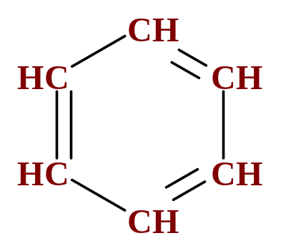
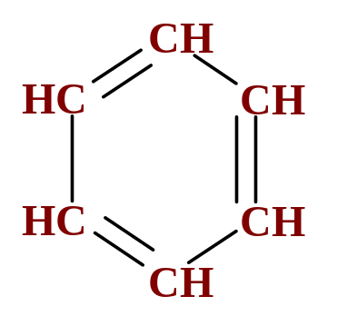
Aromatic Hydrocarbons
Aromatic hydrocarbons usually contain benzene rings-six membered rings of carbon atoms with alternating C-C single and C=C double bonds.
  The structure of benzene is
Notes:
2

Slide 28
Aromatic Hydrocarbons
Aromatic hydrocarbons usually contain benzene rings-six membered rings of carbon atoms with alternating C-C single and C=C double bonds.
  Figure 24.11 illustrates the delocalization of the π electrons in benzene.
  Aromatic compounds are found everywhere from pain relievers to flavoring agents. (see Figure 24.13)
Notes:
2

Slide 29
Naming Hydrocarbons
The following four IUPAC rules are applied in naming the branched-chain alkanes.
  Determine the longest continuous (not necessarily straight) chain of carbon atoms.
  The base name corresponds to the number of carbon atoms in the longest chain. (see Table 24.5)
  The full name for the alkane will include the names of any branches.
Notes:
2

Slide 30
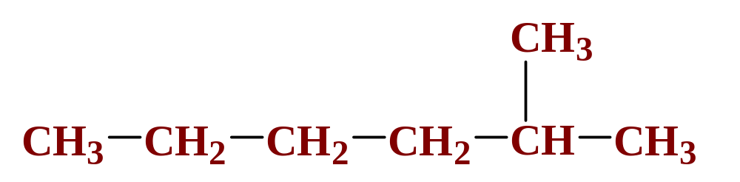
Naming Hydrocarbons
The following four IUPAC rules are applied in naming the branched-chain alkanes.
  Determine the longest continuous (not necessarily straight) chain of carbon atoms.
Notes:
2

Slide 31
Naming Hydrocarbons
The following four IUPAC rules are applied in naming the branched-chain alkanes.
  Any chain branching off the longest chain is named as an alkyl group.
  Table 24.6 lists some alkyl groups.
Notes:
2

Slide 32
Naming Hydrocarbons
The following four IUPAC rules are applied in naming the branched-chain alkanes.
  The complete name of a branch requires a number that locates the branch on the longest chain.
  Always number from the end of the longest chain closest to the first branch.
Notes:
2

Slide 33
Naming Hydrocarbons
The following four IUPAC rules are applied in naming the branched-chain alkanes.
  The complete name of a branch requires a number that locates the branch on the longest chain.
2-methylhexane
Notes:
2

Slide 34
Naming Hydrocarbons
The following four IUPAC rules are applied in naming the branched-chain alkanes.
  When there are more than one alkyl branch of the same kind, this number is indicated by a prefix, such as di-, tri-, tetra-, used with the name of the alkyl group.
  The position of each group on the longest chain is given by numbers.
Notes:
2

Slide 35
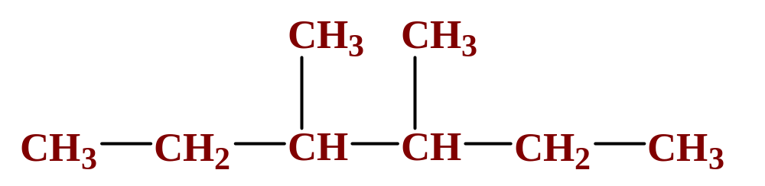
Naming Hydrocarbons
The following four IUPAC rules are applied in naming the branched-chain alkanes.
  When there are more than one alkyl branch of the same kind, this number is indicated by a prefix, such as di-, tri-, tetra-, used with the name of the alkyl group.
3,4-dimethylhexane
Notes:
2

Slide 36
Naming Hydrocarbons
The following four IUPAC rules are applied in naming the branched-chain alkanes.
  When there are two or more different branches, the name of each branch, with its position number, precedes the base name.
  The branch names are placed in alphabetical order.
Notes:
2

Slide 37
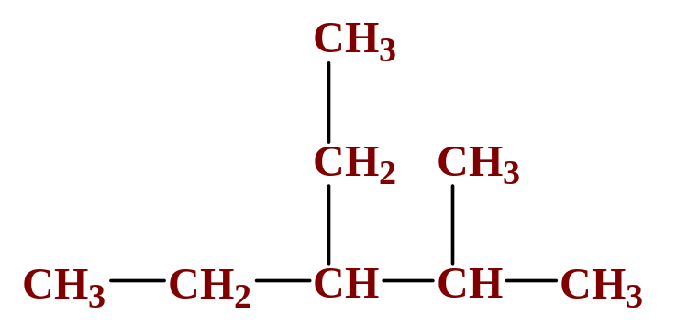
Naming Hydrocarbons
The following four IUPAC rules are applied in naming the branched-chain alkanes.
  When there are two or more different branches, the name of each branch, with its position number, precedes the base name.
3-ethyl-2-methylpentane
Notes:
2

Slide 38
Nomenclature of Alkenes and Alkynes
The following four IUPAC rules are applied in naming the branched-chain alkenes and alkynes.
  The rules are essentially the same as those for alkanes, except that names end in –ene for alkenes and –yne for alkynes.
  The position of the double (or triple) bond is indicated in the name by bond position number.
Notes:
2

Slide 39
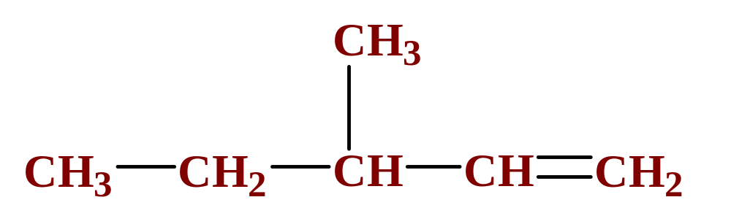
Nomenclature of Alkenes and Alkynes
The following four IUPAC rules are applied in naming the branched-chain alkenes and alkynes.
3-methyl-1-pentene
Notes:
2

Slide 40
Nomenclature of Alkenes and Alkynes
The following four IUPAC rules are applied in naming the branched-chain alkenes and alkynes.
  Recall that alkenes also exhibit cis and trans isomerism and so either cis or trans must be included in the name.
Notes:
2

Slide 41
Derivatives of Hydrocarbons
A functional group is a reactive portion of a molecule that undergoes predictable reactions.
  Table 24.7 lists some common organic functional groups.
  In the previous sections we discussed the hydrocarbons and their reactions.
  All other organic compounds can be considered to be derivatives of hydrocarbons.
Notes:
2

Slide 42
Organic Compounds Containing Oxygen
Many of the important functional groups in organic compounds contain oxygen.
  Examples are
      alcohols
      ethers
      aldehydes
      ketones
      carboxylic acids
      esters
Notes:
2

Slide 43
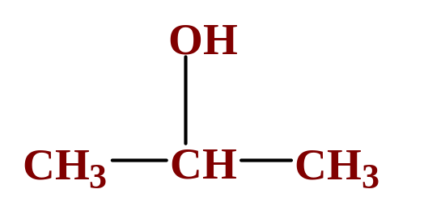
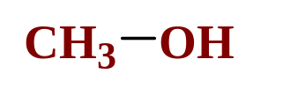
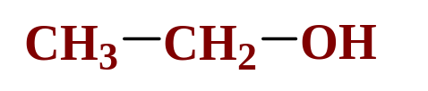
Organic Compounds Containing Oxygen
An alcohol is a compound obtained by substituting a hydroxyl group (-OH) for an –H atom on a carbon atom of a hydrocarbon group.
  Some examples are
methanol
ethanol
2-propanol
Notes:
2

Slide 44
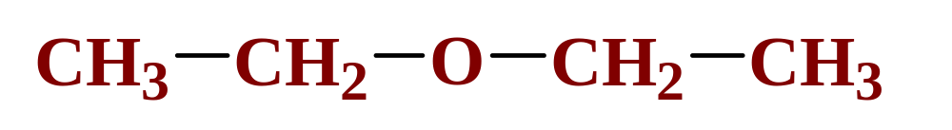
Organic Compounds Containing Oxygen
An ether is a compound with an oxygen “bridge” between two alkyl groups.
  An example is
diethyl ether
  This is the most common ether, often called simply ether, used as an anesthetic.
Notes:
2

Slide 45
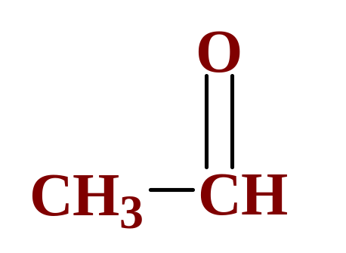
Organic Compounds Containing Oxygen
An aldehyde is a compound containing a carbonyl group with at least one H atom attached to it.
  An example is
ethanal
Notes:
2

Slide 46
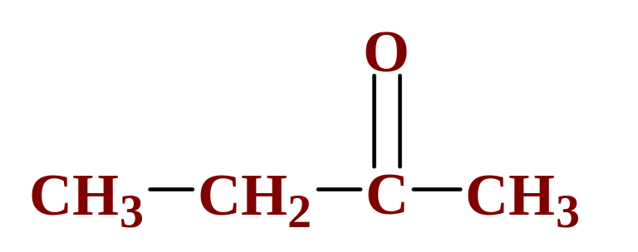
Organic Compounds Containing Oxygen
A ketone is a compound containing a carbonyl group with two hydrocarbon groups attached to it.
  An example is
2-butanone
Notes:
2

Slide 47
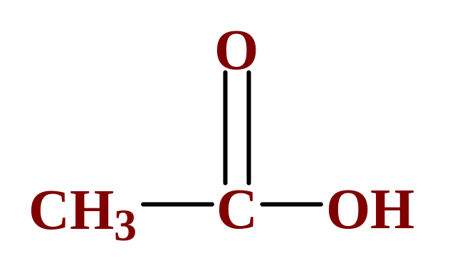
Organic Compounds Containing Oxygen
A carboxylic acid is a compound containing the carboxyl group, -COOH.
  An example is
ethanoic acid
Notes:
2

Slide 48
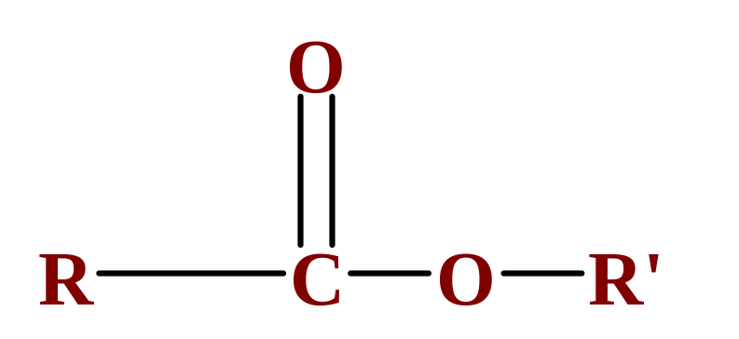
Organic Compounds Containing Oxygen
An ester is a compound formed from a carboxylic acid, RCOOH, and an alcohol, R’OH.
  The general structure is
Notes:
2

Slide 49
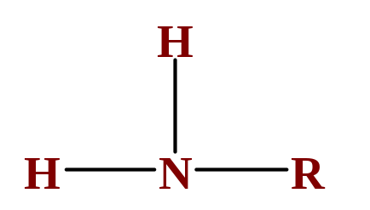
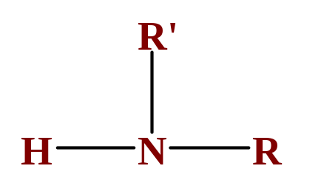
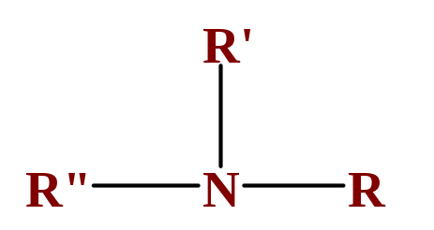
Organic Compounds Containing Nitrogen
Most organic bases are amines, which are compounds that are structurally derived by replacing one or more hydrogen atoms of ammonia with hydrocarbon groups.
primary amine
secondary amine
tertiary amine
Notes:
2

Slide 50
Organic Compounds Containing Nitrogen
Most organic bases are amines, which are compounds that are structurally derived by replacing one or more hydrogen atoms of ammonia with hydrocarbon groups.
  Table 24.9 lists some common amines.
Notes:
2

Slide 51
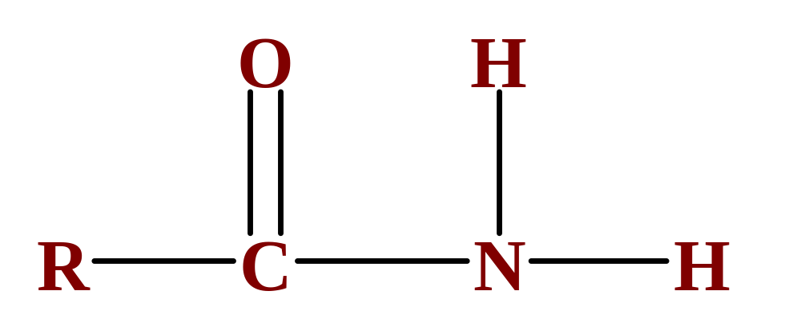
Organic Compounds Containing Nitrogen
Amides are compounds derived from the reaction of ammonia, or of a primary or secondary amine, with a carboxylic acid.
  The general formula for a common amide is
Notes:
2

Slide 52
Operational Skills
Writing a condensed structural formula
Predicting cis-trans isomers
Predicting the major product of an addition reaction
Writing the IUPAC name of a hydrocarbon given the structural formula, and vice versa
Notes:
2

Slide 53

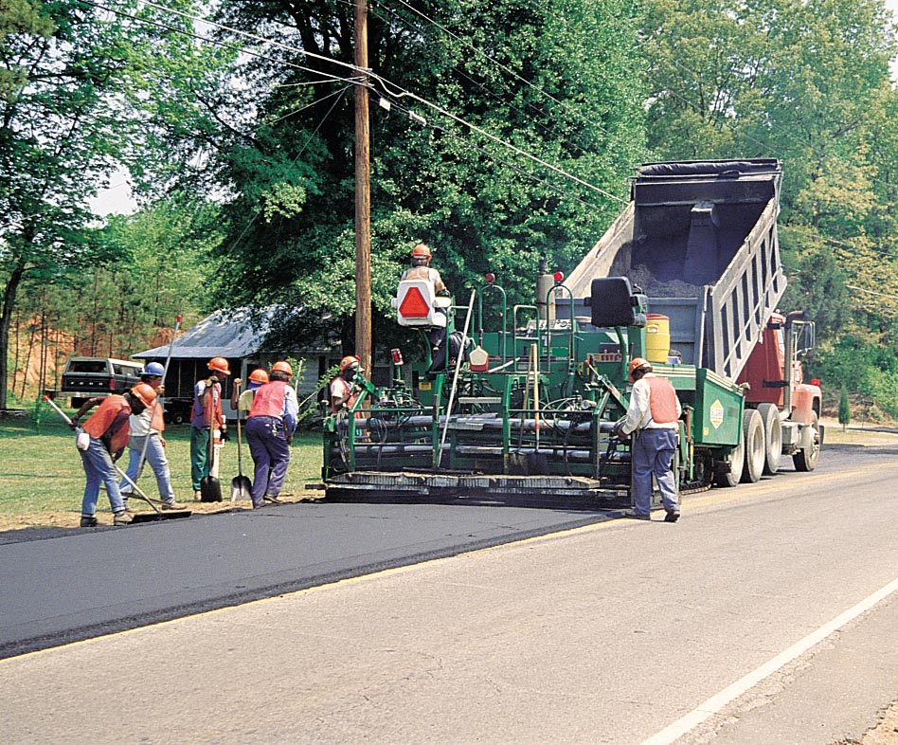
Figure 24.1: Products containing polyethylene.
Photo courtesy of American Color.
Return to slide 3

Slide 54
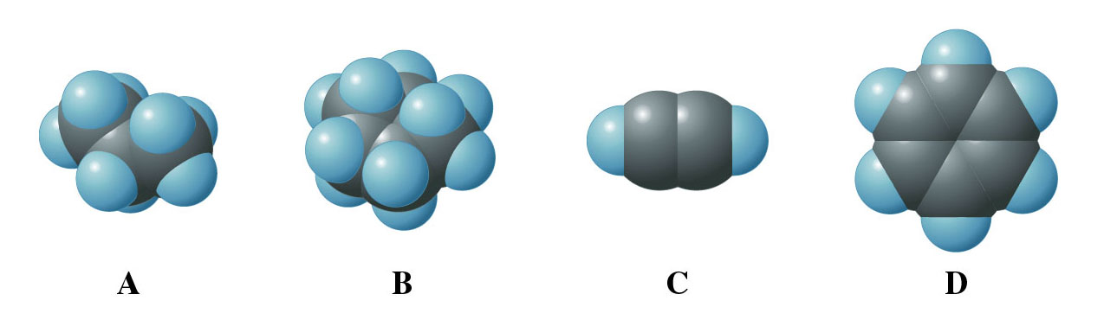
Figure 24.2: Molecular models for the different hydrocarbons.
Return to slide 4

Slide 55
Figure 24.2: Molecular models for the different hydrocarbons.
Return to slide 5

Slide 56
Figure 24.2: Molecular models for the different hydrocarbons.
Return to slide 6

Slide 57
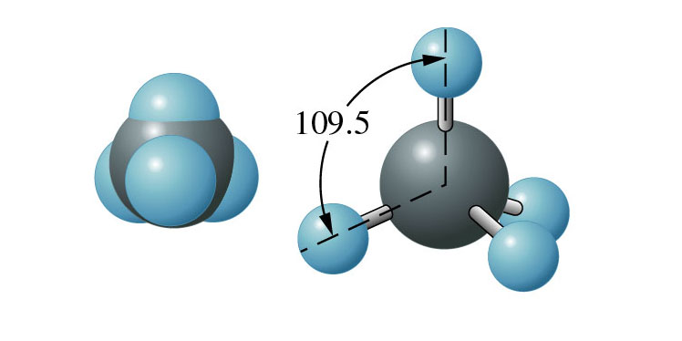
Figure 24.3: Three-dimensional models of methane.
Return to slide 7

Slide 58
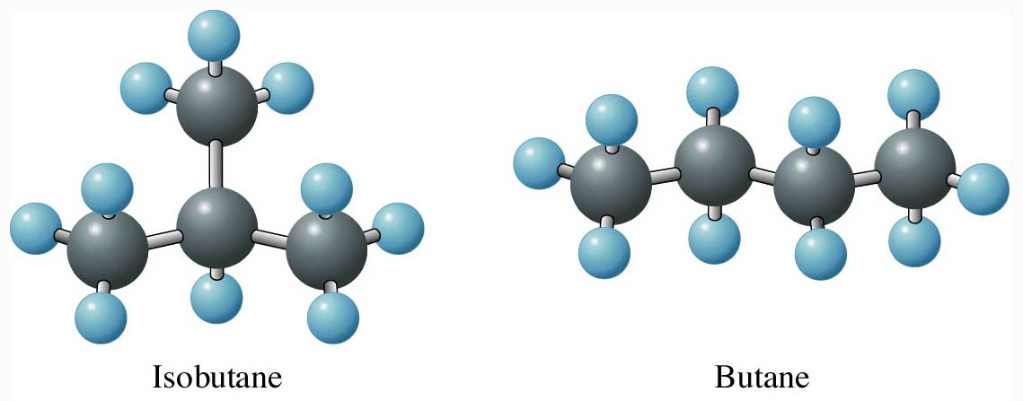
Figure 24.4: Models of isobutane and butane.
Return to slide 13

Slide 59
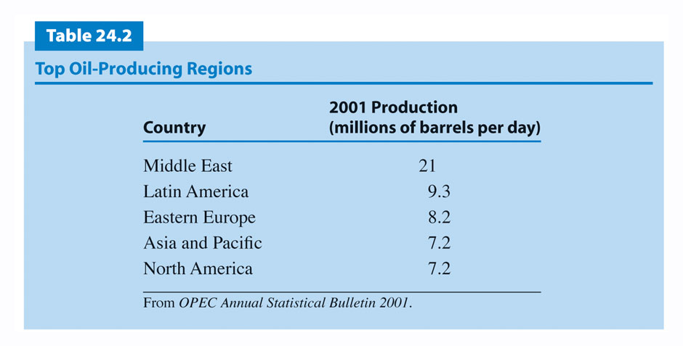
Return to slide 16

Slide 60
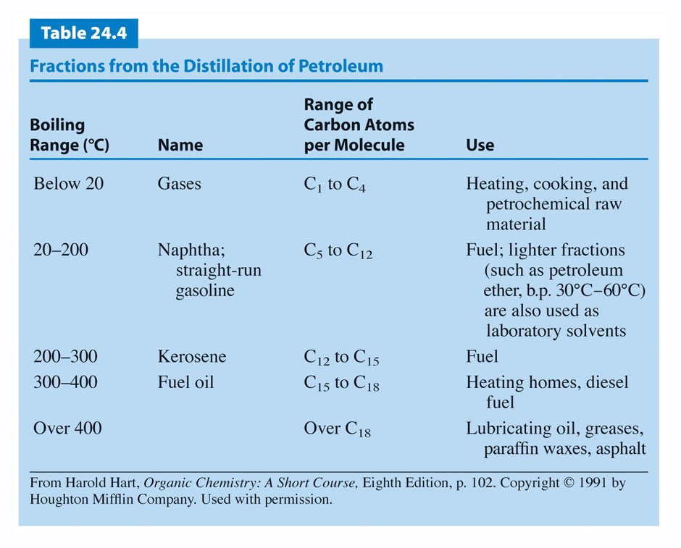
Return to slide 16

Slide 61
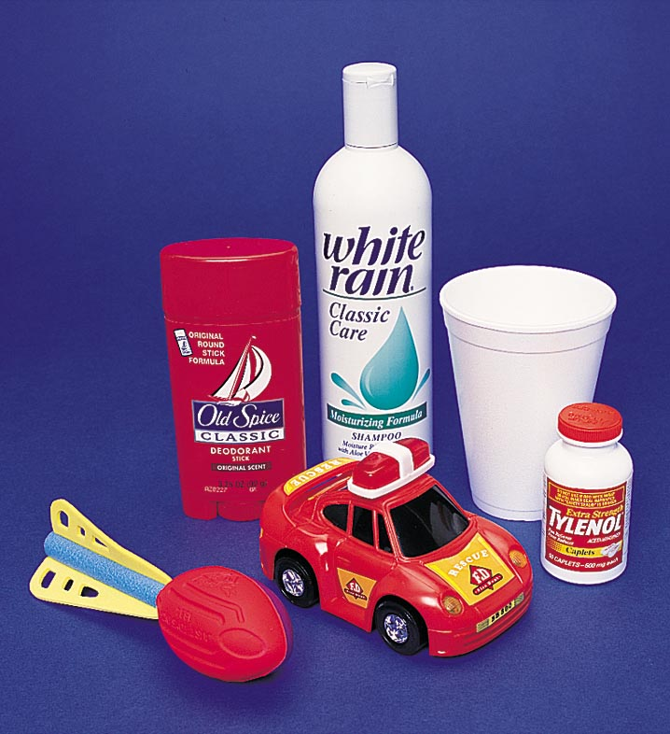
Figure 24.7: Consumer products derived from petroleum.
Photo courtesy of American Color.
Return to slide 16

Slide 62
Animation: Carbon-Carbon Double Bond
(Click here to open QuickTime animation)
Return to slide 21

Slide 63
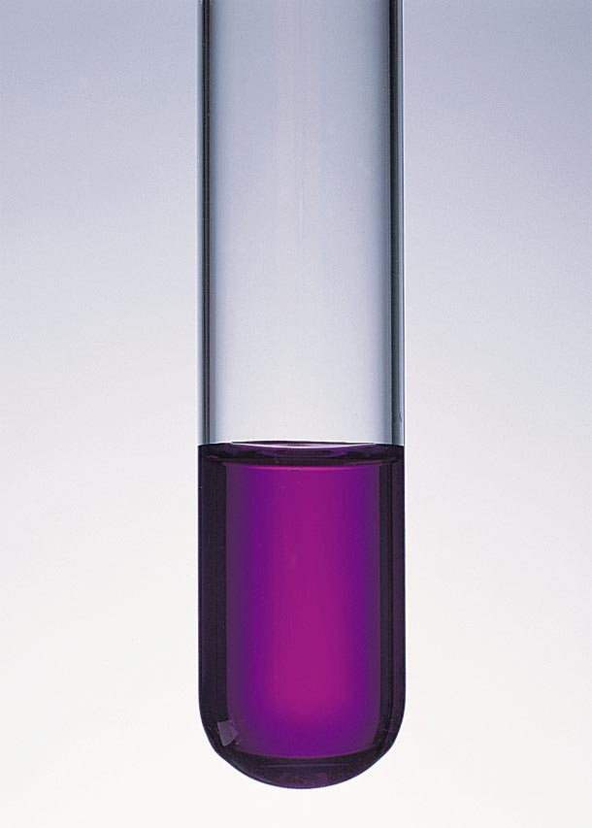
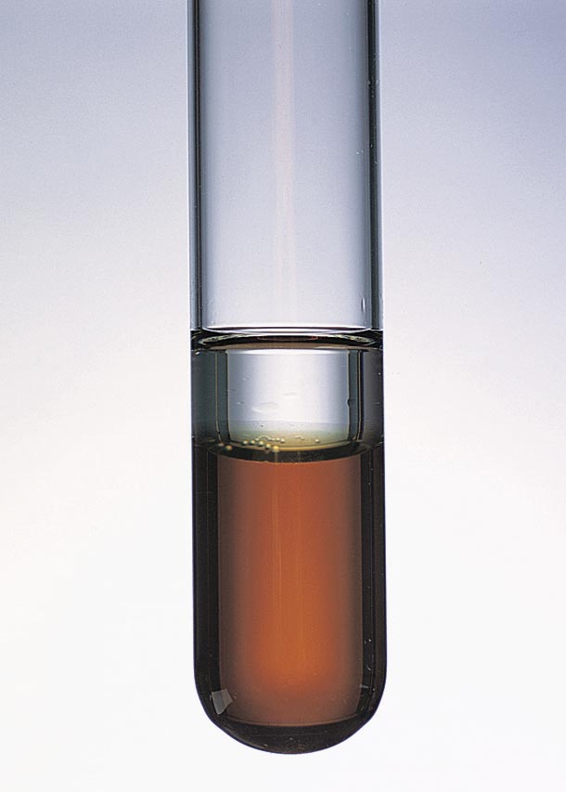
Figure 24.9: Test for unsaturation using KMnO₄(aq) solution. Photo courtesy of American Color.
Return to slide 23

Slide 64
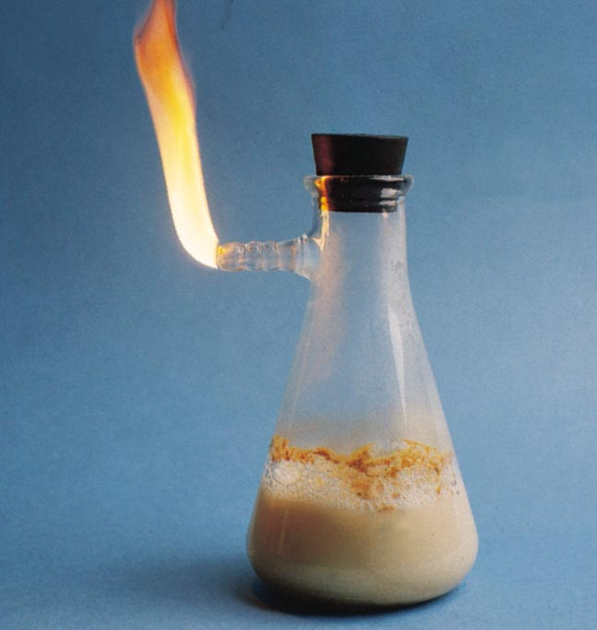
Figure 24.10: Preparation of acetylene gas. Photo courtesy of James Scherer.
Return to slide 26

Slide 65
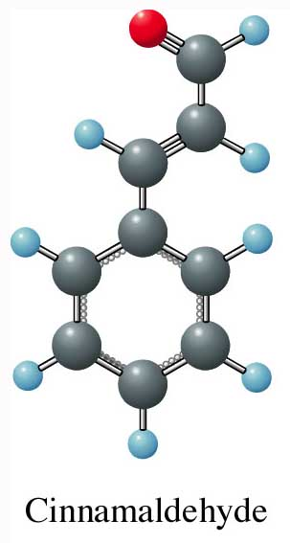
Figure 24.13:
A ball-and-stick model of cinnamaldehyde.
Return to slide 28

Slide 66
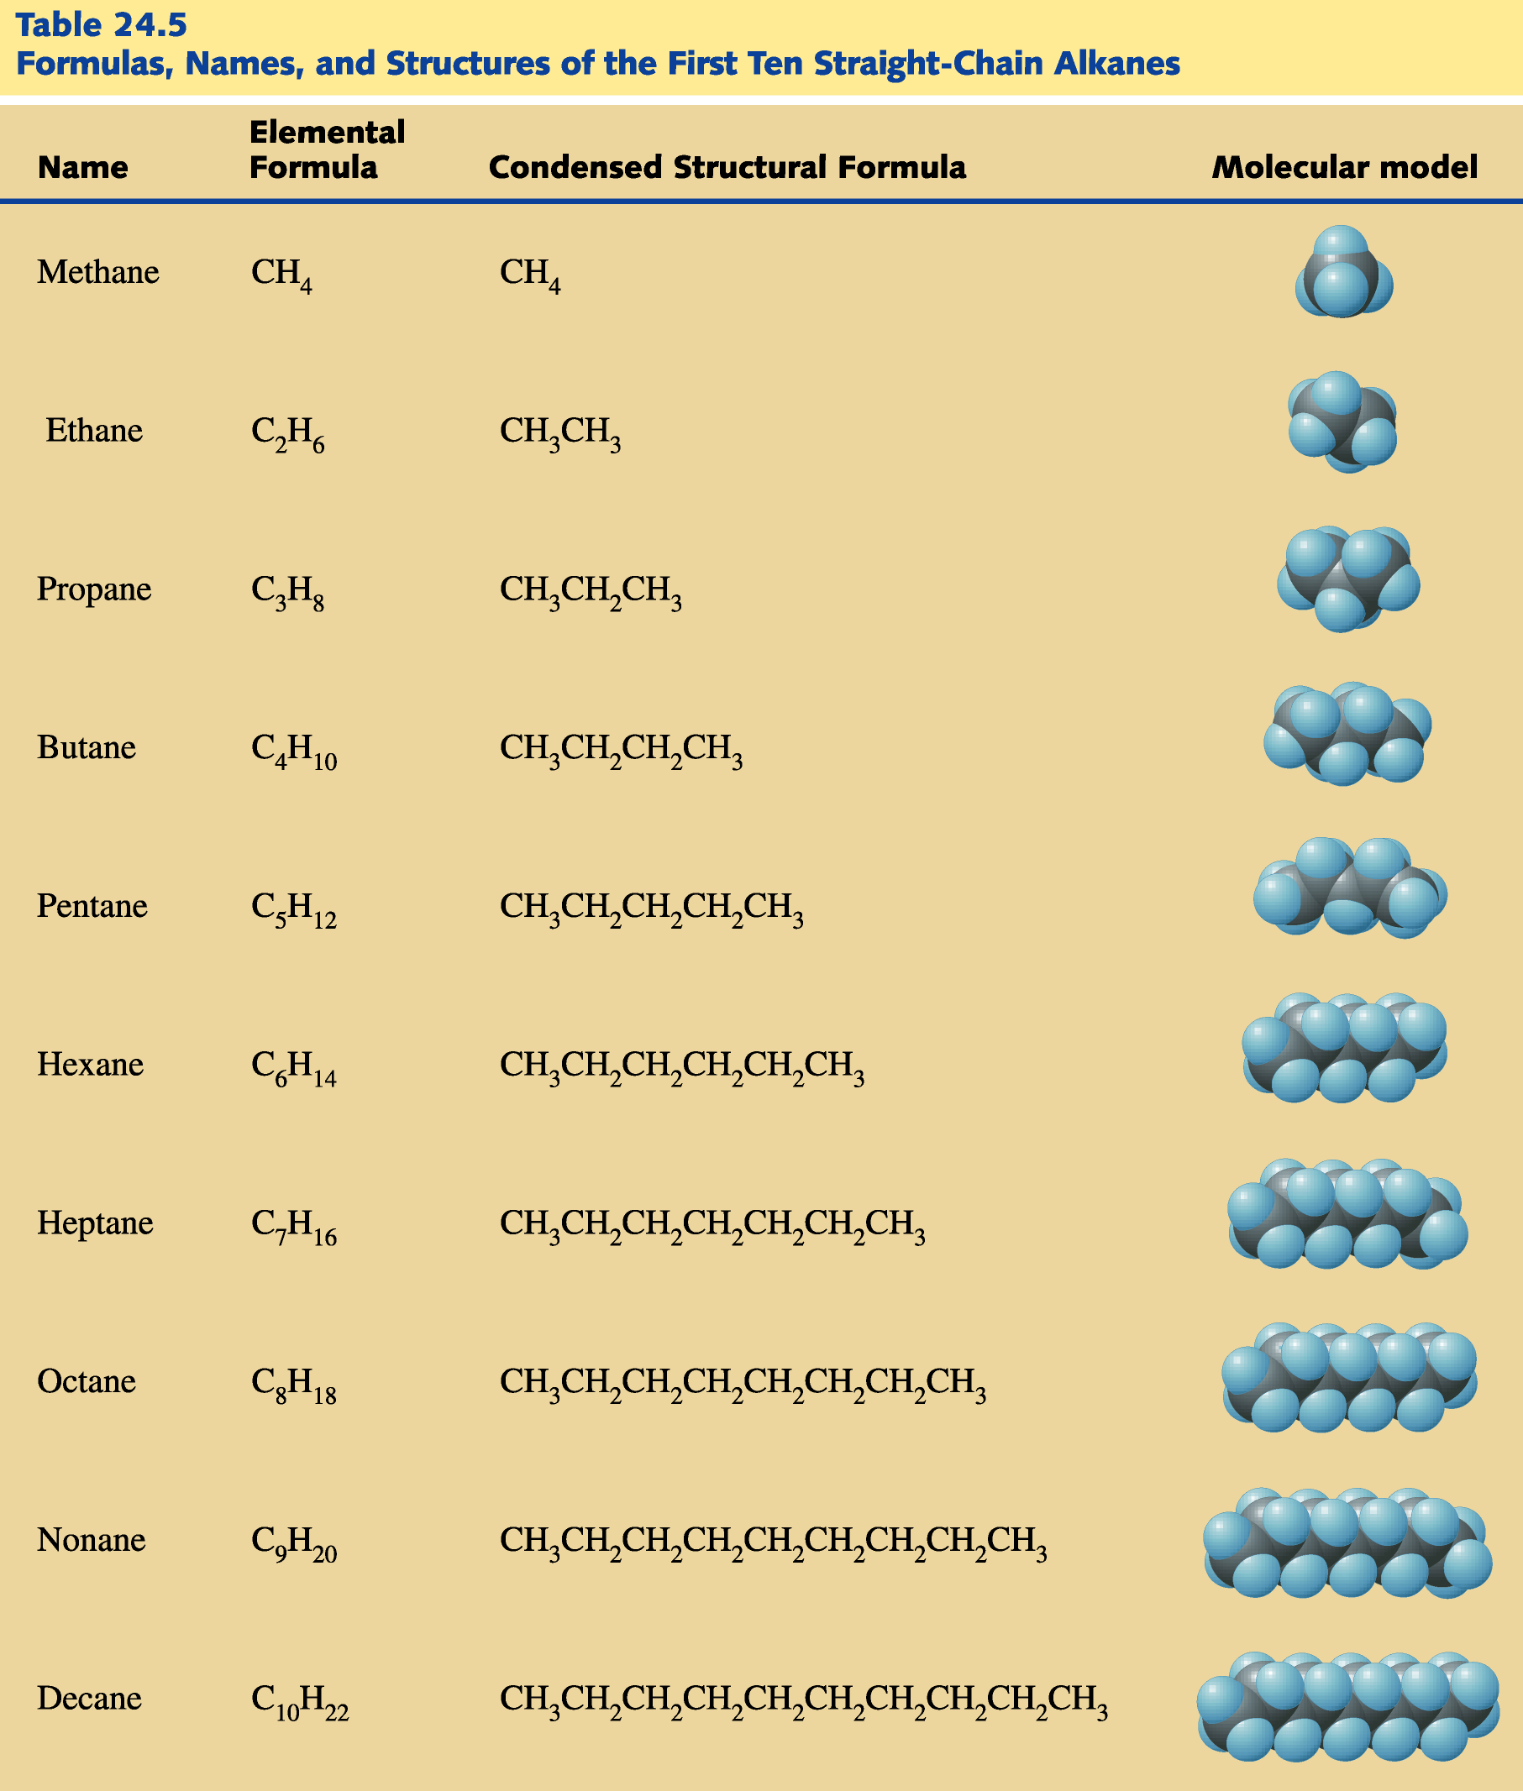
Return to slide 29

