Slide 1
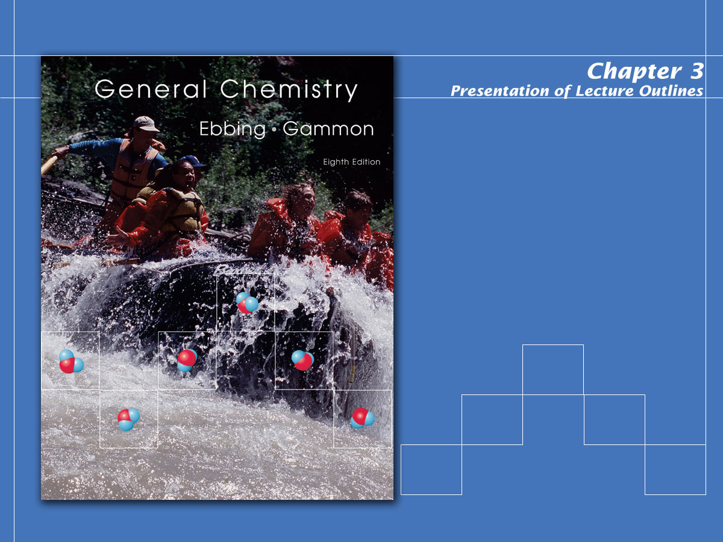
Calculations with Chemical Formulas and Equations

Slide 2

Mass and Moles of a Substance
Chemistry requires a method for determining the numbers of molecules in a given mass of a substance.
  This allows the chemist to carry out “recipes” for compounds based on the relative numbers of atoms involved.
  The calculation involving the quantities of reactants and products in a chemical equation is called stoichiometry.
Notes:
2

Slide 3
Molecular Weight and Formula Weight
The molecular weight of a substance is the sum of the atomic weights of all the atoms in a molecule of the substance.
  For, example, a molecule of H₂O contains 2 hydrogen atoms (at 1.0 amu each) and 1 oxygen atom (16.0 amu), giving a molecular weight of 18.0 amu.
Notes:
2

Slide 4
Molecular Weight and Formula Weight
The formula weight of a substance is the sum of the atomic weights of all the atoms in one formula unit of the compound, whether molecular or not.
  For example, one formula unit of NaCl contains 1 sodium atom (23.0 amu) and one chlorine atom (35.5 amu), giving a formula weight of 58.5 amu.
Notes:
2

Slide 5
Mass and Moles of a Substance
The Mole Concept
  A mole is defined as the quantity of a given substance that contains as many molecules or formula units as the number of atoms in exactly 12 grams of carbon–12. (See Figure 3.2)
  The number of atoms in a 12-gram sample of carbon–12 is called Avogadro’s number (to which we give the symbol N_{a}). The value of Avogadro’s number is 6.02 x 10²³.
Notes:
2

Slide 6
Mass and Moles of a Substance
The molar mass of a substance is the mass of one mole of a substance.
  For all substances, molar mass, in grams per mole, is numerically equal to the formula weight in atomic mass units.
  That is, one mole of any element weighs its atomic mass in grams.
Notes:
2

Slide 7
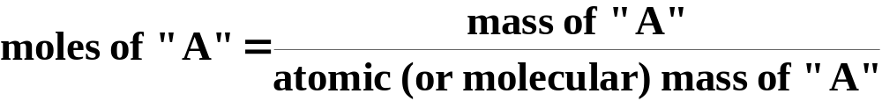
Mass and Moles of a Substance
Mole calculations
  Converting the number of moles of a given substance into its mass, and vice versa, is fundamental to understanding the quantitative nature of chemical equations.
Notes:
2

Slide 8
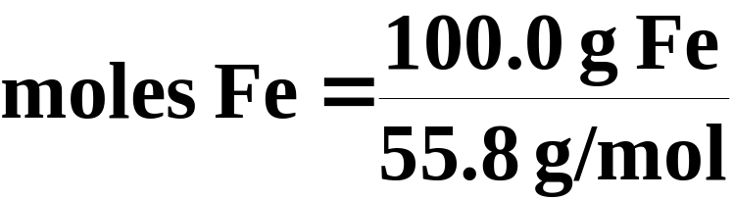

Mass and Moles of a Substance
Mole calculations
  Suppose we have 100.0 grams of iron (Fe). The atomic weight of iron is 55.8 g/mol. How many moles of iron does this represent?
Notes:
2

Slide 9

Mass and Moles of a Substance
Mole calculations
  Conversely, suppose we have 5.75 moles of magnesium (atomic wt. = 24.3 g/mol). What is its mass?
Notes:
2

Slide 10
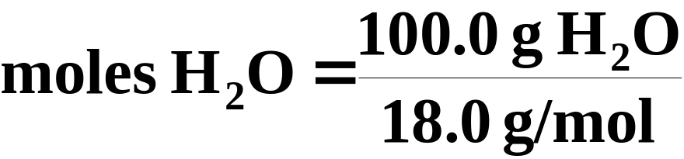

Mass and Moles of a Substance
Mole calculations
  This same method applies to compounds. Suppose we have 100.0 grams of H₂O (molecular weight = 18.0 g/mol). How many moles does this represent?
Notes:
2

Slide 11

Mass and Moles of a Substance
Mole calculations
  Conversely, suppose we have 3.25 moles of glucose, C₆H₁₂O₆ (molecular wt. = 180.0 g/mol). What is its mass?
Notes:
2

Slide 12
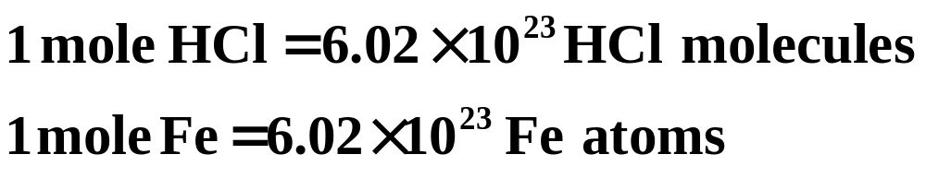
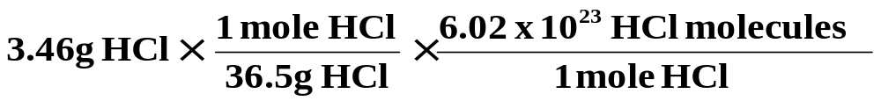
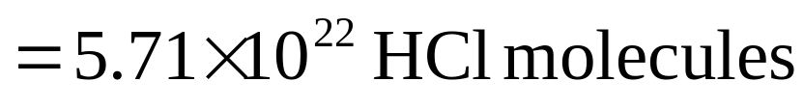
Mass and Moles and Number of Molecules or Atoms
The number of molecules or atoms in a sample is related to the moles of the substance:
Suppose we have a 3.46-g sample of hydrogen chloride, HCl. How many molecules of HCl does this represent?
Notes:
2

Slide 13
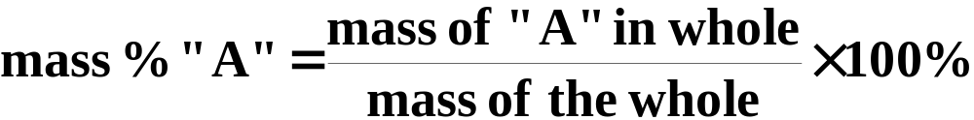
Determining Chemical Formulas
The percent composition of a compound is the mass percentage of each element in the compound.
  We define the mass percentage of “A” as the parts of “A” per hundred parts of the total, by mass. That is,
Notes:
2

Slide 14
Mass Percentages from Formulas
Let’s calculate the percent composition of butane, C₄H₁₀.
  First, we need the molecular mass of C₄H₁₀.
  Now, we can calculate the percents.
Notes:
2

Slide 15
Determining Chemical Formulas
Determining the formula of a compound from the percent composition.
  The percent composition of a compound leads directly to its empirical formula.
  An empirical formula (or simplest formula) for a compound is the formula of the substance written with the smallest integer (whole number) subscripts.
Notes:
2

Slide 16
Determining Chemical Formulas
Determining the empirical formula from the percent composition.
  Benzoic acid is a white, crystalline powder used as a food preservative. The compound contains 68.8% C, 5.0% H, and 26.2% O by mass. What is its empirical formula?
  In other words, give the smallest whole-number ratio of the subscripts in the formula
C_{x} H_{y}O_{z}
Notes:
2

Slide 17
Determining Chemical Formulas
Determining the empirical formula from the percent composition.
  For the purposes of this calculation, we will assume we have 100.0 grams of benzoic acid.
  Then the mass of each element equals the numerical value of the percentage.
  Since x, y, and z in our formula represent mole-mole ratios, we must first convert these masses to moles.
C_{x} H_{y}O_{z}
Notes:
2

Slide 18
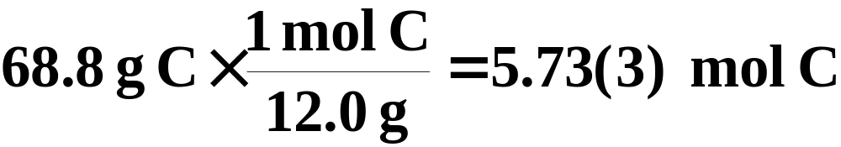
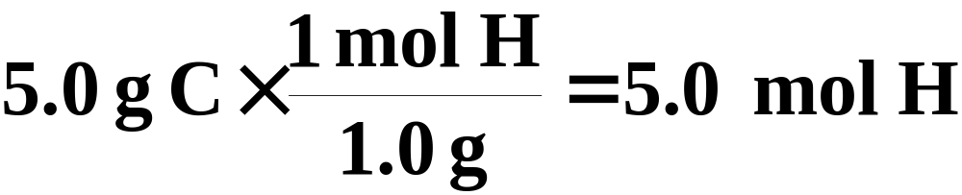
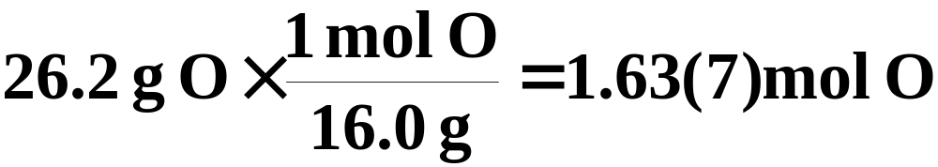
Determining Chemical Formulas
Determining the empirical formula from the percent composition.
  Our 100.0 grams of benzoic acid would contain:
This isn’t quite a whole number ratio, but if we divide each number by the smallest of the three, a better ratio might emerge.
Notes:
2

Slide 19

Determining Chemical Formulas
Determining the empirical formula from the percent composition.
  Our 100.0 grams of benzoic acid would contain:
now it’s not too difficult to See that the smallest whole number ratio is 7:6:2.
The empirical formula is C₇H₆O₂ .
Notes:
2

Slide 20
Determining Chemical Formulas
Determining the molecular formula from the empirical formula.
  An empirical formula gives only the smallest whole-number ratio of atoms in a formula.
  The molecular formula should be a multiple of the empirical formula (since both have the same percent composition).
  To determine the molecular formula, we must know the molecular weight of the compound.
Notes:
2

Slide 21
Determining Chemical Formulas
Determining the molecular formula from the empirical formula.
  For example, suppose the empirical formula of a compound is CH₂O and its molecular weight is 60.0 g/mol.
  The molar weight of the empirical formula (the empirical weight) is only 30.0 g/mol.
  This would imply that the molecular formula is actually the empirical formula doubled, or
C₂H₄O₂
Notes:
2

Slide 22
Stoichiometry: Quantitative Relations in Chemical Reactions
Stoichiometry is the calculation of the quantities of reactants and products involved in a chemical reaction.
  It is based on the balanced chemical equation and on the relationship between mass and moles.
  Such calculations are fundamental to most quantitative work in chemistry.
Notes:
2

Slide 23
Molar Interpretation of a Chemical Equation
The balanced chemical equation can be interpreted in numbers of molecules, but generally chemists interpret equations as “mole-to-mole” relationships.
  For example, the Haber process for producing ammonia involves the reaction of hydrogen and nitrogen.
Notes:
2

Slide 24
Molar Interpretation of a Chemical Equation
This balanced chemical equation shows that one mole of N₂ reacts with 3 moles of H₂ to produce 2 moles of NH₃.
1 molecule N₂ + 3 molecules H₂ 2 molecules NH₃
  Because moles can be converted to mass, you can also give a mass interpretation of a chemical equation.
Notes:
2

Slide 25
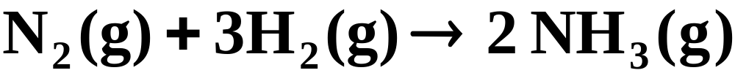
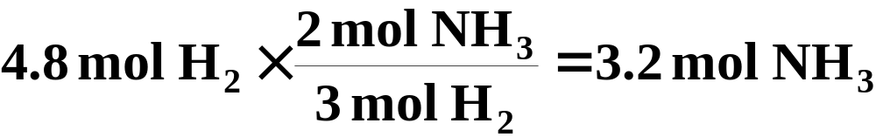
Molar Interpretation of a Chemical Equation
Suppose we wished to determine the number of moles of NH₃ we could obtain from 4.8 mol H₂.
Because the coefficients in the balanced equation represent mole-to-mole ratios, the calculation is simple.
Notes:
2

Slide 26

Mass Relationships in Chemical Equations
Amounts of substances in a chemical reaction by mass.
  How many grams of HCl are required to react with 5.00 grams manganese dioxide according to this equation?
Notes:
2

Slide 27
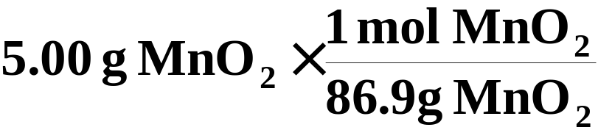
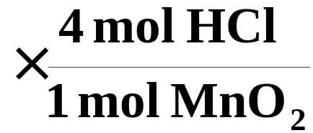
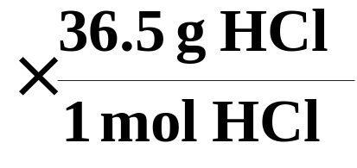

Mass Relationships in Chemical Equations
First, you write what is given (5.00 g MnO₂) and convert this to moles.
Then convert to moles of what is desired.(mol HCl)
Finally, you convert this to mass (g HCl)
Notes:
2

Slide 28
Limiting Reagent
The limiting reactant (or limiting reagent) is the reactant that is entirely consumed when the reaction goes to completion. (See Figure 3.14)
  The limiting reagent ultimately determines how much product can be obtained.
  For example, bicycles require one frame and two wheels. If you have 20 wheels but only 5 frames, it is clear that the number of frames will determine how many bicycles can be made.
Notes:
2

Slide 29
Limiting Reagent
Zinc metal reacts with hydrochloric acid by the following reaction.
  If 0.30 mol Zn is added to hydrochloric acid containing 0.52 mol HCl, how many moles of H₂ are produced?
Notes:
2

Slide 30
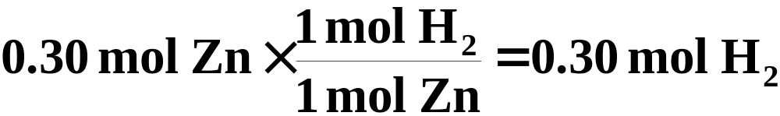
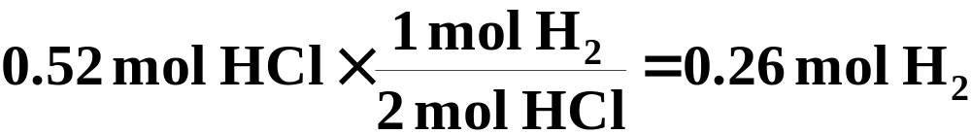
Limiting Reagent
  Take each reactant in turn and ask how much product would be obtained if each were totally consumed. The reactant that gives the smaller amount is the limiting reagent.
Since HCl is the limiting reagent, the amount of H₂ produced must be 0.26 mol.
Notes:
2

Slide 31
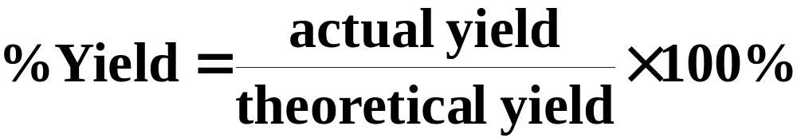
Theoretical and Percent Yield
The theoretical yield of product is the maximum amount of product that can be obtained from given amounts of reactants.
  The percentage yield is the actual yield (experimentally determined) expressed as a percentage of the theoretical yield (calculated).
Notes:
2

Slide 32
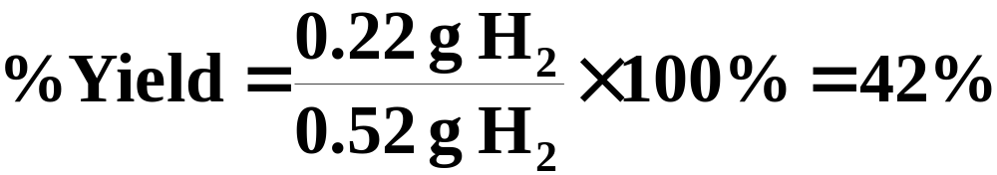
Theoretical and Percent Yield
To illustrate the calculation of percentage yield, recall that the theoretical yield of H₂ in the previous example was 0.26 mol (or 0.52 g) H₂.
If the actual yield of the reaction had been 0.22 g H₂, then
Notes:
2

Slide 33
Operational Skills
Calculating the formula weight from a formula.
Calculating the mass of an atom or molecule.
Converting moles of substance to grams and vice versa.
Calculating the number of molecules in a given mass.
Calculating the percentage composition from the formula.
Calculating the mass of an element in a given mass of compound.
Calculating the percentages C and H by combustion.
Determining the empirical formula from percentage composition.
Determining the true molecular formula.
Relating quantities in a chemical equation.
Calculating with a limiting reagent.
Notes:
2

Slide 34

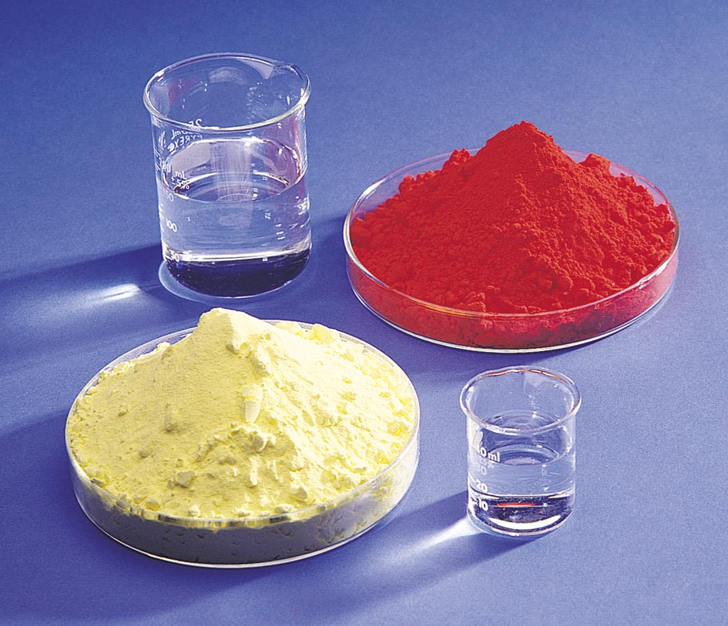
Figure 3.2:
One mole each of various substances.
Photo courtesy of American Color.
Return to Slide 5

Slide 35
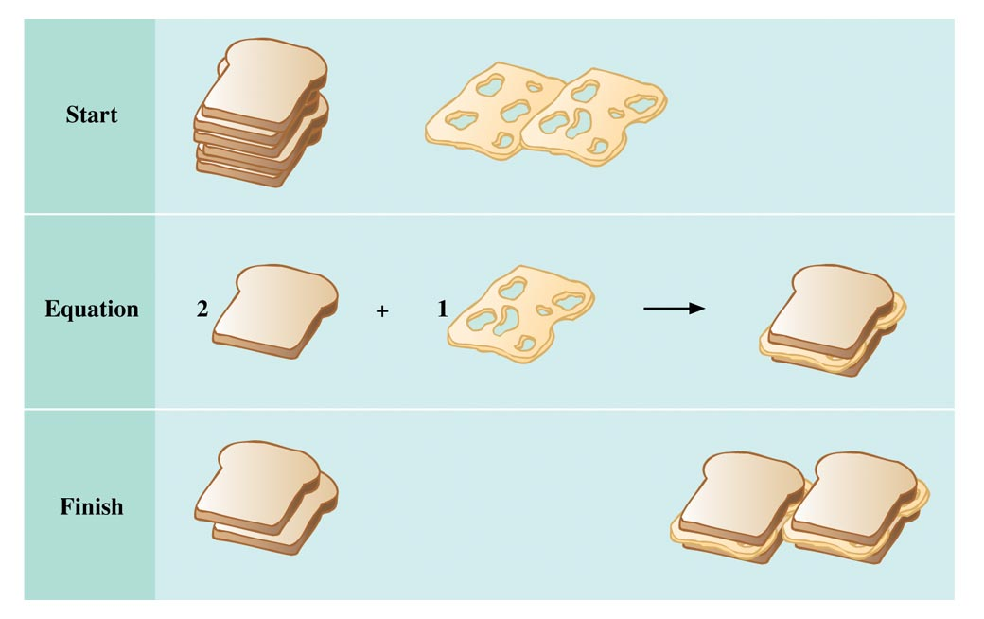
Figure 3.14: Limiting reactant analogy using cheese sandwiches.
Return to Slide 28

