Slide 1
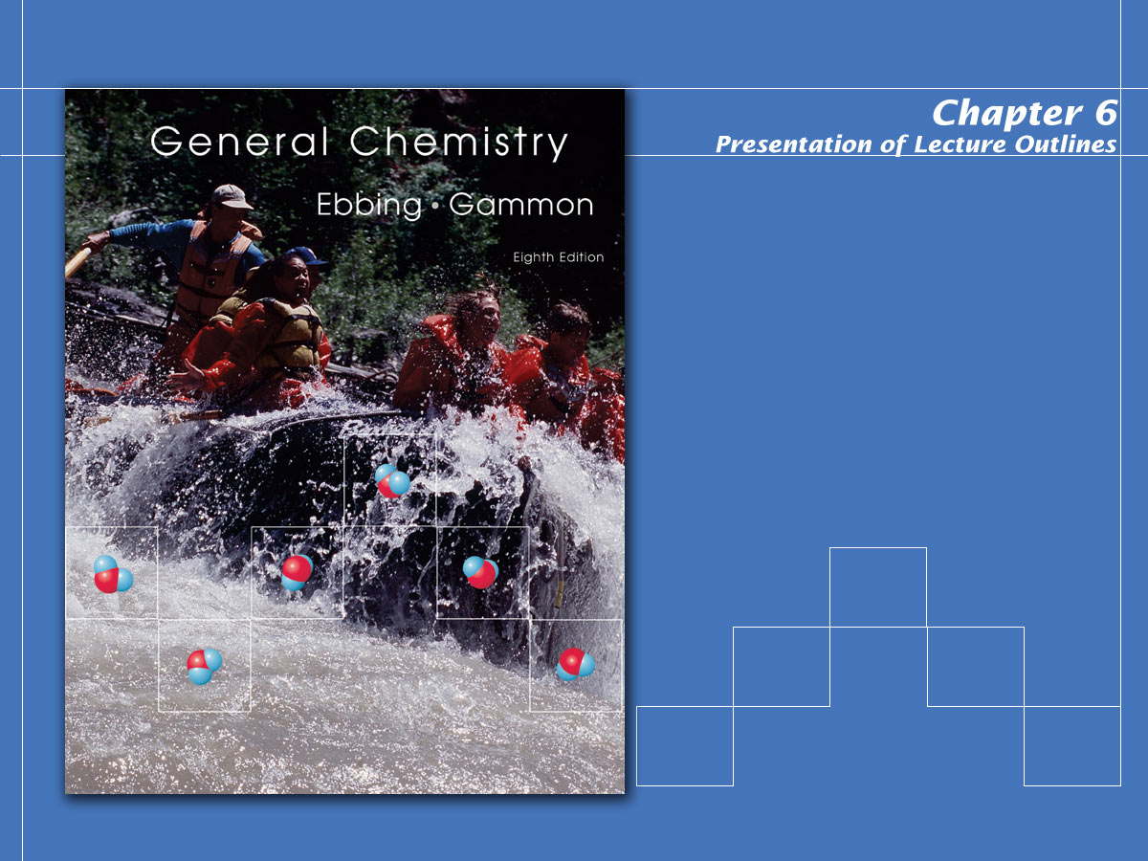
Thermochemistry

Slide 2
Thermochemistry
Thermodynamics is the science of the relationship between heat and other forms of energy.
Thermochemistry is the study of the quantity of heat absorbed or evolved by chemical reactions.
Copyright © Houghton Mifflin Company.All rights reserved.
Presentation of Lecture Outlines, 6–<number>
Notes:
2

Slide 3
Energy
Energy is defined as the capacity to move matter.
  Energy can be in many forms:
    Radiant Energy -Electromagnetic radiation.
    Thermal Energy - Associated with random motion of a molecule or atom.
    Chemical Energy - Energy stored within the structural limits of a molecule or atom.
Copyright © Houghton Mifflin Company.All rights reserved.
Presentation of Lecture Outlines, 6–<number>
Notes:
2

Slide 4
Energy
There are three broad concepts of energy:
  Kinetic Energy is the energy associated with an object by virtue of its motion.
  Potential Energy is the energy an object has by virtue of its position in a field of force.
  Internal Energy is the sum of the kinetic and potential energies of the particles making up a substance.
We will look at each of these in detail.
Copyright © Houghton Mifflin Company.All rights reserved.
Presentation of Lecture Outlines, 6–<number>
Notes:
2

Slide 5
Heat of Reaction
In chemical reactions, heat is often transferred from the “system” to its “surroundings,” or vice versa.
  The substance or mixture of substances under study in which a change occurs is called the thermodynamic system (or simply system.)
  The surroundings are everything in the vicinity of the thermodynamic system.
Copyright © Houghton Mifflin Company.All rights reserved.
Presentation of Lecture Outlines, 6–<number>
Notes:
3

Slide 6
Heat of Reaction
Heat is defined as the energy that flows into or out of a system because of a difference in temperature between the system and its surroundings.
  Heat flows from a region of higher temperature to one of lower temperature; once the temperatures become equal, heat flow stops.
  (See Animation: Kinetic Molecular Theory/Heat Transfer)
Copyright © Houghton Mifflin Company.All rights reserved.
Presentation of Lecture Outlines, 6–<number>
Notes:
3

Slide 7
Heat of Reaction
Heat is denoted by the symbol q.
  The sign of q is positive if heat is absorbed by the system.
  The sign of q is negative if heat is evolved by the system.
  Heat of Reaction is the value of q required to return a system to the given temperature at the completion of the reaction.
Copyright © Houghton Mifflin Company.All rights reserved.
Presentation of Lecture Outlines, 6–<number>
Notes:
3

Slide 8
Heat of Reaction
An exothermic process is a chemical reaction or physical change in which heat is evolved (q is negative).
An endothermic process is a chemical reaction or physical change in which heat is absorbed (q is positive).
Copyright © Houghton Mifflin Company.All rights reserved.
Presentation of Lecture Outlines, 6–<number>
Notes:
3

Slide 9
Heat of Reaction
Exothermicity
  “out of” a system
Δq < 0
Endothermicity
  “into” a system
Δq > 0
Surroundings
Surroundings
Energy
Energy
System
System
Copyright © Houghton Mifflin Company.All rights reserved.
Presentation of Lecture Outlines, 6–<number>
Notes:
8

Slide 10
Enthalpy and Enthalpy Change
    An extensive property is one that depends on the quantity of substance.
Enthalpy, denoted H, is an extensive property of a substance that can be used to obtain the heat absorbed or evolved in a chemical reaction.
Copyright © Houghton Mifflin Company.All rights reserved.
Presentation of Lecture Outlines, 6–<number>
Notes:
3

Slide 11

Enthalpy and Enthalpy Change
The change in enthalpy for a reaction at a given temperature and pressure (called the enthalpy of reaction) is obtained by subtracting the enthalpy of the reactants from the enthalpy of the products.
Copyright © Houghton Mifflin Company.All rights reserved.
Presentation of Lecture Outlines, 6–<number>
Notes:
3

Slide 12
Thermochemical Equations
A thermochemical equation is the chemical equation for a reaction (including phase labels) in which the equation is given a molar interpretation, and the enthalpy of reaction for these molar amounts is written directly after the equation.
Copyright © Houghton Mifflin Company.All rights reserved.
Presentation of Lecture Outlines, 6–<number>
Notes:
3

Slide 13
Thermochemical Equations
In a thermochemical equation it is important to note phase labels because the enthalpy change, ΔH, depends on the phase of the substances.
Copyright © Houghton Mifflin Company.All rights reserved.
Presentation of Lecture Outlines, 6–<number>
Notes:
3

Slide 14
Thermochemical Equations
The following are two important rules for manipulating thermochemical equations:
  When a thermochemical equation is multiplied by any factor, the value of DH for the new equation is obtained by multiplying the DH in the original equation by that same factor.
  When a chemical equation is reversed, the value of DH is reversed in sign.
Copyright © Houghton Mifflin Company.All rights reserved.
Presentation of Lecture Outlines, 6–<number>
Notes:
3

Slide 15

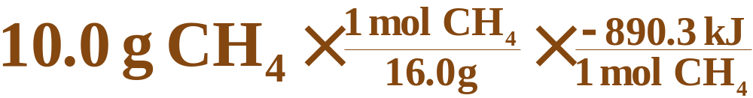

Applying Stoichiometry and Heats of Reactions
Consider the reaction of methane, CH₄, burning in the presence of oxygen at constant pressure. Given the following equation, how much heat could be obtained by the combustion of 10.0 grams CH₄?
Copyright © Houghton Mifflin Company.All rights reserved.
Presentation of Lecture Outlines, 6–<number>
Notes:
3

Slide 16
Measuring Heats of Reaction
To See how heats of reactions are measured, we must look at the heat required to raise the temperature of a substance, because a thermochemical measurement is based on the relationship between heat and temperature change.
The heat required to raise the temperature of a substance is its heat capacity.
Copyright © Houghton Mifflin Company.All rights reserved.
Presentation of Lecture Outlines, 6–<number>
Notes:
3

Slide 17
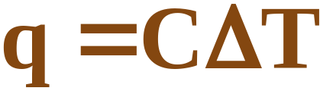
Measuring Heats of Reaction
Heat Capacity and Specific Heat
  The heat capacity, C, of a sample of substance is the quantity of heat required to raise the temperature of the sample of substance one degree Celsius.
  Changing the temperature of the sample requires heat equal to:
Copyright © Houghton Mifflin Company.All rights reserved.
Presentation of Lecture Outlines, 6–<number>
Notes:
3

Slide 18

A Problem to Consider
Suppose a piece of iron requires 6.70 J of heat to raise its temperature by one degree Celsius. The quantity of heat required to raise the temperature of the piece of iron from 25.0ºC to 35.0ºC is:
Copyright © Houghton Mifflin Company.All rights reserved.
Presentation of Lecture Outlines, 6–<number>
Notes:
3

Slide 19
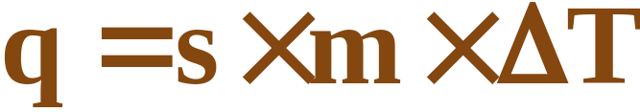
Measuring Heats of Reaction
Heat capacities are also compared for one gram amounts of substances. The specific heat capacity (or “specific heat”) is the heat required to raise the temperature of one gram of a substance by one degree Celsius.
  To find the heat required you must multiply the specific heat, s, of the substance times its mass in grams, m, and the temperature change, DT.
Copyright © Houghton Mifflin Company.All rights reserved.
Presentation of Lecture Outlines, 6–<number>
Notes:
3

Slide 20
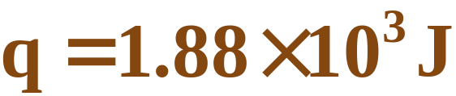
A Problem to Consider
Calculate the heat absorbed when the temperature of 15.0 grams of water is raised from 20.0ºC to 50.0ºC. (The specific heat of water is 4.184 J/g^{.o}C.)
Copyright © Houghton Mifflin Company.All rights reserved.
Presentation of Lecture Outlines, 6–<number>
Notes:
3

Slide 21

Heats of Reaction: Calorimetry
A calorimeter is a device used to measure the heat absorbed or evolved during a physical or chemical change. (See Figure 6.12)
  The heat absorbed by the calorimeter and its contents is the negative of the heat of reaction.
Copyright © Houghton Mifflin Company.All rights reserved.
Presentation of Lecture Outlines, 6–<number>
Notes:
3

Slide 22
A Problem to Consider
When 23.6 grams of calcium chloride, CaCl₂, was dissolved in water in a calorimeter, the temperature rose from 25.0ºC to 38.7ºC.
  If the heat capacity of the solution and the calorimeter is 1258 J/ºC, what is the enthalpy change per mole of calcium chloride?
Copyright © Houghton Mifflin Company.All rights reserved.
Presentation of Lecture Outlines, 6–<number>
Notes:
3

Slide 23

Heats of Reaction: Calorimetry
  First, let us calculate the heat absorbed by the calorimeter.
Now we must calculate the heat per mole of calcium chloride.
Copyright © Houghton Mifflin Company.All rights reserved.
Presentation of Lecture Outlines, 6–<number>
Notes:
3

Slide 24
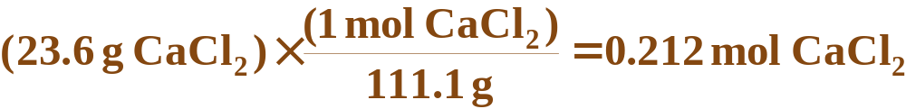
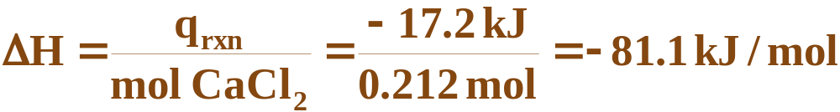
Heats of Reaction: Calorimetry
Calcium chloride has a molecular mass of 111.1 g, so
Now we can calculate the heat per mole of calcium chloride.
Copyright © Houghton Mifflin Company.All rights reserved.
Presentation of Lecture Outlines, 6–<number>
Notes:
3

Slide 25
Hess’s Law
Hess’s law of heat summation states that for a chemical equation that can be written as the sum of two or more steps, the enthalpy change for the overall equation is the sum of the enthalpy changes for the individual steps. (See Animation: Hess’s Law)
Copyright © Houghton Mifflin Company.All rights reserved.
Presentation of Lecture Outlines, 6–<number>
Notes:
3

Slide 26
Hess’s Law
For example, suppose you are given the following data:
Could you use these data to obtain the enthalpy change for the following reaction?
Copyright © Houghton Mifflin Company.All rights reserved.
Presentation of Lecture Outlines, 6–<number>
Notes:
3

Slide 27
Hess’s Law
If we multiply the first equation by 2 and reverse the second equation, they will sum together to become the third.
Copyright © Houghton Mifflin Company.All rights reserved.
Presentation of Lecture Outlines, 6–<number>
Notes:
3

Slide 28
Standard Enthalpies of Formation
The term standard state refers to the standard thermodynamic conditions chosen for substances when listing or comparing thermodynamic data: 1 atmosphere pressure and the specified temperature (usually 25ºC).
    The enthalpy change for a reaction in which reactants are in their standard states is denoted DHº (“delta H zero” or “delta H naught”).
Copyright © Houghton Mifflin Company.All rights reserved.
Presentation of Lecture Outlines, 6–<number>
Notes:
4

Slide 29
Standard Enthalpies of Formation
The standard enthalpy of formation of a substance, denoted ΔH_{f}º, is the enthalpy change for the formation of one mole of a substance in its standard state from its component elements in their standard state.
  Note that the standard enthalpy of formation for a pure element in its standard state is zero.
Copyright © Houghton Mifflin Company.All rights reserved.
Presentation of Lecture Outlines, 6–<number>
Notes:
4

Slide 30
Standard Enthalpies of Formation
The law of summation of heats of formation states that the enthalpy of a reaction is equal to the total formation energy of the products minus that of the reactants.
  Σ is the mathematical symbol meaning “the sum of”, and m and n are the coefficients of the substances in the chemical equation.
Copyright © Houghton Mifflin Company.All rights reserved.
Presentation of Lecture Outlines, 6–<number>
Notes:
4

Slide 31
A Problem to Consider
Large quantities of ammonia are used to prepare nitric acid according to the following equation:
  What is the standard enthalpy change for this reaction? Use Table 6.2 for data.
Copyright © Houghton Mifflin Company.All rights reserved.
Presentation of Lecture Outlines, 6–<number>
Notes:
4

Slide 32




A Problem to Consider
You record the values of ΔH_{f}º under the formulas in the equation, multiplying them by the coefficients in the equation.
  You can calculate ΔHº by subtracting the values for the reactants from the values for the products.
Copyright © Houghton Mifflin Company.All rights reserved.
Presentation of Lecture Outlines, 6–<number>
Notes:
4

Slide 33

A Problem to Consider
Using the summation law:
  Be careful of arithmetic signs as they are a likely source of mistakes.
Copyright © Houghton Mifflin Company.All rights reserved.
Presentation of Lecture Outlines, 6–<number>
Notes:
4

Slide 34
Fuels
Food fills three needs of the body:
  It supplies substances for the growth and repair of tissue.
  It supplies substances for the synthesis of compounds used in the regulation of body processes.
  It supplies energy. About 80% of the energy we need is for heat. The rest is used for muscular action and other body processes
Copyright © Houghton Mifflin Company.All rights reserved.
Presentation of Lecture Outlines, 6–<number>
Notes:
4

Slide 35

Fuels
A typical carbohydrate food, glucose (C₆H₁₂O₆) undergoes combustion according to the following equation.
  One gram of glucose yields 15.6 kJ (3.73 kcal) when burned.
Copyright © Houghton Mifflin Company.All rights reserved.
Presentation of Lecture Outlines, 6–<number>
Notes:
4

Slide 36

Fuels
A representative fat is glyceryl trimyristate, C₄₅H₈₆O₆. The equation for its combustion is:
  One gram of fat yields 38.5 kJ (9.20 kcal) when burned. Note that fat contains more than twice the fuel per gram than carbohydrates contain.
Copyright © Houghton Mifflin Company.All rights reserved.
Presentation of Lecture Outlines, 6–<number>
Notes:
4

Slide 37
Fuels
Fossil fuels account for nearly 90% of the energy usage in the United States.
  Anthracite, or hard coal, the oldest variety of coal, contains about 80% carbon.
  Bituminous coal, a younger variety of coal, contains 45% to 65% carbon.
  Fuel values of coal are measured in BTUs (British Thermal Units).
  A typical value for coal is 13,200 BTU/lb.
  1 BTU = 1054 kJ
Copyright © Houghton Mifflin Company.All rights reserved.
Presentation of Lecture Outlines, 6–<number>
Notes:
4

Slide 38
Fuels
With supplies of petroleum estimated to be 80% depleted by the year 2030, the gasification of coal has become a possible alternative.
  First, coal is converted to carbon monoxide using steam.
  The carbon monoxide can then be used to produce a variety of other fuels, such as methane.
Copyright © Houghton Mifflin Company.All rights reserved.
Presentation of Lecture Outlines, 6–<number>
Notes:
4

Slide 39
Operational Skills
Calculating kinetic energy.
Writing thermochemical equations.
Manipulating thermochemical equations.
Calculating the heat of reaction from the stoichiometry.
Relating heat and specific heat.
Calculating ΔH from calorimetric data.
Applying Hess’s law.
Calculating the enthalpy of reaction from standard enthalpies of formation.
Copyright © Houghton Mifflin Company.All rights reserved.
Presentation of Lecture Outlines, 6–<number>
Notes:
4

Slide 40

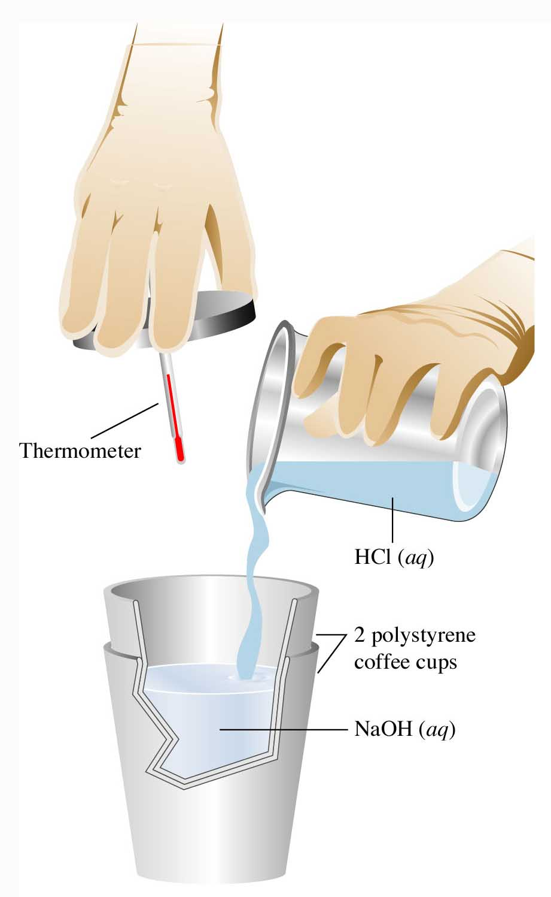
Figure 6.12: Coffee-cup calorimeter.
Return to Slide 31
Copyright © Houghton Mifflin Company.All rights reserved.
Presentation of Lecture Outlines, 6–<number>

