Slide 1

Electron Configurations and Periodicity

Slide 2
Practice AP Question Warm Up 1999
2a. The longest wavelength of light with enough energy to break the Cl – Cl bond in Cl₂(g) is 495nm.
i. Calculate the frequency, in s⁻¹, of the light.
ii. Calculate the energy, in J, of a photon of light
iii. Calculate the minimum energy, in kJ mol⁻¹, of the Cl-Cl bond.
A certain line in the spectrum of atomic hydrogen is associated with the electronic transition in the H atom from the 6th energy level (n=6) to the second energy level (n=2).
    Indicate whether the H atom emits energy or whether it absorbs energy during the transition. Justify your answer.
    Calculate the wavelength, in nm, of the radiation associated with the spectral line.
    Account for the observation that the amount of energy associated with the same electronic transition (n=6 to n=2) in the He⁺ ion is greater than that associated with the corresponding transition in the H atom.

Slide 3

Electron Spin
In Chapter 7, we saw that electron pairs residing in the same orbital are required to have opposing spins.
  This causes electrons to behave like tiny bar magnets. (see Figure 8.3)
  A beam of hydrogen atoms is split in two by a magnetic field due to these magnetic properties of the electrons. (see Figure 8.2)
Notes:
2

Slide 4
Electron Configuration
An “electron configuration” of an atom is a particular distribution of electrons among available sub shells.
  The notation for a configuration lists the sub-shell symbols sequentially with a superscript indicating the number of electrons occupying that sub shell.
  For example, lithium (atomic number 3) has two electrons in the “1s” sub shell and one electron in the “2s” sub shell 1s² 2s¹.
Notes:
2

Slide 5
Electron Configuration
An orbital diagram is used to show how the orbitals of a sub shell are occupied by electrons.
Each orbital is represented by a circle.
  Each group of orbitals is labeled by its sub shell notation.
1s 2s 2p
Electrons are represented by arrows: up for m_{s} = +1/2 and down for m_{s} = -1/2
Notes:
2

Slide 6
The Pauli Exclusion Principle
The Pauli exclusion principle, which summarizes experimental observations, states that no two electrons can have the same four quantum numbers.
In other words, an orbital can hold at most two electrons, and then only if the electrons have opposite spins.
Notes:
2

Slide 7
The Pauli Exclusion Principle
The maximum number of electrons and their orbital diagrams are:
Sub shell | Number of Orbitals | Maximum Number of Electrons
s (l = 0) | 1 | 2
p (l = 1) | 3 | 6
d (l =2) | 5 | 10
f (l =3) | 7 | 14
Notes:
2

Slide 8
Aufbau Principle
Every atom has an infinite number of possible electron configurations.
  The configuration associated with the lowest energy level of the atom is called the “ground state.”
  Other configurations correspond to “excited states.”
  Table 8.1 lists the ground state configurations of atoms up to krypton. (A complete table appears in Appendix D.)
Notes:
2

Slide 9
Warm Up.
Write the electron Configuration
For Iron, Gold and Radium (shorthand is acceptable)

Slide 10
Aufbau Principle
The Aufbau principle is a scheme used to reproduce the ground state electron configurations of atoms by following the “building up” order.
  Listed below is the order in which all the possible sub-shells fill with electrons.
1s, 2s, 2p, 3s, 3p, 4s, 3d, 4p, 5s, 4d, 5p, 6s, 4f, 5d, 6p, 7s, 5f
  You need not memorize this order. As you will see, it can be easily obtained.
Notes:
2

Slide 11
Order for Filling Atomic Subshells
1s
2s 2p
3s 3p 3d
4s 4p 4d 4f
5s 5p 5d 5f
6s 6p 6d 6f
Notes:
5

Slide 12
Orbital Energy Levels in Multi-electron Systems
3d
4s
3p
3s
Energy
2p
2s
1s
(See Animation: Orbital Energies)
Notes:
3

Slide 13
Aufbau Principle
With boron (Z=5), the electrons begin filling the 2p subshell.
Z=5 | Boron | 1s²2s²2p¹ | or | [He]2s²2p¹
Z=6 | Carbon | 1s²2s²2p² | or | [He]2s²2p²
Z=7 | Nitrogen | 1s²2s²2p³ | or | [He]2s²2p³
Z=8 | Oxygen | 1s²2s²2p⁴ | or | [He]2s²2p⁴
Z=9 | Fluorine | 1s²2s²2p⁵ | or | [He]2s²2p⁵
Z=10 | Neon | 1s²2s²2p⁶ | or | [He]2s⁶2p⁶
Notes:
2

Slide 14
Configurations and the Periodic Table
Note that elements within a given family have similar configurations.
  For instance, look at the noble gases.
Helium | 1s²
Neon | 1s²2s²2p⁶
Argon | 1s²2s²2p⁶3s²3p⁶
Krypton | 1s²2s²2p⁶3s²3p⁶3d¹⁰4s²4p⁶
Notes:
2

Slide 15
Configurations and the Periodic Table
Note that elements within a given family have similar configurations.
  The Group IIA elements are sometimes called the alkaline earth metals.
Beryllium | 1s²2s²
Magnesium | 1s²2s²2p⁶3s²
Calcium | 1s²2s²2p⁶3s²3p⁶4s²
Notes:
2

Slide 16
Configurations and the Periodic Table
Electrons that reside in the outermost shell of an atom - or in other words, those electrons outside the “noble gas core”- are called valence electrons.
  These electrons are primarily involved in chemical reactions.
  Elements within a given group have the same “valence shell configuration.”
  This accounts for the similarity of the chemical properties among groups of elements.
Notes:
2

Slide 17
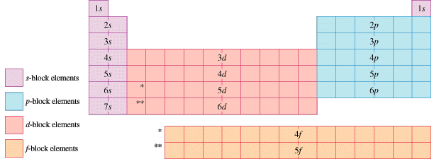
Configurations and the Periodic Table
Notes:
2

Slide 18
Orbital Diagrams
Consider carbon (Z = 6) with the ground state configuration 1s²2s²2p².
  Three possible arrangements are given in the following orbital diagrams.
1s 2s 2p
    Diagram 1:
    Diagram 2:
    Diagram 3:
  Each state has a different energy and different magnetic characteristics.
Notes:
2

Slide 19
Orbital Diagrams
Hund’s rule states that the lowest energy arrangement (the “ground state”) of electrons in a sub-shell is obtained by putting electrons into separate orbitals of the sub shell with the same spin before pairing electrons.
  Looking at carbon again, we see that the ground state configuration corresponds to diagram 1 when following Hund’s rule.
1s 2s 2p
Notes:
2

Slide 20
Magnetic Properties
Although an electron behaves like a tiny magnet, two electrons that are opposite in spin cancel each other. Only atoms with unpaired electrons exhibit magnetic susceptibility.
  A paramagnetic substance is one that is weakly attracted by a magnetic field, usually the result of unpaired electrons.
  A diamagnetic substance is not attracted by a magnetic field generally because it has only paired electrons.
Notes:
2

Slide 21
Periodic Properties
The periodic law states that when the elements are arranged by atomic number, their physical and chemical properties vary periodically.
  We will look at three periodic properties:
    Atomic radius
    Ionization energy
    Electron affinity
Notes:
2

Slide 22
Periodic Properties
Atomic radius
  Within each period (horizontal row), the atomic radius tends to decrease with increasing atomic number (nuclear charge).
  Within each group (vertical column), the atomic radius tends to increase with the period number.
Notes:
2

Slide 23
Lithium
Sodium
Cesium

Slide 24
potassium
Copper
Krypton
19 P+
29 P+
36 P+

Slide 25
Periodic Properties
Two factors determine the size of an atom.
  One factor is the principal quantum number, n. The larger is “n”, the larger the size of the orbital.
  The other factor is the effective nuclear charge, which is the positive charge an electron experiences from the nucleus minus any “shielding effects” from intervening electrons.
Notes:
2

Slide 26

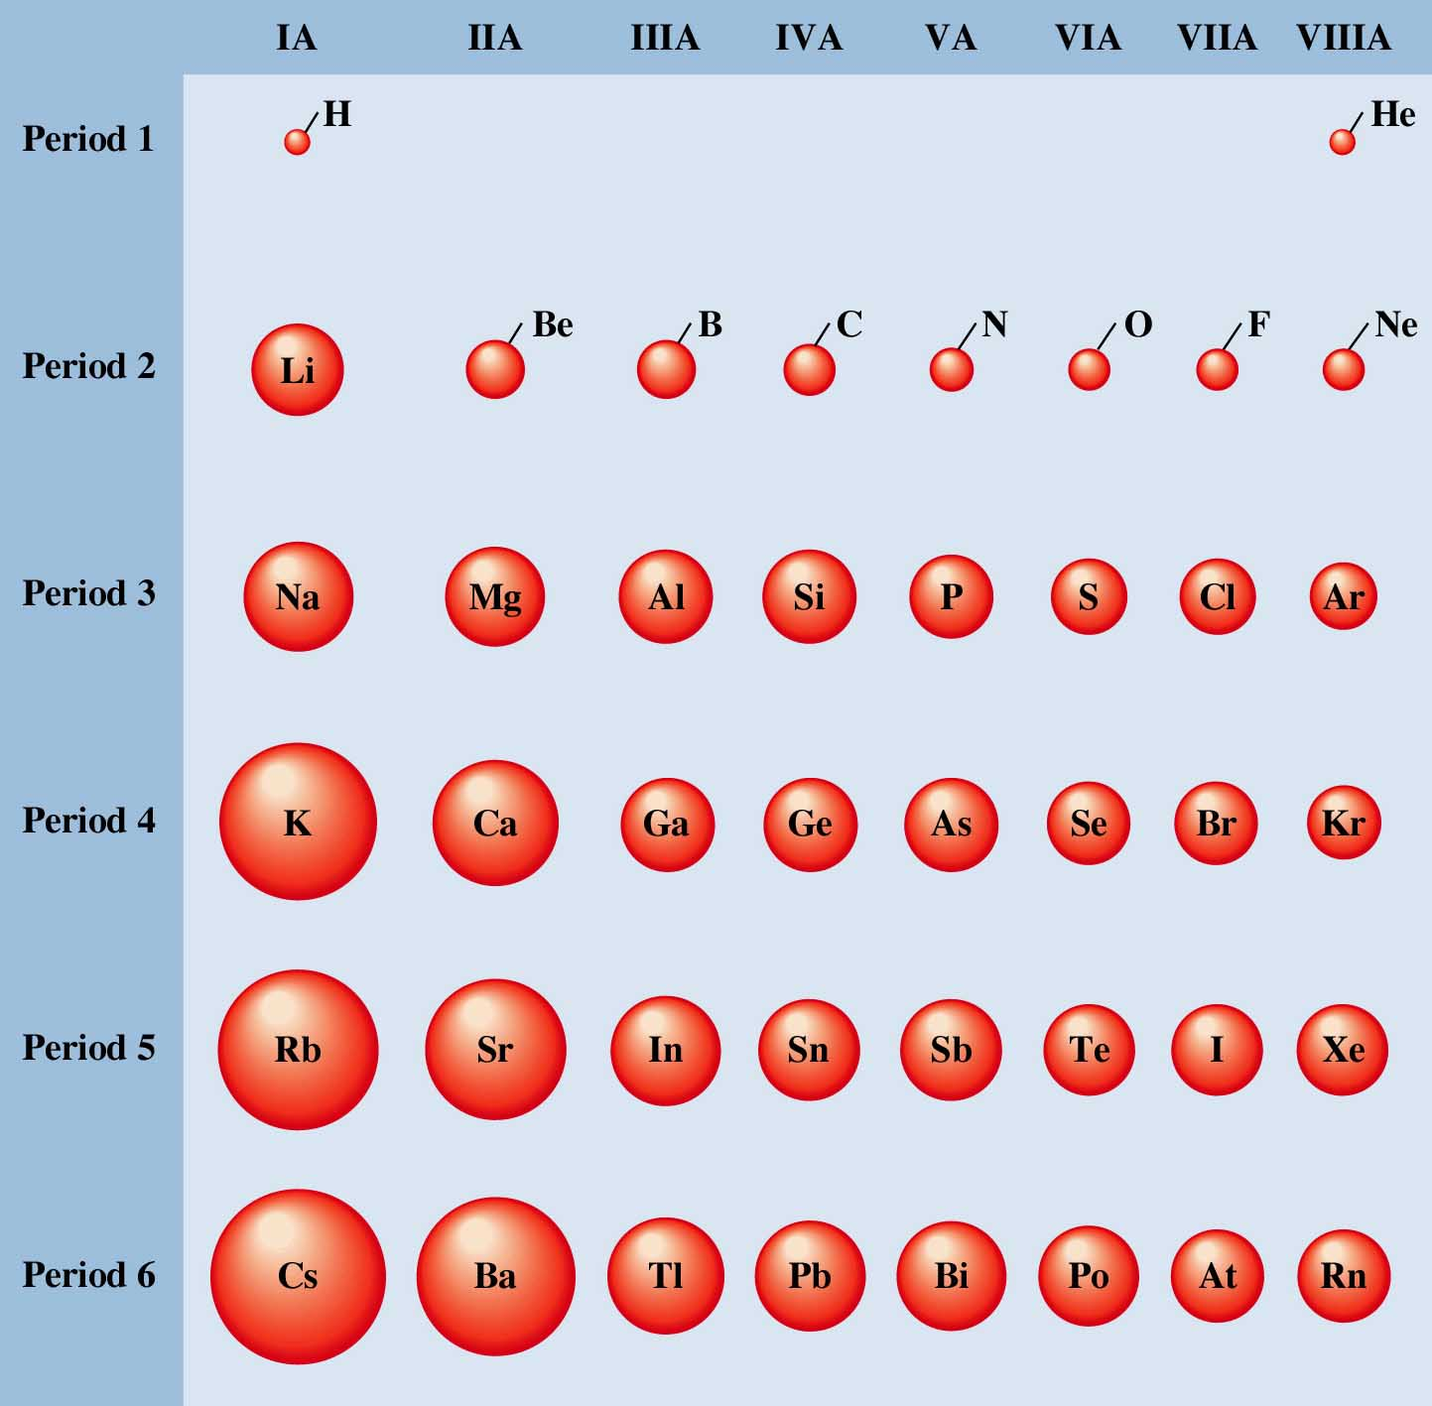
Figure 8.17: Representation of atomic radii (covalent radii) of the main-group elements.

Slide 27
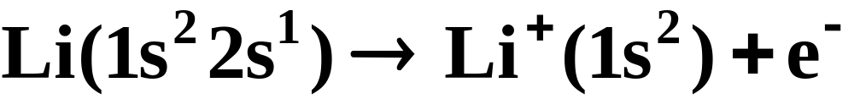
Periodic Properties
Ionization energy
  The first ionization energy of an atom is the minimal energy needed to remove the highest energy (outermost) electron from the neutral atom.
    For a lithium atom, the first ionization energy is illustrated by:
Ionization energy = 520 kJ/mol
Notes:
2

Slide 28
Periodic Properties
Ionization energy
    There is a general trend that ionization energies increase with atomic number within a given period.
    This follows the trend in size, as it is more difficult to remove an electron that is closer to the nucleus.
    For the same reason, we find that ionization energies, again following the trend in size, decrease as we descend a column of elements.
Notes:
2

Slide 29
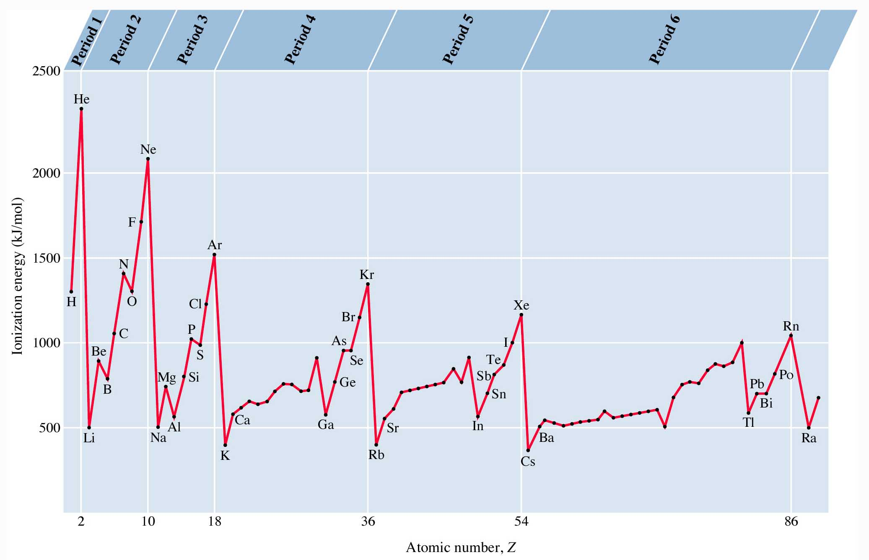
Figure 8.18: Ionization energy versus atomic number.

Slide 30
Periodic Properties
Ionization energy
  The electrons of an atom can be removed successively.
    The energies required at each step are known as the first ionization energy, the second ionization energy, and so forth.
    Table 8.3 lists the successive ionization energies of the first ten elements.
Notes:
2

Slide 31
Periodic Properties
Electron Affinity
  The electron affinity is the energy change for the process of adding an electron to a neutral atom in the gaseous state to form a negative ion.
    For a chlorine atom, the first electron affinity is illustrated by:
Electron Affinity = -349 kJ/mol
Notes:
2

Slide 32
Periodic Properties
Electron Affinity
  The more negative the electron affinity, the more stable the negative ion that is formed.
  Broadly speaking, the general trend goes from lower left to upper right as electron affinities become more negative.
  Table 8.4 gives the electron affinities of the main-group elements.
Notes:
2

Slide 33
The Main-Group Elements
The physical and chemical properties of the main-group elements clearly display periodic behavior.
  Variations of metallic-nonmetallic character.
  Basic-acidic behavior of the oxides.
Notes:
2

Slide 34
Group IA, Alkali Metals
  Largest atomic radii
  React violently with water to form H₂
  Readily ionized to 1+
  Metallic character, oxidized in air
  R₂O in most cases
Notes:
22

Slide 35
Group IIA, Alkali Earth Metals
Readily ionized to 2+
React with water to form H₂
Closed s shell configuration
Metallic
Notes:
23

Slide 36
Transition Metals
May have several oxidation states
Metallic
Reactive with acids
Notes:
24

Slide 37
Group III A
Metals (except for boron)
Several oxidation states (commonly 3+)
Notes:
25

Slide 38
Group IV A
Form the most covalent compounds
Oxidation numbers vary between 4+ and 4-
Notes:
26

Slide 39
Group V A
Form anions generally(1-, 2-, 3-), though positive oxidation states are possible
Form metals, metalloids, and nonmetals
Notes:
27

Slide 40
Group VI A
Form 2- anions generally, though positive oxidation states are possible
React vigorously with alkali and alkali earth metals
Nonmetals
Notes:
28

Slide 41
Halogens
Form monoanions
High electronegativity (electron affinity)
Diatomic gases
Most reactive nonmetals (F)
Notes:
29

Slide 42
Noble Gases
Minimal reactivity
Monatomic gases
Closed shell
Notes:
30

Slide 43
Operational Skills
Applying the Pauli exclusion principle.
Determining the configuration of an atom using the Aufbau principle.
Determining the configuration of an atom using the period and group numbers.
Applying Hund’s rule.
Applying periodic trends.
Notes:
30

Slide 44
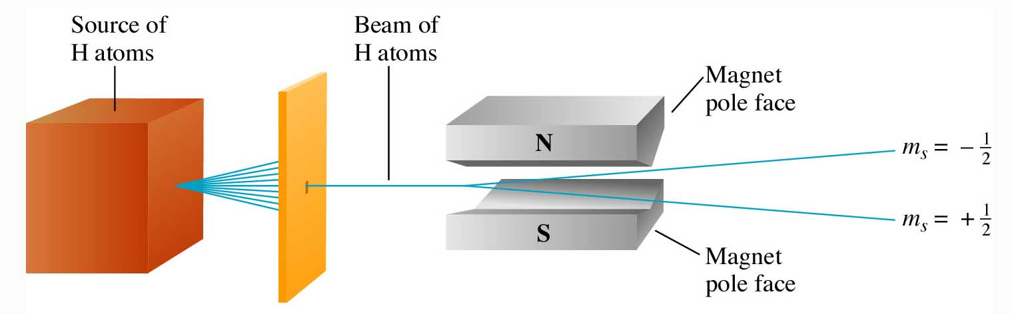
Figure 8.2: The Stern-Gerlach experiment.
Return to slide 2

Slide 45
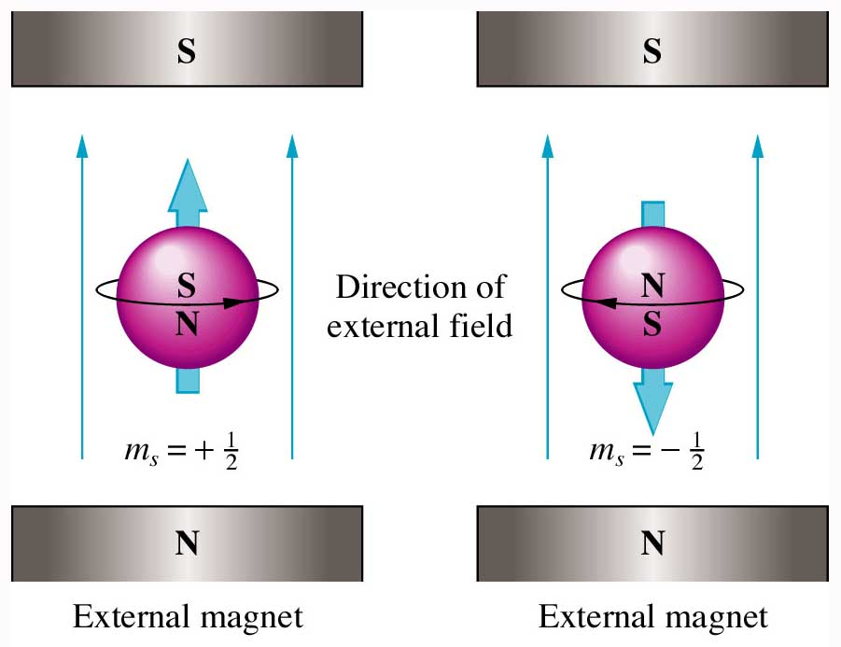
Figure 8.3: A representation of electron spin.
Return to slide 2

Slide 46
Animation: Orbital Energies
(Click here to open QuickTime video)
Return to slide 10

