Slide 1
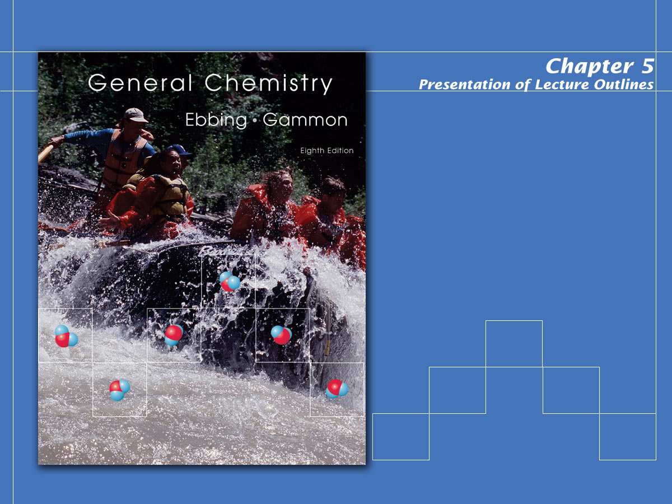
The Gaseous State

Slide 2

Gas Laws
In the first part of this chapter we will examine the quantitative relationships, or empirical laws, governing gases.
First, however, we need to understand the concept of pressure.
Notes:
2

Slide 3
Pressure
Force exerted per unit area of surface by molecules in motion.
P = Force/unit area
  1 atmosphere = 14.7 psi
  1 atmosphere = 760 mm Hg (See Fig. 5.2)
  1 atmosphere = 101,325 Pascals
  1 Pascal = 1 kg/m.s²
Notes:
2

Slide 4
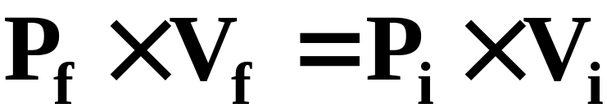
The Empirical Gas Laws
Boyle’s Law: The volume of a sample of gas at a given temperature varies inversely with the applied pressure. (See Figure 5.5 and Animation: Boyle’s Law)
V α 1/P (constant moles and T)
or
Notes:
3

Slide 5

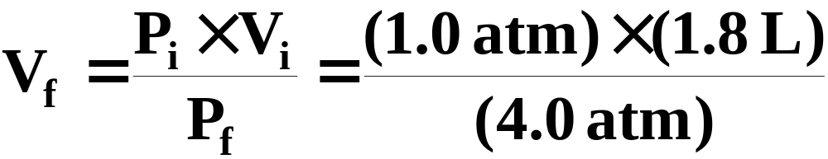
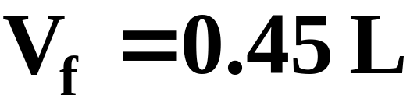
A Problem to Consider
A sample of chlorine gas has a volume of 1.8 L at 1.0 atm. If the pressure increases to 4.0 atm (at constant temperature), what would be the new volume?
Notes:
7

Slide 6
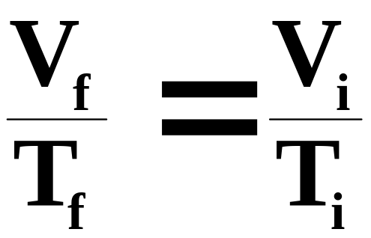
The Empirical Gas Laws
Charles’s Law: The volume occupied by any sample of gas at constant pressure is directly proportional to its absolute temperature.
(See Animation: Charle’s Law and Video: Liquid Nitrogen and Balloons)
V α T_{abs} (constant moles and P)
or
(See Animation: Microscopic Illustration of Charle’s Law)
Notes:
3

Slide 7
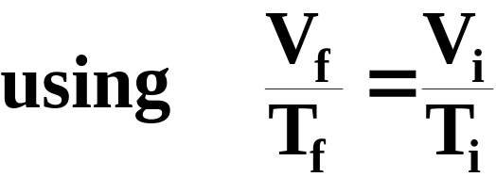
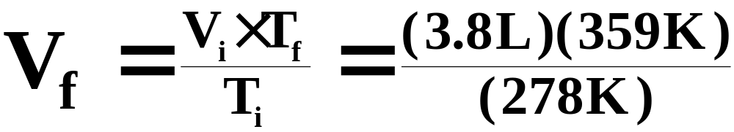
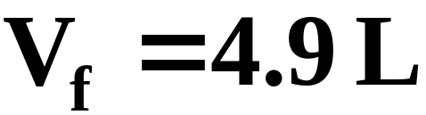
A Problem to Consider
A sample of methane gas that has a volume of 3.8 L at 5.0°C is heated to 86.0°C at constant pressure. Calculate its new volume.
Notes:
7

Slide 8
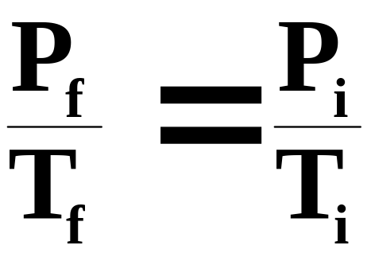
The Empirical Gas Laws
Gay-Lussac’s Law: The pressure exerted by a gas at constant volume is directly proportional to its absolute temperature.
P α T_{abs} (constant moles and V)
or
Notes:
3

Slide 9
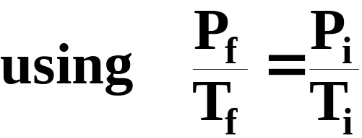
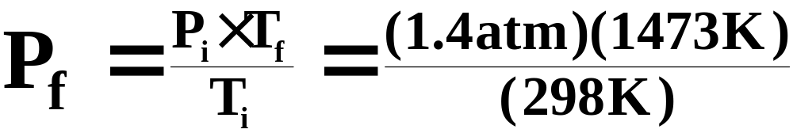
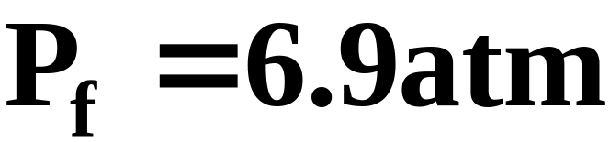
A Problem to Consider
An aerosol can has a pressure of 1.4 atm at 25°C. What pressure would it attain at 1200°C, assuming the volume remained constant?
Notes:
7

Slide 10
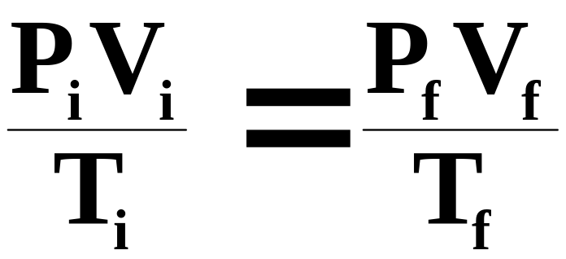
The Empirical Gas Laws
Combined Gas Law: In the event that all three parameters, P, V, and T, are changing, their combined relationship is defined as follows:
Notes:
3

Slide 11
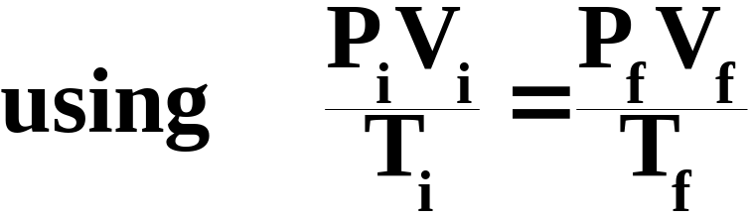
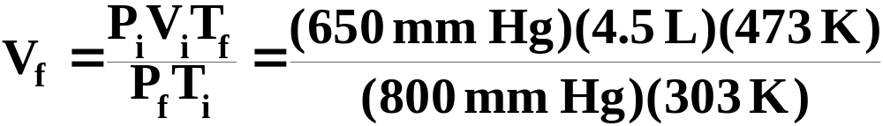

A Problem to Consider
A sample of carbon dioxide occupies 4.5 L at 30°C and 650 mm Hg. What volume would it occupy at 800 mm Hg and 200°C?
Notes:
7

Slide 12
The Empirical Gas Laws
Avogadro’s Law: Equal volumes of any two gases at the same temperature and pressure contain the same number of molecules.
  The volume of one mole of gas is called the molar gas volume, V_{m}. (See figure 5.12)
  Volumes of gases are often compared at standard temperature and pressure (STP), chosen to be 0 ºC and 1 atm pressure.
Notes:
3

Slide 13

The Empirical Gas Laws
Avogadro’s Law
  At STP, the molar volume, V_{m}, that is, the volume occupied by one mole of any gas, is 22.4 L/mol
  So, the volume of a sample of gas is directly proportional to the number of moles of gas, n.
(See Animation: Pressure and Concentration)
Notes:
3

Slide 14
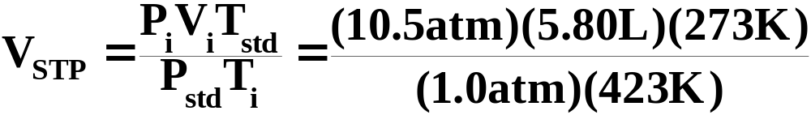
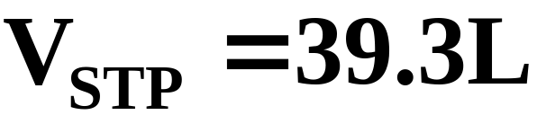
A Problem to Consider
A sample of fluorine gas has a volume of 5.80 L at 150.0 oC and 10.5 atm of pressure. How many moles of fluorine gas are present?
First, use the combined empirical gas law to determine the volume at STP.
Notes:
7

Slide 15

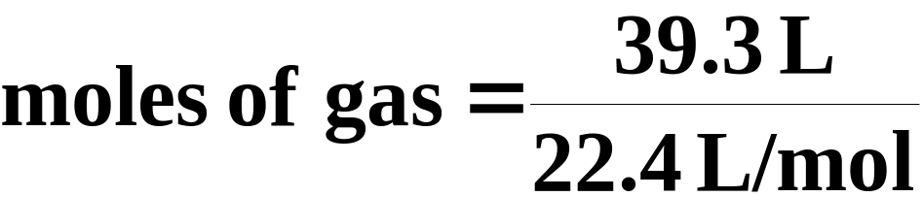

A Problem to Consider
Since Avogadro’s law states that at STP the molar volume is 22.4 L/mol, then
Notes:
7

Slide 16

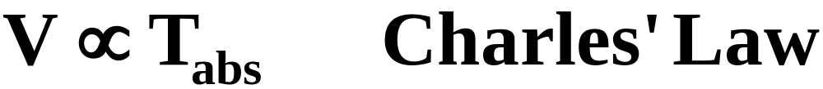
The Ideal Gas Law
From the empirical gas laws, we See that volume varies in proportion to pressure, absolute temperature, and moles.
Notes:
4

Slide 17
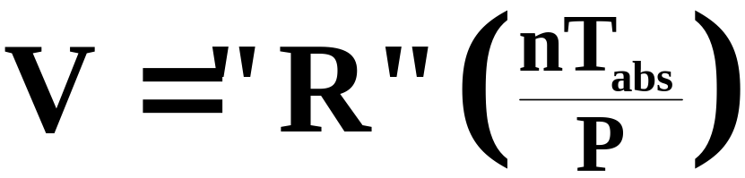
The Ideal Gas Law
This implies that there must exist a proportionality constant governing these relationships.
  Combining the three proportionalities, we can obtain the following relationship.
  where “R” is the proportionality constant referred to as the ideal gas constant.
Notes:
4

Slide 18
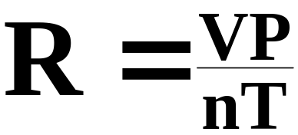
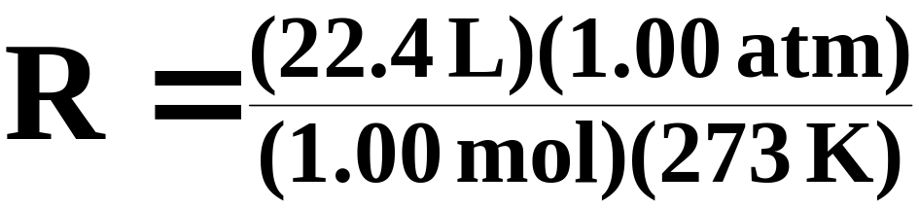
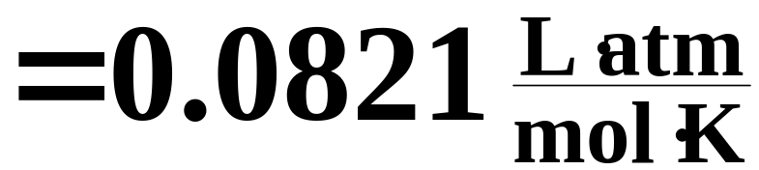
The Ideal Gas Law
The numerical value of R can be derived using Avogadro’s law, which states that one mole of any gas at STP will occupy 22.4 liters.
Notes:
4

Slide 19

The Ideal Gas Law
Thus, the ideal gas equation, is usually expressed in the following form:
P is pressure (in atm)
V is volume (in liters)
n is number of atoms (in moles)
R is universal gas constant 0.0821 L.atm/K.mol
T is temperature (in Kelvin)
(See Animation: The Ideal Gas Law PV=nRT)
Notes:
4

Slide 20
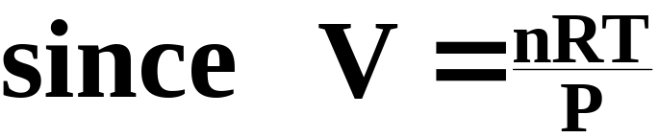
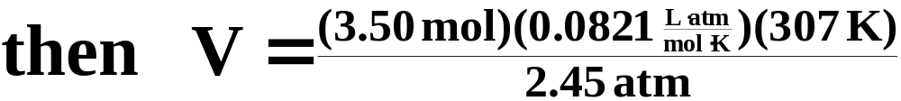

A Problem to Consider
An experiment calls for 3.50 moles of chlorine, Cl₂. What volume would this be if the gas volume is measured at 34°C and 2.45 atm?
Notes:
5

Slide 21
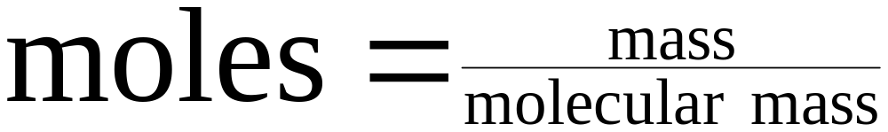
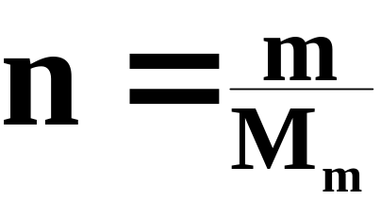
Molecular Weight Determination
In Chapter 3 we showed the relationship between moles and mass.
or
Notes:
12

Slide 22

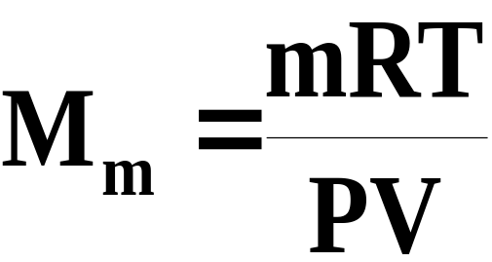
Molecular Weight Determination
If we substitute this in the ideal gas equation, we obtain
If we solve this equation for the molecular mass, we obtain
Notes:
12

Slide 23

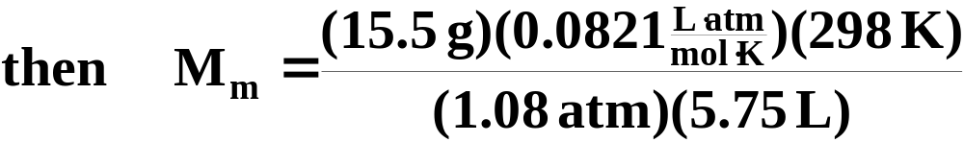

A Problem to Consider
A 15.5 gram sample of an unknown gas occupied a volume of 5.75 L at 25°C and a pressure of 1.08 atm. Calculate its molecular mass.
Notes:
5

Slide 24
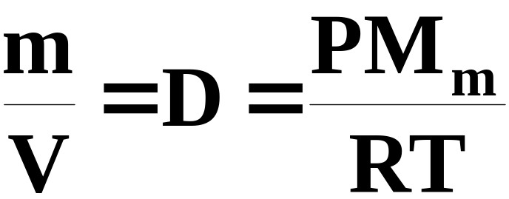
Density Determination
If we look again at our derivation of the molecular mass equation,
we can solve for m/V, which represents density.
Notes:
12

Slide 25
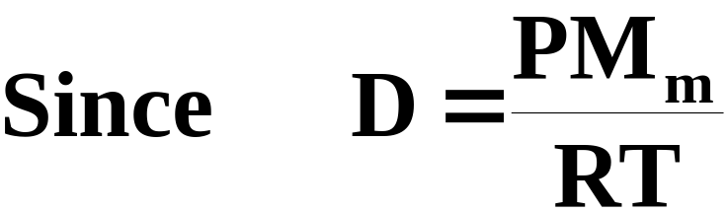
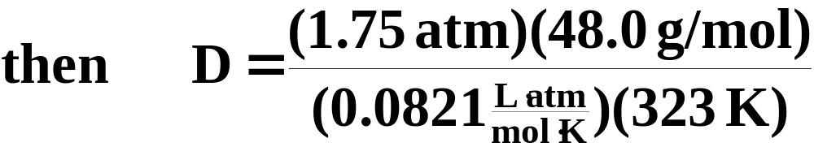

A Problem to Consider
Calculate the density of ozone, O₃ (Mm = 48.0g/mol), at 50°C and 1.75 atm of pressure.
Notes:
5

Slide 26
Stoichiometry Problems Involving Gas Volumes
Consider the following reaction, which is often used to generate small quantities of oxygen.
Suppose you heat 0.0100 mol of potassium chlorate, KClO₃, in a test tube. How many liters of oxygen can you produce at 298 K and 1.02 atm?
Notes:
13

Slide 27
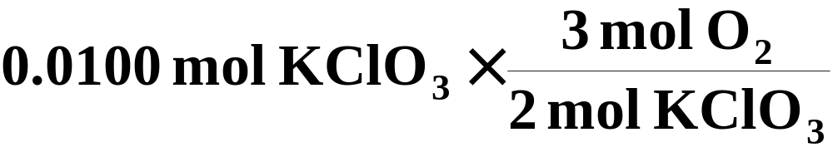
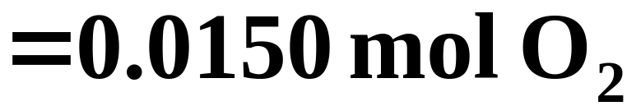
Stoichiometry Problems Involving Gas Volumes
First we must determine the number of moles of oxygen produced by the reaction.
Notes:
13

Slide 28
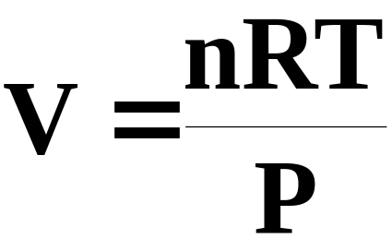
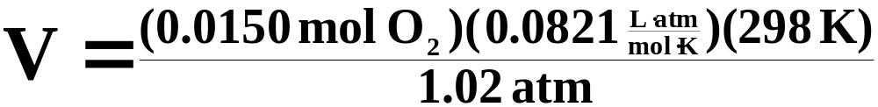

Stoichiometry Problems Involving Gas Volumes
Now we can use the ideal gas equation to calculate the volume of oxygen under the conditions given.
Notes:
13

Slide 29

Partial Pressures of Gas Mixtures
Dalton’s Law of Partial Pressures: the sum of all the pressures of all the different gases in a mixture equals the total pressure of the mixture. (Figure 5.19)
Notes:
13

Slide 30
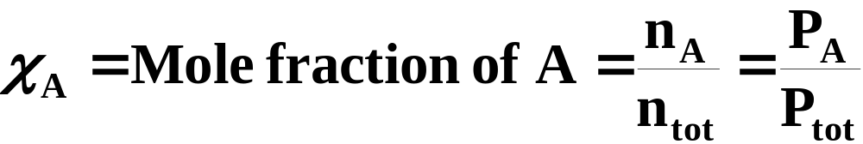
Partial Pressures of Gas Mixtures
The composition of a gas mixture is often described in terms of its mole fraction.
  The mole fraction,  , of a component gas is the fraction of moles of that component in the total moles of gas mixture.
Notes:
13

Slide 31


Partial Pressures of Gas Mixtures
The partial pressure of a component gas, “A”, is then defined as
  Applying this concept to the ideal gas equation, we find that each gas can be treated independently.
Notes:
13

Slide 32
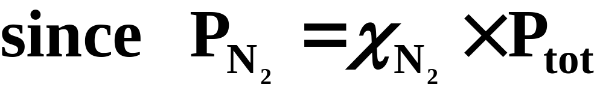
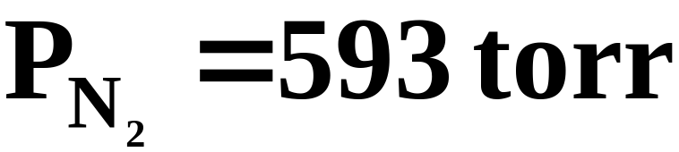
A Problem to Consider
Given a mixture of gases in the atmosphere at 760 torr, what is the partial pressure of N₂ (χ = 0 .7808) at 25°C?
Notes:
5

Slide 33
Collecting Gases “Over Water”
A useful application of partial pressures arises when you collect gases over water. (See Figure 5.20)
  As gas bubbles through the water, the gas becomes saturated with water vapor.
  The partial pressure of the water in this “mixture” depends only on the temperature. (See Table 5.6)
Notes:
13

Slide 34
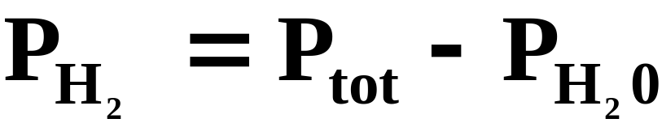
A Problem to Consider
Suppose a 156 mL sample of H₂ gas was collected over water at 19ºC and 769 mm Hg. What is the mass of H₂ collected?
  First, we must find the partial pressure of the dry H₂.
Notes:
5

Slide 35
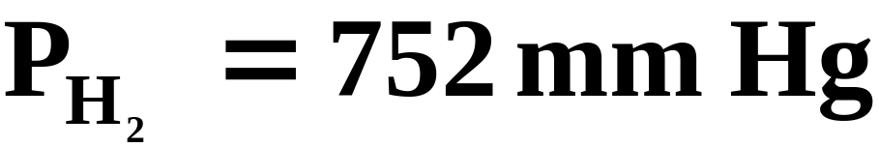
A Problem to Consider
Suppose a 156 mL sample of H₂ gas was collected over water at 19ºC and 769 mm Hg. What is the mass of H₂ collected?
  Table 5.6 lists the vapor pressure of water at 19ºC as 16.5 mm Hg.
Notes:
5

Slide 36


A Problem to Consider
Now we can use the ideal gas equation, along with the partial pressure of the hydrogen, to determine its mass.
Notes:
5

Slide 37
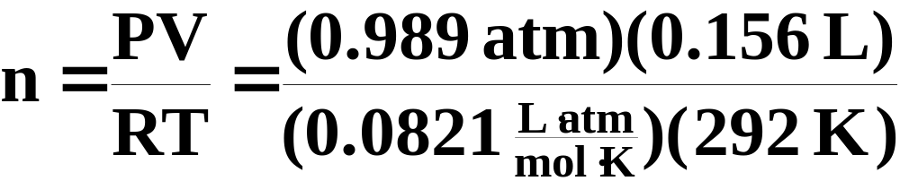

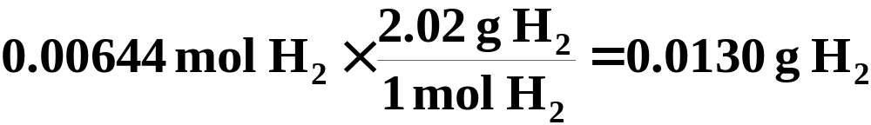
A Problem to Consider
From the ideal gas law, PV = nRT, you have
Next,convert moles of H₂ to grams of H₂.
Notes:
5

Slide 38
Kinetic-Molecular Theory
A simple model based on the actions of individual atoms
Volume of particles is negligible
Particles are in constant motion
No inherent attractive or repulsive forces
The average kinetic energy of a collection of particles is proportional to the temperature (K)
(See Animation: Kinetic Molecular Theory)
(See Animations: Visualizing Molecular Motion and Visualizing Molecular Motion [many Molecules])
Notes:
20

Slide 39
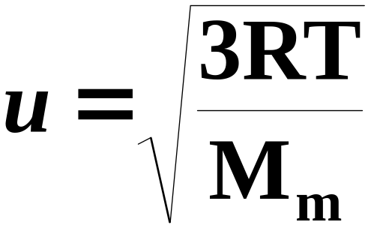
Molecular Speeds; Diffusion and Effusion
The root-mean-square (rms) molecular speed, u, is a type of average molecular speed, equal to the speed of a molecule having the average molecular kinetic energy. It is given by the following formula:
Notes:
21

Slide 40
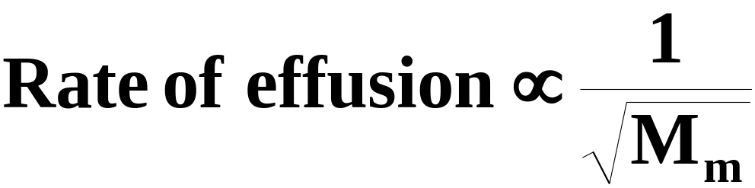
Molecular Speeds; Diffusion and Effusion
Diffusion is the transfer of a gas through space or another gas over time.
Effusion is the transfer of a gas through a membrane or orifice.
  The equation for the rms velocity of gases shows the following relationship between rate of effusion and molecular mass. (See Figure 5.22)
Notes:
21

Slide 41
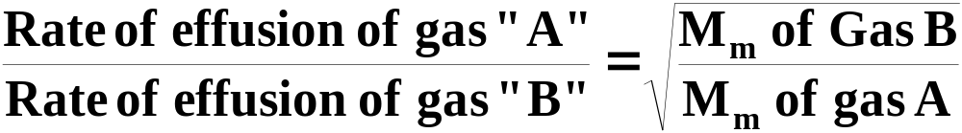
Molecular Speeds; Diffusion and Effusion
According to Graham’s law, the rate of effusion or diffusion is inversely proportional to the square root of its molecular mass. (See Figures 5.28 and 5.29)
Notes:
21

Slide 42
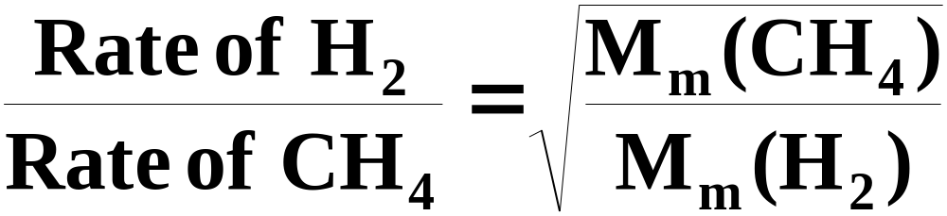
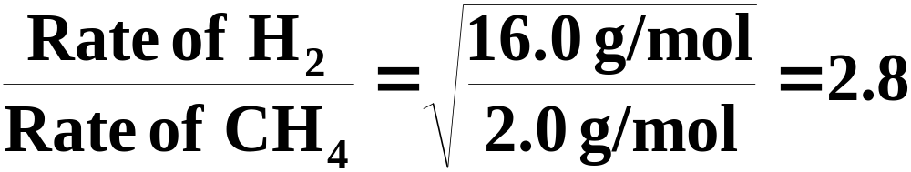
A Problem to Consider
How much faster would H₂ gas effuse through an opening than methane, CH₄?
So hydrogen effuses 2.8 times faster than CH₄
Notes:
23

Slide 43
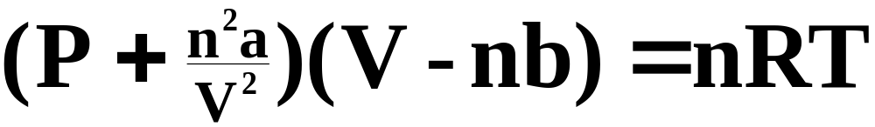
Real Gases
Real gases do not follow PV = nRT perfectly. The van der Waals equation corrects for the nonideal nature of real gases.
a corrects for interaction between atoms.
b corrects for volume occupied by atoms.
Notes:
29

Slide 44
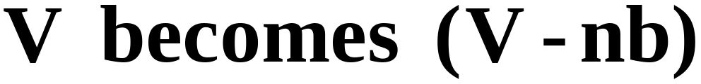
Real Gases
In the van der Waals equation,
where “nb” represents the volume occupied by “n” moles of molecules. (See Figure 5.32)
Notes:
29

Slide 45

Real Gases
Also, in the van der Waals equation,
where “n²a/V²” represents the effect on pressure to intermolecular attractions or repulsions. (See Figure 5.33)
Table 5.7 gives values of van der Waals constants for various gases.
Notes:
29

Slide 46
A Problem to Consider
If sulfur dioxide were an “ideal” gas, the pressure at 0°C exerted by 1.000 mol occupying 22.41 L would be 1.000 atm. Use the van der Waals equation to estimate the “real” pressure.
Table 5.7 lists the following values for SO₂
a = 6.865 L^{2.}atm/mol²
b = 0.05679 L/mol
Notes:
29

Slide 47

A Problem to Consider
First, let’s rearrange the van der Waals equation to solve for pressure.
R= 0.0821 L. atm/mol. K
T = 273.2 K
V = 22.41 L
a = 6.865 L^{2.}atm/mol²
b = 0.05679 L/mol
Notes:
29

Slide 48



A Problem to Consider
The “real” pressure exerted by 1.00 mol of SO₂ at STP is slightly less than the “ideal” pressure.
Notes:
29

Slide 49
Operational Skills
Converting units of pressure.
Using the empirical gas laws.
Deriving empirical gas laws from the ideal gas law.
Using the ideal gas law.
Relating gas density and molecular weight.
Solving stoichiometry problems involving gases.
Calculating partial pressures and mole fractions.
Calculating the amount of gas collected over water.
Calculating the rms speed of gas molecules.
Calculating the ratio of effusion rates of gases.
Using the van der Waals equation.
Notes:
29

Slide 50


Figure 5.2: A mercury barometer.
Return to Slide 3

Slide 51

Figure 5.5: Boyle’s experiment.
Return to Slide 4

Slide 52
Animation: Boyle’s Law
(Click here to open QuickTime animation)
Return to Slide 4

Slide 53
Animation: Charle’s Law
(Click here to open QuickTime animation)
Return to Slide 6

Slide 54
Video: Liquid Nitrogen & Balloons
(Click here to open QuickTime video)
Return to Slide 6

Slide 55
Animation: Microscopic Illustration of Charle’s Law
(Click here to open QuickTime animation)
Return to Slide 6

Slide 56

Figure 5.12: The molar volume of a gas.
Photo courtesy of James Scherer.
Return to Slide 12

Slide 57
Animation: Pressure and Concentration of a Gas
(Click here to open QuickTime animation)
Return to Slide 13

Slide 58
Animation: The Ideal Gas Law
(Click here to open QuickTime animation)
Return to Slide 19

Slide 59


Figure 5.19: An illustration of Dalton’s law of partial pressures.
Return to Slide 29

Slide 60

Figure 5.20: Collection of gas over water.
Return to Slide 33

Slide 61

Return to Slide 33

Slide 62
Animation: Kinetic Molecular Theory
(Click here to open QuickTime animation)
Return to Slide 38

Slide 63
Animation: Visualizing Molecular Motion [One Molecule]
(Click here to open QuickTime animation)
Return to Slide 38

Slide 64
Animation: Visualizing Molecular Motion [Many Molecules]
(Click here to open QuickTime animation)
Return to Slide 38

Slide 65
Animation: Diffusion of a Gas
(Click here to open QuickTime animation)
Return to Slide 40

Slide 66
Animation: Effusion of a Gas
(Click here to open QuickTime animation)
Return to Slide 40

Slide 67

Figure 5.22: Elastic collision of steel balls: The ball is released and transmits energy to the ball on the right. Photo courtesy of American Color.
Return to Slide 40

Slide 68

Figure 5.28:
Gaseous Effusion
Return to Slide 41

Slide 69

Figure 5.29: Hydrogen Fountain
Return to Slide 41

Slide 70

Figure 5.32: Molecular Volume
Return to Slide 44

Slide 71

Figure 5.33: Intermolecular Attractions
Return to Slide 45

