Slide 1


Section 1 Properties of Acids and Bases
Chapter 14
Objectives
List five general properties of aqueous acids and bases.
Name common binary acids and oxyacids, given their chemical formulas.
List five acids commonly used in industry and the laboratory, and give two properties of each.
Define acid and base according to Arrhenius’s theory of ionization.
Explain the differences between strong and weak acids and bases.

Slide 2
Section 1 Properties of Acids and Bases
Chapter 14
Acids
1. Aqueous solutions of acids have a sour taste.
2. Acids change the color of acid-base indicators.
3. Some acids react with active metals and release hydrogen gas, H₂.
Ba(s) + H₂SO₄(aq) BaSO₄(s) + H₂(g)
4. Acids react with bases to produce salts and water.
NaOH(aq) + HCl(aq) NaCl (aq) + H₂O(g)
5. Acids conduct electric current.

Slide 3
Section 1 Properties of Acids and Bases
Chapter 14
Acids, continued
Acid Nomenclature
A binary acid is an acid that contains only two different elements: hydrogen and one of the more electronegative elements.
  HF, HCl, HBr, and HI
Binary Acid Nomenclature
  1. The name of a binary acid begins with the prefix hydro-.
  2. The root of the name of the second element follows this prefix.
  3. The name then ends with the suffix -ic.

Slide 4
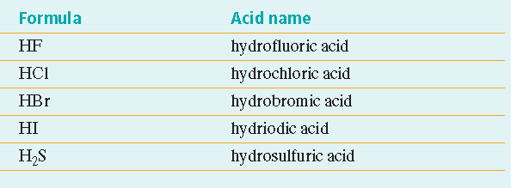
Section 1 Properties of Acids and Bases
Chapter 14
Acids, continued
Acid Nomenclature, continued

Slide 5
Section 1 Properties of Acids and Bases
Chapter 14
Acids, continued
Acid Nomenclature, continued
An oxyacid is an acid that is a compound of hydrogen, oxygen, and a third element, usually a nonmetal.
  HNO₃, H₂SO₄
The names of oxyacids follow a pattern.
The names of their anions are based on the names of the acids.

Slide 6
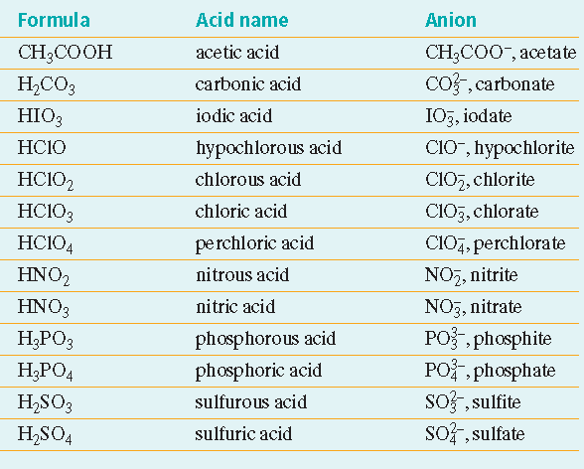
Section 1 Properties of Acids and Bases
Chapter 14
Acids, continued
Acid Nomenclature, continued

Slide 7
Section 1 Properties of Acids and Bases
Chapter 14
Bases
1. Aqueous solutions of bases taste bitter.
2. Bases change the color of acid-base indicators.
3. Dilute aqueous solutions of bases feel slippery.
4. Bases react with acids to produce salts and water.
5. Bases conduct electric current.

Slide 8
Section 1 Properties of Acids and Bases
Chapter 14
Arrhenius Acids and Bases
An Arrhenius acid is a chemical compound that increases the concentration of hydrogen ions, H⁺, in aqueous solution.
An Arrhenius base is a substance that increases the concentration of hydroxide ions, OH⁻, in aqueous solution.

Slide 9
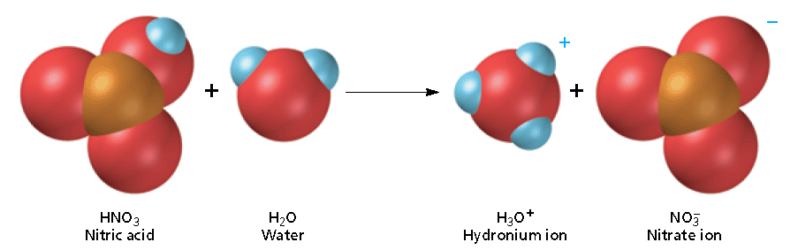
Section 1 Properties of Acids and Bases
Chapter 14
Arrhenius Acids and Bases, continued
Aqueous Solutions of Acids
Arrhenius acids are molecular compounds with ionizable hydrogen atoms.
Their water solutions are known as aqueous acids.
All aqueous acids are electrolytes.

Slide 10
Warm Up……
Have out last nights homework.
For Warm-up Complete questions #1-3 on page 477. Read about lead aand copper pipes and the effects of Acidic Tap water.

Slide 11
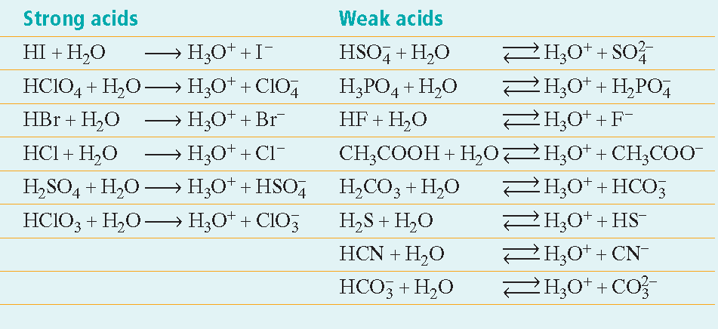
Section 1 Properties of Acids and Bases
Chapter 14
Arrhenius Acids and Bases, continued
Aqueous Solutions of Acids, continued
Common Aqueous Acids

Slide 12
Section 1 Properties of Acids and Bases
Chapter 14
Arrhenius Acids and Bases, continued
Strength of Acids
A strong acid is one that ionizes completely in aqueous solution.
  a strong acid is a strong electrolyte
  HClO₄, HCl, HNO₃
A weak acid releases few hydrogen ions in aqueous solution.
  hydronium ions, anions, and dissolved acid molecules in aqueous solution
  HCN
  Organic acids (—COOH), such as acetic acid

Slide 13
Section 1 Properties of Acids and Bases
Chapter 14
Arrhenius Acids and Bases, continued
Aqueous Solutions of Bases
Most bases are ionic compounds containing metal cations and the hydroxide anion, OH⁻.
  dissociate in water
Ammonia, NH₃, is molecular
  Ammonia produces hydroxide ions when it reacts with water molecules.

Slide 14
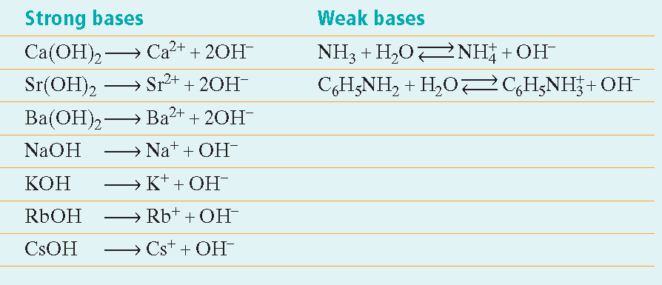
Section 1 Properties of Acids and Bases
Chapter 14
Arrhenius Acids and Bases, continued
Strength of Bases
The strength of a base depends on the extent to which the base dissociates.
Strong bases are strong electrolytes

Slide 15

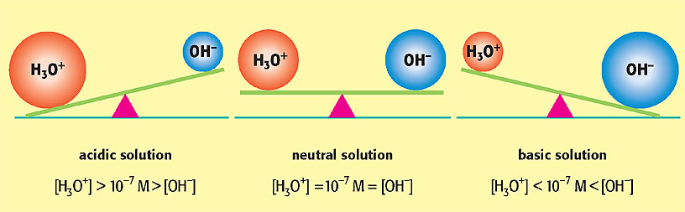
Relationship of [H₃O⁺] to [OH–]
Section 1 Properties of Acids and Bases
Chapter 14

Slide 16
Chapter 14
Section 2 Acid-Base Theories
Lesson Starter
List three terms that describe the person in the photo.
The person has been described in many different ways, but he or she is still the same person.
Acids and bases also can be described differently based on the circumstances.

Slide 17
Chapter 14
Section 2 Acid-Base Theories
Warm Up
Determine if the following compounds are acids or bases, name the compounds and write the dissociation in water.
A. H₃PO₄
NaOH
Ba(OH)₂
H₂SO₃
HBr

Slide 18

Chapter 14
Section 2 Acid-Base Theories
Brønsted-Lowry Acids and Bases
A Brønsted-Lowry acid is a molecule or ion that is a proton donor.
Hydrogen chloride acts as a Brønsted-Lowry acid when it reacts with ammonia.
Water can act as a Brønsted-Lowry acid.

Slide 19
Chapter 14
Section 2 Acid-Base Theories
Brønsted-Lowry Acids and Bases, continued
A Brønsted-Lowry base is a molecule or ion that is a proton acceptor.
Ammonia accepts a proton from the hydrochloric acid. It acts as a Brønsted-Lowry base.
The OH⁻ ion produced in solution by Arrhenius hydroxide bases (NaOH) is the Brønsted-Lowry base.
  The OH⁻ ion can accept a proton.

Slide 20

Chapter 14
Section 2 Acid-Base Theories
Brønsted-Lowry Acids and Bases, continued
In a Brønsted-Lowry acid-base reaction, protons are transferred from one reactant (the acid) to another (the base).
acid base

Slide 21
Chapter 14
Section 2 Acid-Base Theories
Monoprotic and Polyprotic Acids
A monoprotic acid is an acid that can donate only one proton (hydrogen ion) per molecule.
  HClO₄, HCl, HNO₃
  only one ionization step

Slide 22
Chapter 14
Section 2 Acid-Base Theories
Monoprotic and Polyprotic Acids, continued
A polyprotic acid is an acid that can donate more than one proton per molecule.
  H₂SO₄, H₃PO₄
  Multiple ionization steps
  (1)
  (2)
  Sulfuric acid solutions contain H₃O⁺,
ions

Slide 23
Chapter 14
Section 2 Acid-Base Theories
Monoprotic and Polyprotic Acids, continued
A diprotic acid is the type of polyprotic acid that can donate two protons per molecule
  H₂SO₄
A triprotic acid is the type of polyprotic acid that can donate three protons per molecule.
  H₃PO₄

Slide 24
Chapter 14
Section 2 Acid-Base Theories
Lewis Acids and Bases
A Lewis acid is an atom, ion, or molecule that accepts an electron pair to form a covalent bond.
  The Lewis definition is the broadest of the three acid definitions.
  A bare proton (hydrogen ion) is a Lewis acid

Slide 25

Chapter 14
Section 2 Acid-Base Theories
Lewis Acids and Bases, continued
The formula for a Lewis acid need not include hydrogen.
  The silver ion can be a Lewis acid
Any compound in which the central atom has three valence electrons and forms three covalent bonds can react as a Lewis acid.

Slide 26
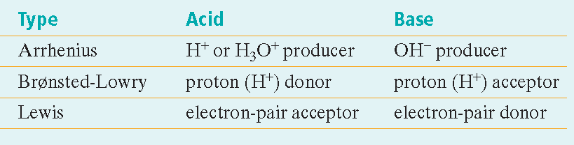
Chapter 14
Section 2 Acid-Base Theories
Lewis Acids and Bases, continued
Acid Base Definitions

Slide 27
Chapter 14
Section 3 Acid-Base Reactions
Lesson Starter
What is the meaning of the word neutralization.
How is the word used in everyday life?
How is it likely to apply to acids and bases?

Slide 28
Chapter 14
Section 3 Acid-Base Reactions
Objectives
Describe a conjugate acid, a conjugate base, and an amphoteric compound.
Explain the process of neutralization.
Define acid rain, give examples of compounds that can cause acid rain, and describe effects of acid rain.

Slide 29
Chapter 14
Section 3 Acid-Base Reactions
Conjugate Acids and Bases
The species that remains after a Brønsted-Lowry acid has given up a proton is the conjugate base of that acid.
acid conjugate
base

Slide 30
Chapter 14
Section 3 Acid-Base Reactions
Conjugate Acids and Bases, continued
Brønsted-Lowry acid-base reactions involve two acid-base pairs, known a conjugate acid-base pairs.
acid₁ base₂ base₁ acid₂

Slide 31
Chapter 14
Section 3 Acid-Base Reactions
Amphoteric Compounds
Any species that can react as either an acid or a base is described as amphoteric.
  example: water
    water can act as a base
    acid₁ base₂ acid₂ base₁
    water can act as an acid
    base₁ acid₂ acid₁ base₂

Slide 32
Chapter 14
Section 3 Acid-Base Reactions
Neutralization Reactions
Strong Acid-Strong Base Neutralization
In aqueous solutions, neutralization is the reaction of hydronium ions and hydroxide ions to form water molecules.
A salt is an ionic compound composed of a cation from a base and an anion from an acid.

Slide 33

Chapter 14
Section 3 Acid-Base Reactions
Acid Rain
NO, NO₂, CO₂, SO₂, and SO₃ gases from industrial processes can dissolve in atmospheric water to produce acidic solutions.
example:
Very acidic rain is known as acid rain.
Acid rain can erode statues and affect ecosystems.

Slide 34

End of Chapter 14 Show

Slide 35
Multiple Choice
Chapter 14
Standardized Test Preparation
1. Which of the following is not a characteristic of
an acid?
A. An acid changes the color of an indicator.
B. An acid has a bitter taste.
C. An acid ionizes in water.
D. An acid produces hydronium ions in water.

Slide 36
Multiple Choice
Chapter 14
Standardized Test Preparation
1. Which of the following is not a characteristic of
an acid?
A. An acid changes the color of an indicator.
B. An acid has a bitter taste.
C. An acid ionizes in water.
D. An acid produces hydronium ions in water.

Slide 37
Multiple Choice
Chapter 14
Standardized Test Preparation
2. When an acid reacts with an active metal,
A. the hydronium ion concentration increases.
B. the metal forms anions.
C. hydrogen gas is produced.
D. carbon dioxide gas is produced.

Slide 38
Multiple Choice
Chapter 14
Standardized Test Preparation
2. When an acid reacts with an active metal,
A. the hydronium ion concentration increases.
B. the metal forms anions.
C. hydrogen gas is produced.
D. carbon dioxide gas is produced.

Slide 39
Multiple Choice
Chapter 14
Standardized Test Preparation
3. Which of the following is a Brønsted-Lowry base?
A. an electron pair donor
B. an electron pair acceptor
C. a proton donor
D. a proton acceptor

Slide 40
Multiple Choice
Chapter 14
Standardized Test Preparation
3. Which of the following is a Brønsted-Lowry base?
A. an electron pair donor
B. an electron pair acceptor
C. a proton donor
D. a proton acceptor

Slide 41
Multiple Choice
Chapter 14
Standardized Test Preparation
4. Which acid is the most commonly produced industrial chemical?
A. hydrochloric acid
B. acetic acid
C. nitric acid
D. sulfuric acid

Slide 42
Multiple Choice
Chapter 14
Standardized Test Preparation
4. Which acid is the most commonly produced industrial chemical?
A. hydrochloric acid
B. acetic acid
C. nitric acid
D. sulfuric acid

Slide 43
Multiple Choice
Chapter 14
Standardized Test Preparation
5. Which of the following is a conjugate pair?
A. H⁺ and OH⁻
B.
C. HCl and Cl⁻
D.

Slide 44
Multiple Choice
Chapter 14
Standardized Test Preparation
5. Which of the following is a conjugate pair?
A. H⁺ and OH⁻
B.
C. HCl and Cl⁻
D.

Slide 45
Multiple Choice
Chapter 14
Standardized Test Preparation
6. What is the formula for acetic acid?
A. CH₃COOH
B. HNO₃
C. HClO₄
D. HCN

Slide 46
Multiple Choice
Chapter 14
Standardized Test Preparation
6. What is the formula for acetic acid?
A. CH₃COOH
B. HNO₃
C. HClO₄
D. HCN

Slide 47
Multiple Choice
Chapter 14
Standardized Test Preparation
7. Which of the following species is the conjugate acid of another species in the list?
A.
B. H₃PO₄
C. H₂O
D.

Slide 48
Multiple Choice
Chapter 14
Standardized Test Preparation
7. Which of the following species is the conjugate acid of another species in the list?
A.
B. H₃PO₄
C. H₂O
D.

Slide 49
Multiple Choice
Chapter 14
Standardized Test Preparation
8. Identify the salt that forms when a solution of H₂SO₄ is titrated with a solution of Ca(OH)₂.
A. calcium sulfate
B. calcium hydroxide
C. calcium oxide
D. calcium phosphate

Slide 50
Multiple Choice
Chapter 14
Standardized Test Preparation
8. Identify the salt that forms when a solution of H₂SO₄ is titrated with a solution of Ca(OH)₂.
A. calcium sulfate
B. calcium hydroxide
C. calcium oxide
D. calcium phosphate

Slide 51
Multiple Choice
Chapter 14
Standardized Test Preparation
9. Which of the following statements is true for the reaction below?
A. HF is the base.
B.
C. F⁻ is the conjugate base.
D.

Slide 52
Multiple Choice
Chapter 14
Standardized Test Preparation
9. Which of the following statements is true for the reaction below?
A. HF is the base.
B.
C. F⁻ is the conjugate base.
D.

Slide 53
Short Answer
Chapter 14
Standardized Test Preparation
10. How does a strong acid differ from a weak acid? Give
one example of each.

Slide 54
Short Answer
Chapter 14
Standardized Test Preparation
10. How does a strong acid differ from a weak acid? Give
one example of each.
Answer: A strong acid is 100% ionized; a weak acid is
less than 100% ionized. Possible strong acids are HCl,
HI, HBr, HNO₃, H₂SO₄, HClO₄, and HClO₃. With very
few exceptions, any other acid will be a weak acid.

Slide 55
Short Answer
Chapter 14
Standardized Test Preparation
11. Identify the conjugate acid-base pairs in the following
reaction:

Slide 56
Short Answer
Chapter 14
Standardized Test Preparation
11. Identify the conjugate acid-base pairs in the following
reaction:
Answer: HClO₂(aq) acid₁,
NH₃(aq) base₂,

Slide 57
Extended Response
Chapter 14
Standardized Test Preparation
12. Phosphoric acid, H₃PO₄, has three hydrogen atoms and is classified as a triprotic acid. Acetic acid, CH₃COOH, has four hydrogen atoms and is classified as a monoprotic acid. Explain the difference, and justify your explanation by drawing the Lewis structure for both acids.

Slide 58
Extended Response
Chapter 14
Standardized Test Preparation
12. Phosphoric acid, H₃PO₄, has three hydrogen atoms and is classified as a triprotic acid. Acetic acid, CH₃COOH, has four hydrogen atoms and is classified as a monoprotic acid. Explain the difference, and justify your explanation by drawing the Lewis structure for both acids.
Answer: Each of the H atoms in phosphoric acid is attached to an oxygen atom and can ionize. Only one of the H atoms in acetic acid is attached to an oxygen atom and can be ionized. The three H atoms bonded to C do not ionize; thus, acetic acid is a monoprotic acid.

Slide 59
Extended Response
Chapter 14
Standardized Test Preparation
12. Phosphoric acid, H₃PO₄, has three hydrogen atoms and is classified as a triprotic acid. Acetic acid, CH₃COOH, has four hydrogen atoms and is classified as a monoprotic acid. Explain the difference, and justify your explanation by drawing the Lewis structure for both acids.
Answer continued:

Slide 60
Extended Response
Chapter 14
Standardized Test Preparation
13. Write the full equation, ionic equation, and net ionic equation for the neutralization reaction between ammonia and sulfuric acid. Identify the spectator ion(s).

Slide 61
Extended Response
Chapter 14
Standardized Test Preparation
13. Write the full equation, ionic equation, and net ionic equation for the neutralization reaction between ammonia and sulfuric acid. Identify the spectator ion(s).
Answer:
full equation:
ionic equation:
net ionic equation:
spectator ion:

