Slide 1


Section 1 The Nature of Chemical Equilibrium
Chapter 18
Reversible Reactions
A chemical reaction in which the products can react to re-form the reactants is called a reversible reaction.

Slide 2
Section 1 The Nature of Chemical Equilibrium
Chapter 18
Reversible Reactions, continued
A reversible chemical reaction is in chemical equilibrium when the rate of its forward reaction equals the rate of its reverse reaction and the concentrations of its products and reactants remain unchanged.

Slide 3
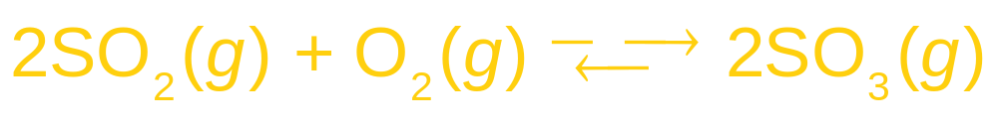
Section 1 The Nature of Chemical Equilibrium
Chapter 18
Equilibrium, a Dynamic State, continued
products of the forward reaction favored, lies to the right
products of the reverse reaction favored, lies to the left
Neither reaction is favored

Slide 4
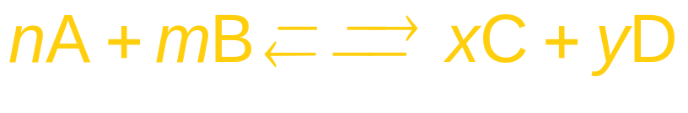
Section 1 The Nature of Chemical Equilibrium
Chapter 18
The Equilibrium Expression
Initially, the concentrations of C and D are zero and those of A and B are maximum.
When these two reaction rates become equal, equilibrium is established.

Slide 5
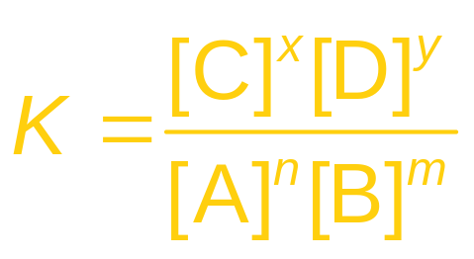
Section 1 The Nature of Chemical Equilibrium
Chapter 18
The Equilibrium Expression, continued
The equilibrium constant is designated by the letter K.

Slide 6
Section 1 The Nature of Chemical Equilibrium
Chapter 18
The Equilibrium Expression, continued
The Equilibrium Constant, continued
If the value of K is small, the reactants are favored.
A large value of K indicates that the products are favored.
Only the concentrations of substances that can actually change are included in K.
  Pure solids and liquids are omitted because their concentrations cannot change.

Slide 7

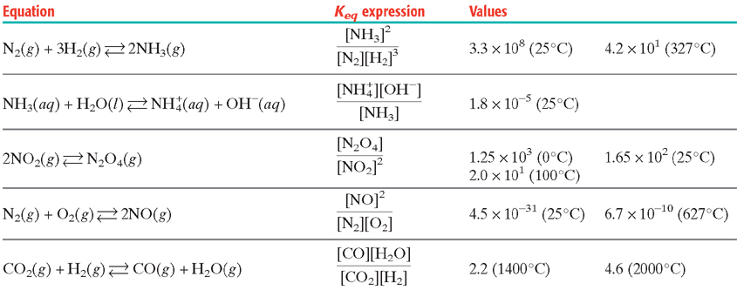
Equilibrium Constants
Section 1 The Nature of Chemical Equilibrium
Chapter 18

Slide 8
Section 1 The Nature of Chemical Equilibrium
Chapter 18
The Equilibrium Expression, continued
Sample Problem A
An equilibrium mixture of N₂, O₂ , and NO gases at
1500 K is determined to consist of 6.4 × 10^{–3} mol/L of
N₂, 1.7 × 10^{–3} mol/L of O₂, and 1.1 × 10^{–5} mol/L of NO.
What is the equilibrium constant for the system at
this temperature?

Slide 9
Section 1 The Nature of Chemical Equilibrium
Chapter 18
The Equilibrium Expression, continued
Sample Problem A Solution
Given: [N₂] = 6.4 × 10^{–3} mol/L
[O₂] = 1.7 × 10^{–3} mol/L
[NO] = 1.1 × 10^{–5} mol/L
Unknown: K
Solution:
The balanced chemical equation is
The chemical equilibrium expression is

Slide 10
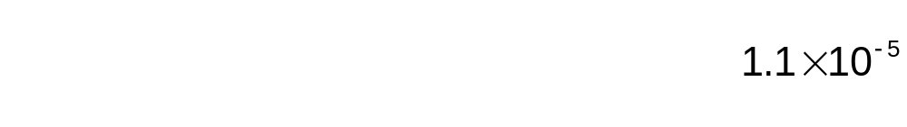
Section 1 The Nature of Chemical Equilibrium
Chapter 18
The Equilibrium Expression, continued
Sample Problem A Solution, continued

Slide 11
Chapter 18
Section 2 Shifting Equilibrium
Objectives
Discuss the factors that disturb equilibrium.

Slide 13
8a. Forward 8b. Reverse
9. Solids and liquids, see notes for why
10. lowers activation energy for both products and reactants thus no overall change in equilibrium.
11a. forward 11b. Forward 11c. Neither 11d. Forward 11e. reverse
11f. Neither 11g. Neither 11h. Reverse 11i. neither
14. high pressure
15a. high pressure, low temps, high concentration of reactants
15b. low temp, high reactant concentration, pressure does not effect
15c. high temperature, high reactant concentration, pressure no effect
15d. high pressure, low temp, high reactant concentration
15e. low pressure, high temp, high reactant concentration
16. low pressure means the blood will not be oxygenated as much then at sea level.

Slide 14
Chapter 18
Section 2 Shifting Equilibrium
Predicting the Direction of Shift
Le Châtelier’s principle states that if a system at equilibrium is subjected to a stress, the equilibrium is shifted in the direction that tends to relieve the stress.
  Changes in pressure, concentration, and temperature illustrate Le Châtelier’s principle.

Slide 15
Chapter 18
Section 2 Shifting Equilibrium
Predicting the Direction of Shift, continued
Changes in Pressure
A change in pressure affects only equilibrium systems in which gases are involved.
For pressure change to effect equilibrium, moles of reactants CAN NOT equal moles of product.

Slide 16
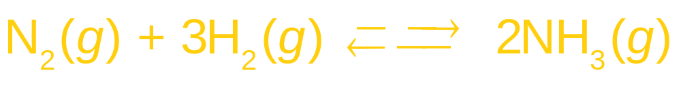
Chapter 18
Section 2 Shifting Equilibrium
Predicting the Direction of Shift, continued
Changes in Pressure, continued
4 molecules of gas 2 molecules of gas
When pressure is applied, the equilibrium will shift to the right, and produce more NH₃.
  By shifting to the right, the system can reduce the total number of molecules. This leads to a decrease in pressure.

Slide 17

Chapter 18
Section 2 Shifting Equilibrium
Predicting the Direction of Shift, continued
Changes in Concentration
An increase in the concentration of a reactant is a stress on the equilibrium system.
An increase in the concentration of A creates a stress.
To relieve the stress, some of the added A reacts with B to form products C and D.
The equilibrium is reestablished with a higher concentration of A than before the addition and a lower concentration of B.

Slide 18
Chapter 18
Section 2 Shifting Equilibrium
Predicting the Direction of Shift, continued
Changes in Concentration, continued
Changes in concentration have no effect on the value of the equilibrium constant.
The concentrations of pure solids and liquids do not change, and are not written in the equilibrium expression.

Slide 19
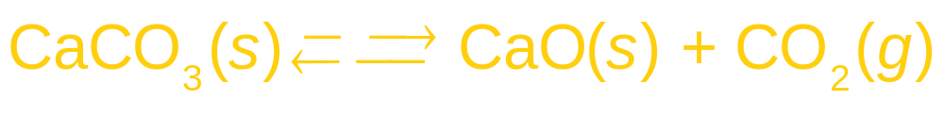
Chapter 18
Section 2 Shifting Equilibrium
Predicting the Direction of Shift, continued
Changes in Concentration, continued
High pressure favors the reverse reaction.
Low pressure favors the formation of CO₂.
Because both CaO and CaCO₃ are solids, changing their amounts will not change the equilibrium concentration of CO₂.

Slide 20
Chapter 18
Section 2 Shifting Equilibrium
Predicting the Direction of Shift, continued
Changes in Temperature
Reversible reactions are exothermic in one direction and endothermic in the other.
The effect of changing the temperature of an equilibrium mixture depends on if the reaction is endothermic or exothermic.

Slide 21
Chapter 18
Section 2 Shifting Equilibrium
Predicting the Direction of Shift, continued
Changes in Temperature, continued
A rise in temperature increases the rate of any reaction.
In an equilibrium system, the rates of the opposing reactions are raised unequally.
The value of the equilibrium constant for a given system is affected by the temperature.

Slide 22
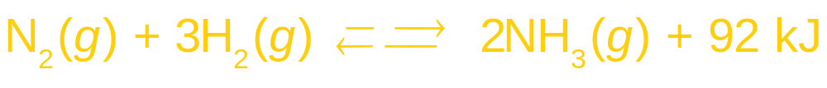
Chapter 18
Section 2 Shifting Equilibrium
Predicting the Direction of Shift, continued
Changes in Temperature, continued
The synthesis of ammonia by the Haber process is exothermic.
A high temperature favors the decomposition of ammonia, the endothermic reaction.
  At low temperatures, the forward reaction is too slow to be commercially useful.
  The temperature used represents a compromise between kinetic and equilibrium requirements.

Slide 23
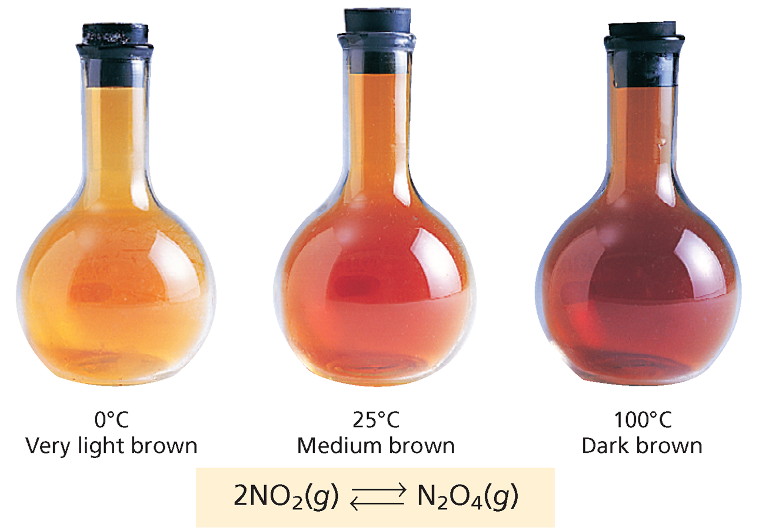
Temperature Changes Affect an Equilibrium System
Chapter 18
Section 2 Shifting Equilibrium

Slide 24
Chapter 18
Section 2 Shifting Equilibrium
Predicting the Direction of Shift, continued
Changes in Temperature, continued
Catalysts have no effect on relative equilibrium amounts.
They only affect the rates at which equilibrium is reached.
  Catalysts increase the rates of forward and reverse reactions in a system by equal factors. Therefore, they do not affect K.

Slide 25

End of Chapter 18 Show

Slide 26
Multiple Choice
Chapter 18
Standardized Test Preparation
1. A chemical reaction is in equilibrium when
A. forward and reverse reactions have ceased.
B. the equilibrium constant equals 1.
C. forward and reverse reaction rates are equal.
D. No reactants remain.

Slide 27
Chapter 18
Standardized Test Preparation
Multiple Choice
1. A chemical reaction is in equilibrium when
A. forward and reverse reactions have ceased.
B. the equilibrium constant equals 1.
C. forward and reverse reaction rates are equal.
D. No reactants remain.

Slide 28
Chapter 18
Standardized Test Preparation
Multiple Choice
2. Which change can cause the value of the equilibrium
constant to change?
A. temperature
B. concentration of a reactant
C. concentration of a product
D. None of the above

Slide 29
Chapter 18
Standardized Test Preparation
Multiple Choice
2. Which change can cause the value of the equilibrium
constant to change?
A. temperature
B. concentration of a reactant
C. concentration of a product
D. None of the above

Slide 30
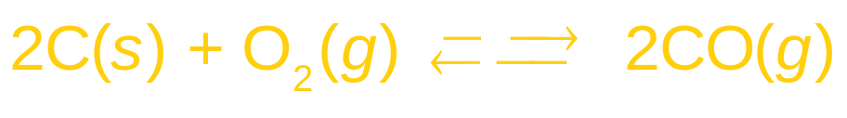
Chapter 18
Standardized Test Preparation
Multiple Choice
3. Consider the following reaction:
The equilibrium constant expression for this reaction is
A. C.
B. D.

Slide 31
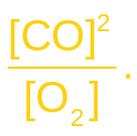
Chapter 18
Standardized Test Preparation
Multiple Choice
3. Consider the following reaction:
The equilibrium constant expression for this reaction is
A. C.
B. D.

Slide 32
Chapter 18
Standardized Test Preparation
Multiple Choice
4. The solubility product of cadmium carbonate, CdCO₃, is 1.0 × 10⁻¹². In a saturated solution of this salt, the concentration of Cd²⁺(aq) ions is
A. 5.0 . 10⁻¹³ mol/L.
B. 1.0 . 10⁻¹² mol/L.
C. 1.0 . 10⁻⁶ mol/L.
D. 5.0 . 10⁻⁷ mol/L.

Slide 33
Chapter 18
Standardized Test Preparation
Multiple Choice
4. The solubility product of cadmium carbonate, CdCO₃, is 1.0 × 10⁻¹². In a saturated solution of this salt, the concentration of Cd²⁺(aq) ions is
A. 5.0 . 10⁻¹³ mol/L.
B. 1.0 . 10⁻¹² mol/L.
C. 1.0 . 10⁻⁶ mol/L.
D. 5.0 . 10⁻⁷ mol/L.

Slide 34
Chapter 18
Standardized Test Preparation
Multiple Choice
5. Consider the following equation for an equilibrium system:
Which concentration(s) would be included in the denominator of the equilibrium constant expression?
A. Pb(s), CO₂(g), and SO₂(g)
B. PbS(s), O₂(g), and C(s)
C. O₂(g), Pb(s), CO₂(g), and SO₂(g)
D. O₂(g)

Slide 35
Chapter 18
Standardized Test Preparation
Multiple Choice
5. Consider the following equation for an equilibrium system:
Which concentration(s) would be included in the denominator of the equilibrium constant expression?
A. Pb(s), CO₂(g), and SO₂(g)
B. PbS(s), O₂(g), and C(s)
C. O₂(g), Pb(s), CO₂(g), and SO₂(g)
D. O₂(g)

Slide 36
Chapter 18
Standardized Test Preparation
Multiple Choice
6. If an exothermic reaction has reached equilibrium,
then increasing the temperature will
A. favor the forward reaction.
B. favor the reverse reaction.
C. favor both the forward and reverse reactions.
D. have no effect on the equilibrium.

Slide 37
Chapter 18
Standardized Test Preparation
Multiple Choice
6. If an exothermic reaction has reached equilibrium,
then increasing the temperature will
A. favor the forward reaction.
B. favor the reverse reaction.
C. favor both the forward and reverse reactions.
D. have no effect on the equilibrium.

Slide 38
Chapter 18
Standardized Test Preparation
Multiple Choice
7. Le Châtelier’s principle states that
A. at equilibrium, the forward and reverse reaction
rates are equal.
B. stresses include changes in concentrations, pressure, and temperature.
C. to relieve stress, solids and solvents are omitted from equilibrium constant expressions.
D. chemical equilibria respond to reduce applied stress.

Slide 39
Chapter 18
Standardized Test Preparation
Multiple Choice
7. Le Châtelier’s principle states that
A. at equilibrium, the forward and reverse reaction
rates are equal.
B. stresses include changes in concentrations, pressure, and temperature.
C. to relieve stress, solids and solvents are omitted from equilibrium constant expressions.
D. chemical equilibria respond to reduce applied stress.

Slide 40
Chapter 18
Standardized Test Preparation
Short Answer
8. Describe the conditions that would allow you to conclusively determine that a solution is saturated. You can use only visual observation and cannot add anything to the solution.

Slide 41
Chapter 18
Standardized Test Preparation
Short Answer
8. Describe the conditions that would allow you to conclusively determine that a solution is saturated. You can use only visual observation and cannot add anything to the solution.
Answer: There would have to be some undissolved solid present in equilibrium with the solution. (The only way to determine for certain that a solution is saturated if no solid is present is to add more of the solid to see if it dissolves.)

Slide 42
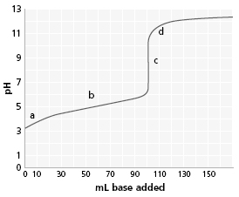
Chapter 18
Standardized Test Preparation
Short Answer
9. The graph to the right shows the neutralization curve for 100 mL of 0.100 M acid with 0.100 M base. Which letter represents the equivalence point? What type of acid and base produced this curve?

Slide 43
Chapter 18
Standardized Test Preparation
Short Answer
9. The graph to the right shows the neutralization curve for 100 mL of 0.100 M acid with 0.100 M base. Which letter represents the equivalence point? What type of acid and base produced this curve?
Answer:
c;
weak acid and strong base

Slide 44
Chapter 18
Standardized Test Preparation
Extended Response
10. Explain how the same buffer can resist a change in pH when either an acid or a base is added. Give an example.

Slide 45
Chapter 18
Standardized Test Preparation
Extended Response
10. Explain how the same buffer can resist a change in pH when either an acid or a base is added. Give an example.
Answer: There are two components to all buffers, one to react with added acid and the other to react with added base. Examples will vary, but the components will include a weak acid and its salt, such as CH₃COOH and CH₃COONa, or a weak base and its salt, such as NH₃ and NH₄Cl.

