Slide 1
What do we know about atoms?
What are atoms made of? (parts of the atom)
How big (or small) are atoms?
Draw a picture of a simple atom in your notebook.
How do you know??????

Slide 2
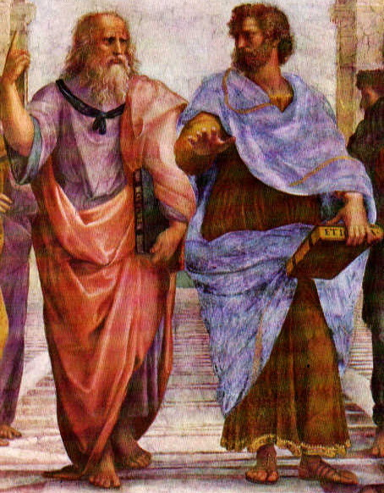
We have come a long way in the understanding of our world.
Going back to famous Greek philosophers (500-600BC), humans questioned how our universe works.
The original notion was the earth was made of Earth, Wind, Fire and Water

Slide 3
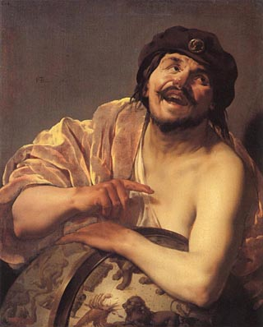
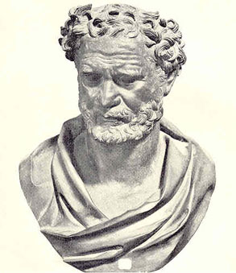
Around 400 BC there was one philosopher who came forward with a new notion of the universe.
Democritus was the first to say the world is built by smaller particles. He called these particles “atoms”.
His ideas were not received with open arms.

Slide 4
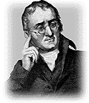
All elements are composed of tiny indivisible particles called atoms.
Atoms of the same elements are identical.
Atoms of different elements can physically mix or chemically combine together in whole number ratios.
Atoms cannot be subdivided, created or destroyed.
Chemical reactions occur when atoms are separated, joined or rearranged. Atoms of one element never change into other elements.

Slide 5

Foundations of Atomic Theory
Section 1 The Atom: From Philosophical Idea to Scientific Theory
Chapter 3
The transformation of a substance or substances into one or more new substances is known as a chemical reaction.
Law of conservation of mass: mass is neither created nor destroyed during ordinary chemical reactions or physical changes

Slide 6
Foundations of Atomic Theory, continued
Section 1 The Atom: From Philosophical Idea to Scientific Theory
Chapter 3
Law of definite proportions: a chemical compound contains the same elements in exactly the same proportions by mass regardless of the size of the sample or source of the compound
Law of multiple proportions: if two or more different compounds are composed of the same two elements, then the ratio of the masses of the second element combined with a certain mass of the first element is always a ratio of small whole numbers

Slide 7
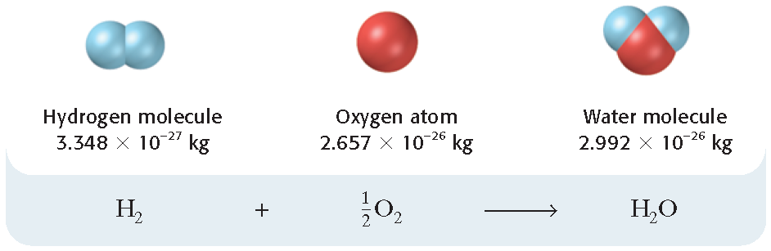
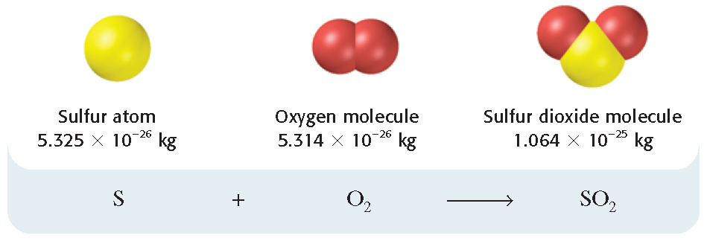
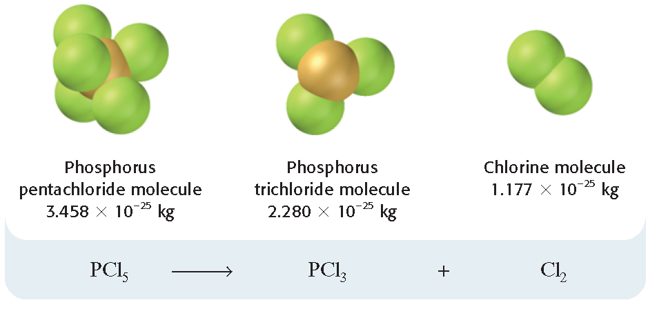
Law of Conservation of Mass

Slide 8
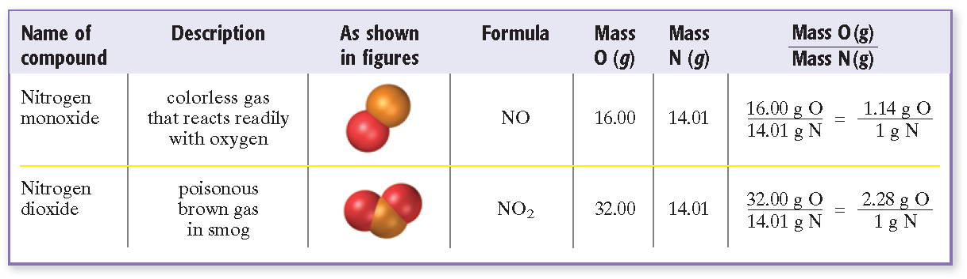
Law of Multiple Proportions

Slide 9
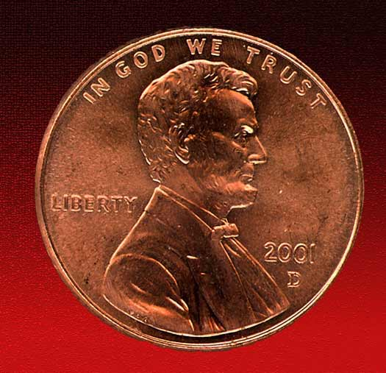
How small is an atom?
In one copper penny there are 6.24 x 10²² atoms
To compare the earth’s population is only 6 x 10⁹ people
If you put 100 000 000 copper atoms side by side they would make a line only 1 cm long.
Why can’t we see Atoms?

Slide 10
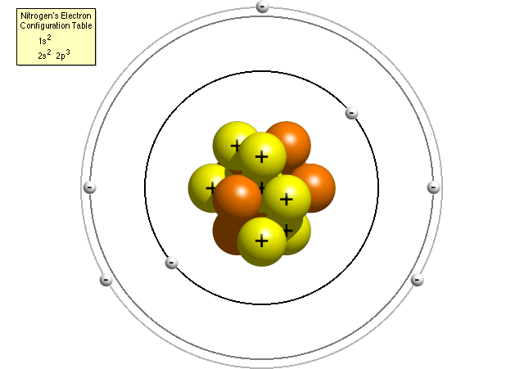
Dalton Lied!!! Well not exactly……his theories were investigated further.
Atoms have since been shown to be able to be divided into smaller particles. (subatomic particles)
Atoms are made of three smaller, subatomic particles.
Protons, Neutrons and Electrons

Slide 11
  A given element can have atoms with different masses. Isotopes
Some important concepts remain unchanged.
  All matter is composed of atoms.
  Atoms of any one element differ in properties from atoms of another element.

Slide 12
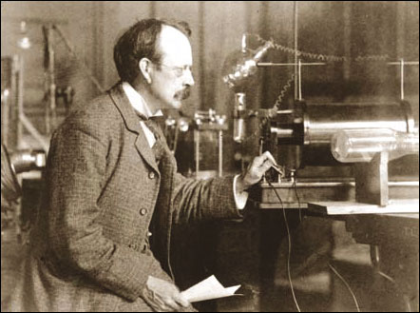
Electrons are the negatively charged subatomic particles.
JJ Thompson (English physicist) discovered electrons in 1897.
He discovered these by using a cathode ray tube.
Passing electric current through gases, then observing how the electric beam reacts to a magnet.

Slide 13
Thompson tried experimented with different gases in the tube with the same results.
Thus concluded electrons were apart of all atoms.
Afterwards Millikan found the charge and mass of an electron about 1/1840 of a proton.

Slide 14
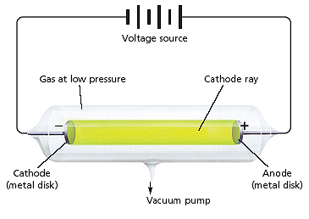
Discovery of the Electron, continued
Chapter 3
Section 2 The Structure of the Atom

Slide 15
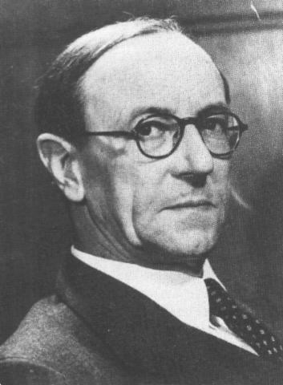
In the 1900s scientist continued studying nuclear chemistry.
They were using particle accelerators to bombard atoms.
In 1932 James Chadwick was able to detect a neutral charged subatomic particle with the same mass of a proton.
This particle was found to be the neutron.

Slide 16
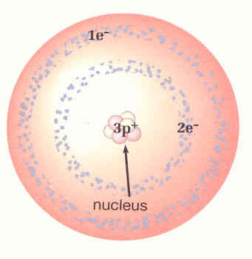
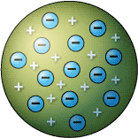

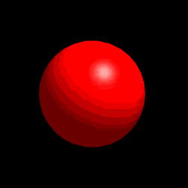
Now we have Protons (+ charge), Neutrons (0 charge), and Electrons (- charge).
Where do all these pieces fit?

Slide 17
In 1911 Ernest Rutherford from Manchester, England came up with the “Bling Bling” Gold Foil Experiment.
Ernie fired Alpha Particles (double positive charged) at a piece of gold foil.

Slide 18
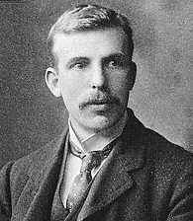
In 1911 Ernest Rutherford from Manchester, England came up with the “Bling Bling” Gold Foil Experiment.
Ernie fired Alpha Particles (double positive charged) at a piece of gold foil.

Slide 19
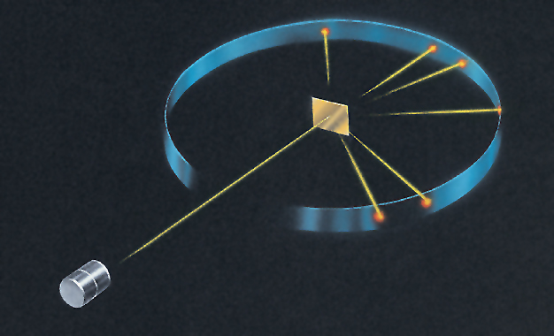
Gold Foil Experiment
Chapter 3
Section 2 The Structure of the Atom

Slide 20
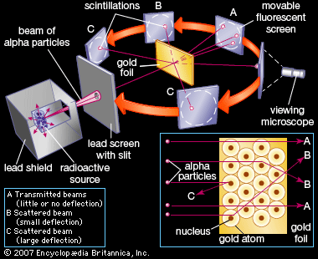
Gold Foil Experiment

Slide 21
Discovery of the Atomic Nucleus
The results of their gold foil experiment led to the discovery of a very densely packed bundle of matter with a positive electric charge.
Rutherford called this positive bundle of matter the nucleus.

Slide 22
Composition of the Atomic Nucleus
Chapter 3
Section 2 The Structure of the Atom
Except for the nucleus of the simplest type of hydrogen atom, all atomic nuclei are made of protons and neutrons.
A proton has a positive charge equal in magnitude to the negative charge of an electron.
Atoms are electrically neutral because they contain equal numbers of protons and electrons.
A neutron is electrically neutral.

Slide 23
Composition of the Atomic Nucleus, continued
Chapter 3
Section 2 The Structure of the Atom
The nuclei of atoms of different elements differ in their number of protons and therefore in the amount of positive charge they possess.
Thus, the number of protons determines that atom’s identity.

Slide 24
Composition of the Atomic Nucleus, continued
Chapter 3
Section 2 The Structure of the Atom
Forces in the Nucleus
When two protons are extremely close to each other, there is a strong attraction between them.
The short-range proton-neutron, proton-proton, and neutron-neutron forces that hold the nuclear particles together are referred to as nuclear forces.

Slide 25
Atomic Number
Chapter 3
Section 3 Counting Atoms
Atoms of different elements have different numbers of protons.
Atoms of the same element all have the same number of protons.
The atomic number (Z) of an element is the number of protons of each atom of that element.

Slide 26
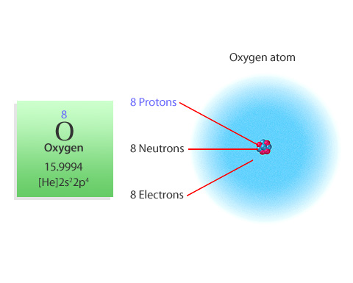
Atomic Number
Chapter 3
Visual Concepts

Slide 27
Isotopes
Chapter 3
Section 3 Counting Atoms
Isotopes are atoms of the same element that have different masses.
The isotopes of a particular element all have the same number of protons and electrons but different numbers of neutrons.
Most of the elements consist of mixtures of isotopes.

Slide 28
Mass Number
Chapter 3
Section 3 Counting Atoms
The mass number is the total number of protons and neutrons that make up the nucleus of an isotope.

Slide 29
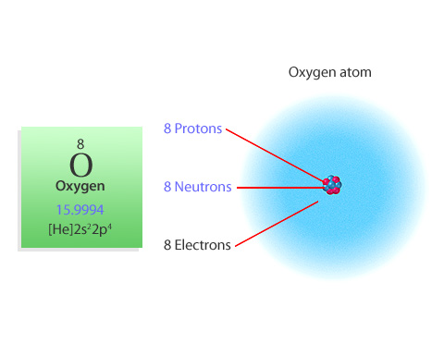
Mass Number
Chapter 3
Visual Concepts

Slide 30
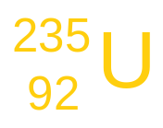
Designating Isotopes
Chapter 3
Section 3 Counting Atoms
Hyphen notation: The mass number is written with a hyphen after the name of the element.
uranium-235
Nuclear symbol: The superscript indicates the mass number and the subscript indicates the atomic number.

Slide 31
Designating Isotopes,
Chapter 3
Section 3 Counting Atoms
The number of neutrons is found by subtracting the atomic number from the mass number.
mass number − atomic number = number of neutrons
235 (protons + neutrons) − 92 protons = 143 neutrons
Nuclide is a general term for a specific isotope of an element.

Slide 32
Designating Isotopes, continued
Chapter 3
Section 3 Counting Atoms
Sample Problem A
How many protons, electrons, and neutrons are there in the following:
atom of chlorine-37? ³⁷Cl
Atom of Chlorine – 34?
atom of Uranium – 235 ? ²³⁵U
Atom of Uranium – 230?
17
92

