Slide 1
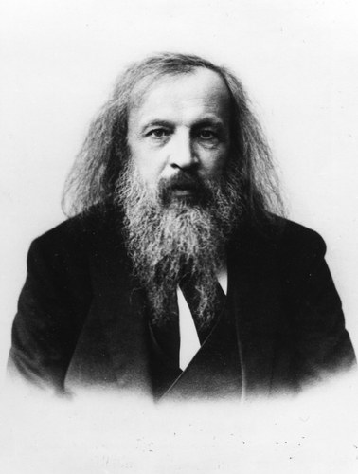
Demitri Mendeleev
In the mid 1800s Demitri Mendeleev worked with 70 elements (only 70 were known at the time).
He created the first Periodic Table by arranging the elements by atomic mass.

Slide 2
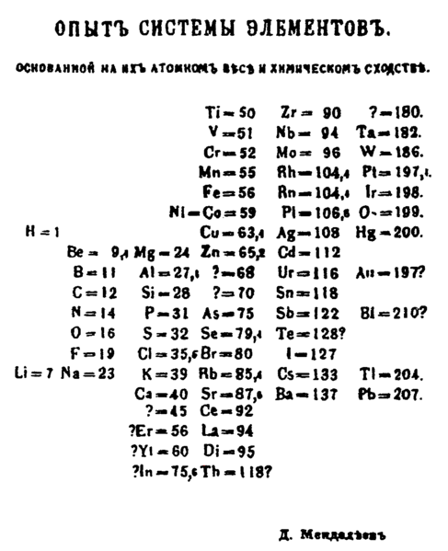
Demitri Mendeleev

Slide 3
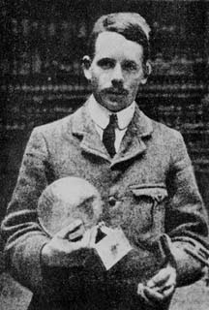
Henry Mosely
In 1913, Henry Moseley arranged the elements by atomic number versus atomic mass.
He used X-rays to determine the nucleus of atoms were different from atom to atom.

Slide 4
1
Periods go left to right, across the table.
18
1
H
2
Groups or families go up and down the table.
13
14
15
16
17
He
2
Metalloids
B
Nonmetals
Groups 3-12
3
Si
Alkali Metals
Alkaline Earth Metals
Halogens
Noble Gas
4
Ge
As
Metals
5
Sb
Te
Transition Metals
6
Po
+4 or -4
Transition Metals vary in charge Fe⁺² Fe ⁺³
+3
7
+1
+2
-3
-2
-1
0
Lanthanides
Inner Transition Metals
Actinides

Slide 5
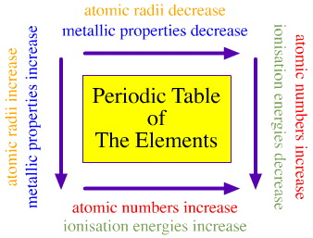

Chemical Periodicity
  The periodic table is full of patterns and trends.
  They are not up there in some random order.
  What are some trends that we have already discussed?

Slide 6
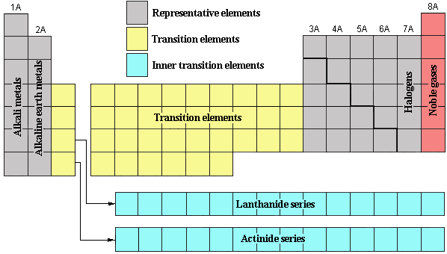
Chemical Periodicity
  Lets review:
  What are the families we know on the periodic table?
  What do these families have in common? How are they different?

Slide 7
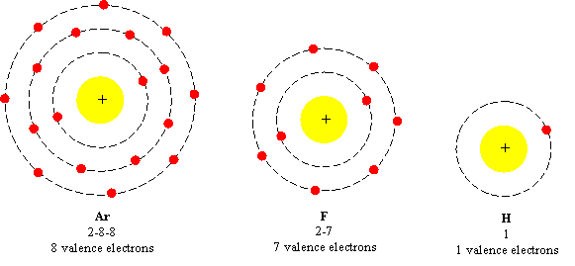
Chemical Periodicity
  Valence Electrons – These electrons are on the highest energy level of the atom.
  Octet Rule – (rule of 8) all atoms want to have 8 valence electrons.
  What elements do you think already have 8 electrons?

Slide 8
Chemical Periodicity
  Group 1 has 1 electron
  Group 2 has 2 electrons
  and so on……we will only worry about representative elements.

Slide 9
Atomic Size
  Other trends include –
  Atomic Size – (in your own words)
  Atomic Radius - Think of circle or sphere, the atomic radius is the distance from the middle (nucleus) the outermost energy level.

Slide 10
Atomic Size
  Lets look at the trends regarding atomic Radius.
  What happens to the radius when we look at a group or family? Why?
Lithium
Sodium
Cesium

Slide 11
Atomic Size
  Lets look at the trends regarding atomic Radius.
  What happens to the radius when we look at a period? Why?
potassium
Copper
Krypton
19 P+
29 P+
36 P+

Slide 12
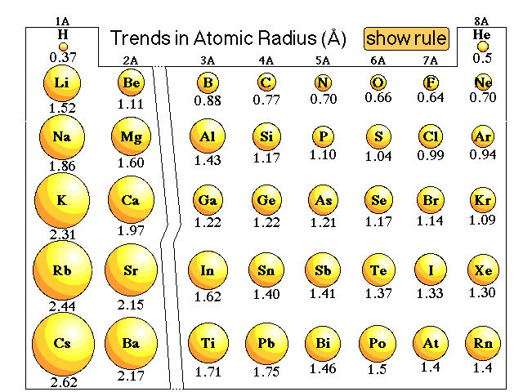
Atomic Size
Decreases across a period
Increases down a group

Slide 13

Atomic Radii, continued
Section 3 Electron Configuration and Periodic Properties
Chapter 5
Sample Problem E
Of the elements magnesium, Mg, chlorine, Cl, sodium, Na, and phosphorus, P, which has the largest atomic radius? Explain your answer in terms of trends of the periodic table.

Slide 14
Ionization Energy
  Ionization Energy – The amount of energy required to remove an electron from an atom.
  Thus forming a cation.
  Remember electrons are held to the atom by ____________.
  What elements do you think have a low ionization energy? (Which elements lose electrons the easiest?)
Protons

Slide 15
Ionization Energy
  In a group or family which elements lose electrons the easiest?
+
+
+
Lithium
Sodium
Cesium

Slide 16
Shielding Effect
  Shielding effect – The result of multiple energy levels interfering to interrupt the interaction of the nucleus with the electrons on the outermost energy level
Shielding increases
+
+
+
Lithium
Sodium
Cesium

Slide 17
Ionization Energy
  What happens to the Ionization Energy when we look at a period?
potassium
Copper
Krypton
19 P+
29 P+
36 P+

Slide 18
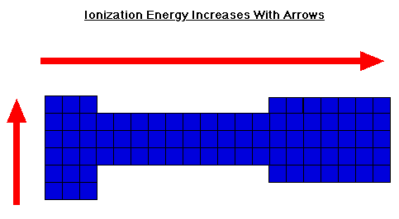
Ionization Energy

Slide 19
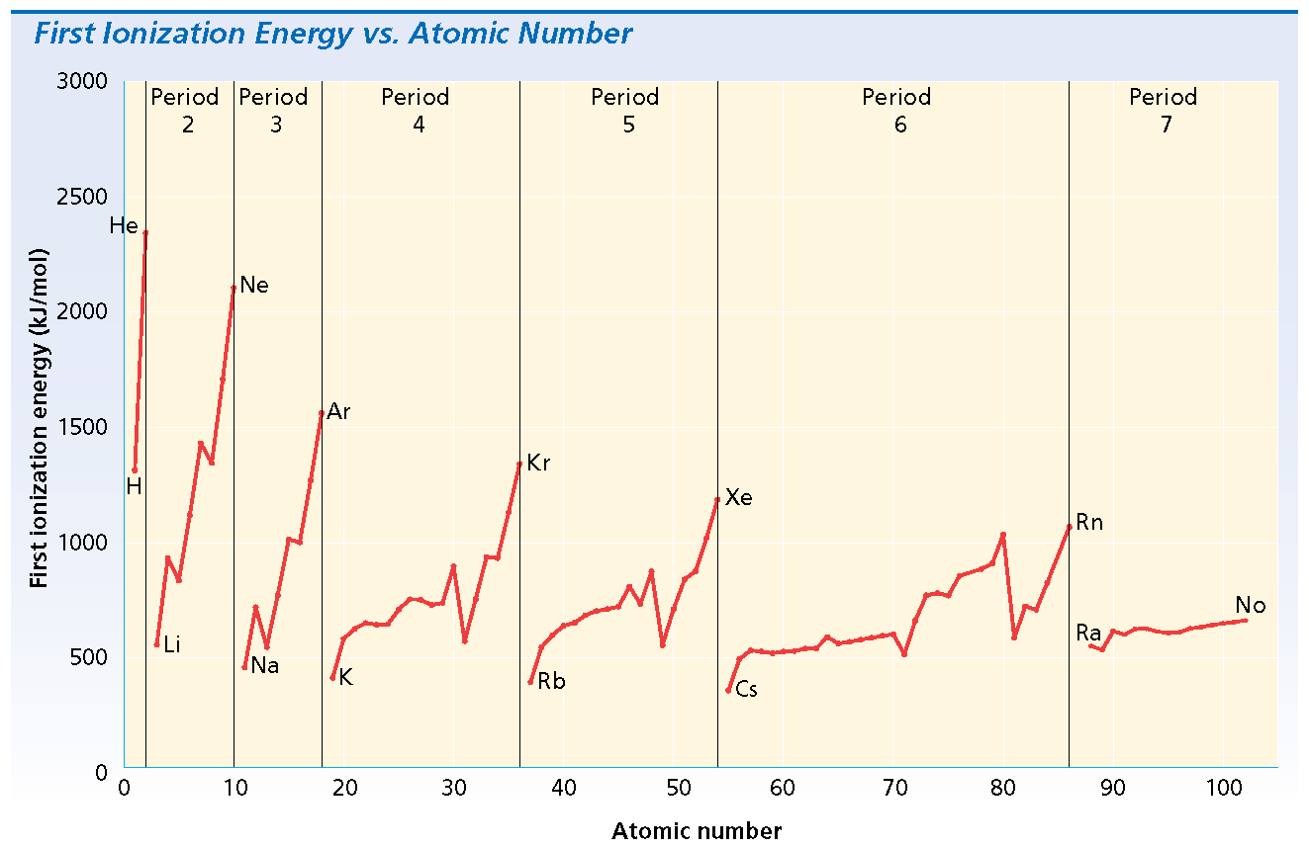
Section 3 Electron Configuration and Periodic Properties
Chapter 5
Ionization Energy, continued
Periodic trends in ionization energy are shown in the graph below.

Slide 20
Section 3 Electron Configuration and Periodic Properties
Chapter 5
Ionization Energy, continued
Sample Problem F
Consider two main-group elements, A and B. Element A has a first ionization energy of 419 kJ/mol. Element B has a first ionization energy of 1000 kJ/mol. Decide if each element is more likely to be in the s block or p block. Which element is more likely to form a positive ion?

Slide 21
Section 3 Electron Configuration and Periodic Properties
Chapter 5
Electron Affinity
The energy change that occurs when an electron is acquired by a neutral atom is called the atom’s electron affinity.
Electron affinity generally increases across periods.
  Increasing nuclear charge along the same sublevel attracts electrons more strongly
Electron affinity generally decreases down groups.
  The larger an atom’s electron cloud is, the farther away its outer electrons are from its nucleus.

Slide 22
Electronegativity
  Electronegativity – the tendency for atoms to attract electrons.
  Now think about what you know. Regarding shielding and why atoms gain or lose electrons.
  Which atoms do you think are the most electronegative?
  Least electronegative?

Slide 23
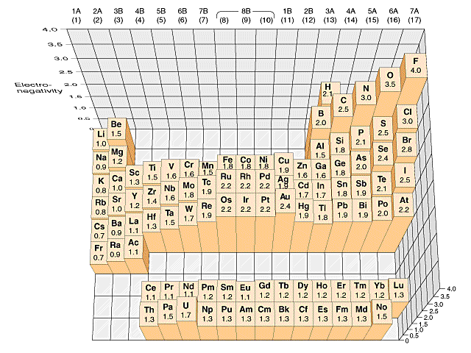
Electronegativity

Slide 24
Electronegativity, continued
Section 3 Electron Configuration and Periodic Properties
Chapter 5
Sample Problem G
Of the elements gallium, Ga, bromine, Br, and calcium, Ca, which has the highest electronegativity? Explain your answer in terms of periodic trends.

