Slide 1
WARM UP
What type of IMF force is expected in the following?
  CH₄ 2) NH₃ 3) SO₂
  Rank the compounds in having the highest boiling point.
  Which has greatest London Dispersion Force?
Explain why the Halogens F and Cl are gas at room temp, Br is Liquid and I is solid.

Slide 2

Lesson Starter
Section 1 Chemical Names and Formulas
Chapter 7
CCl₄ MgCl₂
Guess the name of each of the above compounds based on the formulas written.
What kind of information can you discern from the formulas?
Guess which of the compounds represented is molecular and which is ionic.
Chemical formulas form the basis of the language of chemistry and reveal much information about the substances they represent.

Slide 3
Objectives
Section 1 Chemical Names and Formulas
Chapter 7
Explain the significance of a chemical formula.
Determine the formula of an ionic compound formed between two given ions.
Name an ionic compound given its formula.
Using prefixes, name a binary molecular compound from its formula.
Write the formula of a binary molecular compound given its name.

Slide 4
Significance of a Chemical Formula
Section 1 Chemical Names and Formulas
Chapter 7
  example: octane — C₈H₁₈
The subscript after the C indicates that there are 8 carbon atoms in the molecule.
The subscript after the H indicates that there are 18 hydrogen atoms in
the molecule.

Slide 5
Significance of a Chemical Formula, continued
Section 1 Chemical Names and Formulas
Chapter 7
The chemical formula represents the simplest ratio of the compound’s cations and anions
  example: aluminum sulfate — Al₂(SO₄)₃

Slide 6
Monatomic Ions, continued
Section 1 Chemical Names and Formulas
Chapter 7
Naming Monatomic Ions
Monatomic cations are identified simply by the element’s name.
  examples:
    K⁺ is called the potassium cation
    Mg²⁺ is called the magnesium cation
For monatomic anions, the ending of the element’s name is dropped, and the ending -ide is added to the root name.
  examples:
    F– is called the fluoride anion
    N^{3–} is called the nitride anion

Slide 7
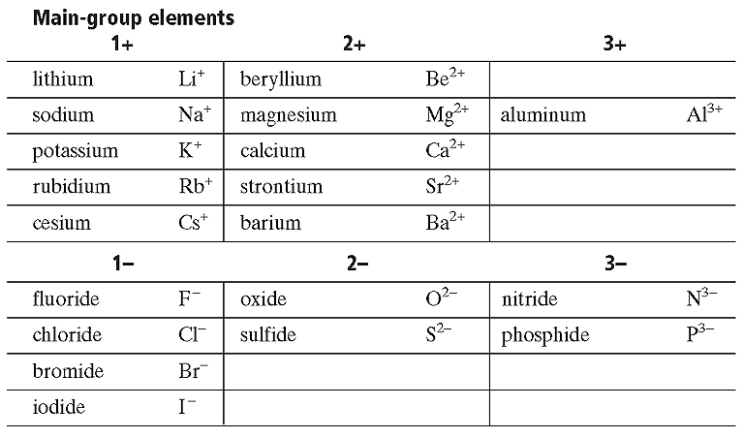
Common Monatomic Ions
Section 1 Chemical Names and Formulas
Chapter 7

Slide 8
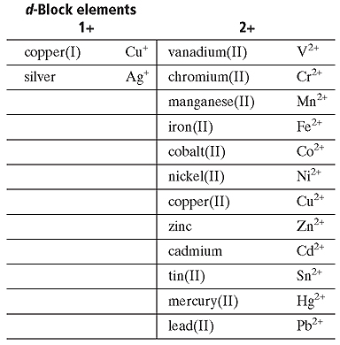
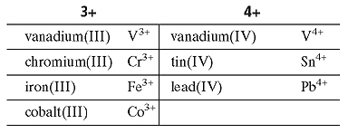
Common Monatomic Ions
Section 1 Chemical Names and Formulas
Chapter 7

Slide 9
Binary Ionic Compounds
Section 1 Chemical Names and Formulas
Chapter 7
Compounds composed of two elements are known as binary compounds.
the total numbers of positive charges and negative charges must be equal.
  example: magnesium bromide
  Ions combined: Mg²⁺, Br–, Br–
  Chemical formula: MgBr₂

Slide 10
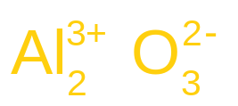
Binary Ionic Compounds, continued
Section 1 Chemical Names and Formulas
Chapter 7
A general rule to use is “crossing over” to balance charges between ions.
  example: aluminum oxide
  1) Write the symbols for the ions.
Al³⁺ O^{2–}
  2) Cross over the charges by using the absolute value of each ion’s charge as the subscript for the other ion.

Slide 11
Binary Ionic Compounds, continued
Section 1 Chemical Names and Formulas
  example: aluminum oxide, continued
  3) Check the combined positive and negative charges to see if they are equal.
(2 × 3+) + (3 × 2−) = 0
  The correct formula is Al₂O₃

Slide 12
Naming Binary Ionic Compounds
Section 1 Chemical Names and Formulas
Chapter 7
The nomenclature, is the term for naming of these compounds.
The name of the cation is given first, followed by the name of the anion:
  example: Al₂O₃ — aluminum oxide

Slide 13
Naming Binary Ionic Compounds, continued
Section 1 Chemical Names and Formulas
Chapter 7
Sample Problem A
Write the formulas for the binary ionic compounds formed between the following elements:
a. zinc and iodine
b. zinc and sulfur

Slide 14
Naming Binary Ionic Compounds, continued
Section 1 Chemical Names and Formulas
Chapter 7
The Stock System of Nomenclature
  examples: Fe²⁺ iron(II)
  Fe³⁺ iron(III)

Slide 15
Naming Binary Ionic Compounds, continued
The Stock System of Nomenclature, continued
Section 1 Chemical Names and Formulas
Chapter 7
Sample Problem B
Write the formula and give the name for the compound formed by the ions Cr³⁺ and F–.

Slide 16


Naming Binary Ionic Compounds, continued
Compounds Containing Polyatomic Ions
Chapter 7
Many common polyatomic ions are oxyanions—polyatomic ions that contain oxygen.
example: nitrogen can form NO₃⁻ or NO₂⁻ .
  The name of the ion with the greater number of oxygen atoms ends in -ate. The name of the ion with the smaller number of oxygen atoms ends in -ite.
nitrate nitrite

Slide 17




Naming Binary Ionic Compounds, continued
Compounds Containing Polyatomic Ions, continued
Section 1 Chemical Names and Formulas
Chapter 7
    In this case, an anion that has one fewer oxygen atom than the -ite anion has is given the prefix hypo-.
    An anion that has one more oxygen atom than the -ate anion has is given the prefix per-.
  hypochlorite chlorite chlorate perchlorate

Slide 18
Chapter 7
Sample Problem C
Write the formula for tin(IV) sulfate.

Slide 19
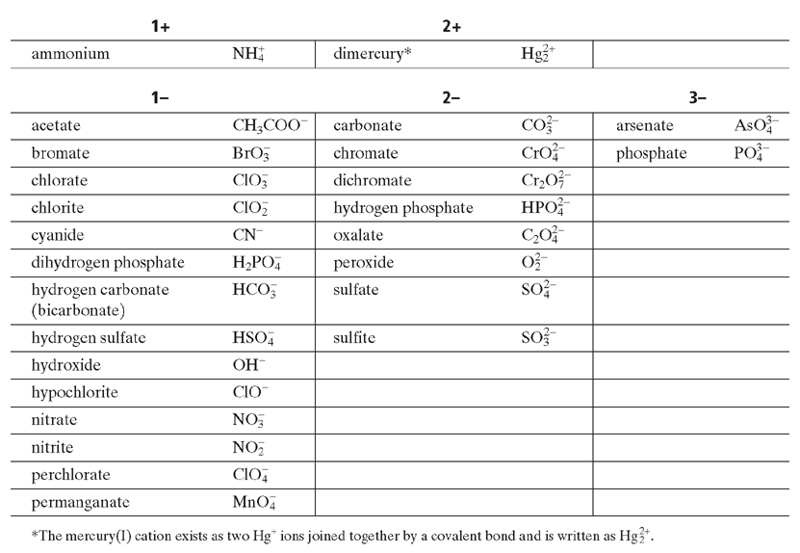
Polyatomic Ions
Section 1 Chemical Names and Formulas
Chapter 7

Slide 20
Naming Binary Molecular Compounds
Section 1 Chemical Names and Formulas
Chapter 7
The old system of naming molecular compounds is based on the use of prefixes.
  examples:CCl₄ — carbon tetrachloride (tetra- = 4)
  CO — carbon monoxide (mono- = 1)
  CO₂ — carbon dioxide (di- = 2)
  tri =3, penta =5, hexa =6, hepta = 7, octa 8, nono 9, deca 10……..

Slide 21
Naming Binary Molecular Compounds, continued
Section 1 Chemical Names and Formulas
Chapter 7
Sample Problem D
a. Give the name for As₂O₅.
b. Write the formula for oxygen difluoride.

Slide 22
Give names, formulas and molar mass of the following.
Name Formula Molar Mass
__________ PbCl₄ ___________
__________ N₂O₄ ___________
__________ Cu₂(SO₄) ___________
__________ PCl₅ ___________

Slide 23
We can also find the mass of a mole of a compound. This is also known as molar mass (instead of atomic mass).
How much mass does a mole of water (H₂O) have? Also called molecular (molar) mass.
H₂O has 3 atoms. (2H and 1O)
H = 1.01 x 2 = 2.02g
O = 16.00 x 1 = 16.00g
H₂O = 18.02g in 1 mole

Slide 24
How many grams are in 3.2 moles of CO₂?
What is the molecular mass for a carbon dioxide molecule?
CO₂ has 3 atoms. (1C and 2O)
C = 12.01 x 1 = 12.01g
O = 16.00 x 2 = 32.00g
CO₂ = 44.01g in 1 mole
How many molecules are in 3.2 mole CO₂?
How many oxygen atoms are in 3.2 moles?

Slide 25
What is the Molar Mass of Potassium Permanganate?

Slide 26
  When calculating percent composition you first need to find the overall molecular weight.
  CO₂
  1 Carbon = 1 x 12.01g/mol = 12.01
  2 Oxygen = 2 x 16.00g/mol = 32.00
  = 44.01 g/mol

Slide 27
  Now divide each piece by total mass
  Carbon = 12.01 _{x} 100 ₌ 27.29% Carbon in CO₂
  44.01
  Oxygen = 32.00 _{x} 100 ₌ 72.71% Oxygen in CO₂
  44.01

Slide 28
  Calculate the percent composition of each of the atoms in KMnO₄.
  How much of each element is in 452g of KMnO₄?

Slide 29
  Empirical shows the lowest whole number ratio of elements in a compound.
  Example: Diborane Hexahydride
  B₂H₆ (molecular formula)
  BH₃ (empirical formula)

Slide 30
  When you calculate an Empirical Formula you are given percent composition.
  You then need to work backwards to find the ratio of moles in the compound.

Slide 31
  Example: Find the empirical formula and name the compound that contains 32.38% sodium, 22.65% sulfur and 44.99% oxygen.
  Steps to solve….
  1) Percent composition
  2) Mass Composition (assume 100g of sample)
  3) Composition in moles
  4) Smallest whole number mole ratio

Slide 32
  Example: Find the empirical formula for a sample that is 63.52% iron and 36.48% sulfur. Name this compound.

Slide 33
  Remember Molecular formulas are not represented in lowest whole ratios.
  To find molecular formula you need to find the common factor related to molecular mass.
  (X factor) x (empirical formula mass) = (Molar Mass)

Slide 34
  Example. Find the molecular formula of a compound with an empirical formula of CH and a formula (molar) mass of 78.110g/mol

Slide 35
  Example. A sample of a compound with a molar mass of 34.00 g/mol is found to consist of 5.97% H and 94.02%O. Find this atom’s empirical formula and molecular formula

Slide 36
  On line you will find the pre lab write up. You will need to include.
  1) A title
  2) A purpose
  3) Materials
  4) Safety (Wash hands! Goggles! No food or drink on this day! Make sure to dispose of waste properly!)
  5) Procedure (including clean up)
  6) A large data table (one page, you created, with a ruler!) that show the mixing boxes. You will need room to make an observation. (End of slide)

Slide 37
 | AgNO₃ (Ag⁺) | Pb(NO₃)₂ (Pb⁺²)
FeCl₃ (Cl⁻) | 1. | 6.
KI (I⁻) | 2. | 7. | CuSO₄ (Cu⁺²) | MgSO₄ (Mg⁺²) | FeCl₃ (Fe⁺³)
NaOH (OH⁻) | 3. | 8. | 11. | 14. | 17.
Na₂CO₃ (CO₃⁻²) | 4. | 9. | 12. | 15. | 18.
Na_{3­}PO₄ (PO₄⁻³) | 5. | 10. | 13. | 16. | 19.

Slide 38
  6) Apart of your lab you will have a separate page numbered 1-19 with all the names and formulas for the lab written out.
  7) The conclusion for this lab will be a paragraph discussing the purpose and if it was achieved.
  You will turn in the entire lab. This will not be a formal lab but you may type it. AP this can go in your AP notebook, I will upload a template this weekend.

