Slide 1

Hw Answers
Another molarity WS
224g KCl
2) 83g
3) 210g Ca(NO₃)₂
0.16M Ca(OH)₂
5) 0.24M Na₂CO₃
6) 0.00496L
0.805M KCl
The number of moles per liter is greater in the 12M solution
0.60L CaCl₂

Slide 2
Book work answers
No
1.H₂SO₄ 2. H₂O 3. 343g B. 1140g
0.143 mol NaOH
a. 132.1 g/mol b. 4.000M
a. Determine Molar mass of AgNO₃ b. 169.9 g/mol c. 1000mL
a. 2H₃PO₄ + 3Ca(OH)₂ → Ca₃(PO₄)₂ + 6H₂O
b. 698g Ca₃(PO₄)₂ 243g H₂O
28) a. 342g b. 0.182m
29) 0.920kg

Slide 3

Section 1 Compounds in Aqueous Solution
Chapter 13
Objectives
Write equations for the dissolution of soluble ionic compounds in water.
Predict whether a precipitate will form when solutions of soluble ionic compounds are combined, and write net ionic equations for precipitation reactions.
Compare dissociation of ionic compounds with ionization of molecular compounds.

Slide 4
Section 1 Compounds in Aqueous Solution
Chapter 13
Dissociation
Dissociation is separation of ions that occurs when an ionic compound dissolves.
1 mol 1 mol 1 mol
1 mol 1 mol 2 mol

Slide 5

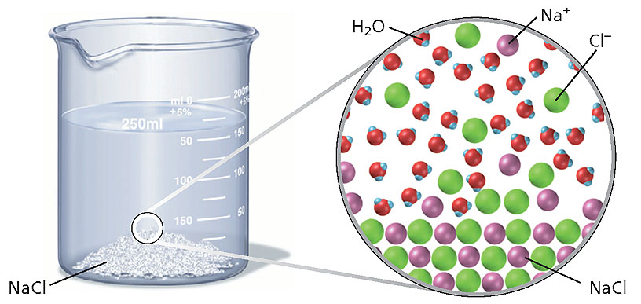
Dissociation of NaCl
Section 1 Compounds in Aqueous Solution
Chapter 13

Slide 6
Dissociation, continued
Section 1 Compounds in Aqueous Solution
Chapter 13
Sample Problem A
Write the equation for the dissolution of aluminum sulfate, Al₂(SO₄)₃ , in water. How many moles of aluminum ions and sulfate ions are produced by dissolving 1 mol of aluminum sulfate? What is the total number of moles of ions produced by dissolving 1 mol of aluminum sulfate?

Slide 7
Dissociation, continued
Section 1 Compounds in Aqueous Solution
Chapter 13
Sample Problem A Solution
Given: amount of solute = 1 mol Al₂(SO₄)₃
solvent identity = water
Unknown: a. moles of aluminum ions and sulfate ions
b. total number of moles of solute ions produced
Solution:

Slide 8
Section 1 Compounds in Aqueous Solution
Chapter 13
Dissociation, continued
Precipitation Reactions
A precipitation reaction is a double displacement reaction where a solid (precipitate) is formed from two aqueous solutions.

Slide 9
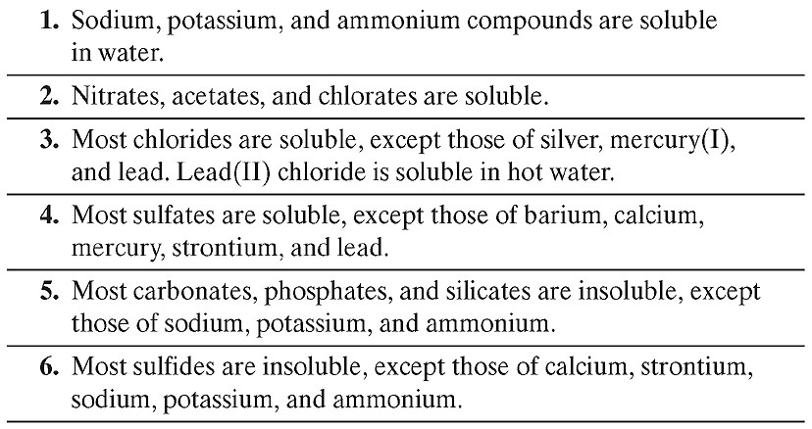
General Solubility Guidelines
Section 1 Compounds in Aqueous Solution
Chapter 13

Slide 10
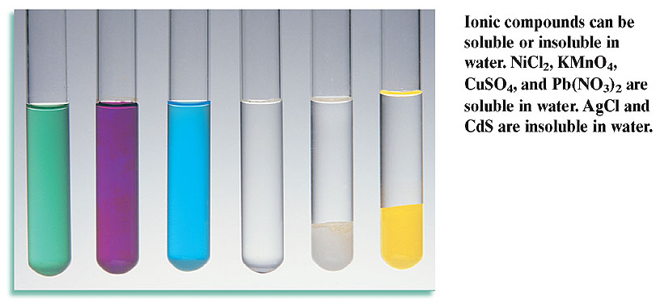
Soluble and Insoluble Ionic Compounds
Section 1 Compounds in Aqueous Solution
Chapter 13

Slide 11
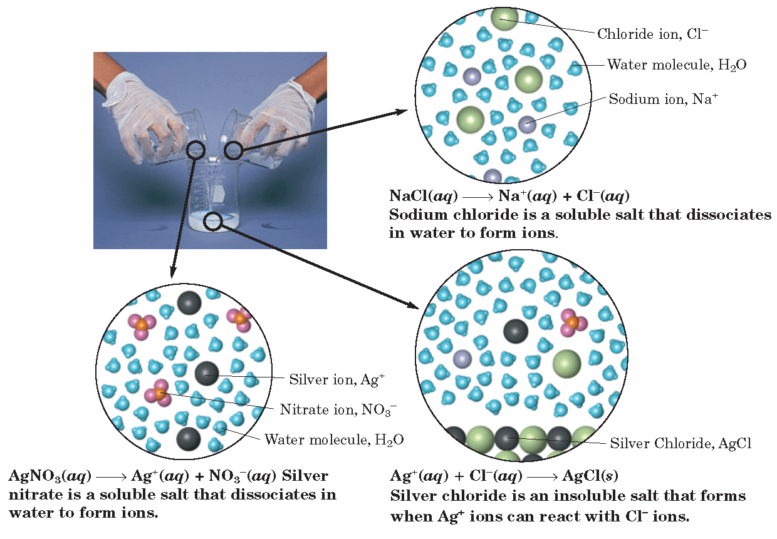
Particle Model for the Formation of a Precipitate
Section 1 Compounds in Aqueous Solution
Chapter 13

Slide 12
Section 1 Compounds in Aqueous Solution
Chapter 13
Dissociation, continued
Net Ionic Equations
A net ionic equation includes only those compounds and ions that undergo a chemical change in a reaction in an aqueous solution.
Ions that do not take part in a chemical reaction and are found in solution both before and after the reaction are spectator ions.

Slide 13
Write overall reaction (double displacement)
Identify insoluble compound (precipitate)
Write overall ionic equation, dissociate all soluble compounds
Cancel spectators, write net ionic.

Slide 14
Section 1 Compounds in Aqueous Solution
Chapter 13
Dissociation, continued
Net Ionic Equations, continued
Overall ionic equation
net ionic equation

Slide 15
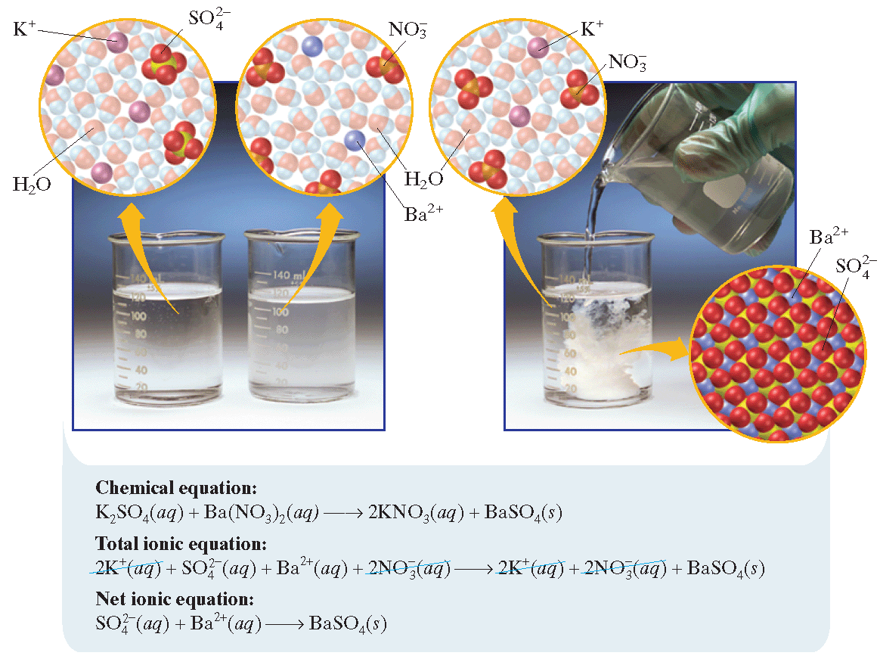
Writing a Net Ionic Equation
Section 1 Compounds in Aqueous Solution
Chapter 13

Slide 16
Dissociation, continued
Net Ionic Equations, continued
Section 1 Compounds in Aqueous Solution
Chapter 13
Sample Problem B
Identify the precipitate that forms when aqueous solutions of zinc nitrate and ammonium sulfide are combined. Write the equation for the possible double-displacement reaction. Then write the formula equation, overall ionic equation, and net ionic equation for the reaction.

Slide 17
Dissociation, continued
Net Ionic Equations, continued
Section 1 Compounds in Aqueous Solution
Chapter 13
Sample Problem B Solution
Given: identity of reactants: zinc nitrate and ammonium sulfide
reaction medium: aqueous solution
Unknown: a. equation for the possible double-displacement
reaction
b. identity of the precipitate
c. formula equation
d. overall ionic equation
e. net ionic equation

Slide 18
Dissociation, continued
Net Ionic Equations, continued
Section 1 Compounds in Aqueous Solution
Chapter 13
Sample Problem B Solution, continued
Solution:
a. equation for the possible double-displacement reaction
b. Table 1 reveals that zinc sulfide is not a soluble sulfide and is therefore a precipitate. Ammonium nitrate is soluble according to the table.
c. The formula equation

Slide 19
Dissociation, continued
Net Ionic Equations, continued
Section 1 Compounds in Aqueous Solution
Chapter 13
Sample Problem B Solution, continued
d. The overall ionic equation
The ammonium and nitrate ions appear on both sides of the equation as spectator ions.
The net ionic equation

Slide 20

Section 1 Compounds in Aqueous Solution
Chapter 13
Ionization
Ions are formed from solute molecules by the action of the solvent in a process called ionization.
When a molecular compound dissolves and ionizes in a polar solvent, ions are formed where none existed in the undissolved compound.
Hydrogen chloride, HCl, is a molecular compound that ionizes in aqueous solution.
  HCl contains a highly polar bond.

Slide 21

Section 1 Compounds in Aqueous Solution
Chapter 13
Ionization, continued
The Hydronium Ion
Some molecular compounds ionize in an aqueous solution to release H⁺.
The H⁺ ion attracts other molecules or ions so strongly that it does not normally exist alone.
The H₃O⁺ ion is known as the hydronium ion.

Slide 22
Section 1 Compounds in Aqueous Solution
Chapter 13
Strong and Weak Electrolytes
Strong and weak electrolytes differ in the degree of ionization or dissociation.

Slide 23
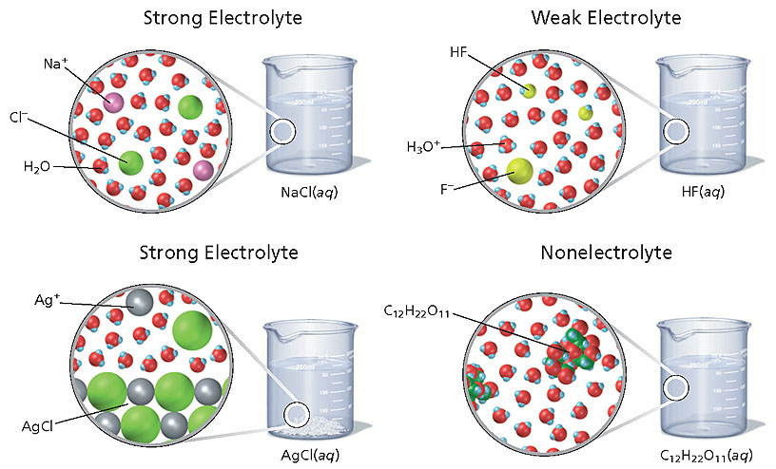
Models for Strong and Weak Electrolytes and Nonelectrolytes
Section 1 Compounds in Aqueous Solution
Chapter 13

Slide 24
Section 1 Compounds in Aqueous Solution
Chapter 13
Strong and Weak Electrolytes, continued
Strong Electrolytes
A strong electrolyte is any compound whose dilute aqueous solutions conduct electricity well; this is due to the presence of all or almost all of the dissolved compound in the form of ions.
To whatever extent they dissolve in water, they yield only ions.
  HCl, HBr, HI
  All soluble ionic compounds

Slide 25

Section 1 Compounds in Aqueous Solution
Chapter 13
Strong and Weak Electrolytes, continued
Weak Electrolytes
A weak electrolyte is any compound whose dilute aqueous solutions conduct electricity poorly; this is due to the presence of a small amount of the dissolved compound in the form of ions.
Some molecular compounds form aqueous solutions that contain not only dissolved ions but also some dissolved molecules that are not ionized.
[HF] >> [H⁺] and [F–]

Slide 26
Multiple Choice
Chapter 12
Standardized Test Preparation
1. Water is an excellent solvent because
A. it is a covalent compound.
B. it is a nonconductor of electricity.
C. its molecules are quite polar.
D. it is a clear, colorless liquid.

Slide 27
Multiple Choice
Chapter 12
Standardized Test Preparation
1. Water is an excellent solvent because
A. it is a covalent compound.
B. it is a nonconductor of electricity.
C. its molecules are quite polar.
D. it is a clear, colorless liquid.

Slide 28
Multiple Choice
Chapter 12
Standardized Test Preparation
2. Two liquids are likely to be immiscible (mix together) if
A. both have polar molecules.
B. both have nonpolar molecules.
C. one is polar and the other is nonpolar.
D. one is water and the other is methyl alcohol, CH₃OH.

Slide 29
Multiple Choice
Chapter 12
Standardized Test Preparation
2. Two liquids are likely to be immiscible if
A. both have polar molecules.
B. both have nonpolar molecules.
C. one is polar and the other is nonpolar.
D. one is water and the other is methyl alcohol, CH₃OH.

Slide 30
Multiple Choice
Chapter 12
Standardized Test Preparation
3. The solubility of a gas in a liquid would be increased
by an
A. addition of an electrolyte.
B. addition of an emulsifier.
C. agitation of the solution.
D. increase in its partial pressure.

Slide 31
Multiple Choice
Chapter 12
Standardized Test Preparation
3. The solubility of a gas in a liquid would be increased
by an
A. addition of an electrolyte.
B. addition of an emulsifier.
C. agitation of the solution.
D. increase in its partial pressure.

Slide 32
Multiple Choice
Chapter 12
Standardized Test Preparation
4. Which of the following types of compounds is most likely to be a strong electrolyte?
A. a polar compound
B. a nonpolar compound
C. a covalent compound
D. an ionic compound

Slide 33
Multiple Choice
Chapter 12
Standardized Test Preparation
4. Which of the following types of compounds is most likely to be a strong electrolyte?
A. a polar compound
B. a nonpolar compound
C. a covalent compound
D. an ionic compound

Slide 34
Multiple Choice
Chapter 12
Standardized Test Preparation
5. A saturated solution can become supersaturated under which of the following conditions?
A. It contains electrolytes.
B. The solution is heated and then allowed to cool.
C. More solvent is added.
D. More solute is added.

Slide 35
Multiple Choice
Chapter 12
Standardized Test Preparation
5. A saturated solution can become supersaturated under which of the following conditions?
A. It contains electrolytes.
B. The solution is heated and then allowed to cool.
C. More solvent is added.
D. More solute is added.

Slide 36
Multiple Choice
Chapter 12
Standardized Test Preparation
6. Molarity is expressed in units of
A. moles of solute per liter of solution.
B. liters of solution per mole of solute.
C. moles of solute per liter of solvent.
D. liters of solvent per mole of solute.

Slide 37
Multiple Choice
Chapter 12
Standardized Test Preparation
6. Molarity is expressed in units of
A. moles of solute per liter of solution.
B. liters of solution per mole of solute.
C. moles of solute per liter of solvent.
D. liters of solvent per mole of solute.

Slide 38
Multiple Choice
Chapter 12
Standardized Test Preparation
7. What mass of NaOH is contained in 2.5 L of a 0.010 M solution?
A. 0.010 g
B. 1.0 g
C. 2.5 g
D. 0.40 g

Slide 39
Multiple Choice
Chapter 12
Standardized Test Preparation
7. What mass of NaOH is contained in 2.5 L of a 0.010 M solution?
A. 0.010 g
B. 1.0 g
C. 2.5 g
D. 0.40 g

Slide 40
Multiple Choice
Chapter 12
Standardized Test Preparation
8. Which one of the following statements is false?
A. Gases are generally more soluble in water under high pressures than under low pressures.
B. As temperature increases, the solubilities of some solids in water increase and the solubilities of other solids in water decrease.
C. Water dissolves many ionic solutes because of its ability to hydrate ions in solution.
D. Many solids dissolve more quickly in a cold solvent than in a warm solvent.

Slide 41
Multiple Choice
Chapter 12
Standardized Test Preparation
8. Which one of the following statements is false?
A. Gases are generally more soluble in water under high pressures than under low pressures.
B. As temperature increases, the solubilities of some solids in water increase and the solubilities of other solids in water decrease.
C. Water dissolves many ionic solutes because of its ability to hydrate ions in solution.
D. Many solids dissolve more quickly in a cold solvent than in a warm solvent.

Slide 42
Multiple Choice
Chapter 13
Standardized Test Preparation
1. Acetic acid is a weak electrolyte because it
A. is miscible with water.
B. forms hydronium and hydroxide ions in
aqueous solution.
C. lowers the freezing point of water.
D. ionizes only slightly in aqueous solution.

Slide 43
Chapter 13
Standardized Test Preparation
Multiple Choice
1. Acetic acid is a weak electrolyte because it
A. is miscible with water.
B. forms hydronium and hydroxide ions in
aqueous solution.
C. lowers the freezing point of water.
D. ionizes only slightly in aqueous solution.

Slide 44
Multiple Choice
Chapter 13
Standardized Test Preparation
2. Which of the following solutions would contain
the highest concentration of hydronium ions,
H₃O⁺?
A. 0.10 M HCl
B. 0.10 M HF
C. 0.10 M CH₃COOH
D. 0.10 M NaCl

Slide 45
Multiple Choice
Chapter 13
Standardized Test Preparation
2. Which of the following solutions would contain
the highest concentration of hydronium ions,
H₃O⁺?
A. 0.10 M HCl
B. 0.10 M HF
C. 0.10 M CH₃COOH
D. 0.10 M NaCl

Slide 46
Multiple Choice
Chapter 13
Standardized Test Preparation
3. Which of the following is the best representation of the precipitation reaction that occurs when aqueous solutions of sodium carbonate and calcium chloride are mixed?
A. Na⁺(aq) + Cl⁻(aq) 2NaCl(s)
B.
C.
D. No precipitation reaction occurs.

Slide 47
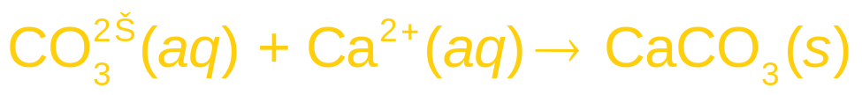
Chapter 13
Standardized Test Preparation
Multiple Choice
3. Which of the following is the best representation of the precipitation reaction that occurs when aqueous solutions of sodium carbonate and calcium chloride are mixed?
A. Na⁺(aq) + Cl⁻(aq) 2NaCl(s)
B.
C.
D. No precipitation reaction occurs.

