Slide 1

Warm Up
Take out your lab and have it ready to turn in.
On separate paper answer the following:
Write the net ionic equation for the reaction of hydrofluoric acid and potassium hydroxide.
  In this reaction identify the acid with its conjugate base.
What is the difference between a strong and weak acid?
Compare and contrast Acids and bases. (make it large so I can read the information on your sheet)

Slide 2

Section 1 Aqueous Solutions and the Concept of pH
Chapter 15
Objectives
Describe the self-ionization of water.
Define pH, and give the pH of a neutral solution at 25°C.
Explain and use the pH scale.
Given [H₃O⁺] or [OH⁻], find pH.
Given pH, find [H₃O⁺] or [OH⁻].

Slide 3
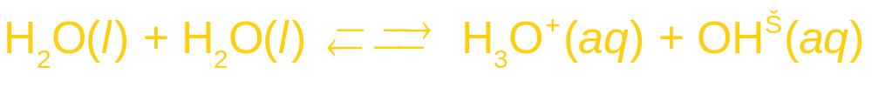
Section 1 Aqueous Solutions and the Concept of pH
Chapter 15
Hydronium Ions and Hydroxide Ions
Self-Ionization of Water
In the self-ionization of water, two water molecules produce a hydronium ion and a hydroxide ion by transfer of a proton.
The ionization constant of water, K_{w}, is expressed by the following equation.
K_{w} = [H₃O⁺][OH⁻]

Slide 4
Section 1 Aqueous Solutions and the Concept of pH
Chapter 15
Hydronium Ions and Hydroxide Ions, continued
Self-Ionization of Water, continued
At 25°C,
K_{w} = [H₃O⁺][OH⁻] = (1.0 × 10⁻⁷)(1.0 × 10⁻⁷) = 1.0 × 10⁻¹⁴

Slide 5
Section 1 Aqueous Solutions and the Concept of pH
Chapter 15
Hydronium Ions and Hydroxide Ions, continued
Neutral, Acidic, and Basic Solutions
Solutions in which [H₃O⁺] = [OH⁻] is neutral.
Solutions in which the [H₃O⁺] > [OH⁻] are acidic.
  [H₃O⁺] > 1.0 × 10⁻⁷ M
Solutions in which the [OH⁻] > [H₃O⁺] are basic.
  [OH⁻] > 1.0 × 10⁻⁷ M

Slide 6
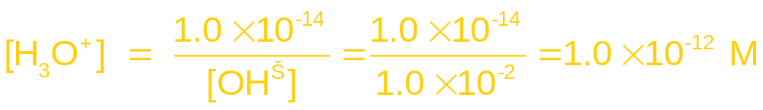
Section 1 Aqueous Solutions and the Concept of pH
Chapter 15
Hydronium Ions and Hydroxide Ions, continued
Calculating [H₃O⁺] and [OH–]
Strong acids and bases are considered completely ionized or dissociated in weak aqueous solutions.
1 mol 1 mol 1 mol
1.0 × 10⁻² M NaOH solution has an [OH⁻] of 1.0 × 10⁻² M
The [H₃O⁺] of this solution is calculated using K_{w}.
K_{w} = [H₃O⁺][OH⁻] = 1.0 × 10⁻¹⁴

Slide 7
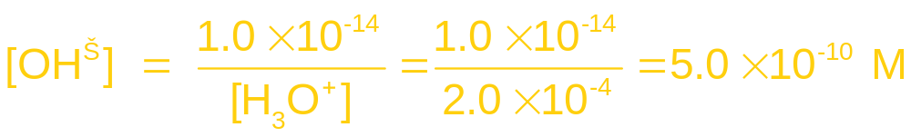
Section 1 Aqueous Solutions and the Concept of pH
Chapter 15
Hydronium Ions and Hydroxide Ions, continued
Calculating [H₃O⁺] and [OH–]
If the [H₃O⁺] of a solution is known, the [OH⁻] can be calculated using K_{w}.
[HCl] = 2.0 × 10⁻⁴ M
[H₃O⁺] = 2.0 × 10⁻⁴ M
K_{w} = [H₃O⁺][OH⁻] = 1.0 × 10⁻¹⁴

Slide 8

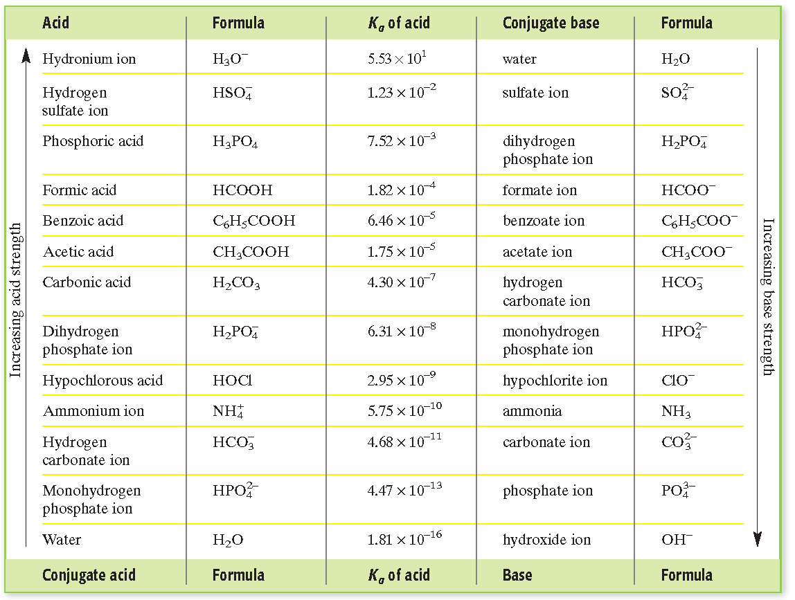
Some Strong Acids and Some Weak Acids
Section 1 Aqueous Solutions and the Concept of pH
Chapter 15

Slide 9
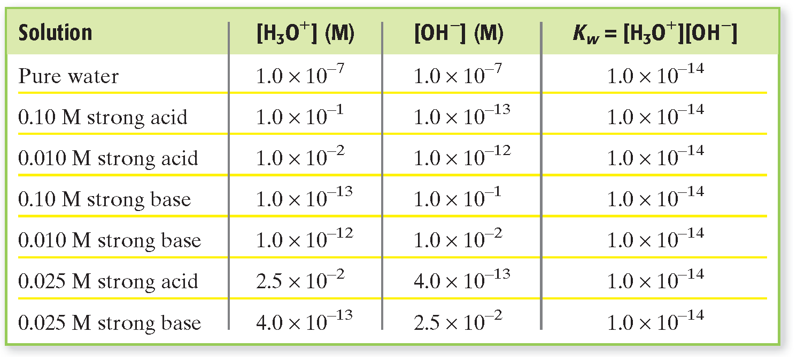
Concentrations and K_{w}
Section 1 Aqueous Solutions and the Concept of pH
Chapter 15

Slide 10
Hydronium Ions and Hydroxide Ions, continued
Calculating [H₃O⁺] and [OH–]
Section 1 Aqueous Solutions and the Concept of pH
Chapter 15
Sample Problem A
A 1.0 × 10⁻⁴ M solution of HNO₃ has been prepared for a laboratory experiment.
a. Calculate the [H₃O⁺] of this solution.
b. Calculate the [OH–].

Slide 11
Hydronium Ions and Hydroxide Ions, continued
Calculating [H₃O⁺] and [OH–], continued
Section 1 Aqueous Solutions and the Concept of pH
Chapter 15
Sample Problem A Solution
Given: Concentration of the solution = 1.0 × 10⁻⁴ M HNO₃
Unknown: a. [H₃O⁺]
b. [OH⁻]
Solution:
HNO₃ is a strong acid
a.
1 mol 1 mol 1 mol 1 mol

Slide 12
Hydronium Ions and Hydroxide Ions, continued
Calculating [H₃O⁺] and [OH–], continued
Section 1 Aqueous Solutions and the Concept of pH
Chapter 15
Sample Problem A Solution, continued
a.
b. [H₃O⁺][OH⁻] = 1.0 × 10⁻¹⁴

Slide 13
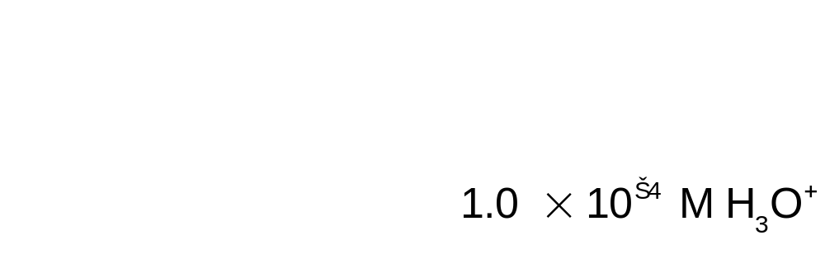
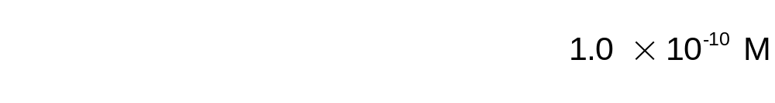
Hydronium Ions and Hydroxide Ions, continued
Calculating [H₃O⁺] and [OH–], continued
Section 1 Aqueous Solutions and the Concept of pH
Chapter 15
Sample Problem A Solution, continued
a.
b.

Slide 14
Section 1 Aqueous Solutions and the Concept of pH
Chapter 15
The pH Scale
The pH of a solution is defined as the negative of the common logarithm of the hydronium ion concentration, [H₃O⁺].
pH = −log [H₃O⁺]
  example: a neutral solution has a [H₃O⁺] = 1×10⁻⁷
  The logarithm of 1×10⁻⁷ is −7.0.
pH = −log [H₃O⁺] = −log(1 × 10⁻⁷) = − (−7.0) = 7.0

Slide 15
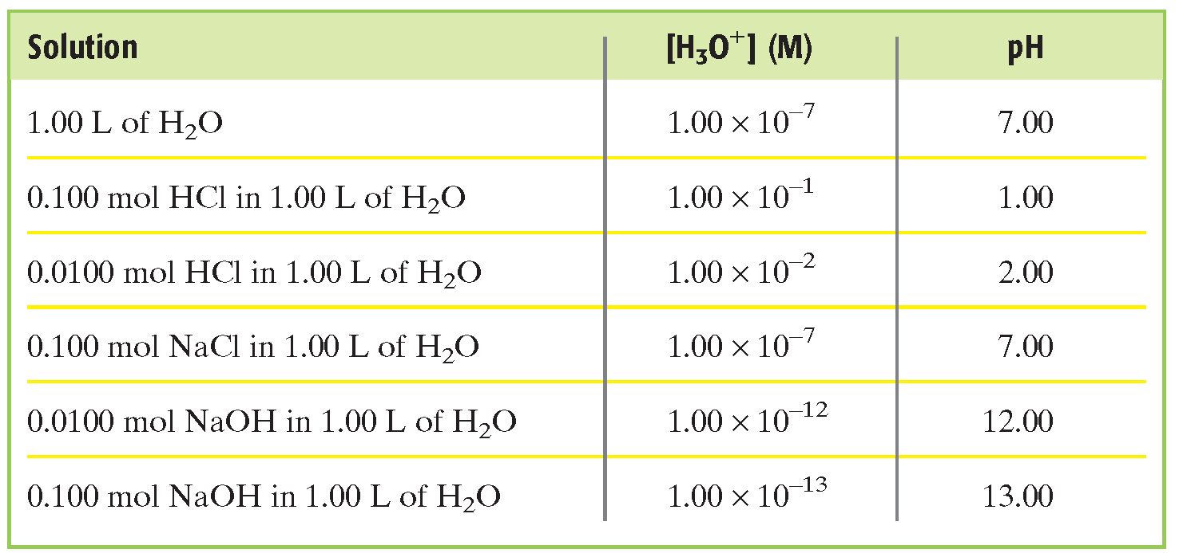
pH Values as Specified [H₃O⁺]
Section 1 Aqueous Solutions and the Concept of pH
Chapter 15

Slide 16
Section 1 Aqueous Solutions and the Concept of pH
Chapter 15
The pH Scale
The pOH of a solution is defined as the negative of the common logarithm of the hydroxide ion concentration, [OH–].
pOH = −log [OH–]
  example: a neutral solution has a [OH–] = 1×10 ^{– 7}
  The pH = 7.0.
The negative logarithm of K_{w} at 25°C is 14.0.
pH + pOH = 14.0

Slide 17
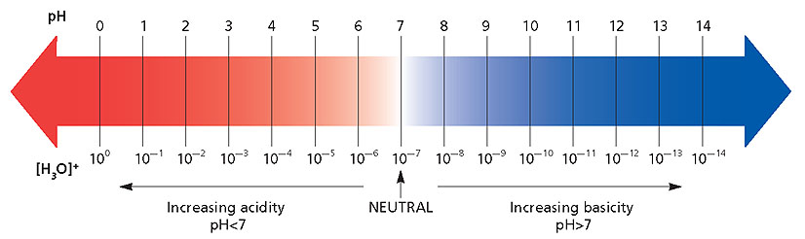
Section 1 Aqueous Solutions and the Concept of pH
Chapter 15
The pH Scale

Slide 18
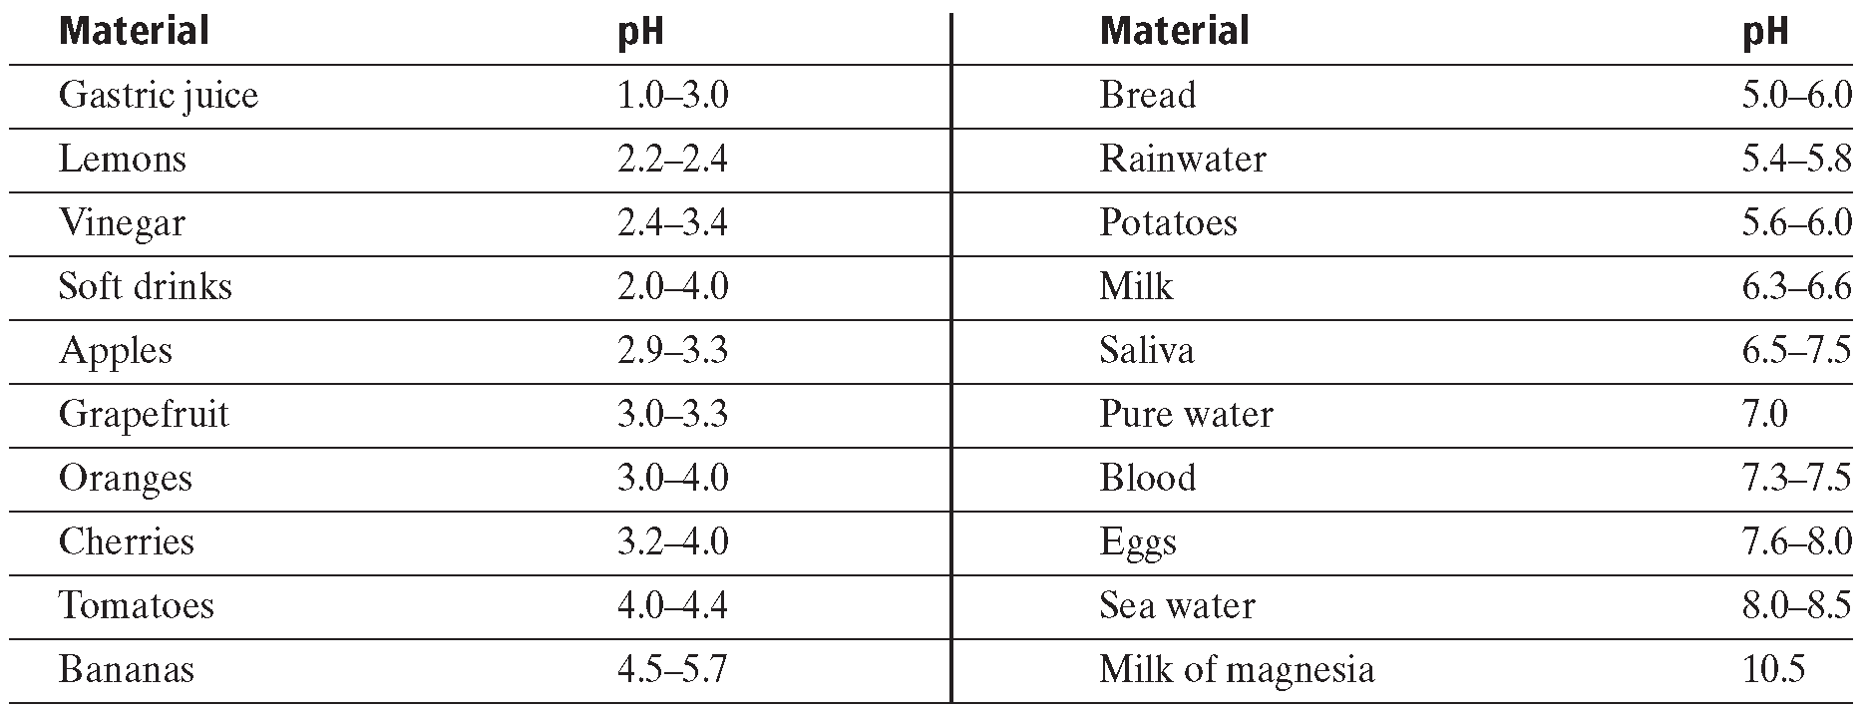
Approximate pH Range of Common Materials
Section 1 Aqueous Solutions and the Concept of pH
Chapter 15

Slide 19
Section 1 Aqueous Solutions and the Concept of pH
Chapter 15
Calculations Involving pH
There must be as many significant figures to the right of the decimal as there are in the number whose logarithm was found.
  example: [H₃O⁺] = 1 × 10⁻⁷
  one significant figure
  pH = 7.0

Slide 20
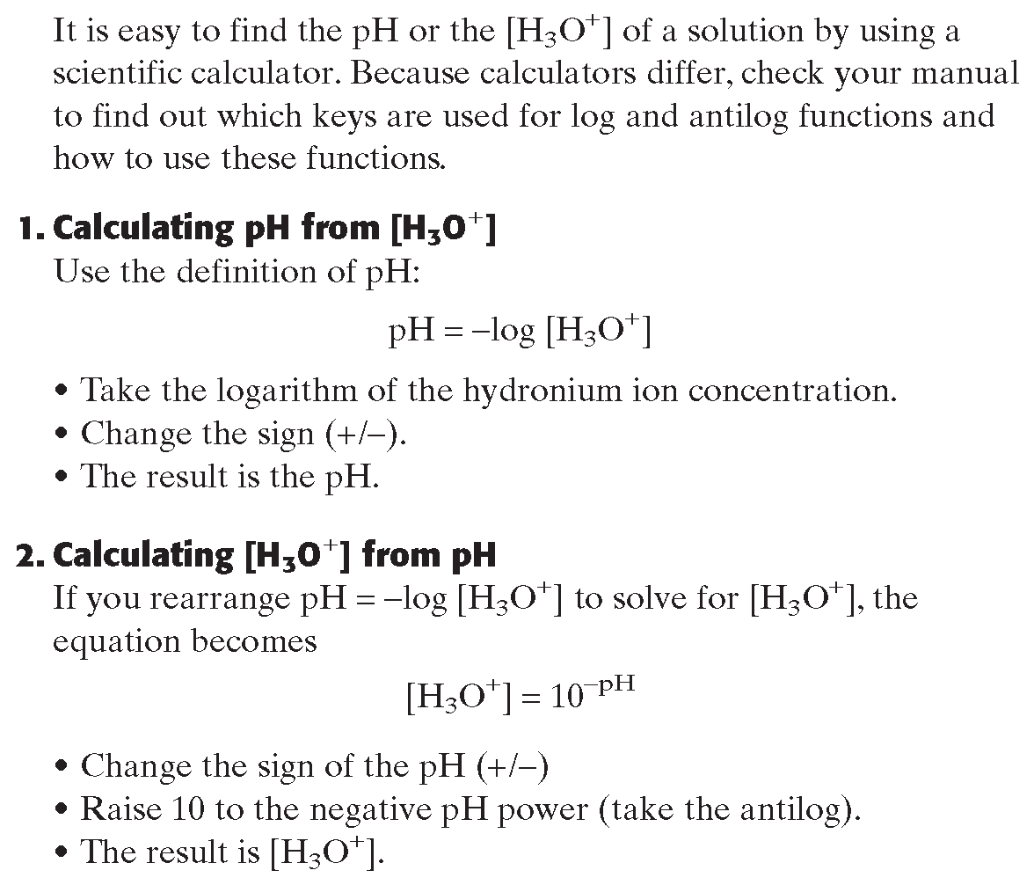
Using Logarithms in pH Calculations
Section 1 Aqueous Solutions and the Concept of pH
Chapter 15

Slide 21
Section 1 Aqueous Solutions and the Concept of pH
Chapter 15
Calculations Involving pH, continued
Calculating pH from [H₃O⁺], continued
Sample Problem B
What is the pH of a 1.0 ×10^{–3} M NaOH solution?

Slide 22
Section 1 Aqueous Solutions and the Concept of pH
Chapter 15
Calculations Involving pH, continued
Calculating pH from [H₃O⁺], continued
Sample Problem B Solution
Given: Identity and concentration of solution = 1.0 × 10⁻³ M NaOH
Unknown: pH of solution
Solution: concentration of base → concentration of OH⁻ → concentration of H₃O⁺ → pH
[H₃O⁺][OH⁻] = 1.0 × 10⁻¹⁴
pH = −log [H₃O⁺] = −log(1.0 × 10⁻¹¹) = 11.00

Slide 23
Section 1 Aqueous Solutions and the Concept of pH
Chapter 15
Calculations Involving pH, continued
Calculating pH from [H₃O⁺], continued
pH = −log [H₃O⁺]
log [H₃O⁺] = −pH
[H₃O+] = antilog (−pH)
[H₃O⁺] = 10^{−pH}
The simplest cases are those in which pH values are integers.

Slide 24
Section 1 Aqueous Solutions and the Concept of pH
Chapter 15
Calculations Involving pH, continued
Calculating [H₃O⁺] and [OH–] from pH, continued
Sample Problem D
Determine the hydronium ion concentration of an aqueous solution that has a pH of 4.0.

Slide 25
Section 1 Aqueous Solutions and the Concept of pH
Chapter 15
Calculations Involving pH, continued
Calculating [H₃O⁺] and [OH–] from pH, continued
Sample Problem D Solution
Given: pH = 4.0
Unknown: [H₃O⁺]
Solution:
[H₃O⁺] = 10^{−pH}
[H₃O⁺] = 1 × 10⁻⁴ M

Slide 26
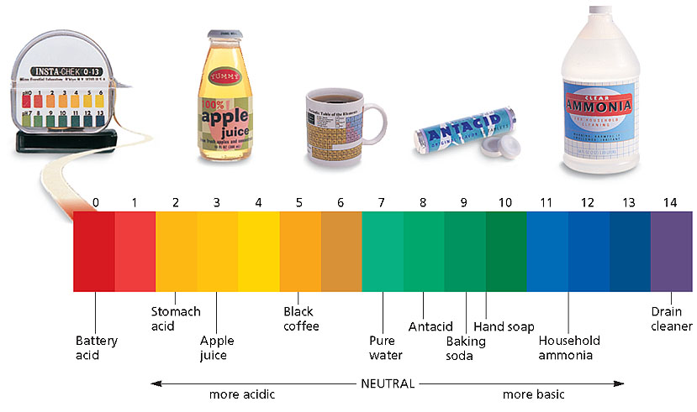
pH Values of Some Common Materials
Section 1 Aqueous Solutions and the Concept of pH
Chapter 15

Slide 27
Section 2 Determining pH and Titrations
Chapter 15
Objectives
Describe how an acid-base indicator functions.
Explain how to carry out an acid-base titration.
Calculate the molarity of a solution from titration data.

Slide 28
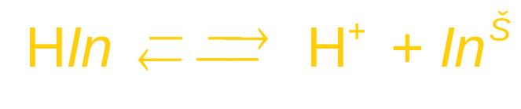
Section 2 Determining pH and Titrations
Chapter 15
Indicators and pH Meters
Acid-base indicators are compounds whose colors are sensitive to pH.
Indicators change colors because they are either weak acids or weak bases.
HIn and In⁻ are different colors.
In acidic solutions, most of the indicator is HIn
In basic solutions, most of the indicator is In–

Slide 29
Section 2 Determining pH and Titrations
Chapter 15
Indicators and pH Meters
The pH range over which an indicator changes color is called its transition interval.
Indicators that change color at pH lower than 7 are stronger acids than the other types of indicators.
  They tend to ionize more than the others.
Indicators that undergo transition in the higher pH range are weaker acids.

Slide 30
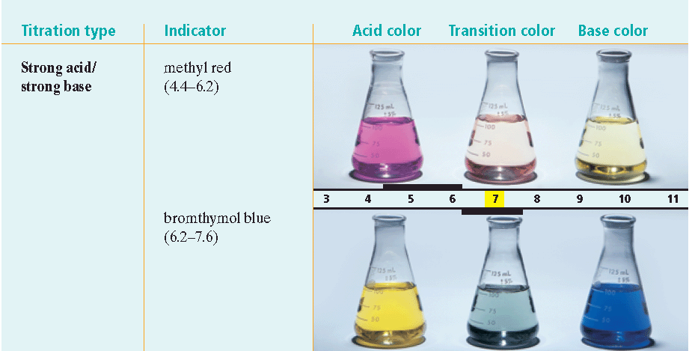
Color Ranges of Indicators
Section 2 Determining pH and Titrations
Chapter 15

Slide 31
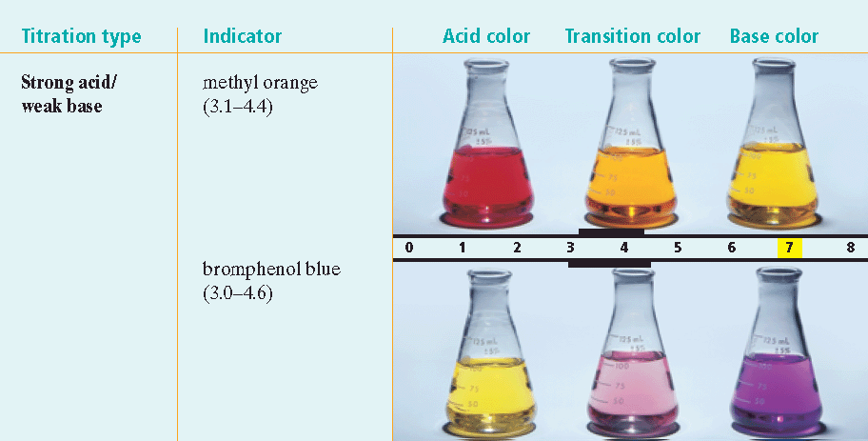
Color Ranges of Indicators
Section 2 Determining pH and Titrations
Chapter 15

Slide 32
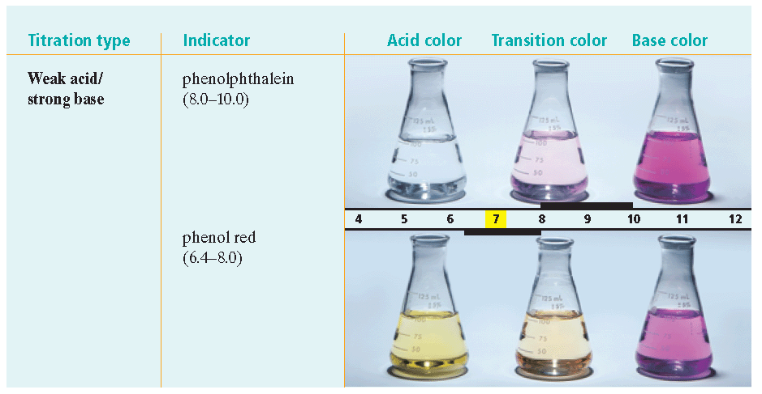
Color Ranges of Indicators
Section 2 Determining pH and Titrations
Chapter 15

Slide 33
Section 2 Determining pH and Titrations
Chapter 15
Titration
Neutralization occurs when hydronium ions and hydroxide ions are supplied in equal numbers by reactants.
H₃O⁺(aq) + OH⁻(aq) 2H₂O(l)
Titration is the controlled addition and measurement of the amount of a solution of known concentration required to react completely with a measured amount of a solution of unknown concentration.

Slide 34
Section 2 Determining pH and Titrations
Chapter 15
Titration, continued
Equivalence Point
The point at which the two solutions used in a titration are present in chemically equivalent amounts is the equivalence point.
The point in a titration at which an indicator changes color is called the end point of the indicator.

Slide 35
Section 2 Determining pH and Titrations
Chapter 15
Titration, continued
Equivalence Point, continued
Indicators that undergo transition at about pH 7 are used to determine the equivalence point of strong-acid/strong base titrations.
  The neutralization of strong acids with strong bases produces a salt solution with a pH of 7.

Slide 36
Section 2 Determining pH and Titrations
Chapter 15
Titration, continued
Equivalence Point, continued
Indicators that change color at pH lower than 7 are used to determine the equivalence point of strong-acid/weak-base titrations.
  The equivalence point of a strong-acid/weak-base titration is acidic.

Slide 37
Section 2 Determining pH and Titrations
Chapter 15
Titration, continued
Equivalence Point, continued
Indicators that change color at pH higher than 7 are used to determine the equivalence point of weak-acid/strong-base titrations.
  The equivalence point of a weak-acid/strong-base titration is basic.

Slide 38
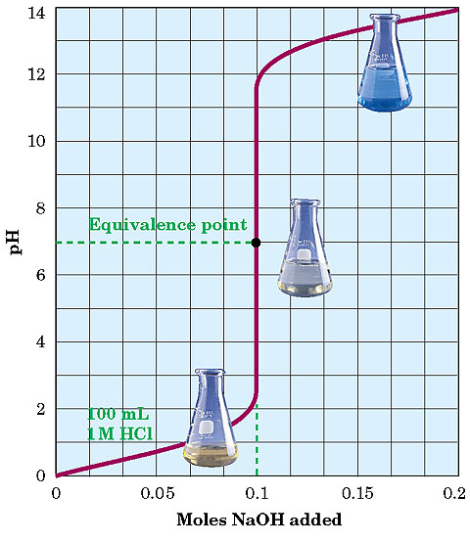
Titration Curve for a Strong Acid and a Strong Base
Section 2 Determining pH and Titrations
Chapter 15

Slide 39
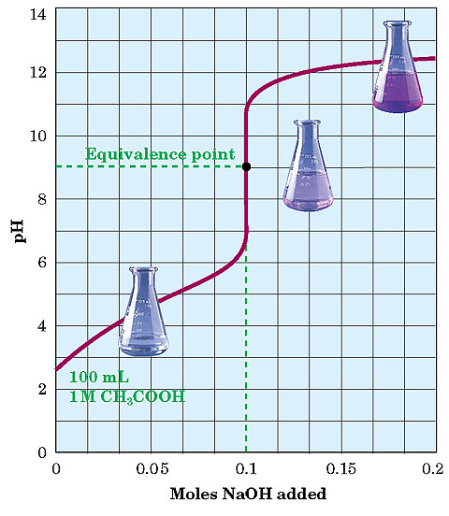
Titration Curve for a Weak Acid and a Strong Base
Section 2 Determining pH and Titrations
Chapter 15

Slide 40
Section 2 Determining pH and Titrations
Chapter 15
Molarity and Titration
The solution that contains the precisely known concentration of a solute is known as a standard solution.
A primary standard is a highly purified solid compound used to check the concentration of the known solution in a titration
The standard solution can be used to determine the molarity of another solution by titration.

Slide 41
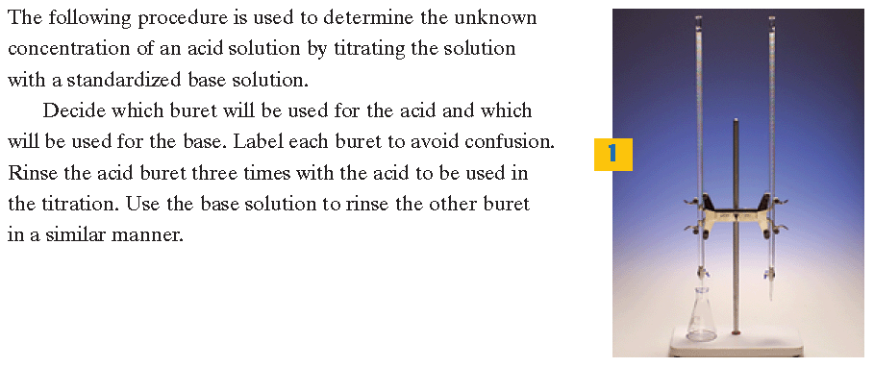
Performing a Titration, Part 1
Section 2 Determining pH and Titrations
Chapter 15

Slide 42
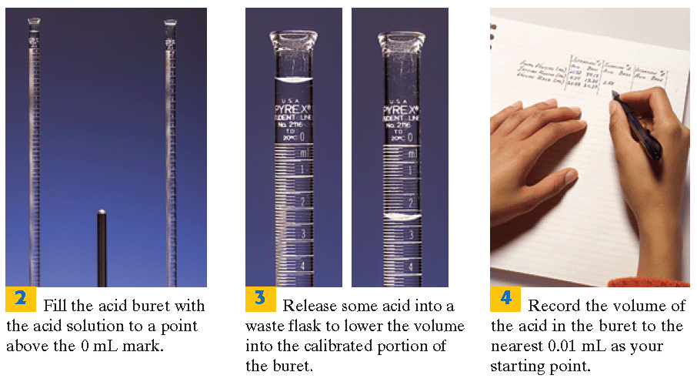
Performing a Titration, Part 1
Section 2 Determining pH and Titrations
Chapter 15

Slide 43
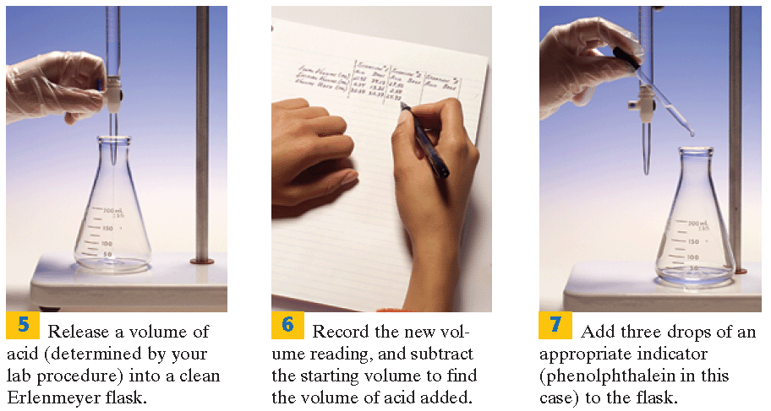
Performing a Titration, Part 1
Section 2 Determining pH and Titrations
Chapter 15

Slide 44
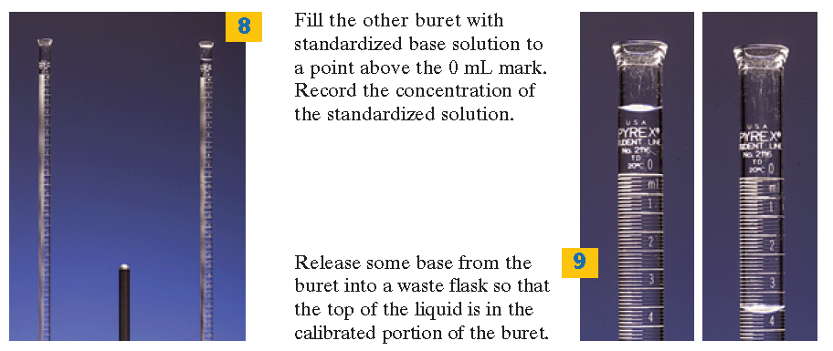
Performing a Titration, Part 2
Section 2 Determining pH and Titrations
Chapter 15

Slide 45
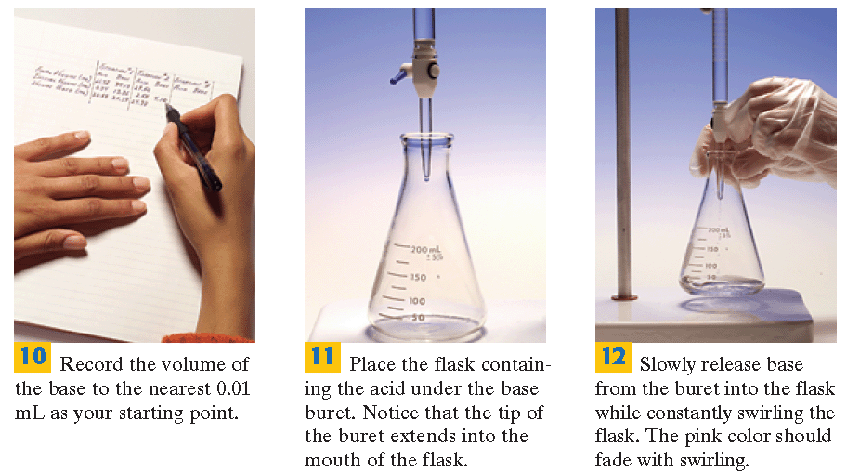
Performing a Titration, Part 2
Section 2 Determining pH and Titrations
Chapter 15

Slide 46
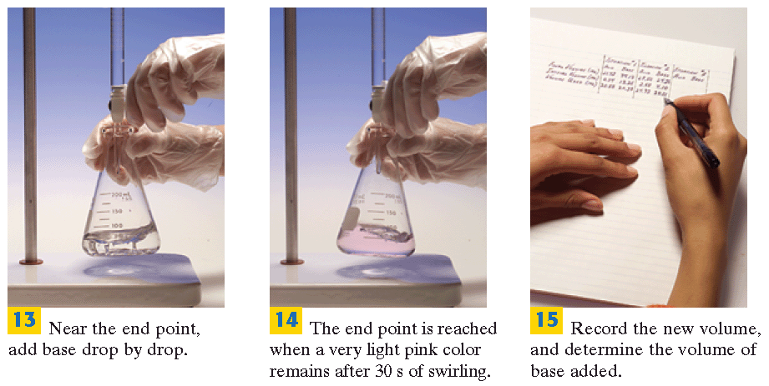
Performing a Titration, Part 2
Section 2 Determining pH and Titrations
Chapter 15

Slide 47
Section 2 Determining pH and Titrations
Chapter 15
Molarity and Titration, continued
To determine the molarity of an acidic solution, 10 mL HCl, by titration
  Titrate acid with a standard base solution 20.00 mL of 5.0 × 10⁻³ M NaOH was titrated
  Write the balanced neutralization reaction equation.
  HCl(aq) + NaOH(aq) NaCl(aq) + H₂O(l)
1 mol 1 mol 1 mol 1 mol
  Determine the chemically equivalent amounts of HCl and NaOH.

Slide 48
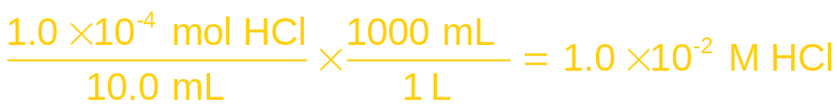
Section 2 Determining pH and Titrations
Chapter 15
Molarity and Titration, continued
Calculate the number of moles of NaOH used in the titration.
  20.0 mL of 5.0 × 10⁻³ M NaOH is needed to reach the end point
amount of HCl = mol NaOH = 1.0 × 10⁻⁴ mol
Calculate the molarity of the HCl solution

Slide 49
Section 2 Determining pH and Titrations
Chapter 15
Molarity and Titration, continued
Start with the balanced equation for the neutralization reaction, and determine the chemically equivalent amounts of the acid and base.
2. Determine the moles of acid (or base) from the known solution used during the titration.
3. Determine the moles of solute of the unknown solution used during the titration.
4. Determine the molarity of the unknown solution.

Slide 50
Section 2 Determining pH and Titrations
Chapter 15
Molarity and Titration, continued
Sample Problem F
In a titration, 27.4 mL of 0.0154 M Ba(OH)₂ is added to a 20.0 mL sample of HCl solution of unknown concentration until the equivalence point is reached. What is the molarity of the acid solution?

Slide 51
Section 2 Determining pH and Titrations
Chapter 15
Molarity and Titration, continued
Sample Problem F Solution
Given: volume and concentration of known solution
= 27.4 mL of 0.0154 M Ba(OH)₂
Unknown: molarity of acid solution
Solution:
balanced neutralization equation
chemically equivalent amounts
Ba(OH)₂ + 2HCl BaCl₂ + 2H₂O
1 mol 2 mol 1 mol 2 mol

Slide 52
Section 2 Determining pH and Titrations
Chapter 15
Molarity and Titration, continued
Sample Problem F Solution, continued
2. volume of known basic solution used (mL)
amount of base used (mol)
3. mole ratio, moles of base used
moles of acid used from unknown solution

Slide 53
Section 2 Determining pH and Titrations
Chapter 15
Molarity and Titration, continued
Sample Problem F Solution, continued
4. volume of unknown, moles of solute in unknown
molarity of unknown

Slide 54
Section 2 Determining pH and Titrations
Chapter 15
Molarity and Titration, continued
Sample Problem F Solution, continued
1. 1 mol Ba(OH)₂ for every 2 mol HCl.
2.
3.

Slide 55

Section 2 Determining pH and Titrations
Chapter 15
Molarity and Titration, continued
Sample Problem F Solution, continued
4.

Slide 56

Antacid
Chapter 15
Visual Concepts
Click below to watch the Visual Concept.
Visual Concept

Slide 57

End of Chapter 15 Show

Slide 58
Multiple Choice
Chapter 15
Standardized Test Preparation
1. Distilled water contains
A. H₂O.
B. H₃O⁺.
C. OH⁻.
D. All of the above

Slide 59
Multiple Choice
Chapter 15
Standardized Test Preparation
1. Distilled water contains
A. H₂O.
B. H₃O⁺.
C. OH⁻.
D. All of the above

Slide 60
Multiple Choice
Chapter 15
Standardized Test Preparation
2. What is the pH of a 0.0010 M HNO₃?
A. 1.0
B. 3.0
C. 4.0
D. 5.0

Slide 61
Multiple Choice
Chapter 15
Standardized Test Preparation
2. What is the pH of a 0.0010 M HNO₃?
A. 1.0
B. 3.0
C. 4.0
D. 5.0

Slide 62
Multiple Choice
Chapter 15
Standardized Test Preparation
3. Which of the following solutions would have a pH value greater than 7?
A. [OH⁻] = 2.4 × 10⁻² M
B. [H₃O⁺] = 1.53 × 10⁻² M
C. 0.0001 M HCl
D. [OH⁻] = 4.4 × 10⁻⁹ M

Slide 63
Multiple Choice
Chapter 15
Standardized Test Preparation
3. Which of the following solutions would have a pH value greater than 7?
A. [OH⁻] = 2.4 × 10⁻² M
B. [H₃O⁺] = 1.53 × 10⁻² M
C. 0.0001 M HCl
D. [OH⁻] = 4.4 × 10⁻⁹ M

Slide 64
Multiple Choice
Chapter 15
Standardized Test Preparation
4. If the pH of a solution of the strong base NaOH
is known, which property of the solution can be
calculated?
A. molar concentration
B. [OH⁻]
C. [H₃O⁺]
D. All of the above

Slide 65
Multiple Choice
Chapter 15
Standardized Test Preparation
4. If the pH of a solution of the strong base NaOH
is known, which property of the solution can be
calculated?
A. molar concentration
B. [OH⁻]
C. [H₃O⁺]
D. All of the above

Slide 66
Multiple Choice
Chapter 15
Standardized Test Preparation
5. A neutral aqueous solution
A. has a 7.0 M H₃O⁺ concentration.
B. contains neither hydronium ions nor hydroxide
ions.
C. has an equal number of hydronium ions and
hydroxide ions.
D. None of the above

Slide 67
Multiple Choice
Chapter 15
Standardized Test Preparation
5. A neutral aqueous solution
A. has a 7.0 M H₃O⁺ concentration.
B. contains neither hydronium ions nor hydroxide
ions.
C. has an equal number of hydronium ions and
hydroxide ions.
D. None of the above

Slide 68
Multiple Choice
Chapter 15
Standardized Test Preparation
6. Identify the salt that forms when a solution of H₂SO₄ is titrated with a solution of Ca(OH)₂.
A. calcium sulfate
B. calcium hydroxide
C. calcium oxide
D. calcium phosphate

Slide 69
Multiple Choice
Chapter 15
Standardized Test Preparation
6. Identify the salt that forms when a solution of H₂SO₄ is titrated with a solution of Ca(OH)₂.
A. calcium sulfate
B. calcium hydroxide
C. calcium oxide
D. calcium phosphate

Slide 70
Multiple Choice
Chapter 15
Standardized Test Preparation
7. The pH of a solution is 6.32. What is the pOH?
A. 6.32
B. 4.8 × 10⁻⁷
C. 7.68
D. 2.1 × 10⁻⁸

Slide 71
Multiple Choice
Chapter 15
Standardized Test Preparation
7. The pH of a solution is 6.32. What is the pOH?
A. 6.32
B. 4.8 × 10⁻⁷
C. 7.68
D. 2.1 × 10⁻⁸

Slide 72
Multiple Choice
Chapter 15
Standardized Test Preparation
8. The K_{w} value for water can be affected by
A. dissolving a salt in the solution.
B. changes in temperature.
C. changes in the hydroxide ion concentration.
D. the presence of a strong acid

Slide 73
Multiple Choice
Chapter 15
Standardized Test Preparation
8. The K_{w} value for water can be affected by
A. dissolving a salt in the solution.
B. changes in temperature.
C. changes in the hydroxide ion concentration.
D. the presence of a strong acid

Slide 74
Multiple Choice
Chapter 15
Standardized Test Preparation
9. Which of the pH levels listed below is the most acidic?
A. pH = 1
B. pH = 5
C. pH = 9
D. pH = 13

Slide 75
Multiple Choice
Chapter 15
Standardized Test Preparation
9. Which of the pH levels listed below is the most acidic?
A. pH = 1
B. pH = 5
C. pH = 9
D. pH = 13

Slide 76
Short Answer
Chapter 15
Standardized Test Preparation
10. A solution has a pH of 4.75. What is the hydronium
ion concentration? Is the solution acidic or basic?

Slide 77
Short Answer
Chapter 15
Standardized Test Preparation
10. A solution has a pH of 4.75. What is the hydronium
ion concentration? Is the solution acidic or basic?
Answer: [H₃O⁺] = 1.8 × 10⁻⁵ M; acidic

Slide 78
Short Answer
Chapter 15
Standardized Test Preparation
11. A weak acid that is used as an indicator is added to a strong acid solution before titration of the strong acid with a strong base. Why doesn’t the weak acid affect the value calculated for the concentration of the acid?

Slide 79
Short Answer
Chapter 15
Standardized Test Preparation
11. A weak acid that is used as an indicator is added to a strong acid solution before titration of the strong acid with a strong base. Why doesn’t the weak acid affect the value calculated for the concentration of the acid?
Answer: A very small amount of indicator is added. Therefore, the amount of base required to neutralize the very small amount of the weak acid is not significant.

Slide 80
Extended Response
Chapter 15
Standardized Test Preparation
12. The hydroxide ion concentration in a solution is 1.6 × 10⁻¹¹ M. What are the [H₃O⁺], the pH, and the pOH of the solution?

Slide 81
Extended Response
Chapter 15
Standardized Test Preparation
12. The hydroxide ion concentration in a solution is 1.6 × 10⁻¹¹ M. What are the [H₃O⁺], the pH, and the pOH of the solution?
Answer: [H₃O⁺] = 6.3 × 10⁻⁴ M
pH = 3.20
pOH = 10.80

Slide 82
Extended Response
Chapter 15
Standardized Test Preparation
13. Write the balanced equation and the net ionic equation that represent the reaction that takes place when milk of magnesia (magnesium hydroxide) reacts with hydrochloric acid in your stomach.

Slide 83
Extended Response
Chapter 15
Standardized Test Preparation
13. Write the balanced equation and the net ionic equation that represent the reaction that takes place when milk of magnesia (magnesium hydroxide) reacts with hydrochloric acid in your stomach.
Answer:

