Slide 1

Warm Up
Calculate the reaction Enthalpy for the following reaction
5CO₂(g) + Si₃N₄ → 3SiO(s) + 2N₂O(g) + 5CO(g)
Use the following equations
CO(g) + SiO₂(s) → SiO(g) + CO₂(g) ΔH = +520.9kJ
8CO₂(g) + Si₃N₄(s) → 3SiO₂(s) + 2N₂O(g) + 8CO(g)
ΔH = +461.05kJ
Ans = 2024kJ

Slide 2
Today’s Activity
Everyone needs their own textbook.
Complete Page 567 section review #1-7. Turn in after 20 seconds.

Slide 3

Chapter 17
Section 1 The Reaction Process
Objectives
Explain the concept of reaction mechanism.
Use the collision theory to interpret chemical reactions.
Define activated complex.
Relate activation energy to enthalpy of reaction.

Slide 4
Chapter 17
Section 1 The Reaction Process
Chemists have found that chemical reactions occur at widely differing rates.
The speed of a chemical reaction depends on the energy pathway that a reaction follows and the changes that take place on the molecular level when substances interact.

Slide 5
Chapter 17
Section 1 The Reaction Process
Reaction Mechanisms
Only ions or molecules with very high kinetic energy can overcome repulsive forces and get close enough to react.
example: H₂(g) + I₂(g)
2HI(g)
The reaction mechanism is the step-by-step sequence of reactions by which the overall chemical change occurs.
Species that appear in some steps but not in the net equation are known as intermediates.

Slide 6
Chapter 17
Section 1 The Reaction Process
Reaction Mechanisms, continued
Possible reaction mechanisms for the formation of HI
Step 1: I₂ 2I
Step 2: 2I + H₂ 2HI
I₂ + H₂ 2HI
Step 1: I₂ 2I
Step 2: I + H₂ H₂I
Step 3: H₂I + I 2HI
I₂ + H₂ 2HI
Reaction intermediates do not appear in the net equation
  I and H₂I

Slide 7
Chapter 17
Section 1 The Reaction Process
Collision Theory
In order for reactions to occur between substances, their particles must collide.
The set of assumptions regarding collisions and reactions is known as collision theory.
Reactant molecules must collide with a favorable orientation and with enough energy to merge the valence electrons and disrupt the bonds of the molecules to form to the products.

Slide 8

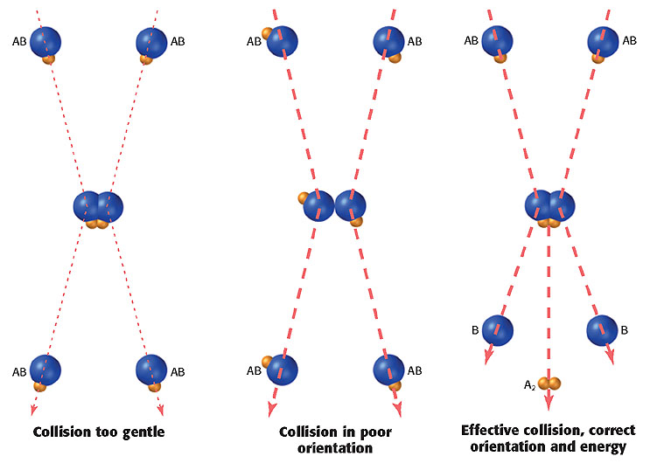
Particle Collisions
Chapter 17
Section 1 The Reaction Process

Slide 9
Chapter 17
Section 1 The Reaction Process
Collision Theory, continued
A chemical reaction produces new bonds which are formed between specific atoms in the colliding molecules.
Unless the collision brings the correct atoms close together and in the proper orientation, the molecules will not react.

Slide 10
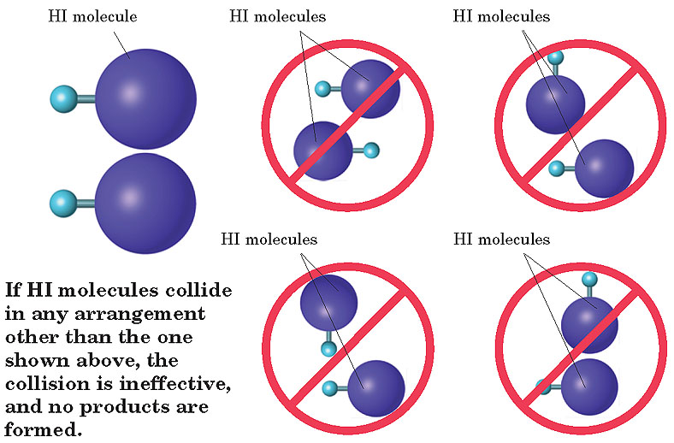
Possible Collision Orientations for the Reaction of H₂ and I₂
Chapter 17
Section 1 The Reaction Process

Slide 11
Chapter 17
Section 1 The Reaction Process
Collision Theory, continued
Collision theory provides two reasons why a collision between reactant molecules may fail to produce a new chemical species:
  the collision is not energetic enough to supply the required energy
  the colliding molecules are not oriented in a way that enables them to react with each other

Slide 12
Chapter 17
Section 1 The Reaction Process
Activation Energy
The reaction for the formation of water from the diatomic gases oxygen and hydrogen is exothermic.
2H₂(g) + O₂(g)
2H₂O(l)
The reaction does not occur spontaneously and immediately to at room temperature.
  Bond breaking is an endothermic process, and bond forming is exothermic.

Slide 13
Chapter 17
Section 1 The Reaction Process
Activation Energy, continued
An initial input of energy is needed to overcome the repulsion forces that occur between reactant molecules when they are brought very close together.
  This initial energy input activates the reaction.
Activation energy (E_{a}) is the minimum energy required to transform the reactants into an activated complex.

Slide 14
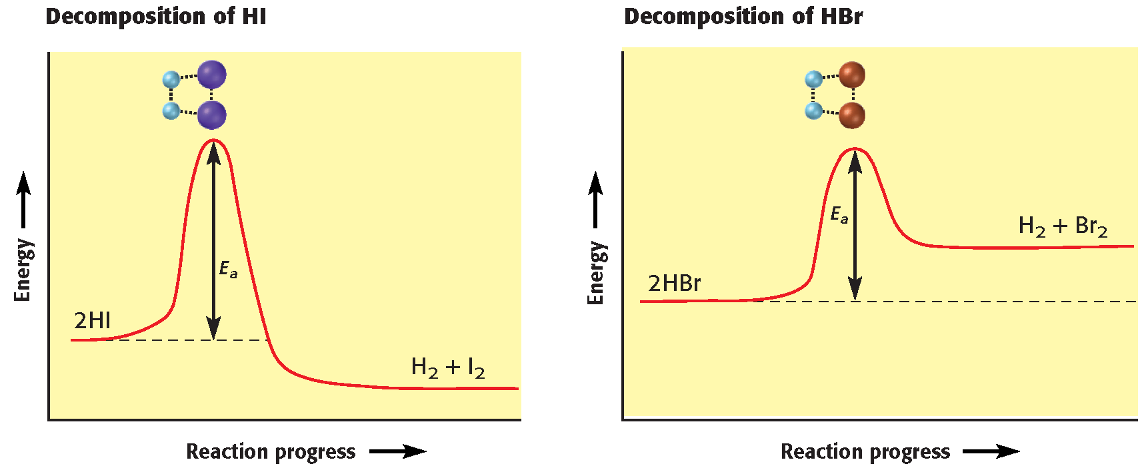
Activation Energies
Chapter 17
Section 1 The Reaction Process

Slide 15
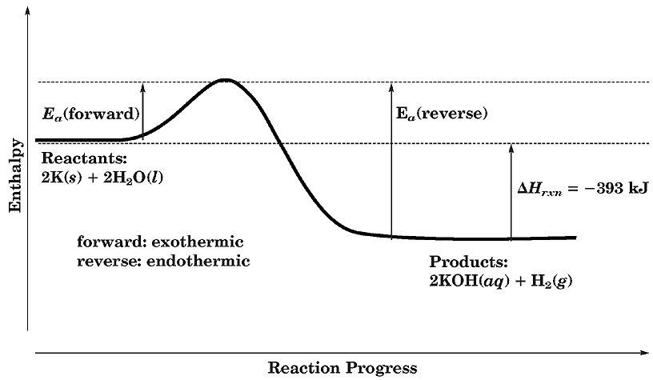
Activation Energy Differences in Exothermic and Endothermic Reactions
Chapter 17
Section 1 The Reaction Process

Slide 16
Chapter 17
Section 1 The Reaction Process
The Activated Complex
In the brief interval of bond breakage and bond formation, the collision complex is in a transition state.
  Some partial bonding exists in this transitional structure.
A transitional structure that results from an effective collision and that persists while old bonds are breaking and new bonds are forming is called an activated complex.
  The activated complex is a very short-lived molecular complex.

Slide 17
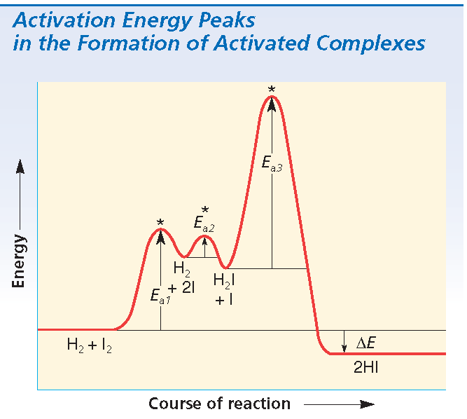
Chapter 17
Section 1 The Reaction Process
The Activated Complex, continued
There are three activated complexes during the formation of HI.
H₂(g) + I₂(g) 2HI(g)

Slide 18
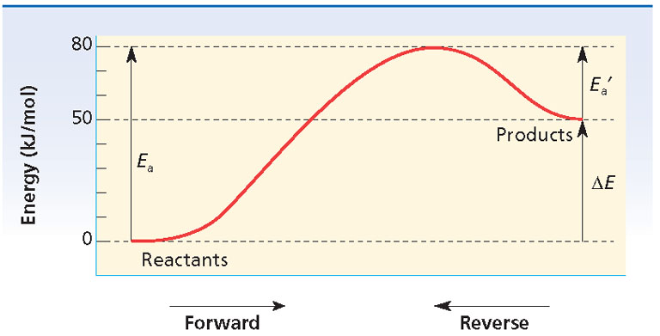
Chapter 17
Section 1 The Reaction Process
Sample Problem A
Copy the energy diagram below, and label the reactants, products, E_{a}, and E_{a}´. Determine the value of E_{forward} , E_{reverse} , E_{a}, and E_{a}´.

Slide 19
Chapter 17
Section 1 The Reaction Process
Sample Problem A Solution

Slide 20
Chapter 17
Section 1 The Reaction Process
Sample Problem A Solution, continued
∆E_{forward} = energy of products − energy of reactants
∆E_{forward} = 50 kJ/mol − 0 kJ/mol = +50 kJ/mol
∆E_{reverse} = energy of reactants − energy of products
∆E_{reverse} = 0 kJ/mol − 50 kJ/mol = − 50 kJ/mol
E_{a} = energy of activated complex − energy of reactants
E_{a} = 80 kJ/mol − 0 kJ/mol = 80 kJ/mol
E_{a}´ = energy of activated complex − energy of products
E_{a}´ = 80 kJ/mol − 50 kJ/mol = 30 kJ/mol

Slide 21
Draw an energy diagram where the products start at -50kJ. The reaction has a forward ΔE = -80kJ and a E_{a} = 80kJ. What is the E_{a}’ and the ΔE reverse?
Label the activated complex, Ea, Ea’, reactants and producs for the diagram.

Slide 22
Chapter 17
Section 2 Reaction Rate
Objectives
Define chemical kinetics, and explain the two conditions necessary for chemical reactions to occur.
Discuss the factors that influence reaction rate.
Define catalyst, and discuss two different types.
Relate the order of a reaction to the rate law for the reaction.
Explain and write rate laws for chemical reactions.

Slide 23
Chapter 17
Section 2 Reaction Rate
The change in concentration of reactants per unit time as a reaction proceeds is called the reaction rate.
The area of chemistry that is concerned with reaction rates and reaction mechanisms is called chemical kinetics.

Slide 24
Chapter 17
Section 2 Reaction Rate
Rate-Influencing Factors
  The rate of a reaction depends on the collision frequency of the reactants and on the collision efficiency.
  The nature of the reactants, the surface area, the temperature, the concentration, and the presence of a catalyst are factors that influence the rate of a chemical reaction.

Slide 25
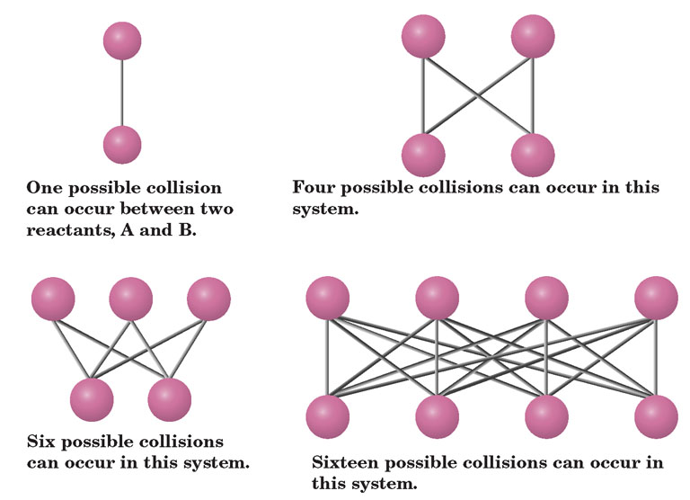
Concentration Vs. Possible Collisions
Chapter 17
Section 2 Reaction Rate

Slide 26
Chapter 17
Section 2 Reaction Rate
Rate-Influencing Factors, continued
Presence of Catalysts
Sometimes reaction rates can be increased dramatically by the presence of a catalyst.
A catalyst is a substance that changes the rate of a chemical reaction without itself being permanently consumed.
The action of a catalyst is called catalysis.

Slide 27
Chapter 17
Section 2 Reaction Rate
Rate-Influencing Factors, continued
Presence of Catalysts, continued
A catalyst provides an alternative energy pathway or reaction mechanism in which the potential-energy barrier between reactants and products is lowered.
Catalysts do not appear among the final products of reactions they accelerate.

Slide 28
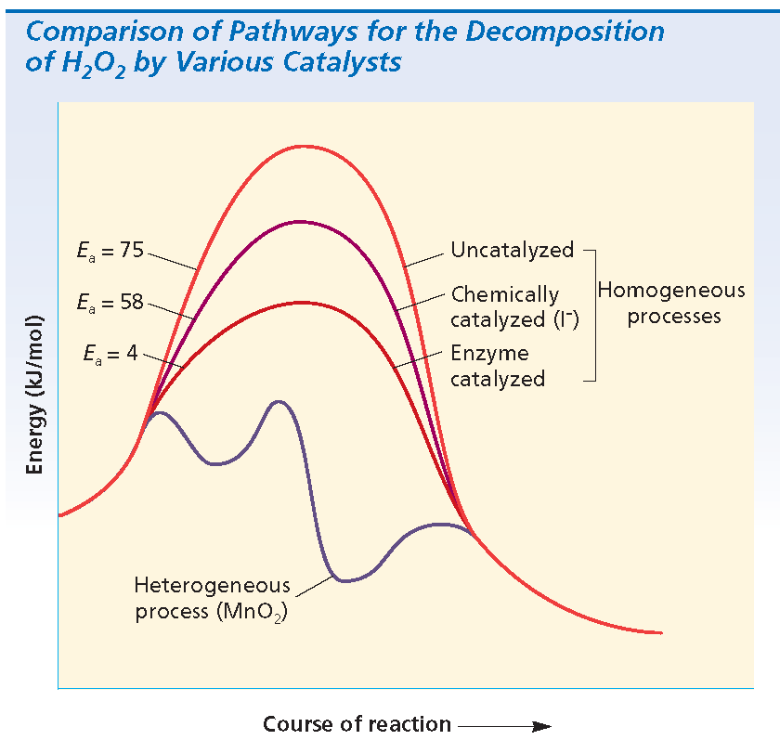
Chapter 17
Section 2 Reaction Rate
Rate-Influencing Factors, continued
Presence of Catalysts, continued

Slide 29
Chapter 17
Section 2 Reaction Rate
Rate Laws for Reactions
An equation that relates reaction rate and concentrations of reactants is called the rate law for the reaction.

Slide 30
Chapter 17
Section 2 Reaction Rate
Rate Laws for Reactions, continued
Using the Rate Law
The general form for the rate law is given by the following equation:
R = k[A]^{n}[B]^{m}
The power to which a reactant concentration is raised is called the order in that reactant.

Slide 31
Chapter 17
Section 2 Reaction Rate
Rate Laws for Reactions, continued
Using the Rate Law, continued
An order of one for a reactant means that the reaction rate is directly proportional to the concentration of that reactant.
An order of two means that the reaction rate is directly proportional to the square of the reactant.
An order of zero means that the rate does not depend on the concentration of the reactant, as long as some of the reactant is present.

Slide 32
Chapter 17
Section 2 Reaction Rate
Rate Laws for Reactions, continued
Using the Rate Law, continued
The sum of all of the reactant orders is called the order of the reaction, or overall order.
NO₂(g) + CO(g)
NO(g) + CO₂(g)
R = k[NO₂]²
second order in NO₂
zero order in CO
second order overall
The orders in the rate law may or may not match the coefficients in the balanced equation.

Slide 33
Chapter 17
Section 2 Reaction Rate
Rate Laws for Reactions, continued
Specific Rate Constant
The specific rate constant (k) is the proportionality constant relating the rate of the reaction to the concentrations of reactants.
  1. Once the reaction orders (powers) are known, the value of k must be determined from experimental data.
  2. The value of k is for a specific reaction; k has a different value for other reactions, even at the same conditions.

Slide 34
Chapter 17
Section 2 Reaction Rate
Rate Laws for Reactions, continued
Specific Rate Constant, continued
3. The units of k depend on the overall order of the reaction.
4. The value of k does not change for different concentrations of reactants or products. So, the value of k for a reaction remains the same throughout the reaction and does not change with time.

Slide 35
Chapter 17
Section 2 Reaction Rate
Rate Laws for Reactions, continued
Specific Rate Constant, continued
5. The value of k is for the reaction at a specific temperature; if we increase the temperature of the reaction, the value of k increases.
6. The value of k changes (becomes larger) if a catalyst is present.

Slide 36
Chapter 17
Section 2 Reaction Rate
Rate Laws for Reactions, continued
Sample Problem B
Three experiments that have identical conditions were performed to measure the initial rate of the reaction
2HI(g) H₂(g) + I₂(g)
The results for the three experiments in which only the HI concentration was varied are as follows:
Write the rate law for the reaction. Find the value and units
of the specific rate constant.
Experiment | [HI] (M) | Rate (M/s)
1 | 0.015 | 1.1 × 10⁻³
2 | 0.030 | 4.4 × 10⁻³
3 | 0.045 | 9.9 × 10⁻³

Slide 37
Chapter 17
Section 2 Reaction Rate
Rate Laws for Reactions, continued
Sample Problem B Solution
The general rate law for this reaction is R = k[HI]^{n}
Concentration ratio:
rate ratio:
rate law: R = k[HI]²

Slide 38
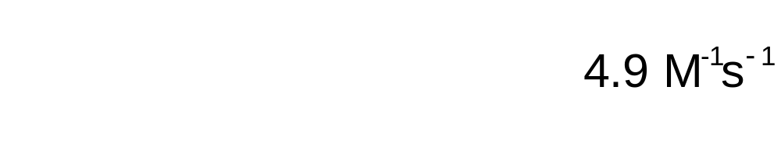
Chapter 17
Section 2 Reaction Rate
Rate Laws for Reactions, continued
Sample Problem B Solution, continued

Slide 39
Chapter 17
Section 2 Reaction Rate
Rate Laws for Reactions, continued
Sample Problem C
Three experiments were performed to measure the initial rate of the reaction
A + B C
Conditions were identical in the three experiments, except that the concentrations of reactants varied. The results are as follows:
Write the rate law for the reaction. Find the value and units
of the specific rate constant.
Experiment | [A] (M) | [B] (M) | Rate (M/s)
1 | 1.2 | 2.4 | 8.0 × 10^{–8}
2 | 1.2 | 1.2 | 4.0 × 10⁻⁸
3 | 3.6 | 2.4 | 7.2 × 10⁻⁷

Slide 40
Chapter 17
Section 2 Reaction Rate
Rate Laws for Reactions, continued
Sample Problem C Solution
The general rate law for this reaction is R = k[A]^{n}[B]^{m}.
To find m, compare Experiments 1 and 2, which have the same [A].
  Concentration ratio:
  rate ratio:
m is 1, and the reaction is first order in B

Slide 41
Chapter 17
Section 2 Reaction Rate
Rate Laws for Reactions, continued
Sample Problem C Solution, continued
To find n, compare Experiments 1 and 3, which have the same [B].
  Concentration ratio:
  rate ratio:
n is 2, and the reaction is second order in A
The rate law is R k[A]²[B].

Slide 42
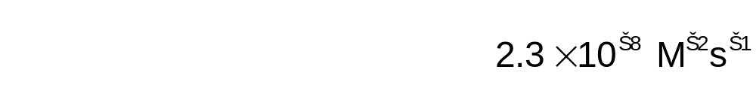
Chapter 17
Section 2 Reaction Rate
Rate Laws for Reactions, continued
Sample Problem C Solution, continued

Slide 43
Chapter 17
Section 2 Reaction Rate
Rate Laws for Reactions, continued
Rate Laws and Reaction Pathway
The form of the rate law depends on the reaction mechanism.
For a reaction that occurs in a single step, the reaction rate of that step is proportional to the product of the reactant concentrations, each of which is raised to its stoichiometric coefficient.
A + B
2C
R_{forward} = k_{forward}[A][B]

Slide 44
Chapter 17
Section 2 Reaction Rate
Rate Laws for Reactions, continued
Rate Laws and Reaction Pathway, continued
2C
A + B
R_{reverse} = k_{reverse}[C]²
If a chemical reaction proceeds in a sequence of steps, the rate law is determined from the slowest step because it has the lowest rate.
This slowest-rate step is called the rate-determining step for the chemical reaction.

Slide 45
Chapter 17
Section 2 Reaction Rate
Rate Laws for Reactions, continued
Rate Laws and Reaction Pathway, continued
NO₂(g) + CO(g)
NO(g) + CO₂(g)
The reaction is believed to be a two-step process represented by the following mechanism.
Step 1: NO₂ + NO₂
NO₃ + NO slow
Step 2: NO₃ + CO
NO₂ + CO₂ fast
Step 1 is the rate-determining step.
  rate law: R = k[NO₂]²

Slide 46
Chapter 17
Section 2 Reaction Rate
Rate Laws for Reactions, continued
Sample Problem D
Nitrogen dioxide and fluorine react in the gas phase according to the following equation.
2NO₂(g) + F₂(g) 2NO₂F(g)
A proposed mechanism for this reaction follows.
Step 1: NO₂ + F₂ NO₂F + F (slow)
Step 2: F + NO₂ NO₂F (fast)
Identify the rate-determining step, and write an acceptable rate law.

Slide 47
Chapter 17
Section 2 Reaction Rate
Rate Laws for Reactions, continued
Sample Problem D Solution
Step 1: NO₂ + F₂ NO₂F + F
Step 2: F + NO₂ NO₂F
2NO₂(g) + F₂(g) 2NO₂F(g)
F is an intermediate.
We can write the rate law from Step 1 because it is the rate-determining step.
R = k [NO₂][F₂]

Slide 48
Chapter 17
Section 2 Reaction Rate
Rate Laws for Reactions, continued
Sample Problem E
A reaction involving reactants X and Y was found to occur by a one-step mechanism:
X + 2Y XY₂
Write the rate law for this reaction, and then determine the effect of each of the following on the reaction rate:
a. doubling the concentration of X
b. doubling the concentration of Y
c. using one-third the concentration of Y

Slide 49
Chapter 17
Section 2 Reaction Rate
Rate Laws for Reactions, continued
Sample Problem E Solution
Because the equation represents a single-step mechanism, the rate law can be written from the equation. The rate will vary directly with the concentration of X and directly with the square of the concentration of Y.
R = k[X][Y]²
a. Doubling the concentration of X will double the rate.
R=k[2X][Y]²

Slide 50
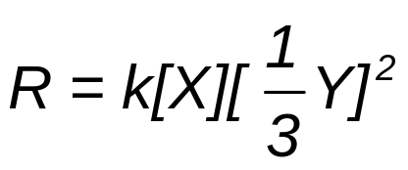
Chapter 17
Section 2 Reaction Rate
Rate Laws for Reactions, continued
Sample Problem E Solution, continued
b. Doubling the concentration of Y will increase the rate fourfold.
R = k[X][2Y]²
c. Using one-third the concentration of Y will reduce the rate to one-ninth of its original value.

Slide 51

End of Chapter 17 Show

Slide 52
Multiple Choice
Chapter 17
Standardized Test Preparation
1. The sequence of steps that occurs in a reaction process is called the
A. order of the reaction.
B. rate law.
C. overall reaction.
D. reaction mechanism.

Slide 53
Multiple Choice
Chapter 17
Standardized Test Preparation
1. The sequence of steps that occurs in a reaction process is called the
A. order of the reaction.
B. rate law.
C. overall reaction.
D. reaction mechanism.

Slide 54
Multiple Choice
Chapter 17
Standardized Test Preparation
2. To be effective, a collision requires
A. enough energy only.
B. favorable orientation only.
C. enough energy and a favorable orientation.
D. a reaction mechanism.

Slide 55
Multiple Choice
Chapter 17
Standardized Test Preparation
2. To be effective, a collision requires
A. enough energy only.
B. favorable orientation only.
C. enough energy and a favorable orientation.
D. a reaction mechanism.

Slide 56
Multiple Choice
Chapter 17
Standardized Test Preparation
3. How does the energy of the activated complex compare with the energies of the reactants and products?
  A. It is lower than both the energy of the reactants and the energy of the products.
  B. It is lower than the energy of the reactants but higher than the energy of the products.
  C. It is higher than the energy of the reactants but lower than the energy of the products.
D. It is higher than both the energy of the reactants and the energy of the products.

Slide 57
Multiple Choice
Chapter 17
Standardized Test Preparation
3. How does the energy of the activated complex compare with the energies of the reactants and products?
  A. It is lower than both the energy of the reactants and the energy of the products.
  B. It is lower than the energy of the reactants but higher than the energy of the products.
  C. It is higher than the energy of the reactants but lower than the energy of the products.
D. It is higher than both the energy of the reactants and the energy of the products.

Slide 58
Multiple Choice
Chapter 17
Standardized Test Preparation
4. If a collision between molecules is very gentle, the molecules are
A. more likely to be oriented favorably.
B. less likely to be oriented favorably.
C. likely to react.
D. likely to rebound without reacting.

Slide 59
Multiple Choice
Chapter 17
Standardized Test Preparation
4. If a collision between molecules is very gentle, the molecules are
A. more likely to be oriented favorably.
B. less likely to be oriented favorably.
C. likely to react.
D. likely to rebound without reacting.

Slide 60
Multiple Choice
Chapter 17
Standardized Test Preparation
5. A species that changes the rate of a reaction but is neither consumed nor changed is
A. a catalyst.
B. an activated complex.
C. an intermediate.
D. a reactant.

Slide 61
Multiple Choice
Chapter 17
Standardized Test Preparation
5. A species that changes the rate of a reaction but is neither consumed nor changed is
A. a catalyst.
B. an activated complex.
C. an intermediate.
D a reactant.

Slide 62
Multiple Choice
Chapter 17
Standardized Test Preparation
6. A rate law relates
A. reaction rate and temperature.
B. reaction rate and concentration.
C. temperature and concentration.
D. energy and concentration.

Slide 63
Multiple Choice
Chapter 17
Standardized Test Preparation
6. A rate law relates
A. reaction rate and temperature.
B. reaction rate and concentration.
C. temperature and concentration.
D. energy and concentration.

Slide 64
Multiple Choice
Chapter 17
Standardized Test Preparation
7. In a graph of how energy changes with reaction progress, the activated complex appears at the
A. left end of the curve.
B. right end of the curve.
C. bottom of the curve.
D. peak of the curve.

Slide 65
Multiple Choice
Chapter 17
Standardized Test Preparation
7. In a graph of how energy changes with reaction progress, the activated complex appears at the
A. left end of the curve.
B. right end of the curve.
C. bottom of the curve.
D. peak of the curve.

Slide 66
Multiple Choice
Chapter 17
Standardized Test Preparation
8. The slowest step in a mechanism is called
A. the rate-determining step.
B. the uncatalyzed reaction.
C. the activation step.
D. None of the above

Slide 67
Multiple Choice
Chapter 17
Standardized Test Preparation
8. The slowest step in a mechanism is called
A. the rate-determining step.
B. the uncatalyzed reaction.
C. the activation step.
D. None of the above

Slide 68
Multiple Choice
Chapter 17
Standardized Test Preparation
9. A certain reaction is zero order in reactant A and second order in reactant B. What happens to the reaction rate when the concentrations of both reactants are doubled?
A. The reaction rate remains the same.
B. The reaction increases by a factor of two.
C. The reaction rate increases by a factor of four.
D. The reaction rate increases by a factor of eight.

Slide 69
Multiple Choice
Chapter 17
Standardized Test Preparation
9. A certain reaction is zero order in reactant A and second order in reactant B. What happens to the reaction rate when the concentrations of both reactants are doubled?
A. The reaction rate remains the same.
B. The reaction increases by a factor of two.
C. The reaction rate increases by a factor of four.
D. The reaction rate increases by a factor of eight.

Slide 70
Short Answer
Chapter 17
Standardized Test Preparation
10. Two molecules collide but bounce apart unchanged. What two reasons could account for their failure to react?

Slide 71
Short Answer
Chapter 17
Standardized Test Preparation
10. Two molecules collide but bounce apart unchanged. What two reasons could account for their failure to react?
Answer: They had insufficient energy for bonds to break, or they did not collide in a favorable orientation.

Slide 72
Short Answer
Chapter 17
Standardized Test Preparation
11. Sketch a diagram that shows how the energy changes with the progress of an endothermic reaction. Label the curve “Reactants,” “Products,” and “Activated complex.” On the same diagram, sketch a second curve to show the change caused by a catalyst.

Slide 73
Short Answer
Chapter 17
Standardized Test Preparation
11. Sketch a diagram that shows how the energy changes with the progress of an endothermic reaction. Label the curve “Reactants,” “Products,” and “Activated complex.” On the same diagram, sketch a second curve to show the change caused by a catalyst.
Answer: The humped curve should have a final plateau that is higher than its initial plateau. The second curve should share the same plateaus as the first but should have a lower hump.

Slide 74
Extended Response
Chapter 17
Standardized Test Preparation
12. Suggest ways of measuring the concentration of a reactant or product in a reaction mixture.

Slide 75
Extended Response
Chapter 17
Standardized Test Preparation
12. Suggest ways of measuring the concentration of a reactant or product in a reaction mixture.
Answer: Answers may vary. Among the methods that might be suggested are by observing a change in color intensity, by removing samples and analyzing for one component, and by measuring pressure change.

Slide 76
Extended Response
Chapter 17
Standardized Test Preparation
13. Why are reaction orders not always equal to the coefficients in a balanced chemical equation?

Slide 77
Extended Response
Chapter 17
Standardized Test Preparation
13. Why are reaction orders not always equal to the coefficients in a balanced chemical equation?
Answer: Reactions often occur by a multi-step mechanism. Reaction orders reflect the coefficients in the rate-determining step of such a mechanism, not the coefficients in the overall equation.

