Slide 1

Section 3 Using Scientific Measurements
Chapter 2
Accuracy and Precision
Accuracy refers to the how close you are to the actual value.
Precision refers to the how close your measurements are to each other.

Slide 2
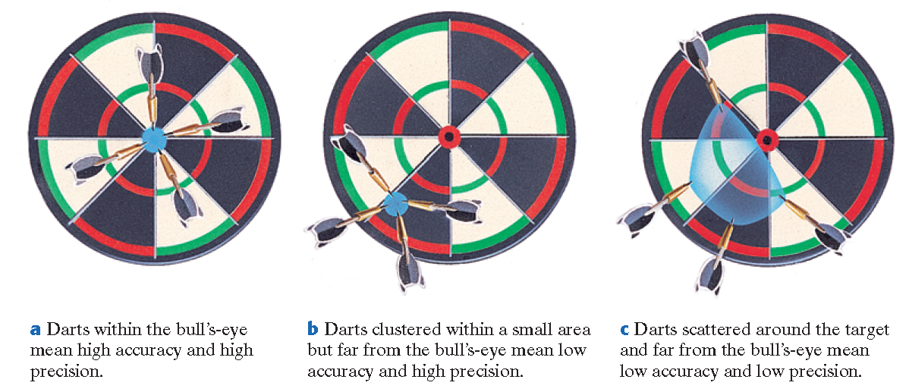
Accuracy and Precision
Section 3 Using Scientific Measurements
Chapter 2

Slide 3
Variable – something in an experiment that may change from experiment to experiment.
Control – Something in an experiment that will stay consistent throughout the testing process.

Slide 4
Chapter 2
Section 1 Scientific Method
Scientific Method
The scientific method is a logical approach to solving problems by observing and collecting data, formulating hypotheses, testing hypotheses, and formulating theories that are supported by data.

Slide 5
Chapter 2
Section 1 Scientific Method
Observing and Collecting Data
Observing is the use of the senses to obtain information.
data may be
  qualitative (descriptive)
  quantitative (numerical)
A system is a specific portion of matter in a given region of space that has been selected for study during an experiment or observation.

Slide 6
Chapter 2
Section 1 Scientific Method
Testing Hypotheses
Testing a hypothesis requires experimentation that provides data to support or refute a hypothesis or theory.
Controls are the experimental conditions that remain constant.
Variables are any experimental conditions that change.

Slide 7
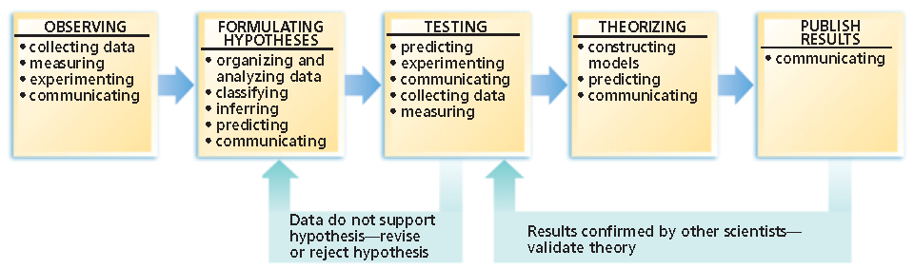
Scientific Method
Chapter 2
Section 1 Scientific Method

Slide 8
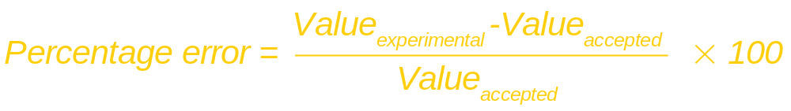
Section 3 Using Scientific Measurements
Chapter 2
Accuracy and Precision, continued
Percentage Error
Percentage error tells you how close you are to the accepted value.

Slide 9
Accuracy and Precision
Section 3 Using Scientific Measurements
Chapter 2
Sample Problem C
A student measures the mass and volume of a substance and calculates its density as 1.40 g/mL. The correct, or accepted, value of the density is 1.30 g/mL. What is the percentage error of the student’s measurement?

Slide 10
Measurement and Significant Figures
Chapter 2 Section 3
To count the number of significant figures in a measurement, observe the following rules:
  All nonzero digits are significant.
  Zeros between significant figures are significant.
  Zeros preceding the first nonzero digit are not significant.
  Zeros to the right of the decimal after a nonzero digit are significant.
  Zeros at the end of a nondecimal number may or may not be significant. (Use scientific notation.)
Notes:
2

Slide 11
Significant Figures
Sample Problem
How many significant figures are in each of the following measurements?
a. 28.6 g
b. 3440. cm
c. 910 m
d. 0.046 04 L
e. 0.006 700 0 kg

Slide 12
Measurement and Significant Figures
An exact number is a number that arises when you count items or when you define a unit.
  For example, when you say you have nine coins in a bottle, you mean exactly nine.
  When you say there are twelve inches in a foot, you mean exactly twelve.
  Note that exact numbers have no effect on significant figures in a calculation.
Notes:
2

Slide 13
Significant Figures, continued
Addition or Subtraction with Significant Figures
When you +/- your answer will have the same number of DECIMALS as the number with the least amount in the problem.
Multiplication/Division with Significant Figures
Your answer will have same number of SIG FIGS as the least number in your problem.

Slide 14
Significant Figures
Section 3 Using Scientific Measurements
Chapter 2
Sample Problem E
Carry out the following calculations. Express each answer to the correct number of sig. figs.
a. 5.44 m - 2.6103 m
b. 2.4 g/mL × 15.82 mL

Slide 15
Section 3 Using Scientific Measurements
Chapter 2
Conversion Factors and Significant Figures
There is no uncertainty exact conversion factors.
Most exact conversion factors are defined quantities.
5.4423 kg 1000 g
1 kg
= 5442.3 g

Slide 16
Section 3 Using Scientific Measurements
Chapter 2
Scientific Notation
In scientific notation, numbers are written in the form M × 10^{n}, where the factor M is a number between 1 and 10.
And n is a whole number that tells you how far the decimal moves.
example: 0.000 12 mm = 1.2 × 10⁻⁴ mm
  Move the decimal point four places to the right, and multiply the number by 10⁻⁴. Negative n means a number less than one. Positive is a large number.

Slide 17
Write these numbers in Scientific Notation.
1 254 000
0.00400
Write in standard form.
1.443 x 10⁵
9.910 x 10⁻³

Slide 18
Section 3 Using Scientific Measurements
Chapter 2
Scientific Notation, continued
Mathematical Operations Using Scientific Notation
1. Addition and subtraction —These operations can be performed only if the values have the same exponent (n factor).
example: 4.2 × 10⁴ kg + 7.9 × 10³ kg
or

Slide 19
Section 3 Using Scientific Measurements
Chapter 2
Scientific Notation, continued
Mathematical Operations Using Scientific Notation
2. Multiplication —The M factors are multiplied, and the exponents are added algebraically.
example: (5.23 × 10⁶ µm)(7.1 × 10⁻² µm)
= (5.23 × 7.1)(10⁶ × 10⁻²)
= 37.133 × 10⁴ µm²
= 3.7 × 10⁵ µm²

Slide 20
Chapter 2
Section 2 Units of Measurement
Lesson Starter
Would you be breaking the speed limit in a 40 mi/h zone if you were traveling at 60 km/h?
  one kilometer = 0.62 miles
  60 km/h = 37.2 mi/h
  You would not be speeding!
km/h and mi/h measure the same quantity using different units

Slide 21
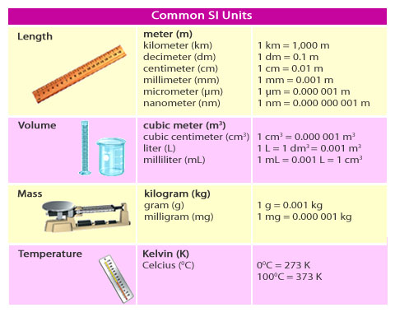
SI (Le Systéme International d´Unités)
Chapter 2
Visual Concepts

Slide 22
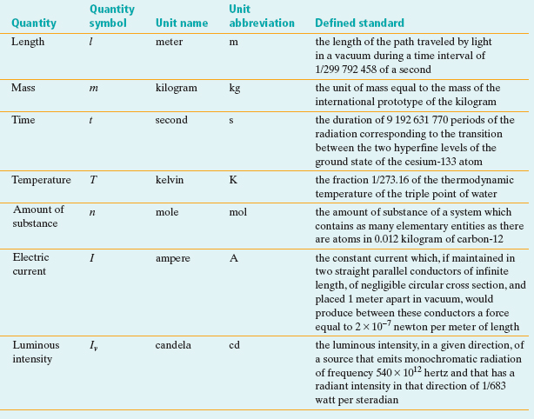
Chapter 2
Section 2 Units of Measurement
SI Base Units

Slide 23
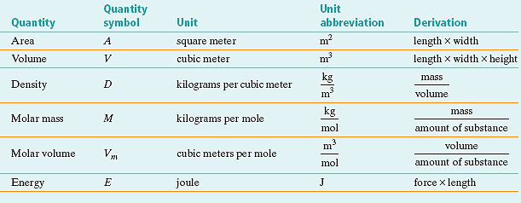
Chapter 2
Section 2 Units of Measurement
Derived SI Units
Combinations of SI base units form derived units.
  pressure is measured in kg/m•s², or pascals

Slide 24
Chapter 2
Section 2 Units of Measurement
Derived SI Units, continued
Volume
Volume is the amount of space occupied by an object.
  The derived SI unit is cubic meters, m³
  The cubic centimeter, cm³, is often used
  The liter, L, is a non-SI unit
  1 L = 1000 cm³
  1 mL = 1 cm³

Slide 25
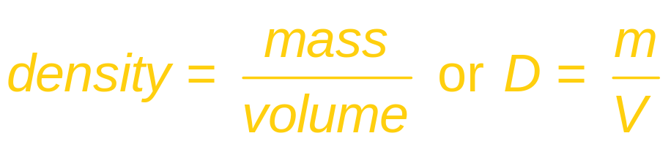
Chapter 2
Section 2 Units of Measurement
Derived SI Units, continued
Density
Density is the ratio of mass to volume, or mass divided by volume.
  The derived SI unit is kilograms per cubic meter, kg/m³
  g/cm³ or g/mL are also used
  Density is a characteristic physical property of a substance.

Slide 26
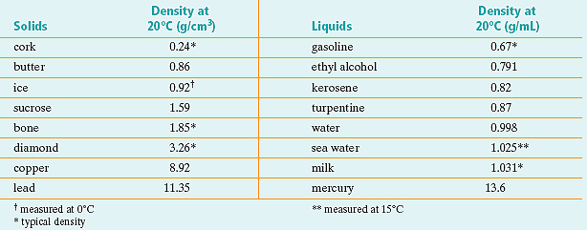
Chapter 2
Section 2 Units of Measurement
Derived SI Units, continued
Density
Density can be used as one property to help identify a substance

Slide 27
Derived SI Units, continued
Chapter 2
Section 2 Units of Measurement
Sample Problem A
A sample of aluminum metal has a density of 2.7 g/cm³. The mass of the sample is 8.4g. Calculate the volume of aluminum.

Slide 28
Derived SI Units, continued
Chapter 2
Section 2 Units of Measurement
Sample Problem A Solution
Given: mass (m) = 8.4 g
density (D) = 2.7 g/cm³
Unknown: volume (V)
Solution:

Slide 29
Chapter 2
Section 2 Units of Measurement
Conversion Factors
A conversion factor is a ratio derived from the equality between two different units that can be used to convert from one unit to the other.
  example: How quarters and dollars are related

Slide 30
Chapter 2
Section 2 Units of Measurement
Conversion Factors, continued
Dimensional analysis is a mathematical technique that allows you to use units to solve problems involving measurements.
quantity sought = quantity given × conversion factor
example: the number of quarters in 12 dollars
number of quarters = 12 dollars × conversion factor

Slide 31
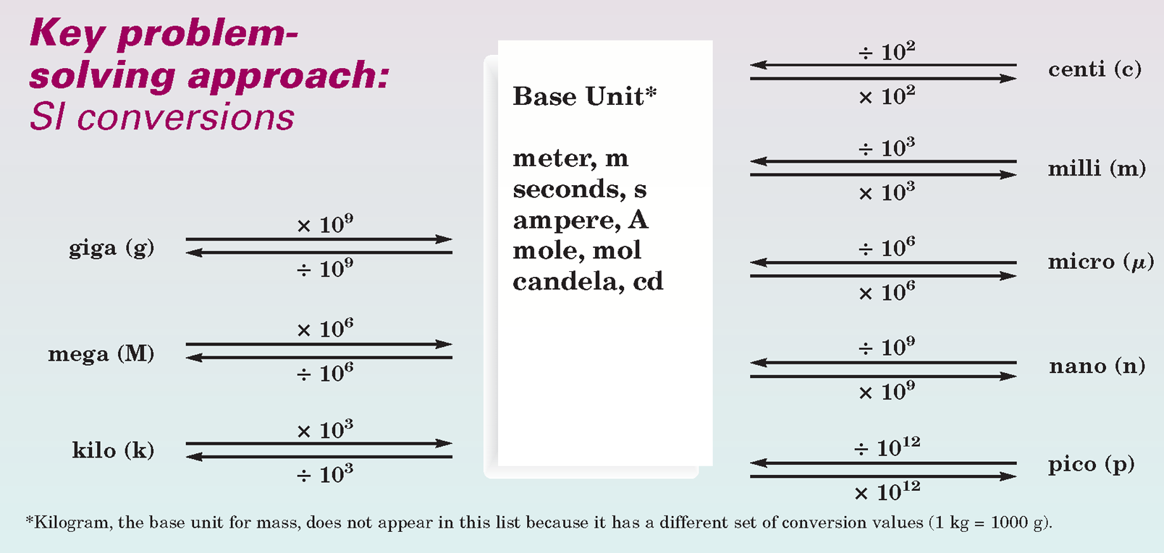
SI Conversions
Chapter 2
Section 2 Units of Measurement

Slide 32
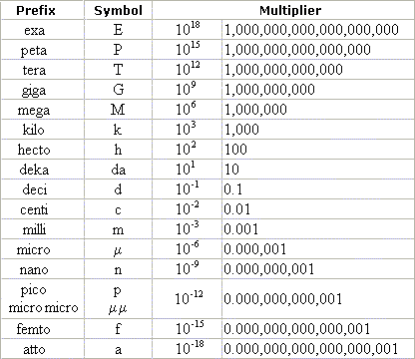

Slide 33
Conversion Factors, continued
Chapter 2
Section 2 Units of Measurement
Sample Problem B
Express a mass of 5.712 grams in milligrams and in kilograms.
How many Mg are in 3.44ng?

