Slide 1

North Carolina Transportation and Infrastructure Revenues in the Era of COVID-19 and Beyond
NC-CAV Seminar Presentation
December 4, 2020

Slide 2
Background
For much of the 21st Century, North Carolina has experienced robust economic growth. The State’s gross domestic product has grown significantly, outpacing economic growth experienced in other Southeastern states.
Contributing factors include: quality of life, relatively low cost of living, available land ripe for development, and a highly skilled workforce.

Slide 3
Supply and Demand
The State has experienced extraordinary population growth, increasing the “supply” of transportation revenues but also greatly increasing transportation “demand.”
From 2010 to 2019, the State's population growth has outperformed the nation, having grown 10.0 percent compared to the nation's 5.9 percent.
Coupled with this change, aggregated vehicle traffic growth has increased substantially on the State’s roadways.
In addition, the State’s largest international airports, Charlotte-Douglas International Airport (“CLT”) and Raleigh-Durham International Airport (“RDU”), have experienced more than double-digit growth in the percentage of passenger enplanements for the period 2010-2019.

Slide 4
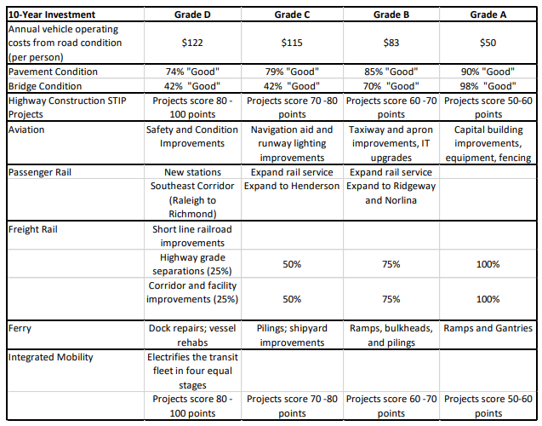
Supply and Demand

Slide 5
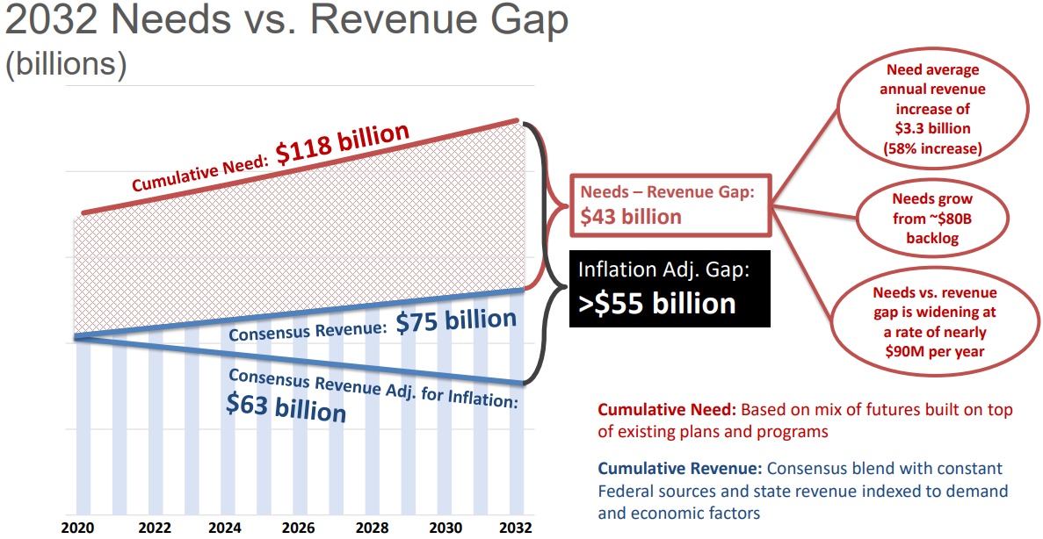
Supply and Demand

Slide 6
Growth in Revenues
Despite this growth, federal and state transportation revenues have remained largely stagnant
After a dip in 2001, and again in 2009, air traffic has grown steadily, providing stable revenue streams in the form of passenger facility charges, landing fees, parking revenues, and a variety of other transportation funding sources to many of the State’s large airports.
Transportation revenues that support vehicular travel, such as vehicle registration fees, federal and state gas tax revenues, and other funding methods have remained relatively stable.
While other states have seen anemic growth in transportation demand and revenues, this has not the case in North Carolina, and is representative of a large population shift away “Rust Belt” northern and Midwest states to “Sun Belt” and Western states.

Slide 7
Growth in Revenues
Recent events have placed significant strain on the State’s transportation and infrastructure revenues
Relative to even some of the most recent economic “shocks,” such as the “Great Recession”, COVID-19 has led to a catastrophic, although somewhat brief, drop in transportation revenues
As a result, the transportation industry has been hit with a “trifecta” of revenue losses: declines in federal and state motor fuels tax revenues as a result of declines in gallons of gasoline and diesel purchased, declines in new vehicle purchases as a result of the decline in the overall economy as part of the highway use tax, and declines in sales and use tax revenue that goes to primarily fund public transportation that has placed added strains on public transportation agencies throughout the State.
According to the North Carolina Department of Transportation, transportation revenues have declined over 30 percent in the months immediately after COVID before rebounding in the final quarter of 2020.

Slide 8
Moving Beyond COVID
Notably, this sharp decline in transportation revenues has caused delays in the planning schedules of transportation and infrastructure projects.
The good news is that transportation revenues are starting to rebound, but the bad news is that some transportation forecasts project travel in North Carolina may not rebound to normal forecasted growth levels for at least the next several years.
Ridership on public transportation is down significantly from prior years, and it is unclear when or if public transportation use will return back to pre-pandemic levels.
Aviation travel is still down significantly, as traffic at both RDU and CLT are down more than 20 percent year-over-year from 2019

Slide 9
Moving Beyond COVID
As we look toward to 2021 and beyond, the future of transportation in North Carolina and around the U.S. remains uncertain, with some signs of structural changes taking place.
Work-related trips may be impacted for the long-term, as many in the knowledge-based economy are able to work from home one or more days per week.
Airline travel may also experience a long-term impact, as companies evaluate the cost-benefit of conducting business virtually instead of in-person

Slide 10
Challenges Ahead
As a result, major challenges lie ahead for transportation planners and policymakers to accurately forecast future transportation revenues.
First, COVID-19 has introduced a new potential forecasting “error” in planning models.
Second, it is possible that the public may have passed a critical threshold for telework, which begs the question: how do we accurately account for this “loss” or replacement in trips?
Third, the introduction of electric and connected and automated vehicles introduces significant levels of uncertainty into historical transportation revenue forecasting approaches
Finally, as vehicles become more fuel efficient, the potential power of the gas tax to sufficiently keep pace with demand will continue to decline

Slide 11
Modeling Needs
Sophisticated financial models that consider these new uncertainties are essential.
Credible financial forecasts are critical to the long-term design, planning, and delivery of transportation infrastructure projects.
Transportation professionals will increasingly be called upon to provide reliable forecasts that best assess the post-COVID-19 aftermath to better inform policymakers and ensure that transportation projects have the necessary long-term revenue streams.

Slide 12
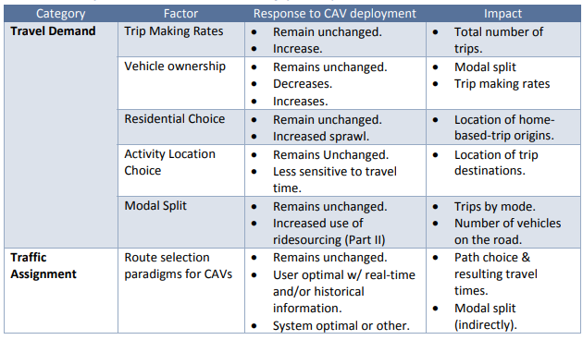
Modeling in CAV World
Behavioral Factors to be considered in modeling of CAV Impacts

Slide 13
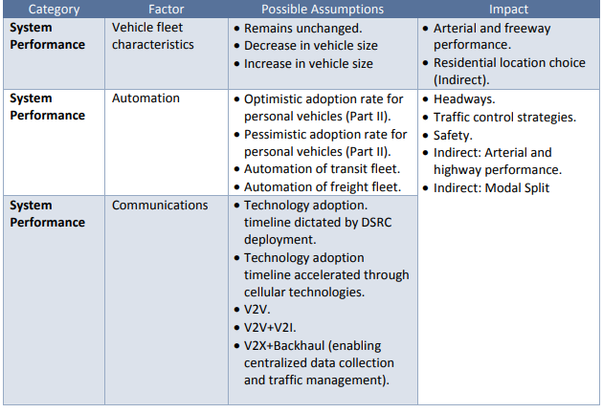
Modeling in a CAV World
Technology Factors to be considered in modeling of CAV Impacts

Slide 14
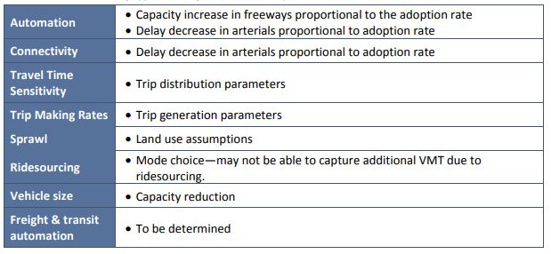
Modeling in a CAV World
Potential Modeling Approach Using Traditional 4-step Model

Slide 15
For Further Resaearch
Kuhr, James, et al. Travel modeling in an era of connected and automated transportation systems: an investigation in the Dallas-Fort Worth area. No. D-STOP/2017/122. University of Texas at Austin. Data-Supported Transportation Operations & Planning Center (D-STOP), 2017.
Guanetti, Jacopo, Yeojun Kim, and Francesco Borrelli. "Control of connected and automated vehicles: State of the art and future challenges." Annual Reviews in Control 45 (2018): 18-40.
Basar, Gulsevi, and Mecit Cetin. "Auction-based tolling systems in a connected and automated vehicles environment: Public opinion and implications for toll revenue and capacity utilization." Transportation Research Part C: Emerging Technologies 81 (2017): 268-285.
Abdel-Aty, Mohamed, Yina Wu, Moatz Saad, and Md Sharikur Rahman. "Evaluation of Managed Lane Facilities in a Connected Vehicle Environment." (2019).
Zhang, Wenwen, and Kaidi Wang. "Parking futures: shared automated vehicles and parking demand reduction trajectories in Atlanta." Land Use Policy 91 (2020): 103963.
Clements, Lewis M., and Kara M. Kockelman. "Economic effects of automated vehicles." Transportation Research Record 2606.1 (2017): 106-114.

Slide 16
Thank You! Questions?
Nicolas Norboge, Ph.D.
Institute for Transportation Research and Education
ndnorbog@ncsu.edu

