Slide 1
Online Graphic Designer and Photo Editor
Sajedul Islam
ID: 171605, MIT 16th Batch.

Slide 2

OVERVIEW
Introduction
Motivation
System Descriptions
Tools and Technologies
Goals and Scopes
Conclusion

Slide 3
Introduction
Graphic is the art and practice of planning and projecting ideas and experiences with visual and textual content.
To design graphics and edit existing images or photos every designer or editor wishes for a handy and flexible application.
This handy and flexible web application will help them to design better graphics and edit existing images or photos.

Slide 4
Motivation
Providing a very handy, flexible and powerful web application that can design/edit graphic contents.
Developing device and platform independent system.
Developing responsive and interactive web application.
Providing a user friendly and always ready to use system.

Slide 5
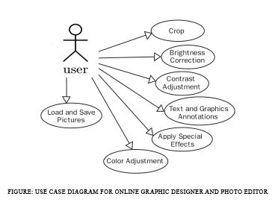
System Descriptions
This Online Graphic Designer and Photo Editor is a web application that lets the users to create new graphic elements, vectors, design graphic contents, edit or manipulate existing images and store it on the client device.
This application is easy to use and provides all the required facilities for designing and editing.

Slide 6
Tools and Technologies
implementation the requirements are:
Web Language: PHP
Web Server: Apache or Wamp Server
Database: MySQL
Client On Internet: Web Browser, Operating System(any)
Web Server: HTTP server
Web Language: JavaScript, jQuery, JSON
Design Language: HTML, CSS
For the further development such as providing pro-services only to the registered users and business or commercial project

Slide 7
Goals and Scopes
Goals
To provide a handy, flexible and powerful system.
To overcome the drawbacks of the usual systems and existing web applications.
Save time, cost and effort of the user.
Scopes
The System has a wide scope which covers the following perspectives:
The user will have all the necessary designing and editing tools available.
Support for different popular file formats.

Slide 8
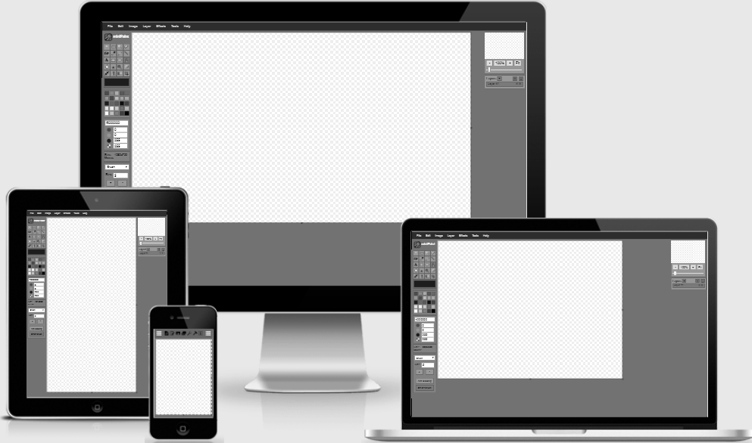
Scopes
Can be used on any device or platform.
Modification or further development can be done easily.
Very user friendly and always ready to use system.
Figure : Mock up design of the system

Slide 9
Conclusion
The Online Graphic Designer and Photo Editor is very user friendly and helpful for the designers and editors. By using this web application they can easily perform their designing or editing tasks in a better and efficient way. It will also save their time, cost and effort of the work.
Links
GitHub Repository
Live View

Slide 10
THANKS!
Any questions?

