Slide 1
Fruit Catcher Game
Digital Image Processing Project

Slide 2
Features
Catch a fruit to score!
Control the basket using your webcam and cardboard!
8 kinds of fruits: apple, orange, banana, blueberry, cherry, strawberry, grape, and peach.

Slide 3
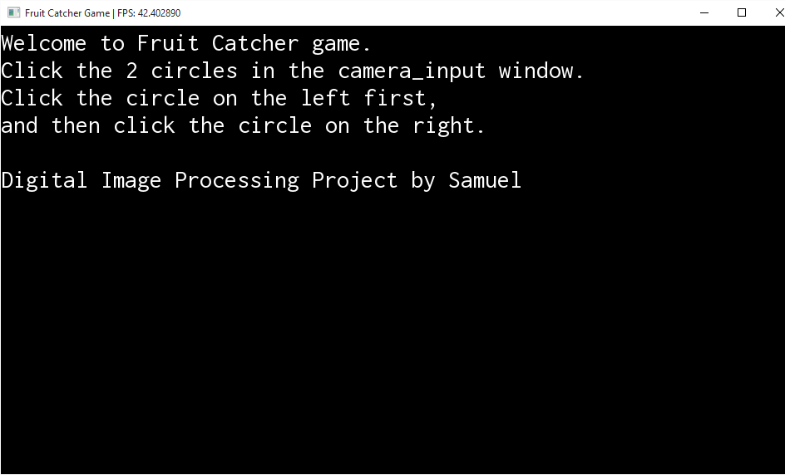

Slide 4
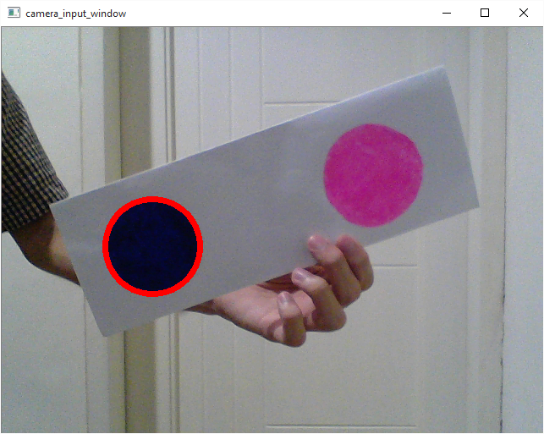

Slide 5
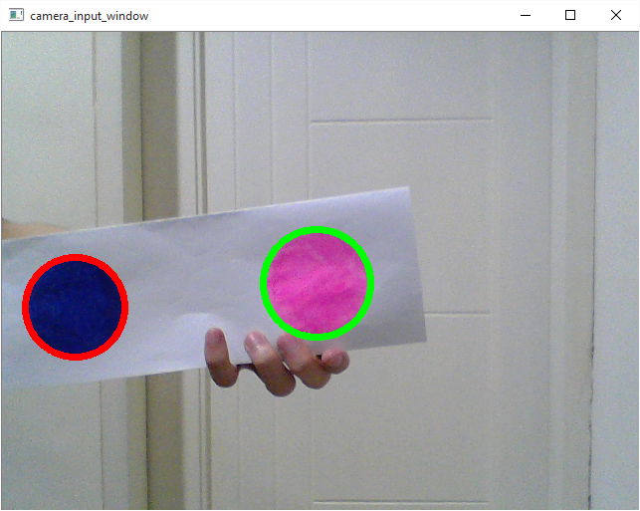

Slide 6
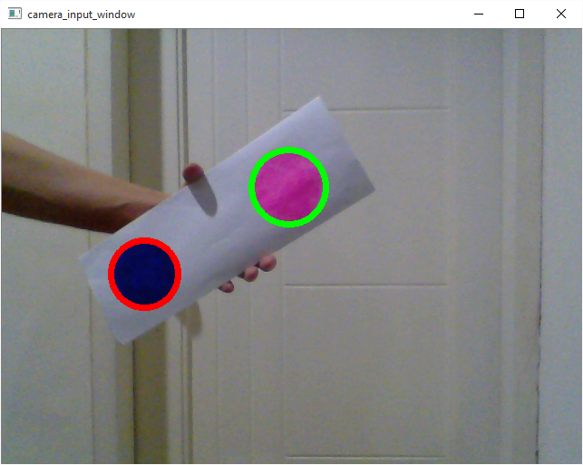

Slide 7
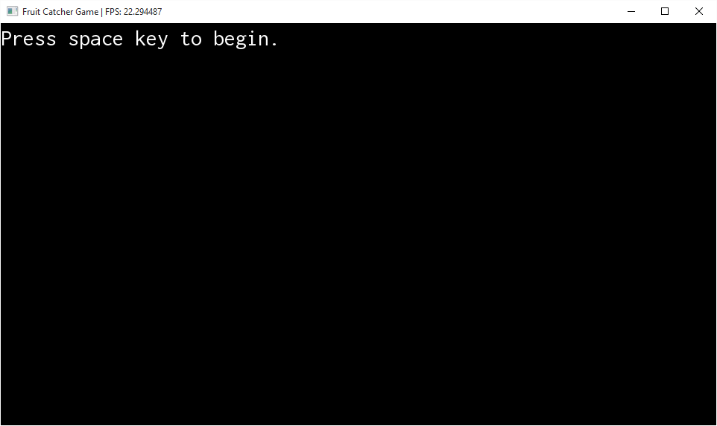

Slide 8
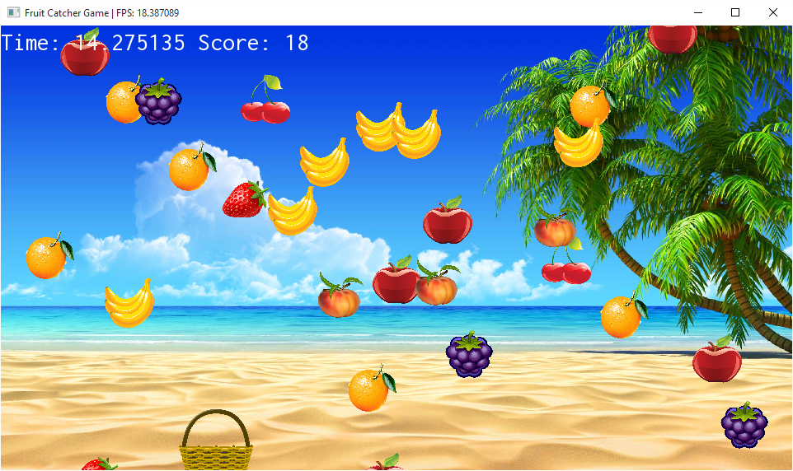

Slide 9
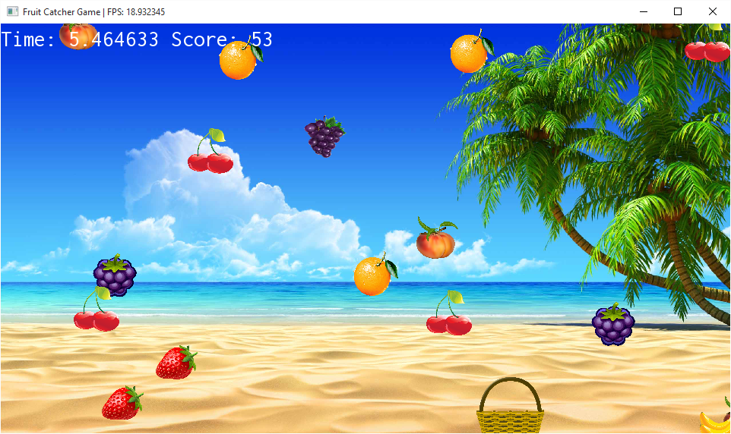

Slide 10
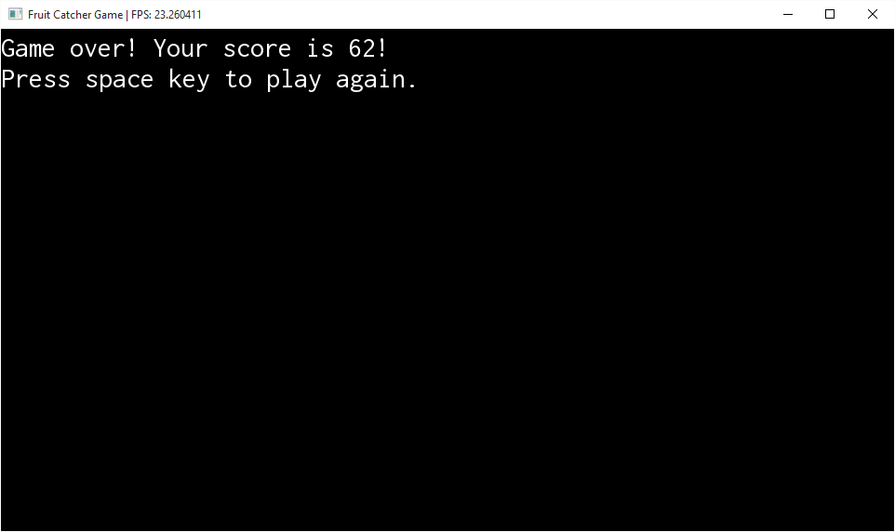

Slide 11
