Slide 1

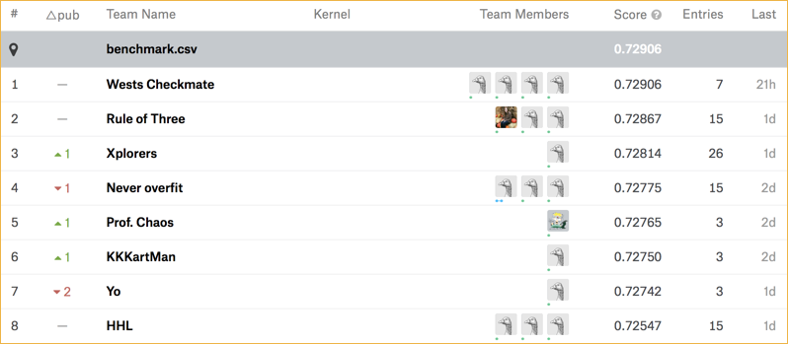
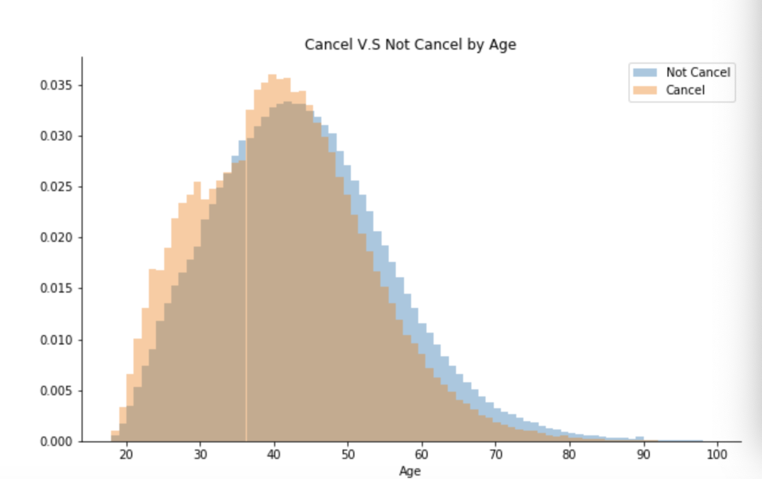
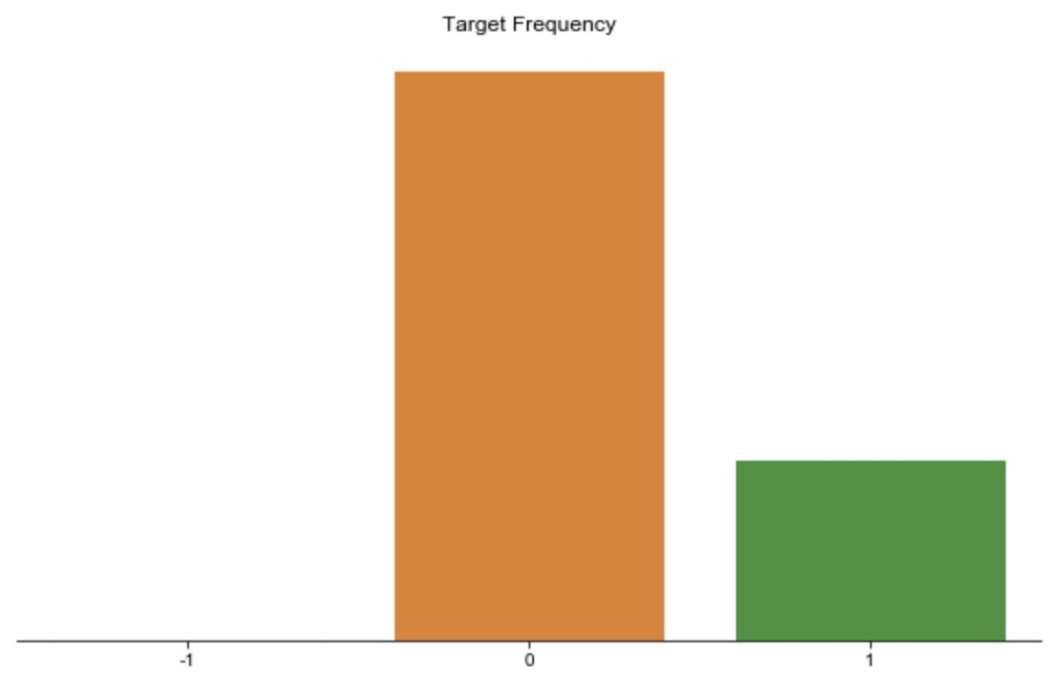
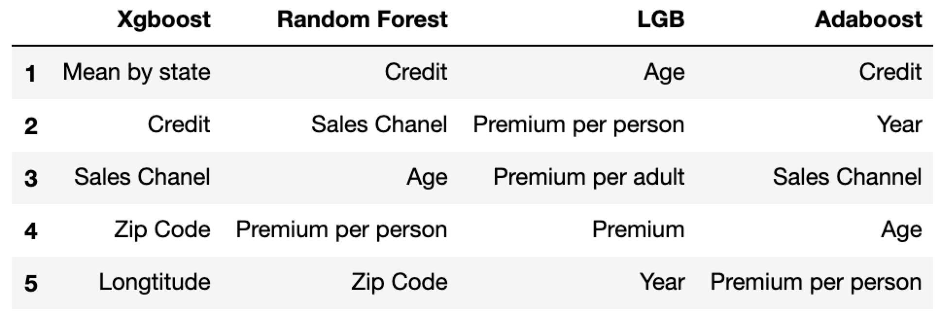
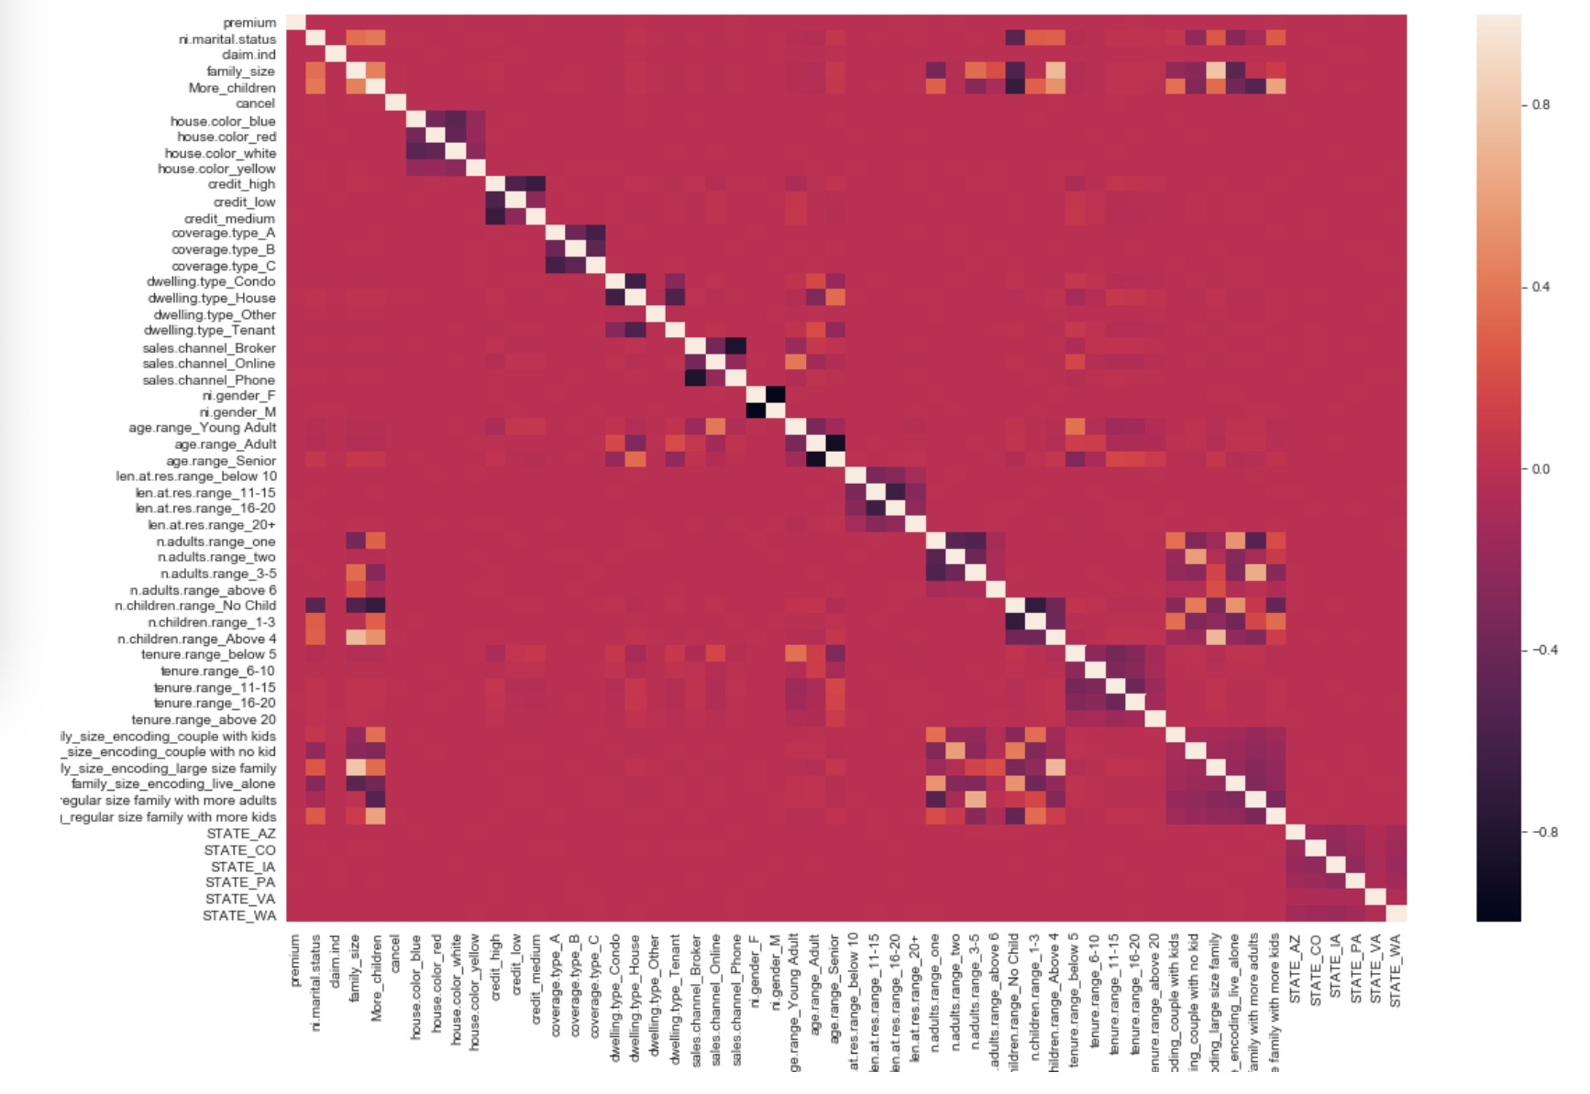
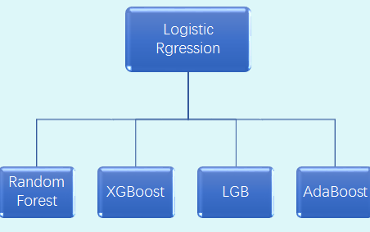
Policy Cancellation Rate Prediction
for Kangaroo auto insurance company
Multivariate Statistical Inference
Spring 2019
Yunhao Huang, Yiming Tan, Xiaoxi Zhao
Background
Feature Engineering
Results
The second factor is age. If we plot the age without target, we can observe people between 20 to 45 are more likely to cancel the policy, but people who are older are not likely to cancel the policy. That can be interpret in this way: young people are good at using social media, they have more information of this kind of policy. Once they find the better alternative choices, they may cancel this one and buy the other one in some conditions. However, for elder people, they don’t have many choices because they are not good at using social medias. So they are less likely to find a good alteration for this policy.
Yunhao Huang, Yiming Tan, Xiaoxi Zhao
The insurance companies are always interested in the policy cancellation and the reasons behind it. Competing in the NESS 2019 Statathon Competition on Kaggle, we aim to create a retention model based on historical policy data for Kangaroo Auto Insurance Company. Based on the model, we will predict those house insurance policies that are most likely to cancel as well as interpret the results and find out which features contribute the most into a policy cancellation.
Mean encoding: Instead of using one-hot encoding, we replaced the categorical data with the mean response of each category to include more meaningful information, and also to deal with the features with too many categories.
Premium per person/adult: Premium value itself seems to be an important feature, but it does not perform well in the model. It is more reasonable to consider premium divided by family size and number of adults. Thinking about the features from data understanding and real life is sometimes an effective way in feature engineering.
Zip code: Consider neighborhood effect by mapping the zip codes to corresponding cities, states, longitude, latitude and average income. As for cities and states, we did mean encoding as before.
Effects of FE: Compared with the original features, the established features tend to have a better performance, as listed in the feature importances table in the conclusion section.
Our Final Auc are: 73.32% in training set; 73.10% in validation set; 72.775% in test set. And we finally got 4th place in the competition.
Exploratory Data Analysis
In the training dataset, we have 792026 non-cancelled policies (75.5%), 253097 cancelled policies (24.1%). The data is imbalanced.
Conclusion
Both the numerical data and categorical data share very similar distributions in the training and test set, making the classification task difficult.
If we plot the feature importance of each model, the top 5 feature importance of each model are as follow:
Most of the features are uncorrelated with each other and they don’t seem to have a linear relationship with the response variable.
Methodology
Base Models: Random Forest, XGBoost, LiteGBM and AdaBoost. We first tuned parameters and trained each of the model separately to make sure each has an acceptable performance. Since the feature importances in the models vary, which means that models are making decisions from different aspects of the data, we can use stacking to combine the model to slightly improve the performance.
Stacking: Stacking is an ensemble learning technique to combine multiple classification models via a meta-classifier. Above the base models level, we built up a stacking level to combine the prediction results of the base models, where predicted probabilities from the base models were considered as predictors, and a logistic regression model was built on them to predict the target probabilities.
In summary, the importance features are:
First Tier: Credit, Age, Sales channel, Premium per person
Second Tier: Zip Code, Year
Thrid Tier: Mean by state, Longitude, Premium per adult, Premium.
In more details Credit, Age, Sales channel and Premium per person appear in 3 out of 4 models, Zip code and year appear in 2 models, Mean by state, Longitude, premium per adult and premium appear in 1 model. So we can say Credit, Age, Sales channels and Premium per person can be the most important factors. Next we will going to interpret these factors.
The third factor is sales channel, which can be divided as phone, online. This factors are also reasonable since your are more likely to trust people you familiar with. If the clients bought the product from broker, they actually discuss the product with the broker in person, so they are not likely to cancel the policy because the product is recommended by the people they familiar. However, if they bought the product by phone or from online, they are more likely to cancel because it is less trusty.
The first factor is the financial credit of the client. This factor can be interpret along with mean income group by state. If the client has good financial credit, which means that they are not likely to wrong about the financial status. So these group of clients will care more about their quality of live, so these client are more likely to live in a luxury house, if there are some damage in their house, they will pay a lot of money to fix the damage without insurance. So these people are not likely to cancel the policy in the condition of sufficient money. In the same reason, if the state has high mean income, which means that we are more likely to see high financial credit client in the state.
The Fourth factor is premium per person, this variable is equal to premium divided by family size, where family size is equal to the number of children plus the number of adults.This factor can be interpret as how much money of this product each family member should afford. This factors can reflect financial status of the family from the other aspect. If this value is large, which means each family member should afford more money of this policy, and they could cancel this policy if this value is too high.
Thus the linear models for classification for example logistic regression, LDA and QDA will not have a good prediction performance in this case.
Stacking Level
We will generate some nonlinear features, and focus on the tree-based ensemble models and stack the classification results together.
Base Models
The programming language used here is python.

