Slide 1
policy cancellation Rate prediction for Kangaroo Auto Insurance Company
Yunhao Huang, Xiaoxi Zhao
Hongye Jiang, Shuang Lu

Slide 2
Introduction
NESS 2019 Statathon Competition on Kaggle.
Create a retention model based on historical policy data for Kangaroo Auto Insurance Company.
Predict those house insurance policies that are most likely to cancel as well as understand what variables are most influential in causing a policy cancellation.

Slide 3
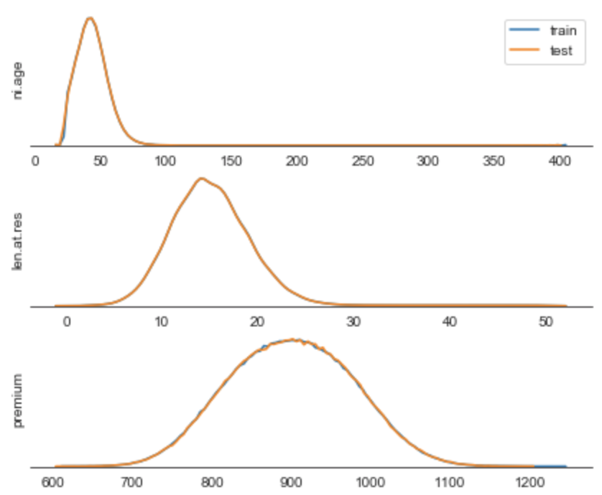
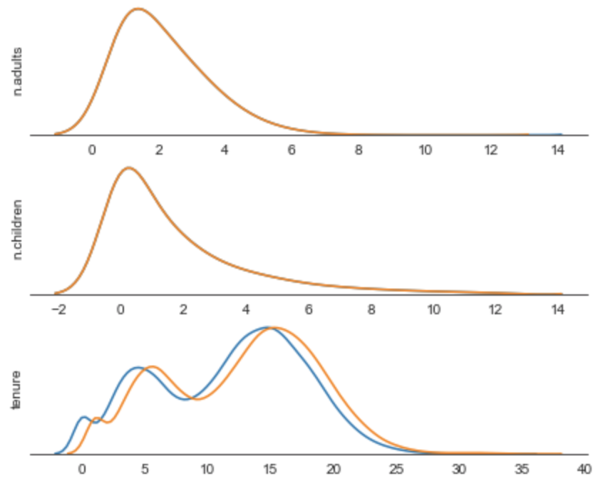
exploratory data analysis
Train and test dataset have similar distributions for numerical variables

Slide 4
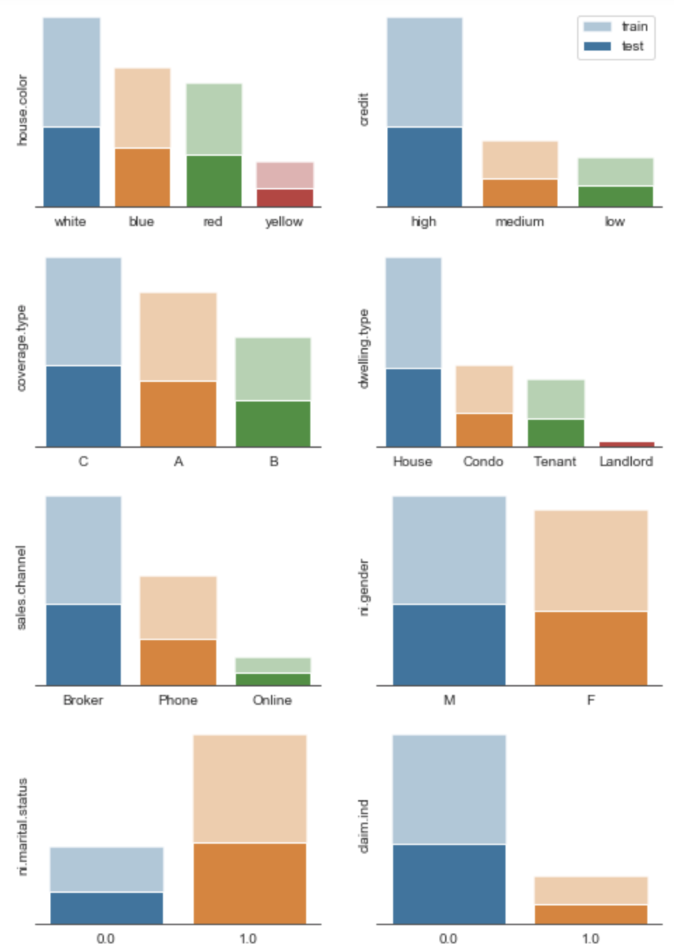
exploratory data analysis
Train and test dataset have similar distributions for categorical variables

Slide 5
Pre-possessing
Remove outliers & NA in training set (only 0.3% data are outliers & NAs)
Bind additional dataset: zip code and income
Fill NA values in test set with median or mode from training set
Mean encoding with cross validation for categorical variables
Additional features:
premium / # of family members, premium / # of adults, etc.

Slide 6
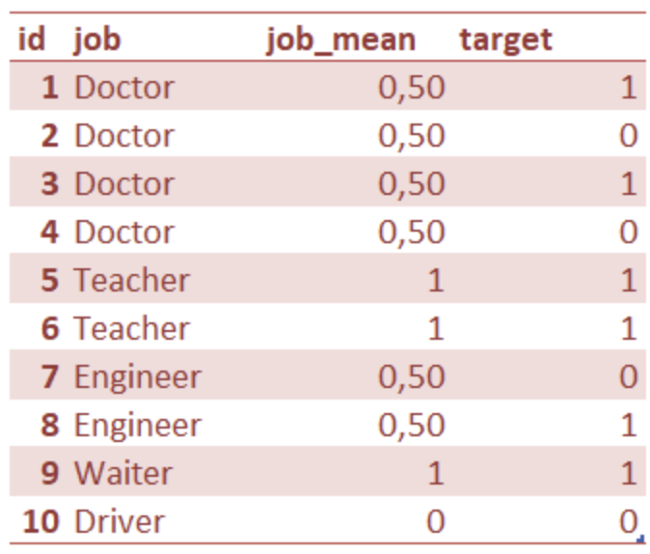
Pre-possessing Mean encoding

Slide 7
Modelling
XGB
Random Forest
LGB
Adaboost
Naive Bayes

Slide 8
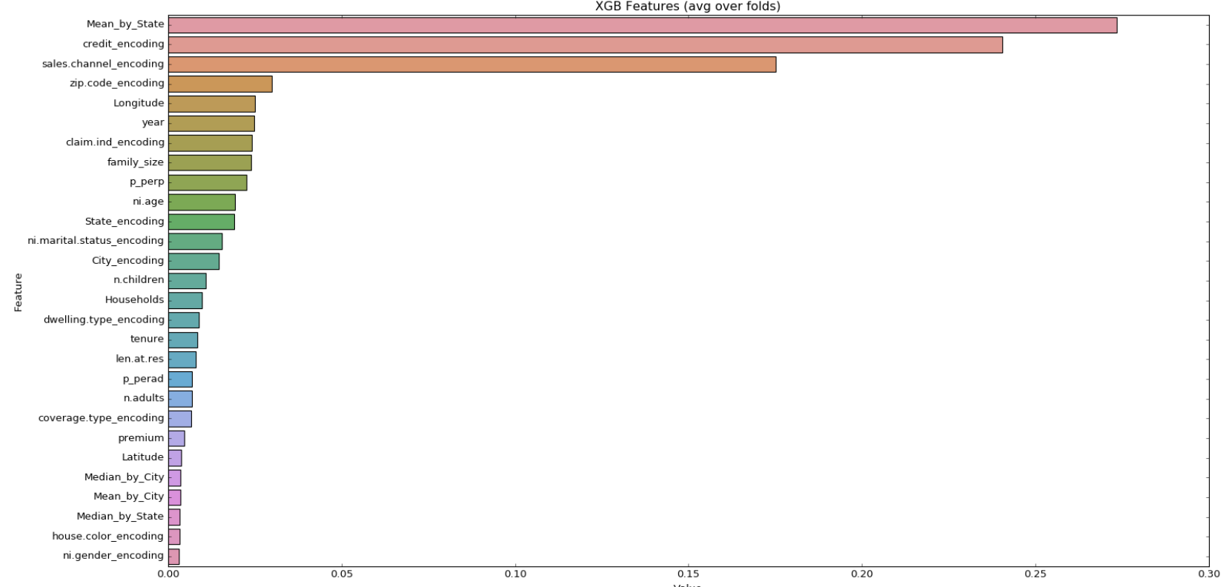
XGBoost
Most significant 3 variable: Mean by State, Credit encoding, Sales Channel

Slide 9
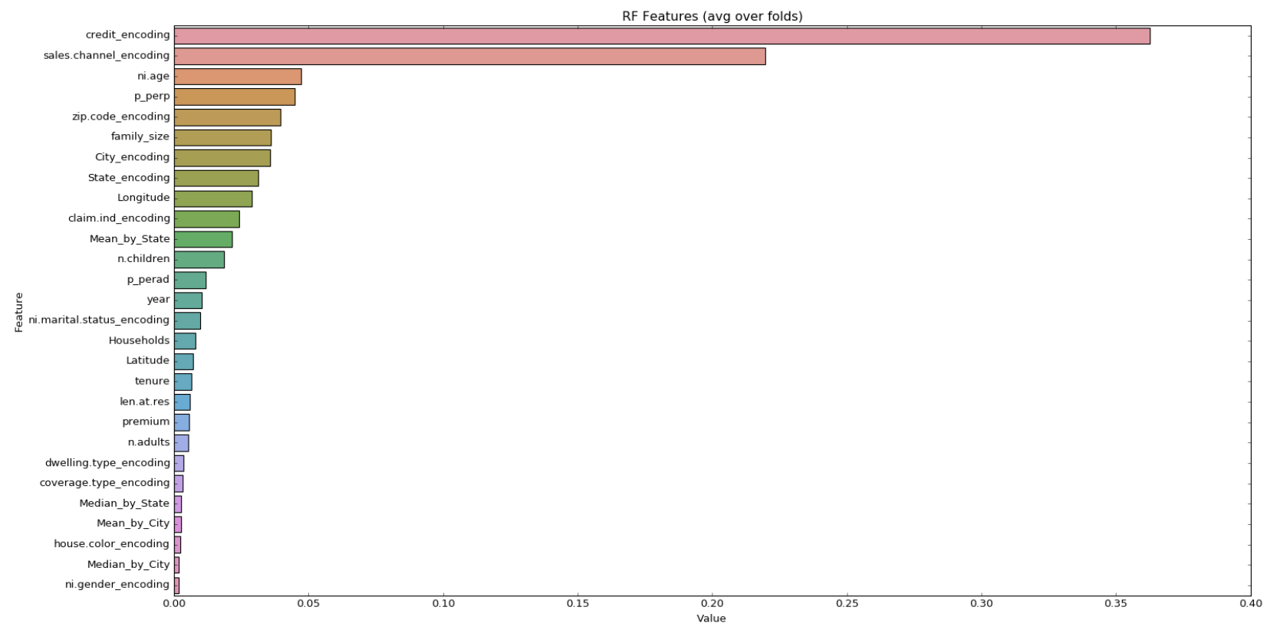
Random Forest
Most significant 3 variable: Credit, Sales Channel, Age

Slide 10
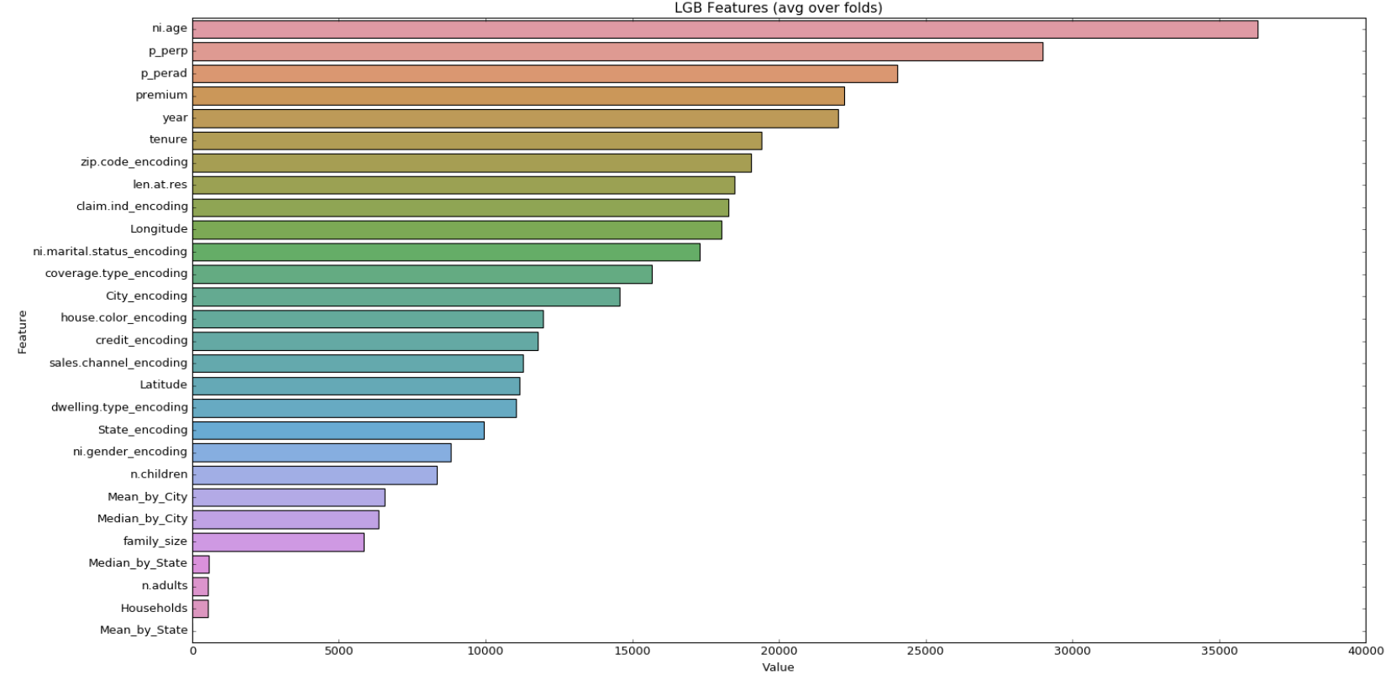
LGB
Most significant 3 variable: Age, Premium per person, Premium per adults

Slide 11
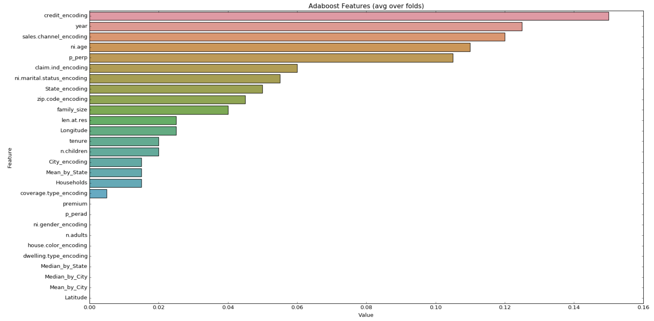
Adaboost
Most significant 3 variable: Credit Encoding, year, Sales Channel

Slide 12
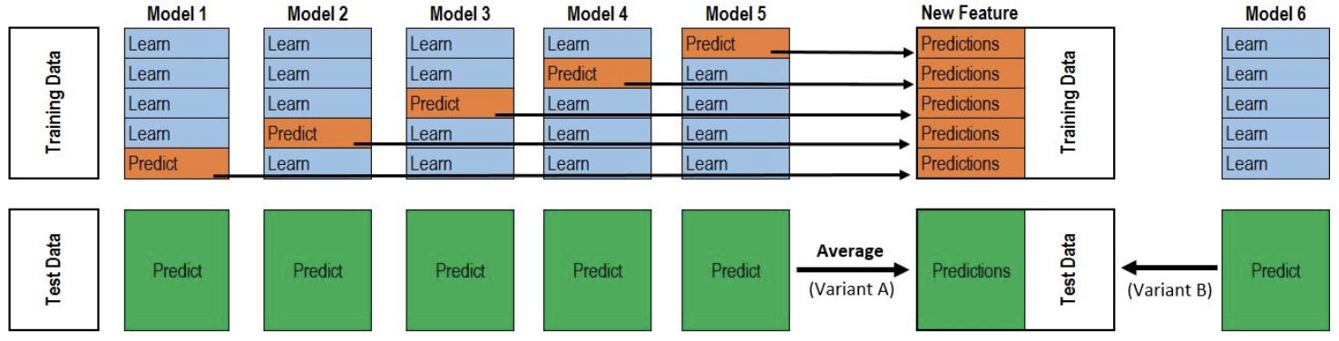
stacking
Reference: https://www.kaggle.com/flennerhag/ml-ensemble-scikit-learn-style-ensemble-learning

Slide 13
Result
Train AUC: 73.32%
Validation AUC: 73.10%
Test AUC: 72.775%

Slide 14
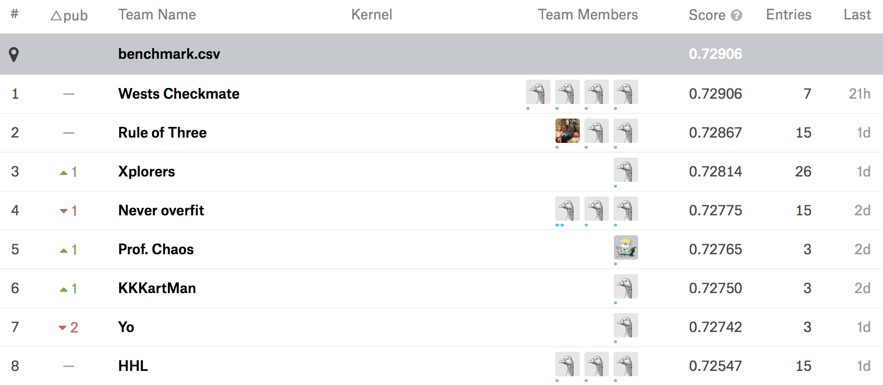

Slide 15
Questions?

