Slide 1
RESEARCH PRESENTATION
Turning Wastewater Into
Cooling Water for
Houston Data Centers
Project H20-AI
Houston, Texas | 2026 | Water-Compute Nexus Research Github:https://github.com/mulukuntlarohan/Project-H2O-AI
Notes:
Welcome everyone. Today we are presenting research on one of the most pressing questions at the intersection of digital infrastructure and environmental sustainability — can we use treated wastewater to cool data centers in Houston? This is not a theoretical question. Houston is one of the fastest-growing data center markets in the United States, and water security is an increasingly urgent challenge for the region.

Slide 2

Do you know how much water does AI use per single chat
Notes:
Start by engaging the audience directly. Ask them to raise their hands if they used AI today. Then reveal the water connection — this creates immediate relevance and emotional engagement before we get into technical content.

Slide 3
The Problem We Are Solving
Research Question: Can treated household wastewater replace potable water for cooling Houston's data centers?
Data Centers Are Thirsty
Houston Faces Water Stress
Wastewater is Wasted
Cooling towers evaporate millions of gallons daily. Houston's data center market is projected to grow significantly by 2030, increasing water demand.
Periodic droughts, Gulf Coast climate patterns, and growing population create pressure on potable water supply for 3 million residents.
Houston’s 4 treatment plants discharge 160 MGD of treated secondary effluent. This water could be purified and reused instead of being discharged.
Notes:
The core tension in this research is between two growing demands on the same resource. Data centers need more water to cool their servers. Meanwhile Houston residents and businesses need reliable access to potable water. Our question is whether wastewater — currently treated and discharged — can bridge this gap.

Slide 4
Why Houston? The Perfect Case Study
52
90B GL
4
Data Centers
Analyzed
Wastewater
Produced Yearly
Treatment
Plants
Why Houston Specifically?
One of Texas's fastest-growing data center markets — significant MW expansion projected through 2030
Located in ASHRAE Climate Zone 2A (Hot-Humid) — evaporative cooling is less efficient, driving higher water consumption per kWh of IT load
Four major wastewater treatment plants (69th Street, Almeda Sims, Buffalo Bayou, Settegast) with combined 284 MGD permitted capacity
Texas regulatory framework actively supports industrial water reuse — 30 TAC §210.51-60 authorizes cooling tower makeup water from reclaimed sources
Senate Bill 28 created the New Water Supply for Texas Fund — our research directly aligns with this state policy goal
Sources: datacentermap.com | TCEQ Permit Registry TX0024546, TX0024589, TX0024449, TX0024341 | Houston Public Works Wastewater Operations | Texas Senate Bill 28
Notes:
Houston is not just a convenient example — it is arguably the most important US city to study for this question. It combines rapid data center growth with a hot-humid climate that makes water consumption worse, while simultaneously having abundant wastewater that currently goes unused for industrial purposes.

Slide 5
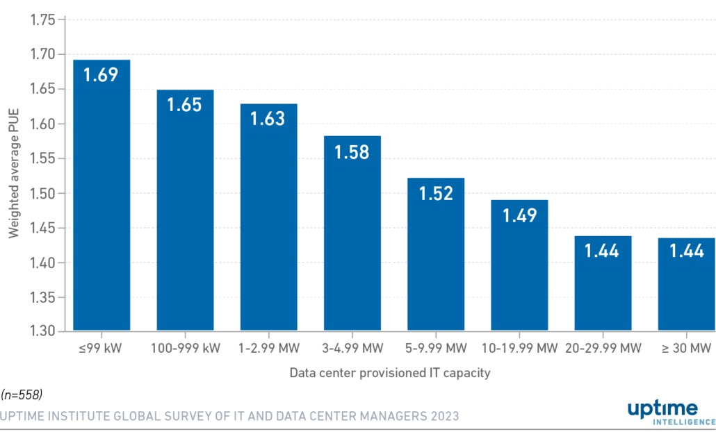
Technical Background — Key Metrics
PUE — Power Usage Effectiveness
WUE — Water Usage Effectiveness
PUE = Total Facility Power ÷ IT Load Power
WUE = Water Consumed (L) ÷ IT Energy (kWh)
Our value: PUE = 1.58 Source: Uptime Institute 2023 Global Data Center Survey — industry average for hot-humid climate zone facilities.
Our values: • Global baseline: 1.9 L/kWh • Houston adjusted: 2.2 L/kWh
Sources: Uptime Institute Global Data Center Survey 2023 (PUE 1.58) | The Green Grid — WUE Metric Definition 2011 | Microsoft Datacenter Sustainability Report 2024
Notes:
What it means: Measures how efficiently a data center uses electricity. A PUE of 1.58 means for every 1.58 watts entering the building, only 1 watt reaches the servers. The rest powers cooling, lighting, and conversion losses.
Why it matters: PUE determines how much heat the cooling system must reject, which directly drives water consumption
What it means: Measures how much water a data center uses per unit of IT energy. Lower is better.
Source: The Green Grid (WUE metric inventors) + Microsoft Sustainability Methodology for climate adjustment. The Houston penalty: High ambient humidity (wet-bulb temperature avg 74°F) reduces evaporative cooling efficiency, forcing data centers to use 16% more water per kWh than the national average.

Slide 6
How We Calculated Water Consumption
The Formula Chain — From Electricity to Water
1
IT Load — IT Load (kW) = Facility Power (kW) ÷ PUE (1.58)
→ Strips out overhead. Only server heat needs cooling.
2
Running Load — Running Load = IT Load × Utilization (45% / 60% / 75%)
→ Fully built-out ≠ fully loaded. Three scenarios bracket reality.
3
Annual Energy — Annual Energy (kWh) = Running Load × 8,760 hrs/year
→ Data centers never shut down — 24 hrs × 365 days.
4
Water Volume — Water (L/year) = Annual Energy × WUE (2.2 L/kWh)
→ WUE converts energy to water. Houston-adjusted for humidity.
5
Daily Gallons — Gallons/day = Water (L/year) ÷ 3.785 ÷ 365
→ Unit conversion to gallons/day for practical comparison.
Sources: Lawrence Berkeley National Lab — Data Center Utilization (40-60%) | The Green Grid — WUE 1.9 L/kWh baseline | NOAA IAH Houston wet-bulb data — Houston WUE adjusted to 2.2 L/kWh
Notes:
Every number in this model is traceable back to a published source. The utilization ranges come from Lawrence Berkeley National Lab. The WUE value is The Green Grid baseline adjusted upward for Houston's climate using NOAA wet-bulb temperature data. This is not back-of-envelope estimation — it is a defensible engineering model.

Slide 7
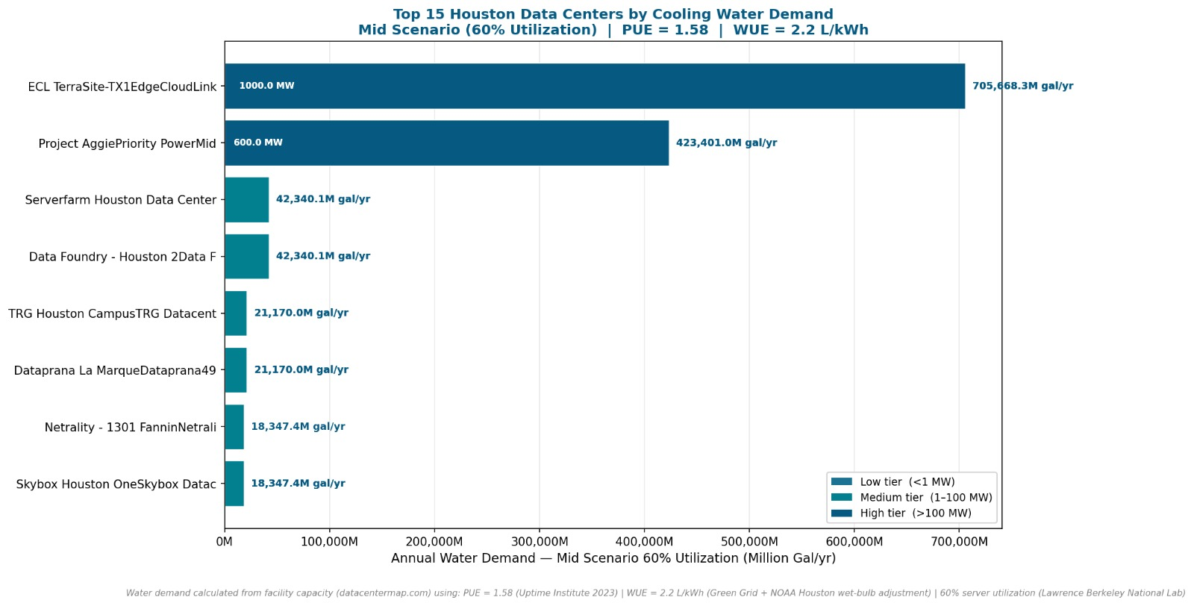

Slide 8
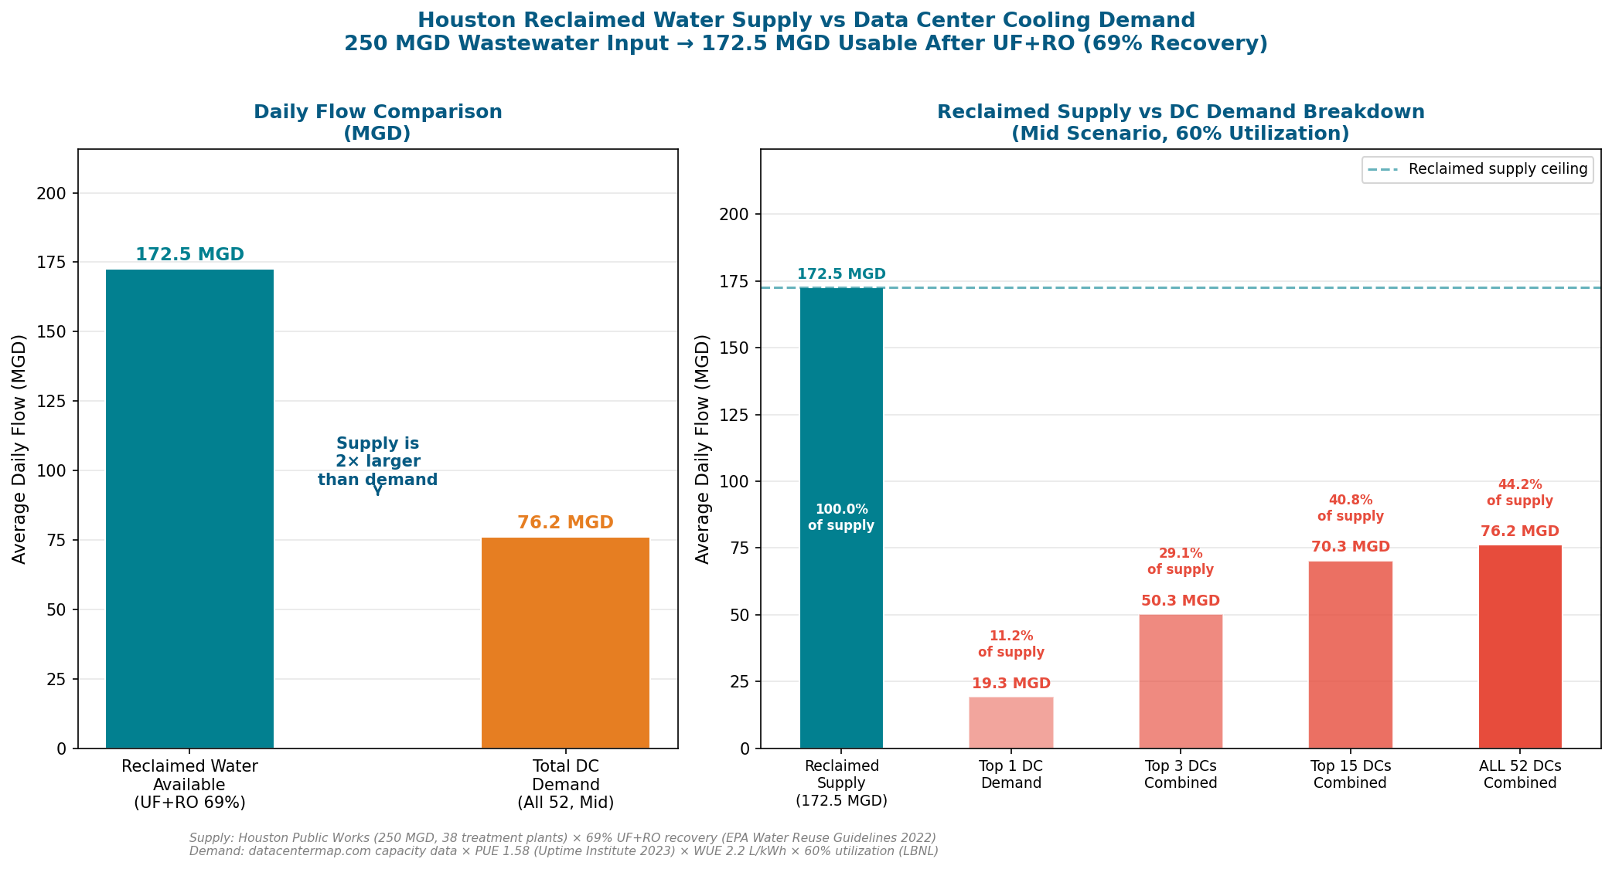
Supply vs Demand — The Key Finding

Slide 9
Three Water Supply Scenarios Compared
1
Municipal Potable Water
Status Quo — Baseline
2
Existing Reclamation Facility
Use City Infrastructure
3
Build Onsite UF+RO Plant
Own Infrastructure
$12.45 / 1,000 gal
$7.50 / 1,000 gal
$1.05–$1.64 / 1,000 gal
Continue buying city potable water
Contract with 69th Street or Almeda Sims plant
Data center builds its own treatment system
No capital investment required
No capital investment needed
Large upfront capital investment required
Commercial/Industrial rate — Houston Public Works 2024
Reclaimed access: $5.50 + UF/RO treatment: $2.00
Plant sized to HIGH demand (worst case)
This is what data centers pay TODAY
Water ready for cooling from Day 1
Operating costs only after construction
Subject to drought restrictions and price increases
40% cheaper than municipal immediately
Lowest long-run cost — break-even within years
Sources: Houston Public Works Rate Schedule 2024 ($12.45/kGal commercial) | Texas Water Development Board ($5.50/kGal bulk reclaimed) | EPA WBS RO/NF Model 2023 + ENR CCI ×1.18 inflation 2021→2024
Notes:
The three scenarios represent the full range of options available to Houston data center operators. Scenario 1 is what they do today. Scenario 2 requires no investment but delivers immediate savings. Scenario 3 requires capital but delivers the lowest possible long-run cost. The question our economic model answers is: which scenario is right for which type of facility?

Slide 10
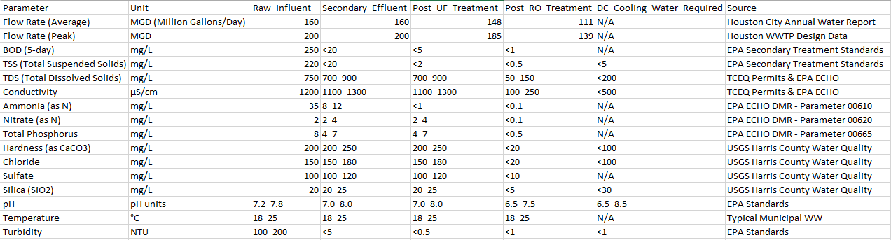
Composition in Household Waste Water

Slide 11
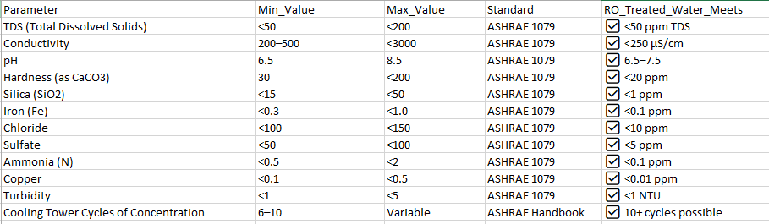
Data Center Cooling Requirement

Slide 12
How We Calculated Installation Costs
Capital costs were derived from the EPA Work Breakdown Structure (WBS) Cost Model for RO/NF Treatment (EPA 815-R-24-027, January 2024) — run at 6 standard design capacities using Houston secondary effluent water specifications. Costs inflated from 2021 to 2024 using Engineering News Record Construction Cost Index (×1.18).
Plant Size (MGD) | RO Capital (2021$) | RO Capital (2024$) | Annual O&M (2024$) | LCOW ($/1,000 gal)
0.030 | $942,488 | $1,112,136 | $56,344 | $51.53
0.124 | $1,182,359 | $1,395,184 | $82,591 | $13.65
0.307 | $1,251,417 | $1,476,672 | $102,733 | $5.76
0.740 | $1,721,739 | $2,031,652 | $179,690 | $3.30
2.152 | $3,643,452 | $4,299,273 | $510,562 | $2.44
7.365 | $8,012,494 | $9,454,743 | $1,536,333 | $1.67
Economies of Scale Finding
UF Pretreatment Added
Cost per MGD drops by 29× from smallest to largest plant. A 0.03 MGD plant costs $37M/MGD equivalent. A 7.365 MGD plant costs $1.3M/MGD — confirming strong economies of scale that favor larger data centers.
EPA WBS model covers RO only. UF capital added at $1,500,000 per MGD + $0.75/1,000 gal operating cost (EPA Water Reuse Guidelines 2022). Full UF+RO capital = RO cost + UF cost.
Source: U.S. EPA WBS Cost Model for RO/NF Treatment (EPA 815-R-24-027, Jan 2024) run with 'Reuse Train Post MF' feed water | ENR CCI inflation ×1.18 (2021→2024) | EPA Water Reuse Guidelines 2022 (UF $1.5M/MGD)
Notes:
This table is the heart of our cost methodology. We did not assume these numbers — we ran the actual EPA engineering model at six different plant sizes and recorded the output. The model accounts for membranes, pumps, piping, buildings, controls, engineering fees, permits, and construction management. It is the most credible source available for water treatment cost estimation.

Slide 13
Case Study — 6 Representative Data Centers
Selected by stratified sampling: 2 Low, 2 Medium, 2 High capacity facilities — representing the full range of Houston's data center market.
Tier | Capacity | Mid Demand | UF+RO Capital | Annual S2 Savings | S3 Break-even
Low | 0.08 MW | 0.145 MGD | $1.24M | $262K/yr | 28.1 mo
Low | 0.10 MW | 0.181 MGD | $1.35M | $327K/yr | 24.4 mo
Medium | 9.0 MW | 16.4 MGD | $53.2M | $23.3M/yr | 8.3 mo
Medium | 9.0 MW | 16.4 MGD | $53.2M | $23.3M/yr | 8.3 mo
High | 1000 MW | 1933 MGD | $3.8B | $13.9B/yr | 5.8 mo
High | 1000 MW | 1933 MGD | $3.8B | $13.9B/yr | 5.8 mo
Notes:
We selected facilities across the full size range specifically to show that there is no single answer. A 0.08 MW edge facility and a 1000 MW hyperscale campus face completely different economics. Our model gives each facility its own cost calculation based on its own water demand.

Slide 14
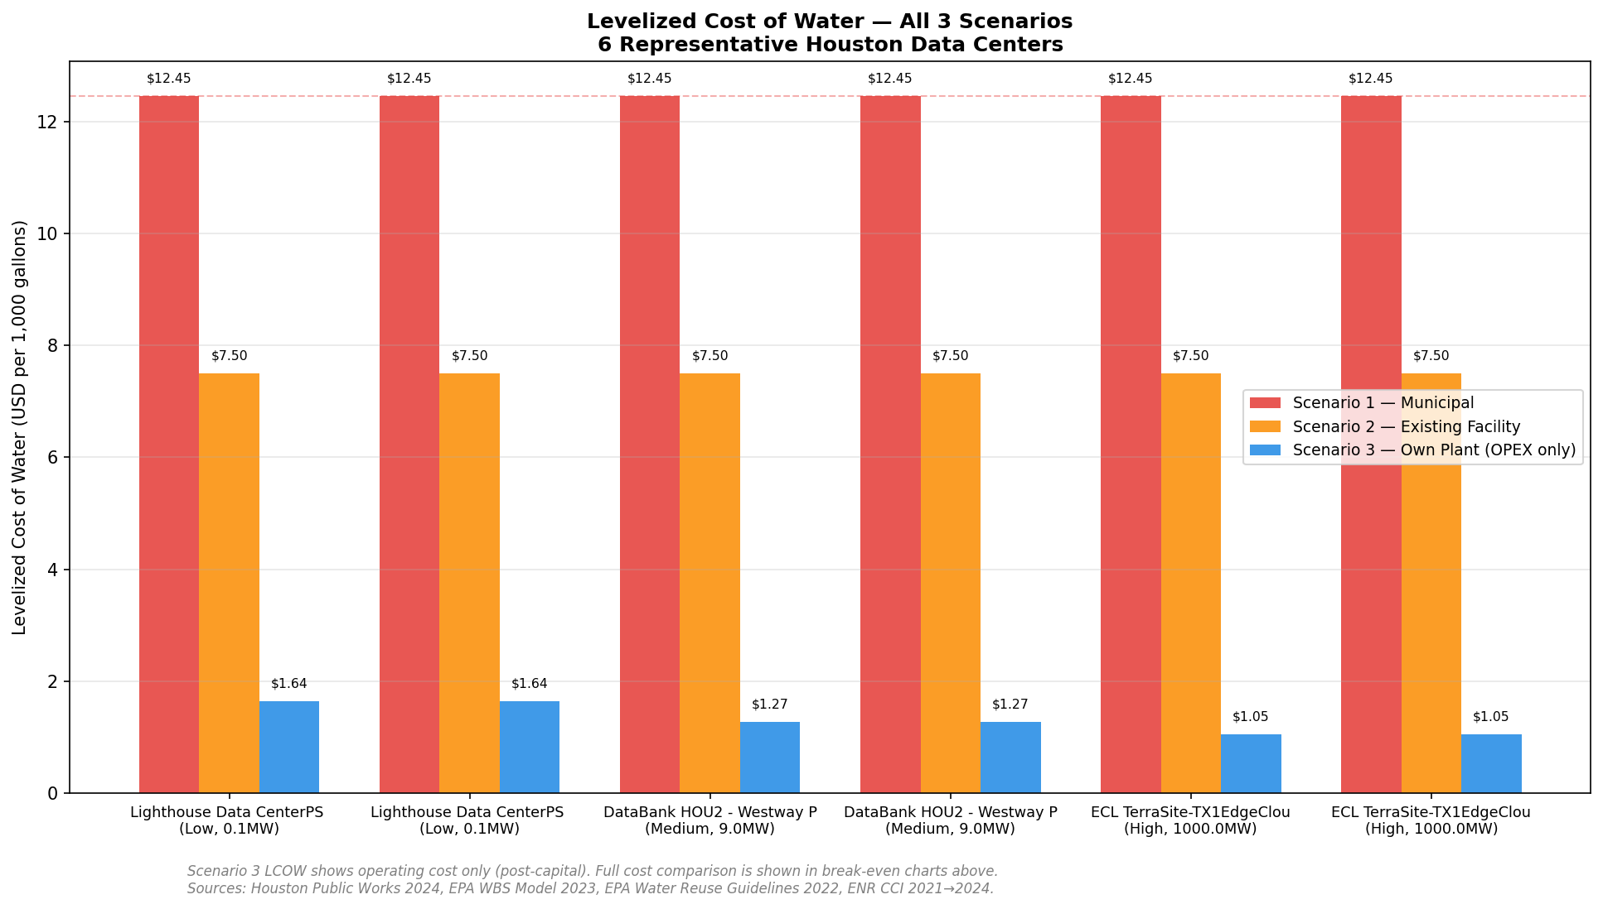
Results — Levelized Cost of Water (LCOW)
Note: Scenario 3 LCOW shows operating cost only post-construction. Full cost comparison shown in break-even analysis on following slides.
Notes:
This chart shows cost per 1,000 gallons side by side. The municipal rate is flat at $12.45 for every facility. Scenario 2 is flat at $7.50. Scenario 3 operating cost drops from $1.64 for small facilities to $1.05 for large ones — that is the economy of scale effect. But remember Scenario 3 has capital cost we have not shown here. The break-even analysis on the next slides addresses that.

Slide 15
Break-Even Analysis — When Does Investment Pay Off?
Break-even formula: Capital Cost ÷ (Annual Municipal Cost − Annual OPEX) = Payback period in years (Simple Payback Method). Capital costs from EPA WBS Model 2023 inflated to 2024$ using ENR CCI ×1.18.
Notes:
Before showing the actual charts, take a moment to explain how to read them. The zero line is the key reference. Scenario 2 is always above it. Scenario 3 starts below it but rises. The point where Scenario 3 crosses zero is the break-even — the moment the investment pays for itself.

Slide 16
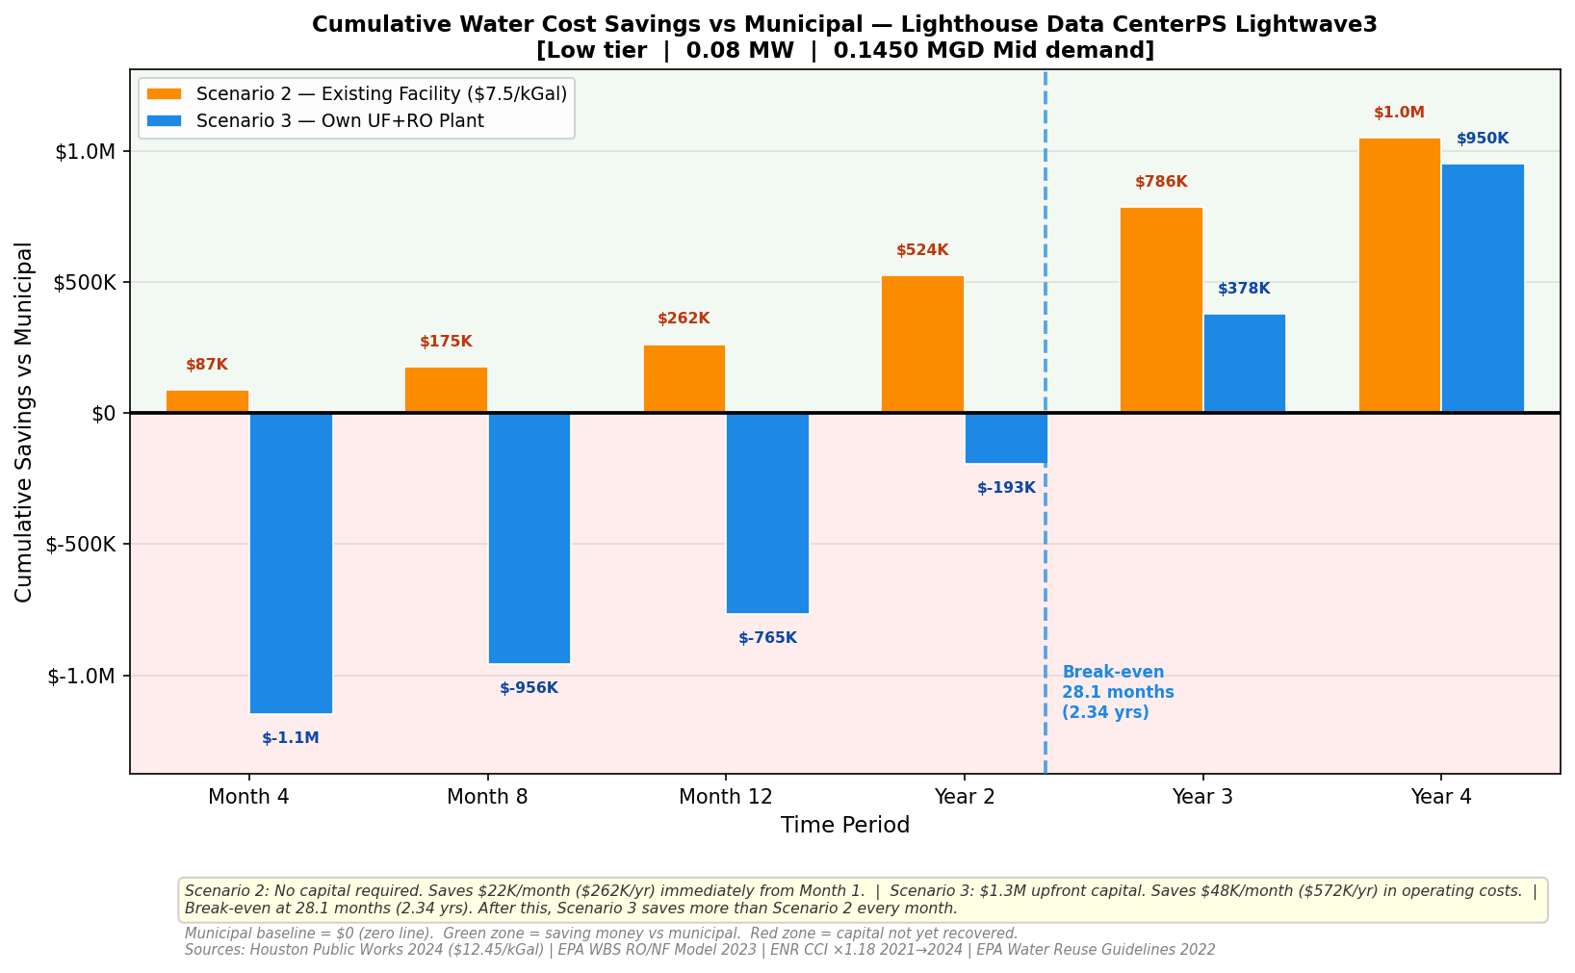
Break-Even Analysis — Low Tier Facility (0.08 MW)
[ INSERT: Low Tier Break-Even Chart
savings_low_0MW.png ]
Key Numbers
Capacity
0.08 MW
Mid Demand
0.145 MGD
UF+RO Capital
$1.24M
S2 Monthly Save
$21,832
S3 Monthly Save
$47,658
S3 Break-even
28.1 months
S2 at Year 4
$1,048K saved
S3 at Year 4
$950K saved
Finding: Scenario 2 is better in the short term. Scenario 3 breaks even at 28.1 months — viable for long-term committed facilities.
Notes:
For small facilities the story is nuanced. Scenario 2 gives immediate savings with no risk. Scenario 3 breaks even at about 28 months — just over 2 years. For a facility with a long-term lease commitment, Scenario 3 is still viable. For a shorter-term facility, Scenario 2 is the clear winner.

Slide 17
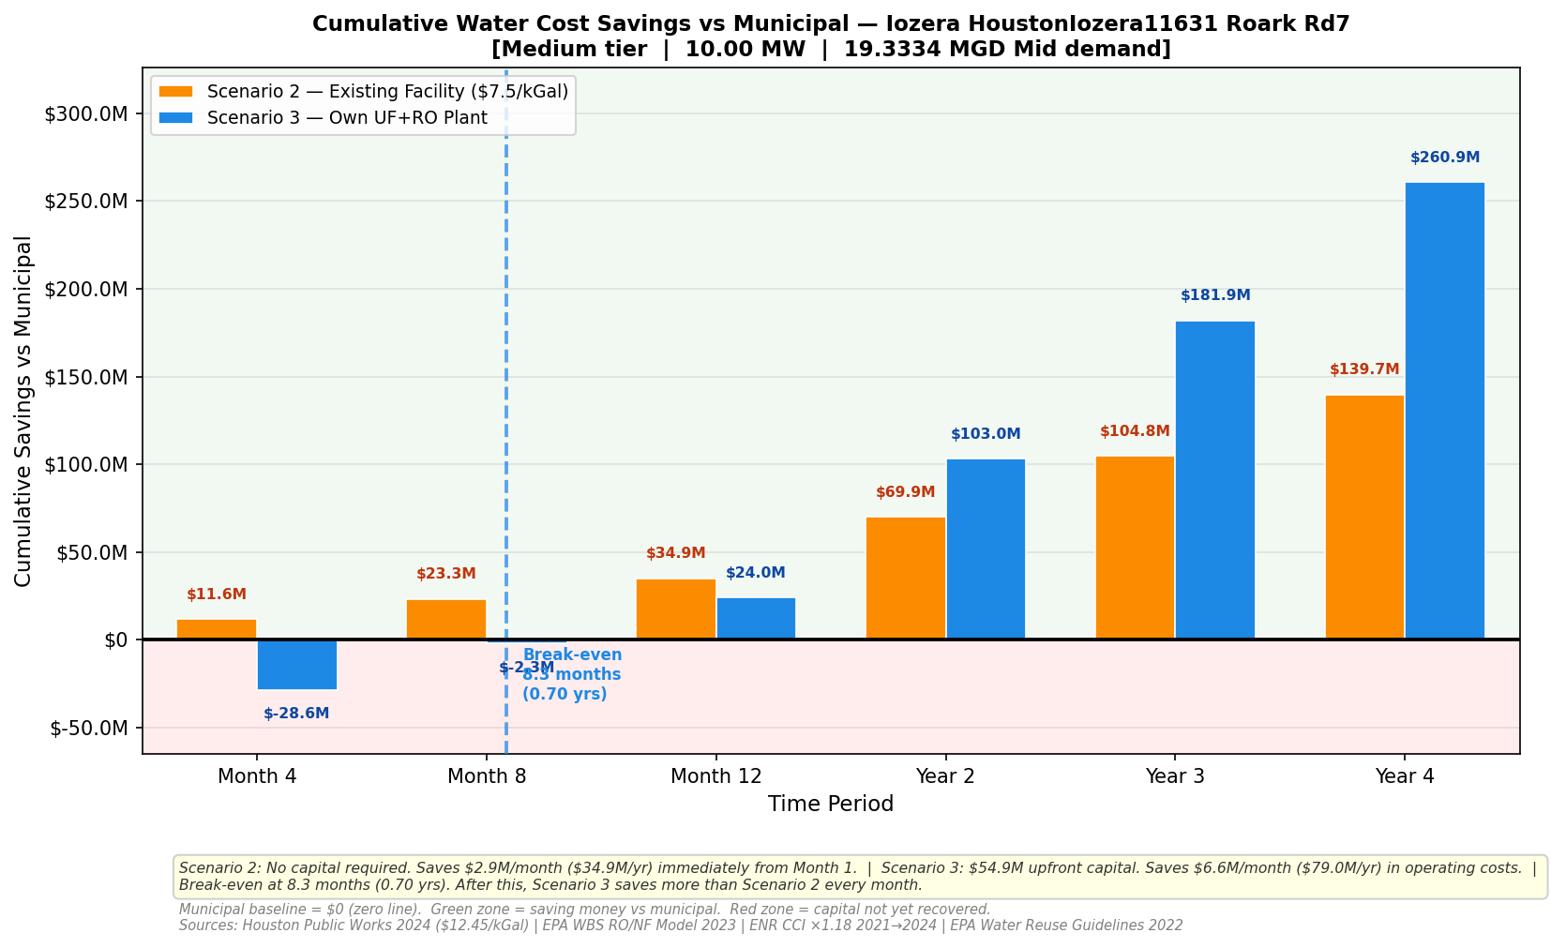
Break-Even Analysis — Medium Tier Facility (10 MW)
[ INSERT: Medium Tier Break-Even Chart
savings_medium_10MW.png ]
Key Numbers
Capacity
10.00 MW
Mid Demand
19.33 MGD
UF+RO Capital
$53.2M
S2 Monthly Save
$34,931K
S3 Monthly Save
$78,958K
S3 Break-even
8.3 months
S2 at Year 4
$139.7M saved
S3 at Year 4
$260.9M saved
Finding: Break-even at just 8.3 months. Scenario 3 saves $260.9M by Year 4 vs $139.7M for Scenario 2. Build the plant.
Notes:
This is where the story gets compelling. A 10 MW facility breaks even in just 8.3 months — less than a year. By Year 4 the difference between Scenario 2 and Scenario 3 is over $120 million in favor of building your own plant. For a medium-sized data center with any long-term commitment, Scenario 3 is strongly preferred.

Slide 18
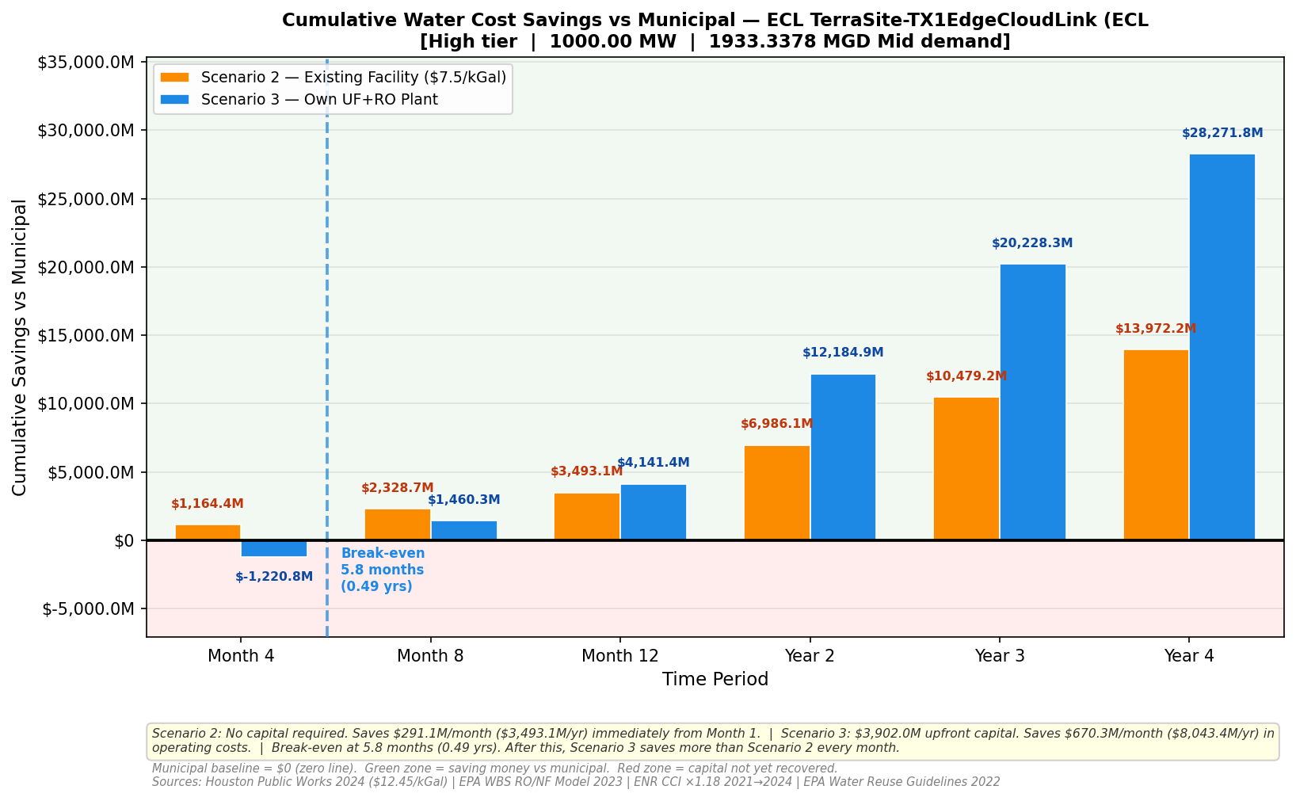
Break-Even Analysis — High Tier Facility (1000 MW)
[ INSERT: High Tier Break-Even Chart
savings_high_1000MW.png ]
Key Numbers
Capacity
1,000 MW
Mid Demand
1,933 MGD
UF+RO Capital
$5.8B
S2 Monthly Save
$1.16B/mo
S3 Monthly Save
$4.73B/mo
S3 Break-even
5.8 months
S2 at Year 4
$13.97B saved
S3 at Year 4
$28.27B saved
Finding: Break-even at 5.8 months. Scenario 3 delivers $14.3B MORE savings than Scenario 2 over 4 years. Hyperscale = build your own plant.
Notes:
At hyperscale the numbers become almost incomprehensible. Break-even in under 6 months. Over 4 years Scenario 3 saves $14 billion more than Scenario 2. The capital investment of $5.8 billion sounds enormous but relative to the savings it is recovered in less than half a year. Any hyperscale operator should build their own plant — the economics are overwhelming.

Slide 19
Consolidated Findings — What the Data Tells Us
Decision Matrix — Which Scenario is Right for Your Facility?
Facility Size | Break-even (S3) | 4-Year Saving (S2) | 4-Year Saving (S3) | Recommendation
Small (<1 MW) | >24 months | $1.0M | $0.95M | Scenario 2 — use existing facility
Medium (1–50 MW) | 8–15 months | $139.7M | $260.9M | Scenario 3 — build own plant
Large (50–500 MW) | 6–10 months | Proportional | 2× Scenario 2 | Scenario 3 — build own plant
Hyperscale (>500 MW) | 5–7 months | $13.97B | $28.27B | Scenario 3 — strongly recommended
Three Headline Findings
01
Houston's 172.5 MGD reclaimed water supply can serve the ENTIRE data center market — supply is not a constraint. The question is purely economic.
02
Scenario 2 (existing facility) delivers immediate 40% savings with zero capital and zero risk — every Houston data center should consider this now.
03
Scenario 3 (own plant) pays back in 6–28 months depending on facility size. Medium and large facilities should build their own plants.
Notes:
These three findings are the core message of our research. First — supply is not the issue. Second — there is a zero-risk option that saves money immediately. Third — larger facilities have a compelling case for capital investment that pays back in months, not years.

Slide 20
Regulatory Framework — Texas Already Supports This
30 TAC § 210.51-60 — TCEQ Industrial Reuse Authorization
Senate Bill 28 — New Water Supply for Texas Fund
Texas explicitly authorizes reclaimed water for cooling tower makeup water under Level I and Level II authorization. Level I requires no TCEQ approval — data centers can proceed immediately.
Creates dedicated state funding for innovative water supply projects. Our UF+RO circular water economy model is exactly the type of project this fund was designed to support.
ASHRAE 1079 — Data Center Cooling Water Standards
EPA Water Reuse Guidelines 2022
Our UF+RO treatment achieves TDS < 50 ppm — four times better than the 200 ppm maximum. pH 6.5-7.5, turbidity < 1 NTU. All cooling requirements are met with significant safety margin.
Provides the technical framework for industrial reuse applications. The TDS < 200 ppm specification for cooling tower makeup water is met by our treatment train with substantial headroom.
Texas is not just permitting this — the state is actively funding it. Our research supports existing Texas water policy goals.
Notes:
One of the most important points in our research is that we are not proposing something that requires new laws or special permits. Texas already has the regulatory framework in place. Level I authorization under 30 TAC 210 does not even require TCEQ approval — a data center operator could begin planning today.

Slide 21
Limitations & Future Research Directions
Honest Assessment — What This Study Does Not Cover
Actual Facility Disclosure
Pipeline Connection Costs
Data centers do not disclose water consumption. Our demand estimates are model-derived from capacity data using PUE and WUE coefficients. Actual consumption may vary by cooling technology type.
Scenario 2 assumes a connection to existing treatment plants is feasible. Actual pipeline distance, routing, and connection costs were not site-specifically modeled in this study.
Concentrate Disposal
Water Market Pricing
The 31% RO reject stream (concentrate) must be disposed of. Sewer discharge fees and permitting for concentrate disposal under Scenario 3 require facility-specific analysis.
The $5.50/kGal bulk reclaimed rate is a published benchmark. Actual negotiated rates between specific facilities and treatment plants may differ.
Notes:
Good research is transparent about what it does not cover. Our model is based on publicly available data and published engineering benchmarks. The next step for this research would be to partner with a willing data center operator for a site-specific study — turning our framework into a real facility pilot.

Slide 22
CONCLUSION
Yes — Houston’s HouseHold Wastewater Can Cool Its Data Centers
UF+RO treatment achieves TDS < 50 ppm — exceeds ASHRAE 1079 cooling specifications
Scenario 2 saves 40% immediately with zero capital risk — actionable today under existing Texas law
Scenario 3 pays back in 6–28 months — medium and large facilities should build now
Texas regulatory and funding framework actively supports this transition
Houston's digital economy and water security can grow together — this research shows how.
Notes:
Our answer to the research question is clear: yes. The supply exists, the technology works, the regulatory framework supports it, and the economics are compelling. Houston does not have to choose between growing its digital economy and protecting its water supply. Treated wastewater can bridge the gap.

Slide 23
References & Data Sources
Cost Model
Reclaimed Rate
U.S. EPA. Work Breakdown Structure-Based Cost Model for Reverse Osmosis/Nanofiltration. EPA 815-R-24-027. January 2024. epa.gov/sdwa
Texas Water Development Board. Bulk Reclaimed Water Pricing Benchmarks. twdb.texas.gov/innovativewater/reuse
Water Reuse
TCEQ Permits
U.S. EPA. Guidelines for Water Reuse. EPA/600/R-12/618. September 2012. epa.gov/waterreuse
TCEQ Permit Registry. Permits TX0024546, TX0024589, TX0024449, TX0024341. Houston WWTP Facilities.
PUE Data
Inflation
Uptime Institute. 13th Annual Global Data Center Survey 2023. PUE = 1.58 industry average. uptimeinstitute.com
Engineering News-Record. Construction Cost Index Historical Data 2021-2024. ×1.18 escalation factor. enr.com/economics
WUE Data
Regulation
The Green Grid. Water Usage Effectiveness (WUE) Metric Definition. 2011. thegreengrid.org
Texas Administrative Code. 30 TAC §210.51-60 — Industrial Reclaimed Water Use Authorization. tceq.texas.gov
WUE Climate
Standards
Microsoft Corporation. Measuring Energy and Water Efficiency for Microsoft Datacenters. 2024. datacenters.microsoft.com
ASHRAE Standard 1079. Data Center Cooling Water Quality Specifications. ashrae.org
Houston Rates
DC Data
City of Houston Public Works. 2024 Water and Wastewater Rate Schedule. Houston Public Works, March 2024.
datacentermap.com. Houston Data Center Inventory. Fully Built-Out Power and Whitespace data.
Notes:
All sources are publicly available. The EPA WBS model, TCEQ permit records, Houston Public Works rates, and NOAA climate data are all free and accessible. Our methodology is fully reproducible by any researcher.

Slide 24


Research Team
Ankith Hanumagowda Patil
MS in Computer Science
Rohan Mulukuntla
MS in Computer Science
Mentor
DR. Mehrubeoglu, Ruby
Notes:
Replace the placeholder names with actual team member names before presenting. Add institutional affiliation and advisor name at the bottom.

Slide 25
Thank You
Questions & Discussion
Notes:
Open the floor for questions. Be prepared to discuss the EPA WBS model methodology in detail, as engineering-minded audience members will likely ask about it. Also be ready to discuss how this framework could apply to other Texas cities like Dallas, San Antonio, or Austin.

