Slide 1

DEBRE MARKOS UNIVERSTIY BURIE CAMPUS
DEPARTMENT OF COMPUTER SCIENCE
PROJECT TITLE: ONLINE VEHICLE MANAGEMENT SYSTEM FOR BURIE Bus Station
Prepared by:
NAME ID NO
ENKUHANE BELAYNEH…………….. ………..048
GETANEH ADDISIE ……………. ..………… 050
GETANEH SHBABAW……………………. …. 051
GETASEW ADUGNAW ……………………. 052
Advisor name: msc Andargie M.
February, 2011E.c
BURIE, Ethiopia

Slide 2
Contents
Introduction
Statement of the problem
Objective of the project
General objective
Specicific objective
Scope of the project
Significant of the project
Methodology
System requirement specification
Functional requirement
non functional requirement
Actors
Use case identification
Use case diagram
Class diagram
Sequence diagram
Deployment diagram

Slide 3
CHAPTER ONE 1.1. Introduction
Online vehicle management system is a system which concerned with how vehicles could be managed and controlled .
It aims to change the manual system to automated system vehicle management system.
Automated systems make it possible to have a better accuracy, to increase the quality of the work, to reduce the time it takes, to minimize cost, to keep the security and organization of data in most advantageous condition

Slide 4
1.2. Statement of Problem
Not sequenced flow of information during retrieve.
It’s a time-consuming process to assign vehicles and to generate required reports.
Difficulty to get the required detailed information about specific vehicle.
Employees couldn’t get high satisfaction .
Lack of security.
There is no effective coordination between various employers.
The organization does not give service for user in 24 hours.

Slide 5
1.4 .OBJECTIVE OF THE PROJECT
1.4.1 General objective
The main objective of this project is to develop a web based Vehicle Management System for BURIE Town bus station.
1.4.2 Specific objective
To study the existing systems.
To identify existing System work flow
To analyze the existing systems problem
Analyze gathered information using VMS document.
Design the proposed system.
Design interactive user interface for vehicle management system.
Implementing the proposed system.
Validation and Testing the System.

Slide 6
Scope of the project
Login page:
Vehicle registration:
Manage user account:
View vehicles information:
Vehicle assignation:
Generate and send reports:
View notification and comment:.
Vehicle maintenances:

Slide 7
1.6 .Significance of the project
After development of the new system: it gives the following advantages:
Easy to process requests.
Easy to manage historical data in secure manner.
Minimizes cost of operations and the work load.
To make easy vehicle assignation.
Employees get high satisfaction .
High coordination between various employers.
To have good authentication and security
To make easy and fast report generate.

Slide 8
Methodology
System requirement
Hardware Requirement
Computer
Flash
Printer
Paper
Software requirement
EDRAW Max
MySQL server
Operating System: Windows 7
Programming Language
Back End
MySQL software of the data base system and PHP language was used in developing and managing the back end of the system.

Slide 9
Front End
The user interface had been developed using html, java script, CSS since it easily designing the front end and connected in to database easily.
System requirement specification
Functional requirements
Account management: Manager create & deactivate account for users
Login page: The login page contains the user name and password
View vehicle information:See the detail information of the vehicles.
Vehicle Maintenance : Vehicles should be maintained when they are damaged
Generate report: It allows manager generating report for the tasks performed and if there is any difficult problem.
Send comment and View comment: It allows manager to see the comments that are submitted from the driver
Request service. Officers request services to the manager.
Get exit permission: the manager prepares exit permission for the driver.
Vehicle Assign:It allows the manager to assign car for the requested service
car registeration:Allow the Manager to register vehicle.

Slide 10
Non- functional requirements
Security :
Authentication and authorization: deals with identifying a user and what a user is allowed to do respectively
Performance: The response time for loading and processing a given task is very fast and triggered by a single click.
Reliability: Increase reliability of the system by removing commonly made errors and feeding correct inputs for processes.
Accessibility: Extent to which a consumer or user can obtain a good or service at the time it is needed

Slide 11
List of Actors
Manager
Driver
Officer
Staff
Mechanics

Slide 12
Use case identification
The most important and basic use cases of this system are the following:-
Login
Create account
Deactivate account
Update account
Check fuel balance
Register vehicle
View vehicle Information
Generate report
View request maintenance
Request service
View Response
approve request
Assign vehicle
Get exit permission
Request maintenance
Send report
View notification
Submit comment
View comment
Logout

Slide 13
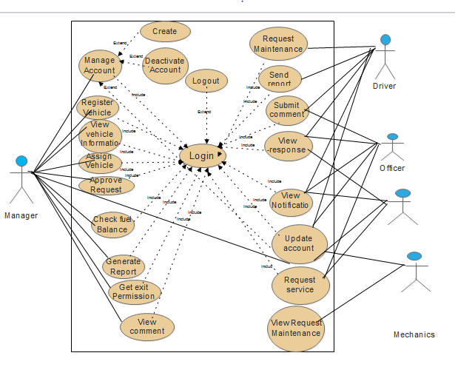
Use case diagram
Staff

Slide 14
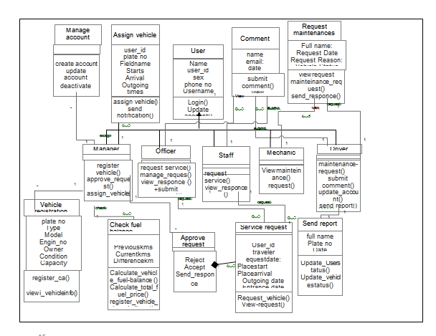
Class diagram

Slide 15
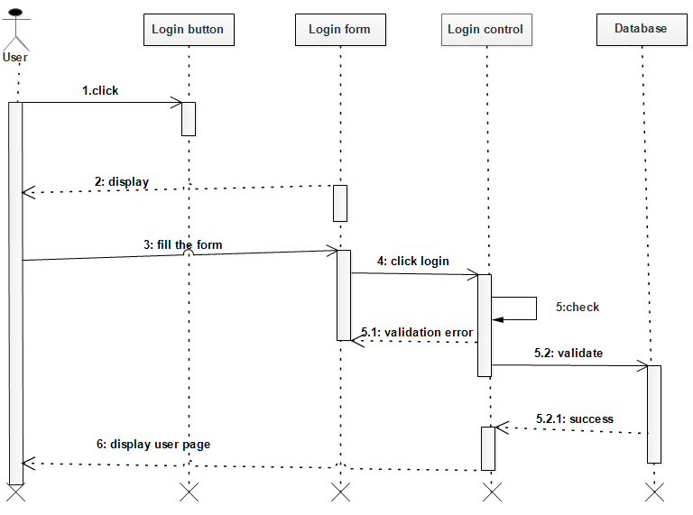
Sequence diagram for login page

Slide 16
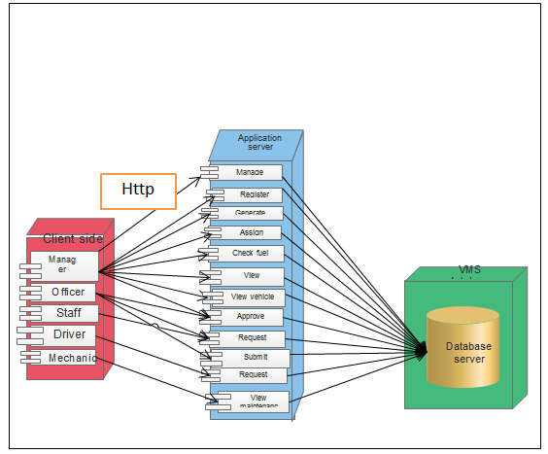
deployment

Slide 17
Thank you!!!

