Slide 1
Tell Co. (Telecommunication)

Slide 2
- Relevant variables and associated data types
Variables(Parameters) | Description | Data type
Bearer Id | Unique identifier of each session | XDR(object)
Dur. (ms).1 | Duration of time in a single session(Bearer ID) | time(float64)
Apps(Google,Netflix,Youtube,other,Social Media,Email,Gaming)(DL/UL) | Applications that users use | Bytes(float64)
Total UL/DL | Total recived and sent data during a single session | Bytes(float64)
MSISDN/Number | Customer identifier(we call it phone no) | Customer no(float64)
Handset Type | Handsets that users use | Brand(object)
Handset Manufacture | Manufacturer of the hand sets | object
Avg RTT

Slide 3
Basic metrics of the datamart
Variables(Parameters) | Metrics | Explanation
Bearer Id | number | As count increase frequent user
Dur. (ms).1 | microsecond | value increase mean spending much
Appslications(Google,Netflix,Youtube,other,Social Media,Email,Gaming)(DL/UL) | (Bytes) | Value increase mean consume much data
Total UL/DL | (Bytes) | Value increase mean much consumption of data
RTT
TCP
throughput

Slide 4
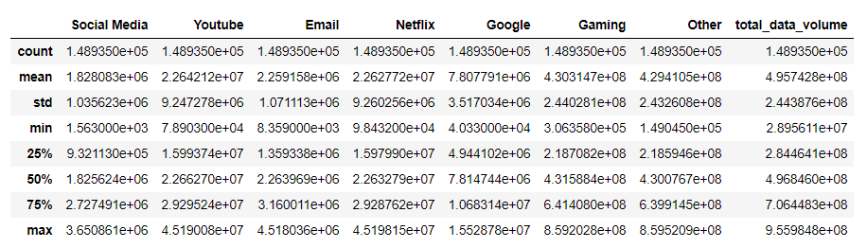
Non-graphical univariate analysis
Averagely Gaming , Other, and Youtube consumption of data is high.
Most application’s data distribution is increase from the least quartile(25%) to max quartile(75)

Slide 5
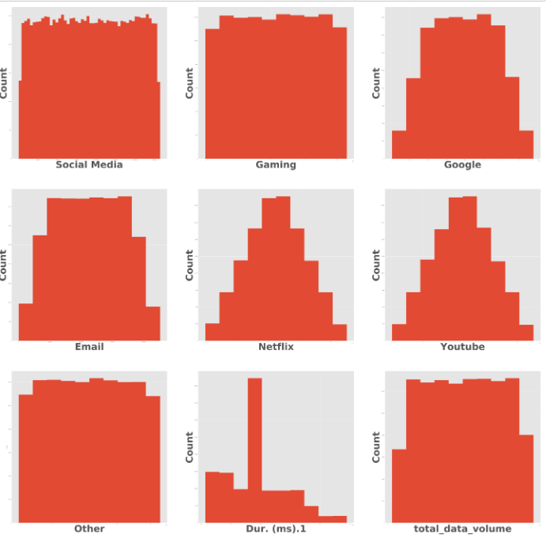

Non-graphical univariate analysis
Graphical univariate analysis
As we mention above Gaming and Other application consumption of data is high

Slide 6
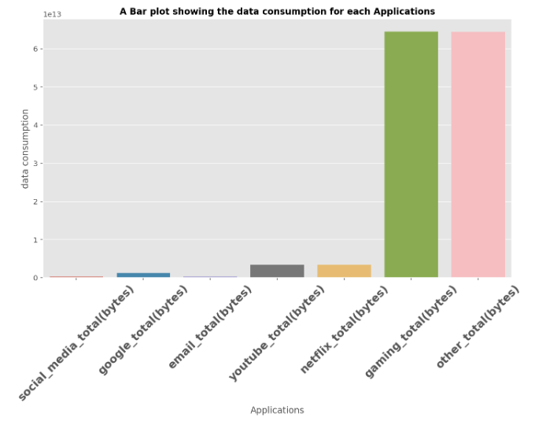
Bivariate analysis
Applications(bytes) | Data consumption
Social media | 2.742394e+11
Goggle | 1.171102e+12
Email | 3.388676e+11
Youtube | 3.396545e+12
Netflix | 3.394314e+12
Gaming | 6.455040e+13
Other | 6.440523e+13

Slide 7
Group customers in 5 group
User Group | Total DL(bytes) | Total DL(bytes)
0 | 1.059394e+13 | 9.547430e+11
1 | 1.086477e+13 | 9.851638e+11
2 | 1.127091e+13 | 1.019782e+12
3 | 1.281640e+13 | 1.157939e+12
4 | 2.216357e+13 | 2.006228e+12
The highest groump mebers have high consumption of data

Slide 8
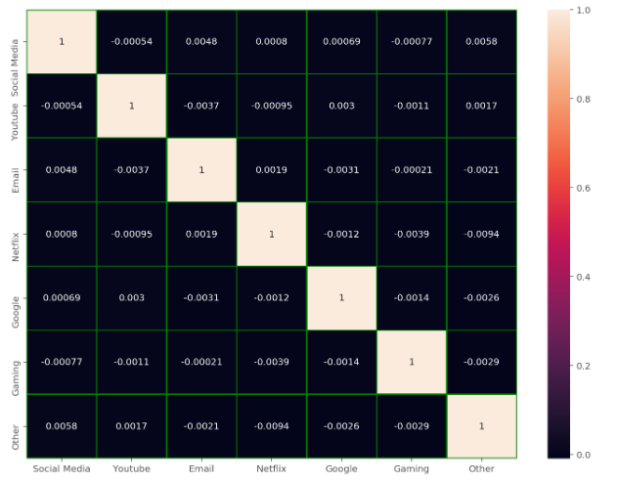
Analysis of customer usage of applications
user use the more correlated applications
Such as email and social media correlated highly which mean the users that spend on Email spend on social meadia as well

Slide 9
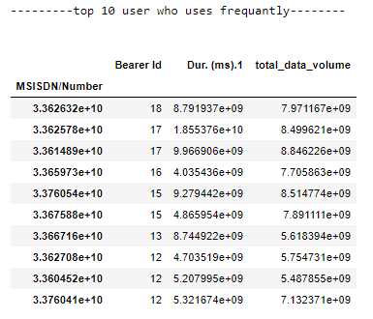
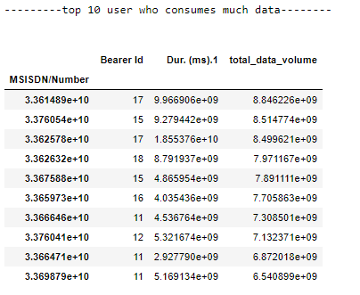
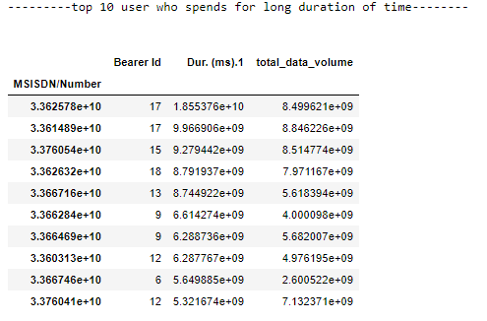
Analysis of customer usage ofghvnbmn,mmkjhfjjjjj
Top 10 users based on three metricses

Slide 10
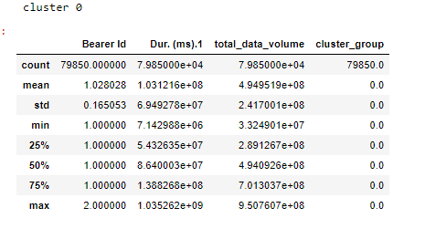
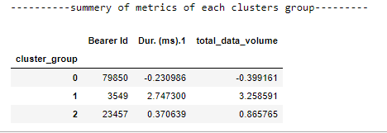
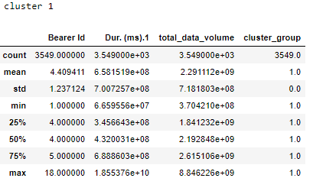
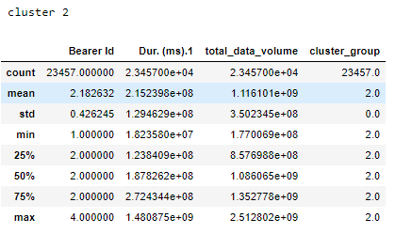
Group users in 3
When we are comparing the dispersion result group 0 are the least engaged group of users

Slide 11
Top 10 engaged users

Slide 12
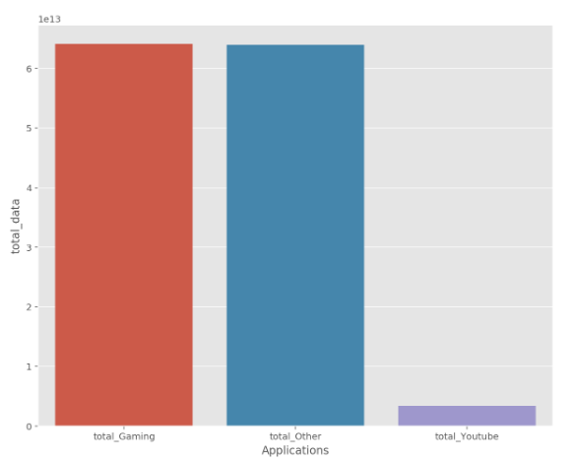
Top 3 most used applications

Slide 13
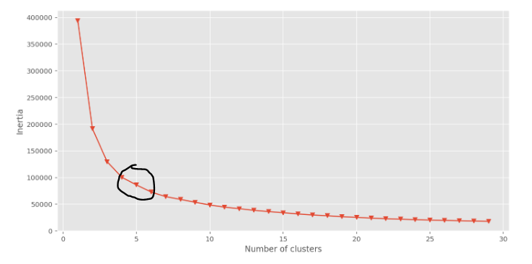
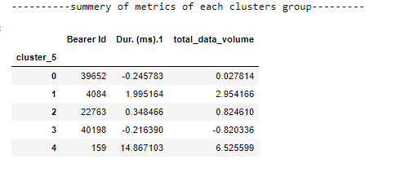
Group users in 5 groups
Elbow method
Summery of metrics of each cluster

Slide 14
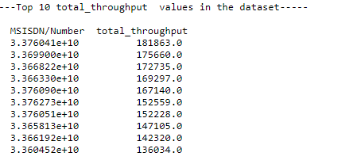
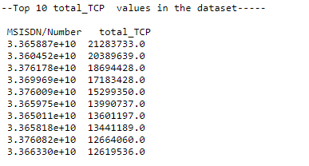
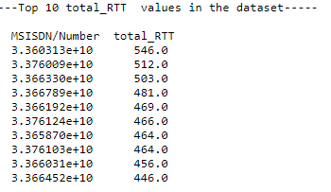
Group 5

Slide 15
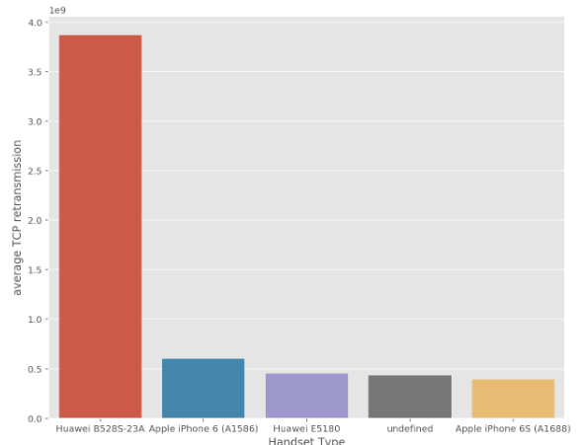
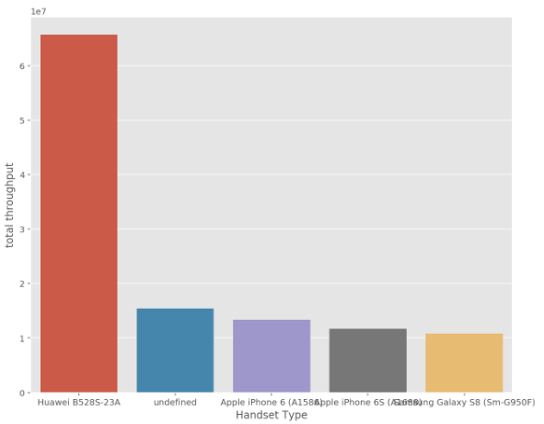
distribution of the average throughpu

Slide 16
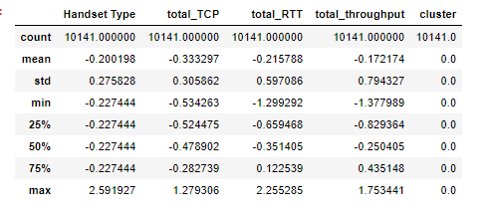
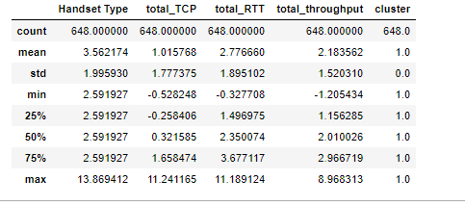
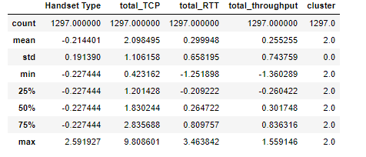
groups of experiences

Slide 17
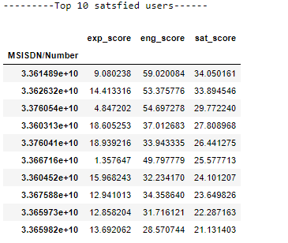
Top 10 engaged users

Slide 18
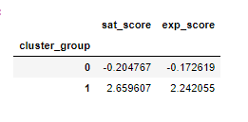
Top 10 engaged users

Slide 19
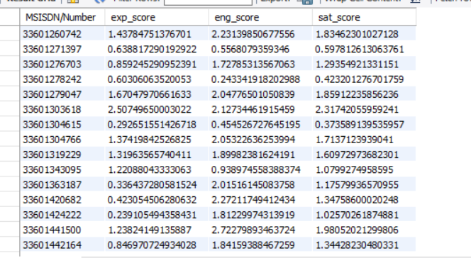
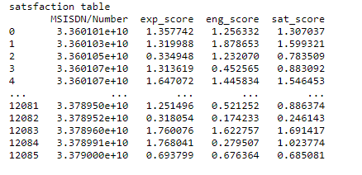
Top 10 engaged users

Slide 20
Reference

