Slide 1
RPG Game Recommendation System
By: Eugene Davis-Paulino, Je’von Kent, and Sean Mulvey

Slide 2
Problems to solve
We want the users to be able to rate some RPG games
We want them to distinguish between the games they like and disliked before recommending some games to them
We want the users to see their most rated subgenres to the third most rated subgenres based off the games

Slide 3
Solution
We created an application where users will be able to create an account to rate the games
We will calculate the games they rate positive and compare the games with the subgenres they are and recommend games closest the game subgenres.
They will see the subgenres in order from the most rated the games to the third most rated games based on the games they rated positive.

Slide 4
Technology used
Java – Code
Java Swing – Forms (Front-end)
Java DB(Derby) – Database (Back-end)

Slide 5
User Stories
As a user, I want to be able to log into my account
As a user, I want to login so I can access the library of games
As a user, I want to create my account, so I can log in
As a user, I want to rate and get recommended an RPG
As a user, I want to be able to rate an RPG, so that it can be added to the ratings and my library
As a user, I want to know the rating of a RPG, so I can play it
As a user, I want to search through the games, so that I know what type of game it is
As a user, I want to filter games by subgenre, so I can specific genres
As a user, I want to be able to view a page for each specific game, so that I can read the description of the game.

Slide 6
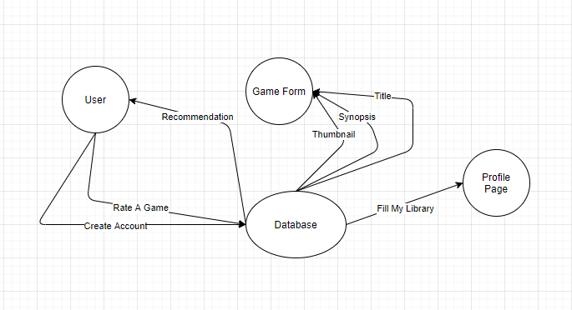
Context Diagram

Slide 7
Live Demo

Slide 8
Questions

