Slide 1
Smart Digital Portfolio website

Slide 2
DIGITAL PORTFOLIO
STUDENT NAME : K . Umamaheswari
REGISTER NUMBER : 24131111801022026
NAANMUDHALVAN I’D : autanm11111124uaic026
DEPARTMENT : B.SC Artificial Intelligence
COLLEGE : Krishnasamy College Of Science ,Arts and Management For Women
UNIVERSITY : Annamalai University

Slide 3
introduction
“Digital” emphasize the shift from traditional paper-based resumes to an online , interactive, and accessible platform.
“Portfolio” highlight that the website is not just a resume, but a comprehensive collection of skills, projects and achievements.
“Website” reflects the chosen medium- a web-based platform that is globally accessible , responsive and customizable.

Slide 4
PROBLEM STATEMENT
Traditional resume not sufficient to showcasing an individual’s skills, project and achievements effectively.
Recruiters often look for quick and visually engaging ways to evaluate a candidate's profile.
Lack of centralized, easily accessible academic/professional profile.

Slide 5
AGENDA
Project Overview
End Users
Tools & Technologies
Implementation
Coding
Results & Screenshots
Features & Functionality
Benefits & Application
Future Scope & GitHub Link
Conclusion

Slide 6
PROJECT OVERVIEW
Design a user-friendly website that highlights:
Career Objectives
About Me Section
Skills with official logos
Projects with descriptions
Contact form
References (GitHub, LinkedIn)
Ensure the website is responsive across devices.
Provide a digital alternative to resume.

Slide 7
END USER
(((
(((
(((
(((
(((
(((
(((
(((
(((
Students & Job Seekers – to showcase skills and projects.
Recruiters/Companies – to evaluate candidates efficiently.
Institutions – to maintain student profiles digitally.

Slide 8
TOOLS AND TECHNIQUES
Tools and techniques
Frontend: HTML, CSS, JavaScript, Bootstrap
Backend: Python / Node.js (as applicable)
Database: MySQL / MongoDB
Version Control: Git & GitHub
Design Tools: Figma / Canva

Slide 9
implementation
HOME PAGE
SKILLS
PROJECT
)
)
)
)
)
)
)
Name , tagline , hero section
)
Grid layout with official language logos
)
Card-based layout with hover effects
)
)
)
)
)
)
)
)
)
)
)
)
)
)
)
CONTACT
REFERENCES
)
)
)
)
)
Simple form with input validation
)
Stylish card for GitHub and LinkedIn
)
)
)
)
)
)
)
)
)
)

Slide 10
Coding
Index.html
Style.css
Script.js

Slide 11
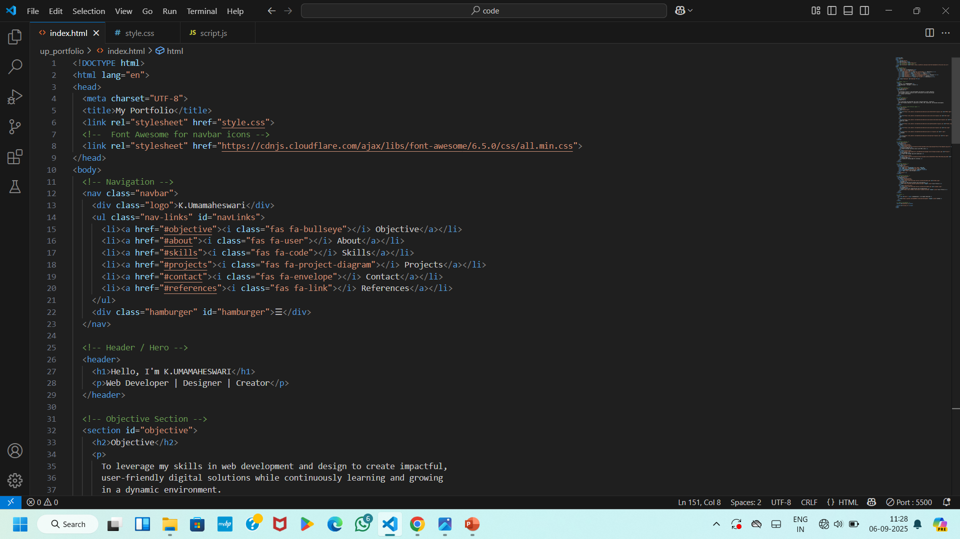

Slide 12
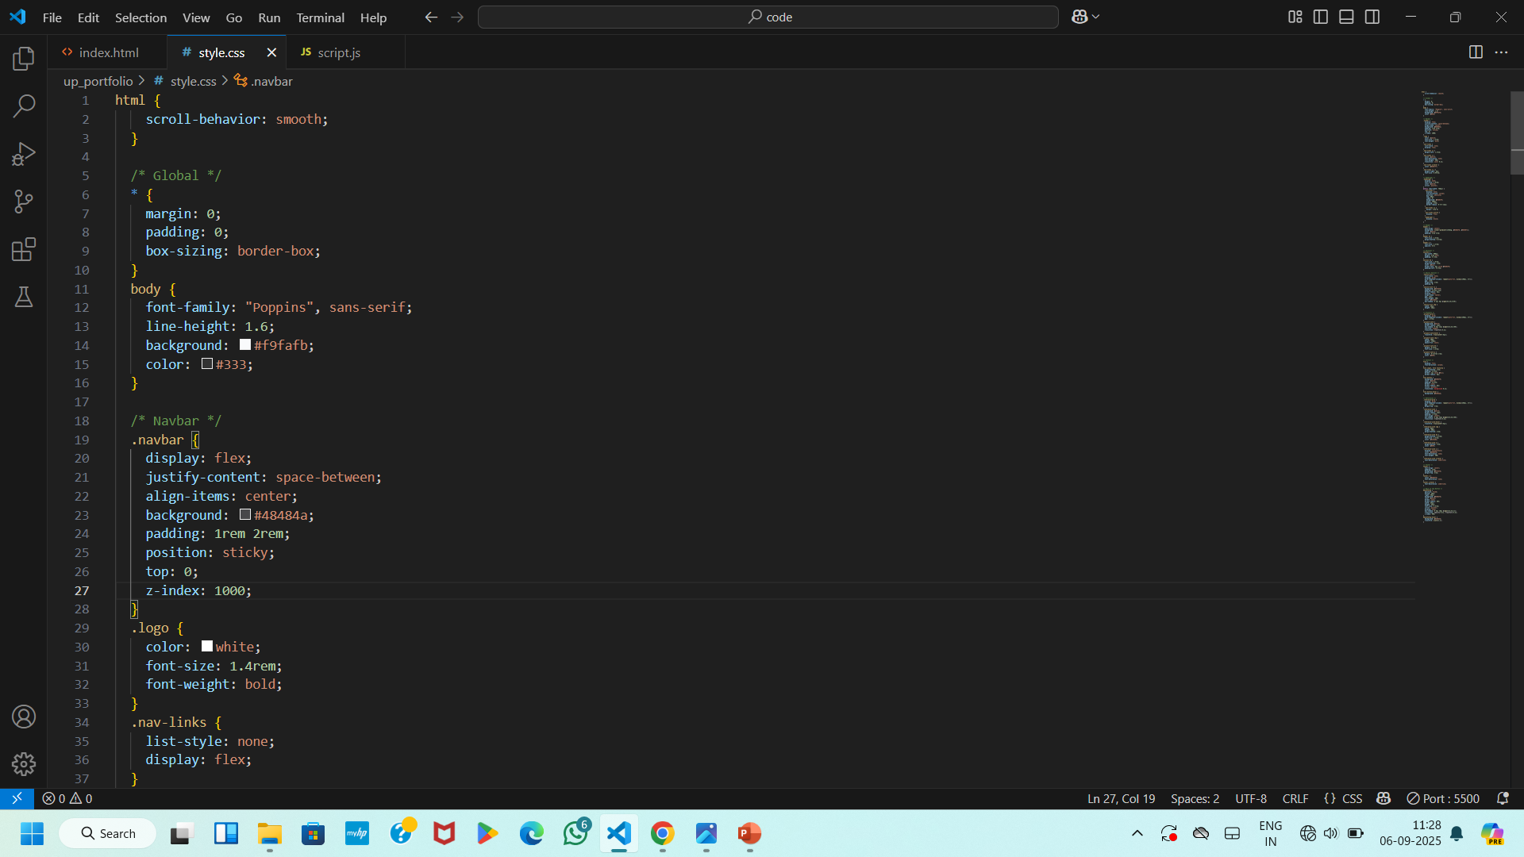

Slide 13
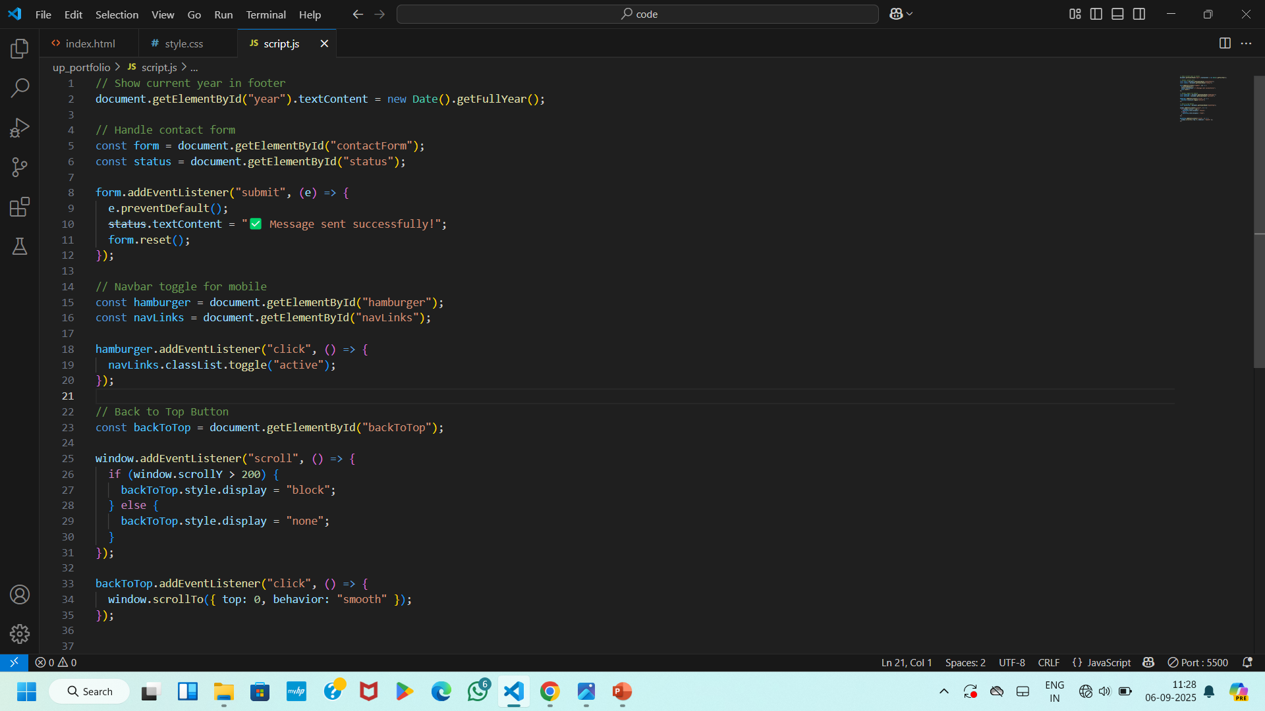

Slide 14
RESULT & SCREENSHOT

Slide 15
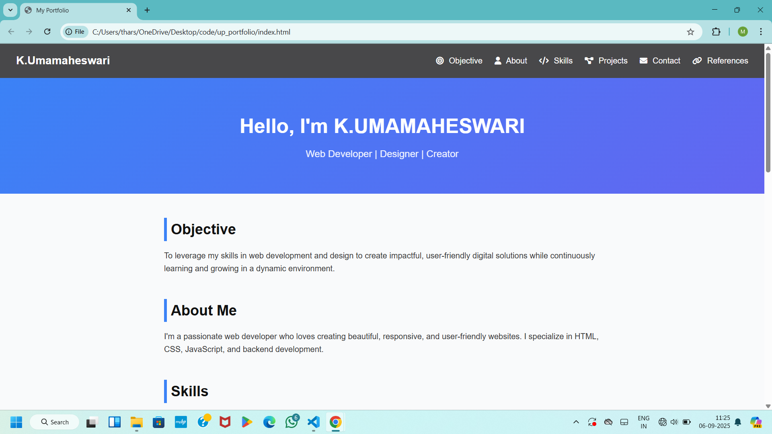
https://github.com/muma85841-cloud/web-development

Slide 16
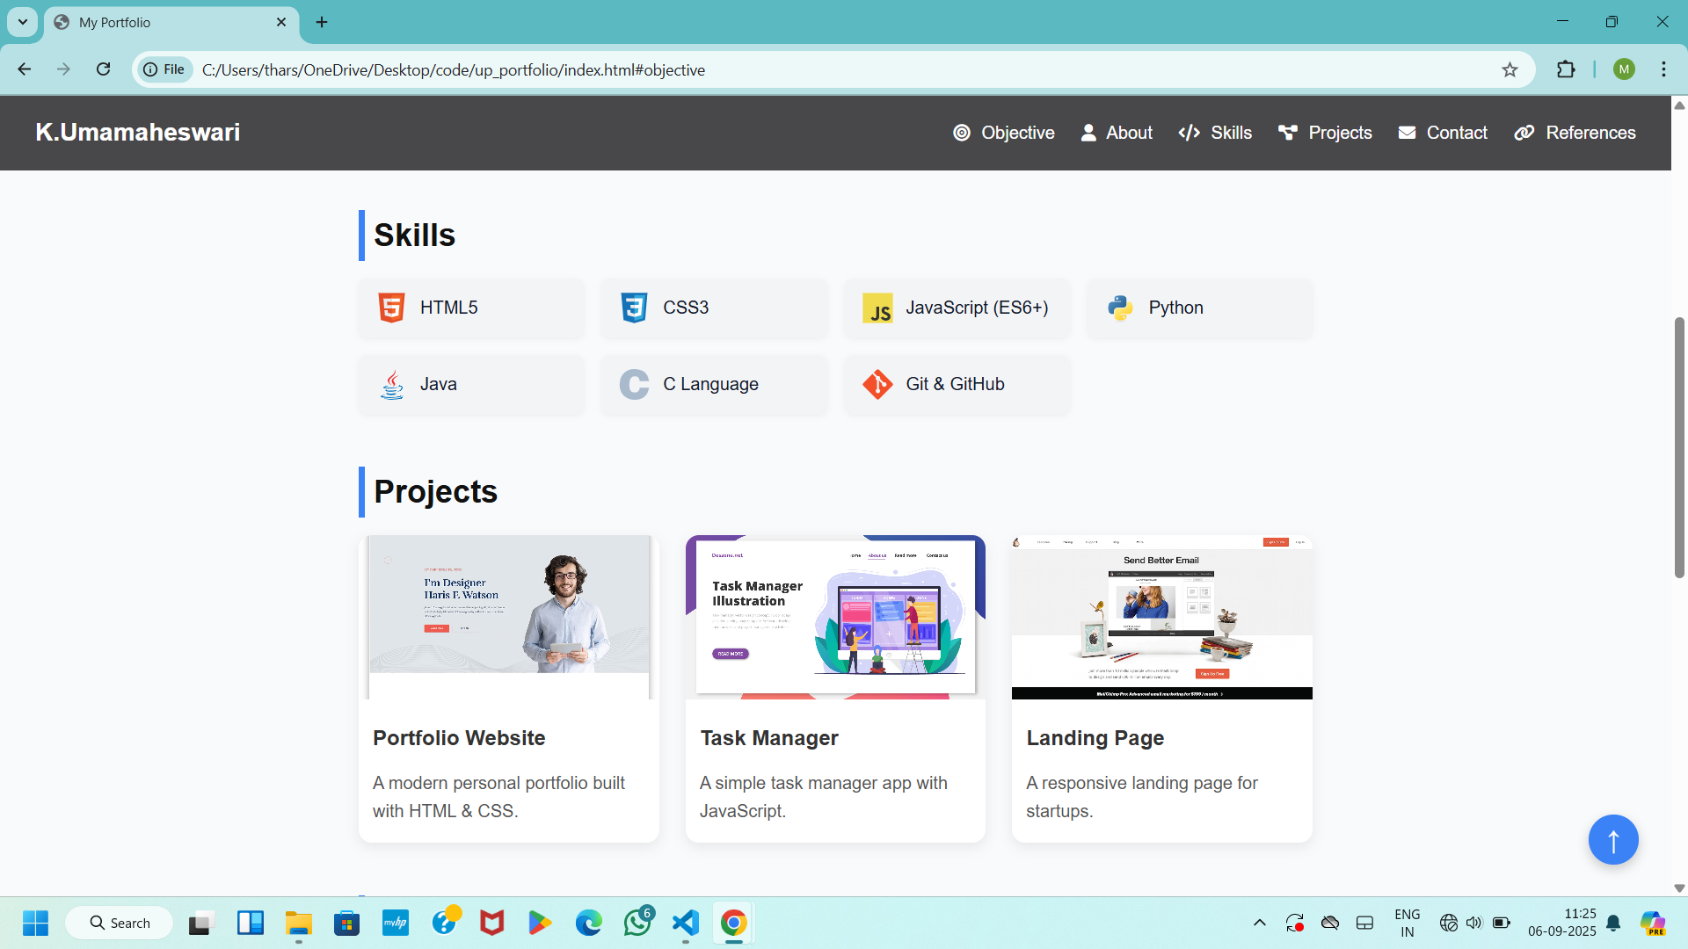

Slide 17
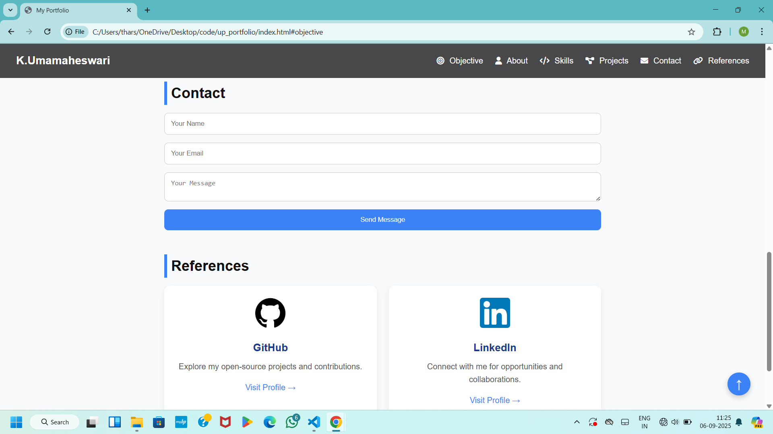

Slide 18
FEATURES AND FUNCTIONALITY
Navigation bar with smooth scrolling and icons
Objective and about me section
Skills section with technology logos
Project cards with images and descriptions
contact form for easy communication
References section
Footer with GitHub link
Mobile-friendly design with hamburger menu
Back-to-top button

Slide 19
Benefits & applications
Acts as a digital resumes available 24/7
Creates a strong online presence
Helps recruiters and clients explore project easily
Demonstrates practical knowledge of web development
Can be continuously updated with new skills and projects

Slide 20
future scope
Add a blog section
Connect backend for contact form
Deploy on custom domain
Integrate analytics to track visitors
AI-based recommendation
GitHub Link : https://github.com/muma85841-cloud/web-development

Slide 21
Conclusion
Successfully built a personal portfolio website
Showcase skills , project , and references effectively
Solves the problem of traditional resumes.
Helps in better visibility for students and professionals.
Provides an efficient tool for recruiters and institutions.

