Slide 1
Together We Can
TEAM 17

Slide 2
Challenge statement:
Data Collection
Conduct assessment
Customize reporting
Analytics
Media Repository

Slide 3
Things We Deliver
Complete Automation
CSV Report generation
Handy Admin Web Portal

Slide 4
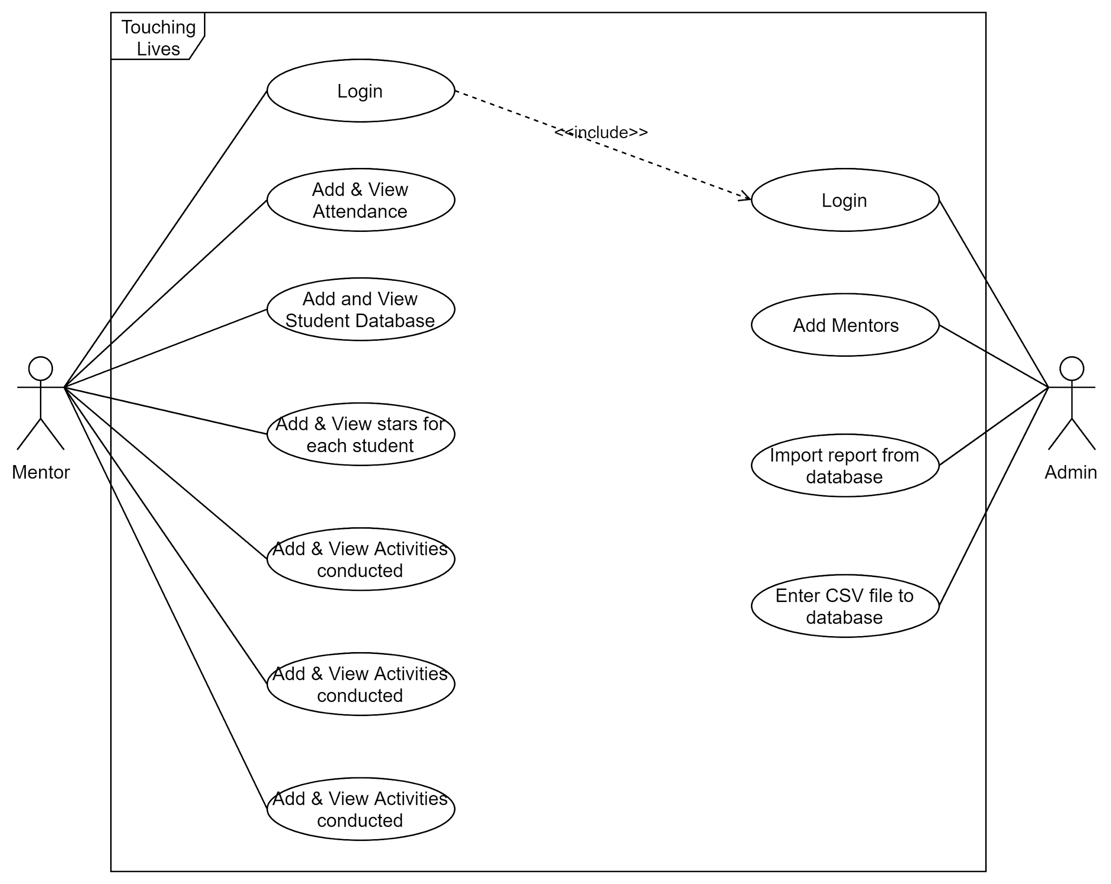
Use case Diagram:

Slide 5
Further scope:
1)Several programs for maintaining kids emotional and physical health can be programmed
2)A WebCrawler which will suggest new topics, themes to the mentors using real world data.
3)Data visualization

