Slide 1


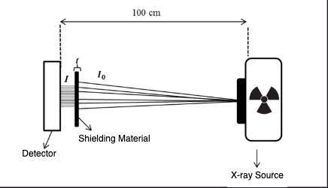

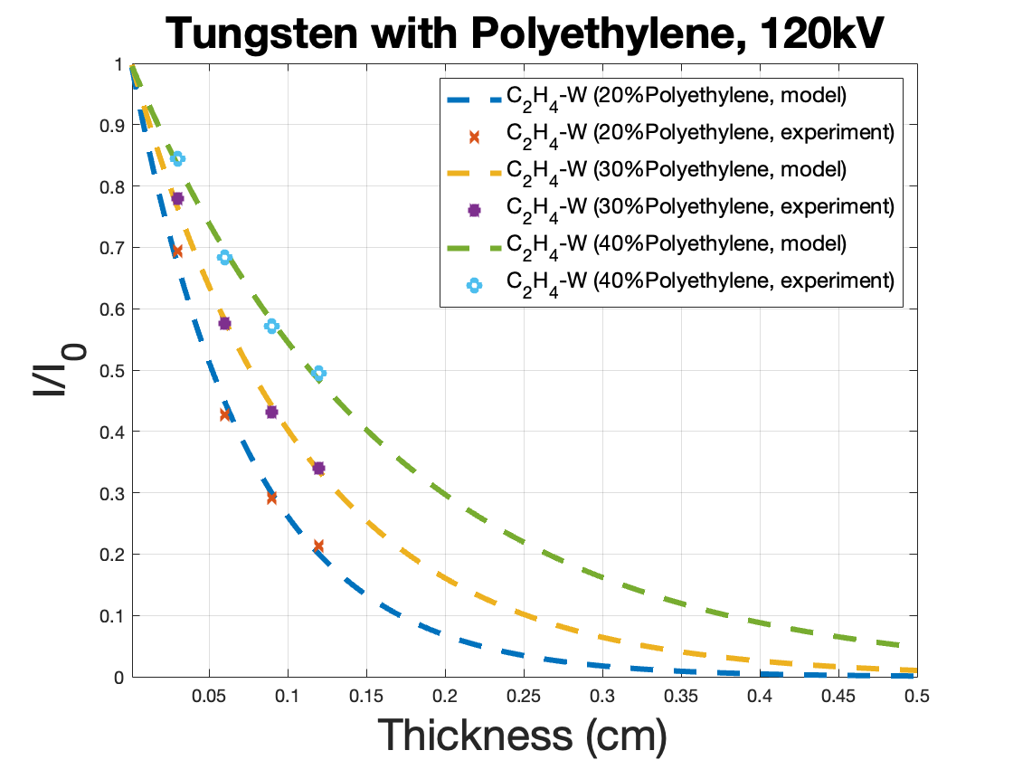
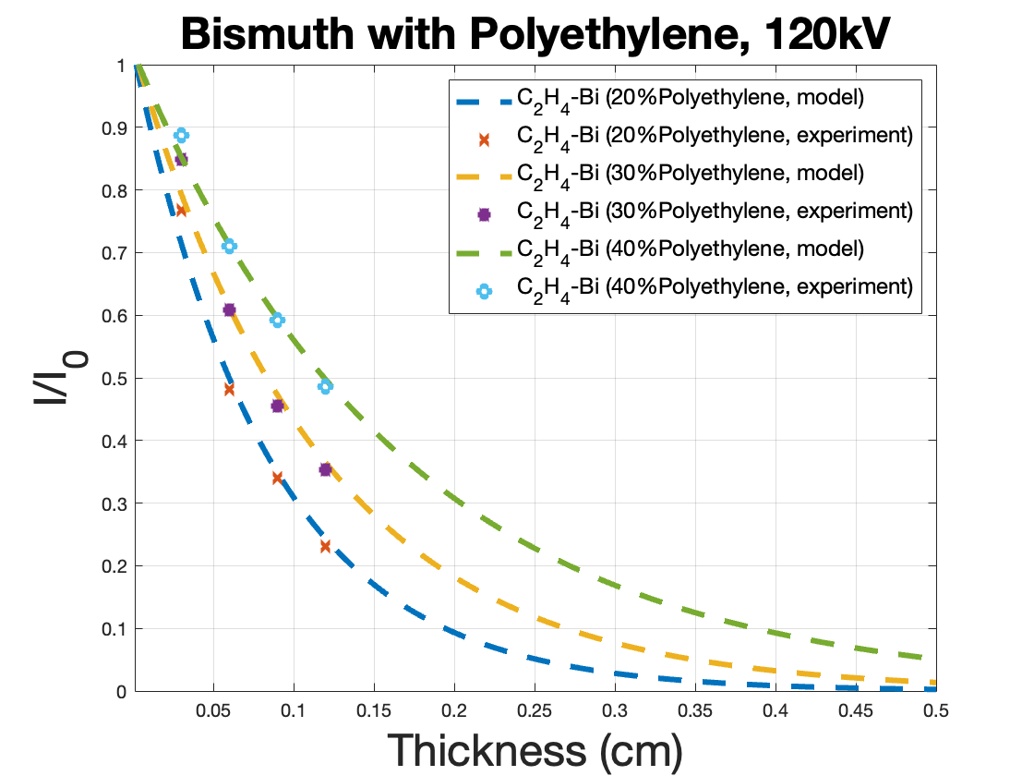
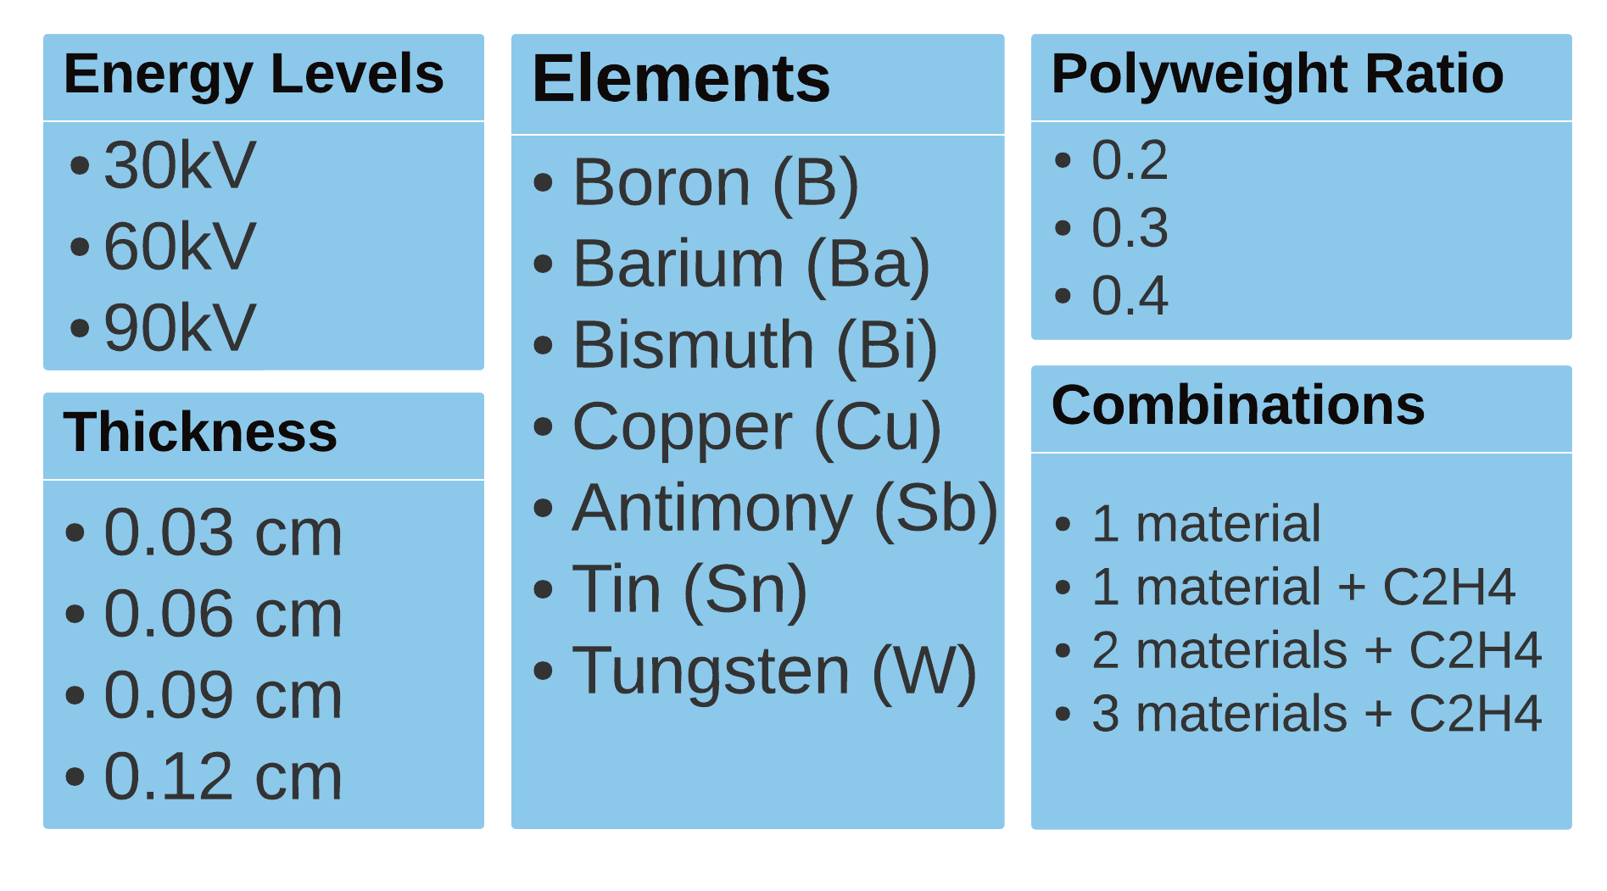
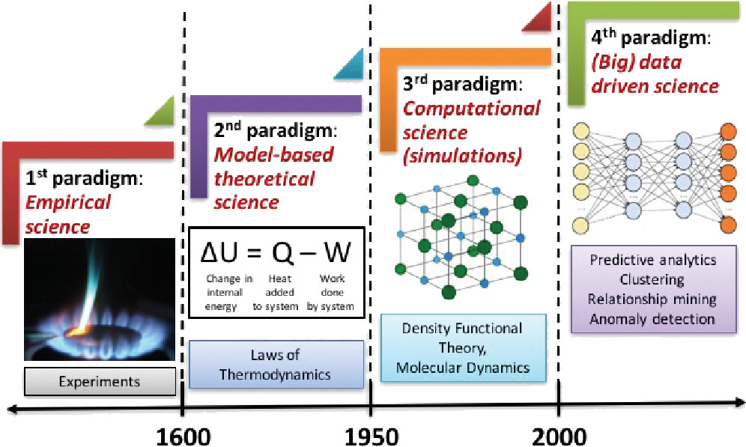
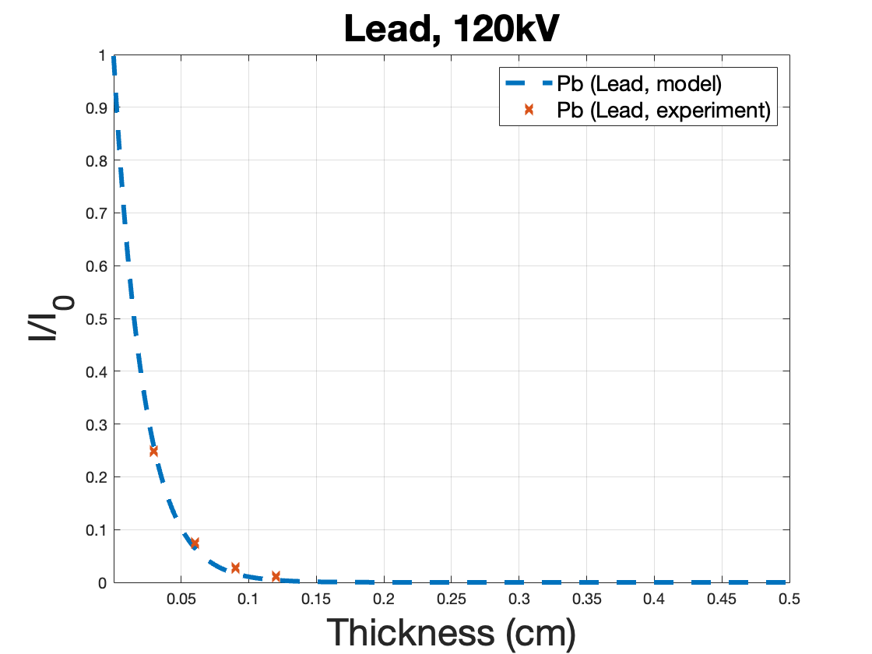
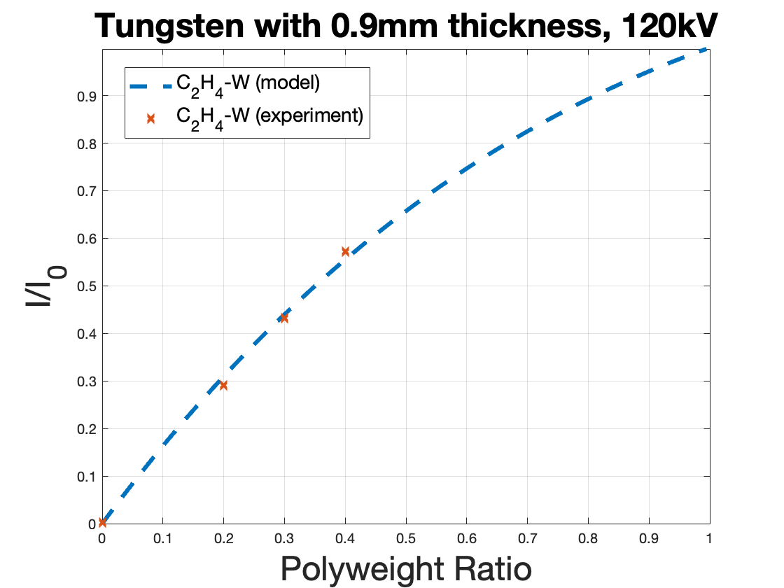
ODYSSEUS: Optimized Deep-learning for Shielding Systems and Energy Usage Simulation
Berke Çalışkan Sena Mumcu Advisor: H. Birkan Yılmaz
Introduction and Problem Statement
PENELOPE is a Monte Carlo simulation that is used widely in material design for wearable radiation protection. Although it is reliable it is computationally intensive and requires significant time and resources.
Our project seeks to overcome these limitations by harnessing the power of AI to provide accurate outputs similar to simulations based on user-specified inputs. By developing an ANN model that can effectively estimate simulation outputs, our tool will significantly reduce the time and cost involved in wearable material design tasks.
Radiation Model
Data Generation
We chose to deal with seven primary elements. Since we also want our model to learn about incorporating polymers into materials, so that it may learn about various types of shielding materials, we chose to include polyethylene in our configurations. In order to obtain a more varied and extensive data collection, we have decided to construct numerous settings for material simulation.
Different source energy levels, diversified element alloys with one and two elements and polyethylene, different material thicknesses, and different ratios within materials are all included in our simulation settings.
Figure 2
Figure 1
Future Directions
Enhance the diversity of simulation data by running simulation with oxidized materials in different combinations.
Research on distinct ANN structures and decide on the most suitable option/ structure.
Implement the ANN model, train and test the model using the generated simulation data.
Motivation
Eliminate the need for computationally intense MC simulations.
Accelerate material design for radiation protection.
Improve cost and resource efficiency in the design process.
Background
Steps for running simulations:
creating material files for various configurations
creating a geometry file that adheres to the PENELOPE simulation guidelines and specifies our experiment setup
creating an input file for penEasy utilizing the material, geometry, and energy files.
Resources
https://www.oecd-nea.org/upload/docs/application/pdf/2020-10/penelope-2018__a_code_system_for_monte_carlo_simulation_of_electron_and_photon_transport.pdf
https://inte.upc.edu/en/downloads/peneasy
Figure 1: Agrawal, Ankit & Choudhary, Alok. (2016). Perspective: Materials informatics and big data: Realization of the “fourth paradigm” of science in materials science. APL Materials. 4. 053208. 10.1063/1.4946894.
Figure 2: Aral N, Banu Nergis F, Candan C. An alternative X-ray shielding material based on coated textiles. Textile Research Journal. 2016;86(8):803-811. doi:10.1177/0040517515590409

