Slide 1
TTC BUS DELAY DATA ANALYSIS
Module 4 | Data Visualization and Analysis
Muhammad U. Mirza
College of Professional Studies, Northeastern University Toronto
ALY 6000: Introduction to Data Analytics
Dr. Maria Ayala
October 15, 2023

Slide 2
TTC Bus Delay Data
January 2023 - August 2023
I chose the TTC Bus Delay dataset from open.toronto.ca. This dataset is a rich source of information that can help us understand the reasons behind bus delays in Toronto. The dataset contains 34981 rows and 10 columns, covering the period from 1 January 2023 to 31 August 2023. There are several variables in the dataset that are of interest, including date, route, time, day, location, incident, min delay, min gap, direction, vehicle. By analyzing this dataset, I hope to gain valuable insights into the factors that contribute to bus delays in Toronto.

Slide 3
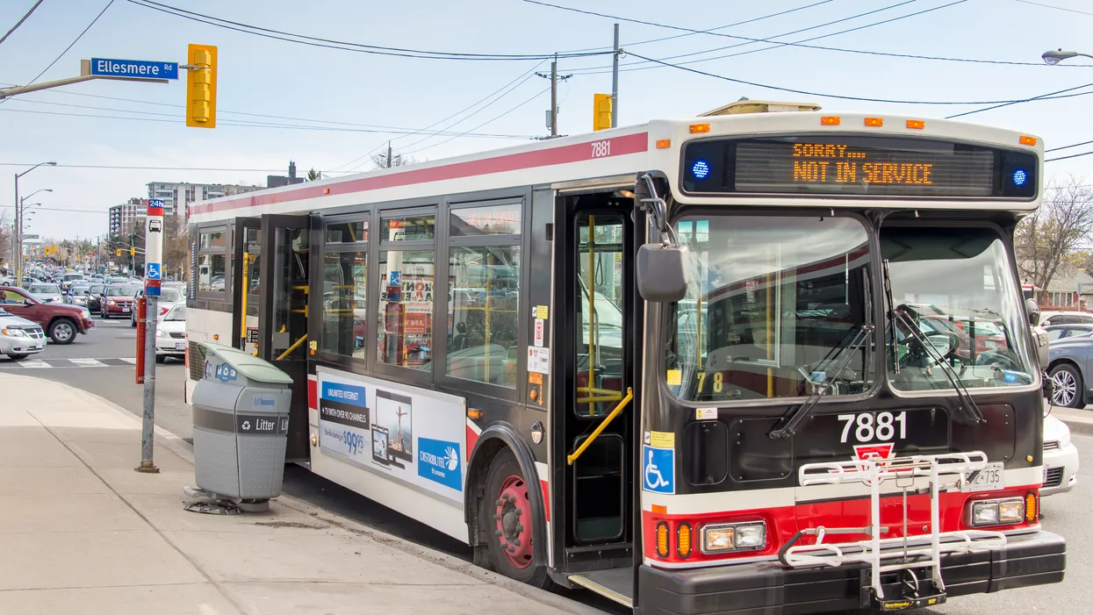
Looking for 3 answers
Q1) What is the predominant factor contributing to delays
in the Toronto Transit Commission (TTC) bus system?
Q2) Are there any noticeable patterns in specific routes and days of the week, that experience substantial delays, which could inform strategies for enhancements or schedule adjustments?
Q3) To what extent are delays in the TTC bus system influenced by seasonal variations?
Photo by Manuel Machado | Dreamstime

Slide 4
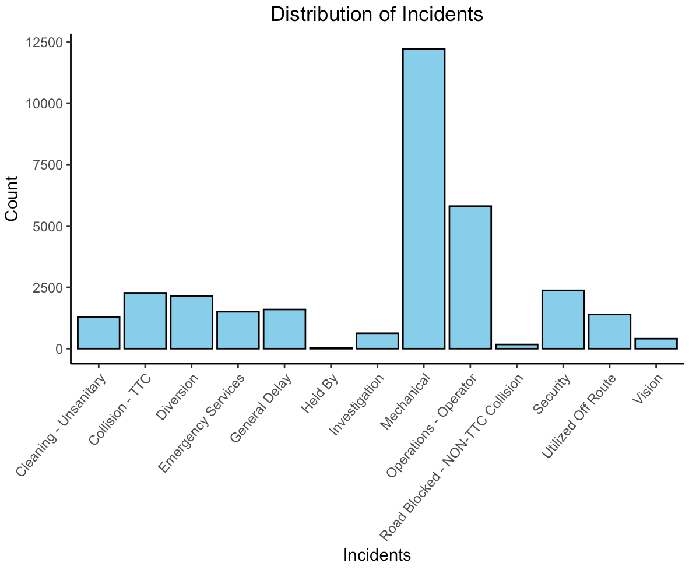
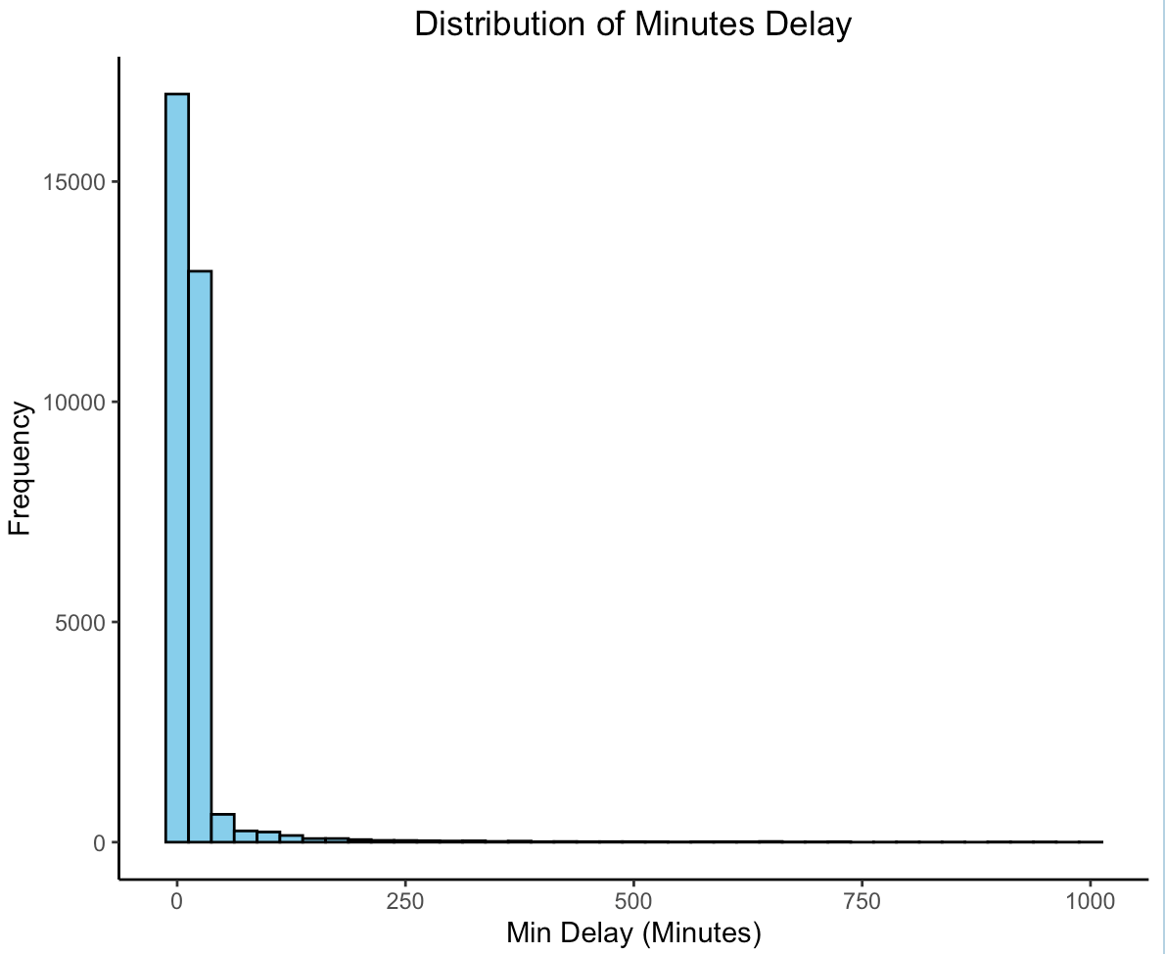
Distribution of Incidents & Minutes Delay
Notes:
It appears that the most common cause of delay is mechanical issues and majority of the delays are of less than 125 minutes.

Slide 5
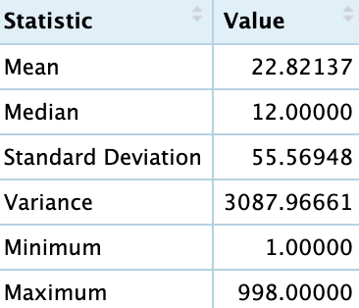
Summary Statistics of Minutes Delay
The average delay is about 23 minutes.
The longest delay is about 998 minutes.
The shortest delay is about 1 minute.
The standard deviation is about 55 which indicates that large range of values.

Slide 6
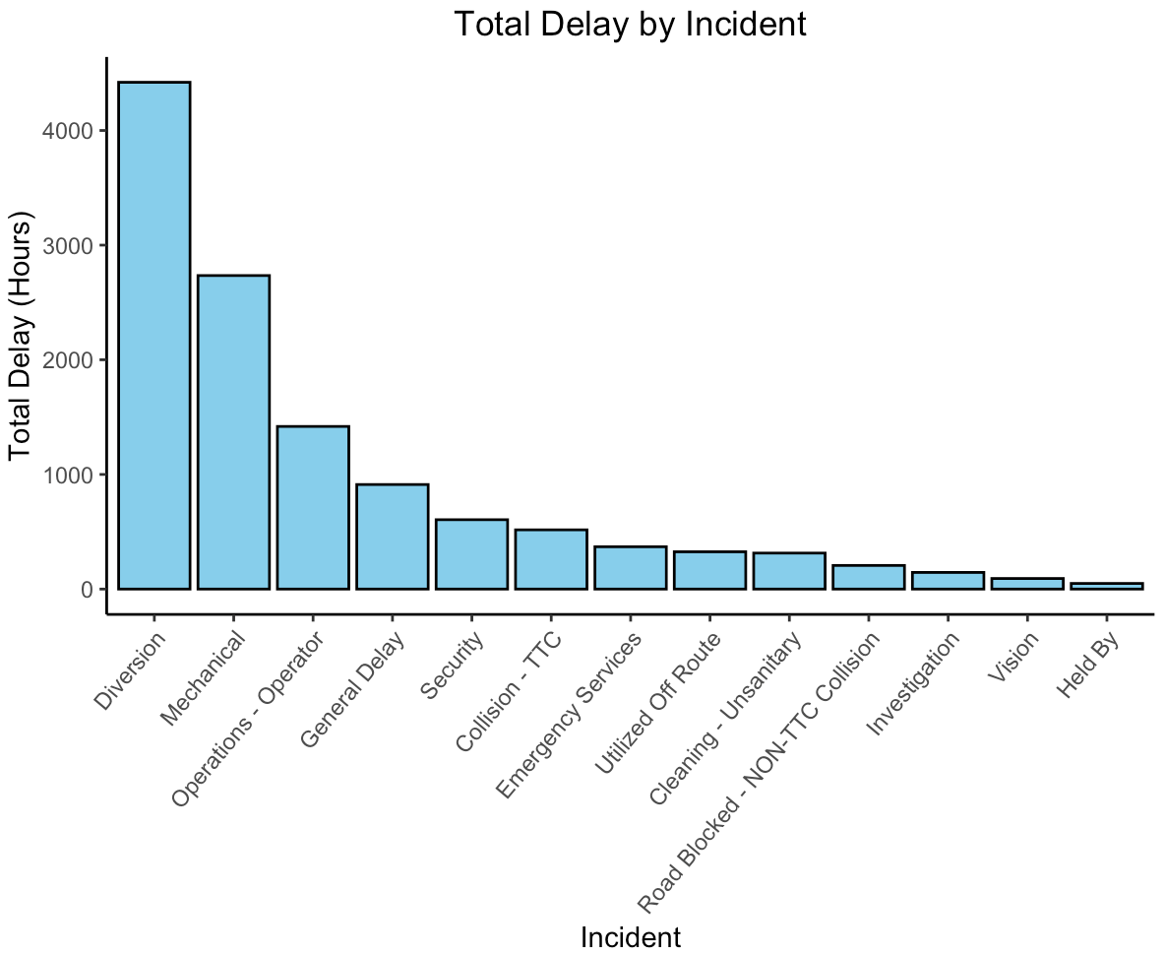
Duration of Delay per Incident
Diversion has the most delay time followed by Mechanical and Operation - Operator.
Notes:
It appears that diversion has caused more than 4000 hrs of delay since Jan 2023 to Aug 2023. This indicates that their might be construction or maintenance work going on which leads to longer routes.

Slide 7
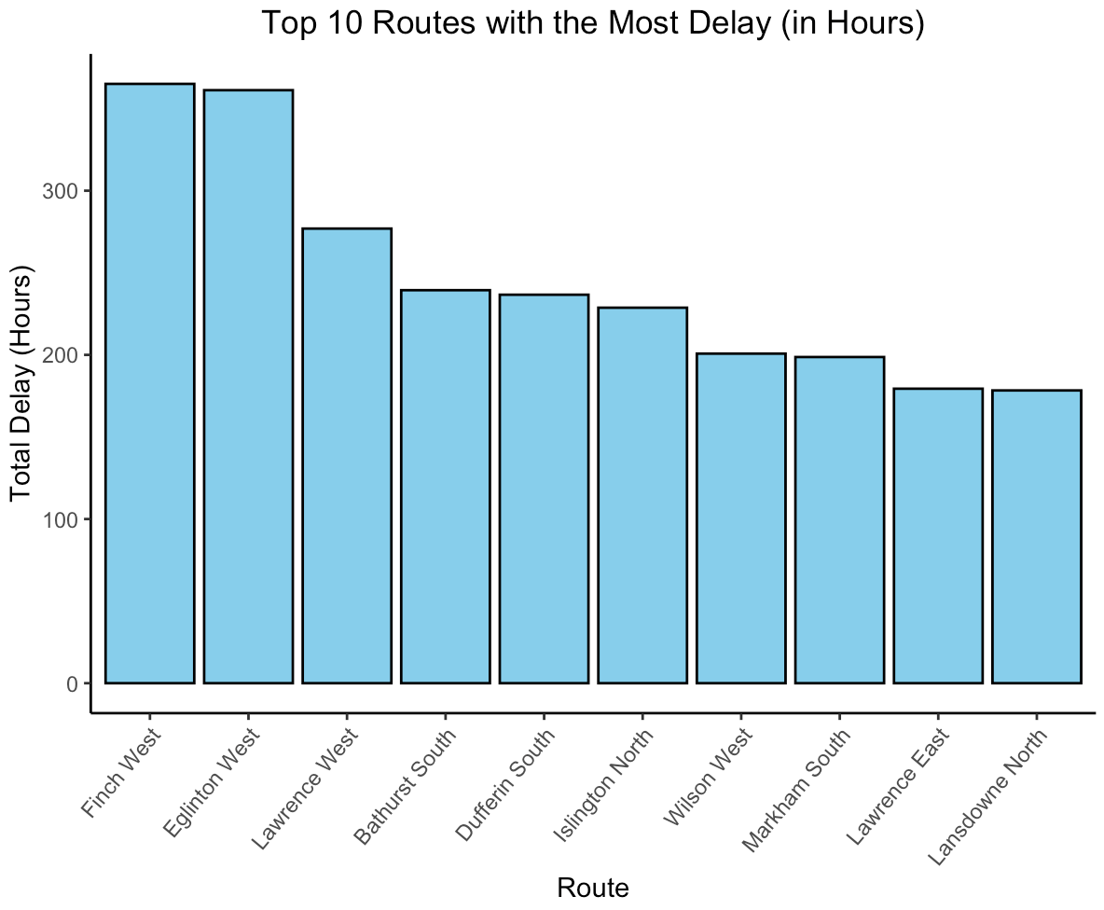
Top 10 Routes with the Most Delay
Finch West route experiences the most delays, followed by Eglinton West and Lawrence West.
It appears that mainly west bound buses experience most delays.
Notes:
It appears that the Finch West route is the most affected by delays. West bound buses experienced the most delays. Names of the top ten routes were taken from https://www.ttc.ca/routes-and-schedules/listroutes/bus.

Slide 8
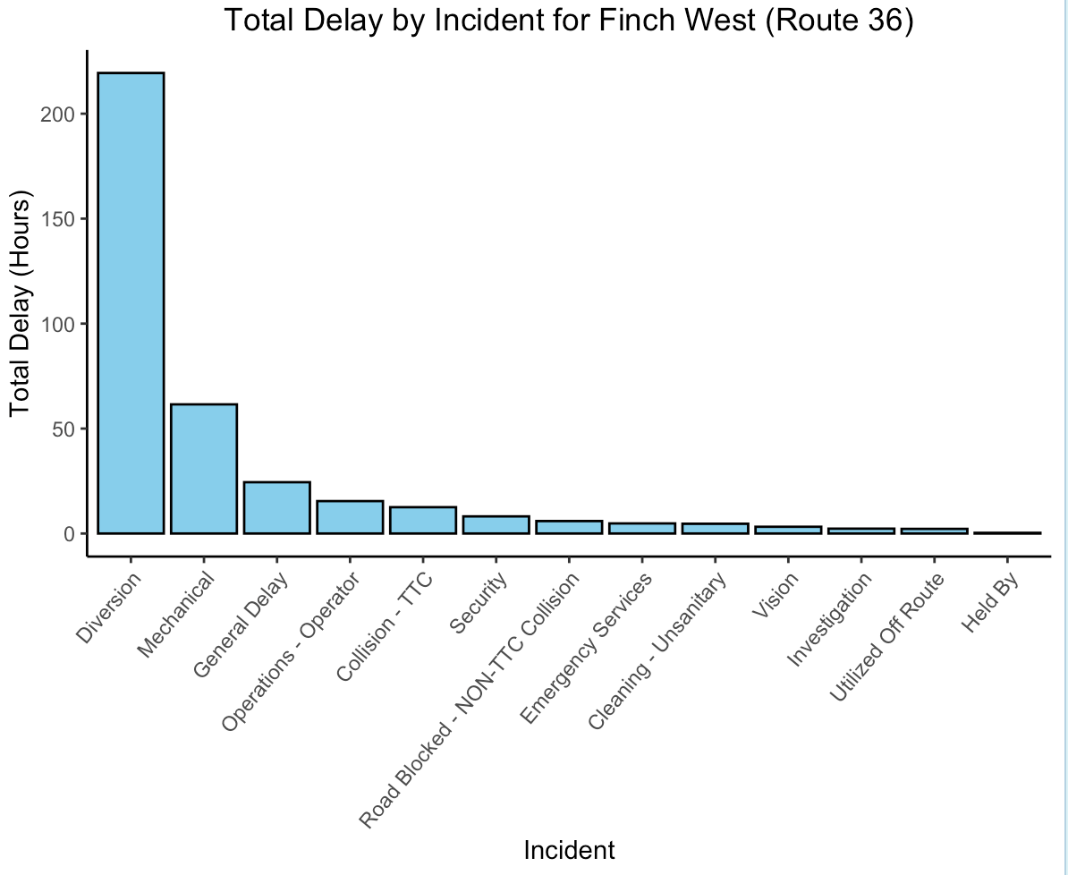
Investigating Finch West
It appears that Diversion causes the most delays followed by Mechanical and General Delay.
Notes:
It appears that the route is experiencing delays mainly due to diversions. This indicates the need of better route planning.

Slide 9
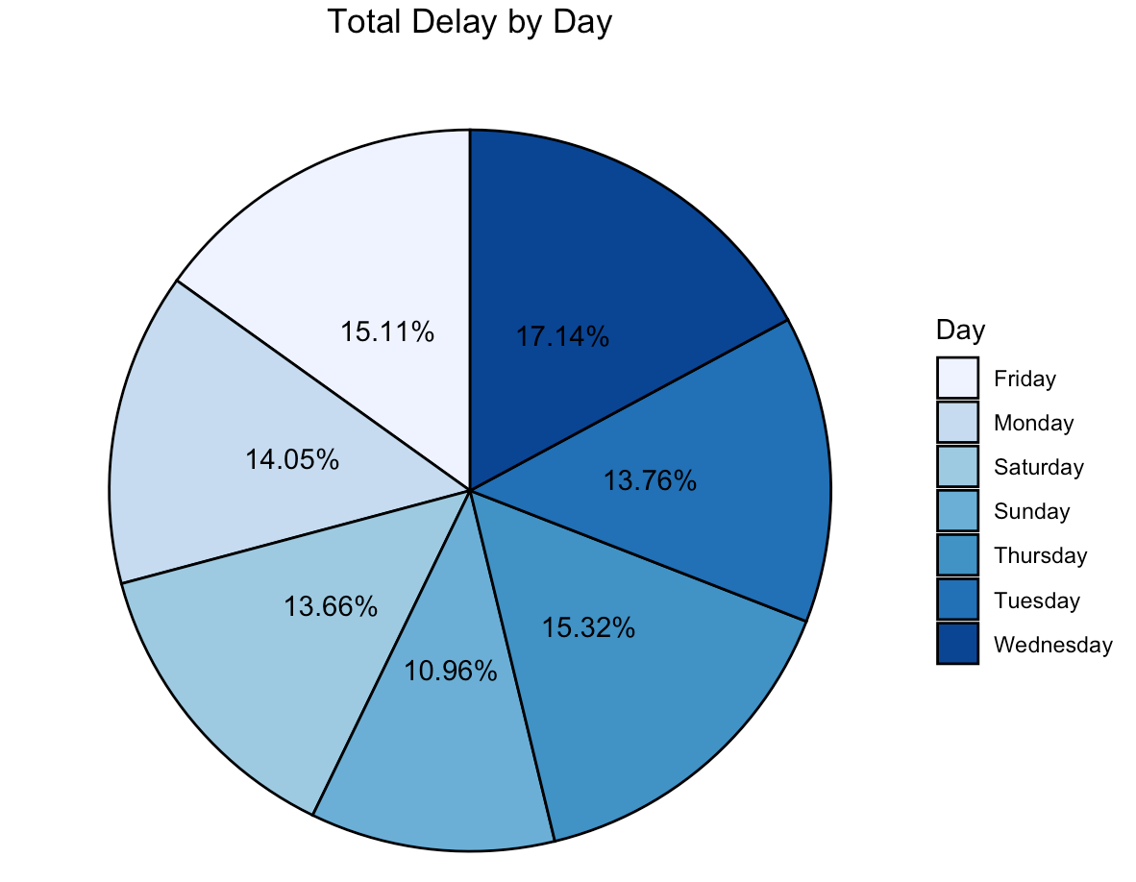
Delay by Day
Delays vary slightly when compared to the day of the week.
Wednesday experiences the most delay whereas Sunday experiences the least delays.
Notes:
Surprisingly most delays occur on Wednesday followed by Friday.

Slide 10
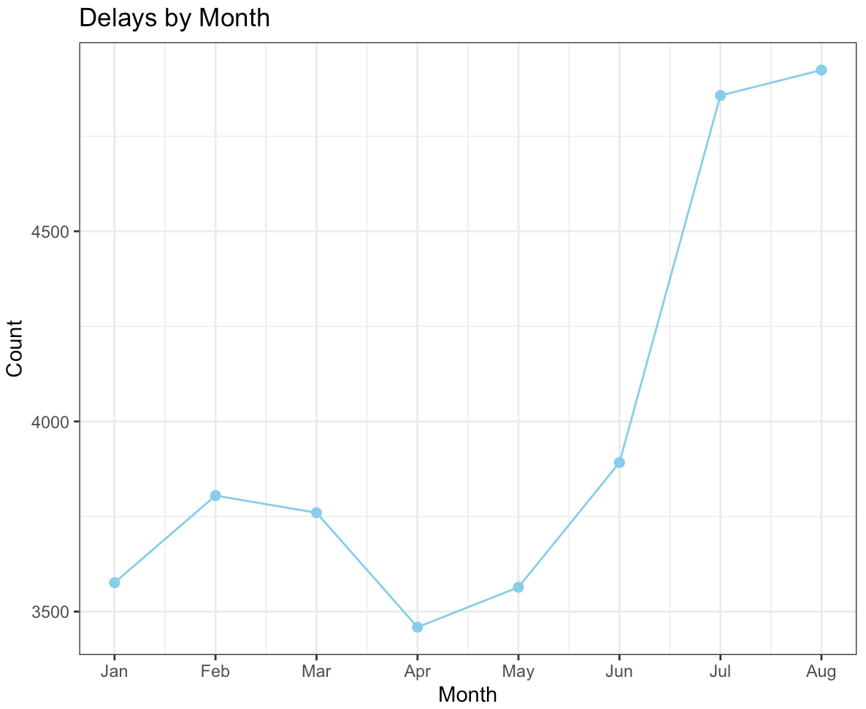
Delays by Month
Delays significantly varies over the 8 months.
Delays decreased during February to April.
Delays significantly increased from May to August.
Notes:
Delays vary over the months. Surprisingly delay increased during the summer months. Maybe because of construction and schools reopening around August.

Slide 11
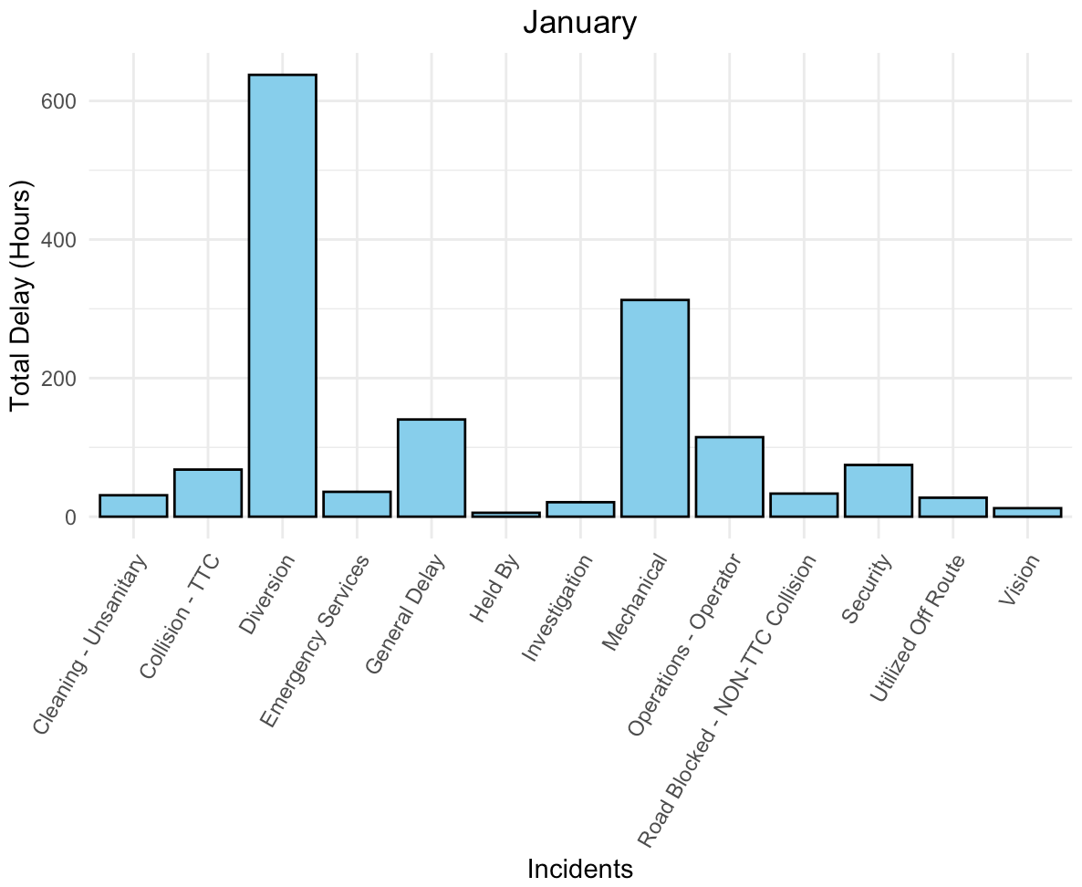
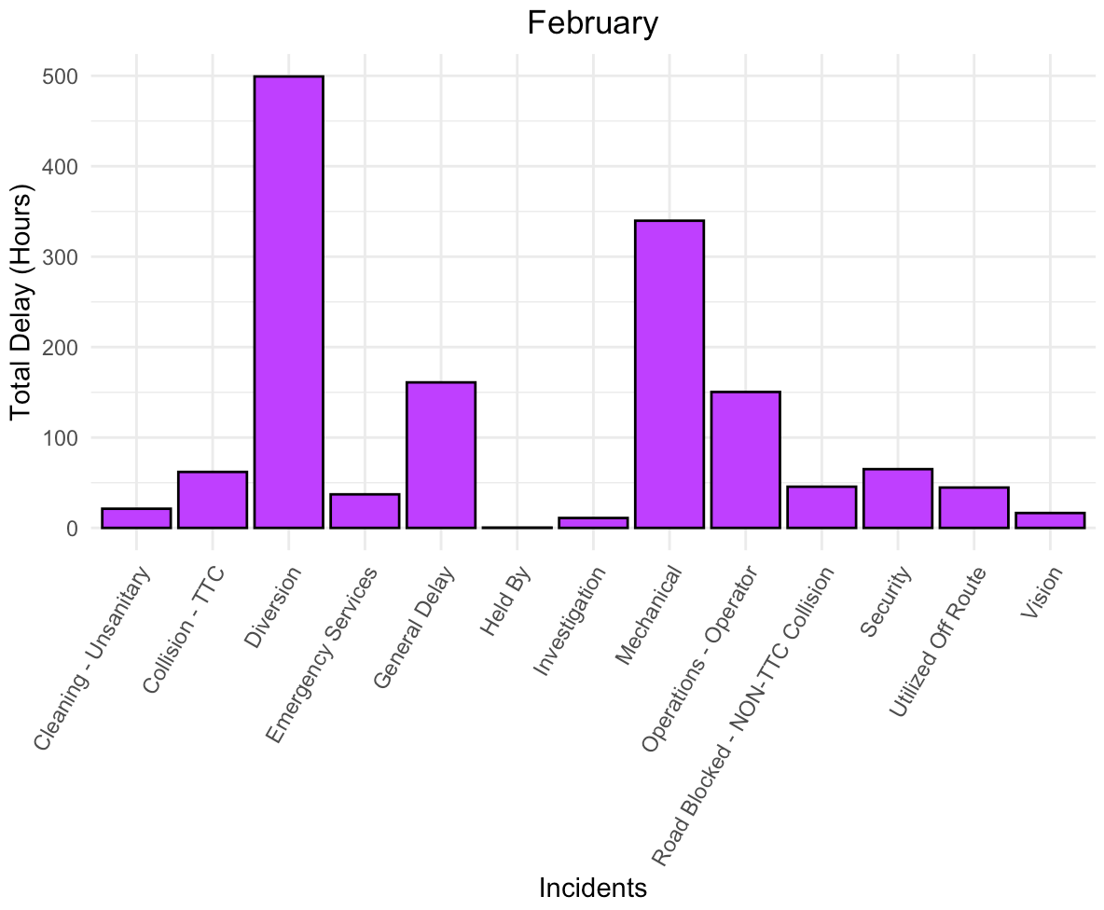
Causes of Delay by Month
In January Diversion caused the most delays followed by Mechanical and General Delay.
In February Diversion caused the most delays followed by Mechanical and General Delay.
Notes:
In the first quarter of the year it appears that most of the delays are caused due to diversions. January experienced the most delays in terms of total delay time.

Slide 12
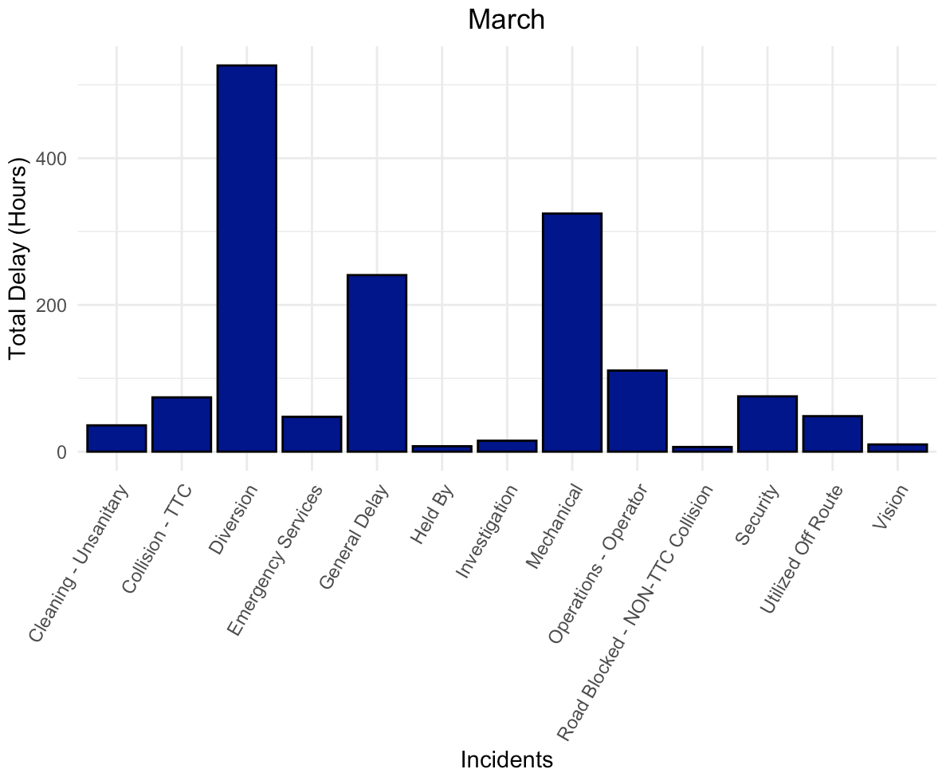
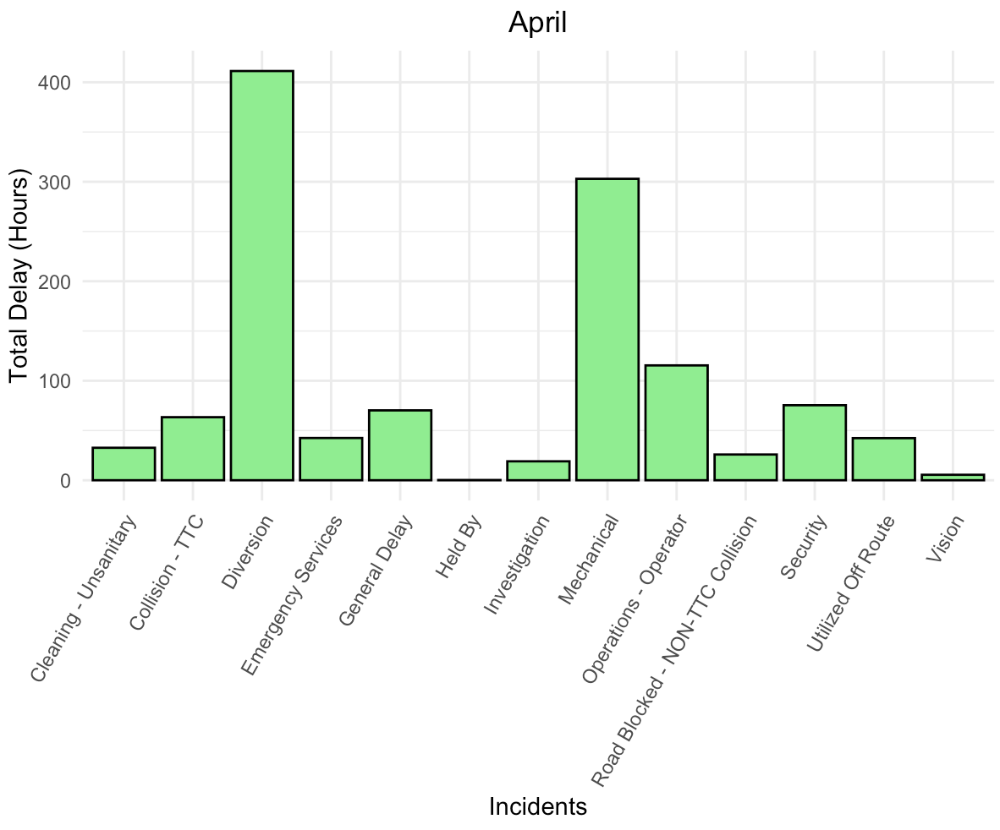
Causes of Delay by Month
In March Diversion caused the most delays followed by Mechanical and General Delay.
In April Diversion caused the most delays followed by Mechanical and Operations - Operator..
Notes:
In the first quarter of the year it appears that most of the delays are caused due to diversions. January experienced the most delays in terms of total delay time.

Slide 13
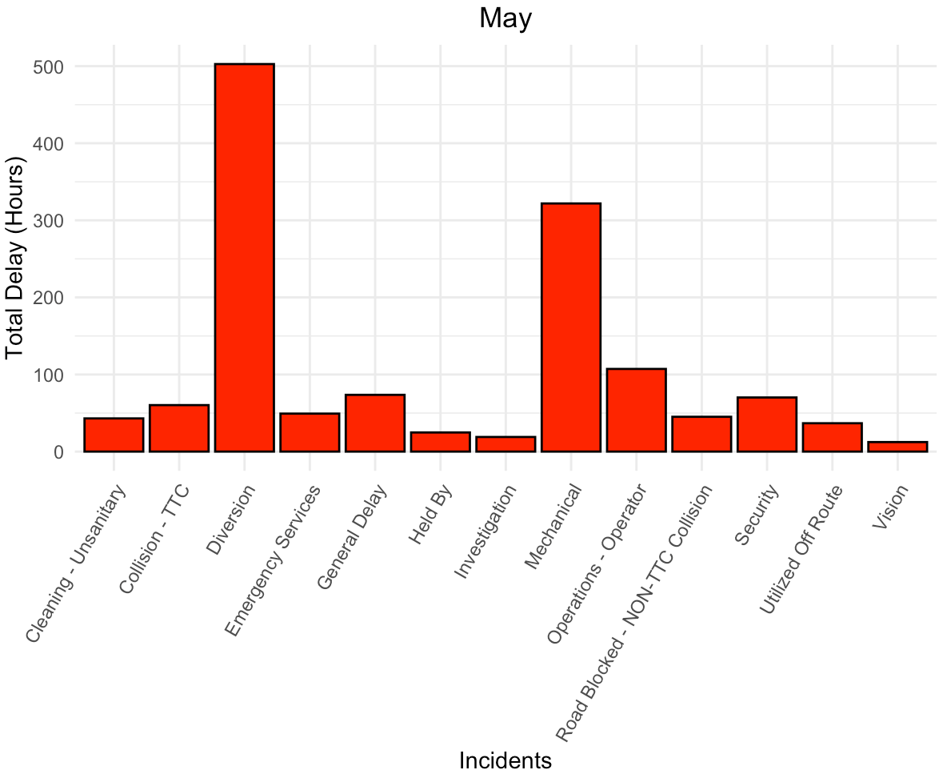
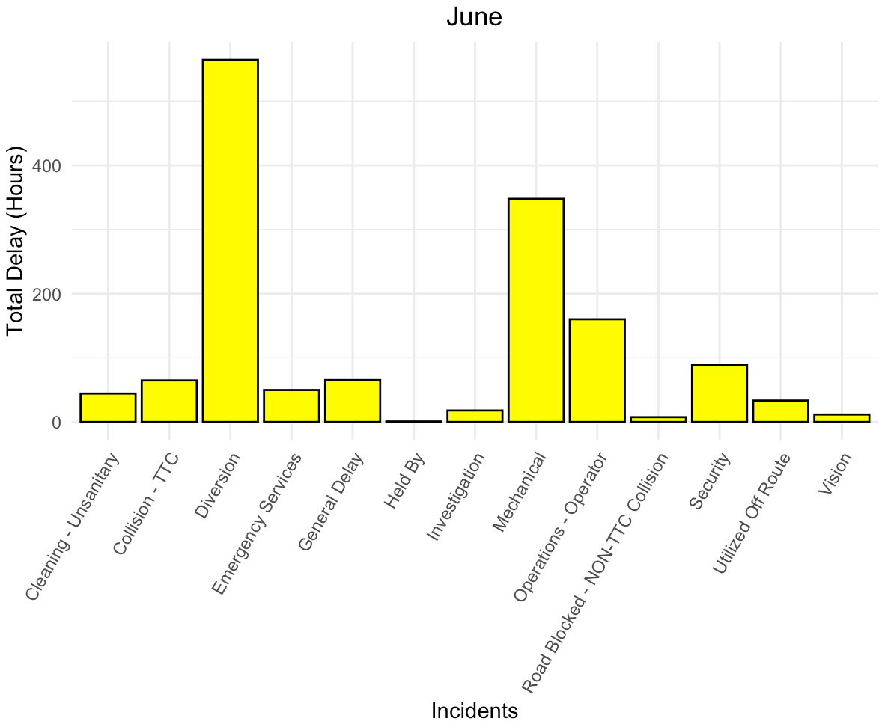
Causes of Delay by Month
In May Diversion caused the most delays followed by Mechanical and Operations - Operator.
In June Diversion caused the most delays followed by Mechanical and Operations - Operator.
Notes:
In the second quarter it appears that diversions is again the most common cause of delays. August experienced the most delays in terms of total delay time.

Slide 14
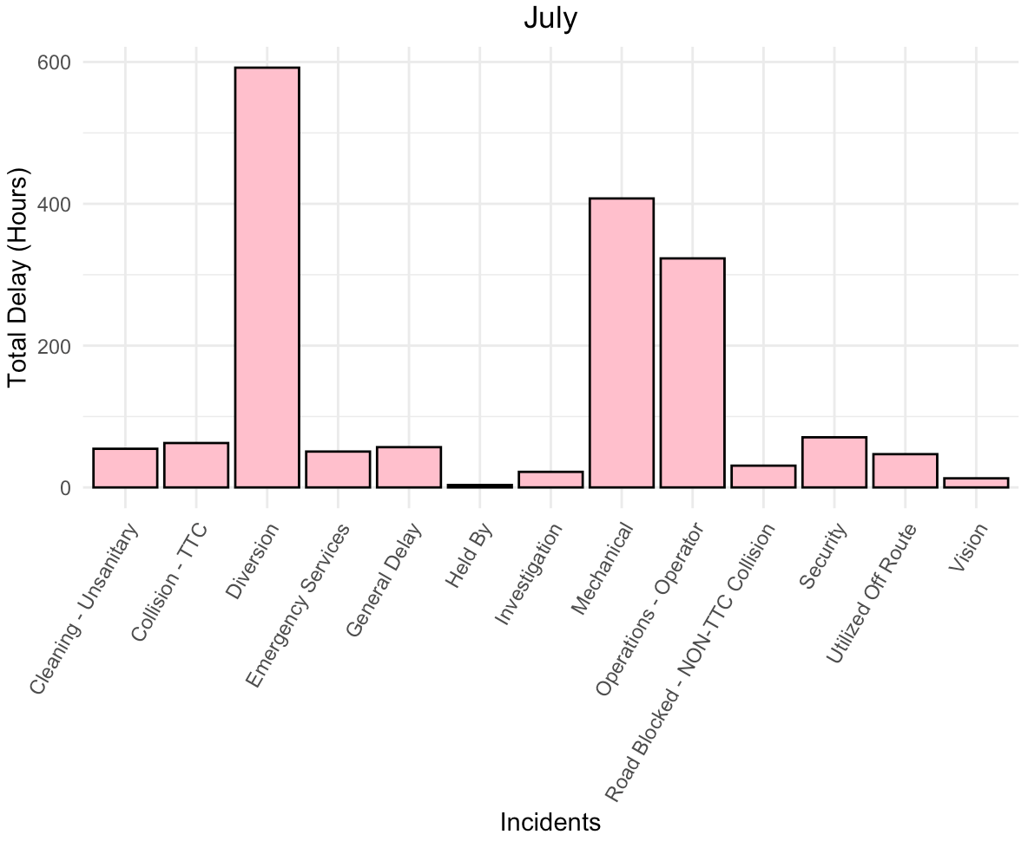
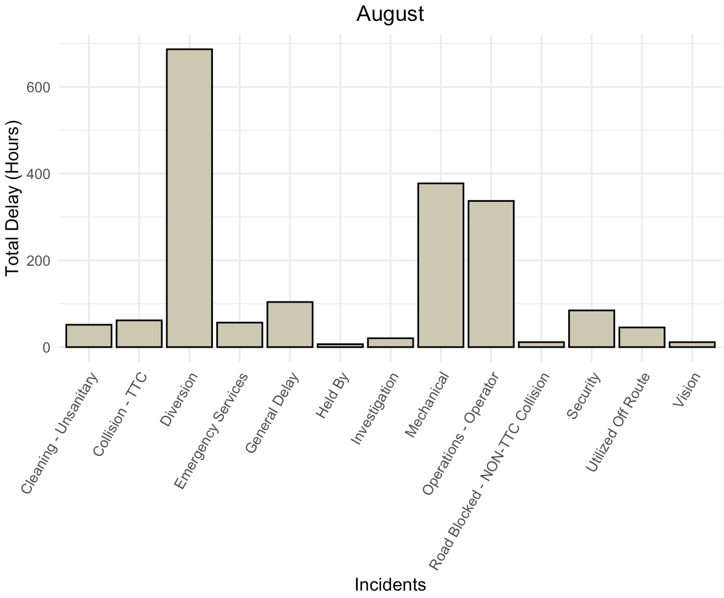
Causes of Delay by Month
In July Diversion caused the most delays followed by Mechanical and Operations - Operator.
In August Diversion caused the most delays followed by Mechanical and Operations - Operator.
Notes:
In the second quarter it appears that diversions is again the most common cause of delays. August experienced the most delays in terms of total delay time.

Slide 15
Conclusion
Key Takeaways
The most common reason for a delay is Mechanical and majority of the delays are of less than 125 minutes.
Diversion has the most delay time followed by Mechanical and Operation - Operator, indicating a need of improvement for route planning and staff training.
Finch West route experiences the most delays mainly caused by diversions, identifying areas for improvement.
West bound buses experience the most delays.
There are more delays during the weekdays as compared to weekends.
Delays fluctuate over the months, decreasing during February and April, and increasing during May and August.
Overall, it appears that Diversions and Mechanical problems causes the most delays, with delays being significantly high during January and August.
It appears that in January possibly harsh weather conditions contribute to increased delays. Whereas in August possibly construction and high influx of people due to tourism and school reopening contribute to increase delays.
It would be interesting to analyze specific times of the day to identify possible patterns causing delays.
It would be interesting to explore the ridership and TTC bus revenue data to understand how bus delay have an impact on the business.

Slide 16
Citation
Open Data Dataset. (2023, August 14). Open Toronto; Toronto Transit Commission. https://open.toronto.ca/dataset/ttc-bus-delay-data/
Kabacoff, R. I. (2022). R in action: Data analysis and graphics with R and tidyverse (3rd ed.). Manning Publications. ISBN 978-1-617-29605-5
Bluman, A. (2018). Elementary statistics: A step by step approach (10th ed.). McGraw Hill.ISBN 13: 978-1-259-755330.
Ayala, M. (2023). Module 3: Cleaning, Sampling, and Visualizing Data. Canvas. From https://northeastern.instructure.com/courses/160395/pages/module-4-%7C-lessons?module_item_id=9215204
Warning message: line appears to contain embedded nulls. (2014, June). Stack Overflow. https://stackoverflow.com/questions/24734911/warning-message-line-appears-to-contain-embedded-nulls
Complete themes — ggtheme. (n.d.). Ggplot2.Tidyverse.org. https://ggplot2.tidyverse.org/reference/ggtheme.html
Paula. (2020, February 15). Manhattan Free Template for Google Slides or PowerPoint Presentations. SlidesMania. https://slidesmania.com/manhattan-free-template-for-google-slides-or-powerpoint-presentations/
Kalyani, B. (2023, August). EDA on TTC Bus Delay Data 2022. Kaggle.com. https://www.kaggle.com/code/bahauddinkalyani/eda-on-ttc-bus-delay-data-2022
Gilson, P. J. (2019, November 21). TTC’s Worst Bus Route Was Just Revealed & It Has Over 1 Hour Worth Of Wait Times - Narcity. Www.narcity.com. https://www.narcity.com/toronto/ttcs-worst-bus-route-was-just-revealed-and-it-has-over-1-hour-worth-of-wait-times
Routes & Schedules. (n.d.). Www.ttc.ca. https://www.ttc.ca/routes-and-schedules/listroutes/bus

Slide 17
CREDITS.
Presentation Template: SlidesMania
Images: Unsplash
Please keep this slide or mention us and the other resources used in the footer of a slide.

