Slide 1

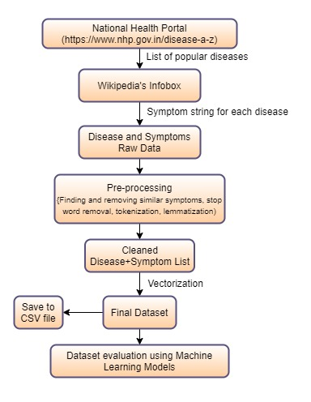
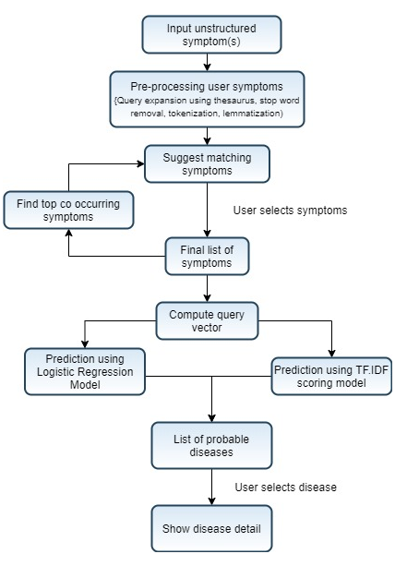
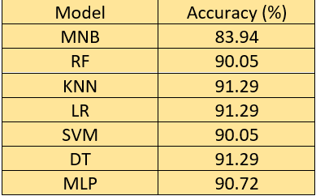
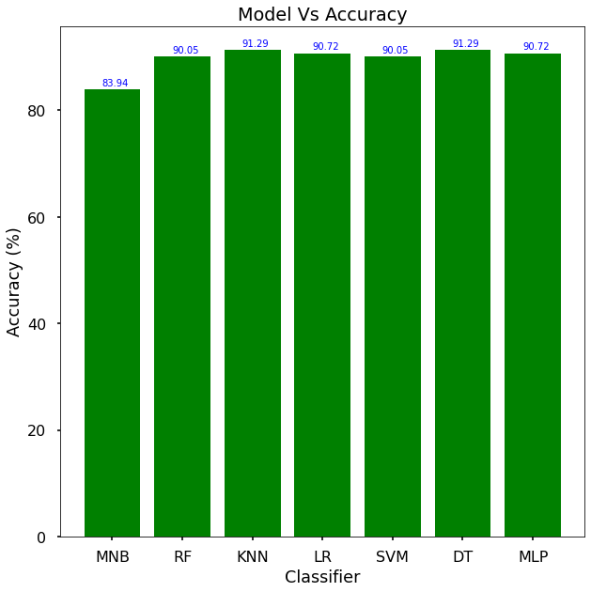
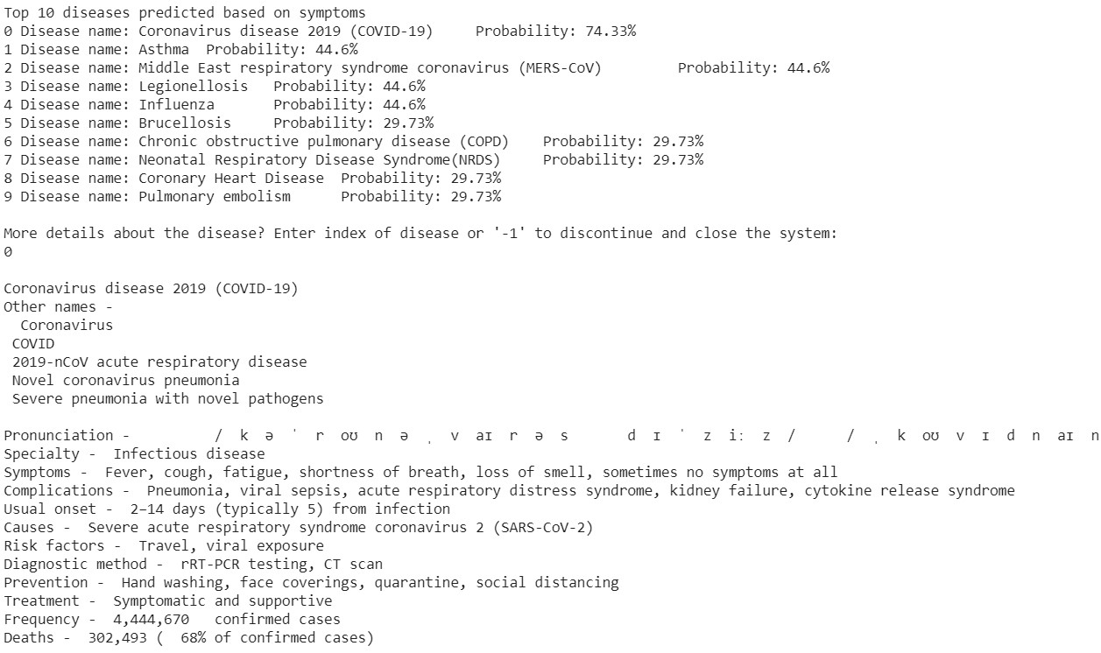
BACKGROUND
Machine Learning applications in healthcare and biomedical domain has lead to early disease detection and better diagnosis. This has enhanced patient care in recent times. Studies have shown that people take the help of the internet for any possible health-related issues. The problem with this approach is that the search engines provide bulk information in scattered format from which it is difficult to conclude.
The detection of disease based on disease is a complex game. Being unfamiliar with biological terms, the users feed the symptoms in non-technical or natural terms which add complexity in predicting diseases. The main objective is to develop a novel architecture that could accept and handle such type of user queries by employing techniques like query expansion using a thesaurus, synonym matching, and symptom suggestion that will allow disease prediction with greater accuracy based on user input. We have scraped data from the web and generated dataset which can be used in future research. Query search retrieval and matching are used in such problems to achieve prediction.
Table 1. Model accuracies
Various ML models were applied and the best accuracy was shown by DT & KNN classifier with an accuracy of 91.29% and best cross validation accuracy was shown by LR (89.1%).
Fig 4 shows the diseases predicted and the detailed information about a disease is shown to the user including the recommended treatments as well.
Disease Detection based on Symptoms
CONCLUSION
Nikunj Agarwal
Department of Computer Science & Engineering,
Indraprastha Institute of Information Technology, Delhi
Rahul Maheshwari
Department of Computer Science & Engineering,
Indraprastha Institute of Information Technology, Delhi
Anand Sharma
Department of Computer Science & Engineering,
Indraprastha Institute of Information Technology, Delhi
The adversity faced by a common user to seek medical help through some technical aid as an alternative to medical help has been solved to some extent by the proposed system. Proposed system achieved a high accuracy of more than 90% which itself makes the system trustworthy and reliable. Health care is one of the most important domain where machine learning can be used to carry out multiple tasks.
Scrapping dataset and increasing the volume of data also helped in making better predictions.
Furthermore sophisticated and highly tuned models can further increase the accuracy and making a much accurate model. Disease and Symptom data can also be incorporated from multiple sources such as CDC databases, UCI databases, etc. to increase the samples in dataset and make the system highly accurate.
Figure 1. Dataset Scraping and Evaluation
Figure 2. System Architecture
The results of the experiment shows that the models developed have high accuracy (>90%). High accuracy means that the
RESULTS
DATASET USED
The dataset of disease and their symptoms has been scraped from the web by running the Python script. The dataset consists of diseases and their symptoms, which are fetched from the following sources
Diseases: The list of diseases has been retrieved from the National Health Portal of India (https://www.nhp.gov.in/disease-a-z), developed and maintained by Centre for Health Informatics (CHI
Symptoms: The script uses the Google Search package to perform searching and fetch the disease's Wikipedia page among the various search results obtained. The HTML code of the page is processed to fetch the symptoms of the disease using the 'infobox' available on the Wikipedia page.
The scraping script fetches over 261 different diseases that form the label and 500+ symptoms. The symptoms are then pre-processed to remove similar symptoms with different names. The dataset, after preprocessing and multiplication, contains around 8835 rows with 489 unique symptoms. Figure 1 shows the systematic flow of steps involved in data scraping.
PROBLEM DEFINITION
The paper proposes a model in which the user can input unstructured symptoms or select the symptoms suggested by the system, based on which, a list of probable diseases is provided back to the user. Further, the user can select any of the output diseases to get more information about its other symptoms, causes, diagnosis, possible treatment, etc. to help the user better understand the disease and current medical condition. The system also suggests other symptoms based on the ones that the user has input.
REFERENCES
Dr. D. P. Shukla Kumar Sen, Shamsher Bahadur Patel. 2013. A data mining technique for prediction of coronary heart disease using neuro-fuzzy. International Journal Of Engineering And Computer Science, 2:2663–2671.
Md Tahmid Rahman Laskar, Md Hossain, Abu Kamal, and Nafiul Rashid. 2016. Automated disease prediction system (adps): A user input-based reliable architecture for disease prediction. International Journal of Computer Applications, 133:24–29.
Ryan McDonald Slav Petrov, Dipanjan Das. 2013. A universal part of-speech tagset. Proceedings of the Eight International Conference on Language Resources and Evaluation (LREC 2012).
https://symptoms.webmd.com/default.htm. Webmd’s symptom checker. Accessed: 2020-05-15.
https://wordnet.princeton.edu/. Princeton university’s wordnet. Accessed: 2020-05-15.
https://www.nhp.gov.in/disease-a-z. National health portal(nhp), developed and maintained by centre for health informatics (chi). Accessed: 2020-05-15.
https://www.thesaurus.com/. Thesaurus. Accessed: 2020-05-15.
Elhadad N Friedman C Markatou M. Wang X, Chused A. 2008. Automated knowledge acquisition from clinical narrative reports. AMIA Annu Symp Proc. 2008 Nov 6;2008:783-7. PMID: 18999156; PMCID: PMC2656103.
Yi Zhang and Bing Liu. 2007. Semantic text classification of disease reporting. Proceedings of the International ACM SIGIR Conference, 2007.
Figure 3. Model Accuracy
PROPOSED SOLUTION
CONTACT
On a general note, the system prompts the user to enter symptoms based on which model predicts diseases with the highest probability and scores. Figure 2 describes the process of disease prediction from user input symptoms. The following subsections discuss each module in detail.
Nikunj Agarwal, Rahul Maheshwari, Anand Sharma
Indraprastha Institute of Information Technology, Delhi
Okhla Industrial Estate, Phase III, Near Govindpuri Metro Station, New Delhi, Delhi 110020
Email: nikunj19093@iiitd.ac.in, rahul19027@iiitd.ac.in, anand19059@iiitd.ac.in
Figure 4. Disease Detection Sample O/p

