Slide 1

Product
Recommendation System
Vignan Pallemeedi
Teja Subbanna
Roshan Mummadi
Varshitha Edla

Slide 2




About Us
Viganan Pallemeedii Teja Subbanna Roshan Mummadi Varshitha Edla
Business Analyst Data Analyst Data Scientist Software Developer

Slide 3
Project Objective
Building recommendation system for products on an ecommerce website like Amazon, Flipkart and many more.

Slide 4
Approach..
Predicting the products, based ratings a user might have given to a specific item.
These ratings will then be ranked and are used to predict the most suitable products.

Slide 5
Business Questions
How can we optimize our recommendation
system to boost sales and revenue?
How can we increase customer engagement and
retention through personalized recommendations?

Slide 6
Proposed Answers
Combine content-based and collaborative filtering techniques,utilizing A/B testing to refine algorithms and improve performance metrics like click-through rates and conversion rates
Implement machine learning algorithms to analyze customer behavior and purchase history, generating personalized product suggestions tailored to individual preferences.

Slide 7
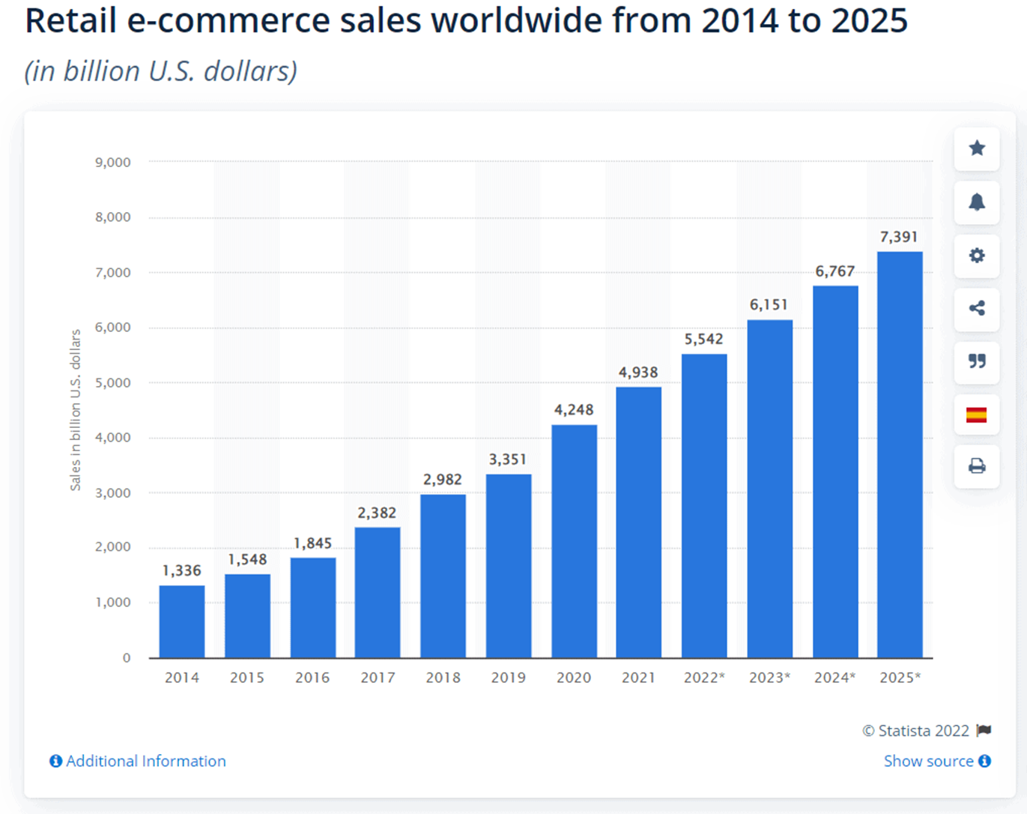
Statistics

Slide 8
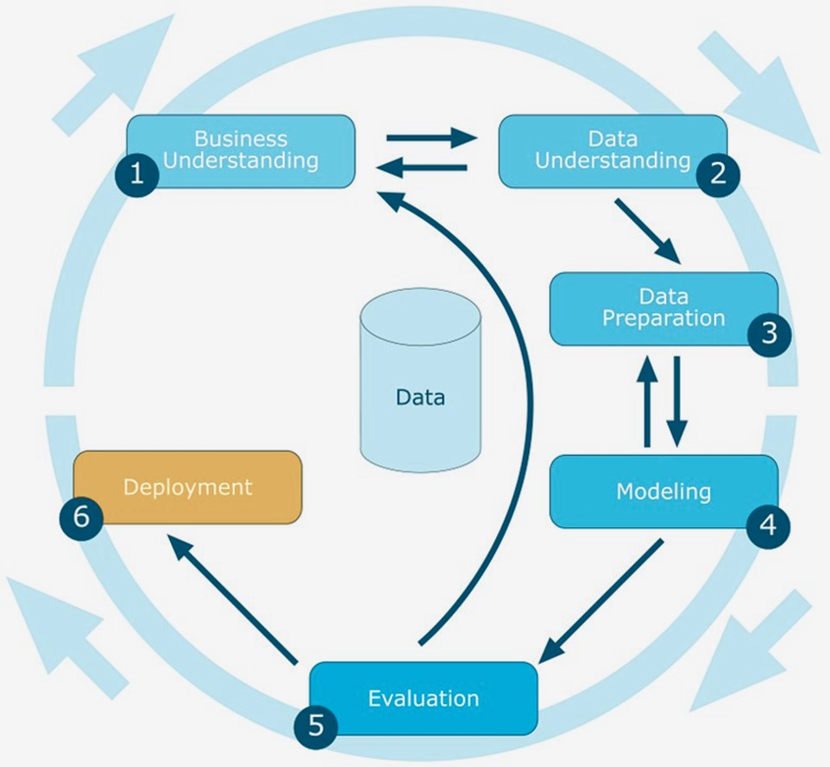
Our Approach Using Crisp-DM

Slide 9
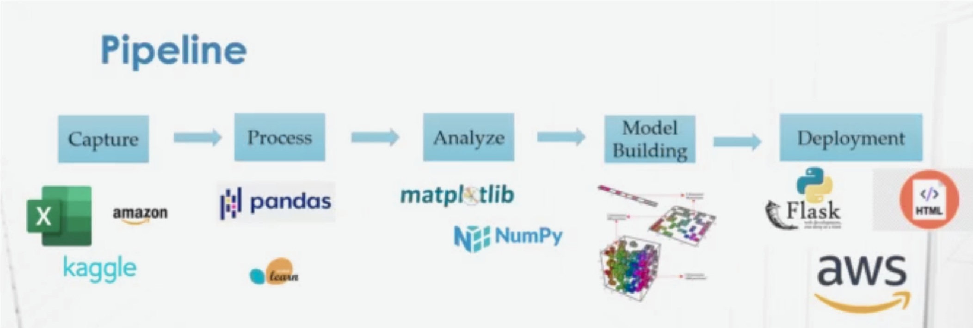
Our Approach Using Pipeline

Slide 10
Thank You

