Slide 1
„The poor and the middle class work for money , the rich have money work for them” - Robert T. Kiyosaki

Slide 2
RICH DAD
POOR DAD
Bartek Mumot

Slide 3
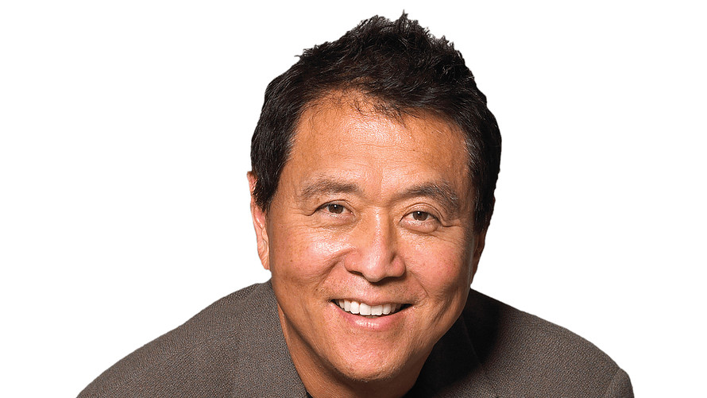
Author
Robert T. Kiyosaki (born April 8, 1947) is an Japanese American investor, businessman, self-help author and motivational speaker

Slide 4
“Having two dads offered me the choice of contrasting points of view : one of a rich man and one of a poor man” - Robert Kiyosaki

Slide 5
CONTRAST
POOR DAD
Get job in good company
The love of money is the root of all evil
I can’t afford it
Play safe
Works for money
RICH DAD
Create or buy a company
The lack of money is the root of all evil
How can I afford it ?
Learn to manage risks
Money works for him

Slide 6
It is not important how much money you make ,it is how much money you keep.Understand the difference between assets and liability.

Slide 7
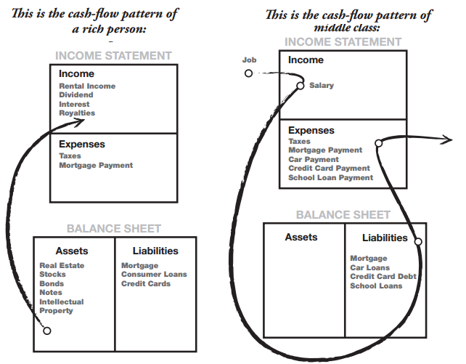

Slide 8
Work to Learn, Don’t Work for Money
Learn skills like PR, Marketing and advertising
Take a second job if it means learning more.

Slide 9
Overcoming Obstacles
Five Obstacles to Financial Independence
1. Fear
2. Cynicism
3. Laziness
4. Bad Habits
5. Arrogance

Slide 10
Why you should read ?
Understand the idea of money
Broaden your vision
Redefine your views about money
Get new ideas for a business

Slide 11
Thank you
„Rich dad poor dad” - Robert T. Kiyosaki

