Slide 1

melodyne
Omri cundangan

Slide 2
Celemony Software
1997
Peter Neubäcker begins developing the Melodyne concept
2000
Celemony is founded
2001
Melodyne is presented for the first time at the Winter NAMM
2007
2016
2009
2011
2011
Single-track version of Melodyne is released as a plug-in
Melodyne editor with DNA Direct Note Access™ is released
Release of Capstan software for removing wow and flutter
Celemony & Presonus present the ARA Audio Random Access™ interface extension
2012
Celemony wins Technical Grammy Award
Melodyne 4 with Multitrack Note Editing, Sound Editor and DNA-based temp detection
Based in Munich, Germany
~25 employees
Two main products:
Melodyne
Capstan
Helped create ARA extension for DAWs

Slide 3
What is Melodyne??????????!
Very expensive software/DAW plugin
Vocal performance tuning
Refine vocal performances by modifying subtleties in the performance
Adjust pitches, timings, modulation of individual notes
Polyphonic instrument performance tuning
See individual notes being played
Adjust, omit, add individual notes of recordings
General recording adjustment/analysis
Equalize/adjust tempo across recording
Extract scales, keys, notes from recorded audio, detect BPM etc.
Made for musicians, intuitive note-based interface

Slide 4

Raving Reviews!!!
“Using Melodyne, you quickly realize it is just as much an instrument as it is a tuning tool.”
- Renowned producer
“Melodyne is hands down the best software for manipulating pitch and timing.”
- User of melodyne
“After using Melodyne it doesn't feel like it's a processed track. It feels like the original track – just been taken to a good place.”
- Another producer

Slide 5
Competitors/Alternatives
Auto Tune Pro
better at quick vocal tuning
works in live environments
better for noticeable artistic effects
Waves Tune
Good pricing
Newtone
Good for FL Studio users
Flex Pitch
Good for Logic Pro users
None of the above support polyphonic instruments editing!

Slide 6
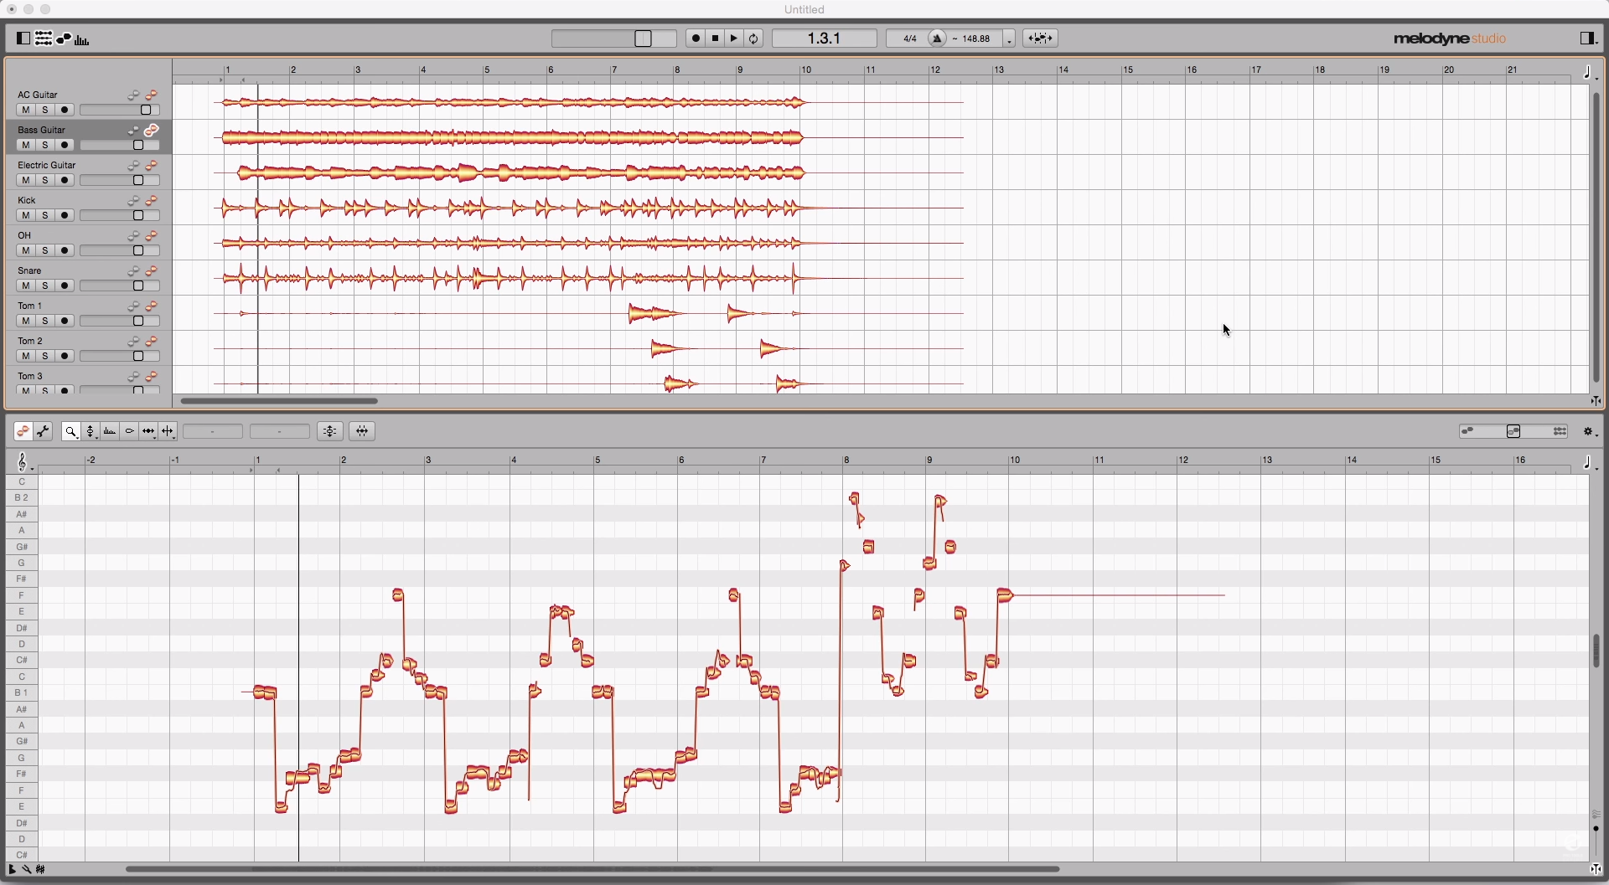
DEMO !!!!!!!!!!!

Slide 7
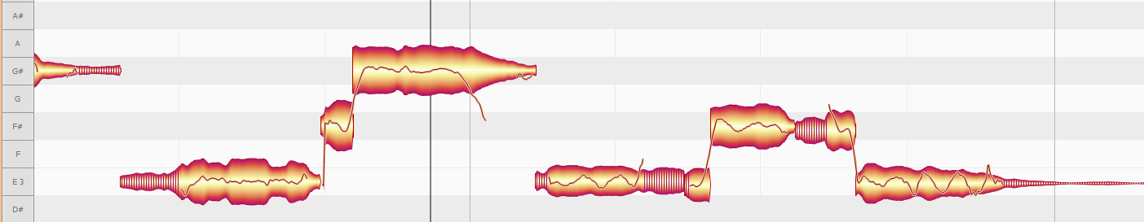
Tools
Pitch: Pitch center, pitch transitions
Vibrato: Intensity/direction of vibrato and trills
Pitch drift: Intensity/direction of pitch drift
Formants: Shift formants, control formant transitions
Sibilants: Attenuate/emphasise sibilants, treated separately from pitch
Amplitude: Control amplitude of notes, amplitude transitions, muting
Timing: Control position, length, and quantization of notes
Time handles: Vary pace of developments within a note
Attack speed: Control starting transients and percussiveness of notes
Note separation: Insert, delete, move note separations

Slide 8
Functions
Sound Editor: Change timbre by adjusting balance between partials
Tempo detection/Tempo editor: Map & edit tempos changes within a recording
Save audio notes as MIDI
Scale correction: Move or quantize notes in accordance with a selected scale
Scale Detective: Extract scales from audio
Macros for pitch and timing: Automatic intelligent correction of notes
Quantize to reference track: Carry over timing of one track to another

Slide 9
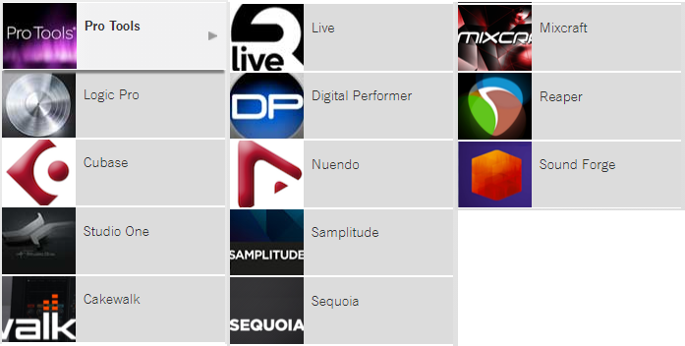
DAW compatibility

Slide 10
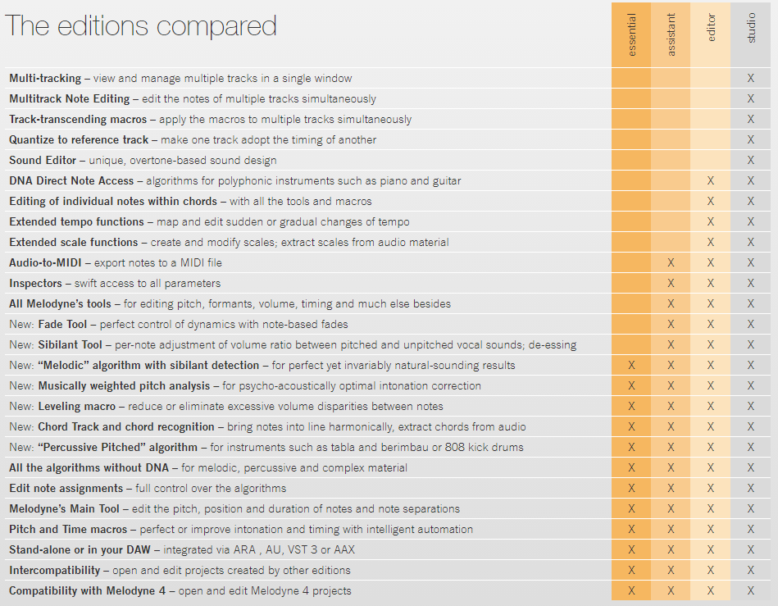
Pricing

Slide 11
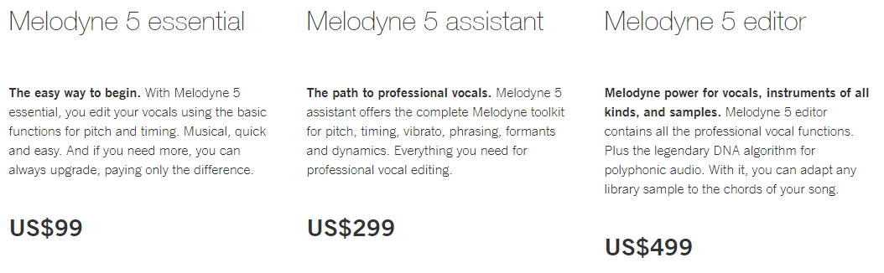
Pricing

Slide 12
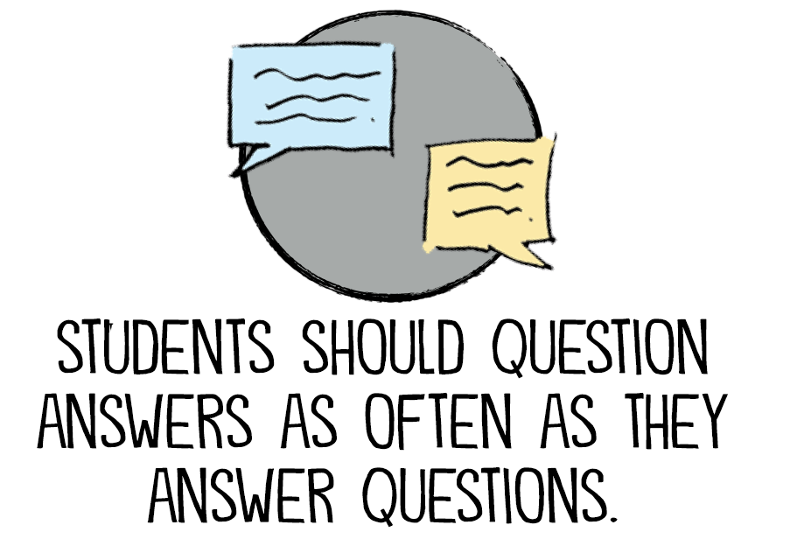

Q U E S T I O N S ? ? ? ? ? ! ! ! ! !

