Slide 1
LightInject for Asp.Net Core
Shawn Vause
Senior Web Applications Engineer @ ZOLL LifeVest
January 10, 2017

Slide 2
Overview
Inversion of Control
Out of the Box
Replacements for Asp.Net Core
LightInject
Questions

Slide 3
Inversion of Control
SOLID Principles
Mechanism/Technique
Dependency instances bound at runtime
Instances/implementations of abstractions not known at compilation time
Loose coupling of dependencies
Maintenance/Modification
Testability
S – Single Responsibility
O – Open/Closed
L – Liskov Substitution
I – Interface Segregation
D – Dependency Injection
Notes:
Mechanism/Technique
Helps us accomplish SOLID principle of dependency injection

Slide 4
Out of the Box
Feature | IServiceProvider
Constructor Injection | +
Framework Provided Services (MVC, Entity Framework, Identity, etc.) | +
Transient Lifetimes | +
Singleton Lifetimes | +
Scoped Lifetimes | +
Named Type Injections | -
Explicit use of resolved constructor parameters | -
Registration Fallbacks | -
Custom Lifetimes | -
Property Injection | -
More… | -

Slide 5

Replacements for Asp.Net Core
AutoFac
Simple Injector
StructureMap
LightInject

Slide 6
LightInject
Feature | IServiceProvider | LightInject
Constructor Injection | + | +
Framework Provided Services (MVC, Entity Framework, Identity, etc.) | + | -
Transient Lifetimes | + | +
Singleton Lifetimes | + | +
Scoped Lifetimes | + | +
Named Type Injections | - | +
Explicit use of resolved constructor parameters | - | +
Registration Fallbacks | - | +
Custom Lifetimes | - | +
Property Injection | - | +
More… | - | +
Notes:
We get all the robustness we are used to in an IOC library
It is a lot like Unity which per Jeff Fritz that project/team has disbanded at MS
Work on-going in open source to try and port but seems to have stalled

Slide 7
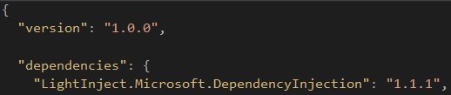
LightInject
Step 1 – project.json

Slide 8

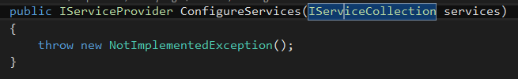
LightInject
Step 2 – Startup.cs

Slide 9
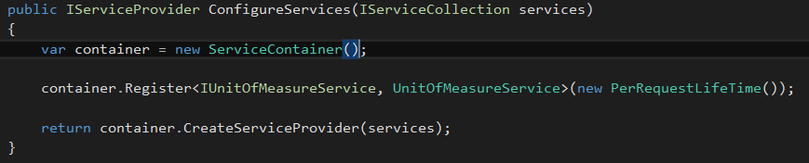
LightInject
Step 3

Slide 10
LightInject
Recommendations
Strongly consider a project specific to dependency injection activities
Build extension method classes for registrations
Out of box strengths in conjunction with full-fledged IOC library (best of both worlds)
Ex: All the framework registration activities
Notes:
Recommendations
Strongly consider a project specific to dependency injection activities
Build extension method classes for registrations
**BOTH KEEPS STARTUP.CS SIZE DOWN**
Out of box strengths in conjunction with full-fledged IOC library (best of both worlds)
Ex: All the framework registration activities
**EXAMPLES TYPICALLY WORK WITH OUT OF BOX IOC, LEVERAGE THAT REMEMBERING LightInject etc BOLT ON TO OUT OF BOX**

Slide 11
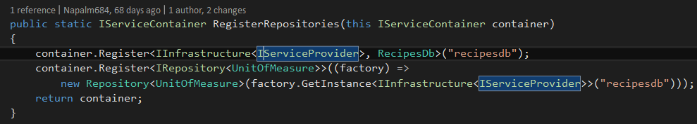
LightInject
Notes:
We have all seen the above registration which would give us the ability to inject a dbcontext to a consumer
DbContext is inherently difficult to test or mock out
Repositories introduced to get around this/make life easier
Generic Repositories reduce duplication of “standard” database code
What if my application uses multiple database I don’t want to couple the repository just to RecipesDb in this case.
I can use named registrations to have multiple registrations for a single type and tell the repository for a given registration what database to use that is registered in the container.

Slide 12
References
Sample Project
https://github.com/napalm684/ReciPiBookCore
LightInject
https://github.com/seesharper/LightInject.Microsoft.DependencyInjection

Slide 13
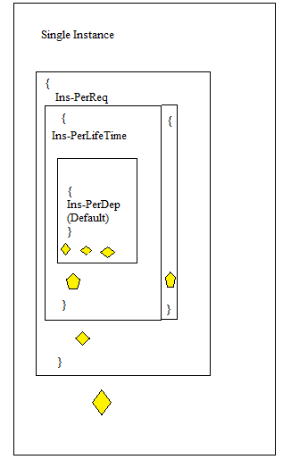

Slide 14

Questions?
Twitter ->
@SuperVause
Blog ->
http://svause.azurewebsites.net/

