Slide 1


Joins
CSCi 232
Alvin Lam

Slide 2
Disambiguation of multiple tables
So far we have mainly only been using a single table when crafting our queries.
Ex) SELECT first_name FROM accounts;
We can clearly tell that the attribute "first_name" comes from the table accounts
With joins we will be introducing multiple different tables, in some cases we will have common attribute names.
To distinguish between which attribute belongs to which table we can use the following syntax:
<table name>.<attribute name>
Ex) SELECT accounts.first_name FROM accounts;
The logic here is the same as above, however we clearly know which table the attribute first_name comes from if we were to introduce another table.

Slide 3
Joins
What is a "Join"
The keyword JOIN will allow us to combine columns from tables based on the values of some common column.
Why use joins?
When constructing our tables it's good practice to have a strong separation of data points leading to our data possibly being scattered across multiple tables.
Tables usually will hold relationships with other tables (one-one, one-many many-many), joins will allow us to utilize these relationships to extract the desired data points we might want to look at.
Note: Primary – foreign key relationships are the most common column pairs to join on.

Slide 4
Inner JOIN Syntax
Keyword(s): [INNER] JOIN
Syntax:
SELECT <attributes> FROM <table1> [[AS] alias]
[INNER] JOIN <table2> [[AS] alias]
<join condition> […]
Where join condition is either:
ON <attribute-1> = <attribute-2>
USING(<attribute>)
The attribute must be identical in both tables

Slide 5
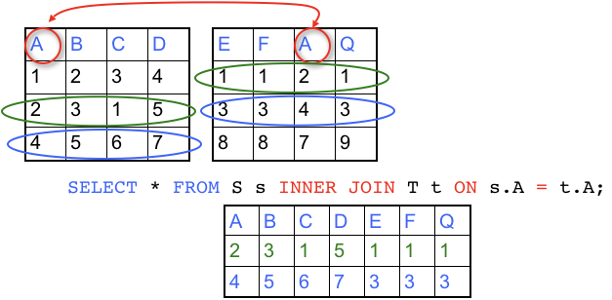
Inner JOIN Example
S
T
Assume we have a table S and T.
Note in both S and T we hold a common attribute A, using this common attribute we can JOIN the columns of these two tables into one.
An inner join will find rows that have the same values for the specified attribute (A in this example) and combine the columns from both tables into one row.

Slide 6
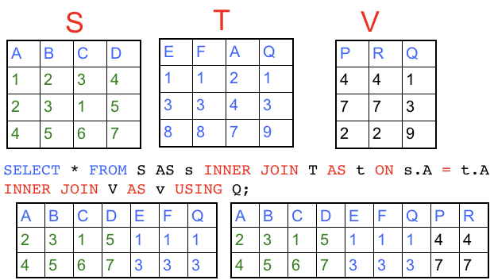
Joining multiple tables (3 or more)
You are able to join multiple tables in one query (as much as you want).
Joins will be evaluated one at a time (2 tables joining together), each join will generate a intermediate result table to be used in the next join if applicable.

Slide 7
Inner JOIN on non-equi-joins
In most cases we usually join on primary – foreign key relationships, because of this we usually see the following pattern:
[…] JOIN <table-2> ON <attribute-1> = <attribute-2>
We can also use any other operator besides the = operation when joining on attributes.
Ex) […] JOIN <table-2> ON <attribute-1> <= <attribute-2>
Ex) […] JOIN <table-2> ON <attribute-1> != <attribute-2>
When using a operation that isn't =, be mindful of the attributes.
You should ensure the data types are the same
Be careful of NULL values

Slide 8
Cartesian product
Recall:
Set = arbitrary collection of items called elements
Cartesian product of two sets X and Y = set of all ordered pairs constructible using one from the first set and one from the second
S x T = {(x,y) | x ∈ X and y ∈ Y}
S x T = The cartesian product of sets S and T
(x,y) = Describes a tuple of x,y. (resulting tuple)
| = "Such that"
x ∈ X and y ∈ Y = x is a element from set X and y is a element from set Y
Ex) A = {1,2,3}, B = {c,a,t}
A × B = {(1,c),(2,c),(3,c), (1,a),(2,a),(3,a), (1,t),(2,t),(3,t)}

Slide 9
Cartesian product
The cartesian product can be constructed from any number (n) of sets.
The cartesian product of n sets consist of ordered n-tuples.
S1 × S2 × …× Sn = { (x1, x2,…, xn) | xi ∈ Si for i = 1, 2, …, n}
Ex) A = {1,2,3}, B = {c,a,t}, C = {p,q}.
A × B X C = {(1,c,p), (2,c,p), (3,c,p), (1,c,q), (2,c,q), (3,c,q), (1,a,p), (2,a,p), (3,a,p), (1,a,q), (2,a,q), (3,a,q), (1,t,p), (2,t,p), (3,t,p), (1,t,q), (2,t,q), (3,t,q)}

Slide 10
Cross join syntax
Keyword: CROSS
Syntax:
SELECT <attributes> FROM <table1> [[AS] alias]
CROSS JOIN <table2> [[AS] alias]
Note: When using doing a cross join of two tables S and T, the amount of rows in the resulting table will be
(Total rows in table S) x (Total rows in table T).
Be careful of running cross joins on tables with large amounts of rows!

Slide 11
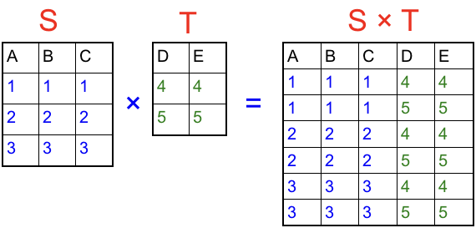
Cartesian product of tables
Assume we have two tables S and T.
The cartesian product of S x T is simply all rows in one table being paired up with every row in the other table.
Query:
SELECT s.A,s.B,s.C,t.A,t.E FROM S s CROSS JOIN T t;

