Slide 1
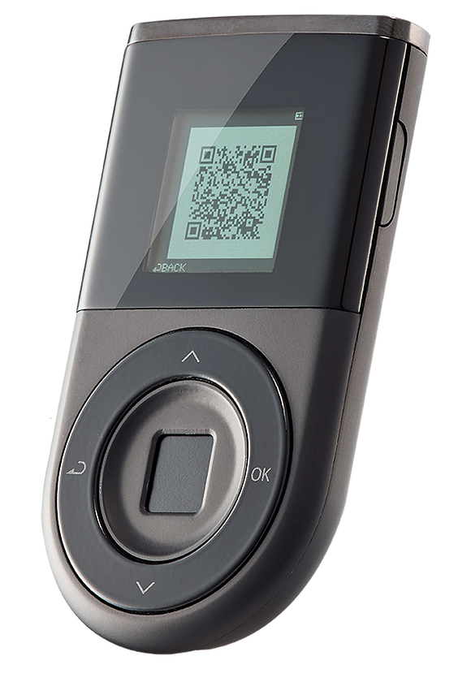

RESILIENT
WALLETS
DELIVERING TRUSTED CONNECTIVITY

Slide 2

Overview
Company Overview
Cryptocurrency Adoption
Hardware Wallet History
Secure Multiparty Computation
User Experience

Slide 3
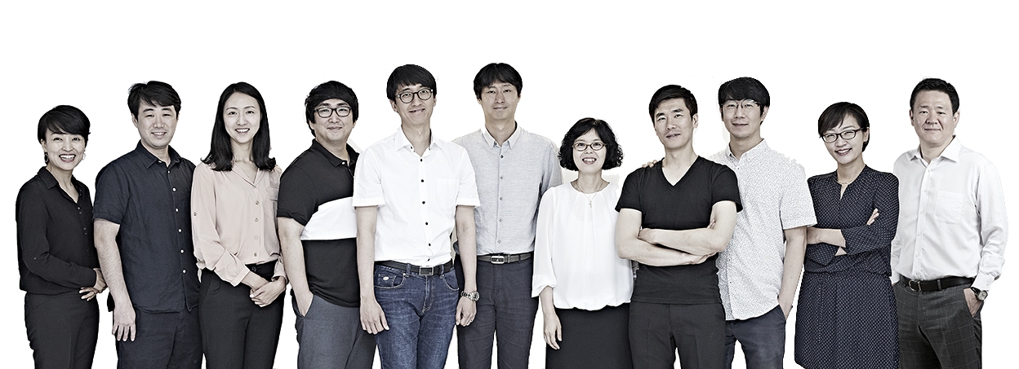
COMPANY OVERVIEW
Pioneers of the world’s first dual-interface USIM smart card.

Slide 4

CRYPTOCURRENCY ADOPTION
Cryptocurrencies will
create “a more sustainable,
inclusive and prosperous
future”.
Mark Carney
Governor of the Bank of England
Image courtesy the Bank of England
Type to enter a caption.

Slide 5
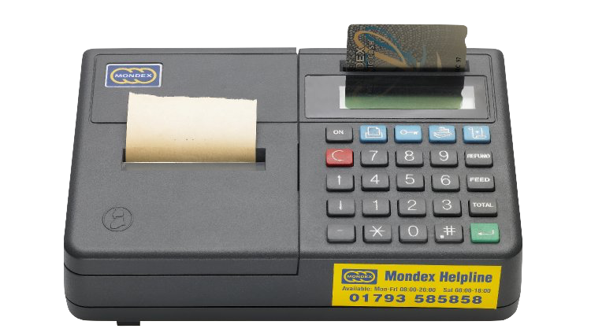
HARDWARE WALLET HISTORY
Tamperproof smart cards for digital currencies are not new.
Image courtesy the Bank of England
Image courtesy British Museum

Slide 6
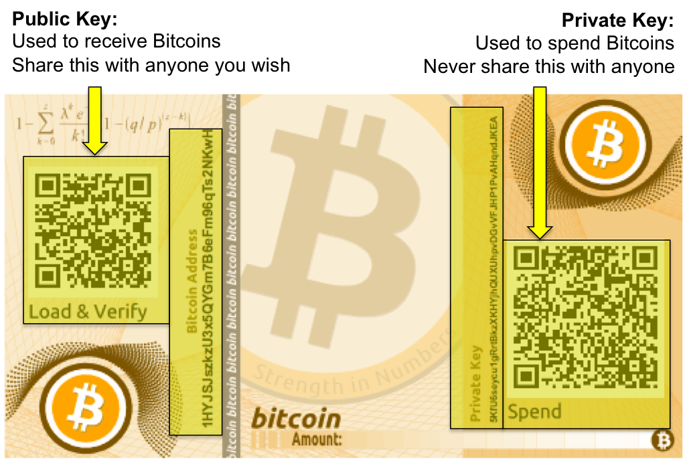
HARDWARE WALLET HISTORY
Paper wallets are cold storage.
Image courtesy the Bank of England
Image courtesy 99Bitcoins

Slide 7
SECURE MULTIPARTY COMPUTATION
Biometric
Wallet
Private Key
Mobile
Phone
EXEXc
Trusted
Party

Slide 8
SECURE MULTIPARTY COMPUTATION
Wallet-level sMPC is more scalable.
BITCOIN
ETHEREUM
ALGORAND
TAPROOT
?
?
Network Level sMPC
Wallet Level sMPC
D’CENT Biometric Wallet
(Adds Another Layer of Resilience)

Slide 9
DILEMMA
USABILITY MATTERS
SECURITY OR CONVENIENCE
Mass adoption of cryptocurrencies will occur when wallets are über convenient and simultaneously offering decent security.

Slide 10
RESILIENT
WALLETS
DELIVERING TRUSTED CONNECTIVITY

