Slide 1
AMS 1
A reliable, fair system of judging professional dance competitions, by presenting judges with the tools necessary to augment and inform the judging process.
By Team 1
Muna Aghamelu
James Zhong
John Backwell

Slide 2
GATHERING USER REQUIREMENTS
Our chosen approach to gather user requirements was a semi-structured interview. This enabled us to explore more into what a user may want by presenting open questions. Here is a summary of the user requirements we gathered from an experience ballroom dancer and a judge under the employment of AMS.
Do you think the current judging system is fair?
Yes and No. Yes because I trust AMS to employ expert dancers but sometimes I feel as though I have executed a finishing dance move better than my counterpart but I still gain a lower score overall.
If I was to say we can create a model that would judge how well you have danced, without any human interaction, what would you think?
I would be slightly worried. However I do see the positives; it will eliminate human bias. I may be the best dancer but due to my facial expression a judge could possibly think less of me… so I see it as a good thing.
You mention facial expression, so do you believe they’re certain parts of the body that define what it means to be a good ballroom dancer?
Yes. It’s all in the sharpness. The pointed toes, the elegant sway of our hands. Judges watch out for how in sync we are with our dance partners. To be a good ballroom dancer you must be one with your partner.
Please tell us about yourself, how long have you been a ballroom dancing judge?
I have been a qualified judge for 5 years of my life. My job is straightforward most of the time, however it can be quite hard when having to compare different dancers and fine tuning the smallest details e.g. is their posture straight enough, were their hand movements in sync with the music. It’s easy to pick out a good dancer, its quantifying how well they dance that makes my job quite difficult.
Have you ever used an app before?
I’m 52, not an old woman. I love using devices, I think this new age of technology is quite interesting. However, I know my peers who aren’t as tech-savvy may have some difficulty using an App. So the app, or whatever you are trying to create, must be really easy to use.
What do you look out for when you judge dancers?
Prior to a dancer coming onto the stage, I have a list of things I’m looking out for. Are they smiling? Are they in tune with the music? Have they included any complex spin moves? It all just depends on the specific routine really.
Ballroom Dancer response
Experienced Judge response

Slide 3
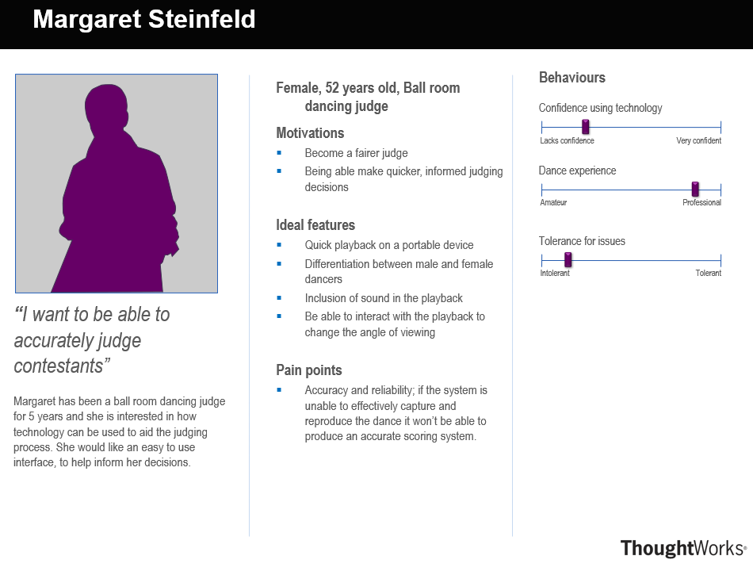
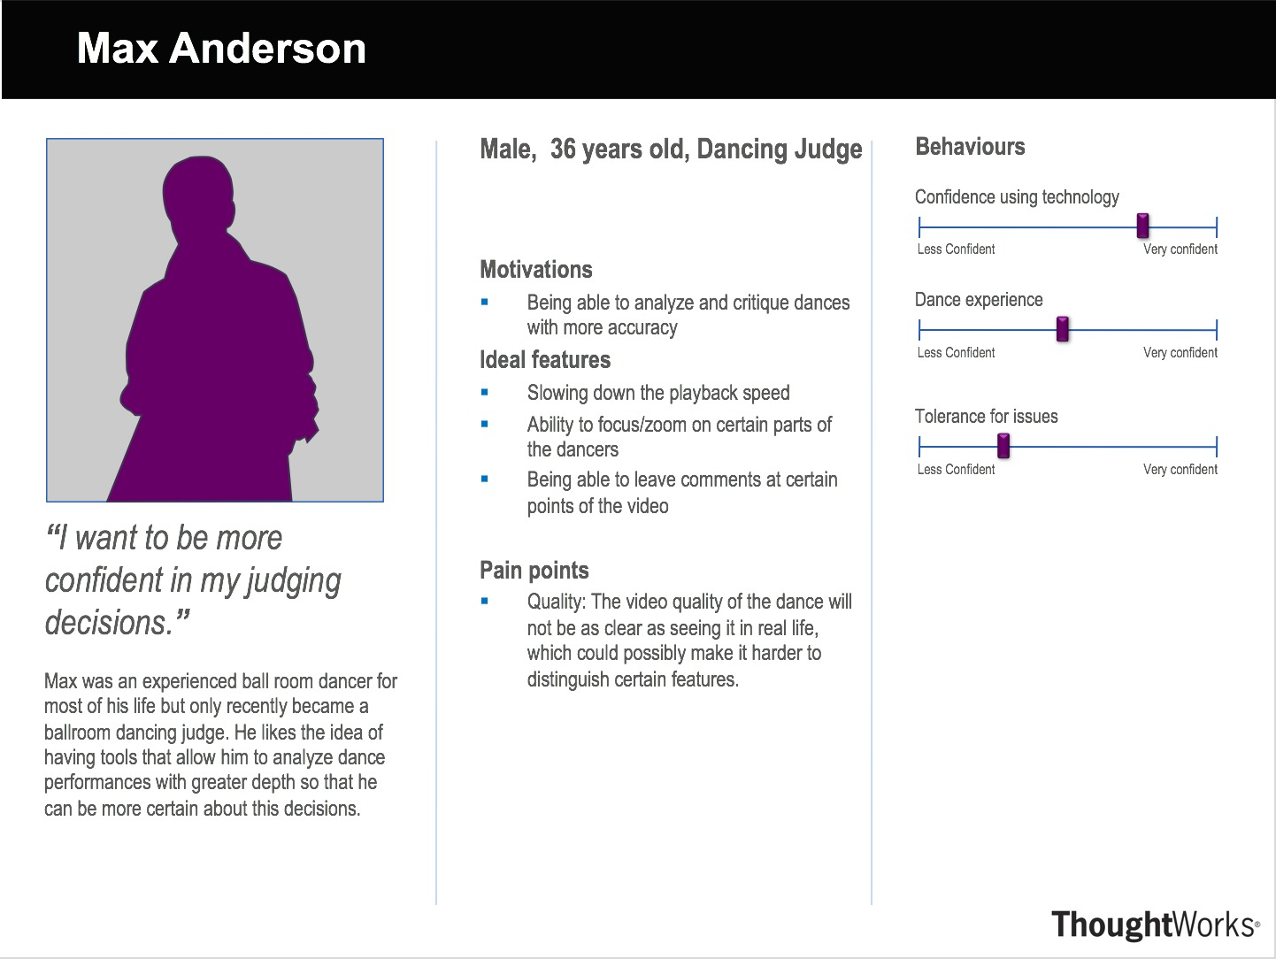
PERSONAS
SCENARIOS
Margaret Steinfeld is a 52 year old ballroom dancing judge, with 5 years of experience. After a long day of watching many different ballroom dancers she needs to make the final decision on how everyone participated before she can head home; her eyes are quite tired, so her concentration has deteriorated slightly. Despite this, she needs needs to make accurate, informed decisions. She takes out her Ipad provided by AMS and opens up the app ‘Judging Aid’. ‘Judging Aid’ enables her to rewatch specific model representation of dancers. The fact that the representation of the dancers is simply schematic allows her to focus on the exact aspects of the dance she is looking for. She is able to click parts of the model to make notes and award specific scores for the execution of a certain move. The app has large icons and a help menu so she can reference anytime she is confused about a certain functionality. She uses ‘Judging Aid’ to make a fast, reliable decision on who scored the highest score in today’s events. She goes home content with her decision.
Max Anderson is a 36 years old ballroom dancing judge. He is an experienced dancer himself but only recently became a professional judge. His skills are put to the test as he judges the first wave of new competitors that day. After watching through a series of dances one after the other, he takes a quick look at the marks he gave and believes that he did good job but cannot help but feel a little bit of uncertainty due to his lack of experience. Fortunately, he decides to take out his ipad and open up the ‘Judging Aid’ app for help. He selects one of the videos which he was unsure about and watches through the playback. He remembers that the footwork was particularly hard to see at the time so he zooms in on the feet and plays it on a slower speed, utilizing the 360 view to give him a better look at the technicalities. Watching the video clears any doubts he had and he submits his marking feeling satisfied and confident with his decision.

Slide 4
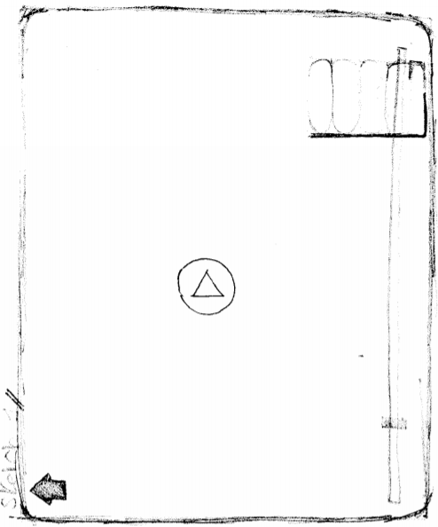
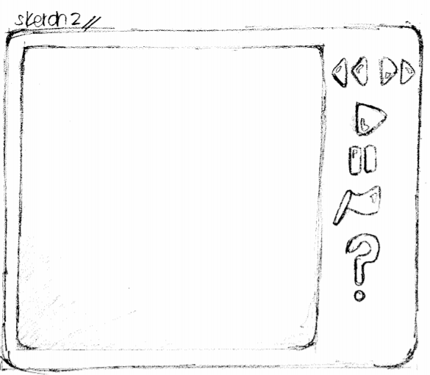
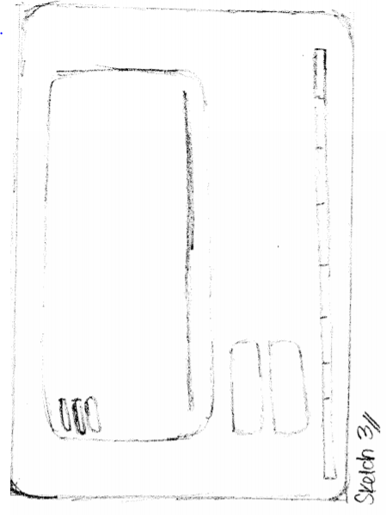
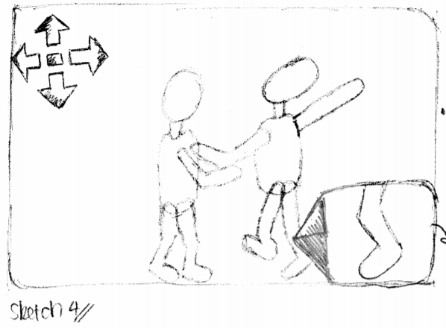
SKETCHES
They function as design alternatives which we would subsequently use to approach the users for their feedback.
‘Drop up’ Menu to reduce blocking the main model view
Gamified approach, large buttons
Model only takes up part of screen, leaves space for additional functionalities
Aspect zoom functionality

Slide 5
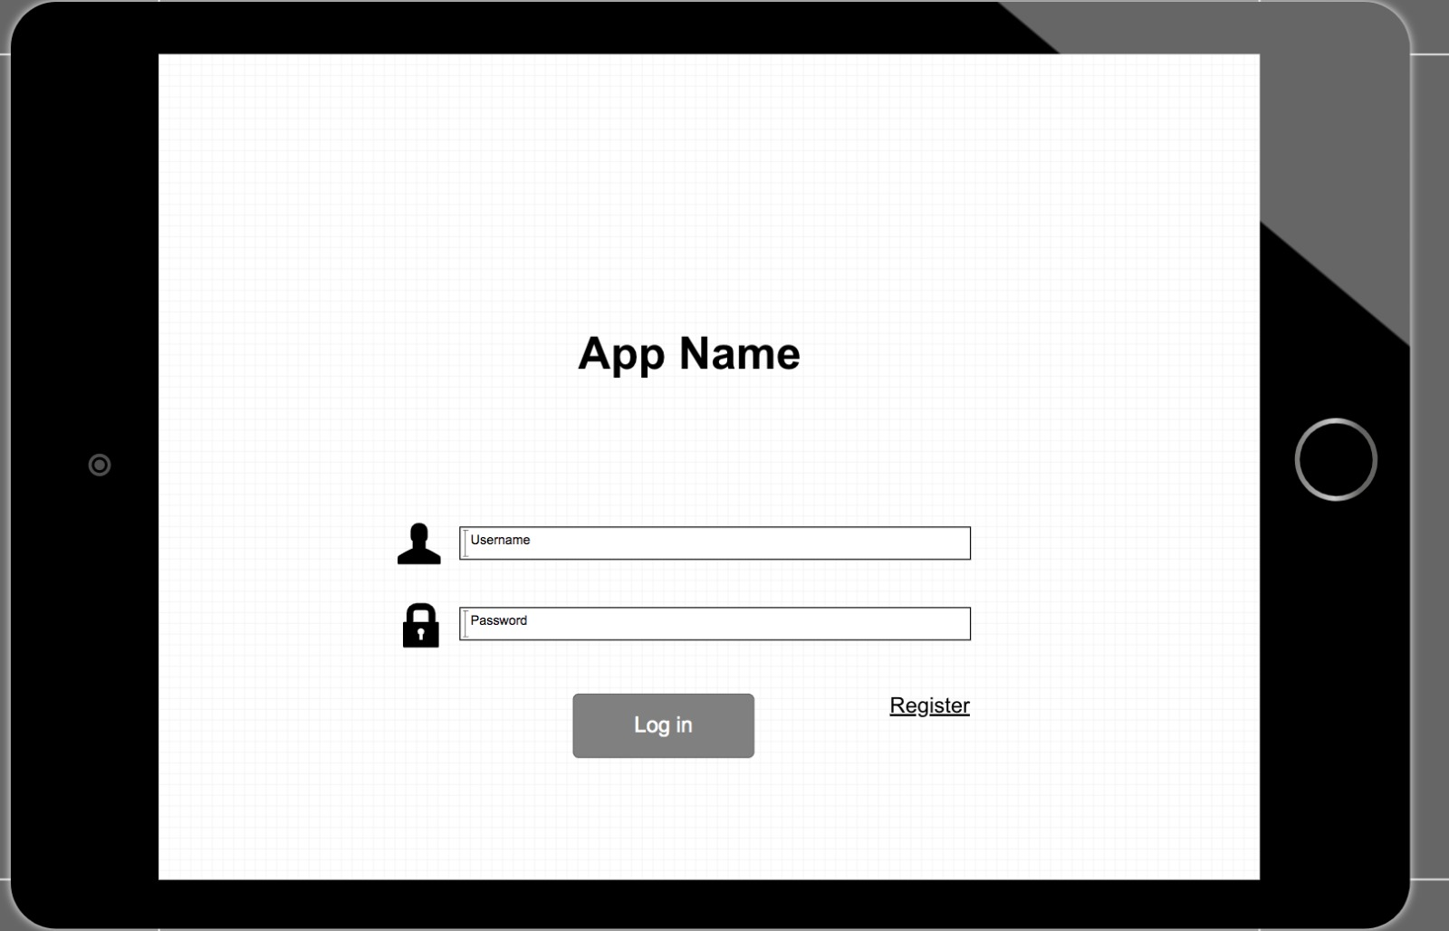
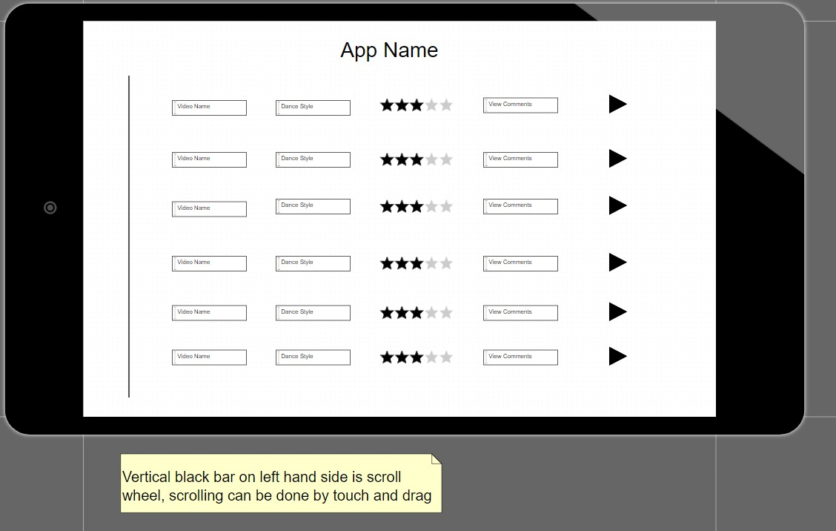
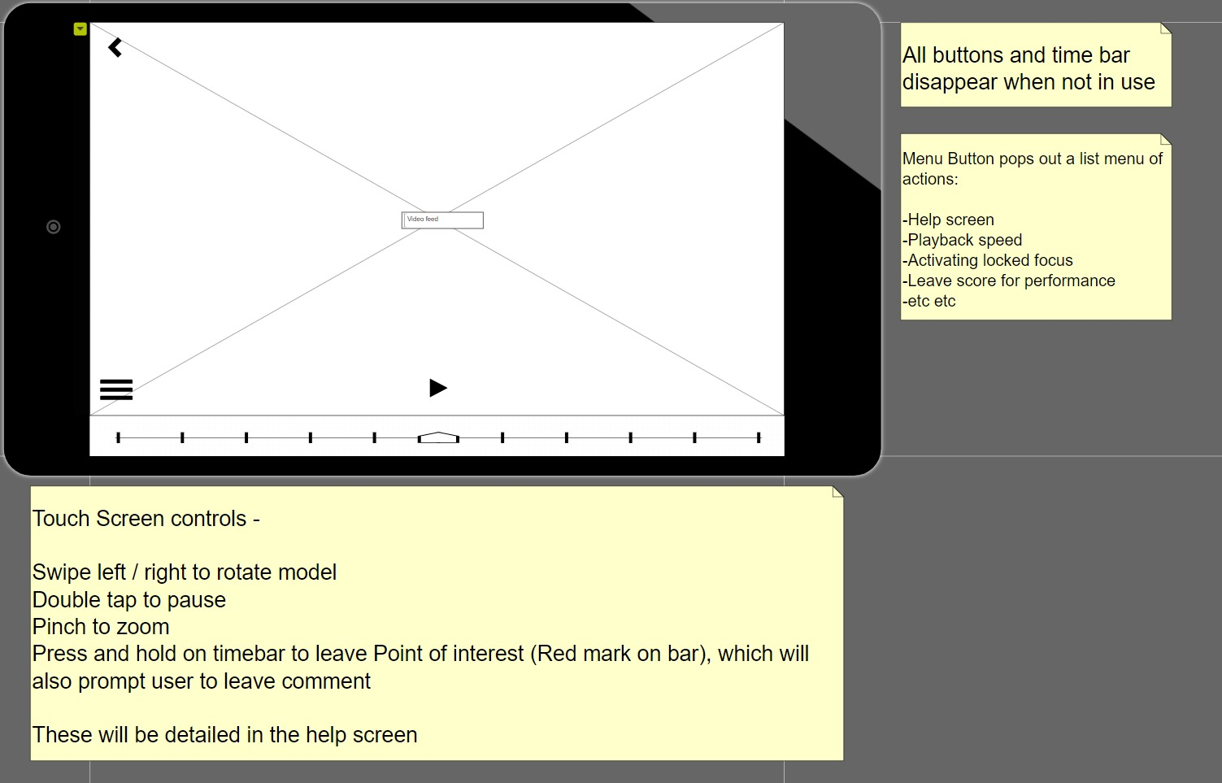
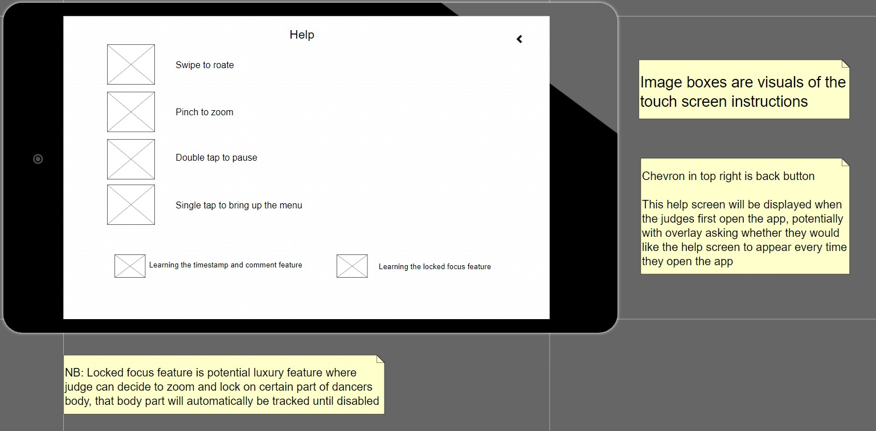
INITIAL PROTOTYPE
* arrows show user interacting with app
User based testing - We tested the initial prototype on 3 ballroom dance judges. The arrows show the ideal flow through the app. Issues that the users ran into when trying to navigate the app lead to several improvements in usability.
We used the ‘thinking aloud protocol’ during user testing to note down what users thought of the system.

Slide 6
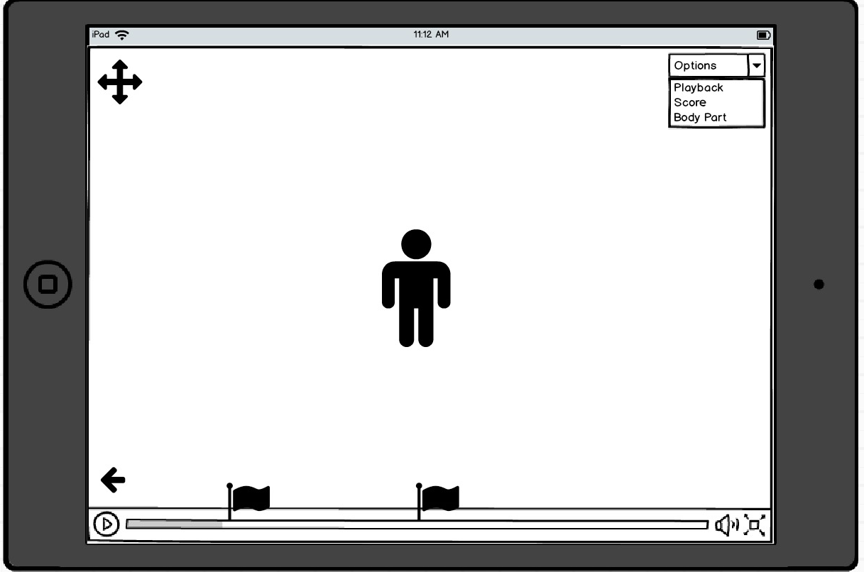
ALTERNATIVE PROTOTYPING
All buttons and time bar disappear when not in use.
Menu Button pops out a list menu of actions: Help screen, playback speed, activating locked focus, leave score for performance etc.
Touch Screen controls: Swipe left/right to rotate model, double tap to pause, pinch to zoom, press and hold on timebar to leave point of interest (red mark on bar), which will also prompt user to leave comment.
These will be detailed in help screen
Pidoco
Alternate design, this is a higher fidelity prototype made using Balsamiq.
We decided to test out a different prototyping software to try and get the best design.
This image shows the same general design, it builds on the above prototype. But shows the ‘flags’ which enable the user to flag reference points of the models dancing and then adding notes.
Balsamiq

Slide 7
EVALUATION OF PROTOTYPE
Heuristic evaluations have been used to complete the evaluation of the prototype
Reference | Heuristic | Problem | Solution | Severity
1 | Help and documentation | The font of the help page is too small, the user is unable to read the text | Increased the font size of the words in the description of what each button did | 3
2 | Visibility of system status | The back button isn’t as intuitive as we hoped, user was unsure how to leave the help screen | Changed it to an ‘x’ the standard symbol for removal | 2
3 | User Control and Freedom | No option to remove a flag | Flag is visibly placed on the timestamp, user can click the flag and then a pop up menu with additional options, such as ‘delete flag’ will appear | 1
4 | Flexibility and efficiency of use | Quit hard to pinpoint exact moments the user wants to flag the model | Inserted a flag icon at the corner of the screen, when clicked it will take a snapshot and pause the model | 2

Slide 8
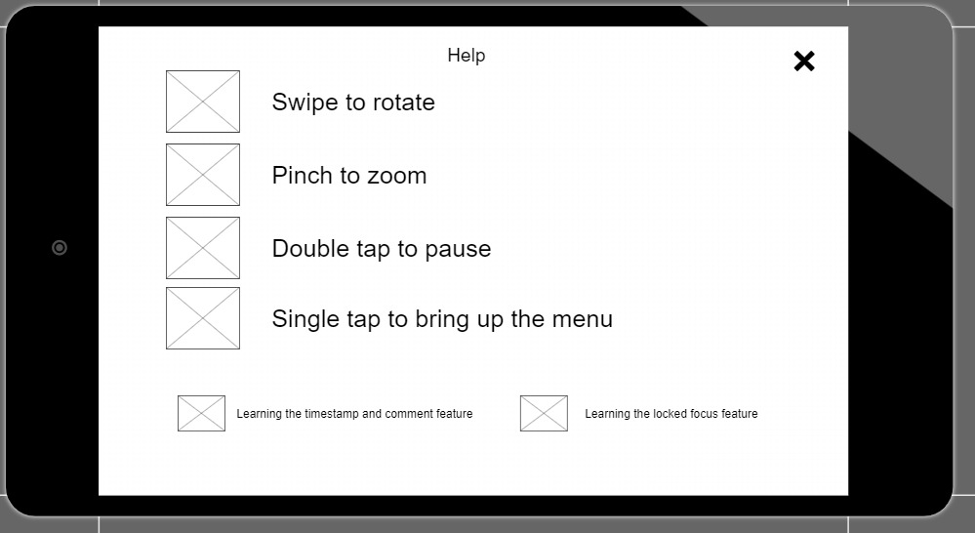
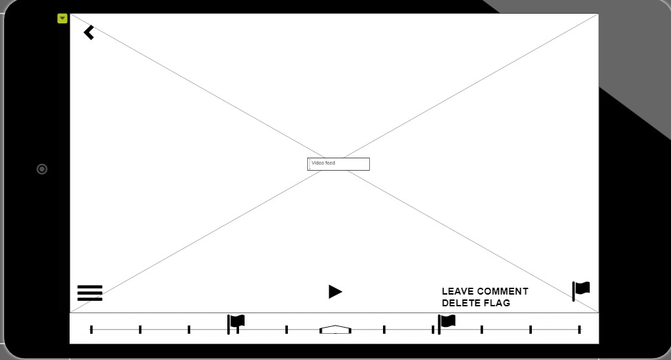
IMPROVED PROTOTYPE
Through evaluation we were able to produce a better prototype that meets the needs of the users
Reference 2
Reference 1
Reference 4
Reference 3

Slide 9
REFERENCES
‘Personas - Design Thinking Book’ - https://www.youtube.com/watch?v=W1kw5xK1C30&list=PLUpc0vYejgqcyC-Rqi1hHDjimxDMqgPJs&index=4
J. Foley and A. van Dam’s book Computer Graphics (1982, Addison Wesley) describes the early Eeld of computer graphics as a root of what would become human-computer interaction.
Preece, J., Sharp, H., & Rogers, Y. (2019). Interaction design: beyond human-computer interaction, Wiley, 5th Edition, Chapters 1, 2, 8, 11 & 12.
10 Usability Heuristics - https://www.youtube.com/watch?v=hWc0Fd2AS3s&list=PLUpc0vYejgqcyC-Rqi1hHDjimxDMqgPJs&index=13
Greenberg, S., Carpendale, S., Marquardt, N. and Buxton, B. 2012. Sketching User Experiences: The Workbook. Morgan Kaufmann, Chapter 1.2
Nielsen Norman Group, World Leaders in Research-Based User Experience, 10 Usability Heuristics for User Interface Design by Jakob Nielsen https://www.nngroup.com/articles/ten-usability-heuristics/

