Slide 1
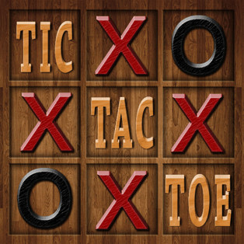
Tic-Tac-Toe Using Assembly Language
Munawar Ali
Muhammad Hamza

Slide 2

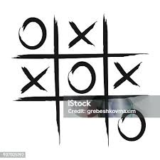
Introduction
A 2-player game played on a 3x3 grid.
Players alternate turns, marking X or O on the grid.
Objective: Align three marks in a row, column, or diagonal.
Purpose:
Understanding Assembly Language concepts.
Developing logical thinking and control flow.

Slide 3
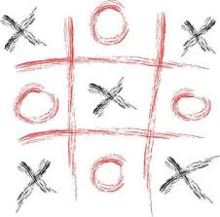
Challenges
Implementing board design.
Update board on valid moves.
Checking rows, columns and diagonals
Maintaining game flow.

Slide 4
Key Features
Modular Design.
Dynamic Board Updates.
Player Input Validation.
Winning and Drawing Conditions.
Taking small size in memory approximately upto1000 bytes.

Slide 5
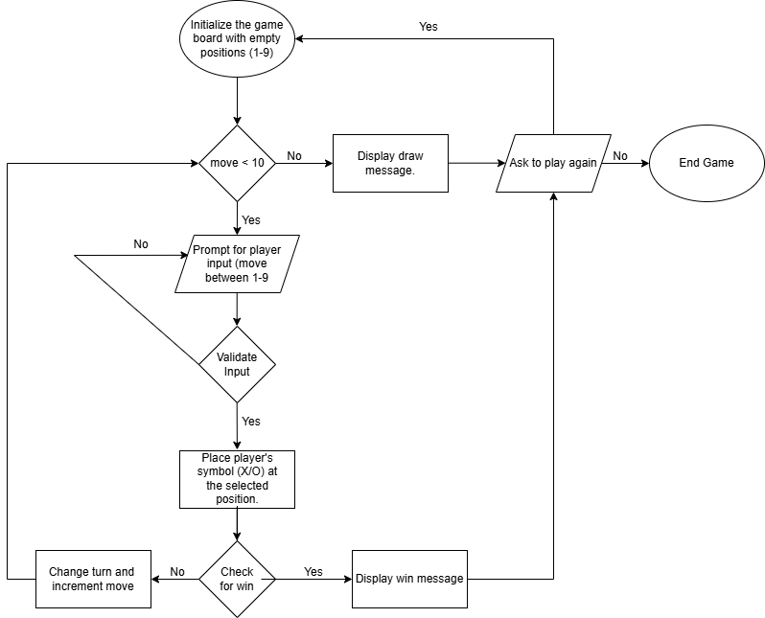
Game Flow
Game Initialization.
Game Loop.
Turn Handling.
End Conditions

Slide 6
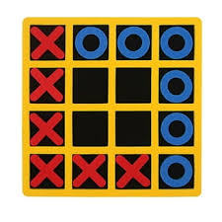
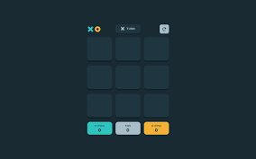
Future Improvement
Make a dynamic board like based on user input: like 4x4.
Making an computer bot so user can play with computer.
Using different UI colors for better visualization like blue for X and red for O.

Slide 7

Thanks Open to questions.

