Slide 1
// HPC BENCHMARK STUDY
Kohn-Sham DFT
Parallel Scaling with Quantum ESPRESSO
Strong Scaling · MPI Parallelism · SCALAPACK · Davidson Diagonalization
512
26,437
2–32
32.07 s
2.61×
KS bands
G-vectors
Processors
Baseline (NP=2)
Max speedup

Slide 2
The Kohn-Sham SCF Equations
THEORY
[ −½∇² + Veff(r) ] ψᵢ(r) = εᵢ ψᵢ(r)
N coupled single-particle Schrödinger-like equations solved self-consistently
EFFECTIVE POTENTIAL
ELECTRON DENSITY
SCF CONVERGENCE
Veff = Vext + VH[n] + Vxc[n]
n(r) = Σᵢ fᵢ |ψᵢ(r)|²
ΔE < ε → converged
Reconstructed every SCF cycle from the current density n(r). Combines external, Hartree and XC contributions.
Sum over occupied KS orbitals weighted by occupations fᵢ. The core observable — determines all ground-state properties.
Iterate: guess n → build Veff → diagonalise H → update n → repeat. Convergence in energy, density, or forces.
Computational cost: O(N³) — diagonalisation bottleneck motivates SCALAPACK for large parallel runs

Slide 3
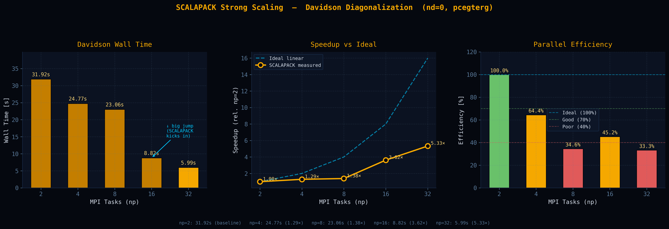
Weak Scaling SCALAPACK
RESULTS

Slide 4
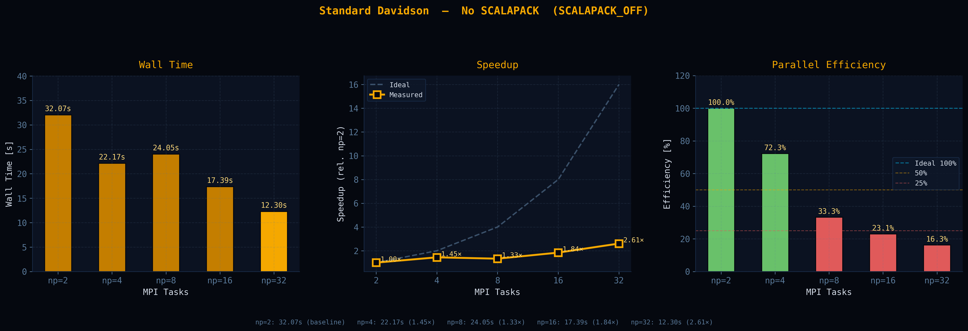
NO
RESULTS
SCALAPACK: 1.97× @ NP=16 · 2.05× @ NP=32 · Maintains 33% efficiency vs 16% standard

Slide 5
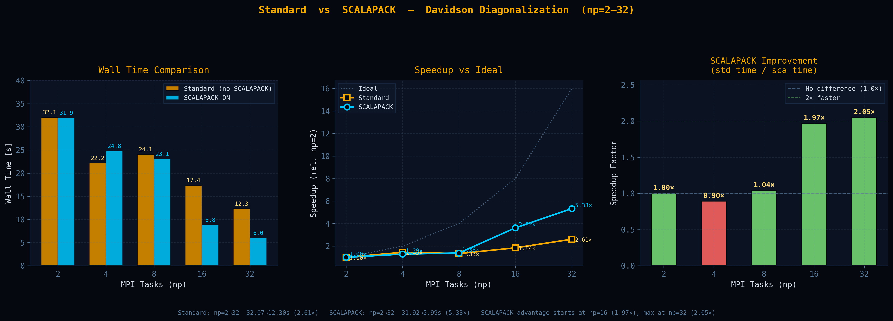
SCALAPACK vs Standard Diagonalization
RESULTS
SCALAPACK: 1.97× @ NP=16 · 2.05× @ NP=32 · Maintains 33% efficiency vs 16% standard

Slide 6
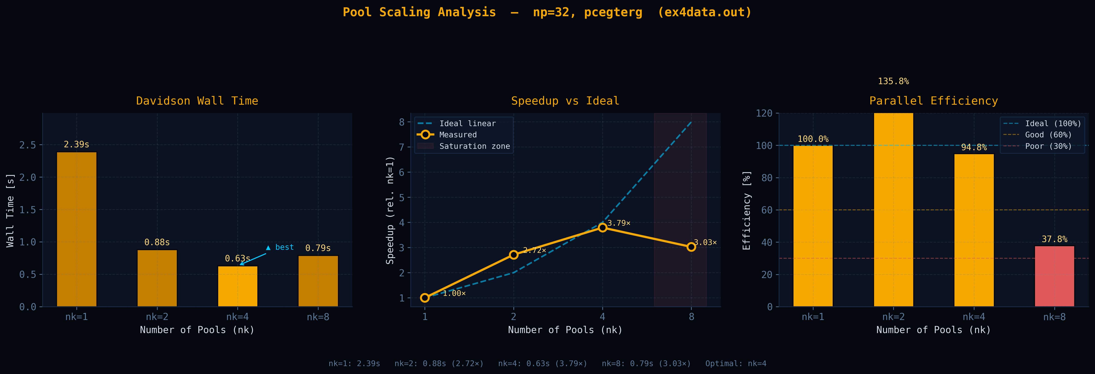
Exercise 4 (pools plot)
RESULTS

Slide 7
Thank You
Kohn-Sham DFT · Quantum ESPRESSO · HPC Parallelization
2.61×
5.34×
94.8%
NP=16
Max Speedup (Std.)
SCALAPACK NP=32
Davidson Fraction
Optimal Processors
https://www.quantum-espresso.org

