Slide 1
PAKISTAN · URDU NLP
UrduStack
Stop Roman-Urdu job scams before the click.
Code-switch-aware Urdu NLP infrastructure for scam and harassment detection
Shahoud Shahid
Munaza Tariq
Team
Team

Slide 2
The Problem
Pakistani digital text defeats English-only, keyword-based moderation
A real scam ad, verbatim
Three scripts, one sentence
"Urgent hiring! 50000 per week,
send processing fee to register."
• Urdu script, Roman Urdu, and English mix freely
• Often within the same message, sometimes the same sentence
Roman Urdu / English — no Urdu script at all
• English-only keyword filters miss it entirely
"processing fee" still slips past leetspeak, spacing tricks, and misspellings
• The harm is real and documented
Fake job postings on Facebook, WhatsApp, and OLX target Pakistani students and jobseekers who lose money to advance-fee scams — alongside abusive and harassing content in the same mixed script

Slide 3
Proposed Solution
Normalize the code-switching first, then score with a model trained for it
• Normalize first
Roman Urdu / English / Urdu script → one consistent Urdu-script representation
• Score with a real trained model
LoRA-tuned XLM-RoBERTa + a hardened heuristic layer, combined — not a keyword list
• Explain the verdict
Shows which phrases drove the score, the threat type, and specific next steps
• Self-hosted, on-device
No data leaves the deployment, $0 per request, sub-second latency
Why not just prompt GPT-4o?
UrduStack
GPT-4o API
Cost / request
$0
~$0.01–0.03
Data stays local
Yes
No
Latency
Sub-second
1–3 s
Offline capable
Yes
No

Slide 4
Key Features
Six implemented capabilities, verified end-to-end against the real trained model
🔤
🛡
🏷
Code-Switch Normalization
Explainable Risk Scoring
Multi-Category Threat Type
Dictionary + FAISS retrieval + phonetic fallback
LoRA model + heuristic ensemble, F1 87.1%
Job scam / phishing / harassment, each with advice
👤
🎙
💬
Named Entity Recognition
Speech-to-Text
Plain-Language Simplify
PERSON / LOCATION / ORGANIZATION — informational
Whisper transcribes spoken Urdu into the pipeline
Rewrites verdicts into everyday Urdu

Slide 5
System Architecture
One FastAPI process, one ModelManager, three real entry points, no external database
1
Website · Gradio Playground · WhatsApp Bot
Entry Surfaces
2
/normalize · /risk-score · /ner · /analyze · /feedback
FastAPI Layer
3
Lazy-loads models · Orchestrates pipeline · Graceful fallback
ModelManager
4
Normalizer · Risk Scorer · NER · STT · Simplify
Core Modules
5
LoRA adapter (4.5 MB) · 485-word dictionary · feedback.csv
Models & Data
Self-hosted: Docker → Hugging Face Spaces, or Colab T4 GPU with a public share link.

Slide 6
How It Works
One request, six pipeline stages — analyze_text() in app/models/model_manager.py
1
2
3
4
5
6
Normalize
Risk Score
NER
Categorize
Simplify
Recommend
Code-switched text →
Urdu script
Max-ensemble:
LoRA vs. heuristic
Extract PERSON /
LOCATION / ORG
Job scam / phishing /
harassment
Plain-language
Urdu explanation
Actionable,
category-specific advice
Example, live:
"job available 50000 per week send processing fee"
→ score 1.00, HIGH, "Fake Job Posting"
Every stage runs in-process — no external API calls, sub-second response.

Slide 7
Technical Implementation
Real technologies, real numbers — every figure below is from a committed, reproducible test run
Model & Training
Stack & Tooling
Base model
Framework
xlm-roberta-base — 270M parameters
FastAPI + Pydantic, PEFT, Transformers, PyTorch
Fine-tuning
NER
LoRA, r=16, α=32 → 4.5 MB adapter
XLM-RoBERTa fine-tuned on WikiAnn
Training data
Speech-to-text
~80k rows: PURUTT (72.7k) + synthetic scam (1.5k) + supplementary
OpenAI Whisper (base)
Calibration
Retrieval
Temperature scaling, T = 1.409 (grid search, 100 values)
FAISS + char-3-gram TF-IDF for fuzzy normalization
Verified: 89.7% accuracy · 87.1% F1 (107 test examples) · 12/12 adversarial cases · 46/46 unit tests

Slide 8
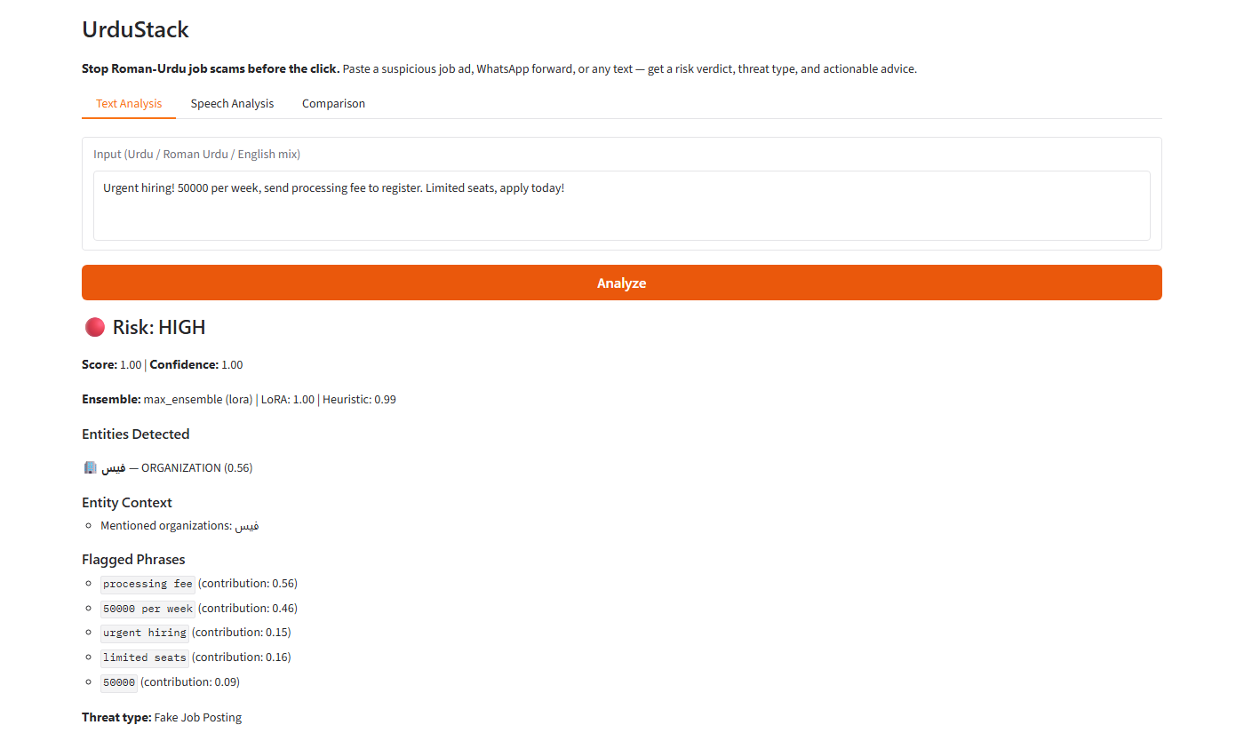
UI/UX & Demonstration
Real, live output — not a mockup
What the user sees
• Paste any suspicious text — Roman Urdu, Urdu script, or English mix
• Risk verdict with score and confidence, in one glance
• Threat type: fake job posting, phishing, or harassment
• Exactly which phrases drove the score, with weights
• Normalized Urdu-script text, and a plain-language explanation
• A specific recommendation — not just a red flag
• Optional feedback loop feeds future retraining

Slide 9
Impact & Benefits
Built for the people existing tools don't cover
• Protects a real, underserved population
Roman-Urdu speakers fall through the gap between English moderation and Urdu-script-only tools
• Explainable, not a black box
Users see why a message was flagged — builds trust, and teaches pattern recognition over time
• Meets people where scams land
Website, Gradio demo, and a WhatsApp bot — not locked behind a developer-only API
• Zero marginal cost, private by design
Self-hosted; no per-request fee, no data sent to a third-party API
Scalability & future potential
• Same architecture extends to other code-switched, under-resourced languages
• Active-learning feedback loop already collects real corrections for retraining
• Multi-category detection can expand to lottery, charity, investment, and loan scams — synthetic data for all 7 already exists
• WhatsApp bot is the highest-leverage distribution channel — reaches victims, not just judges

Slide 10
Conclusion & Future Vision
What we achieved
What's next
• A working, code-switch-aware detection pipeline — trained, calibrated, and evaluated on real data
• Verified semantic generalization beyond keyword matching, not just claimed
• Three real, working surfaces sharing one decision engine
• Honest, evidence-backed documentation of what works and what doesn't yet
• Close the remaining threat-detection gaps with targeted retraining
• Ship the full 6.37M-sentence frequency map for Tier-1 normalization
• Move the WhatsApp bot from demo-time to a persistent, always-on deployment
• Expand multi-category detection to all 7 scam types already in the training data generator
UrduStack — because the language your users actually type in deserves real protection.

