Slide 1
PhantomNet++
A Distributed Framework for Simulating, Detecting, and Defending Against Physical Adversarial Attacks on Vision-Based DNNs

Slide 2
Objectives
Simulate physical adversarial attacks (patch, occlusion, wearable) using Foolbox, ART (Adversarial Robustness Toolbox), GANs (Generative Adversarial Networks).
Develop a Distributed Neural Defense System (DNNS) with multi-agent ensemble.
Train robust quantized models with QKeras + Jacobian Regularization.
Incorporate Explainable AI (LIME, SHAP, Grad-CAM).
Implement Autonomous Response Engine (ARE) for policy-driven mitigation.
Secure inter-agent communication (TLS, RSA, AES).
Develop real-time monitoring dashboard with React.js + ELK Stack.
Ensure scalability & modular deployment via Docker/Kubernetes.

Slide 3
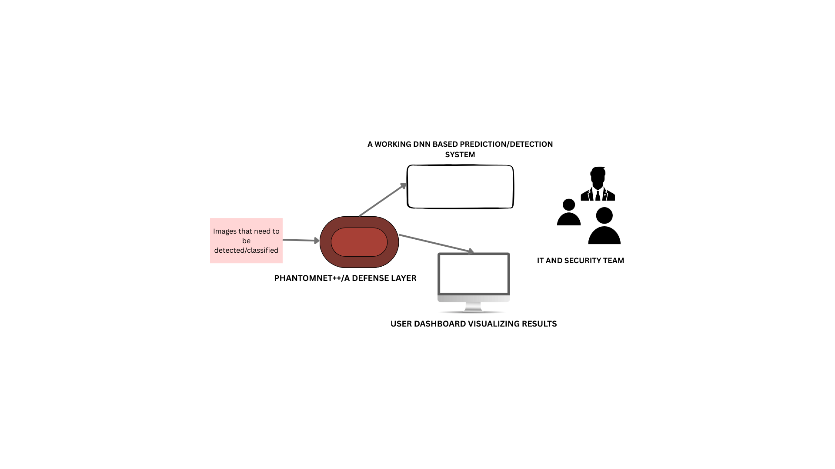

Slide 4
Existing Solutions
Amazon Rekognition / Sighthound → Strong recognition but no adversarial robustness.
TRADES → Improves robustness but lacks detection, explanation, or automated response.
PixelDefend → Works only on digital adversarial images, not physical-world attacks.
YOLOShield → Restricted to YOLO models; lacks multi-model adaptability.
Gap: No integrated, distributed, and explainable framework for real-time defense against physical adversarial threats.
Notes:
Amazon Rekognition / Sighthound → Tools for recognizing faces and objects in images/videos.
TRADES → A training method to make AI models harder to fool with adversarial tricks.
PixelDefend → A filter that “cleans” images before giving them to the AI.
YOLOShield → A defense upgrade made only for the YOLO object detection model.

Slide 5
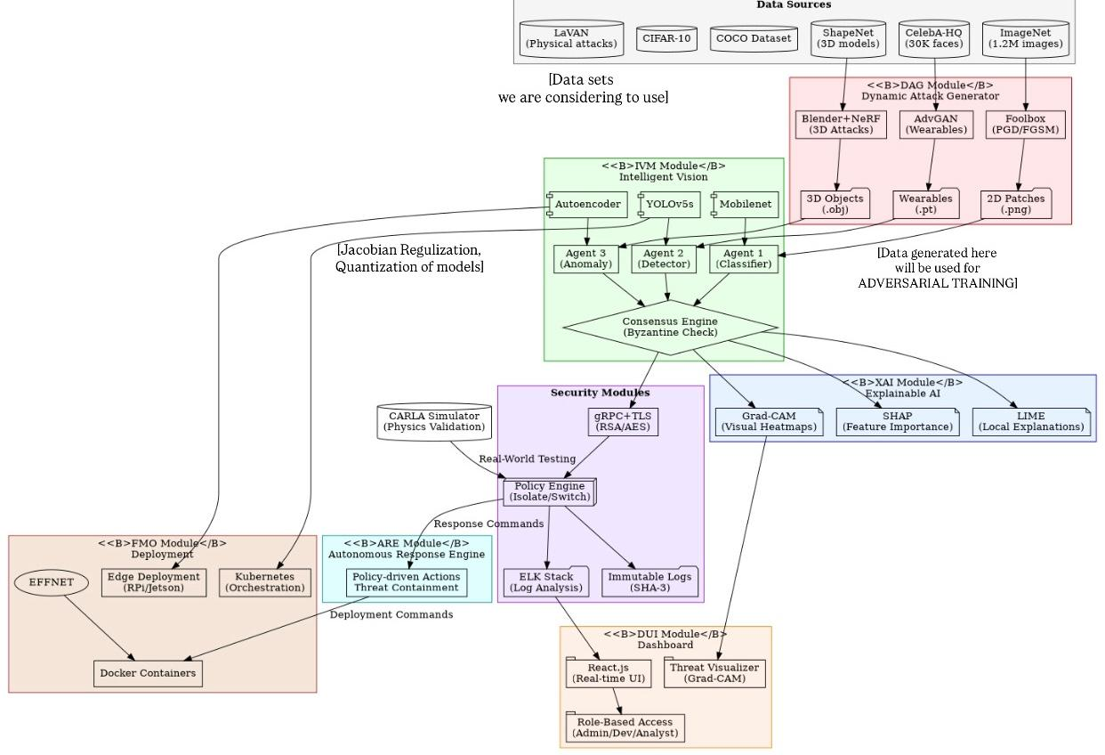
Workflow

Slide 6
Complexity of Problem
Tackles physical adversarial AI attacks, which are far more complex than digital perturbations.
Distributed agents with consensus-based decision-making.
Edge deployment of quantized models for low-latency defense.
Integration of attack simulation, detection, explainability, automated response, and secure coordination in one framework.

Slide 7
Methodology
Data Gathering → ImageNet, CIFAR-10, ShapeNet, COCO, ART adversarial datasets.
Attack Simulation → Generate adversarial inputs using GANs, FGSM (Fast Gradient Sign Method), PGD (Projected Gradient Descent), and EoT (Expectation over Transformation).
Defense System → Deploy ensemble of ResNet & YOLOv5 in distributed agents.
Robust Model Training → Quantization + Jacobian Regularization (QKeras).
Explainability → LIME, SHAP, Grad-CAM.
Autonomous Response → ARE policies for isolating threats & model switching.
Secure Communication → gRPC + TLS/RSA/AES.
Dashboard & SIEM → React.js + ELK for visualization & forensic logs.
Notes:
FGSM = quick/simple attack
PGD = stronger repeated attack
EoT = makes attacks robust in the real world
GANs = smart generator of tricky fake/adversarial data

Slide 8
Tools and Technologies
Programming: Python 3.10+
Frameworks: TensorFlow, PyTorch, Qkeras
Libraries: Foolbox, ART, SHAP, LIME, OpenCV
Containerization: Docker, Kubernetes
Dashboard: React.js, ELK Stack
Version Control: Git, GitHub
IDE: Visual Studio Code

Slide 9
Expected Outcomes and Relevance
Deliverables:
  Distributed AI framework prototype
  Attack simulation + detection engine
  Explainable AI–enabled dashboard
  Secure communication & automated response modules
Relevance:
  Protects autonomous vehicles, surveillance systems, and critical infrastructure from physical adversarial threats.
  Builds trust in AI through explainability and resilience.

Slide 10
Conclusion and Future Work
Conclusion
  PhantomNet++ provides a modular, distributed, explainable, and autonomous defense system for vision-based DNNs.
  Bridges the gap between adversarial attack simulation, robust detection, automated defense, and secure coordination.
Future Work
  Real-world deployment in drones and autonomous vehicles.
  Adapt framework for domain-specific adversarial attacks (e.g., medical imaging, satellite AI).

Slide 11
THANK YOU!

