Slide 1
Group Project – Predicting House Price
Members: Shiqi Wang, Tao Tao, Ying Ben

Slide 2
Introduction
The dataset contains 79 explanatory variables describing almost every aspect of residential home in Ames, Iowa.
Our goal is to predict price of each home.

Slide 3
Literature Review

Slide 4
Kaggle competition history
Kaggle is a competition platform for data analysis
Companies or researchers can upload data, problem descriptions, and desired metrics to the Kaggle and soliciting solutions from a wide range of data scientists. The contestants on Kaggle can download the data, analyze the data, then use the knowledge of machine learning, data mining, build the algorithm model, solve the problem to get the result, and finally submit the result.
Similar problems (with numeric responsive variables)
Predict Future Sales
Recruit Restaurant Visitor Forecasting, i.e., predict number of visitors

Slide 5
Feature Engineering

Slide 6
Data Overview
What our data looks like?
Large number of features (80 features).
Most data is categorical data which illustrates condition of houses.
Have “NA” values in many features.
Problem:
Lots of features are needed to process.
More features will be generated after transforming categorical data to numerical data.
The large amount of features may influence the efficiency of models and be difficult to interpret.
How to deal with “NA” values properly.

Slide 7
Feature Engineering
Objective:
Reduce the number features by selecting or combining proper features.
How to reduce features:
Looking the distribution and variance of features.
Looking the coefficient between features and target.
By experience (e.g. business logic).
Principle component analysis.

Slide 8
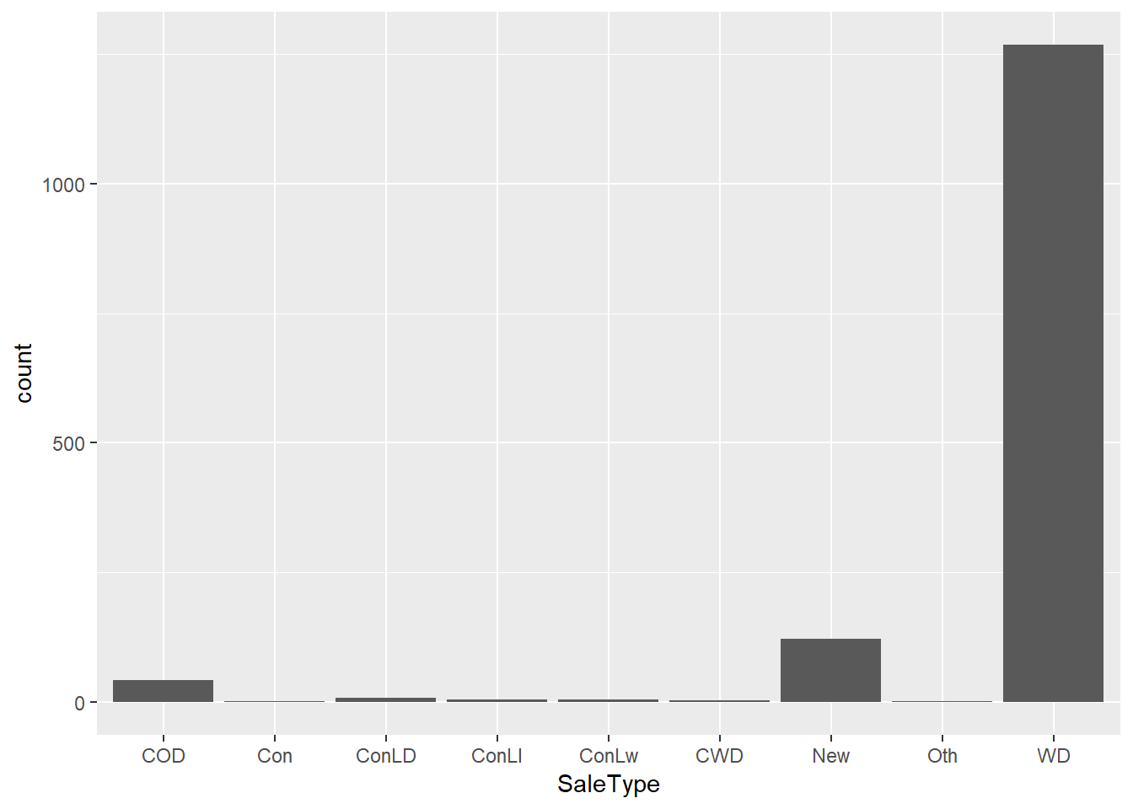
Feature Engineering
Example:
Should we use this feature?
Figure 1. Distribution of feature “SaleType”

Slide 9
Feature Engineering
Analysis:
We can see there are many “WD” values in “SaleType” feature.
The number of “WD” value is more than 1250, and the total number of data is 1460, which means “WD” value take over 85% of all values in “SaleType”.
Too many same values indicate this feature has low variance. (If we transform this feature to dummy variable, we will get lots of 1 in “WD” feature)
Problems:
If a feature has low variance, that means we cannot learn information well by this feature, because same values cannot tell the difference between two data point.

Slide 10
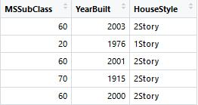
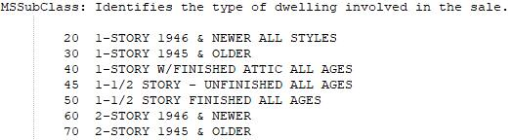
Feature Engineering
Example:
(a)
(b)
Figure 2.a. Table of MSSubClass, YearBuilt and HouseStyle features; Figure2.b. Data description of MSSubClass feature.
Dependency Problem:
Figure 2.b shows the description of feature “MSSubClass”. We can see the “MSSubClass” feature can be represented by feature “YearBuilt” and “HouseStyle”.
If we have used feature “YearBuilt” and “HouseStyle”, we do not need to use feature “MSSubClass” because it depends on feature “YearBuilt” and “HouseStyle”.

Slide 11
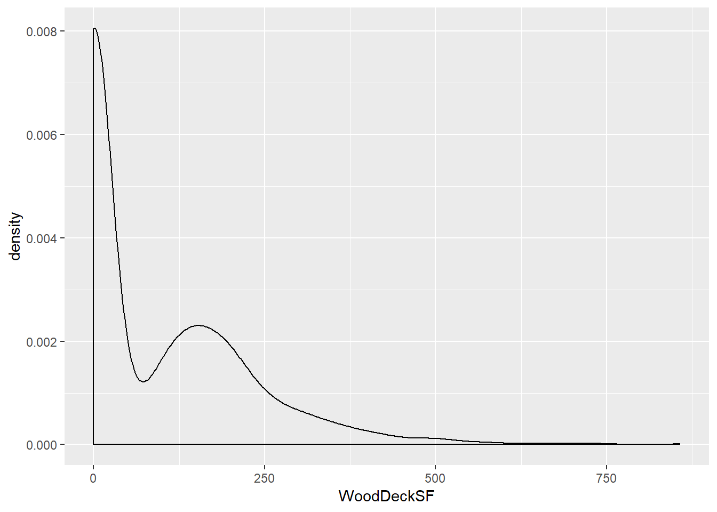
Feature Engineering
Example:
Analysis:
Figure 3 shows the density of feature “WoodDeckSF”, which indicates the square feet of wood deck in the house.
The distribution seems not very strange. The only problem on data is the number of 0 value is nearly a half of whole dataset.
Problems:
It is the business logic problem. The square feet of wood deck should not be the significant factor to sale price.
However, we think it can be better if we convert this feature to whether the house has wood deck.
Figure 3. Density of feature “WoodDeckSF”

Slide 12
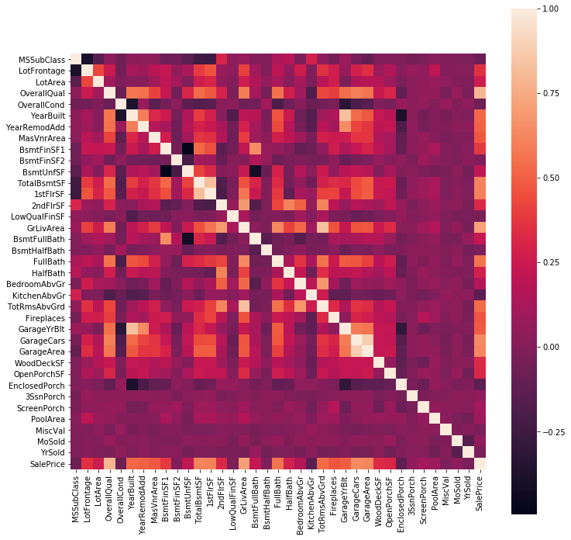
Feature Engineering
Heatmap:
Heatmap represent the correlation between one feature to other features.
If the color is brighter, that indicates these two features have higher correlation.
The red frame shows the correlation between target to other features.
How to choose features:
Generally, if a feature has high correlation to target, we can think it has strong relationship to target.
Temporarily, We choose those features whose correlation (absolute value) to target is higher than a threshold θ > 0.3.
Figure 4. Heat map of numerical features

Slide 13
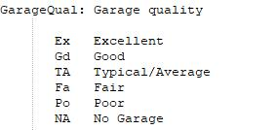
Feature Engineering
“NA” process:
Some data in a feature may lack value and generate “NA” value.
Generally, to numerical feature, we can use mean value to replace “NA”, and to categorical feature, we can use the mode value of the feature to replace “NA”.
Trap: However, not all the “NA” is the real “NA” value, which means the “NA” value has meaning in this feature.
Example:
Figure 5 shows the data description of “GarageQual”. We can see there is “NA” value appeared in this description, and “NA” means the house does not have garage.
Be careful, in this case, we cannot use other value like “TA” to replace the “NA” value, because the “NA” value here is a legal value and indicates a certain condition.
Figure 5. Description of feature “GarageQual”

Slide 14
Feature Engineering
Categorical Variable Process:
Transform categorical variable to dummy variable.
For ranking feature, like “GarageQual”, which indicates the quality of garage, we write a algorithm to do label encoding and remain their ranking order.
For other categorical feature, we generate new features based on the value in the original feature and use 0 and 1 to represent categorical values.
Example of Ranking Feature:
GarageQual:
Ex
Excellent
5
Gd
Good
4
TA
Typical/Average
3
Fa
Fair
2
Po
Poor
1
NA
No Garage
0

Slide 15
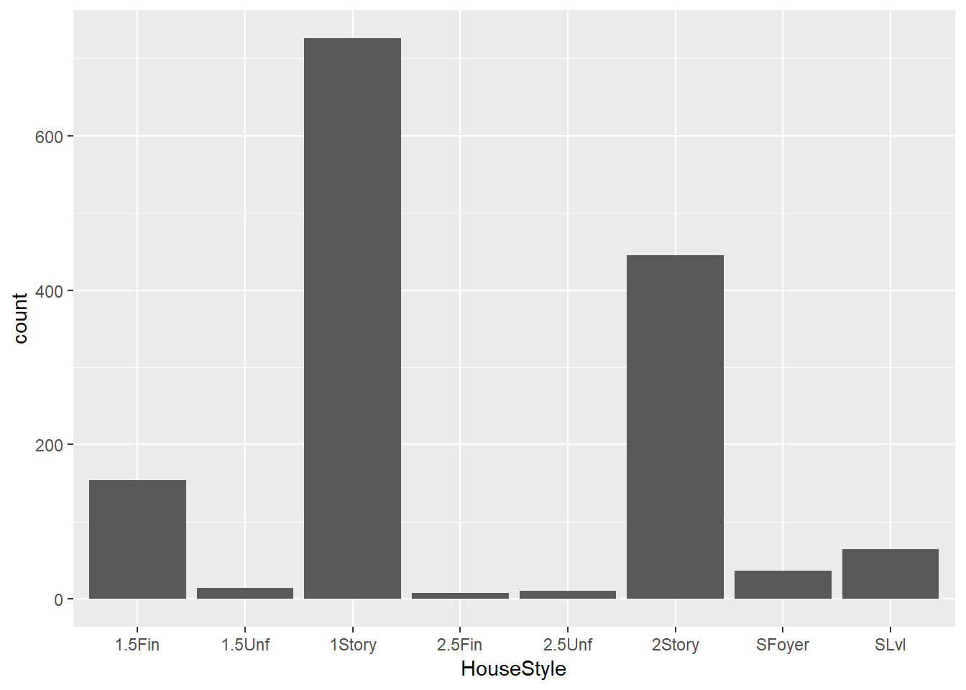
Feature Engineering
Further Step:
When we try to transform categorical variable to dummy variable, we find there are many kinds of values in each feature. If we generate dummy variable directly, we will get a large scale of data.
We view the distribution of the values on these feature, and find some values only have very few number, so we consider to aggregate these values as a new value.
Example:
Figure 6 shows the distribution of “HouseStyle”. We can see “1.5Unf”, “2.5Fin”, “2.5Unf” only have very few number in this feature.
We consider to aggregate these values to other similar values. For example, we combine “1.5Fin” and “1.5Unf” as “1.5Story”.
In other features, if we cannot find similar values, we aggregate those values only have few number as a new value called “others”.
Figure 6. Distribution of feature “HouseStyle”

Slide 16
Model Training

Slide 17
Data Scaling
Standard Scaling:
We scale our data to avoid the influence caused by different ranges of data.
The data is scaled to 0 mean and unit variance.
Compared to minmax scaling, standard scaling does not change the distribution of original data.

Slide 18
Model
We compared several models and use the RMSE as universal standard to evaluate the model’s performance. Each model chose the best parameter with lower RMSE value.
Model | RMSE | Parameters
Linear regression | 0.14658605782219775 | default setting
Ridge | 0.14658309093979632 | Alpha = 0.1
Lasso | 0.14681172551183871 | Alpha = 0.0001
KNN regression | 0.22196999469826473 | n_neighbors = 5
Decision tree regression | 0.1951798317574775 | max_depth = 10
Adaboost | 0.15591714554189595 | default setting
Random forest | 0.14302185176922058 | n_estimators=100,max_depth=50

Slide 19
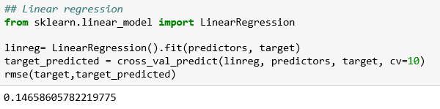
Linear regression

Slide 20
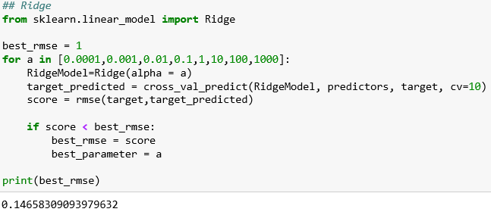
Ridge

Slide 21
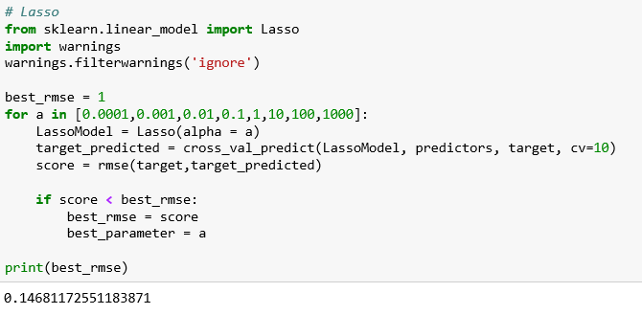
Lasso

Slide 22
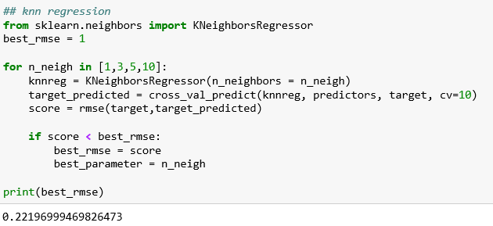
knn regression

Slide 23
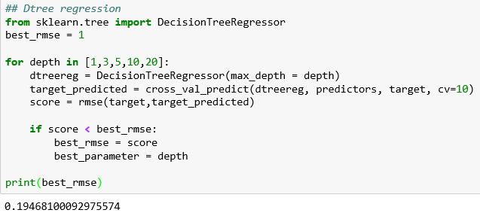
Dtree regression

Slide 24
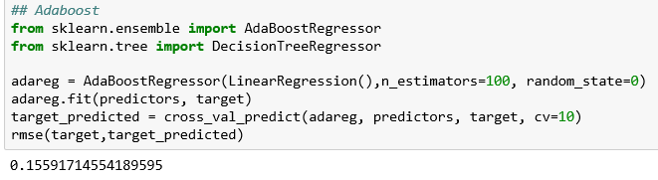
Adaboost

Slide 25
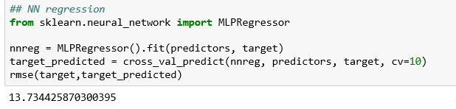
NN regression

Slide 26
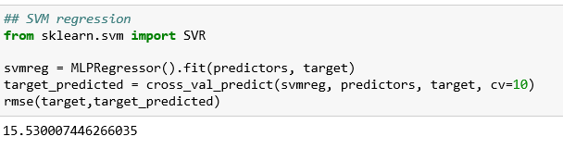
SVM regression

Slide 27
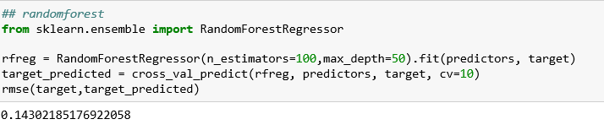
randomforest

Slide 28
Thank you!

